Slide 1
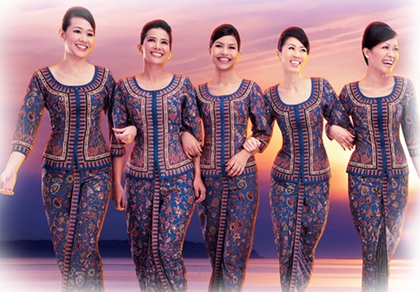
(APP NAME) (SENSIA?)
Are you an aspiring
Steward?
Stewardess?

Slide 2
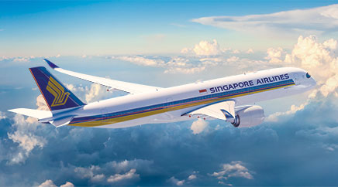
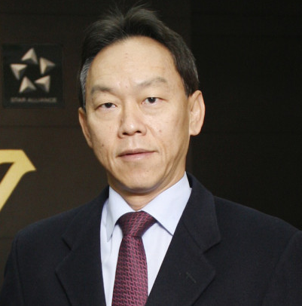
Congrats on graduating from the training programme and reaching stage 5! You are now an official SIA steward(ess). Are you ready for your next flight?
Yes
No

Slide 3
Alright! For your very first flight as an official steward(ess), you will be flying to _____ on an economy class plane. Hope you are feeling excited. It’s time to board the plane! (LMAO)

Slide 4
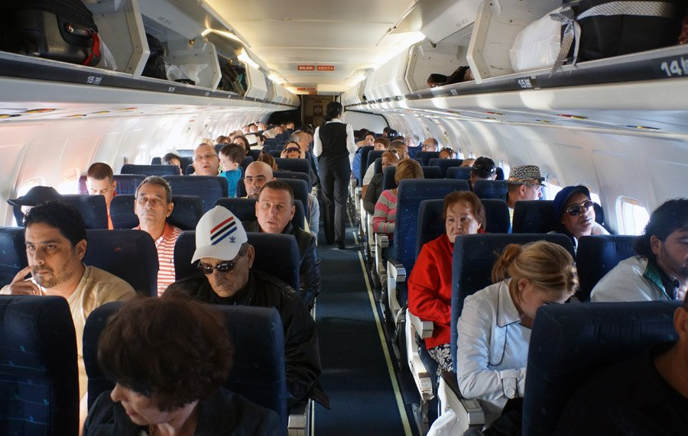

Taking off…

Slide 5

In the air…

Slide 6
In the air…
A Few Too Many
Throughout the flight you’ve been serving alcohol to passengers. One passenger who you’ve been serving in particular has had quite a few drinks and is now becoming disruptive to the other passengers. He requests another drink from you. How do you deal with this situation?
A) Serve one last serving of alcohol and mention it will be the last if passenger promises to not cause disturbance
B) Mention to the customer he is drunk and should refrain from causing disturbance
C) Stop serving alcohol to passenger simply
D) Get your manager to help, as they have authority

Slide 7
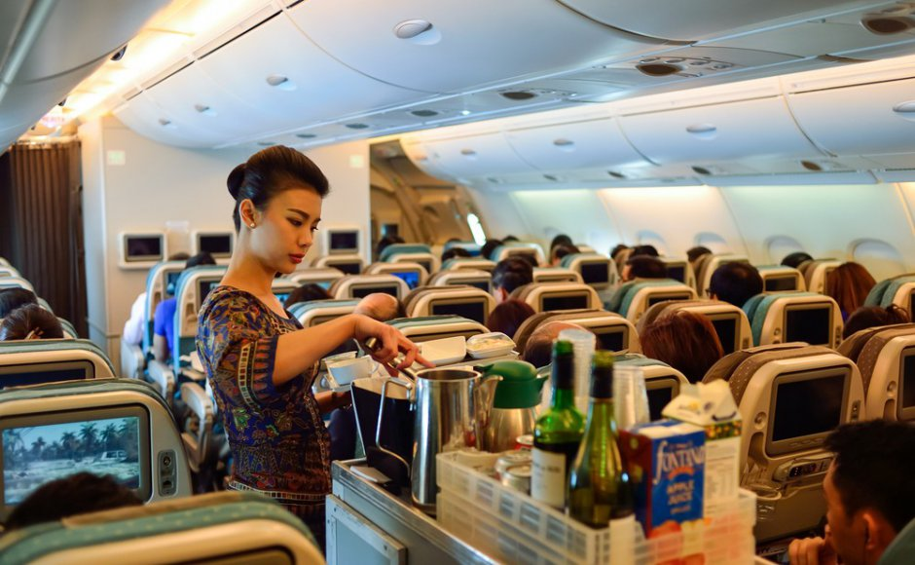
Serving food…

Slide 8
Serving food…
Diaper Dilemma
You are in the middle of a meal service when a passenger with an infant hands a used diaper in your direction. She asks you to dispose of the diaper for her. What do you do?
A) Your cart has a rubbish disposal compartment, request the passenger dispose it in immediately and advise her to wash her hands, handing her paper towels
B) Reject service politely and advise that she dispose of the diaper after food service
C) Suggest to her that you will return as soon as food service is complete

