Slide 1
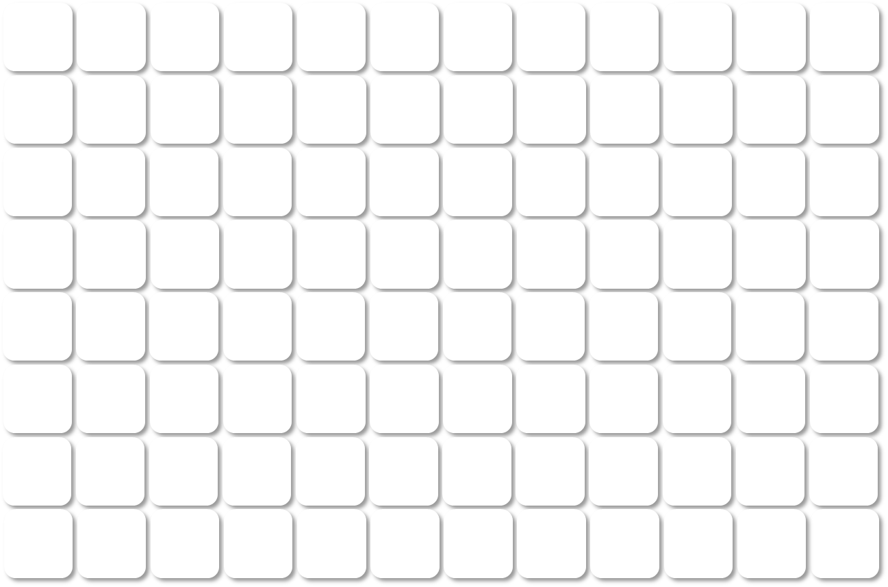
________________
Instrument
Location
Astral:□ QE:□ Exploris: □
Plate □ □ □
YYYY MM DD
Label the plate with the same date
Raw Files Naming algorithm: Zhibin_20160101_InstrumentType_ProjectName_SampleName_FractionNumber
1 2 3 4 5 6 7 8 9 10 11 12
A
A1 A2 A3 A4 A5 A6 A7 A8 A9 A10 A11 A12
B
B1 B2 B3 B4 B5 B6 B7 B8 B9 B10 B11 B12
C
C1 C2 C3 C4 C5 C6 C7 C8 C9 C10 C11 C12
D
D1 D2 D3 D4 D5 D6 D7 D8 D9 D10 D11 D12
E
E1 E2 E3 E4 E5 E6 E7 E8 E9 E10 E11 E12
F
F1 F2 F3 F4 F5 F6 F7 F8 F9 F10 F11 F12
G
G1 G2 G3 G4 G5 G6 G7 G8 G9 G10 G11 G12
H
H1 H2 H3 H4 H5 H6 H7 H8 H9 H10 H11 H12

Slide 2
________________
Instrument
Location
Astral:□ QE:□ Exploris: □
Plate □ □ □
YYYY MM DD
Label the plate with the same date
Raw Files Naming algorithm: Zhibin_20160101_InstrumentType_ProjectName_SampleName_FractionNumber
1 2 3 4 5 6 7 8 9 10 11 12 13 14 15 16 17 18 19 20 21 22 23 24
A B C D E F G H I J K L M N O P

