Slide 1
Terms
Genre
The purpose and type of the writing.
Prose vs. poetry
Poetry = written in verses
Prose = not written in verses

Slide 2
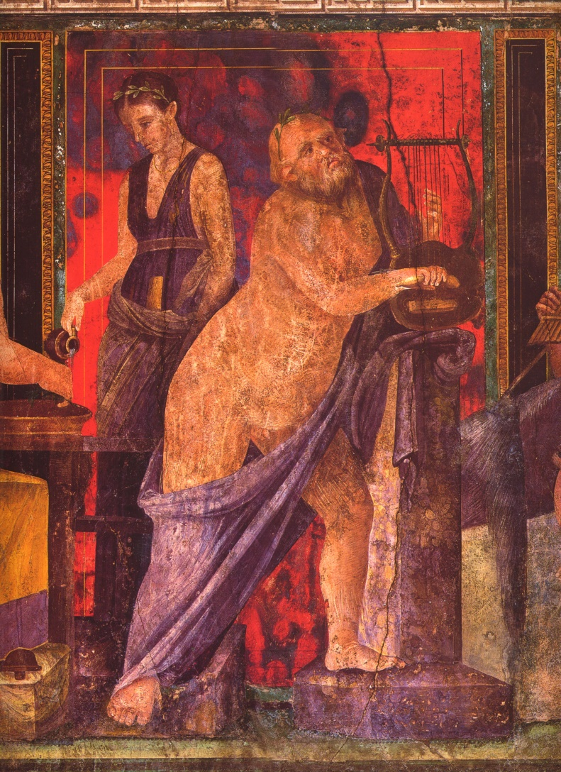
Genres
Prose
History
Epistolary
Oratory
Philosophy
Poetry
Epic
Comedy
Tragedy
Lyric

Slide 3
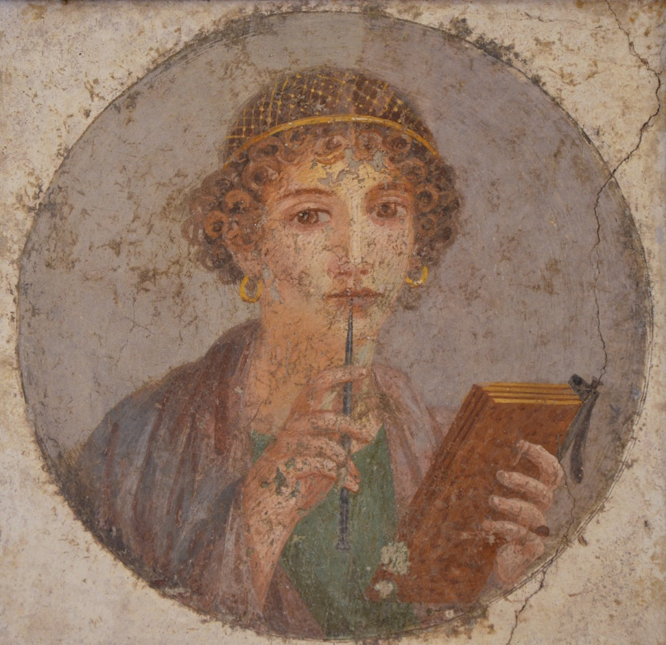
Technologies of Writing
Papyrus
Wax tablets
Epigraphy
Graffiti

Slide 4
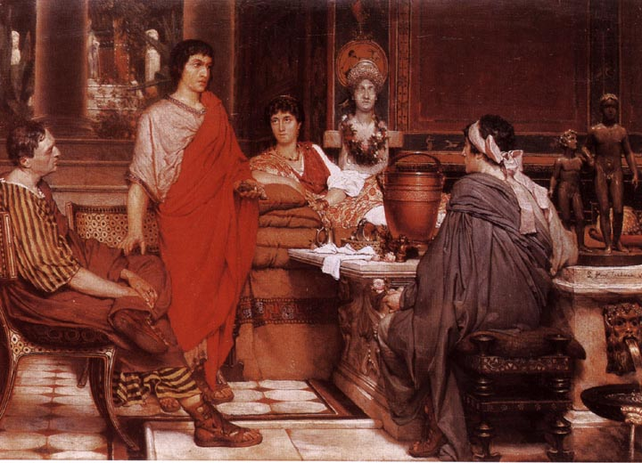
Literacy, Status, Audience

Slide 5
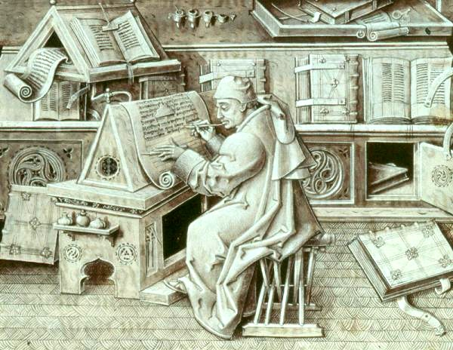
Survival
Jean Miélot, French monk (died 1472 CE)

Slide 6
Phase I: 3rd and 2nd cen. BCE
Poetry
Livius Andronicus
Naevius
Ennius
Plautus
Terence
Prose
Fabius Pictor
Cato the Elder

Slide 7
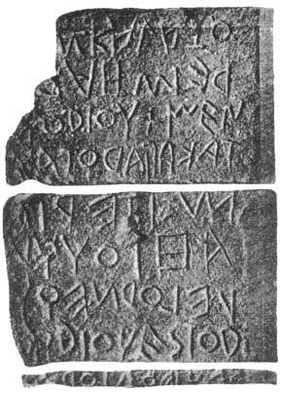
Lapis Niger Inscription
"Whosoever (will violate) this (grove), let him be cursed. (Let no one dump) refuse (nor throw a body...). Let it be lawful for the king (to sacrifice a cow in atonement). (Let him fine) one (fine) for each (offence). Whom the king (will fine, let him give cows). (Let the king have a ---) herald. (Let him yoke) a team, two heads, sterile... Along the route... (Him) who (will) not (sacrifice) with a young animal...in ...lawful assembly in grove..."
c. 570-550 BCE

Slide 8
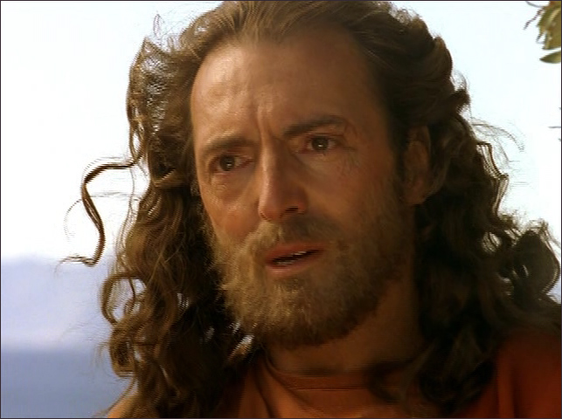
Livius Andronicus
Died c. 207 BCE?
Greek from Tarentum in Magna Graecia
Adapted Homer’s Odyssey into Latin c. 240 BCE
Used as a textbook down into the first century BCE
Regarded by (many of) the Romans as the creator of Roman literature
A later adaptation of the Odyssey…

Slide 9
Naevius
Gnaeus Naevius
From Campania
Said to have served in the First Punic War
Died c. 204 BCE?
Wrote comedy, tragedy and epic, including Bellum Punicum (‘The Punic War’)

Slide 10
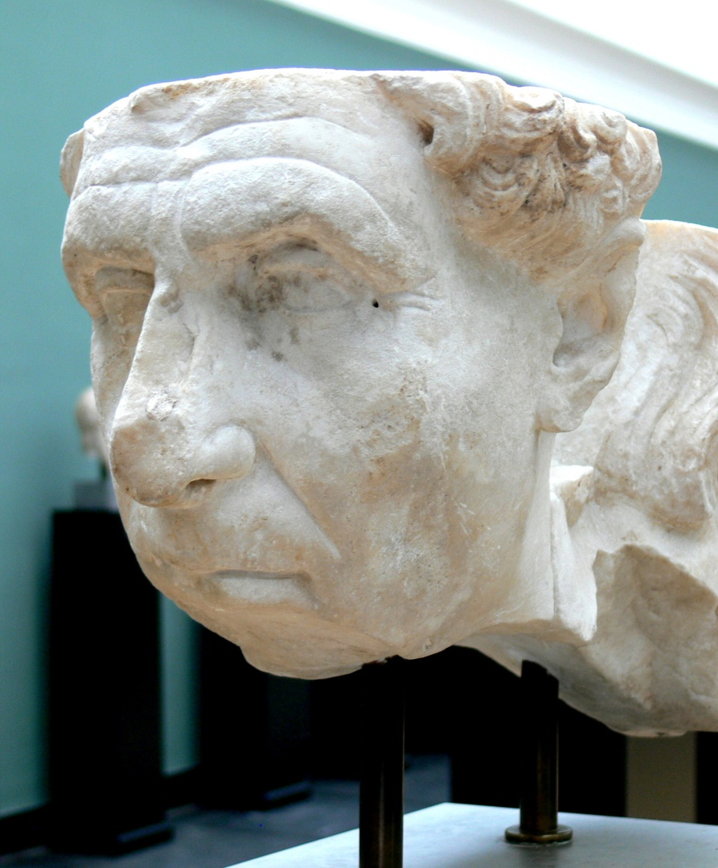
Ennius
239-169 BCE
Born at Rudiae in Calabria, in southern Italy
Spoke Greek, Latin and Oscan
Supposedly brought to Rome by Cato the Elder
Adapted Greek tragedies and composed original epics about Roman history, especially the Annales
Invented a new type of Latin verse

Slide 11
Ennius
O Tite tute Tati tibi tanta tyranne tulisti!
“Oh Titus Tatius, you tyrant, you took these great troubles upon yourself!”
- Ennius, Annales 1.109

Slide 12
Plautus and Terence
Titus Maccius Plautus (fl. 205-184 BCE) and Publius Terentius Afer (c. 185-159 BCE)
Authors of comedic plays
Set on a street in a fictional Athens
Typically involved wily slaves, inept masters, lost children, prostitutes, mistaken identity and love stories
Written in verse but using conversational Latin
Plautus tends towards the bawdy and the slapstick, whereas Terence is moralizing (and dull)

Slide 13
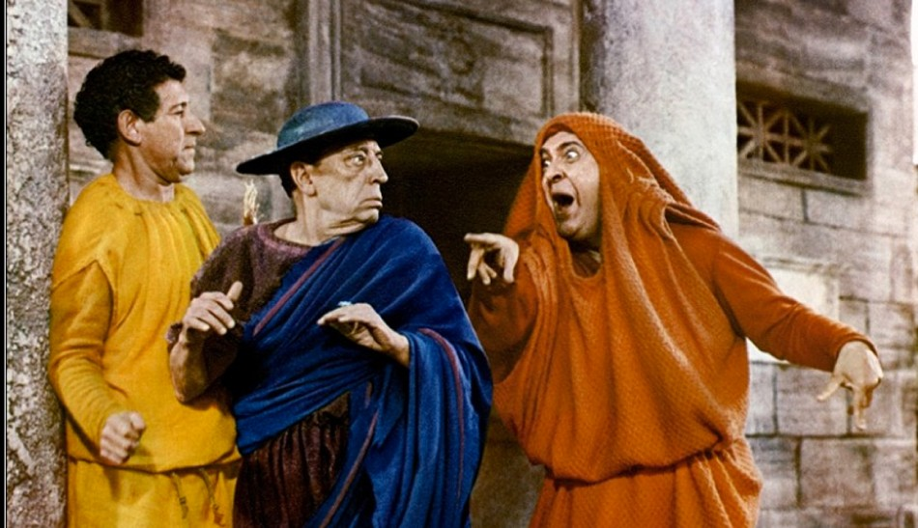
Plautus and Terence
A Funny Thing Happened on the Way to the Forum (1966)

Slide 14
Plautus and Terence
https://www.youtube.com/watch?v=QPds0-hZ1tM\

Slide 15
Fabius Pictor
Born c. 270 BCE
Earliest attested Roman historian
Wrote in Greek
His history covered the foundation of Rome to c. 200 BCE
Used by Polybius, Livy, Dionysius and Plutarch
“Nothing more than a compilation of yearly chronicles” (Cicero)

Slide 16
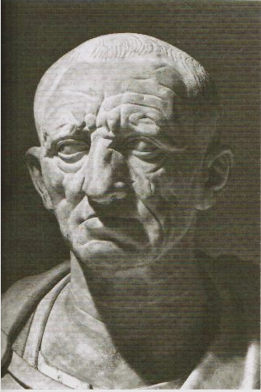
Cato the Elder
Marcus Porcius Cato (the Elder)
c. 234-149 BCE
Consul in 195, censor in 184
Wrote a history of Rome and a book about farming (De Agricultura)
Includes numerous recipes for cabbage

Slide 17
Phase II: 1st cen. BCE
Prose
Cicero
Livy
Poetry
Lucretius
Catullus
Horace
Virgil

Slide 18
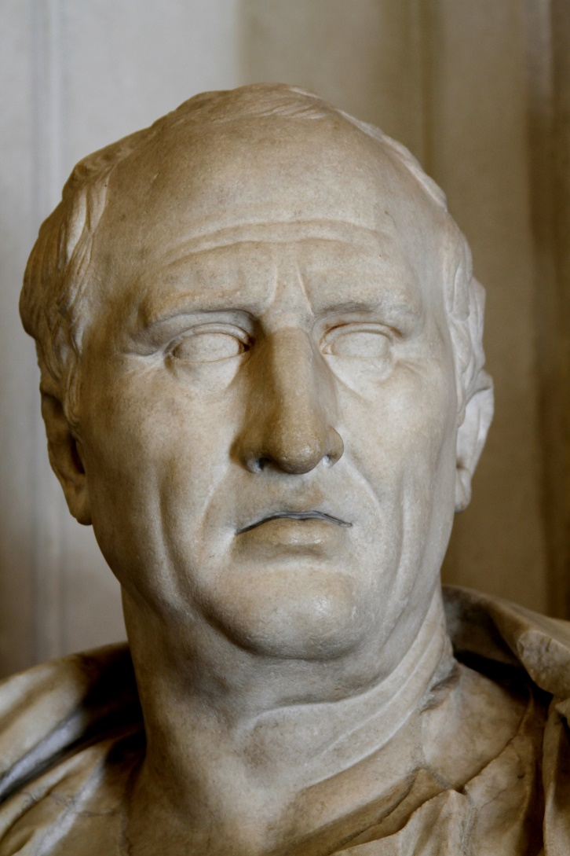
Cicero
Marcus Tullius Cicero
106-43 BCE
Lawyer, orator, politician and writer
Quaestor in 75, praetor in 66, consul in 63
But his political career ended after his consulship
Focused on writing until his murder in 43

Slide 19
Cicero’s Literary Works
Speeches
Legal
Political
Philosophical works
Political treatises
Letters
To Atticus, to his friends

Slide 20
Letter to Atticus 1.2 (65 bce)
“It’s been a while since I got a letter from you. I’ve already written in detail about my election prospects. Currently I’m thinking about defending my fellow candidate Catiline in his extortion trial. We have the jury we want, and the prosecution has been fully cooperative. If he’s acquitted, I hope he’ll be more disposed to becoming allies in our quest for office. But, if things turn out differently, I’ll bear it with a cheerful heart.”

Slide 21
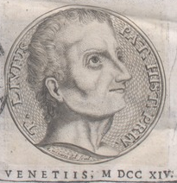
Livy
c. 64 BCE - 12 CE
Born in Patavium (now Padua) in Cisalpine Gaul
Grew up during the civil wars of the 40s BCE
Independently wealthy?
Wrote Ab urbe condita (‘From the Founding of the City’)
Originally 142 books!
Most now lost

Slide 22
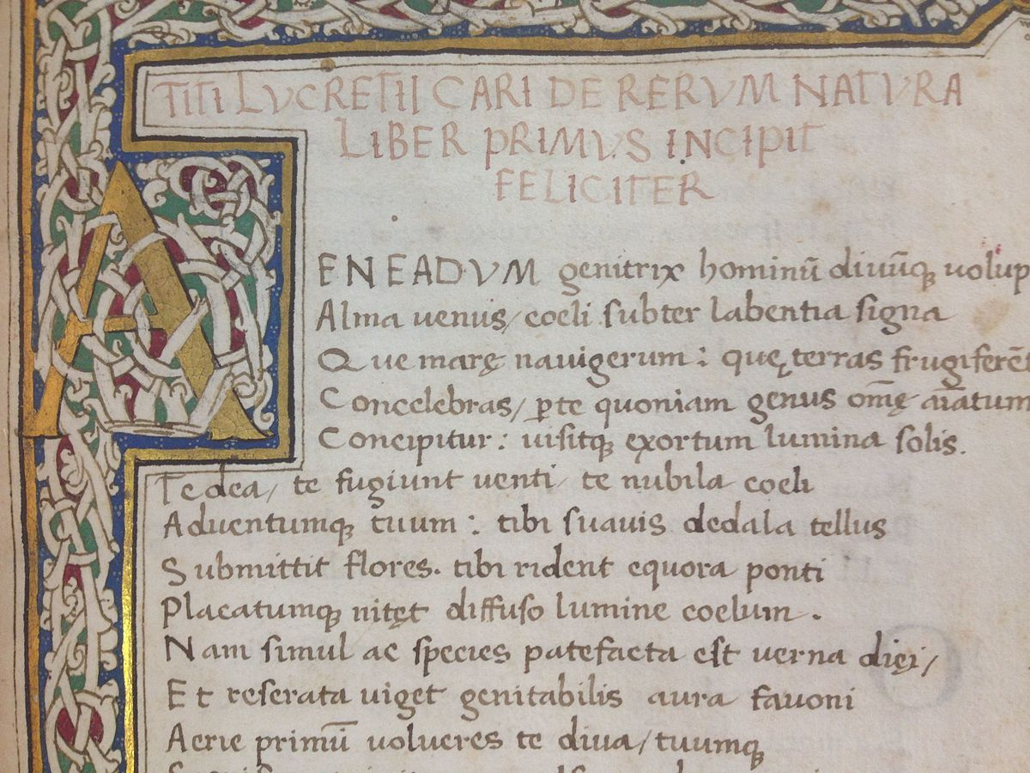
Lucretius
Titus Lucretius Carus
c. 94-55 or 51 BCE
Supposedly committed suicide in a fit of insanity caused by a love potion
Author of De Rerum Natura (‘On the Nature of Things’), a didactic poem intended to convert the reader to Epicureanism

Slide 23
Catullus
Gaius Valerius Catullus
c. 84-53 BCE
From Cisalpine Gaul
Wrote lyric poetry on a variety of subjects, including love, religion, friendship and myth
Catullus as envisioned by Alma-Tadema

Slide 24
Catullus 13
“You will dine well, my Fabullus, at my house
in a few days, if the gods favor you,
if with you, you bring a good and great
meal, not without a fair-skinned girl
both wine and wit and all the banter.
If you bring these, I say, our charming friend,
you will dine well, for the purse of your Catullus
is full of cobwebs.
But in exchange you will receive most pure friendship
or if anything is more sweet or more elegant:
for I will give perfume, which to my girl
Venus and Cupids have given,
which when you will smell it, you will ask the gods,
to make you, Fabullus, all nose.”

Slide 25
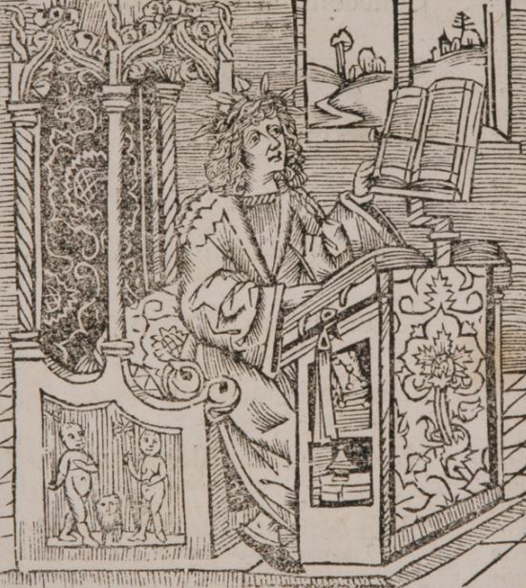
Horace
Quintus Horatius Flaccus
c. 65-8 BCE
Son of a freedman
Educated in Rome and Athens
Served with Brutus during the civil war; lost everything after Philippi in 42
Introduced to Maecenas by Virgil
Wrote lyric poems

Slide 26
Horace, Odes 1.11
“You should not seek – it is forbidden to know – which end of life
the gods have given to me, which end to you, Leuconoe, nor
should you test Babylonian numbers. How much better to suffer
whatever will be, whether Jupiter assigns many winters, or the last,
which now the Tyrrhenian sea weakens with the opposing
pumice stones. Be wise, strain the wine, and cut back hope
for a long life in a short time. While we talk, envious time will
flee: seize the day, trusting as little as possible to tomorrow.”

Slide 27
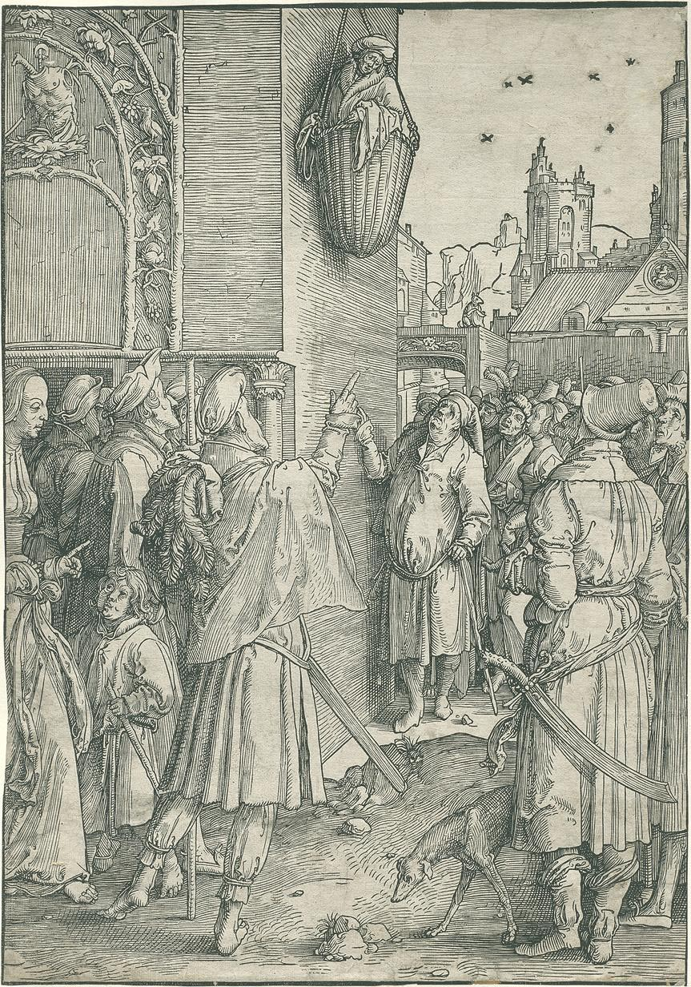
Virgil
Publius Vergilius Maro
c. 70-19 BCE
Supported by Asinius Pollio and Maecenas
Works
Eclogues
Georgics
Aeneid

Slide 28
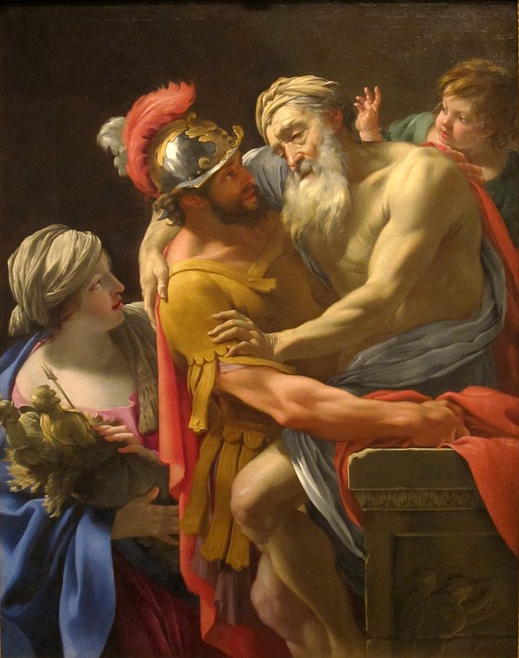
The Aeneid
Tale of Aeneas, a Trojan prince
Son of Anchises and Aphrodite/Venus
Fled Troy, bounced around the Mediterranean, ended up in Italy
Founded Lavinium; Romulus was his descendent

Slide 29
First Eclogue
Meliboeus:
Tityrus, lying there, under the spreading beech-tree cover,
you study the woodland Muse, on slender shepherd’s pipe.
We are leaving the sweet fields and the frontiers of our country:
we are fleeing our country: you, Tityrus, idling in the shade,
teach the woods to echo ‘lovely Amaryllis’.
Tityrus:
O Meliboeus, a god has created this leisure for us.
Since he’ll always be a god to me, a gentle lamb
from our fold, will often drench his altar.
Through him my cattle roam as you see, and I
allow what I wish to be played by my rural reed.

Slide 30
First Eclogue
Meliboeus:
Well I don’t begrudge you: rather I wonder at it: there’s such
endless trouble everywhere over all the countryside. See,
I drive my goats, sadly: this one, Tityrus, I can barely lead.
Here in the dense hazels, just now, she birthed twins,
the hope of the flock, alas, on the bare stones.
I’d have often recalled that this evil was prophesied to me,
by the oak struck by lightning, if my mind had not been dulled.
But, Tityrus, tell me then, who is this god of yours?

Slide 31
First Eclogue
Tityrus:
Meliboeus, foolishly, I thought the City they call Rome
was like ours, to which we shepherds are often accustomed
to drive the tender young lambs of our flocks.
So I considered pups like dogs, kids like their mothers,
so I used to compare the great with the small.
But this city indeed has lifted her head as high among others,
as cypress trees are accustomed to do among the weeping willows.
Meliboeus:
And what was the great occasion for you setting eyes on Rome?

Slide 32
First Eclogue
Tityrus:
Liberty, that gazed on me, though late, in my idleness,
when the hairs of my beard fell whiter when they were cut,
gazed yet, and came to me after so long a time,
when Amaryllis was here, and Galatea had left me.
Since, while Galatea swayed me, I confess,
there was never a hope of freedom, or thought of saving.
My hand never came home filled with coins,
though many a victim left my sheepfolds,
and many a rich cheese was pressed for the ungrateful town.

Slide 33
First Eclogue
Meliboeus:
Amaryllis, I wondered why you called on the gods so mournfully,
and for whom you left the apples there on the trees:
Tityrus was absent: Tityrus, here, the very pines,
the very springs and orchards were calling out for you.
Tityrus:
What could I do? I could not be rid of my bondage
elsewhere, or find gods so ready to help me.
There, Meliboeus, I saw that youth for whom
our altars smoke for six days twice a year.
There he was first to reply to my request:
‘Slave, go feed you cattle as before: rear your bulls.’

Slide 34
First Eclogue
Meliboeus:
Fortunate old man, so these lands will remain yours.
And they’re wide enough for you: though bare stone,
and pools with muddy reeds cover all your pastures.
No strange plants will tempt your pregnant ewes,
no contagious disease from a neighbour’s flock will harm them.
Fortunate old man, here you’ll find the cooling shade,
among familiar streams and sacred springs.

Slide 35
First Eclogue
Meliboeus:
Here, as always, on your neighbour’s boundary, the hedge,
its willow blossoms sipped by Hybla’s bees,
will often lull you into sleep with the low buzzing:
there, under the high cliff, the woodsman sings to the breeze:
while the loud wood-pigeons, and the doves,
your delight, will not cease their moaning from the tall elm.

Slide 36
First Eclogue
Tityrus:
So the swift deer will sooner feed on air,
and the seas leave the fish naked on shore,
or the Parthian drink the Saône, the German the Tigris,
both in exile wandering each other’s frontiers,
than that gaze of his will fade from my mind.
Meliboeus:
But we must go, some to the parched Africans,
some to find Scythia, and Crete’s swift Oaxes,
and the Britons wholly separated from all the world.

Slide 37
First Eclogue
Meliboeus:
Ah, will I gaze on my country’s shores, after long years,
and my poor cottage, its roof thatched with turf,
and gazing at a few ears of corn, see my domain?
An impious soldier will own these well-tilled fields,
a barbarian these crops. See to what war has led
our unlucky citizens: for this we sowed our lands.
Now graft your pears, Meliboeus, plant your rows of vines.
Away with you my once happy flock of goats.

Slide 38
First Eclogue
Meliboeus:
Lying in some green hollow, I’ll no longer see you
clinging far off to some thorn-filled crag:
I’ll sing no songs: no longer grazed by me, my goats,
will you chew the flowering clover and the bitter willows.
Tityrus:
Yet you might have rested here with me tonight
on green leaves: we have ripe apples,
soft chestnuts, and a wealth of firm cheeses:
and now the distant cottage roofs show smoke
and longer shadows fall from the high hills.

Slide 39
Key Terms
Phase I (3rd-2nd cen. BCE)
Phase II (1st cen. BCE)
Poetry
Livius Andronicus
Naevius
Ennius
Plautus
Terence
Prose
Fabius Pictor
Cato the Elder
Prose
Cicero
Livy
Poetry
Lucretius
Catullus
Horace
Virgil

