Slide 1
First of all…
c. or ca. = circa
meaning ‘around’
fl. = floruit
meaning ‘flourished’

Slide 2
Sources
Historical works
Letters
Speeches
Inscriptions
Coins
Monumental art
Personal art
Archaeological remains

Slide 3
Fabius Pictor
Born c. 270 BCE
Earliest attested Roman historian
Wrote in Greek
His history covered the foundation of Rome to c. 200 BCE
Used by Polybius, Livy, Dionysius and Plutarch
“Nothing more than a compilation of yearly chronicles” (Cicero)

Slide 4
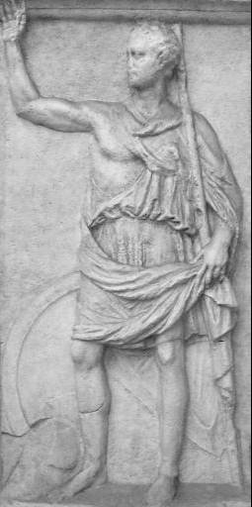
Polybius
c. 200-118 BCE
Born in Megalopolis in Arcadia, Greece
Prominent local politician and military leader
Lived in Rome as a hostage c. 167-150 BCE
Wrote Histories (in Greek) covering 264 to 146 BCE

Slide 5
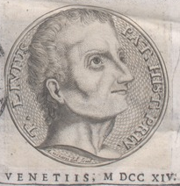
Livy
c. 64 BCE - 12 CE
Born in Patavium (now Padua) in Cisalpine Gaul
Grew up during the civil wars of the 40s BCE
Independently wealthy?
Wrote Ab urbe condita (‘From the Founding of the City’)
Originally 142 books!
Most now lost

Slide 6
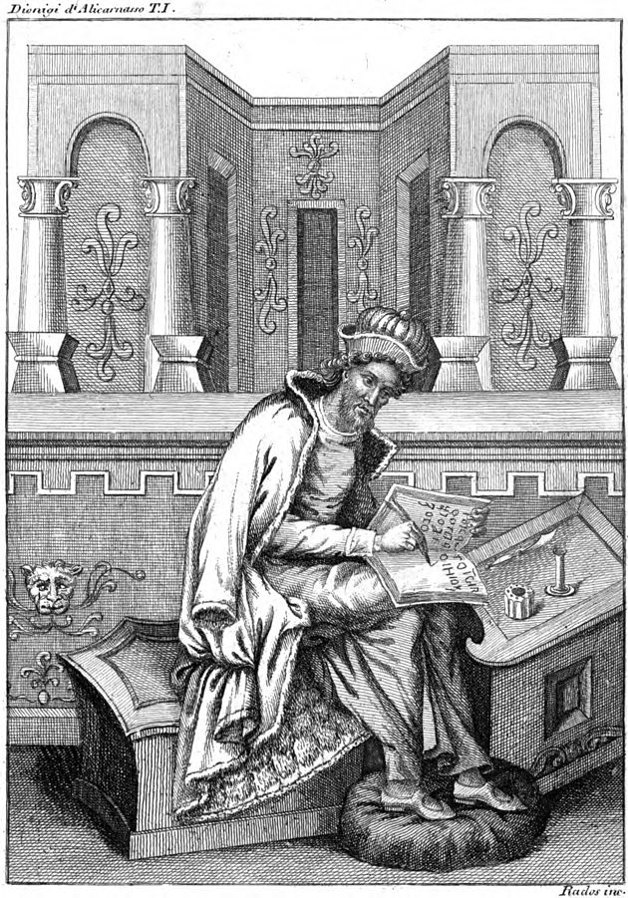
Dionysius of Halicarnassus
c. 60 - after 7 BCE
Born in Halicarnassus (in modern Turkey)
Came to Rome c. 30 BCE
Wrote numerous works, including Roman Antiquities, spanning the foundation of Rome to the Punic Wars
“It is a combination of every kind, forensic, speculative and narrative, to the intent that it may afford satisfaction both to those who occupy themselves with political debates and to those who are devoted to philosophical speculations, as well as to any who may desire mere undisturbed entertainment in their reading of history.” (Rom. Ant. 1.8)

Slide 7
Annales Maximi
Compiled c. 130-115 BCE by the Pontifex Maximus
Comprised 80 books (i.e. codices)
Covered c. 400-130 BCE
Lists of consuls, battles, temple dedications, deaths of priests, new religious ceremonies, plagues, food shortages, and unusual events
i.e. anything portentious

Slide 8
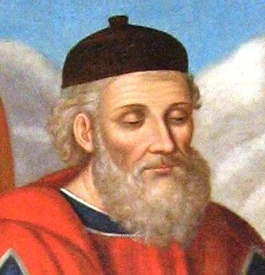
Diodorus Siculus
fl. 1st cen. BCE
From Agyrium, Sicily
Wrote a ‘universal history’ entitled Bibliotheke (The Library)
Attempted to synchronize Greek and Roman history
Interested in the rise and fall of empires

Slide 9
Sallust, Appian, Cassius Dio
Sallust (86 - c. 35 BCE, from Italy)
Tribune who supported Caesar in the civil war
Wrote histories of the Catilinarian conspiracy and the war against Jugurtha
Appian (c. 90-165 CE, from Egypt)
Wrote Roman History in Greek for a Greek audience
Books on the civil war survive
Cassius Dio (c. 155-235 CE)
Wrote Roman History in Greek, covering the founding of Rome to 229 CE

Slide 10
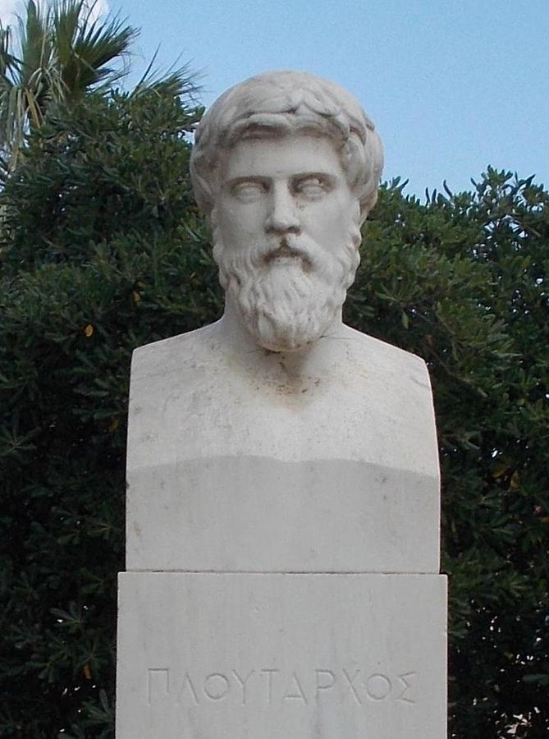
Plutarch
c. 45-125 CE
Born in Chaeronea, Greece
Local official and priest at Delphi
Wrote moralizing essays and Parallel Lives, comparing a Roman statesman to a Greek
Interested in morality and behavior, but had access to many lost sources

Slide 11
Oral History
“And speeches in praise of the dead of past ages are indeed extant; for the families concerned kept them as a sort of mark of honor and a record, both in order to be able to use them if anyone else of the same family died and in order to preserve the memory of the achievements of the family and document its nobility. Of course, the history of Rome has been falsified by these speeches; for there is much in them which never happened – invented triumphs, additional consulates, false claims to patrician status, with lesser men smuggled into another family with the same surname, as if, for instance, I claimed to be descended from Marcus Tullius, who was a patrician and consul with Servius Sulpicius ten years after the expulsion of the kings.”
- Cicero, Brutus 62 (46 BCE)
*

Slide 12
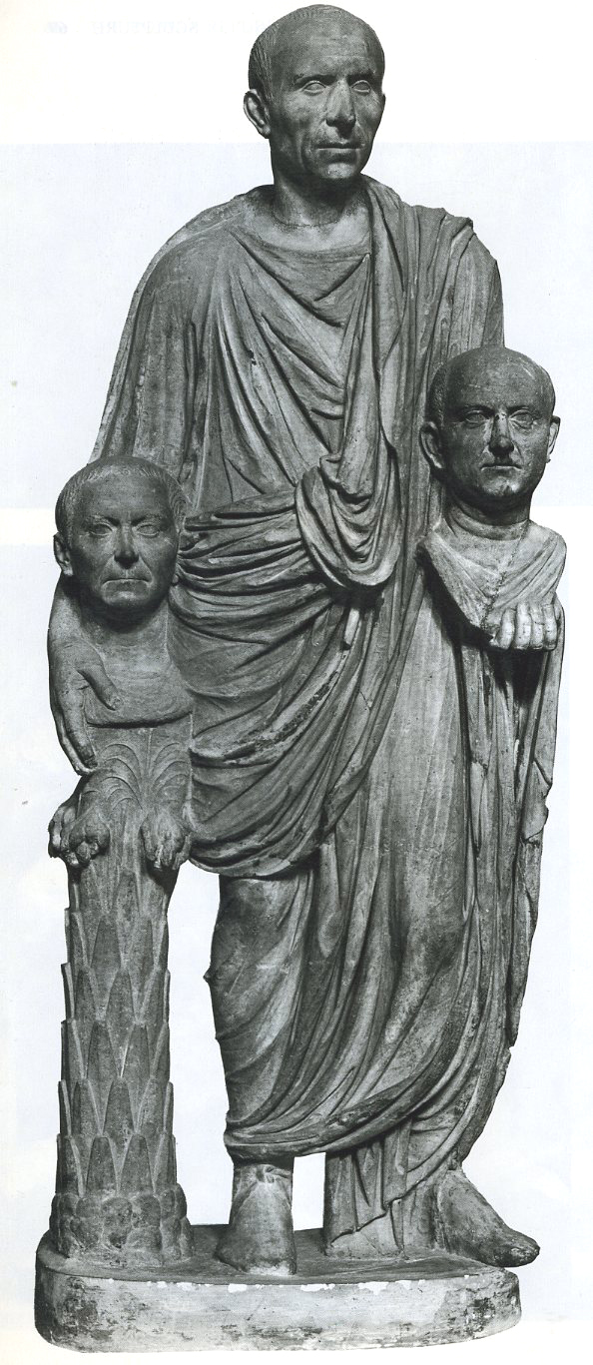
Oral History
Roman ancestor busts
Displayed in houses and brought out for processions and funerals
Barberini Group, c. 75-50 CE

Slide 13
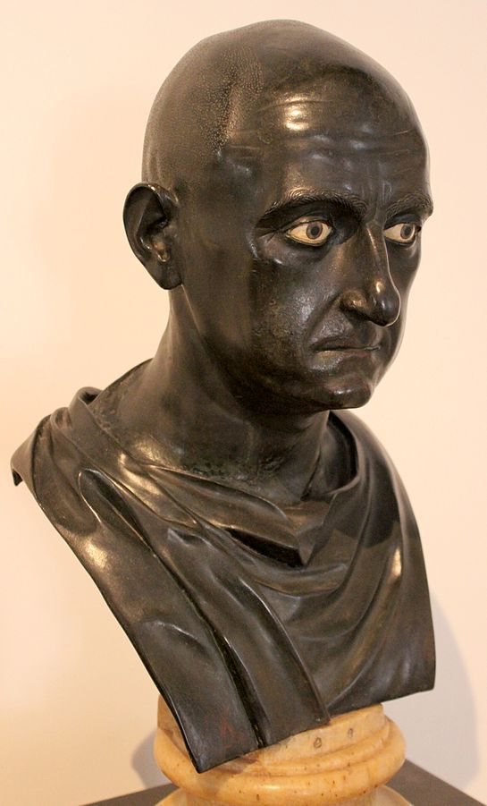
Roman Male Names
Praenomen: first name
e.g. Marcus, Lucius, Publius
Nomen: clan name
e.g. Cornelius, Tullius
Cognomen: family name
e.g. Cicero, Scipio, Cato
Agnomen: honorary name
e.g. Africanus
Citizens only!
Publius Cornelius Scipio Africanus
c. Mid 1st cen. BCE

Slide 14
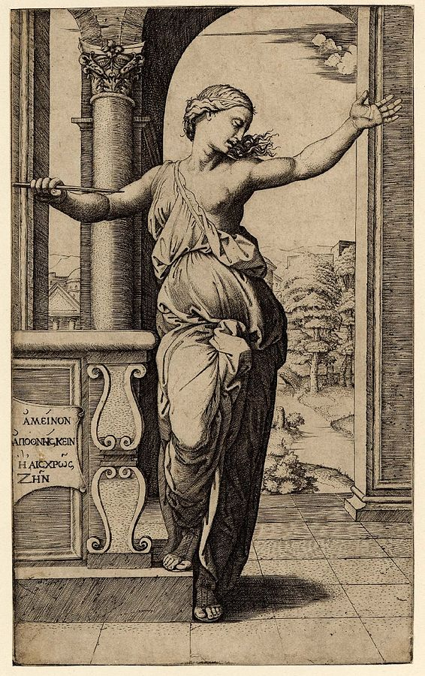
Roman Female Names
Nomen: clan name
e.g. Cornelia, Lucretia
Engraving of Lucretia by Marcantonio Raimondi (1534)

Slide 15
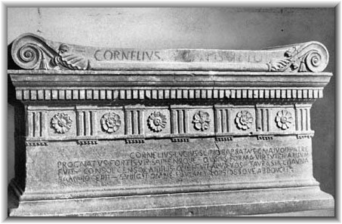
Other Textual Evidence
Inscriptions
Public
Private
Speeches
Letters
“Cornelius Lucius Scipio Barbatus, sprung from Gnaeus his father, a man strong and wise, whose appearance was most in keeping with his virtue, who was consul, censor, and aedile among you - He captured Taurasia Cisauna in Samnium - he subdued all of Lucania and led off hostages.”

Slide 16
Archaeology
The study of the past by way of its physical remains.
Excavation
Landscape archaeology (survey)
Art history
Nautical archaeology
Archaeometry (zooarchaeology, archaeobotany, paleoclimatology, radiocarbon dating)
Excavated texts (epigraphy, papyrology)

Slide 17
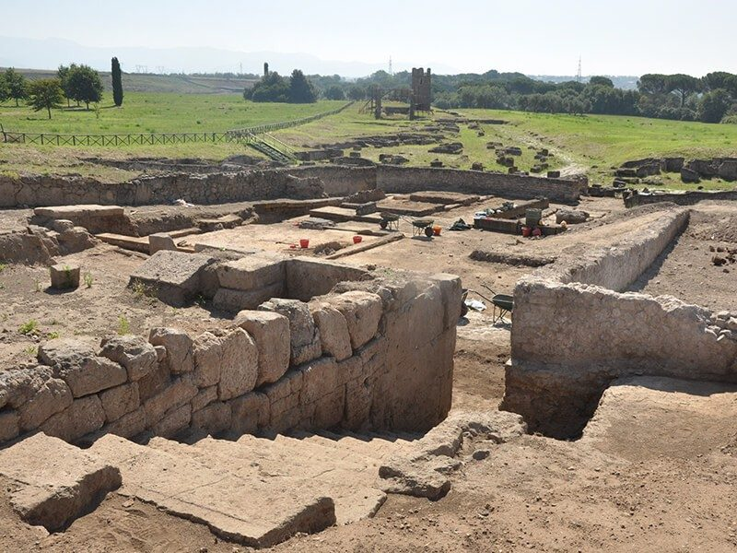
Archaeological Sites
Ancient cities, towns, temples, forts, farms, etc. that were abandoned in the past
Rediscovered (often by chance) and excavated
Varying degrees of preservation
Uncertain identification
Small finds preserved
Gabii, Italy

Slide 18
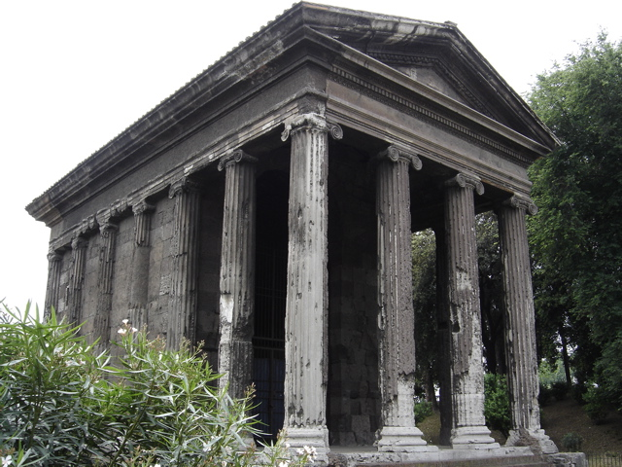
Buildings
Built in the past and still extant today.
Frequently renovated.
Function can change over time.
Frequent cleaning eliminates small finds.
Temple of Portunus, Rome, c. 120-80 BCE

Slide 19
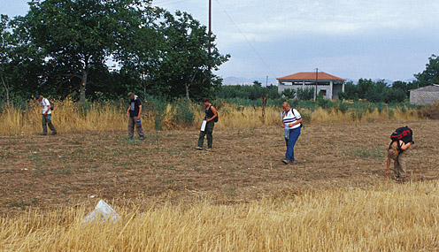
Surface Survey
Examination of the surfaces of plowed fields for evidence of ancient human activity
Identification of standing remains
Mapping
Use of remote sensing (i.e. declassified spy satellite photography)
Survey at Tegea, Greece

Slide 20
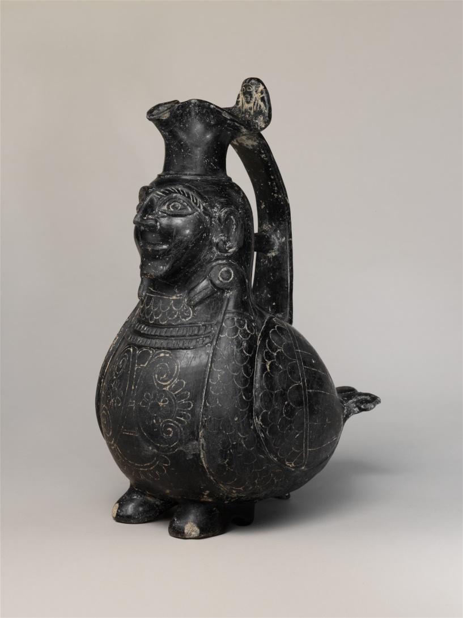
Material Culture
Pottery, coins, glass, metal, weapons, stone sculpture, etc.
Some excavated, some looted
Evidence for daily life, ritual, economy
Etruscan bucchero jug, c. 550-500 BCE

Slide 21
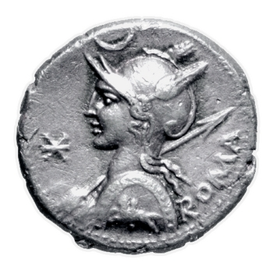
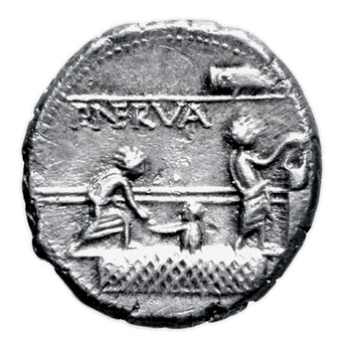
Coins
Good evidence for economic activity and iconography
Large quantities allow for quantitative studies
Usually not excavated.
Silver denarius, Rome, c. 113-112 BCE

Slide 22
Key Terms
Fabius Pictor
Polybius
Livy
Dionysius of Halicarnassus
Annales Maximi
Diodorus Siculus
Plutarch
nomen
epitome

