Slide 1
Myth
“A traditional or legendary story, usually concerning some being or hero or event, with or without a determinable basis of fact or a natural explanation, especially one that is concerned with deities or demigods and explains some practice, rite, or phenomenon of nature.”
From Greek μῦθος = ‘story’

Slide 2
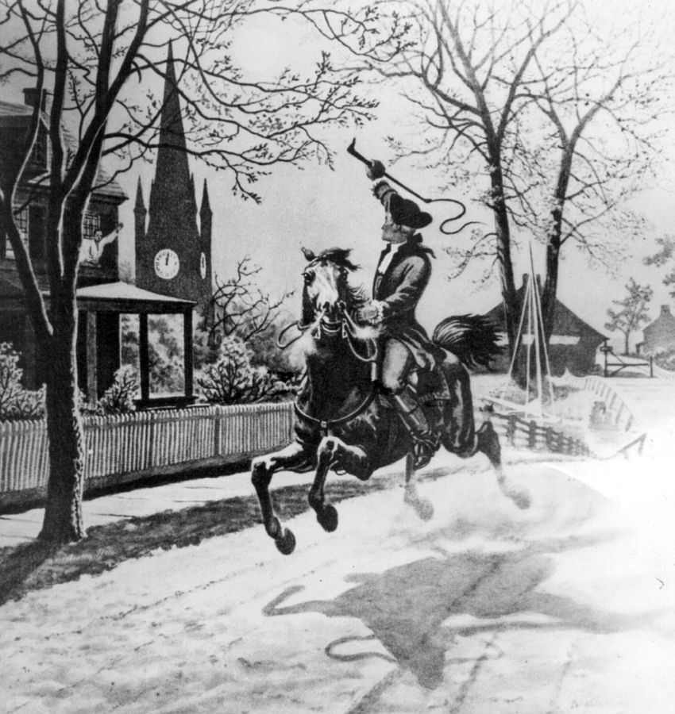
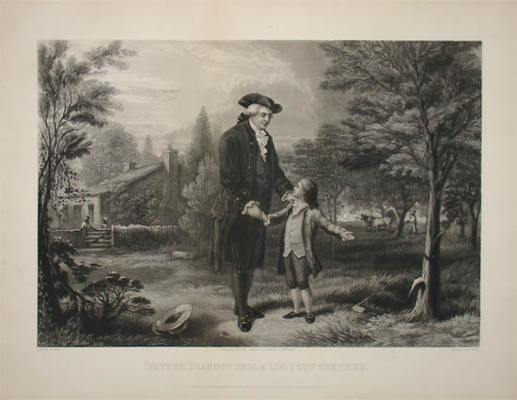
American Foundation Myths
Paul Revere
George Washington
Notes:
Rode from Boston to Concord in 1775; one if by land, two if by sea
Chopped down a cherry tree as a child; when asked, replied “I cannot tell a lie”
Invented by Mason Weems for his 1800 biography

Slide 3
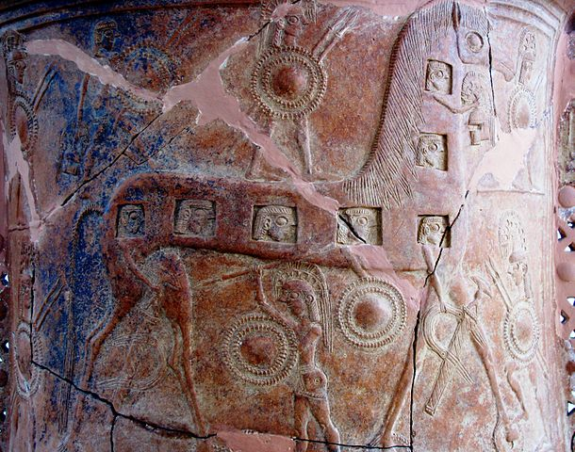
The Trojan War
Mythical war between the Greeks and the Trojans and their allies
Precipitated by the abduction of Helen
Greek besieged Troy for ten years
Eventually gained entry to the city by means of the Trojan horse
Romans believed this happened in 1184 BCE

Slide 4
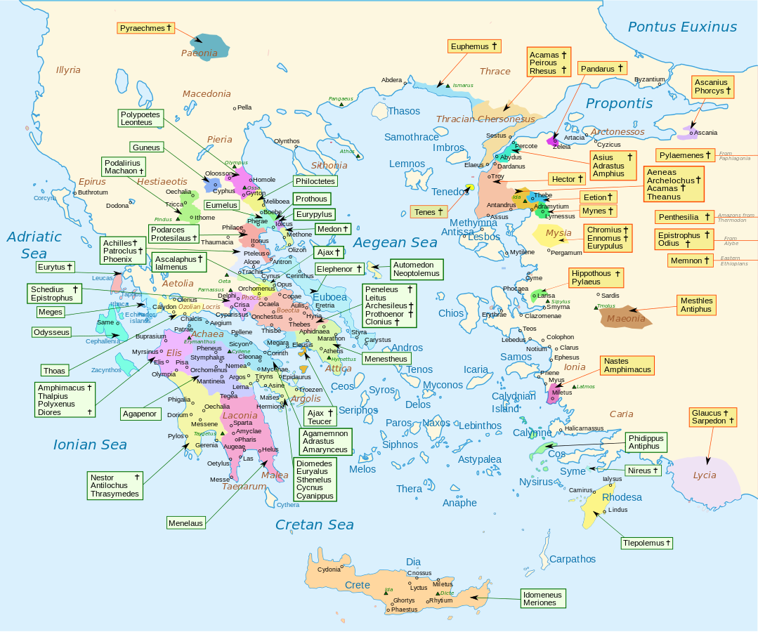

Slide 5
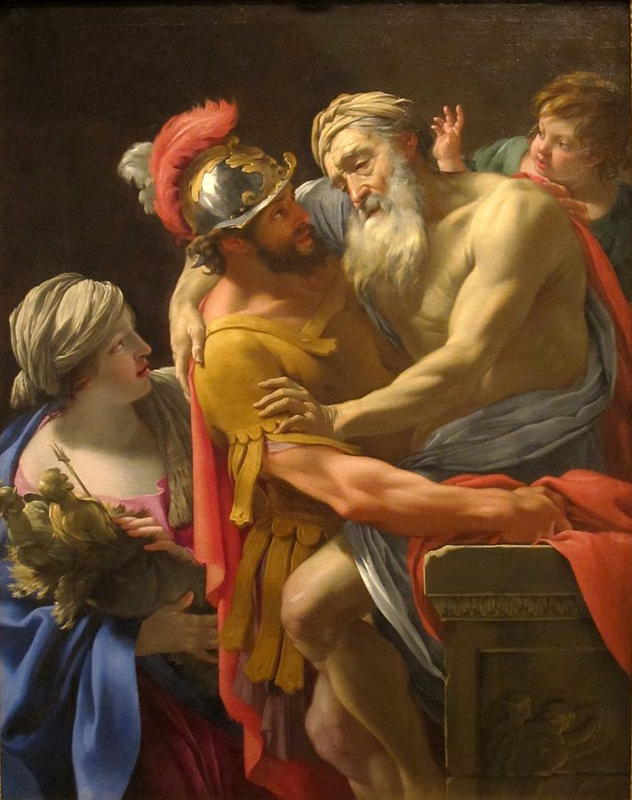
Aeneas
Trojan prince
Son of Anchises and Aphrodite/Venus
Wife Creusa was killed in the sack of Troy
Subject of an epic poem, the Aeneid, by Virgil (70-19 BCE)

Slide 6
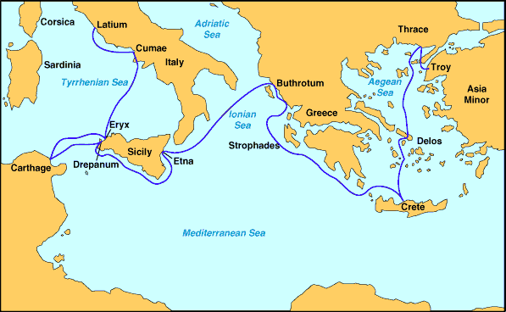
Aeneas

Slide 7
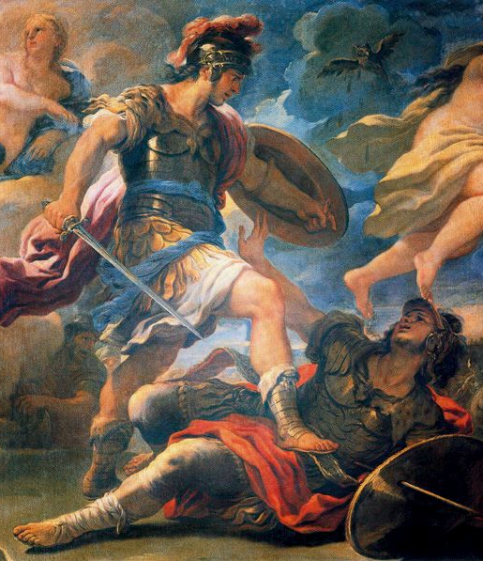
Aeneas in Italy
Defeats and/or forges an alliance with the Latins
Marries Lavinia, daughter of King Latinus
Founds Lavinium
Defeats the Rutulians and the Etruscans
“Men call him Jupiter Indiges.”

Slide 8
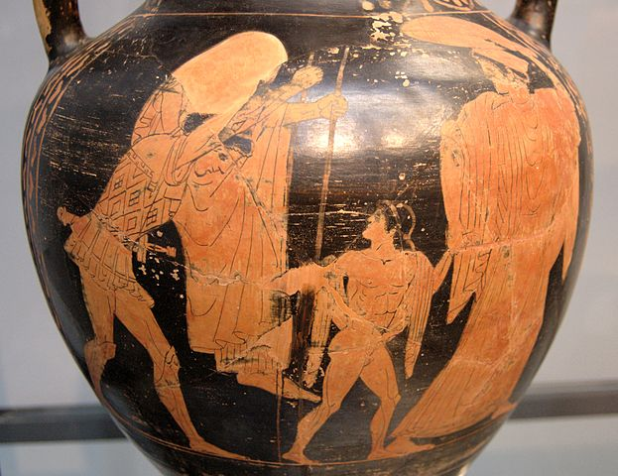
Ascanius
Son of Aeneas by Creusa (Virgil) or Lavinia (Livy)
Founded Alba Longa
Also called Iulus by Virgil
As in ‘Iulius Caesar’
Descendants ruled Alba Longa

Slide 9
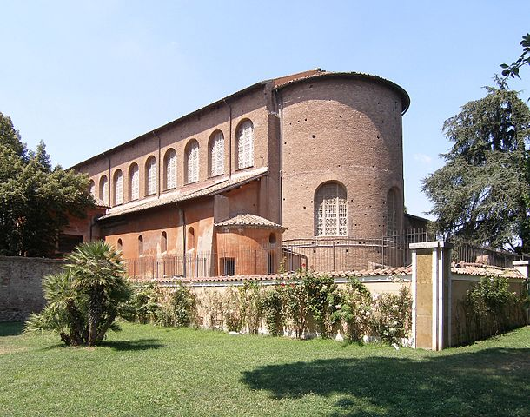
Descendants of Ascanius
Latinus Silvius
Capetus Tiberinus
Aventinus
Numitor and Amulius
Basilica of Santa Sabina on the Aventine Hill in Rome

Slide 10
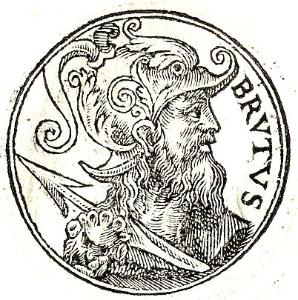
Sidebar: Brutus of Troy
Son or grandson of Ascanius
Accidentally killed his parents and was exiled from Italy
Rescued some imprisoned Trojans and wandered until reaching Britain
Defeated some giants, established London, and renamed the island after himself
So says Geoffrey of Monmouth in the Historia Regum Britanniae

Slide 11
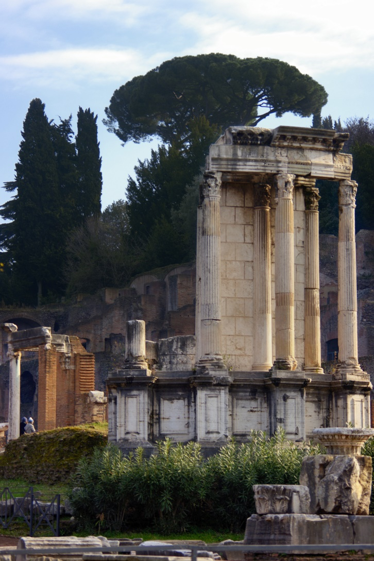
Numitor and Amulius
Sons of King Procas
Numitor, the elder, inherited the kingdom
Overthrown and exiled by Amulius, who killed Numitor’s male children and made his daughter Rhea Silvia a Vestal
When Rhea Silvia conceived immaculately, Amulius ordered her twin sons exposed on the banks of the Tiber
Remains of the Temple of Vesta in Rome

Slide 12
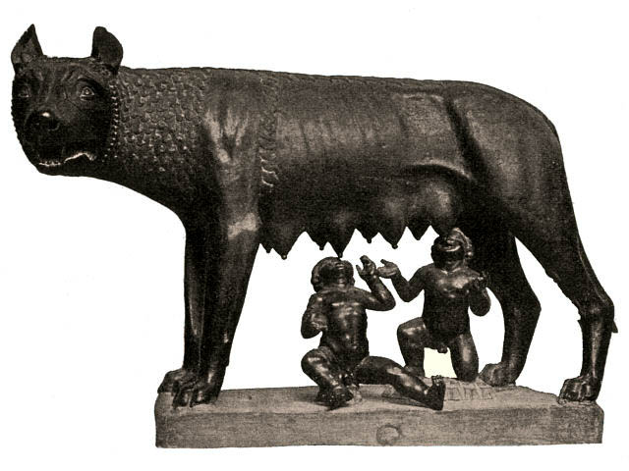
Romulus and Remus
Twin sons of Rhea Silvia
Discovered by a nursing wolf who suckled them
Found by the shepherd Faustulus who raised them as his own children
Learn their true origins from Faustulus and Numitor respectively, and they overthrow Amulius

Slide 13
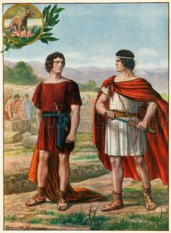
Romulus and Remus
They found their own city on the Tiber where they were exposed
Dispute over seniority
Augury
Or Remus mocked Romulus by jumping over the half-built walls and was killed
753 BCE (the Romans thought)

Slide 14
History or Myth?
Is it plausible?
How would Romans of Livy’s day have known this information?
Is it teleological (does it explain the present instead of the past)?
Are the details specific or stereotypical?
And how does it compare to other evidence…

Slide 15
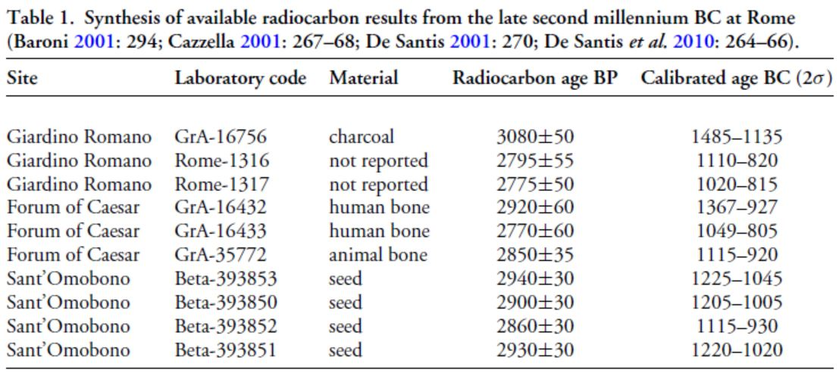
Bronze Age Rome

Slide 16
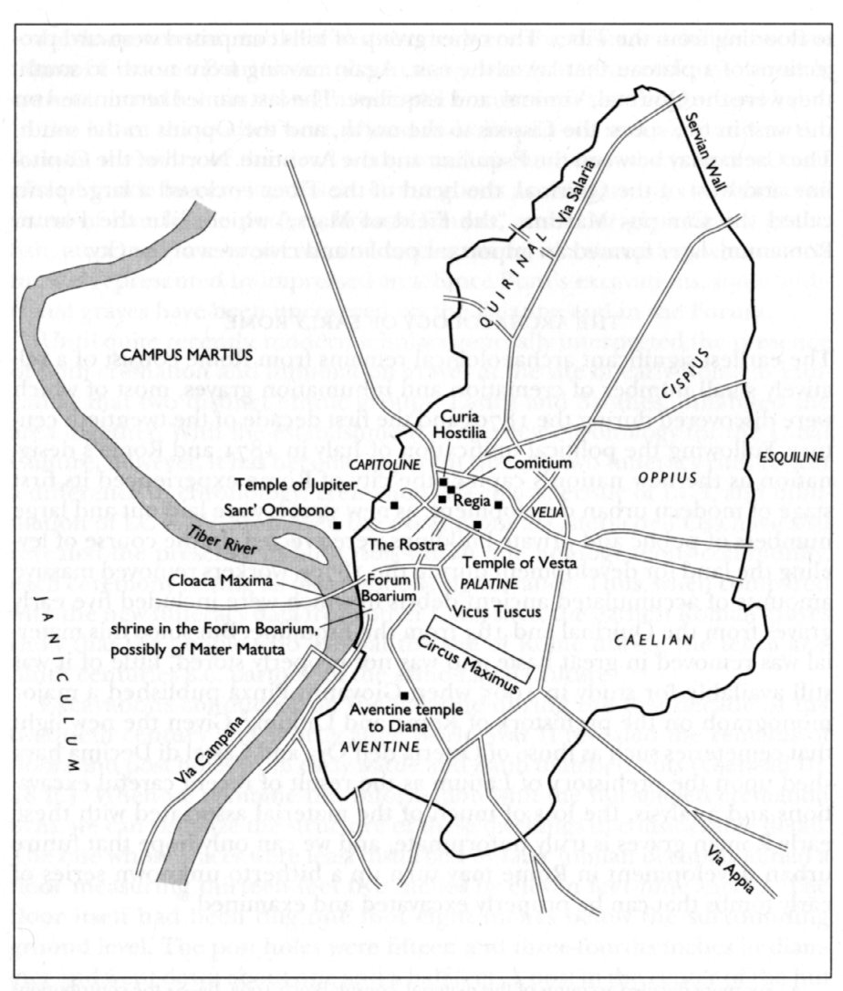
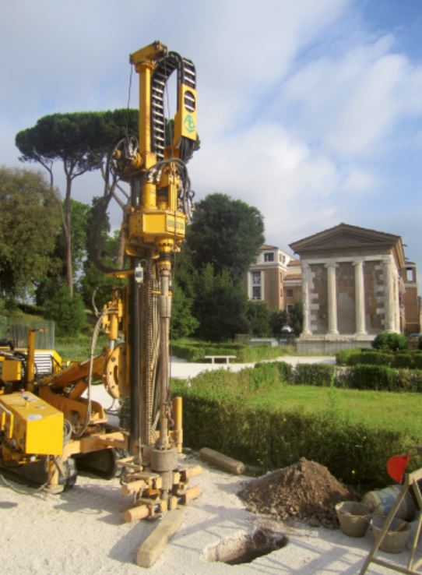
Bronze Age Rome

Slide 17
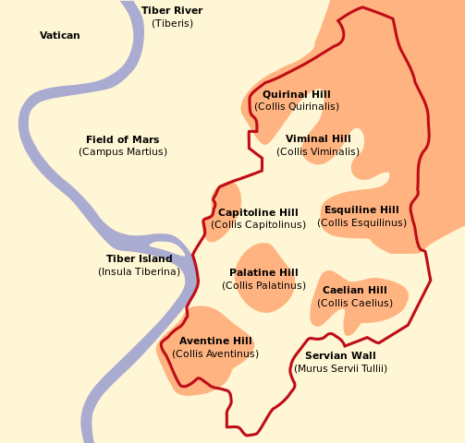
The Seven Hills of Rome
Palatine
Capitoline
Aventine
Caelian
Esquiline
Viminal
Quirinal

Slide 18
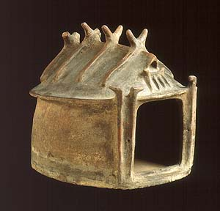
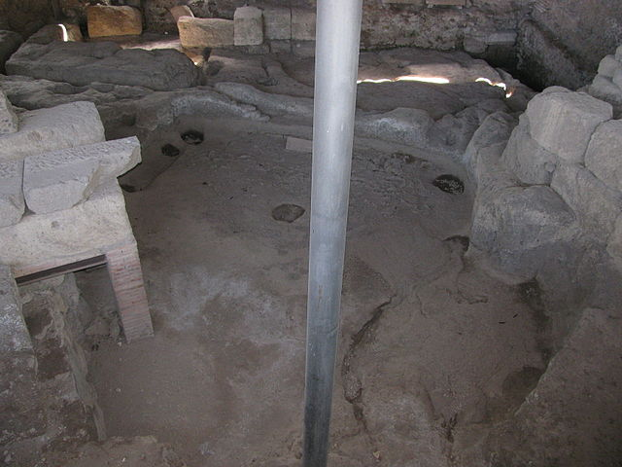
Iron Age Houses
Post holes on the Palatine Hill
Terracotta hut urn, c. 900 BCE

Slide 19
Sant’Omobono

Slide 20
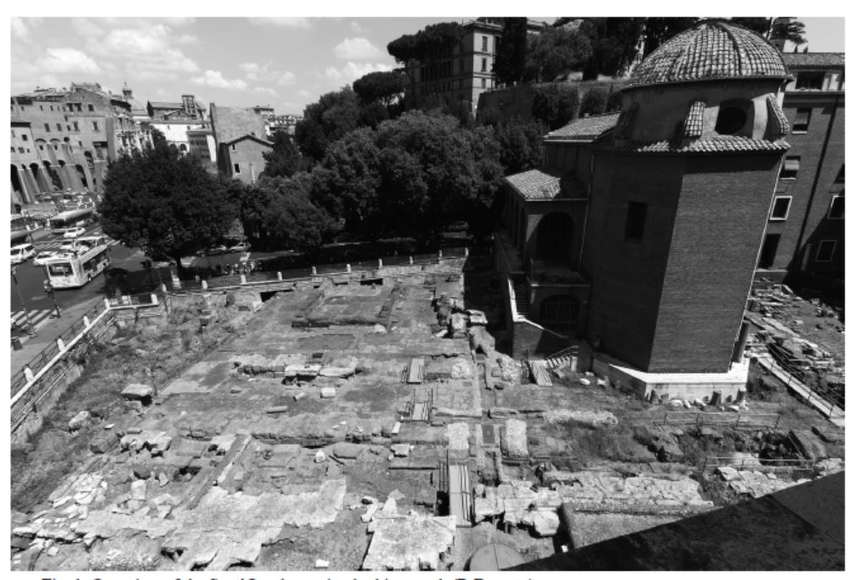
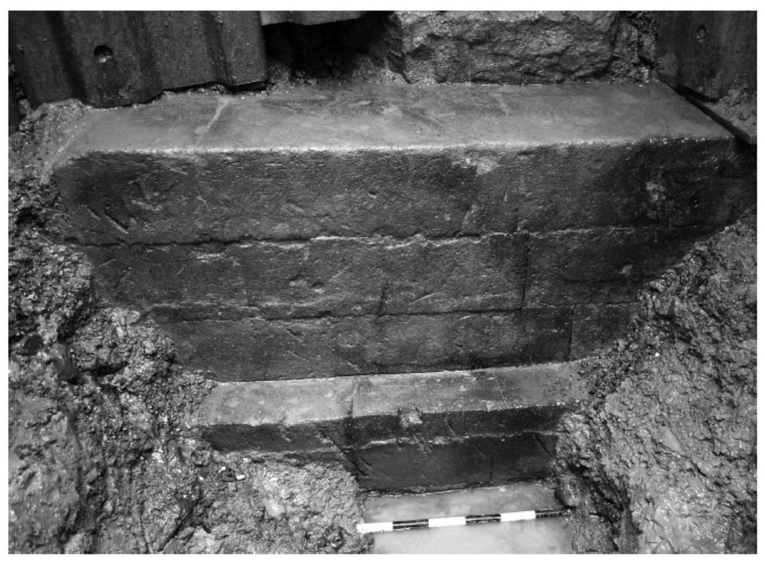
Sant’Omobono
*
Temple podium, early 6th cen. BCE

Slide 21
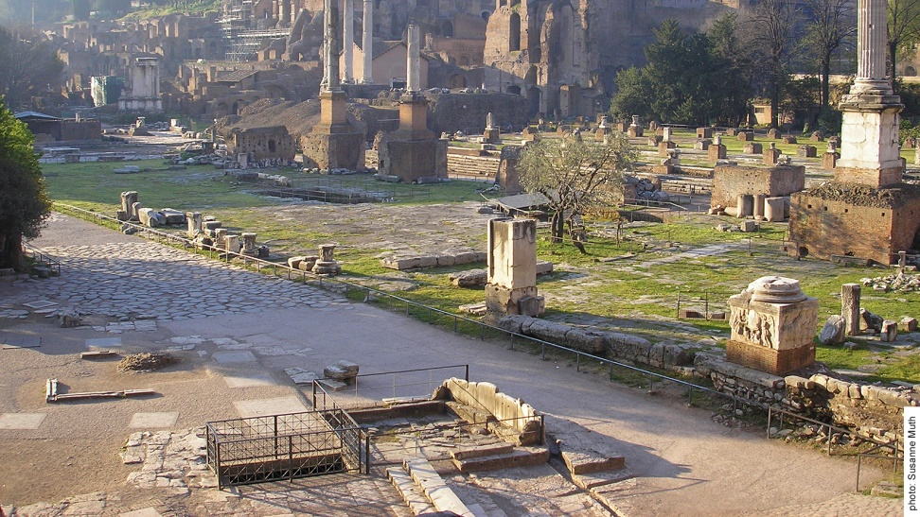
The Comitium

Slide 22
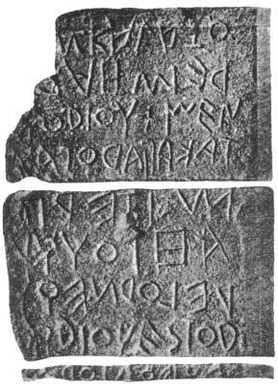
Lapis Niger Inscription
"Whosoever (will violate) this (grove), let him be cursed. (Let no one dump) refuse (nor throw a body...). Let it be lawful for the king (to sacrifice a cow in atonement). (Let him fine) one (fine) for each (offence). Whom the king (will fine, let him give cows). (Let the king have a ---) herald. (Let him yoke) a team, two heads, sterile... Along the route... (Him) who (will) not (sacrifice) with a young animal...in ...lawful assembly in grove..."
*
c. 570-550 BCE

Slide 23
Key Terms
Aeneas
Virgil
Alba Longa
Romulus
Remus
Teleological
Sant’Omobono
Comitium
Lapis Niger

