Slide 1
What is religion, anyway?
Sacra et auspicia = ‘cults and divination’ (Cicero)
Cult
a particular system of religious worship, especially with reference to rites and ceremonies.
Divination
the practice of attempting to foretell future events or discover hidden knowledge by occult or supernatural means.
Augury; prophecy

Slide 2

The Nature of Roman Religion

Slide 3
Key Terms
Epithet
Added name that refers to a specific aspect or form of a god
E.g. Venus Genetrix = ‘Venus the ancestor’
Syncretism
The combining of multiple similar gods
E.g. Mars and Ares
Personification
Place or concept conceived of as a divine being

Slide 4
Sources
Fasti
Public calendars identifying sacred (i.e. festival) days
Survive only in fragments
Anti-pagan polemics
Early Christian writers criticizing ancient Roman religion
Writers interested in other things…
E.g. Livy, Cicero, etc.

Slide 5
The Olympian Gods
Jupiter (Zeus)
Juno (Hera)
Vesta (Hestia)
Ceres (Demeter)
Venus (Aphrodite)
Mars (Ares)
Minerva (Athena)
Neptune (Poseidon)
Vulcan (Hephaestus)
Apollo
Diana (Artemis)
Mercury (Hermes)
Pluto (Hades)

Slide 6
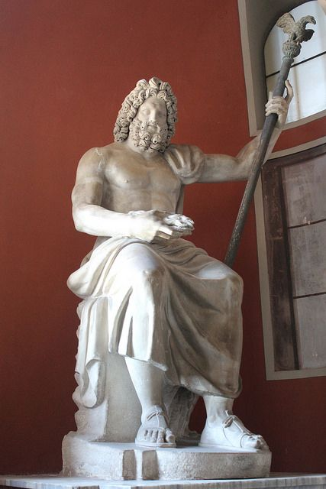
Jupiter
Or ‘Jove’
Descendant of Indo-European god Dyeu-pater = ‘sky father’
So was Zeus
Sky god, controller of thunder
Dominant god of the Roman pantheon
Temple of Jupiter Optimus Maximus on the Capitoline Hill

Slide 7
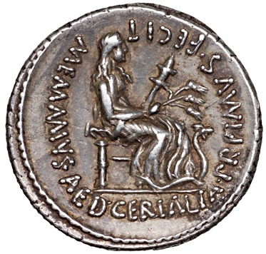
Ceres
Ancient Italian fertility goddess
Hence the word ‘cereal’
Attested as early as 600 BCE in Faliscan inscription
Cult established on Aventine Hill in 494/3 BCE
Temple was the base for the Tribunes of the Plebs
Only associated with Demeter in the late 3rd cen. BCE through Greek influence from Magna Graecia
Priestess of Ceres was the only female public official in Rome

Slide 8
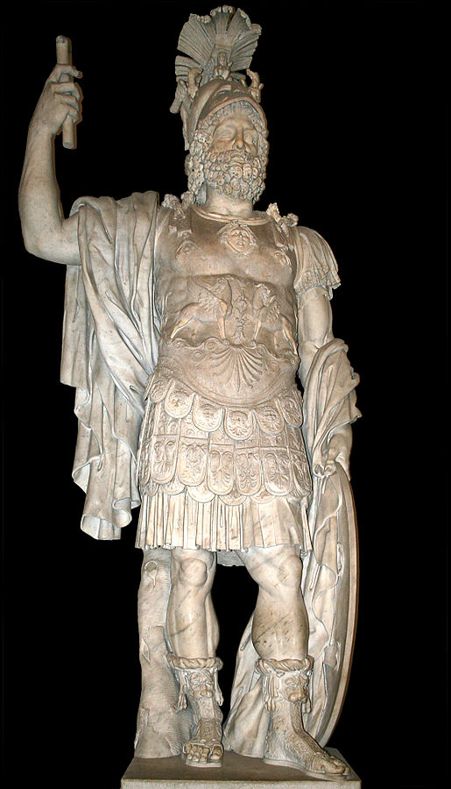
Mars
God of war and agriculture
Father of Romulus and Remus?
Worshipped outside the city at the Campus Martius (‘field of Mars’) where Romans mustered for battle

Slide 9
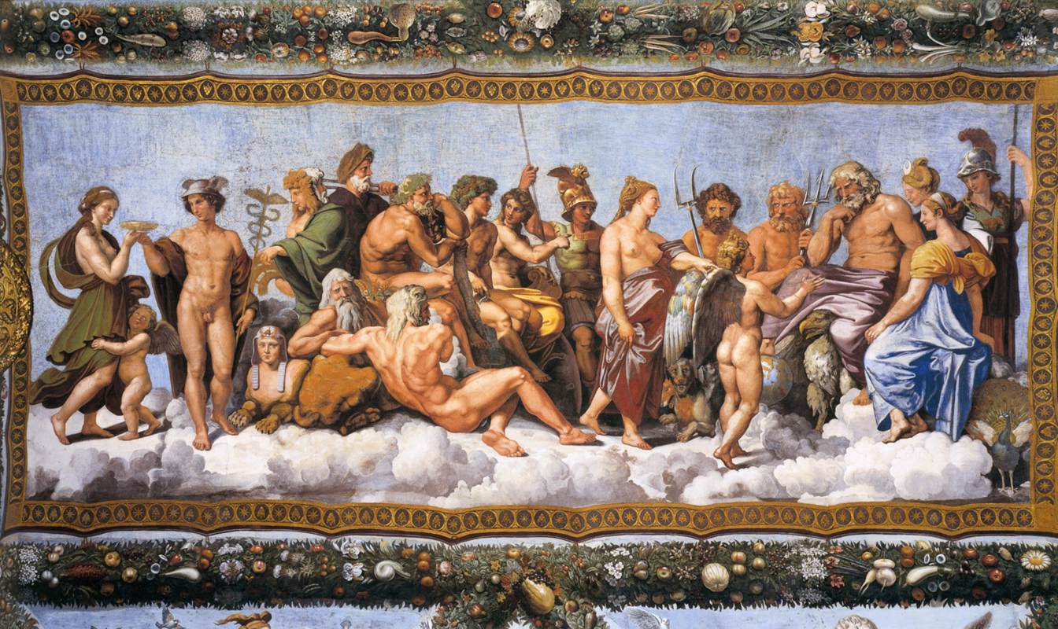
and everybody else…

Slide 10
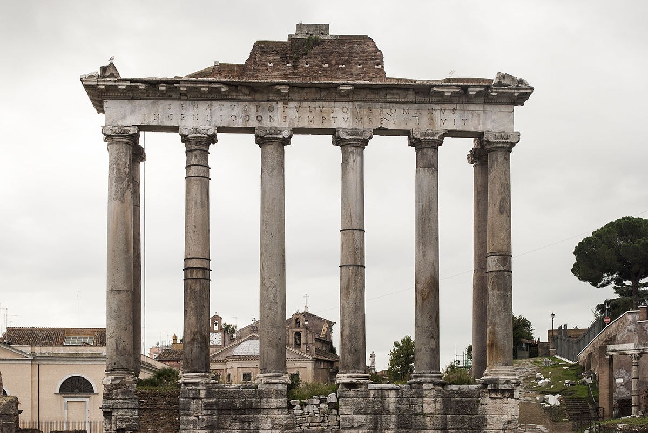
Saturn
Sabine (?) later equated with the Greek Cronus
Associated with agriculture and wealth
Considered the father of Jupiter
Temple in Rome near the Capitoline Hill
Festival of Saturn (‘Saturnalia’) on December 17
Time of freedom and role and reversal
Remains of the Temple of Saturn in Rome

Slide 11
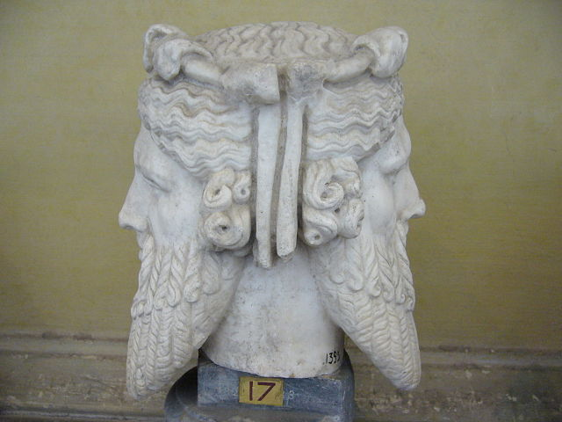
Janus
God of archways, doorways, beginnings and endings
January named after him
Usually first god invoked
Temple doors left open in times of war
Priests of Janus were ‘doorkeepers’ or ‘Janitors’

Slide 12
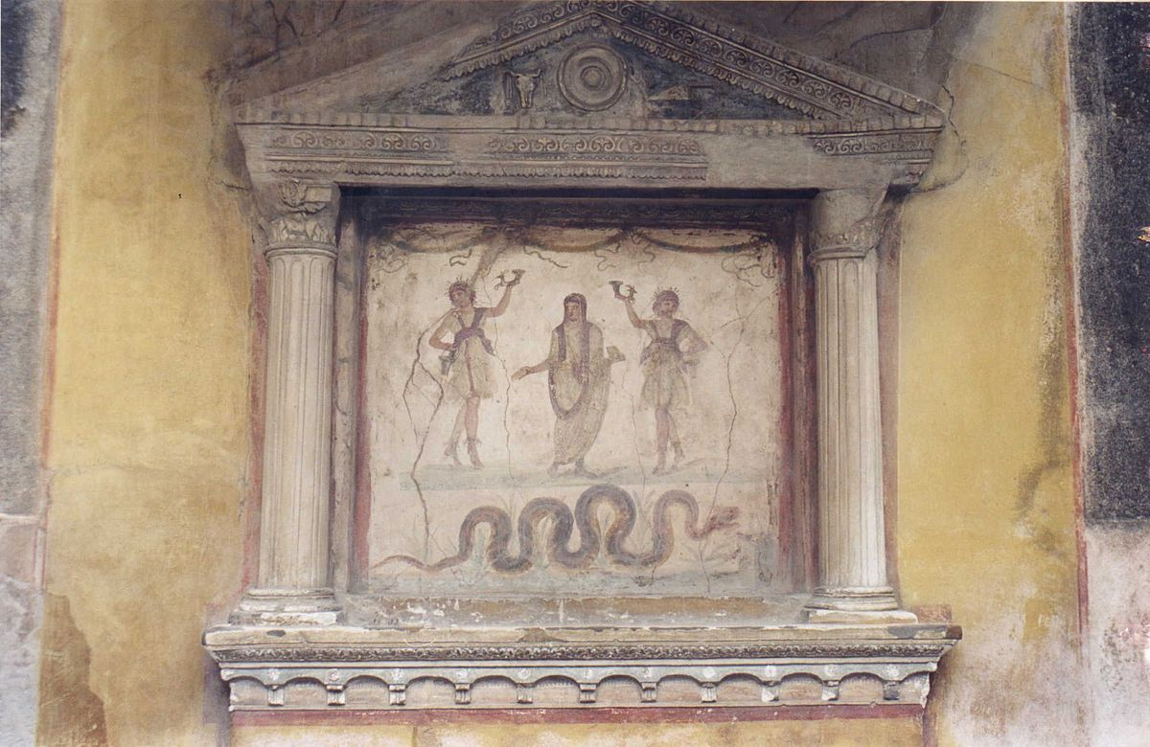
Lares
Guardian gods
Lar familiaris: guardian of the family
Sacrifices made to them on festival days and on major familial occasions, such as births
Often worshipped with the Genius of a family (in the form of a snake)
Other civic Lares as well
Lararium in the House of the Vettii, Pompeii, c. 1st cen. CE

Slide 13
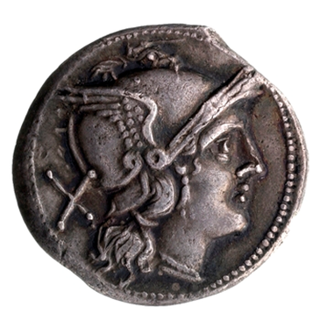
Roma
Personification of Rome
Originated in Greece, i.e. in regions subject to Roman rule
No temple at Rome until the 2nd century CE!
Silver denarius, c. 209-208 BCE

Slide 14
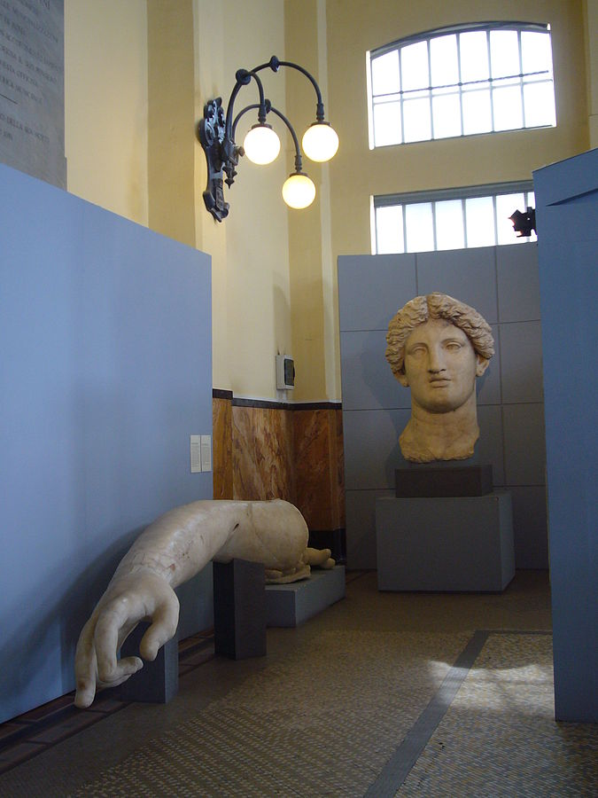
Fortuna Huiusce Dei
“Fortune of This Day”
Vowed by Q. Lutatius Catulus at the Battle of Vercellae in 101 BCE in Cisalpine Gaul
Temple B at Largo Argentina in Rome
Arm and head of a colossal statue of Fortunta, c. 1st cen. BCE

Slide 15
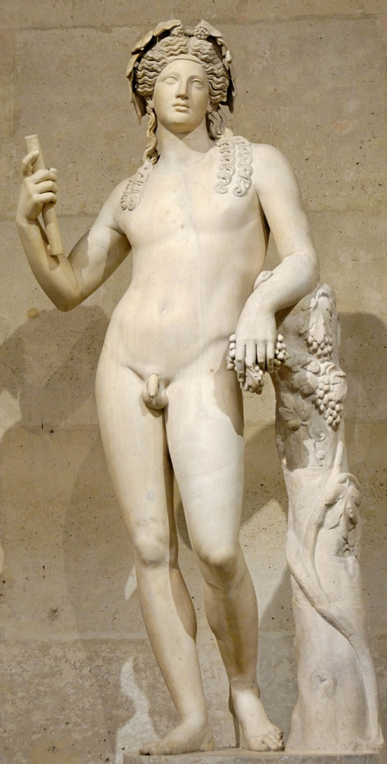
The Bacchanalia Incident
Cult of Bacchus (i.e. Dionysus, Greek god of wine) had spread to Rome by the 3rd cen. BCE
In 186 BCE rumors of sexual deviancy and criminal activity prompted an investigation by the Senate
Over 4000 people were executed in Italy, and the worship of Bacchus was only permitted by individuals with permission of local officials

Slide 16
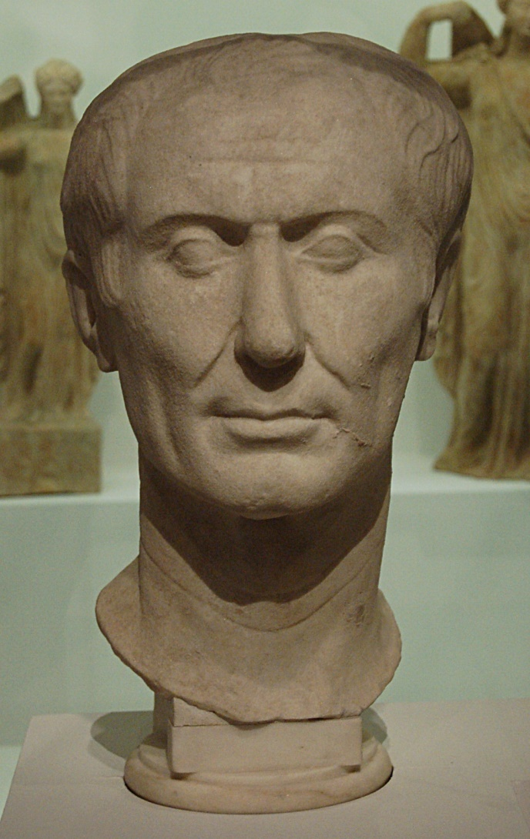
Pontifex Maximus
Head of the college of priests in Rome
Instituted by Numa Pompilius (supposedly)
Supervised temples, religious rituals, burial rules, calendars, divination, marriages, etc.
Julius Caesar, elected Pontifex Maximus in 63 BCE

Slide 17
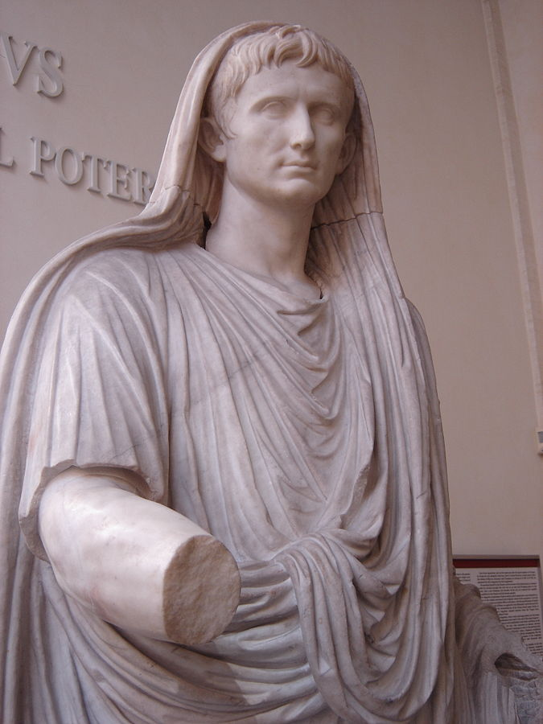
Roman Priests
Most priests were part time and held other positions
Exceptions: Vestal Virgins and the Flamen Dialis (priest of Jupiter)
Fetiales: priests tasked with making divinely sanctioned declarations of war
Augustus dressed as a priest

Slide 18
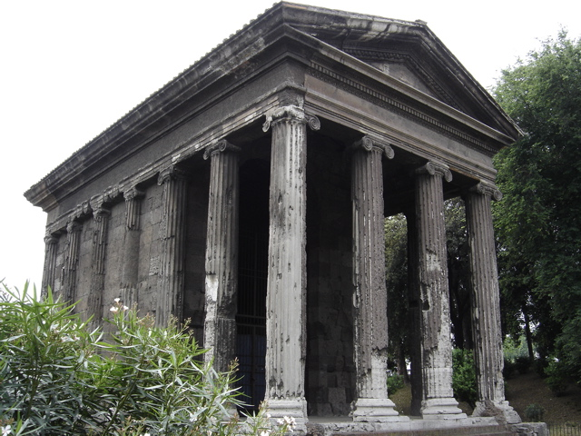
Roman Temples
Altar place in front of temple building for offerings and rituals
Pronaos: porch at front of building
Cella: room inside of temple that housed cult image and offerings
Temple of Portunus (god of harbors)
*
Temple of Portunus, Rome, c. 120-80 BCE

Slide 19
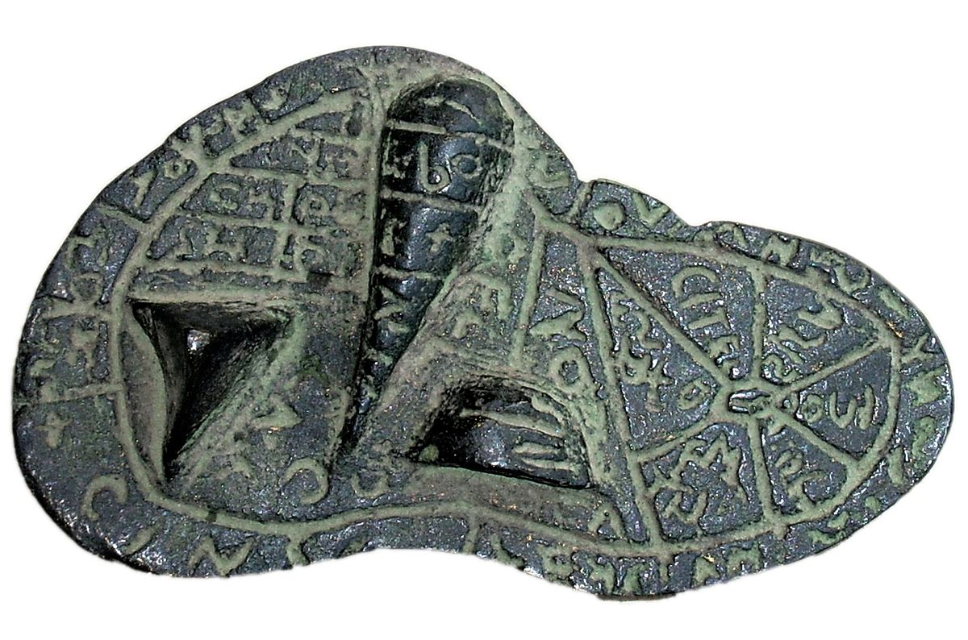
Divination
Also called augury, auspicia
Hence ‘auspicious’
Responsibility of augurs
Roman officials had to gain the gods’ assent before doing anything big, like building a temple or invading someplace
Birds, meteors, animal entrails, etc.
Etruscan experts on liver divination (extispicy) were called haruspices (sing. haruspex)
*
The Liver of Piancenza, bronze, late 2nd cen. BCE

Slide 20
Roman Religion
Included Roman, Greek and Italian gods
Initially concerned with agriculture
Came to primarily serve political purposes
Yet someone divination continued to play a central role…

Slide 21
More Key Terms
Cult
Divination
Jupiter
Mars
Saturn
Janus
Lares
Roma
Pontifex Maximus
Temple
Augur/augury
Extispicy

