Slide 1
Roman Social Orders
Patricians
Descendants of Romulus’ original 100 senators
Equestrians/Knights
Descendants of Servius Tullius’ original cavalry centuries
Consisted of those who could afford to maintain horses
Plebeians/Plebs
All other citizens

Slide 2
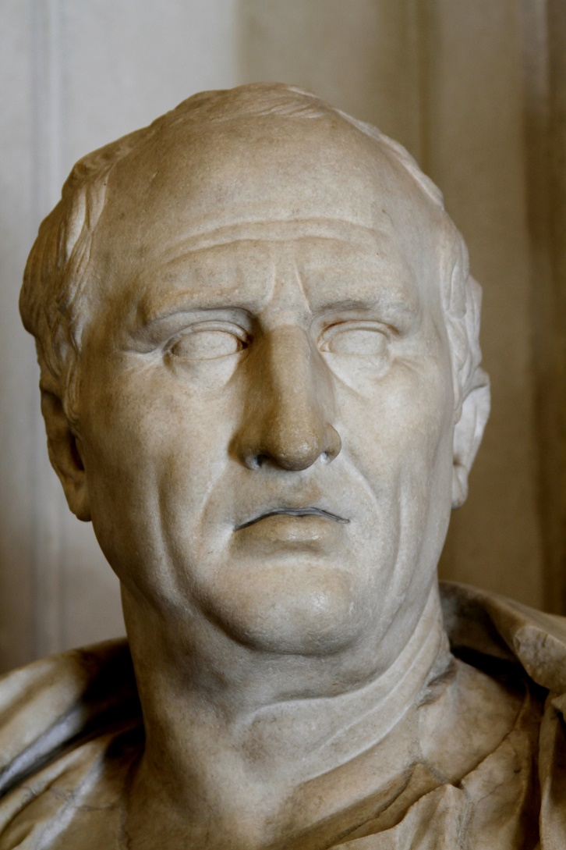
Cicero
Marcus Tullius Cicero
106-43 BCE
Lawyer, orator, politician and writer
Novus homo from a plebeian family
Quaestor in 75, praetor in 66, consul in 63, governor of Cilicia in 51

Slide 3
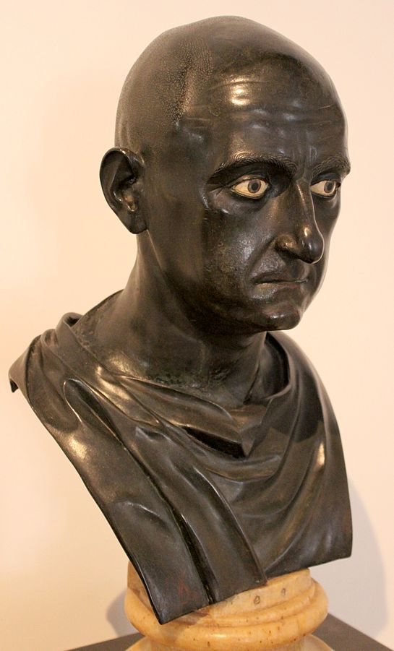
Roman Male Names
Praenomen: first name
e.g. Marcus, Lucius, Publius
Nomen: clan name
e.g. Cornelius, Tullius
Cognomen: family name
e.g. Cicero, Scipio, Cato
Agnomen: honorary name
e.g. Africanus
Citizens only!
Publius Cornelius Scipio Africanus
c. Mid 1st cen. BCE

Slide 4
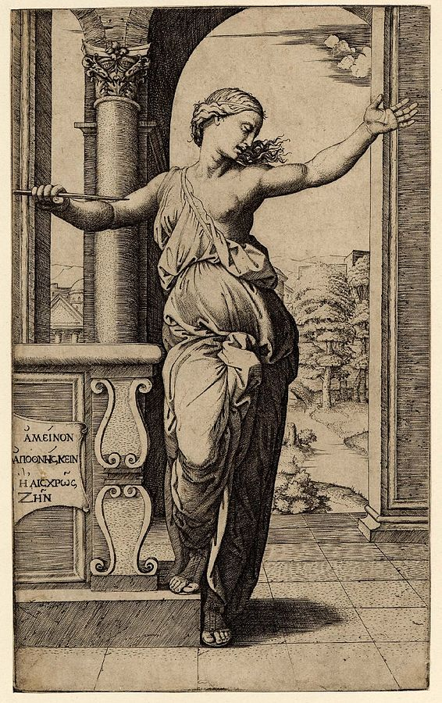
Roman Female Names
Nomen: clan name
e.g. Cornelia, Lucretia
Engraving of Lucretia by Marcantonio Raimondi (1534)

Slide 5
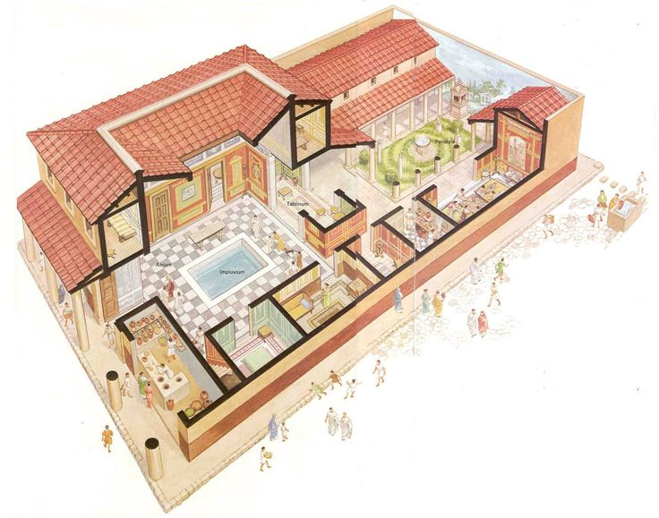
The Roman House

Slide 6
The Paterfamilias
Head of the household
Had legal authority over all living family members, regardless of age, except for women who had entered other families through marriage, plus slaves
Owned all family property
Only member of the family who could initiative legal action
When he died each individual son would become his own paterfamilias

Slide 7
The Paterfamilias
Had the right to:
Acknowledge as child as his offspring
Approve marriages
Compel divorces
Assign heirs
Kill his children or sell them into slavery

Slide 8
But...
Women usually married between ages 15 and 20
Men usually married around 25
But life expectancy was low
So two-thirds of 25-year-old Romans no longer had a living father, and were therefore their own paterfamilias

Slide 9
Forms of Roman Marriage
Cum manu
Sine manu
‘with hand’
Oldest form of Roman marriage
Woman became subject to her husband’s paterfamilias
Only the husband could initiative divorce
Dowry became part of her husband’s family’s property
‘without hand’
Developed in the mid-republic and became increasingly common thereafter
Woman remained subject to her paterfamilias
Either party could initiative divorce
Woman retained control of her dowry

Slide 10
Marriage
*
“About my little girl, I am inclining this way, not that – but for lack of better we must make the best of him. As for the other man, whom you say you think not unsuitable, I doubt whether my girl could be brought to consent, and you say there’s not much to choose. For my part I have no wish to be awkward, but you will be away and in my absence the thing will burn. If both of us were on the spot something acceptable might be made of Servius through Servilia. As it is, even if I were to approve in principle, I see no way of going forward.”
- Cicero, Letters to Atticus 5.4.1 (51 BCE)

Slide 11
Divorce

Slide 12
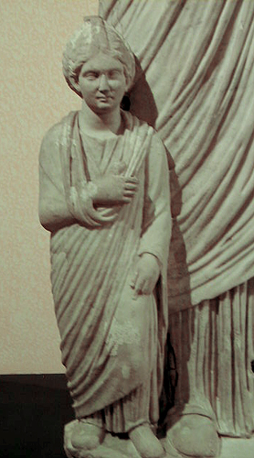
Childhood
Citizen boys wore a purple stripe toga
Manhood began at 14, when he went to the forum for his first shave
Wealthy boys were educated by tutors, usually by a slave called a paedagogus, or in private schools
Wealthy girls were occasionally educated at home

Slide 13
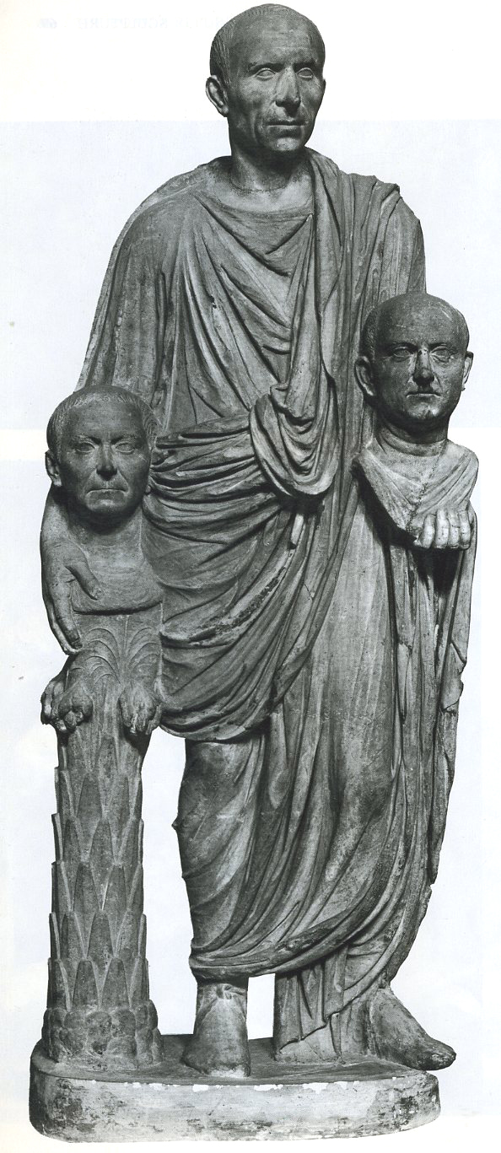
Funerals
Procession
Oration
Wax image made of the deceased and put on display in the atrium with other ancestor portraits
Served as the basis for making stone busts
Barberini Group, c. 50-75 CE

Slide 14
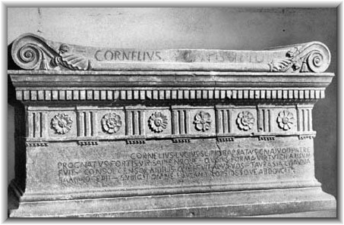
Burials
Both cremation and inhumation practiced
Sarcophagi and cinerary urns placed into tombs
Commemorated with inscriptions and sometimes with reliefs
Lower status individuals formed burial ’clubs’
“Cornelius Lucius Scipio Barbatus, sprung from Gnaeus his father, a man strong and wise, whose appearance was most in keeping with his virtue, who was consul, censor, and aedile among you - He captured Taurasia Cisauna in Samnium - he subdued all of Lucania and led off hostages.”

Slide 15
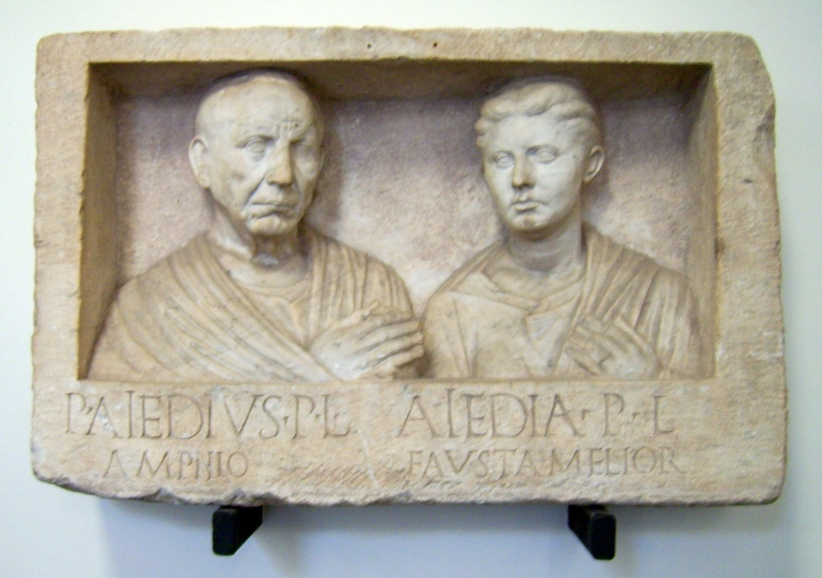
Burials
“Publius Aiedius Amphio, freedman of Publius // Aiedia Fausta Melior, freedwoman of Publius”
Grave relief of Publius Aiedius and Aiedia, Rome, 1st half of the 1st cen. BCE

Slide 16
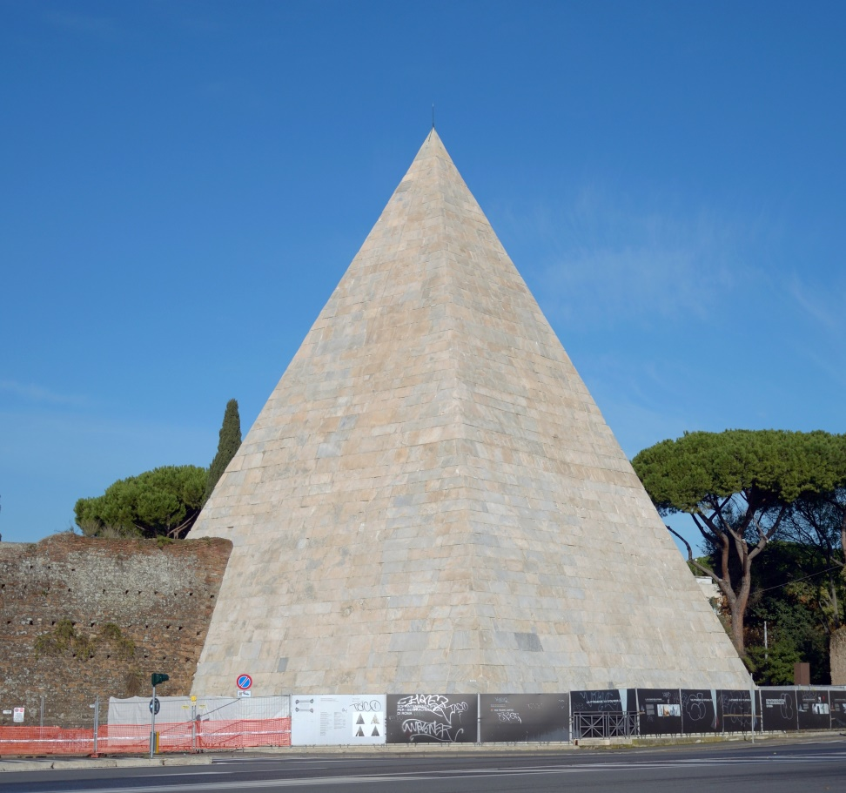
Cestius’ Pyramid
Near the Aventine Hill in Rome
Built for Gaius Cestius c. 18-12 BCE
“Gaius Cestius, son of Lucius, of the gens Pobilia, member of the College of Epulones, praetor, tribune of the plebs, septemvir of the Epulones”
“The work was completed, in accordance with the will, in 330 days, by the decision of the heir Pontus Mela, son of Publius of the Claudia, and Pothus, freedman”
*

Slide 17
Patrons and Clients
Relationship between someone of lower (client) and higher (patron) social standing
Clients greeted the patron at his house every morning, and then accompanied him to the forum
Patrons invited clients to dinner and gave them gifts of money

Slide 18
The Roman House

Slide 19
Dionysius of Halicarnassus
Patrons had to:
Clients had to:
“to explain to their clients the laws;
“doing everything for them that fathers do for their sons with regard to money;
“to bring suit on behalf of their clients when they were wronged;
“to defend them against any who brought charges.”
- Roman Antiquities 2.10
“to assist in providing dowries for their daughters;
“to pay their ransom to the enemy if any of them or of their children were taken prisoner;
“to discharge out of their own purses their patrons’ losses in private suits and the pecuniary fines which they were condemned to pay to the State;
“to share with their patrons the costs incurred in their magistracies and dignities and other public expenditures.”

Slide 20
Virtues
Concordia
The quality of living in harmony with one’s family, especially one’s spouse
Gravitas
Seriousness, solemnity, wisdom and proverbial weightiness
Pietas
Showing proper respect to the gods and to one’s father

Slide 21
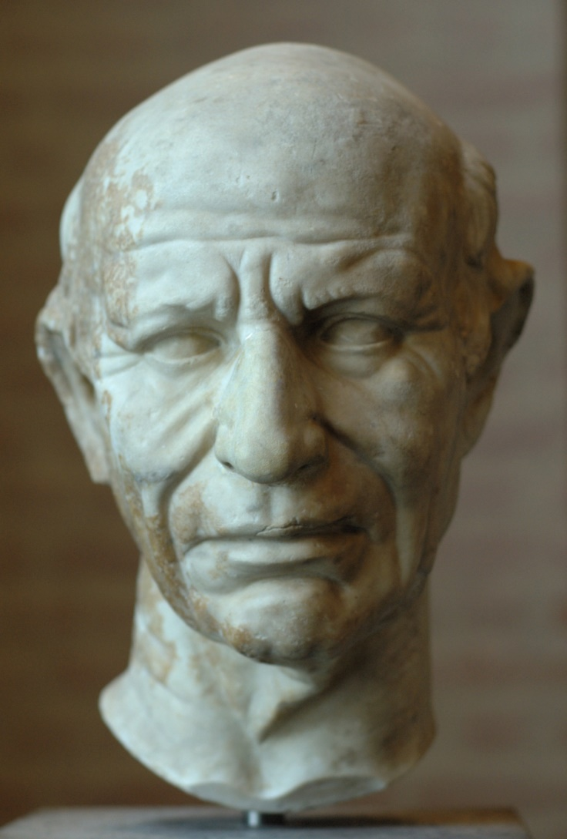
Portraiture
Tendency to emphasize old age
Wrinkles
Baldness
Drooping
Implies the burden of governing the republic weighs heavily on the individual
Called ‘verism,’ i.e. ‘realistic-like’

Slide 22
Slavery
One third of Rome’s population were slaves by the 1st cen. BCE
Performed manual labor, served as household servants, worked in factories, served as secretaries and accountants
Owned outright and had no legally recognized rights
Sometimes permitted to make their own money – called peculium
Sometimes also permitted common law marriages
Could be tortured in order to provide evidence in court cases
Could be freed by their masters, becoming freedmen

Slide 23
Key Terms
Paterfamilias
Gravitas
Pietas
Verism
Freedman

