Slide 1
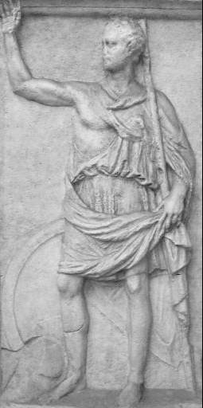
Polybius
c. 200-118 BCE
Born in Megalopolis in Arcadia, Greece
Prominent local politician and military leader
Lived in Rome as a hostage c. 167-150 BCE
Wrote Histories (in Greek) covering 264 to 146 BCE

Slide 2
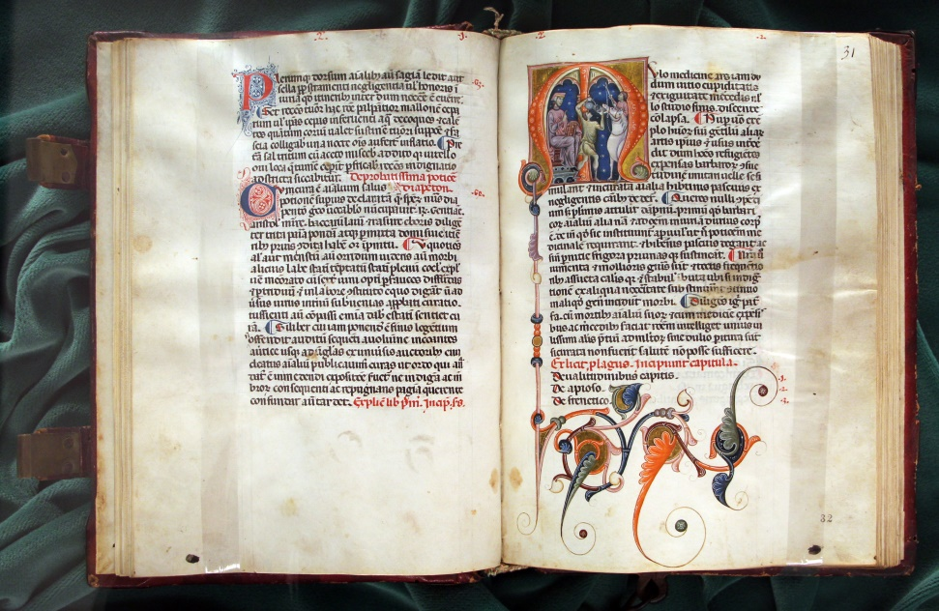
Vegetius
Flavius Vegetius Renatus
fl. c. 400 CE
Author of De Re Militari (‘Concerning Military Matters’) and Digesta Artis Mulomedicinae (‘Digest of the Art of Mule Medicine’)

Slide 3
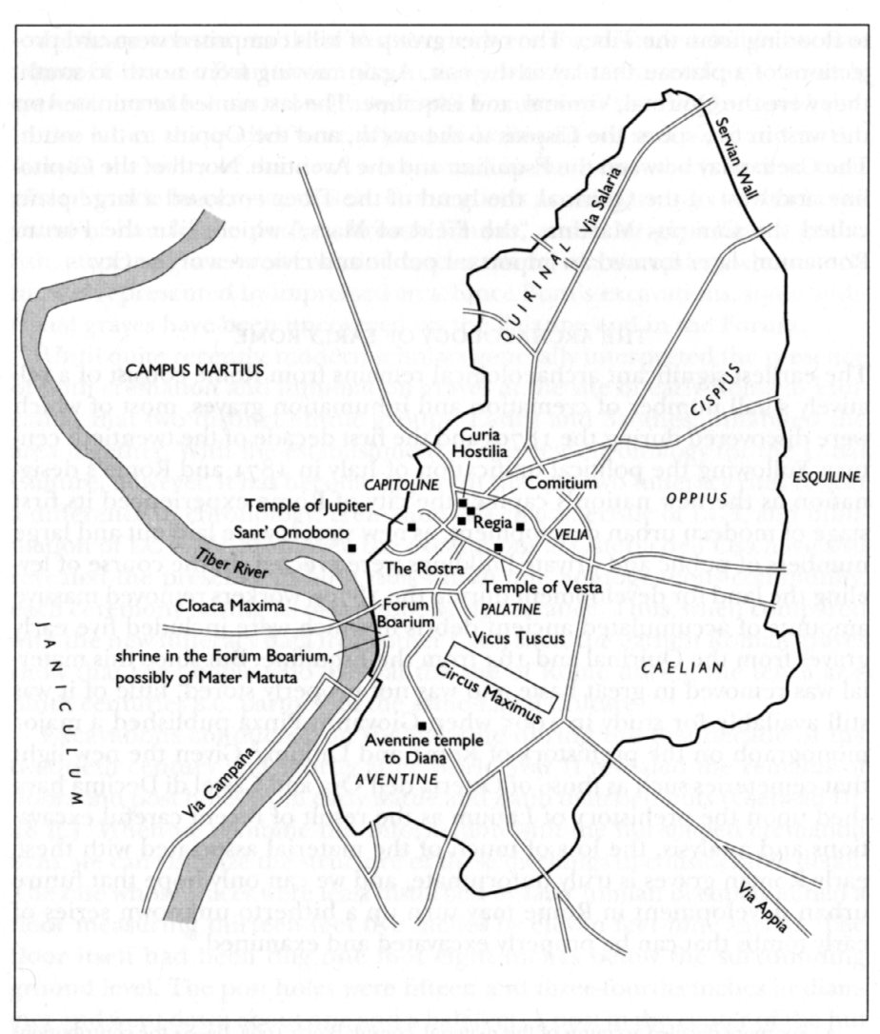
The Campus Martius
‘Field of Mars’
Originally lay outside the boundaries of the city of Rome
Mustering place for the Roman army

Slide 4
Roman Social Orders
Patricians
Descendants of Romulus’ original 100 senators
Equestrians/Knights
Descendants of Servius Tullius’ original cavalry centuries
Consisted of those who could afford to maintain horses
Plebeians/Plebs
All other citizens

Slide 5
Centuries
King Servius Tullius supposedly organized Roman male population into 193 centuries
Each century had 100 men (in theory)
Commanded by a centurion
But most centuries consisted of the wealthy

Slide 6
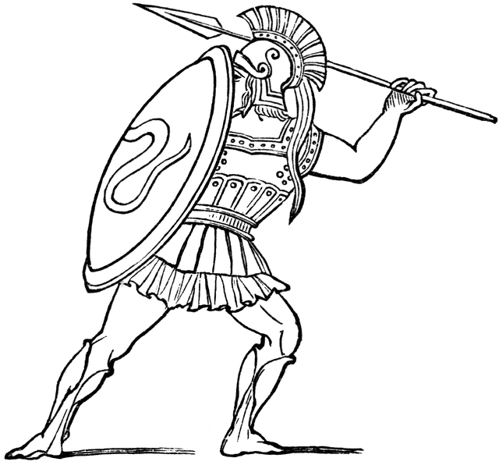
Hoplites
From Greek ὅπλον (hoplon), the large round shield
Other equipment included:
Spear (hasta)
Helmet
Cuirass
Greaves
All typically purchased, owned, and maintained by individual soldiers

Slide 7
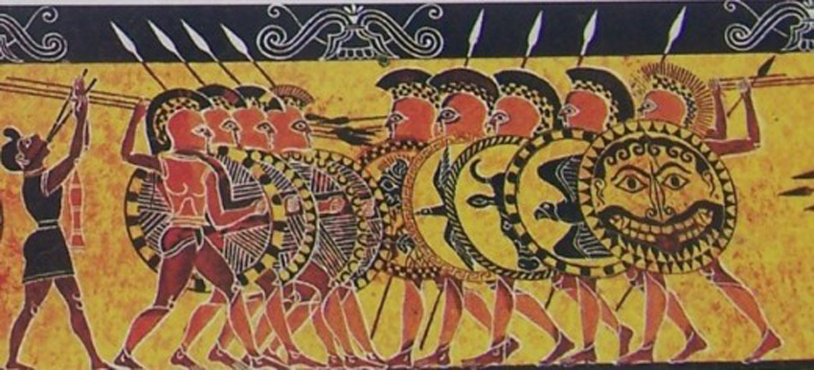
Phalanx Warfare

Slide 8
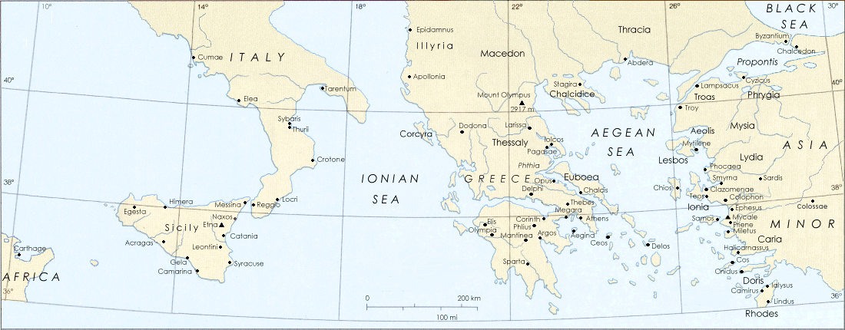
Greek Hoplites

Slide 9
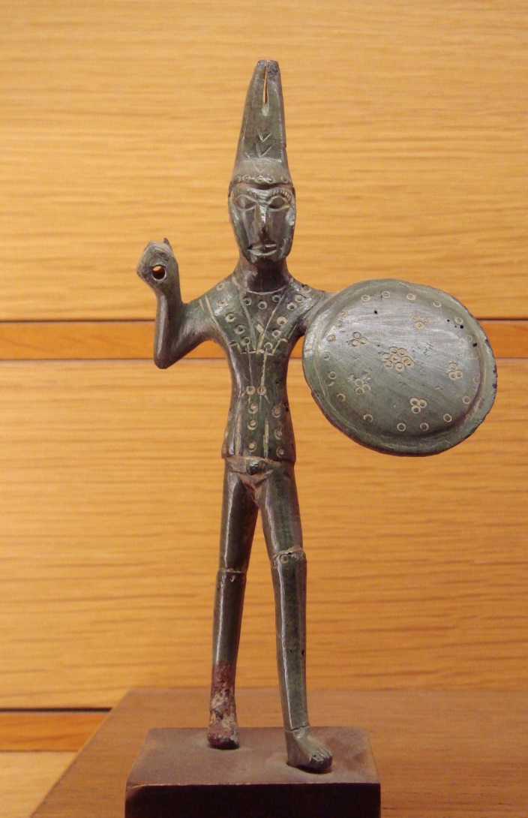
Hoplites in Italy
*
Used in Italy by Etruscans, Greeks and Romans
Standard Roman infantry until late 4th cen. BCE
Bronze statue of an Etruscan hoplite, c. 500-475 BCE. Found near Viterbo.

Slide 10
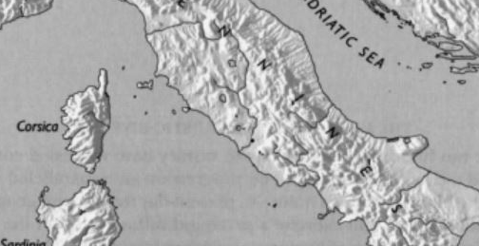
Rough Terrain
Etruria
Latium
Campania

Slide 11
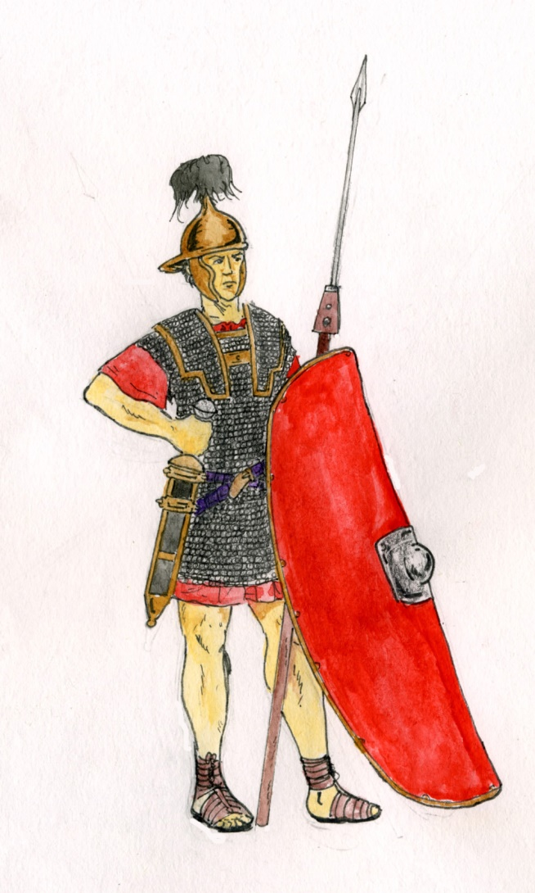
Legions
Introduced during or after the Samnite Wars (343-341 and 326-304 BCE)
Consisted of ‘maniples’ (= Latin for ‘handfuls) each with two centuries of about 60 men
Hoplon replaced with scutum; hasta (spear) replaced with pilum (javelin)
Legionaries were property-owning citizens; others were conscripted only during emergencies

Slide 12
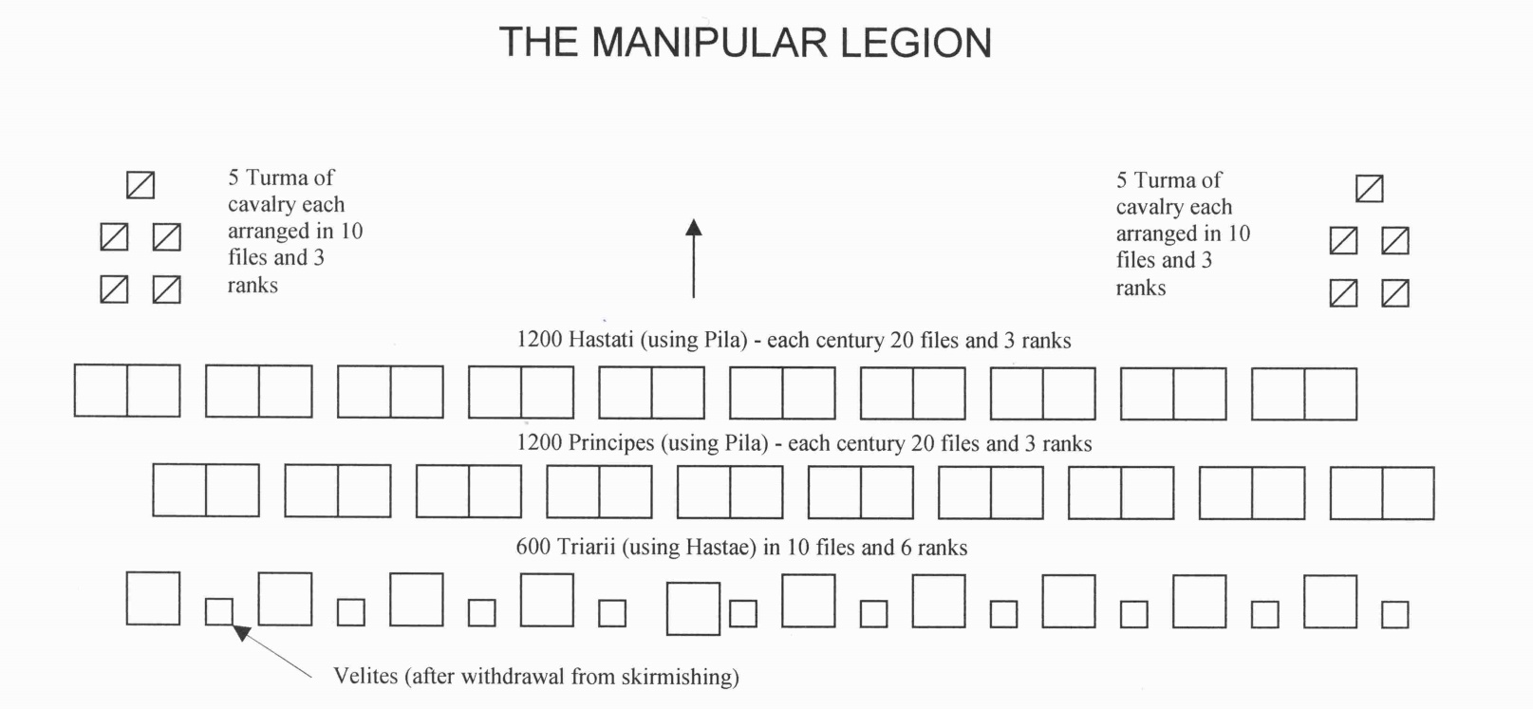
‘Maniple’ Legions

Slide 13
The Roman Navy
Beginning in 311 BCE the Romans elected duoviri navales (‘the two warship men’) to maintain a small fleet, perhaps consisting of ships confiscated from enemies
Defeated by the Carthaginians at the Battle of the Liparian Islands (261 BCE)
Romans developed a new fleet, consisting of tiremes (ships with three rows of oars) and quinqueremes (ships with five rows of oars)

Slide 14
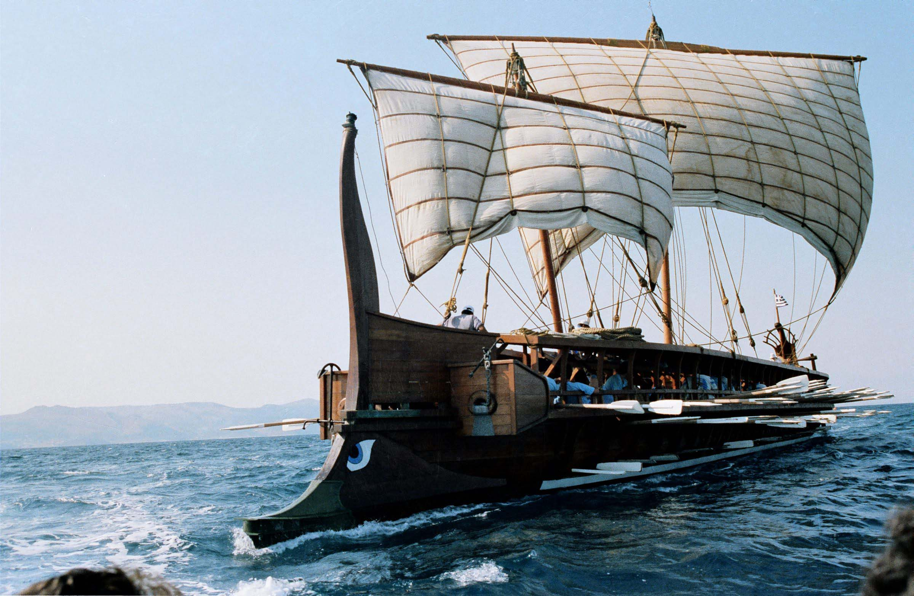
Triremes

Slide 15
Corvus
Means ‘raven’
Boarding bridge that allowed infantry to board enemy ships
First deployed at the Battle of Cape Mylae in 260 BCE

Slide 16
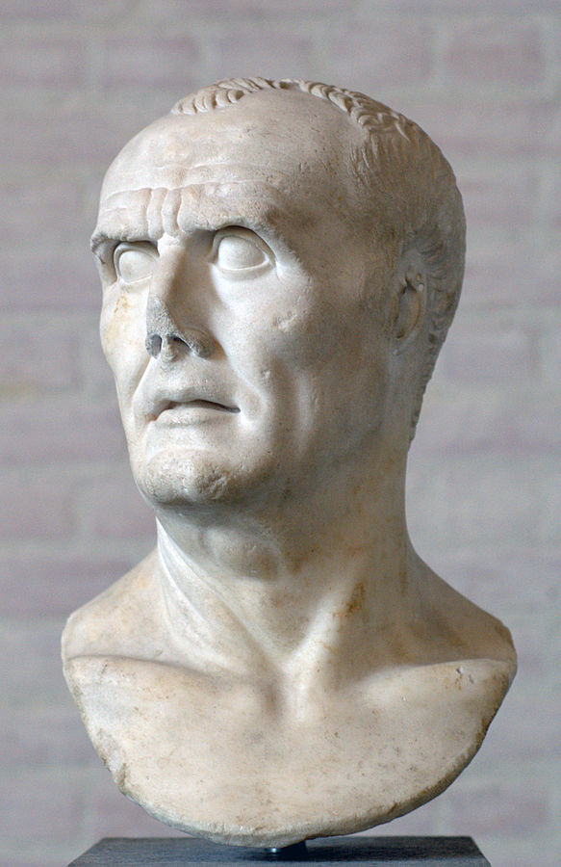
Gaius Marius
c. 157-87 BCE
Consul seven times!
Long military career, serving in the Balearics, Transalpine Gaul, Hispania, and Numidia

Slide 17
Marius’ Reforms
New training in the form of gladiatorial games
Introduction of a new javelin
New requirement to carry two weeks’ provisions
Replacement of the maniple with the cohort
Use of the eagle standard

Slide 18
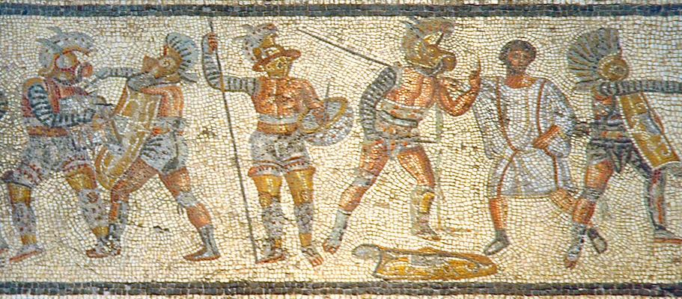
Gladiatorial Training

Slide 19
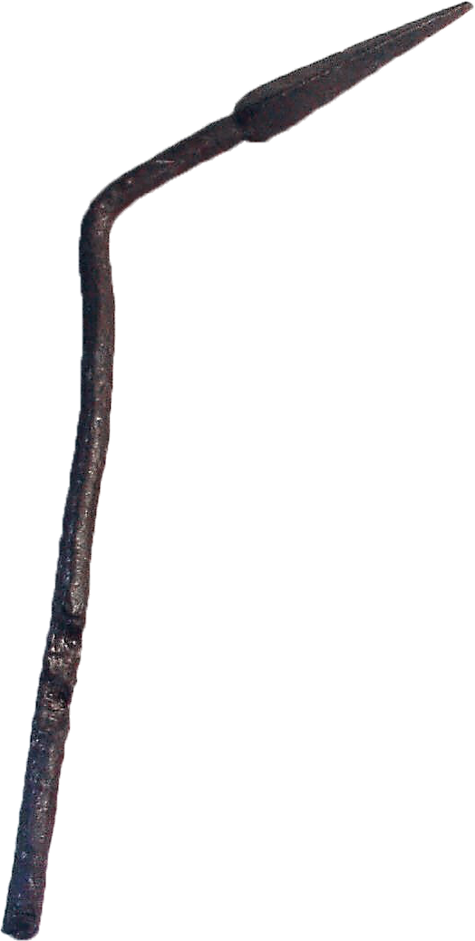
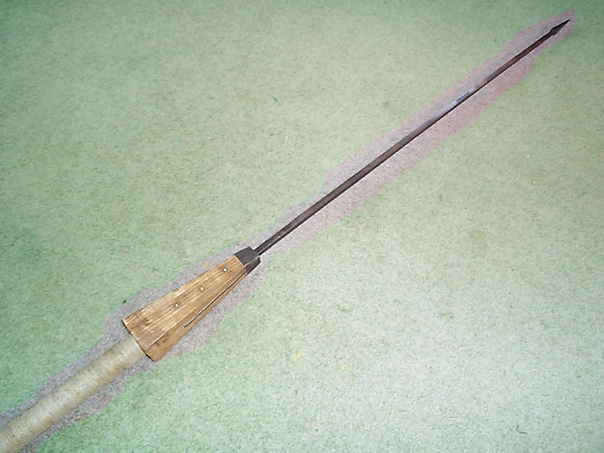
Javelins
“As to the missile weapons of the infantry, they were javelins headed with a triangular sharp iron, eleven inches (279 mm) or a foot long, and were called piles. When once fixed in the shield it was impossible to draw them out, and when thrown with force and skill, they penetrated the cuirass without difficulty.”
- Vegetius,
De Re Militari 1.20

Slide 20
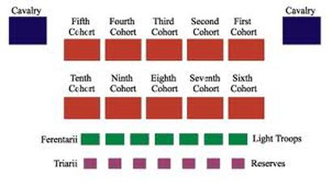
Cohorts

Slide 21
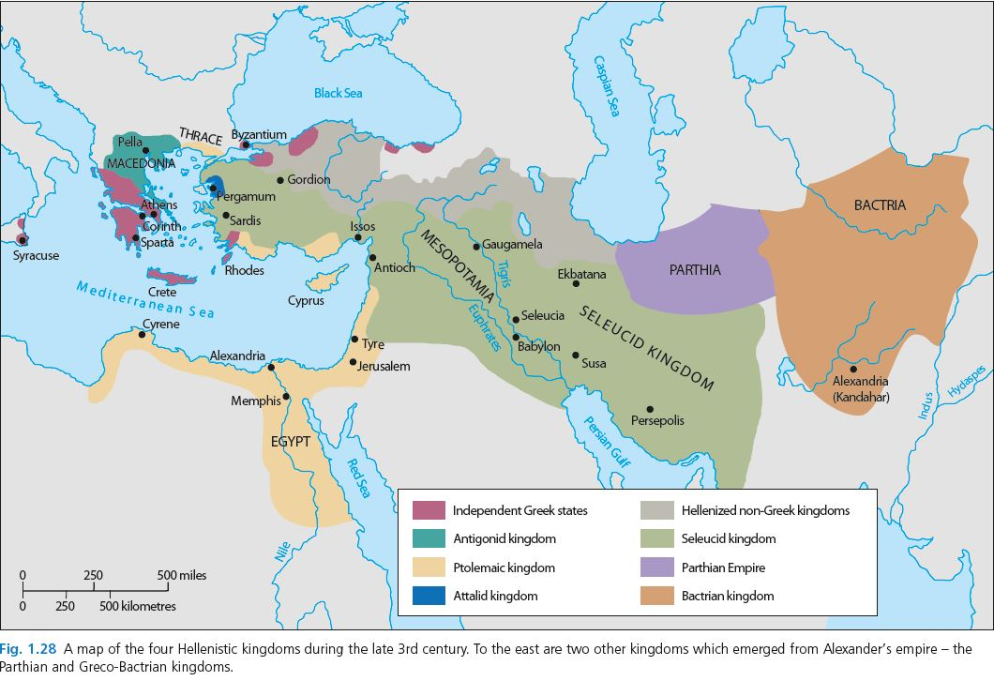
Rome’s Enemies

Slide 22
The Seleucids
“16,000 infantry armed in the Macedonian way…1500 Gallo-Greek cavalry, and next to these 3000 mail-clad cavalry…next to these was placed a herd of 16 elephants…then 1200 Dahae, who were mounted archers, then 3000 light-armed troops, consisting of Cretans and Trallians...next to these came 2500 Mysian archers…a mixture of Cyrtaean slingers and Elymaean archers…”
- Livy 37.40, describing the right wing of King Antiochus III’s army at Magnesia, 189 BCE

Slide 23
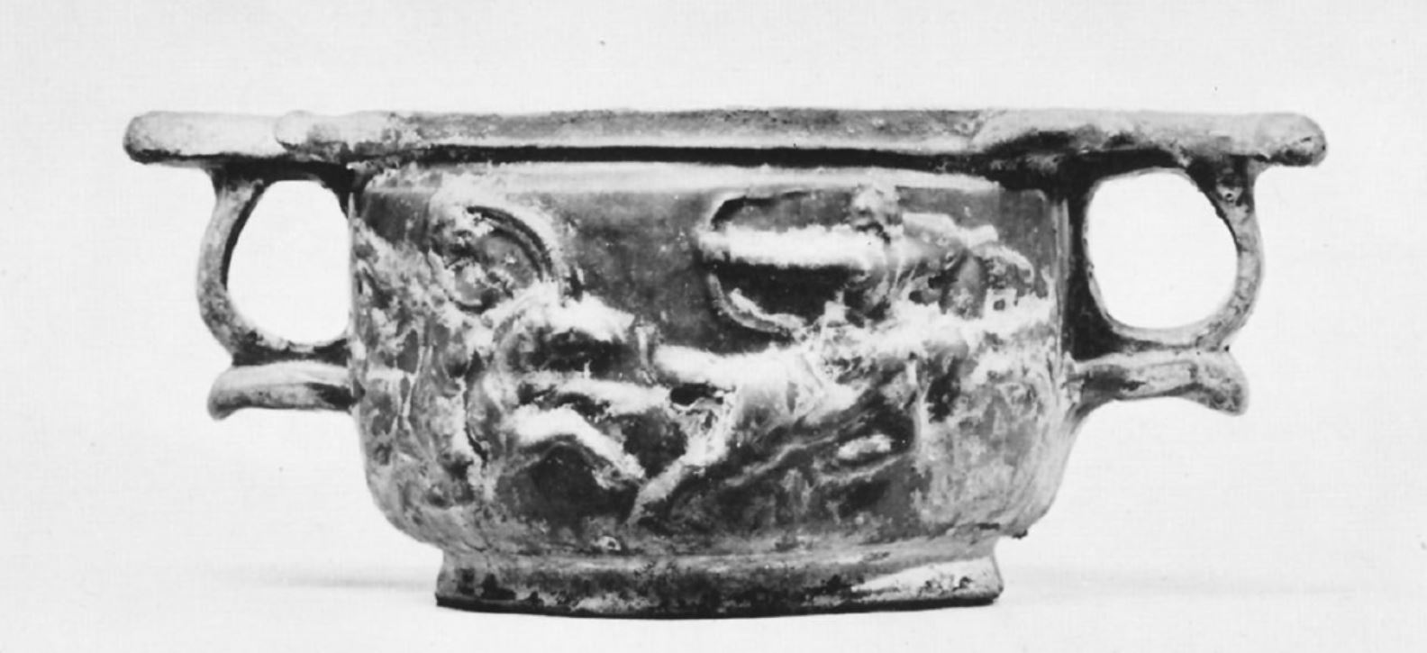
The Parthians

Slide 24
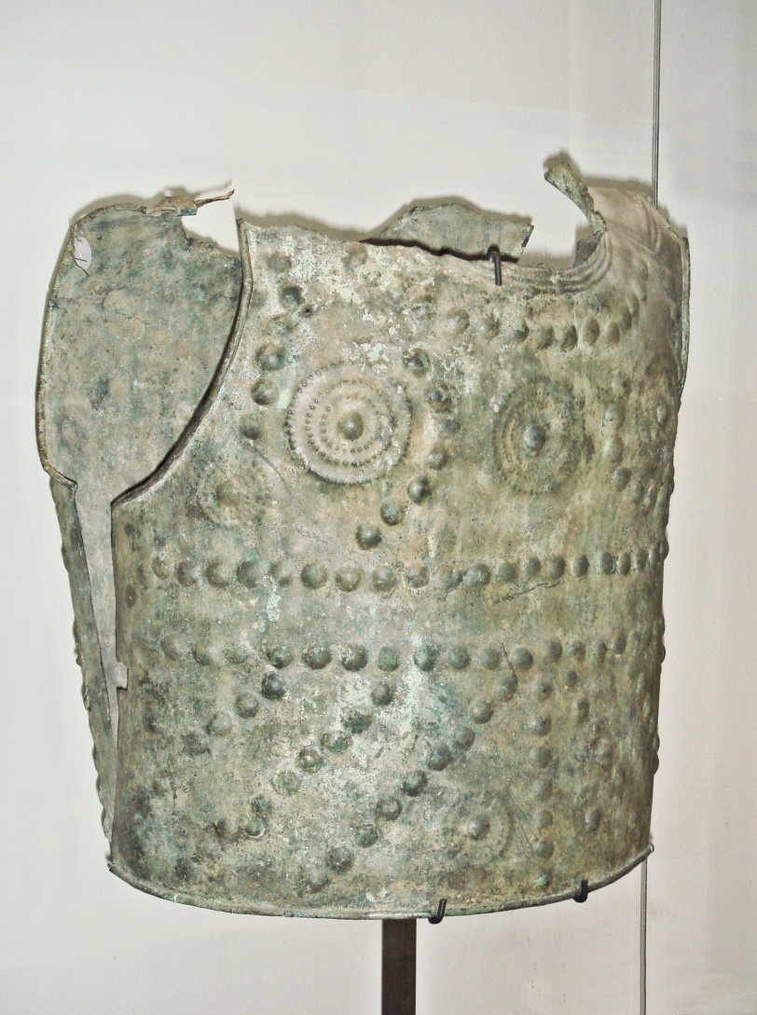
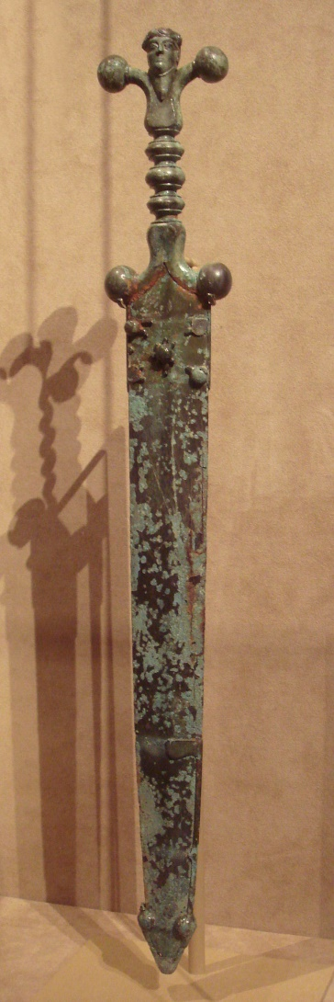
The Gauls

Slide 25
Key Terms
Polybius
Vegetius
Campus Martius
Centuries
Hoplites
Maniples
Legion
Cohort

