Slide 1
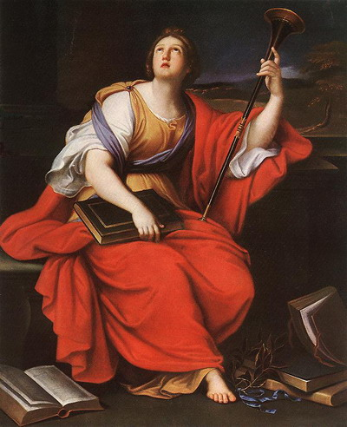
What is History?
From ancient Greek ἱστορία (‘historia’), meaning “knowledge derived from investigation”
Also the source of the word ‘story’

Slide 2
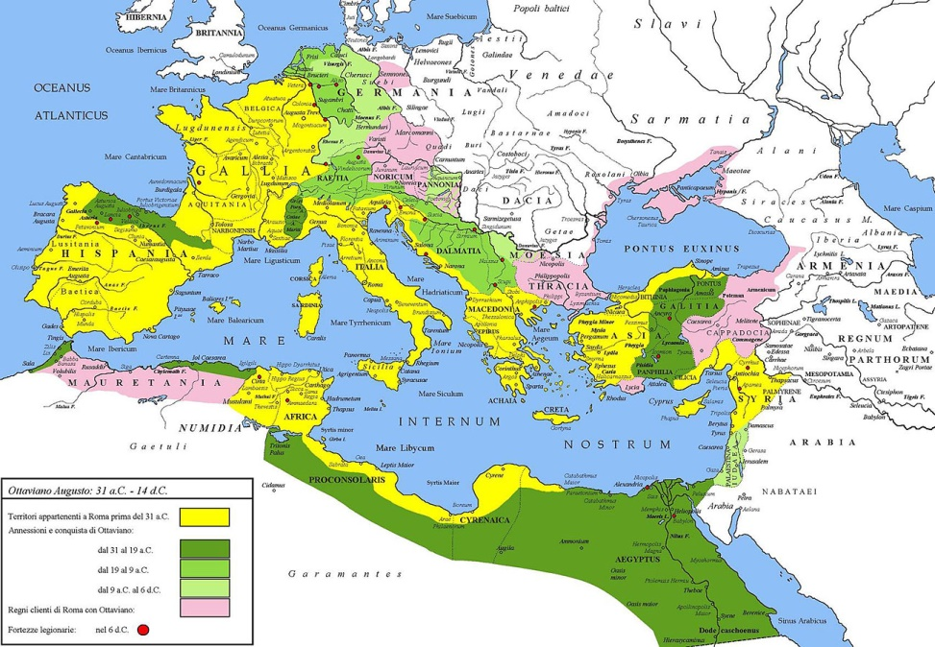
What is Roman History?

Slide 3
Chronology Terms
‘CE’ = ‘common era’
i.e. everything after the purported birth of Jesus
same as ‘AD’ = ‘anno Domini’ = ‘in the year of our lord’
counts up, i.e. 700 CE is later than 300 CE
‘BCE’ = ‘before the common era’
i.e. every before the purported birth of Jesus
same as ‘BC’ = ‘before Christ’
counts down, i.e. 300 BCE is later than 700 BCE
Centuries and millennia counted with ordinals:
7th century BCE | 700-600 BCE
5th century BCE | 500-400 BCE
1st century BCE | 100-1 BCE
1st century CE | 1-100 CE
18th century CE | 1700-1800 CE
4th millennium BCE | 4000-3000 BCE
2nd millennium BCE | 2000-1000 BCE
1st millennium BCE | 1000-1 BCE
1st millennium CE | 1-1000 CE

Slide 4
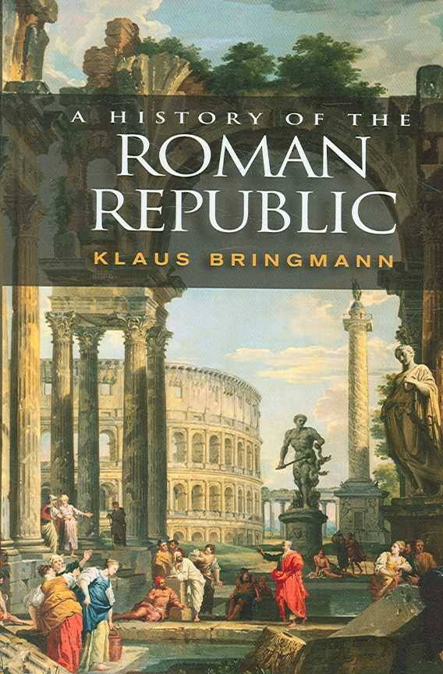
Reading Assignments
K. Bringmann, A History of the Roman Republic, trans. W. J. Smyth
= Bringmann on syllabus
Livy, The Rise of Rome, trans. T. J. Luce
= Livy on syllabus
Plutarch, Roman Lives, trans. R. Waterfield
= Plutarch on syllabus

Slide 5
Commentaries
400-700 words
Focused on individual passages or objects
Authors
Livy, Plutarch, Plautus, Cicero, Res Gestae
Objects marked with asterisk on slides (*)

Slide 6
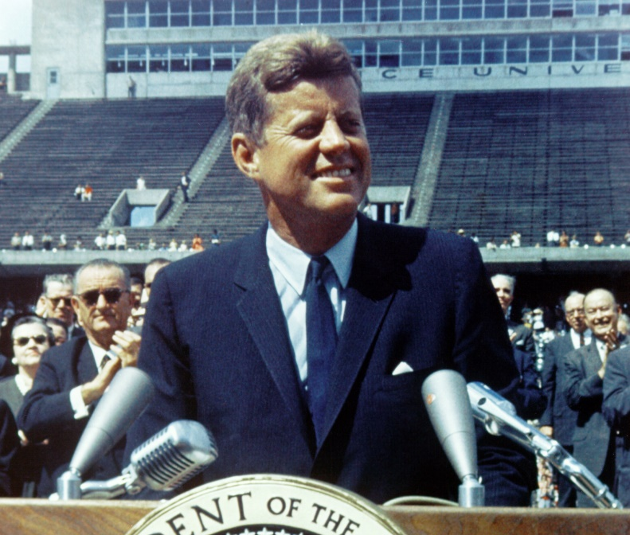
Example
“We choose to go to the Moon in this decade and do the other things, not because they are easy, but because they are hard.”
Summary/description
Context, purpose, audience
Significance
John F. Kennedy, Houston, 1962

Slide 7
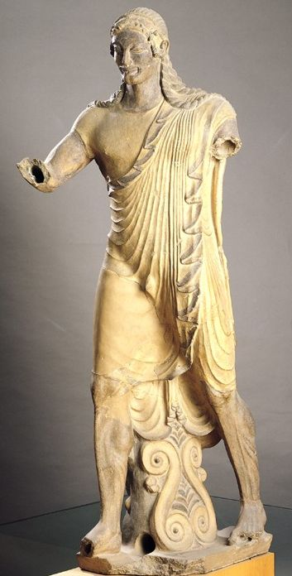
Portonaccio Apollo
*
Description: painted over life-sized terracotta statue of Apollo striding, probably originally on a temple roof
Context: Etruscan, c. 510-500 BCE, found at the Portonaccio sanctuary at Veii
Significance: evidence for Etruscan religious practice, links with Greek colonies; Pliny the Elder mentions an Etruscan sculptor named

