Slide 1



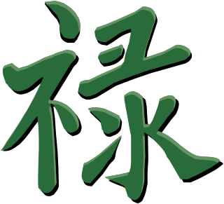
福
中國字
The Origin and Formation of
Chinese Characters

Slide 2
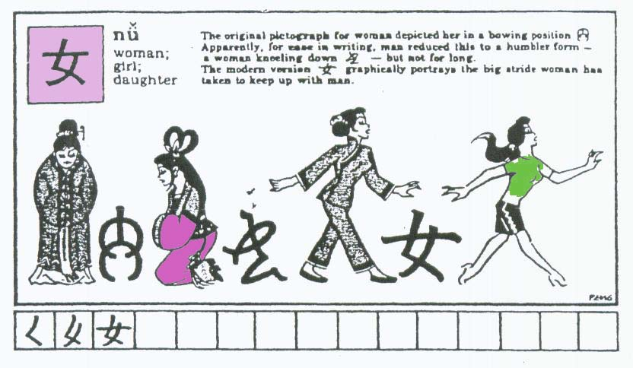
The evolution of the characters

Slide 3
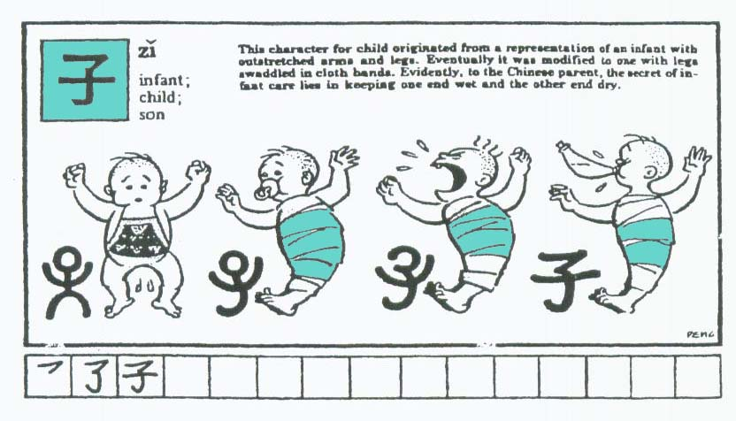
The evolution of the characters

Slide 4
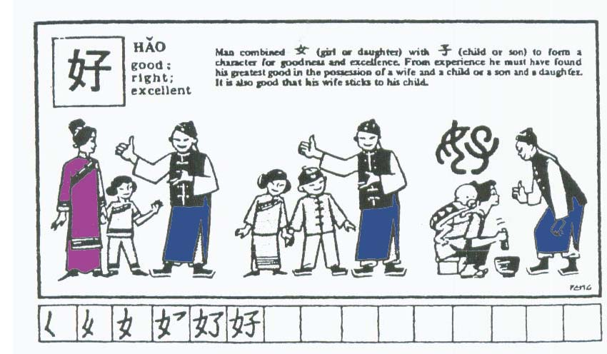
The evolution of the characters

Slide 5
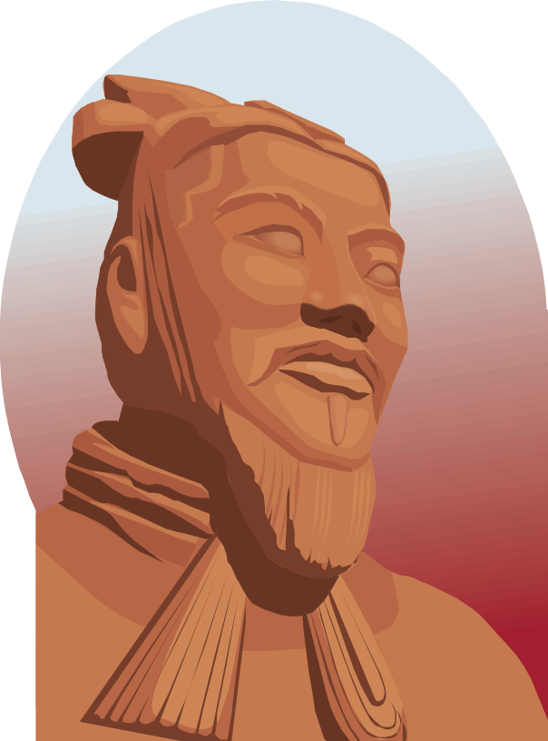
The origin of the charactrs
According to legend, Chinese characters were invented by Cāngjié (c. 2650 BC), a bureaucrat under the legendary emperor

Slide 6


1. Pictograms (Pictographs)
象形字 xiàngxíngzì
日 (rì) for "sun",
月 (yuè) for "moon",
木 (mù) for "tree"

Slide 7


2. Ideograms (Self-explanatory characters)
指事字 zhǐshìzì
上 shàng "up"
下 xià "down".

Slide 8


3. Ideogrammic (Associative) compounds
會意字 huìyìzì
卡 (kǎ/qiǎ, “stuck”) combines 上 and 下, indicating things can’t go up or go down.
明 (míng, “bright)

Slide 9
4. Phono-semantic (Pictophonetic) compounds
形聲字 xíngshēngzì
河 (hé) river, 湖 (hú) lake, 流 (liú) stream, 沖 (chōng) riptide, 滑 (huá) slippery
All these characters have on the left a radical of three dots, which is a simplified pictograph for a water drop, indicating that the character has a semantic connection with water; the right-hand side in each case is a phonetic indicator.

Slide 10
5. Derivative (Mutually-explanatory) cognates
轉注字 zhuǎnzhùzì
referring to characters which have similar meanings and often the same etymological root, but which have diverged in pronunciation and meaning. The English words chance and cadence would fit this pattern, as they share a common Latin root, cadentia "to fall".
The characters 老 lǎo "old" and 考 kǎo "a test" are the most commonly cited example. The words derive from a common etymological root (approximately *klao’), and the character differ only in the modification of one part.

Slide 11
6. Phonetic Loan Characters (Rebus)
假借字 jiǎjièzì
自 (zì), which has lost its original meaning of nose completely and exclusively means oneself
萬 (wàn), which originally meant scorpion but is now used only in the sense of 10, 000

Slide 12
Radicals
酒 湯 海
冷 冰 凍
腿 腰 腎
家 安 寧
貓 狗 獅
Water
Ice
Flesh
Shelter
Wild animal

Slide 13
Radicals
場 墓 地
楊 林 松
熱 燙 烈
喝 問 哭
休 件 偷
Dirt
Tree
Fire
Mouth
People

Slide 14
Phonetic indicator
清 (qīng) clean
情 (qíng) emotion
晴 (qíng) clear
請 (qǐng) please
靖 (jìng) peaceful
青 (qīng)

