Slide 1

Lesson 10: Dialogue 1
交通: Going Home For the Winter Vacation

Slide 2
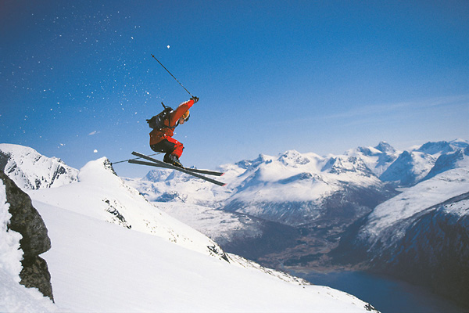
寒假
hánjià
Winter Vacation

Slide 3
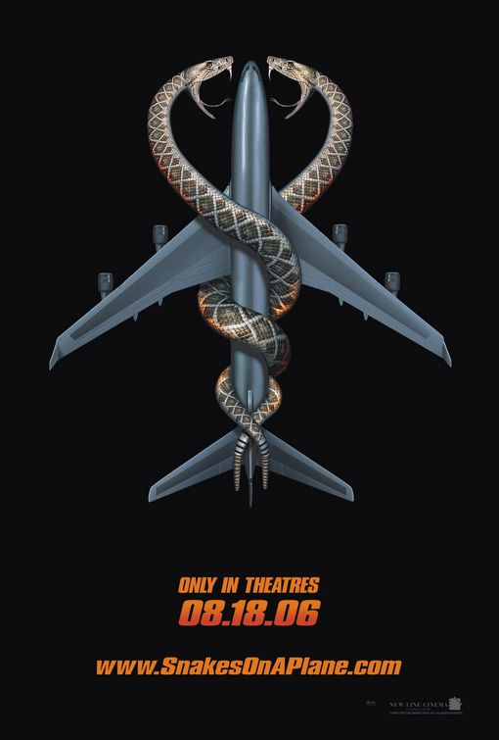
飛機
fēijī
airplane
飛 = fly
機 = machine

Slide 4
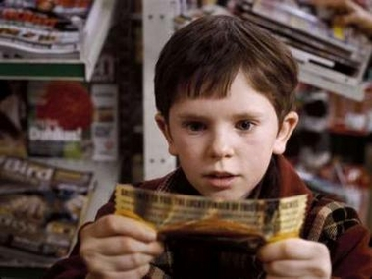
票
piào
ticket

Slide 5
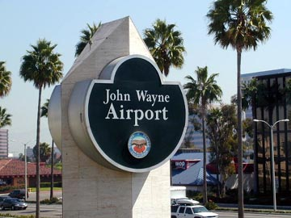
(飛)機場
(fēi)jīchǎng
airport

Slide 6
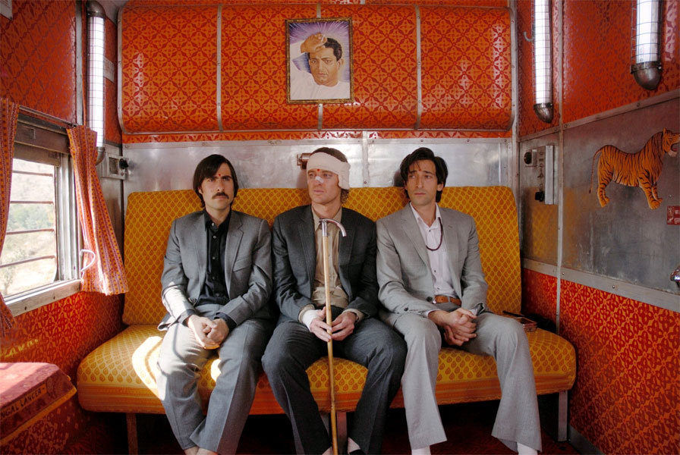
坐
zuò
sit on, to ride, to travel by

Slide 7
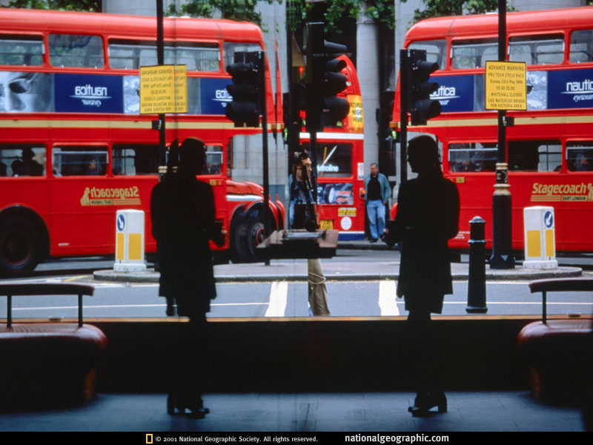
公共汽車
Gōnggòng qìchē
public bus
公共 = public
汽車 = automobile

Slide 8
或者
huòzhě
(either) or

Slide 9
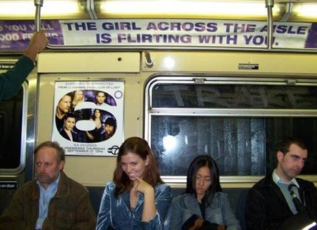
地鐵
dìtiě
subway

Slide 10

走
zǒu
to walk;
to go by way of

Slide 11
先
xiān
first;
in advance

Slide 12
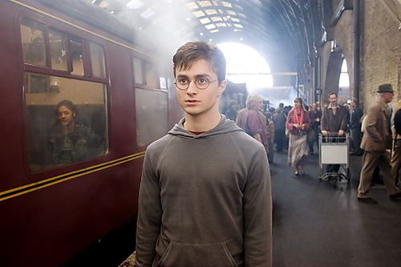
(車)站
(chē)zhàn
(bus, train, etc.) station

Slide 13
下車
xiàchē
get off
(the bus, train, etc)

Slide 14
然後
ránhoù
and then…

Slide 15
綠
lǜ
green

Slide 16
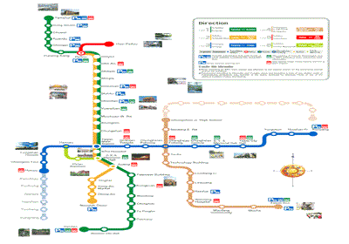
線
xiàn
line (both a physical line or like…a subway line)

Slide 17
最後
zuìhoù
last;
at last;
final

Slide 18

藍
lán
blue

Slide 19

麻煩
máfán
troublesome

Slide 20
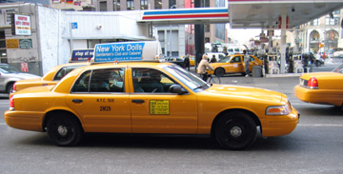
打車
dǎchē
take a taxi

Slide 21
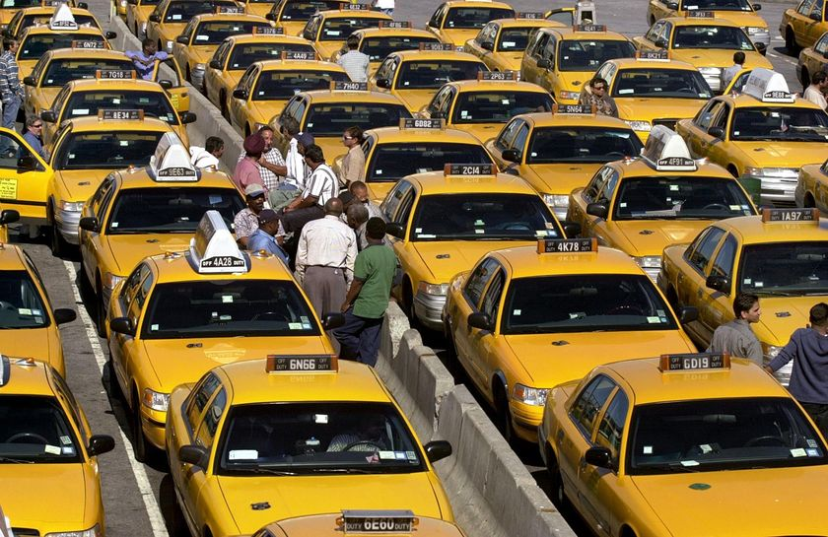
出租汽車
chūzū qìchē
taxi
出租
= for rent

Slide 22
開車
kāichē
to drive

Slide 23
送
sòng
literally, to “give away”
but in this lesson, it “to see off” or “to take someone somewhere and drop them off”

