Slide 1
Mobile Location Prediction in Spatio-Temporal Context
Huiji Gao, Jiliang Tang, Huan Liu
Data Mining and Machine Learning Lab
Arizona State University
June 18, 2012

Slide 2
Mobile Location Prediction
Applications:
Mobile Advertising
Traffic Planning
User oriented coupon dispersion
Disaster Relief
Challenges:
Over-fitting
Long spatial-temporal trajectories with massive n-gram spatial patterns and sparse temporal patterns, smoothing techniques are indispensable.
Integration
Seek a good way to integrate both spatial information and temporal information.

Slide 3
Problem Statement
Given a user with a series of his historical visits in a previous time section, and a context of the latest visit location with the time of the next visit, the location prediction problem in Nokia Mobile Data Challenge can be described as finding the probability of
Where
: the i-th visit at location l;
: the i-th visit happens at time t;
set as the “ending time of current visit”
: the (i-1)-th visit happened at location l_{k}.

Slide 4
Problem Statement
Using Bayes’ rule,
Consider
under the assumption that the probability of current visit time is only relevant to the current visit location.

Slide 5
Problem Statement
Temporal Constraint
Spatial Prior
The probability of the i-th visit happening at time t, observing that the i-th visit location is l.
The probability of next visit at location l given the current visit at l_{k}

Slide 6
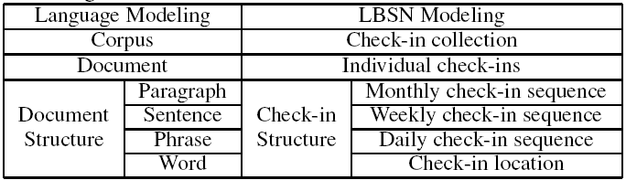
Spatial Prior
Two properties of spatial prior
Power Law Distribution
People tend to go to few places many times, and many places few times.
Short Term Effect
The current visit location is more relevant to the latest visit than the older visit.
Correspondences between language and LBSN modeling
[Gao et al. Exploring Social-Historcal Ties on Location-Based Social Networks. ICWSM 2012]

Slide 7
Spatial Prior
Hierarchical Pitman-Yor (HPY) Language Model to generate
the spatial prior (HPY spatial prior)
Generate the probability of next location based on an
observation of historical visiting sequence.
Consider a combination of all the n-gram patterns in the
previous visits with various pattern weights.
The latest visit has higher weight than the older visit.
[Gao et al. Exploring Social-Historcal Ties on Location-Based
Social Networks. ICWSM 2012]

Slide 8
Temporal Constraint
Temporal Constraint:
Hourly Constraint
Daily Constraint
h: Hour of the day, i.e., 10:00am, 3:00pm
d: Day of the week, i.e., Monday, Sunday

Slide 9
Temporal Constraint
Compute and
For a visit location l that has happened at h (d) in the previous visits, it’s easy to get and
For a visit location l that has not happened at h (d) in the previous visits (majority part in the training set),
how to compute?

Slide 10
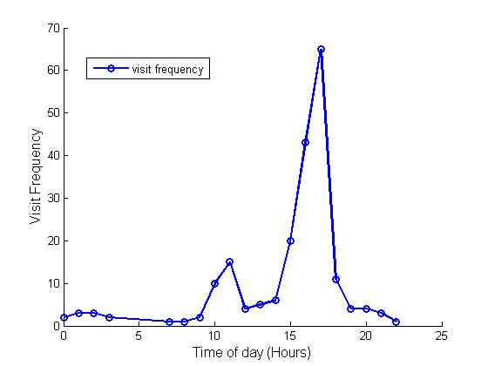
Temporal Constraint
Compute and
Distribution of a user’s visits at a specific location in 24 hours.
(user id: 013; place id: 3 )
Maximizing Likelihood

Slide 11
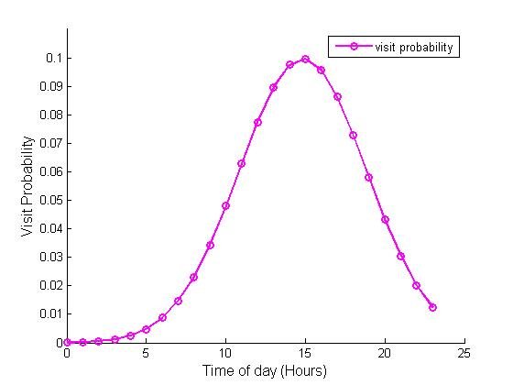
Temporal Constraint
Curve Fitting:
[user id: 013; place id: 3]

Slide 12
Location Prediction
Probability of visiting location l at time t with the latest visit at l_{k}
HPY Prior
Gaussian
Gaussian
HPY Prior Hour-Day Model (HPHD)

Slide 13
Experiments
Experiment Setting
For Submission:
Training set: Set A
Testing set: Set C (no ground truth)
Number of users: 80
For Evaluation
Divide set A into training and testing parts.
Testing set: Toy data provided by Nokia with 3373 unknown locations.
Training set: For each user, all the visits in set A that happened before the visits in testing set.

Slide 14
Experiments
Baseline Methods (Spatial Family)
Most Frequent Visit Model (MFV)
Consider the most frequent visited location
Order-1 Markov Model (OMM)
Consider the most frequent two-gram pattern with the latest visit as context.
Fallback Markov Model
A combination of MFV and OMM
4. HPY Prior Model (HP)
Consider the HPY prior only to predict the next location.

Slide 15
Experiments
Baseline Methods (Temporal Family)
5. Most Frequent Hourly Model (MFH)
Predict the next visit at time h as the most frequent visit location at h in previous visits.
6. Most Frequent Daily Model (MFD)
Predict the next visit at time d as the most frequent visit location at d in previous visits.
7. Most Frequent Hour-Day Model (MFHD)
A combination of MFH and MFD (by mutiplying)

Slide 16
Experiments
Baseline Methods (Spatio-Temporal family)
8. HPY Prior Hourly Model (HPH)
Consider the HPY prior and hourly information.
9. HPY Prior Daily Model (HPD)
Consider the HPY Prior and daily information.
Proposed Method (Spatio-Temporal family)
HPY Prior Hour-Day Model (HPHD)
Consider the HPY prior, hourly information, and daily information.

Slide 17
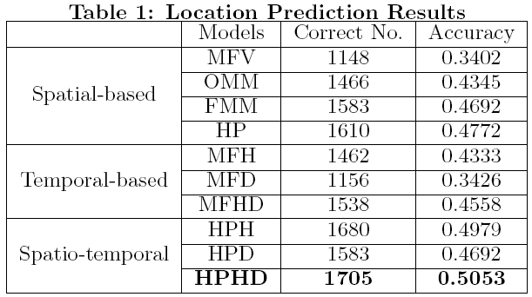
Experiments
Results

Slide 18
Conclusions and Future Work
Gaussian Distribution with Two Peaks
An alternative version of HPHD. (AHPHD)
Not stable, sensitive to peak detection.
Five Submissions
FHD, HP, HPH, HPHD, AHPHD

Slide 19


Acknowledgements
This work is supported, in part, by ONR (N000141010091).
All the data used in this work is provided by Nokia Mobile Data Challenge.

Slide 20
Questions?

