Slide 1
MYTEAM
Ervino Alifio Ramadhan
Markus Raja Sinabutar
Mulya Fajar Ningsih Alwi
Samuel Pandohan Terampil Gultom

Slide 2


We will give you the best service with good quality results

Slide 3
INTRODUCTION
MyServices is a marketplace created specifically for service providers and service users based on mobile web apps. So MyServices is like another general marketplace those are BukaLapak, Lazada, and Shopee but in this case it is selling any services. This business is a modificative business because this business is a modification of several stand-alone service markets out there and we want to combine all of those service markets to be on the same platform to make it easier for service users to find any services through one web application.

Slide 4
OUR SERVICES
MyDevice
MyElectrical
MyShoes
MyCleaner
MyMassagers
MyTailor
MyMechanic
MyBroker
MyNanny
MyDriver
MyChef
MyCart
and more

Slide 5
VISION
Our vision is to reduce the unemployment rate in Indonesia by providing a platform for them to channel their abilities in a way that can easily earn money and also help others to get various kinds of services in an easy way

Slide 6
MISSION
Our missions are:
Provides wide employment opportunities for service providers by offering a wide selection of services
Provides a user friendly platform to increase convenience and ease service users
Offers a wide selection of services with a variety of prices to suit all people

Slide 7
SELF-AWARENESS AND SELF-EFFICACY (SWOT)
Strengths
Weaknesses
Multi Platform
Various service categories
Various price
Easy to access by all generations
Easy and flexible payment system
Human Resources
Can’t predict errors
Can’t control the vendors behaviour
Lack of experiences in building apps and websites
Opportunities
Threats
Can be accessed anytime and anywhere
Service is something that is needed and always be needed
There is a few of competitors
Lower price, campaigns and massive promos from competitors

Slide 8
BUSINESS DIVISION
LEADER
Markus Raja Sinabutar
TECHNICAL
Ervino Alifio Ramadhan
MARKETING
Samuel Pandohan Terampil Gultom
CUSTOMER SERVICE
Mulya Fajar Ningsih Alwi

Slide 9
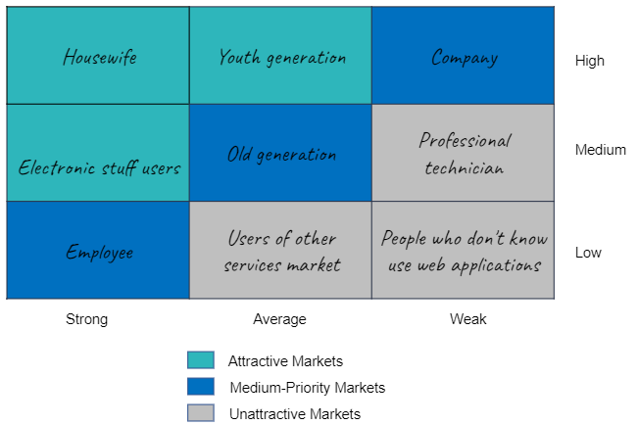
CUSTOMER SEGMENTS
Housewife
Employee
Company
Electronic stuff users
Old Generation (31-50 years old)
Youth Generation (12-30 years old)

Slide 10
VALUE PROPOSITIONS
Provide services that make customers or users comfortable with professional providers
Easy to find the technicians or service providers
Professional and reliable technician or service providers
Provide convenience and user-friendly platform to order services
Giving a best service, good quality results and satisfying for service users

Slide 11
VALUE PROPOSITION
OUR
HELP(S)
WHO
Service Provider Apps and Websites
Service Provider and User of the Service to Meet
Need the Best Service as Needed
BY
AND
(UNLIKE)
Provides Convenience and User Friendly Platform to Order
Giving a Best Service, Good Quality Results and Satisfying
Typical Services Order by Phone

Slide 12
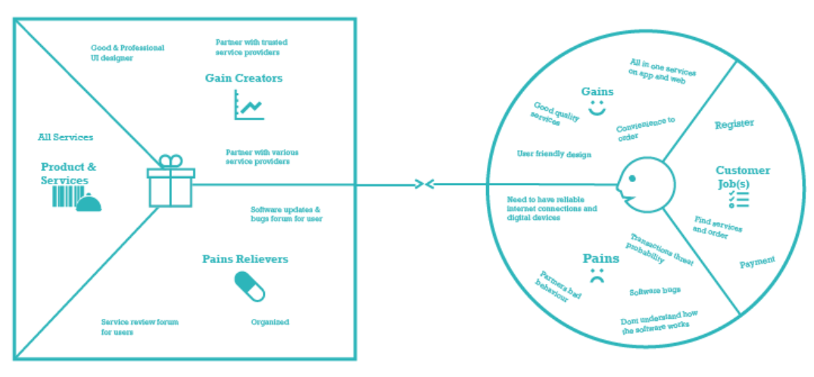
VALUE PROPOSITION CANVAS

Slide 13
CHANNELS
Web application sales, all processes of buying and selling services are carried out through a web application
Social media marketing, we also offer services through social media such as Instagram, WhatsApp business, etc.
E-mail marketing, we also offer services via e-mail by sending any updates related to our service offerings

Slide 14
CUSTOMER RELATIONSHIPS
Customer forum, we will provide a forum on the website for users to ask, report, and review about MyServices service or web application
Customer service and Tech support, we also provide customer service and tech support through e-mail, website, and social media to help users solve their problems related to the MyServices web application or service and even their stuff
Discount and promotion, we will offer discounts and promotions through e-mail and social media in every month
User-friendly web application, we will also provide a mobile web application to makes user easier to access the MyServices web application through a mobile phone

Slide 15
KEY RESOURCES
Google maps, to help service providers to find the service users location and even service users can know the service providers location
Web server and domain, this the main resource for running our server or web application properly, so that all service providers and users can access the MyService web application in online
Devices especially laptop or computer, these physical resources help us to build, develop, and also maintain our web application properly
Printer, this printer help us to manage our business documents
Employees, this is also an important resource because the employee help us to run, develop, and maintain the web application properly and help us to serve the service users
Promoter or advertiser, this promoter or advertiser also needed, to advertising our web application to gain more service providers and users to use MyServices web application

Slide 16
KEY PARTNERSHIPS
Service providers, our partners in service providers such as brokers, mechanic, babysitter/nanny, tailor, digital devices and electrical technician, cleaning service, driver, massagers, etc.
Server infrastructure providers, to help us maintaining and developing the MyServices web application or server
Bank, to help us with the payment system in our web application

Slide 17
KEY ACTIVITIES
Looking and connecting the service providers and service users, we have to look and also attract the service providers and users to use the MyServices web application
Looking for investors, we have to look and also attract the investors to invest in our business to help our initial capital for running the business
Making a database for users data, database is important to save all of the user's data and make us easier to manage it
Linking the web application to the bank payment system, the bank is important because it helps us with the payment system in our web application

Slide 18
KEY ACTIVITIES
Managing and protecting users data, it’s our obligation to manage and also protect the privacy of our service users including their personal data
Troubleshooting and serving service users, we also help our service users with the problems they face related to MyServices service or web application and we will also serve them with a good and professional service quality
Promoting, advertising, design, develop and maintain the web application, promoting and advertising our web application is very important so that we can get customers and service providers, we also design our web application as simple as possible to be a user-friendly web application, and we will also continue to develop and maintain our web application to reduce bugs and other problems that may arise

Slide 19
TIMELINE
MARCH 2021
MAY 2021
JULY 2021
Designing the web application
1. Promoting the web application for pre-launching
2. Looking for service providers and users
Linking the web application to the bank payment system
APRIL 2021
JUNE 2021
Developing the web application
1. Looking for investors
2. Making a database for users data in the web application

Slide 20
TIMELINE
AUGUST 2021
OCTOBER 2021
DECEMBER 2021
Launching the web application
1. Managing and protecting users data
2. Serving service users
3. Connecting service providers and users
Developing the web application
SEPTEMBER 2021
NOVEMBER 2021
1. Advertising the web application
2. Looking for service providers and users
1. Maintaining the web application
2. Troubleshooting

Slide 21
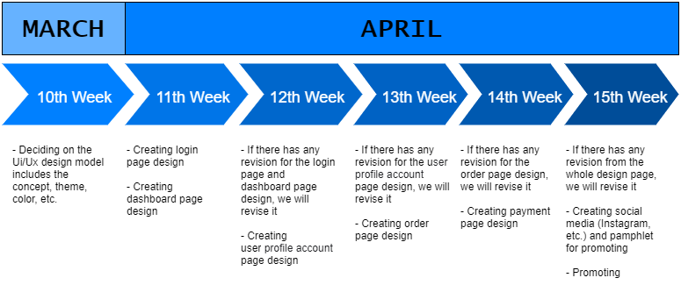

Slide 22
REVENUE STREAMS
Service user orders, we earn money from the user’s order and the income will be 20% of each service that ordered with around Rp300.000,00 price
Advertisement, we also earn money from the ads that will appear on MyServices web application and it’s just for additions on the first launch and temporarily and the income from ads will be around Rp18.000.000,00 in one year

Slide 23
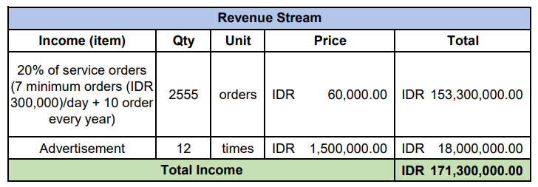

Slide 24
COST STRUCTURE
Development and operational cost, for the operational cost, we have to pay Google API, hardware and software, internet, employee salary, and also the advertisement for MyServices web application and it will be around Rp155.000.000,00 in one year. For the development cost, we have to pay server, printer, and also software license and it will be around Rp22.000.000,00 in one year
Employee salary, for the employee salary, it will be Rp3.000.000,00 each month for one person and will increase Rp1.000.000,00 every year
Advertising the web application, for the advertising of MyServices web application, we do it through social media especially Instagram and it will be Rp600.000,00 each year and around 1-3 times advertising in a year

Slide 25
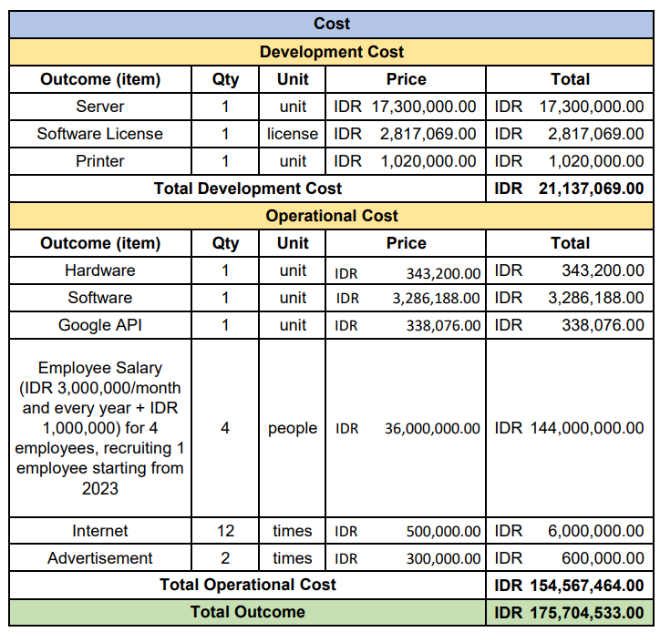

Slide 26
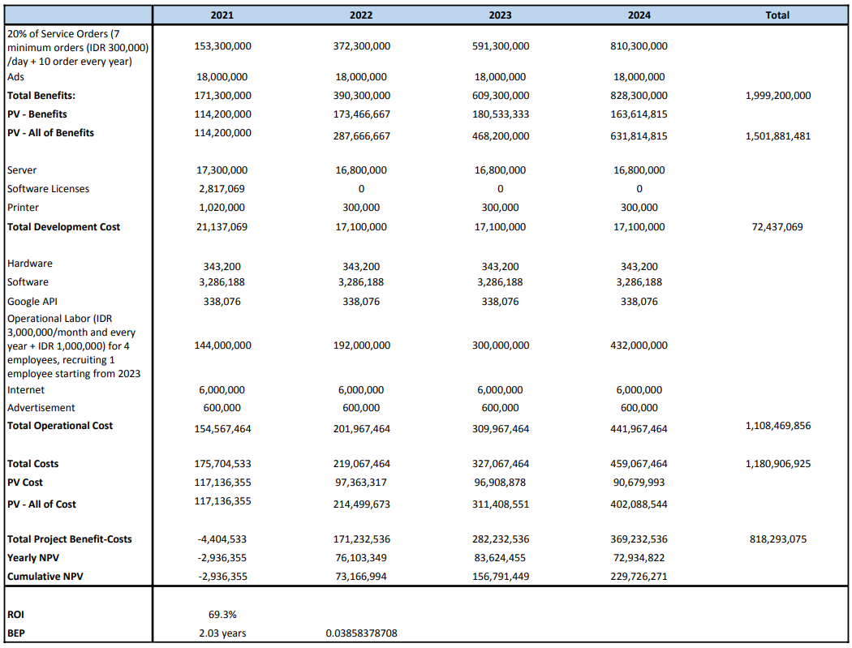

Slide 27
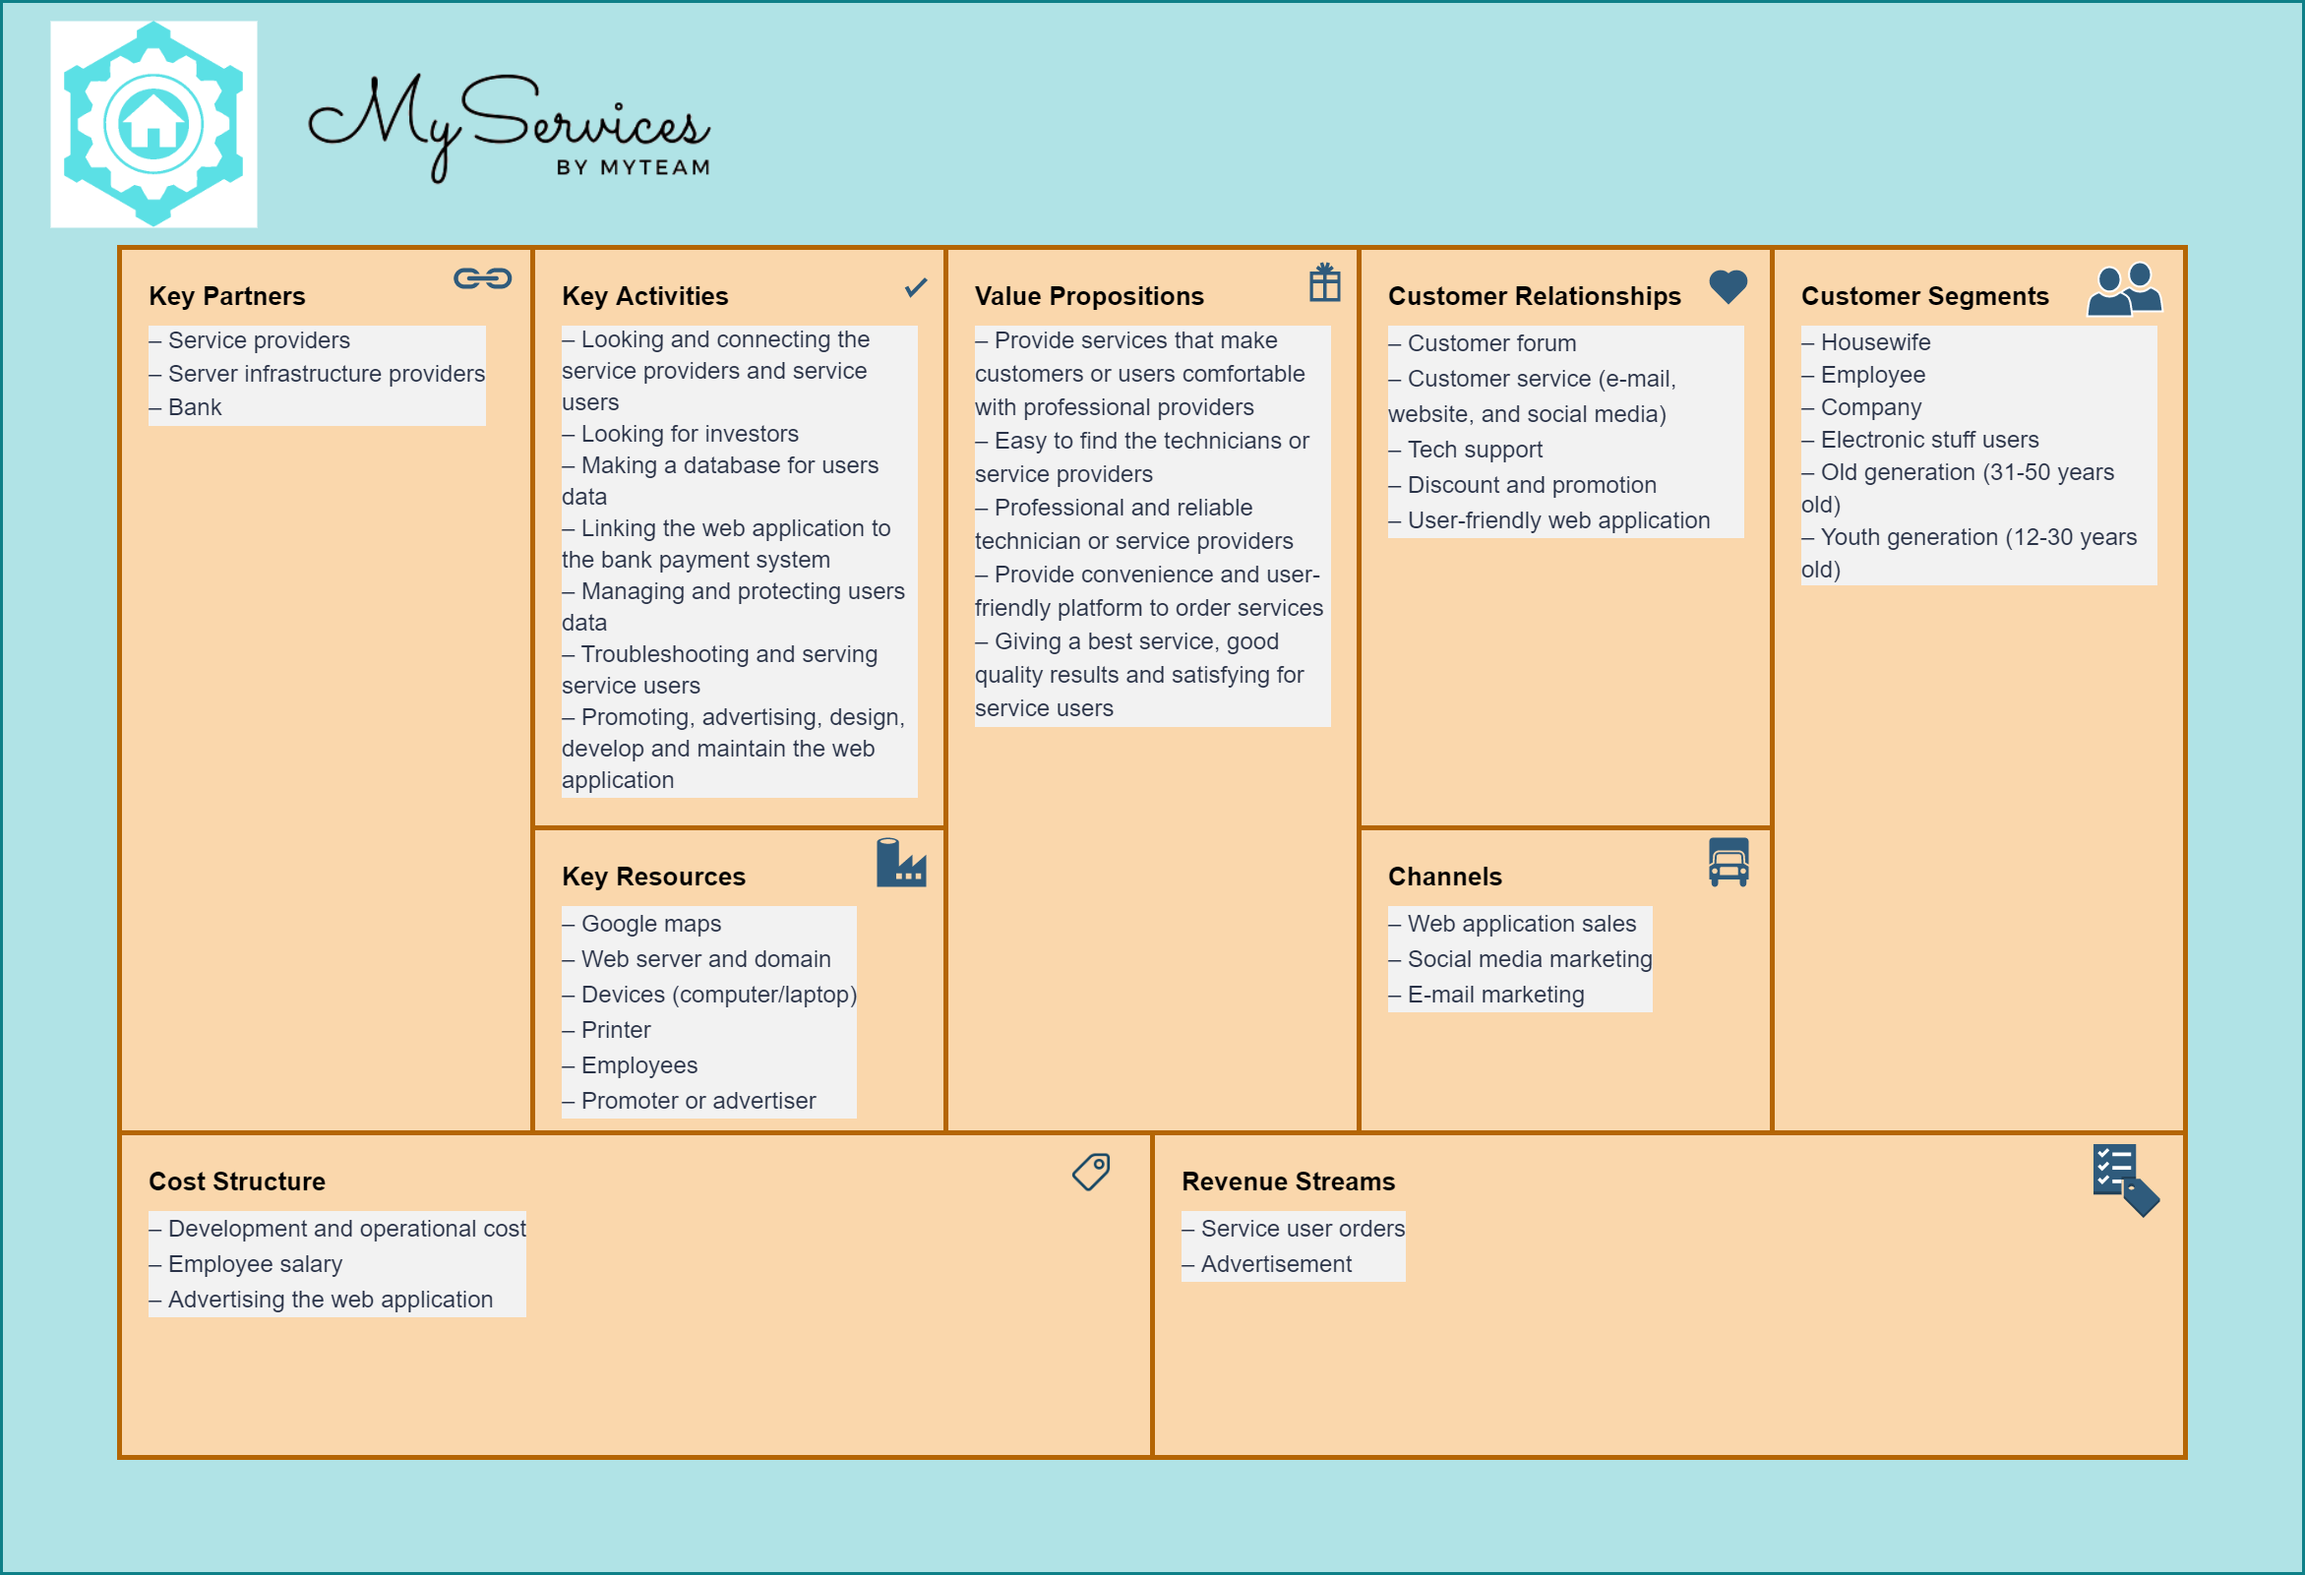

Slide 28
THANK YOU!!
Do you have any questions or feedback?

