Slide 1
parallel programming project - 2d incompressible fluid
Nicole Vadot

Slide 2
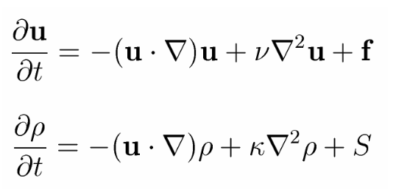
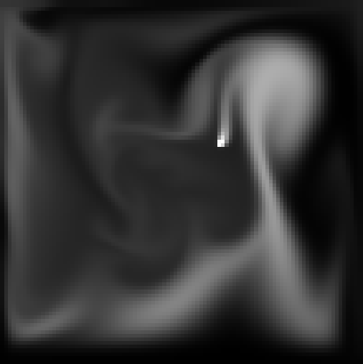
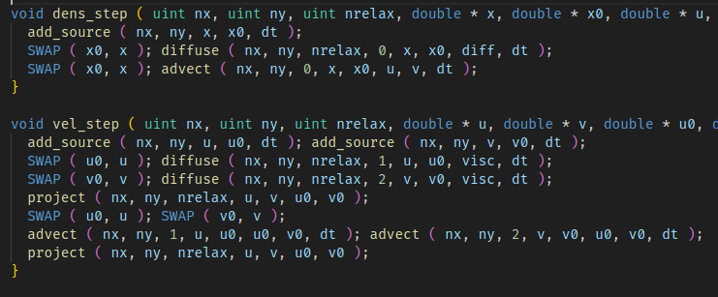
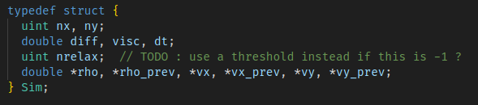
initial serial code
diffusion → Gauss-Seidel relaxation
advection → particle method
incompressibilty → "projection" (also GS)
complexity ~nx*ny*nrelax
nrelax = cst to prevent implicit dependence on nx, ny (no threshold)

Slide 3
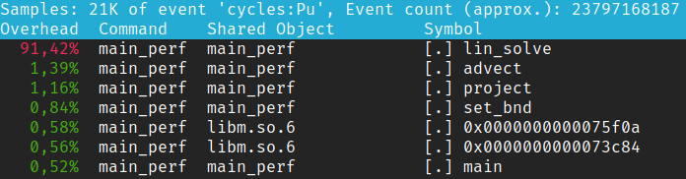
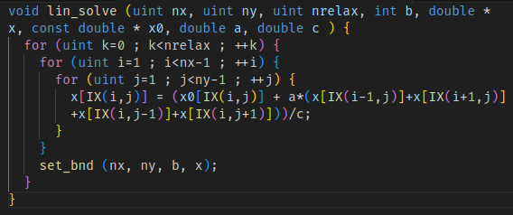
where to optimize ?
make -B USE_OMP=0 USE_GS=0 RELEASE=1 main_perf && perf record ./main_perf 100 100
=> most of the time is spent running lin_solve

Slide 4
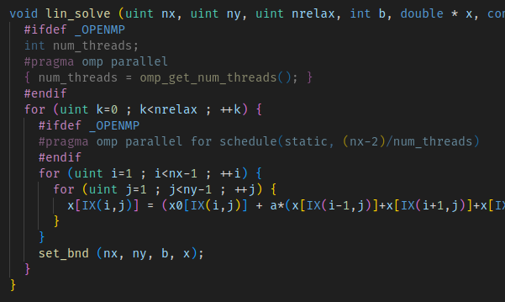
1. optimize lin_solve
works: #pragma omp parallel for
slower ???: #pragma omp parallel for collapse(2)
~similar: #pragma omp parallel for schedule(static, (nx-2)/num_threads))
nx=100, ny=100, nrelax=100
no omp: ~30ms/step
1 thread: ~32ms/step
2 threads: ~16ms/step
3 threads: ~12ms/step
4 threads: ~9.2ms/step
5 threads: ~7.9ms/step
6 threads: ~6.7ms/step
7 threads: ~5.8ms/step
8 threads: ~5.9ms/step
9 threads: ~7.3ms/step
...
overhead!
strong scaling limit!
Notes:
make -B USE_OMP=1 USE_GS=1 RELEASE=1 main_perf && ./main_perf 100 100 1

Slide 5
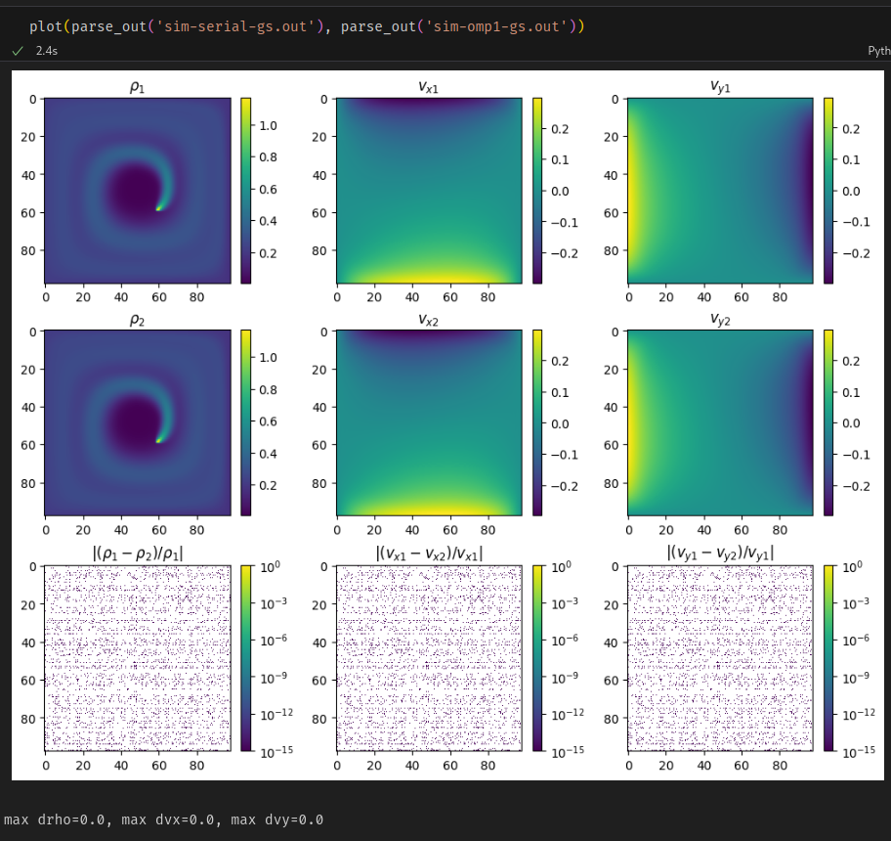
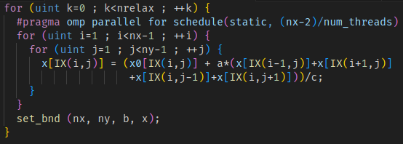
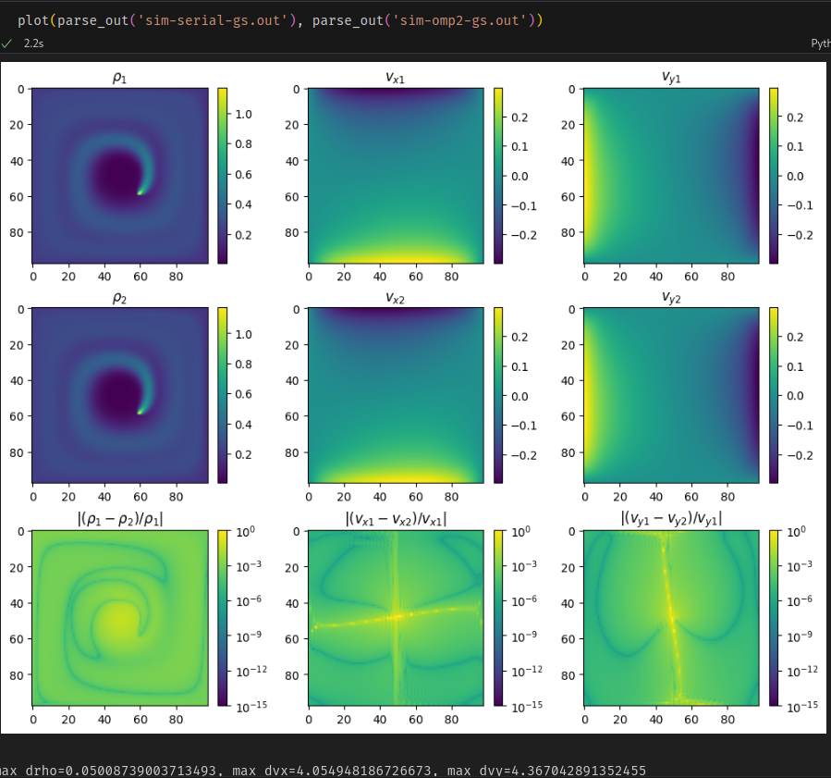
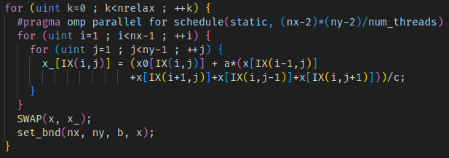
fixing the race condition
problem: results are not repeatable !!
→ race condition between the threads
normally:
updated
i
j-1
i-1
j
i
j
i+1
j
i
j+1
→ use Jacobi method instead of Gauss-Seidel
not updated
threads overlap!
i
j-1
i-1
j
i
j
i+1
j
i
j+1
thread boundary

Slide 6
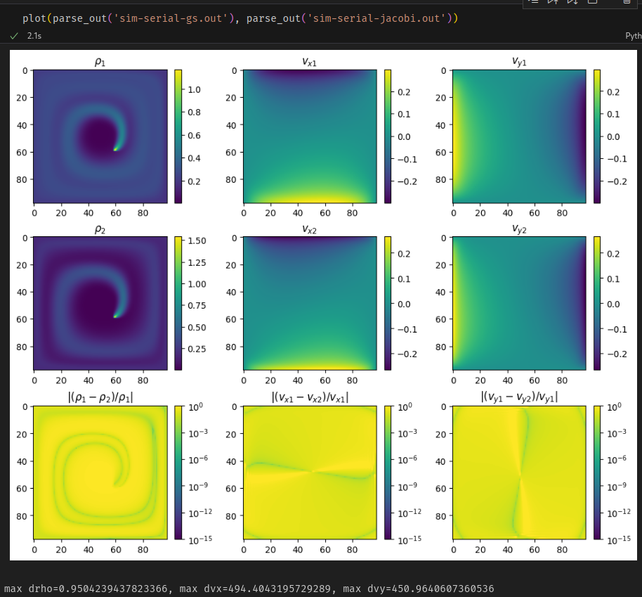
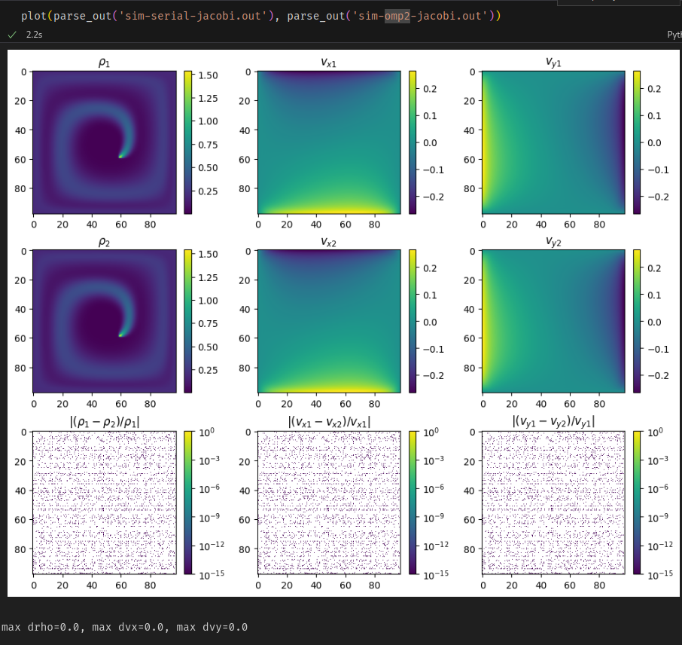
jacobi vs gauss-seidel
→ at fixed nrelax, not the same!
(different convergence rate)
→ jacobi ~5.3ms/step
gs ~30ms/step
→ ~6x speedup
→ no more read-after-write!
timings with jacobi [ms/step]
noomp 5.3
1 th. 5.4
2 th. 3.4
3 th. 2.6
4 th. 2.2
5 th. 2.0
6 th. 1.9
7 th. 2.8

Slide 7
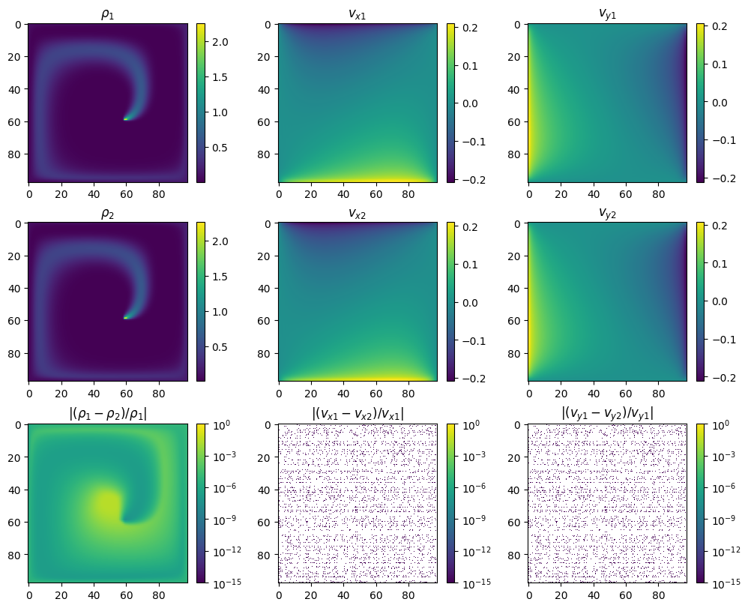
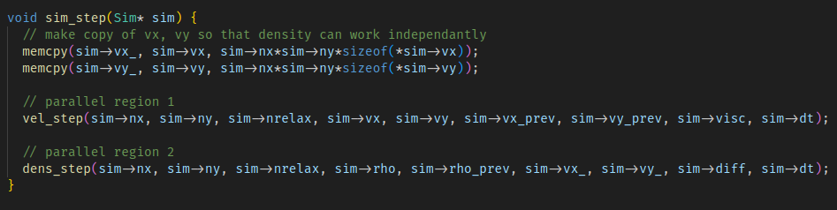
2. improve balance between density and velocity computation
5.3ms/step = 1.0ms/step [density]
+ 4.3ms/step [velocity]
serial algo (leapfrog-style): rho → vx,vy → rho → vx,vy → ...
parallel algo: (rho, vx,vy) → (rho, vx,vy) → ...
new serial implementation vvv
compare with before.. ->
difference is ~1e-7
→ seems OK
Notes:
make -B USE_OMP=0 USE_GS=0 RELEASE=1 main_perf_mpi && mpirun -n 2 ./main_perf_mpi 100 100

Slide 8
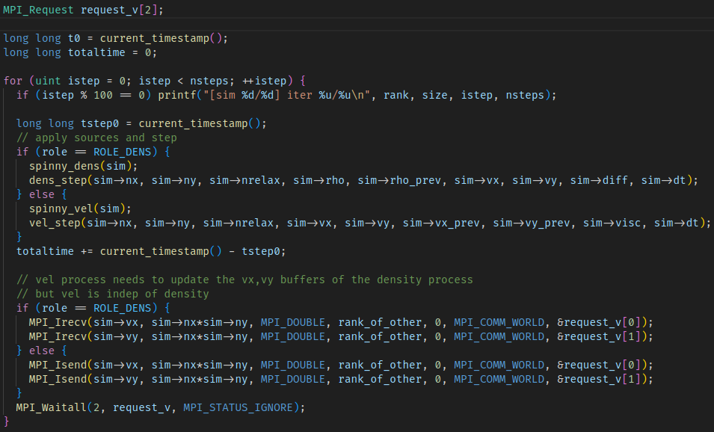
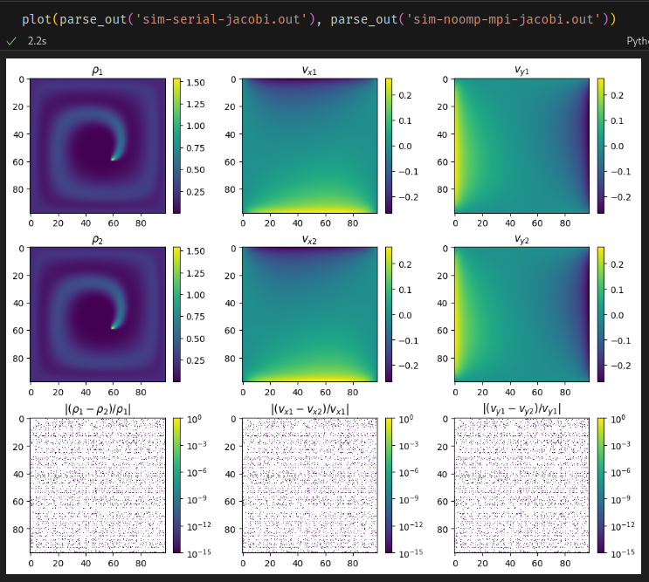
MPI parallel implementation
2 processes: dens and vel, each handles its own evolution
communications are only one-directional!
(vel is indep of dens)
verify identical results [OK] ->
Notes:
the dots in the images are graphical erros from matplotlib, numerically the difference is 0 everywhere

Slide 9
balancing the dens, vel MPI processes
(the theory)
5.3ms/step = 1.0ms/step [density] + 4.3ms/step [velocity]
=> time/step is limited by the longest of dens, vel process
idea: give more threads to velocity than density to equilibrate?
nt threads available, 0 < α < 1
  α*nt go to density
  (1-α)*nt go to velocity
(+/- some rounding and thresholding)
what α to pick?
→ do a scan to minimize time/step
→ intuition -- 4:1 ratio
velocity: 4 calls to lin_solve per step
density: 1 call to lin_solve per step
=> α ~ 1/(4+1) = 0.2
time/step
α
0 0.2 1

Slide 10
balancing the dens, vel MPI processes
(the practice)
didn't get it to work :(
enabling OMP on top of MPI results in slower times (and more threads leads to even slower)
tried tweaking
  MPI_THREAD_LEVEL, MPI_Init{,_thread}
  OMP parallel for collapse, schedule...
  number of threads, grid size...

Slide 11
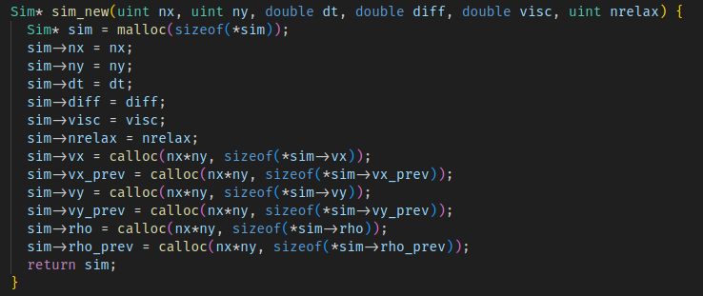
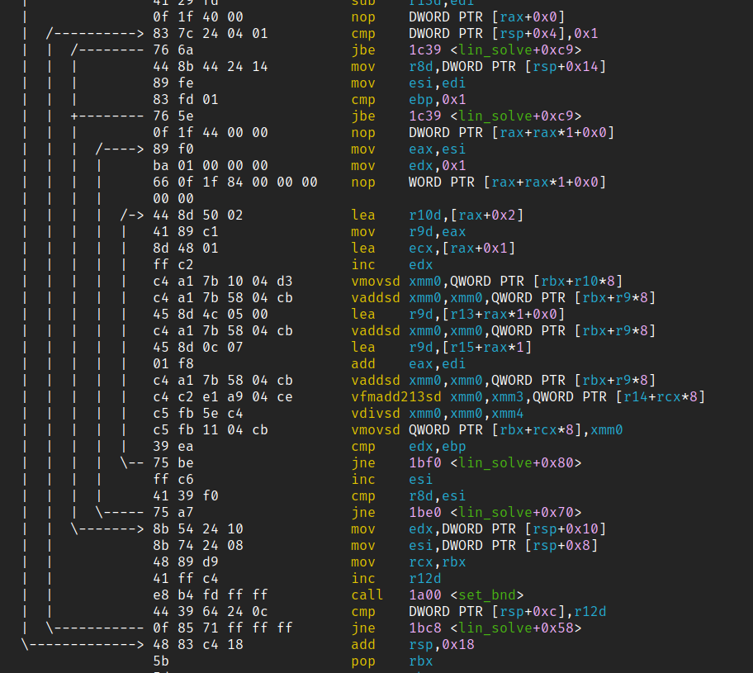
further improvements
first touch: OK probably
MPI carthesian geometry
...but, might help on large grids (not the case here, we are 2D)
prevent fork/join on every lin_solve
+ would require to also parallelize all other loops
(or add omp single everywhere else)
review vectorized instructions
...seems OK... maybe cache misses could be reduced?
interface parallelized MPI with GUI (once MPI+OMP works)
objdump -Mintel --visualize-jumps --disassemble=lin_solve main_perf

Slide 12
