Slide 1
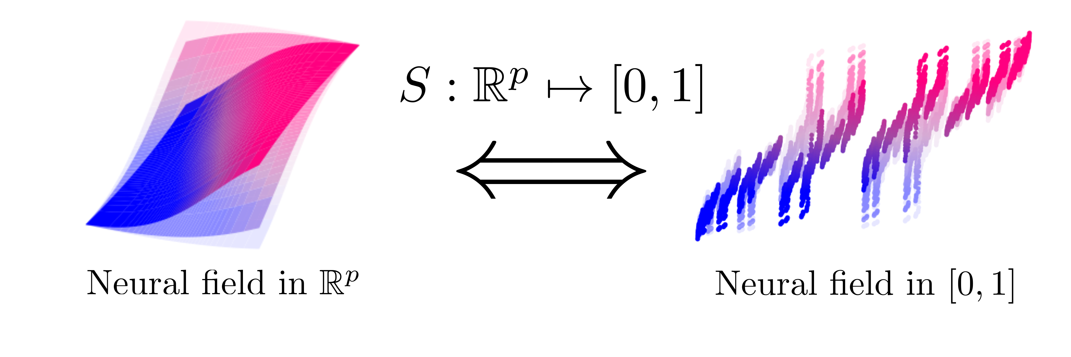
Equivalence of neural field dynamics with different embedding dimensionality
Nicole Vadot
(Supervisor)
Valentin Schmutz
(Supervisor, LCN director)
Wulfram Gerstner
Online: https://ninivert.github.io/lcnthesis/

Slide 2
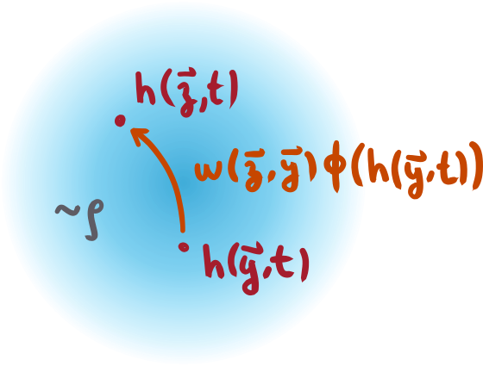
recap: neural fields
& embedding spaces
activation (firing rate)
neural field
connectivity kernel
population density
embedding space
by redefining, we can "hide" the density in the kernel:
=> we get a neural field in [0,1]^{p}
Notes:
in general, there is covariance, so we would need to define ~w = w x rho instead of composition, then do any mapping (e.g. logistic). not as "clean" though
(reweighing method or substitution of CDF)

Slide 3
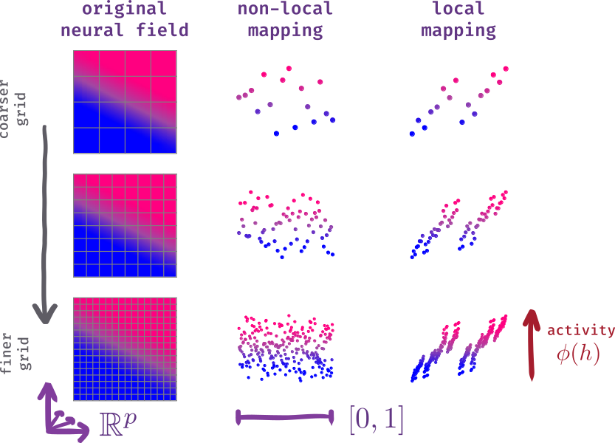
problem statement
neural field in p dimensions
map to neural field in one dimension?
"regularity" of the activity is what allows writing the neural field
can an equivalent neural field in [0,1] also be regular?
what conditions on mapping S to preserve regularity? (→ locality)
Notes:
regularity ~ "smoothness"

Slide 4
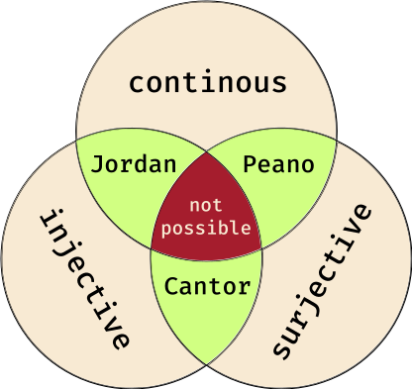
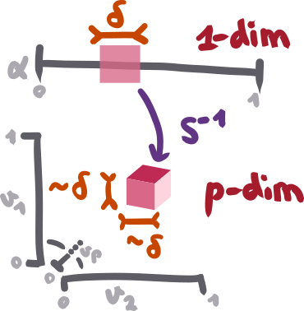
smoothness of the kernel: what properties on S⁻¹ can we hope for?
kernel of the [0,1] embedding
defined as:
wU is highly regular, but
might not be, it depends on S⁻¹
small neighbourhoods
in [0,1]
should be mapped
to small
neighbourhoods
in [0,1]ᵖ →
→ this is tricky
↑ Netto's theorem states
there are no continuous
bijections S⁻¹ : [0,1] ↦ [0,1]²
Notes:
wU is continuous and differentiable: nearby populations sense the same connectivity

Slide 5
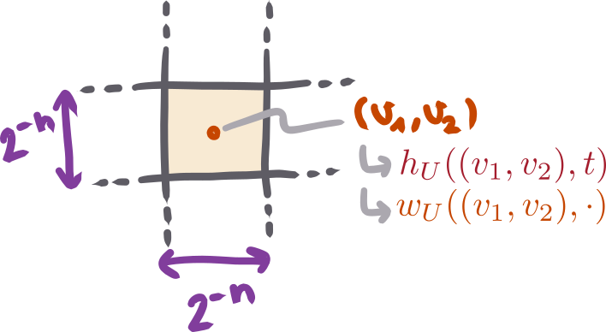
S as the limit of a sequence of mappings S^{n} - motivation
why? → grid discretization
2^{n} bins along each dimension
case p=2, positions of bins
given by:
numerical kernel:
we simulate the discretized neural field
↑ each bin "samples" the
neural field and kernel
Notes:
binary formulation is general. we study examples of mappings which just do permutations
we hope that these mappings will have good properties in the n → infty limit

Slide 6
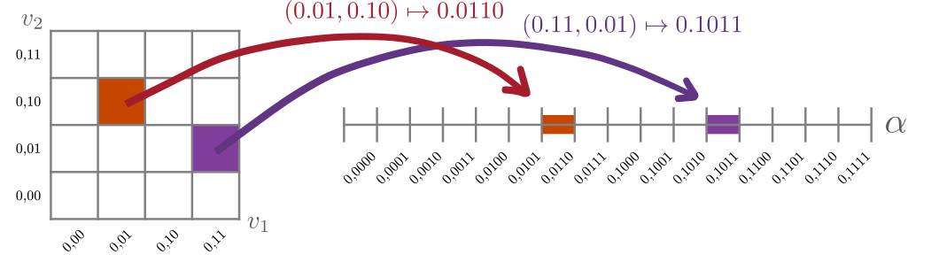
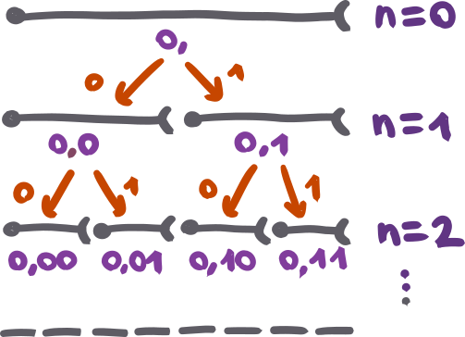
S as the limit of a sequence of mappings S^{n} - definition
↓ Z-mapping
for n = 2
S^{n} maps 4^{n} squares of size 2^{−n} × 2^{−n}
to 4^{n} segments of size 4^{−n}
bins are located using binary expansions →
Notes:
binary formulation is general. we study examples of mappings which just do permutations
we hope that these mappings will have good properties in the n → infty limit

Slide 7
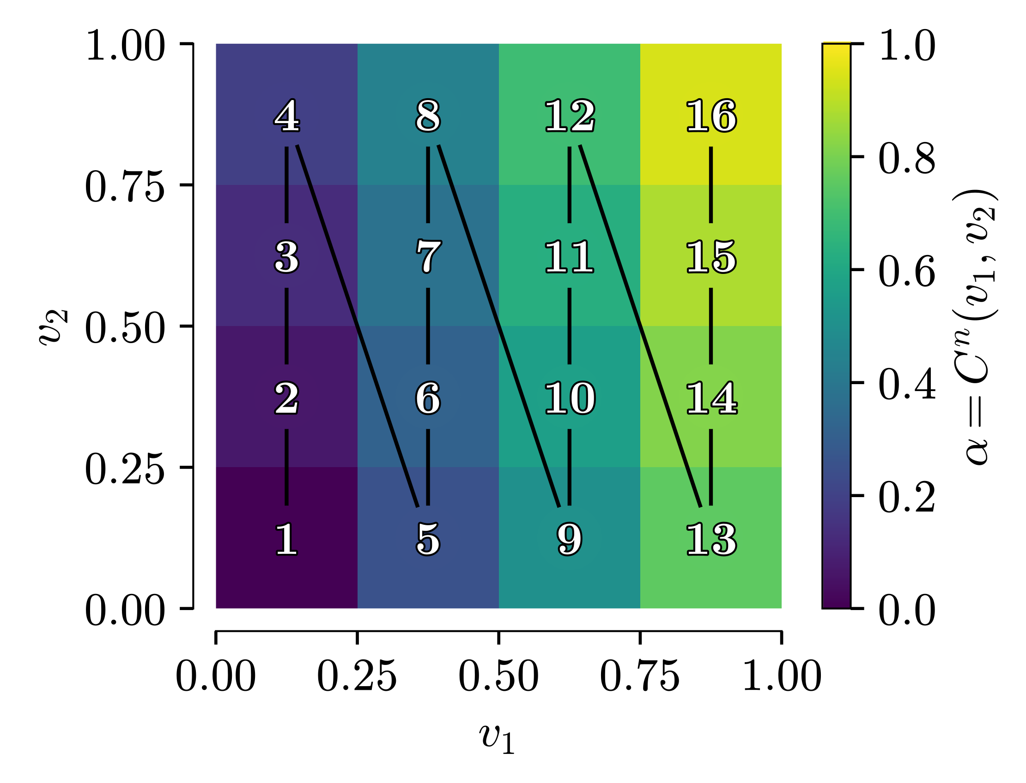
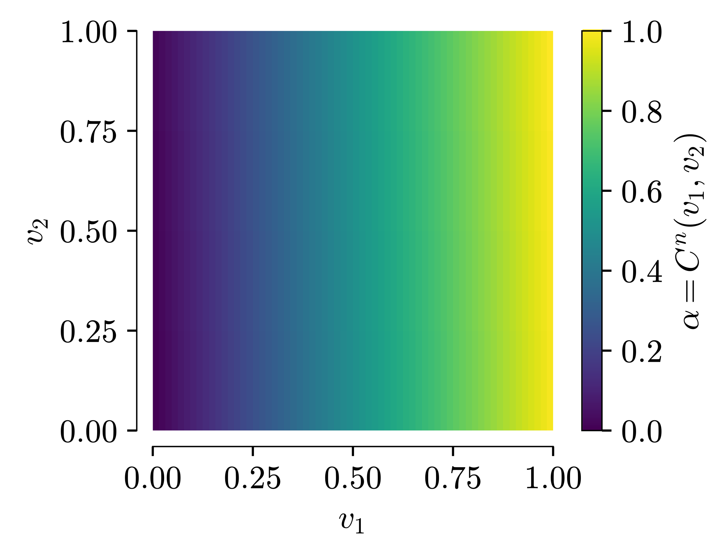
a naive mapping: Column mapping
enumerate the populations columnwise
at finite-n, inverse is
converges to a projection
on the first axis
Column mapping for n = 2 →
Column mapping for n → ∞ →
Notes:
first the bits of v1, then bits of v2
limit is continous, surjection
this is just a reshape, lots of formalism, but will be useful

Slide 8
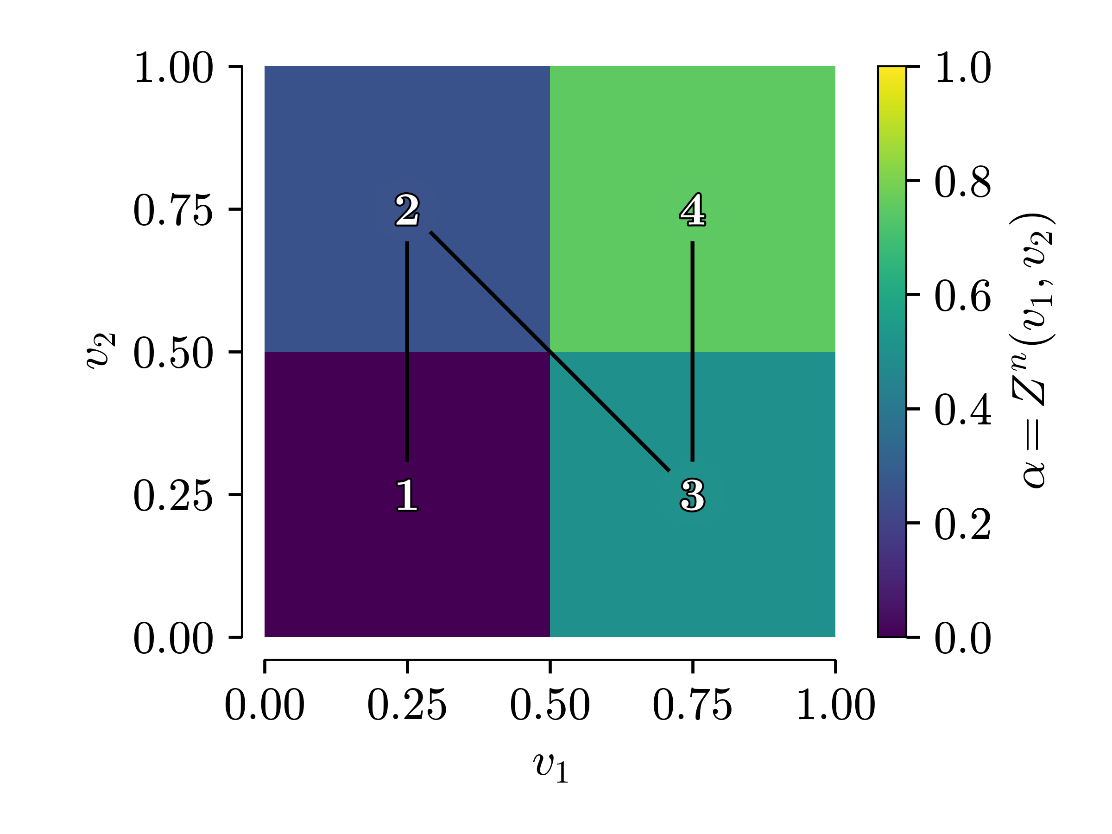
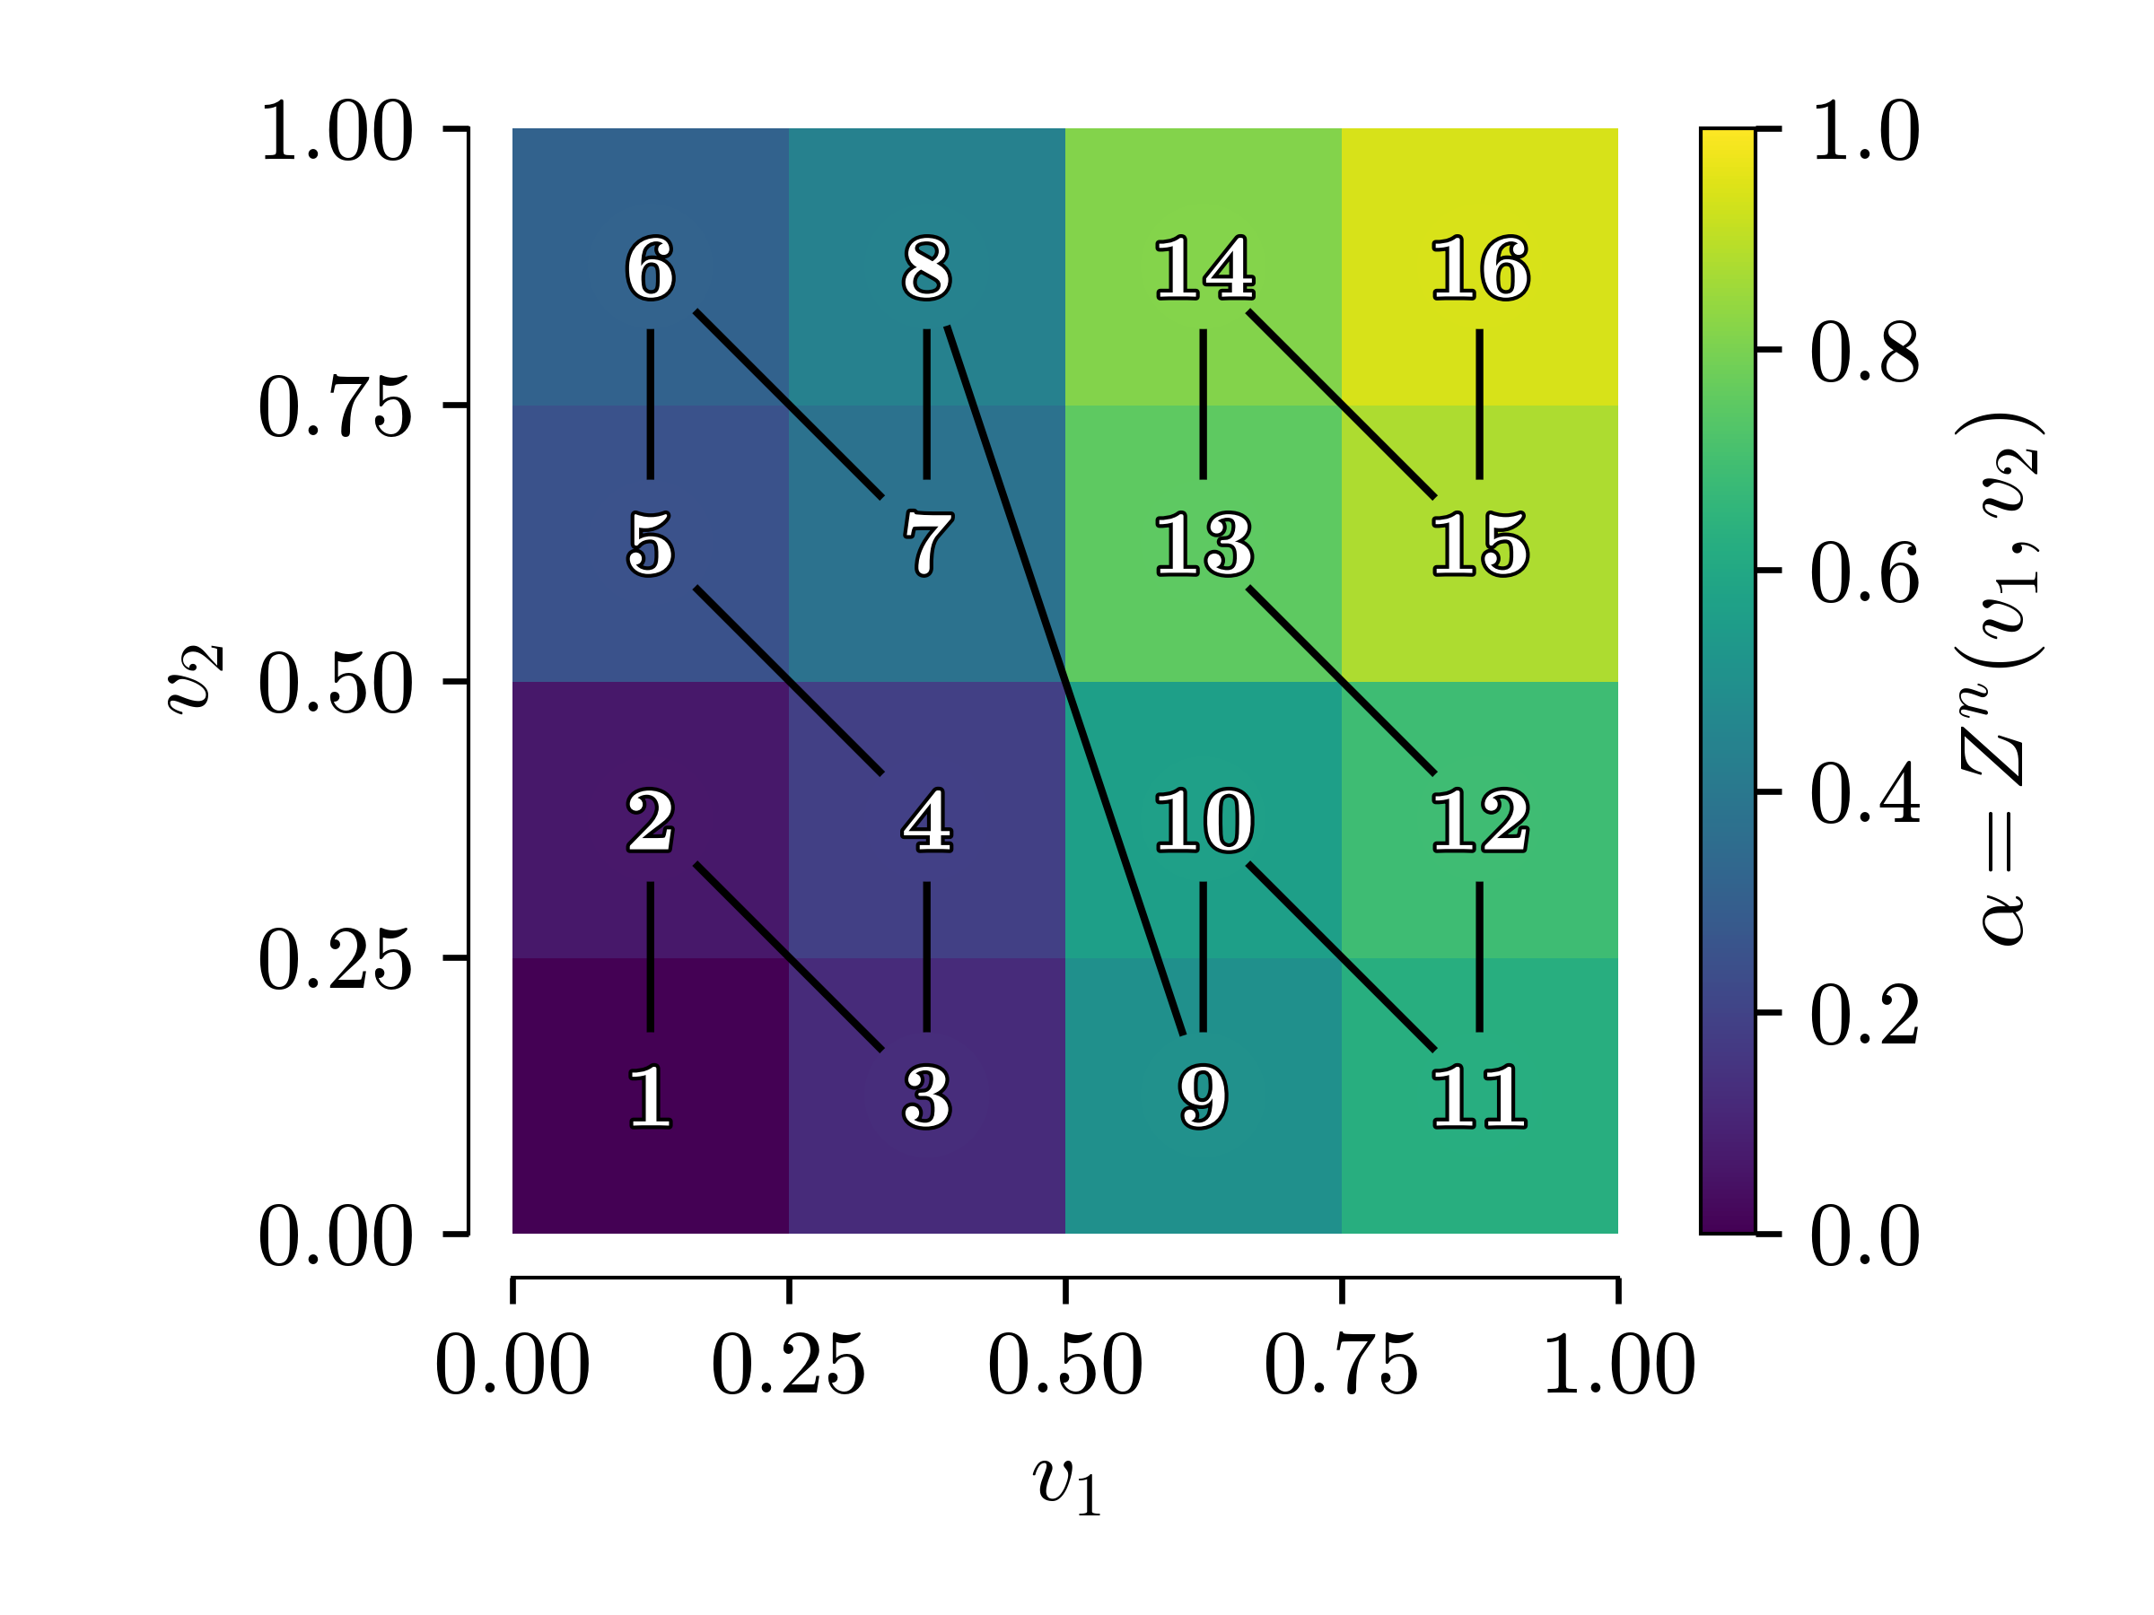
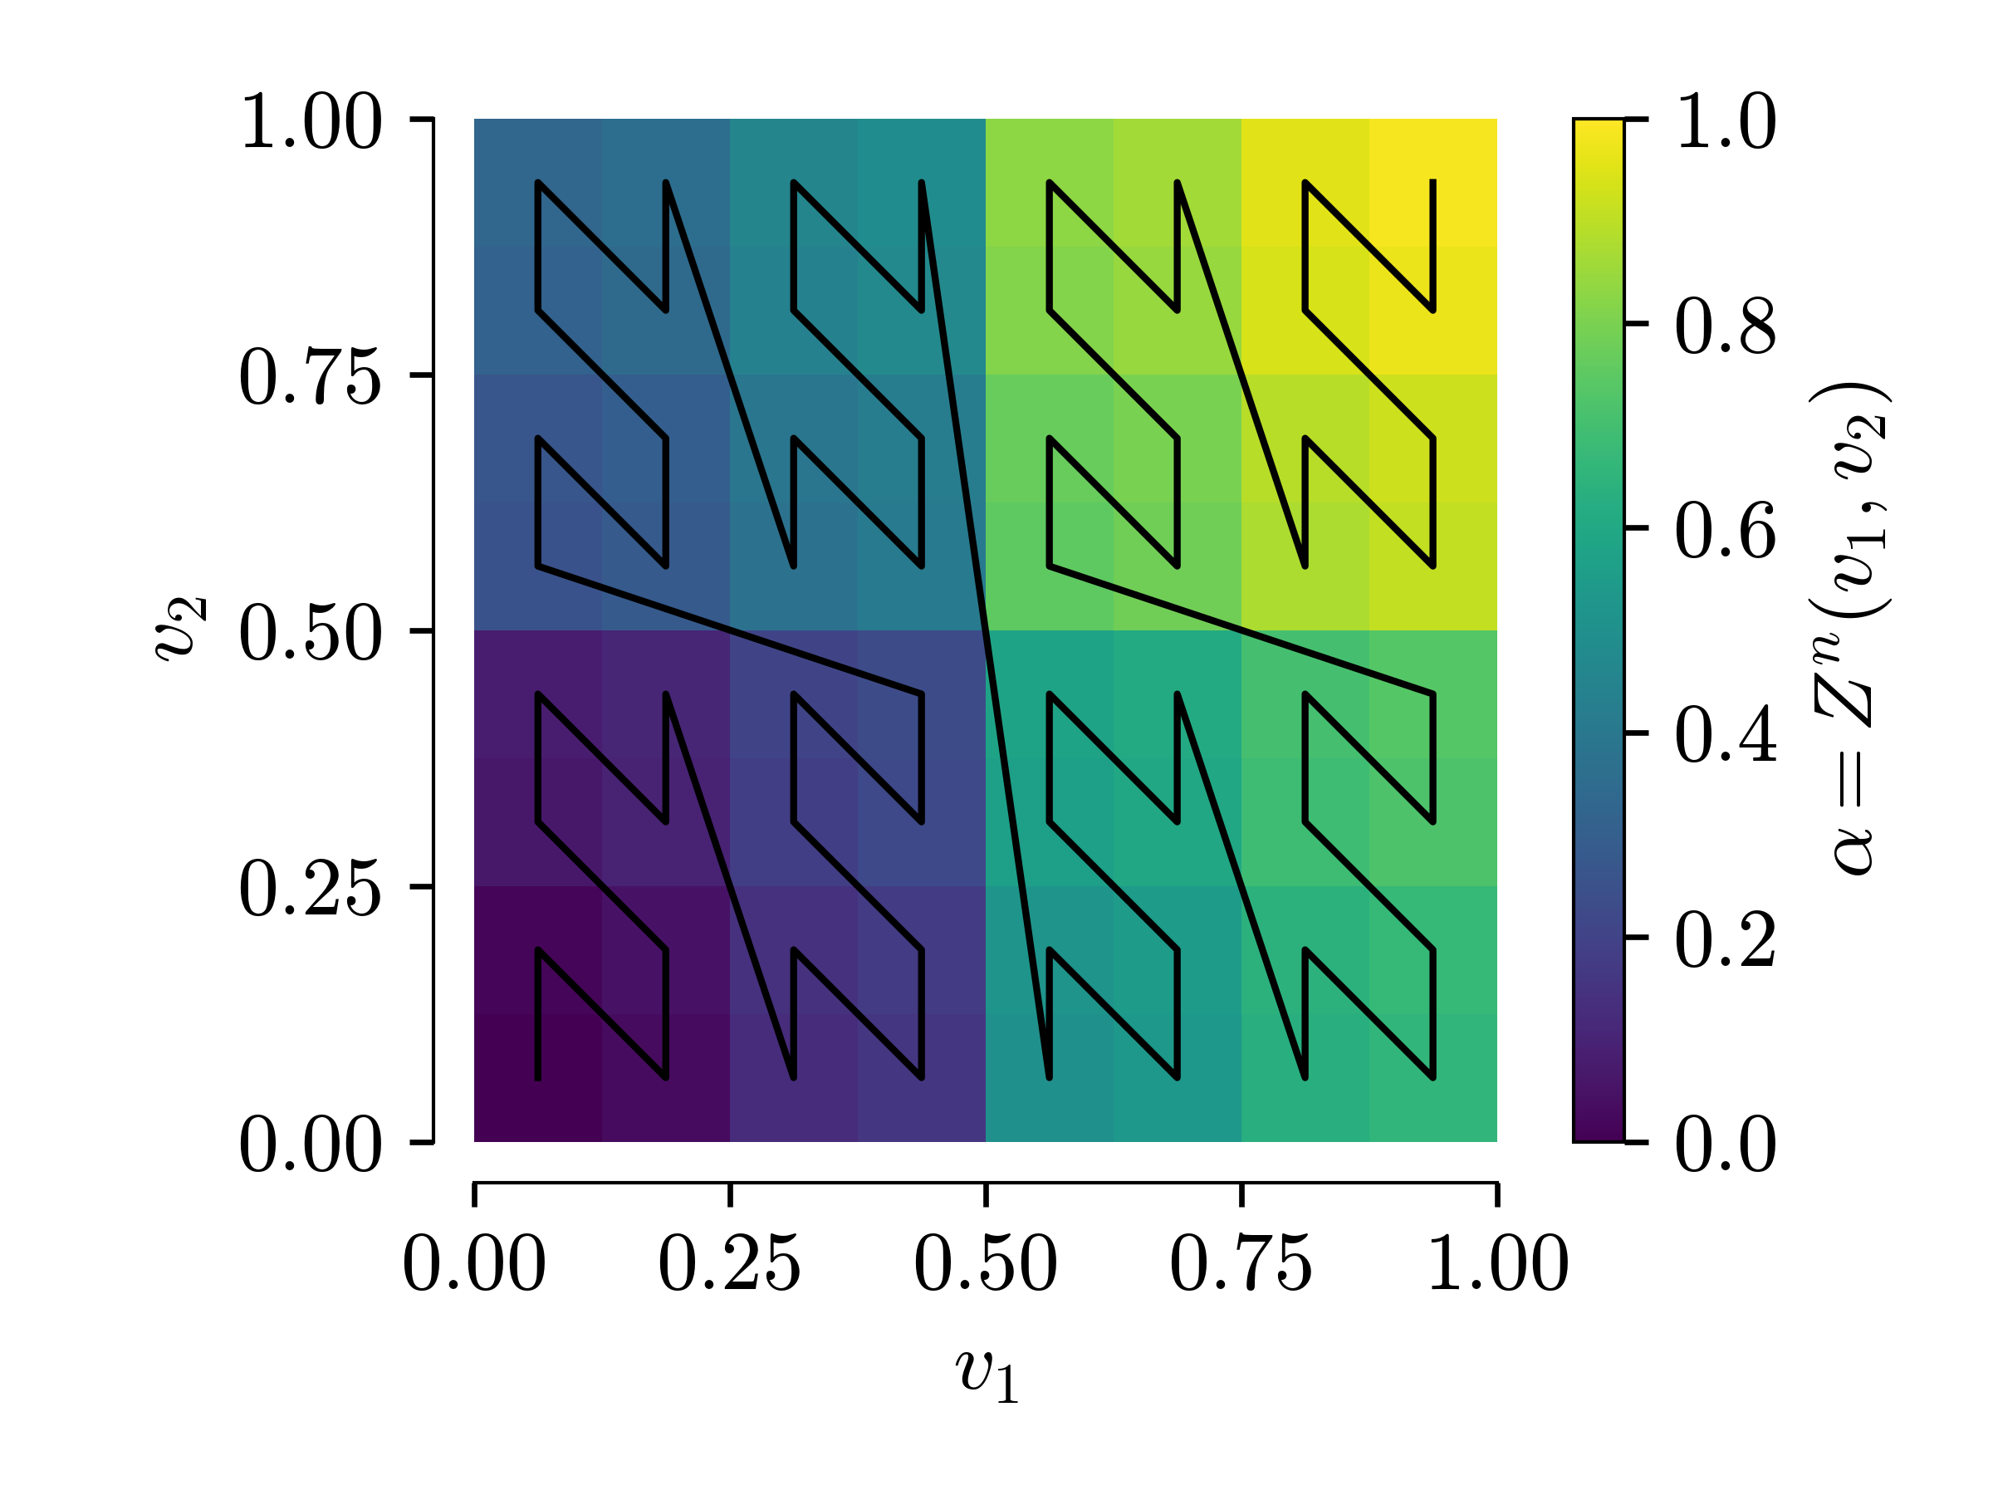
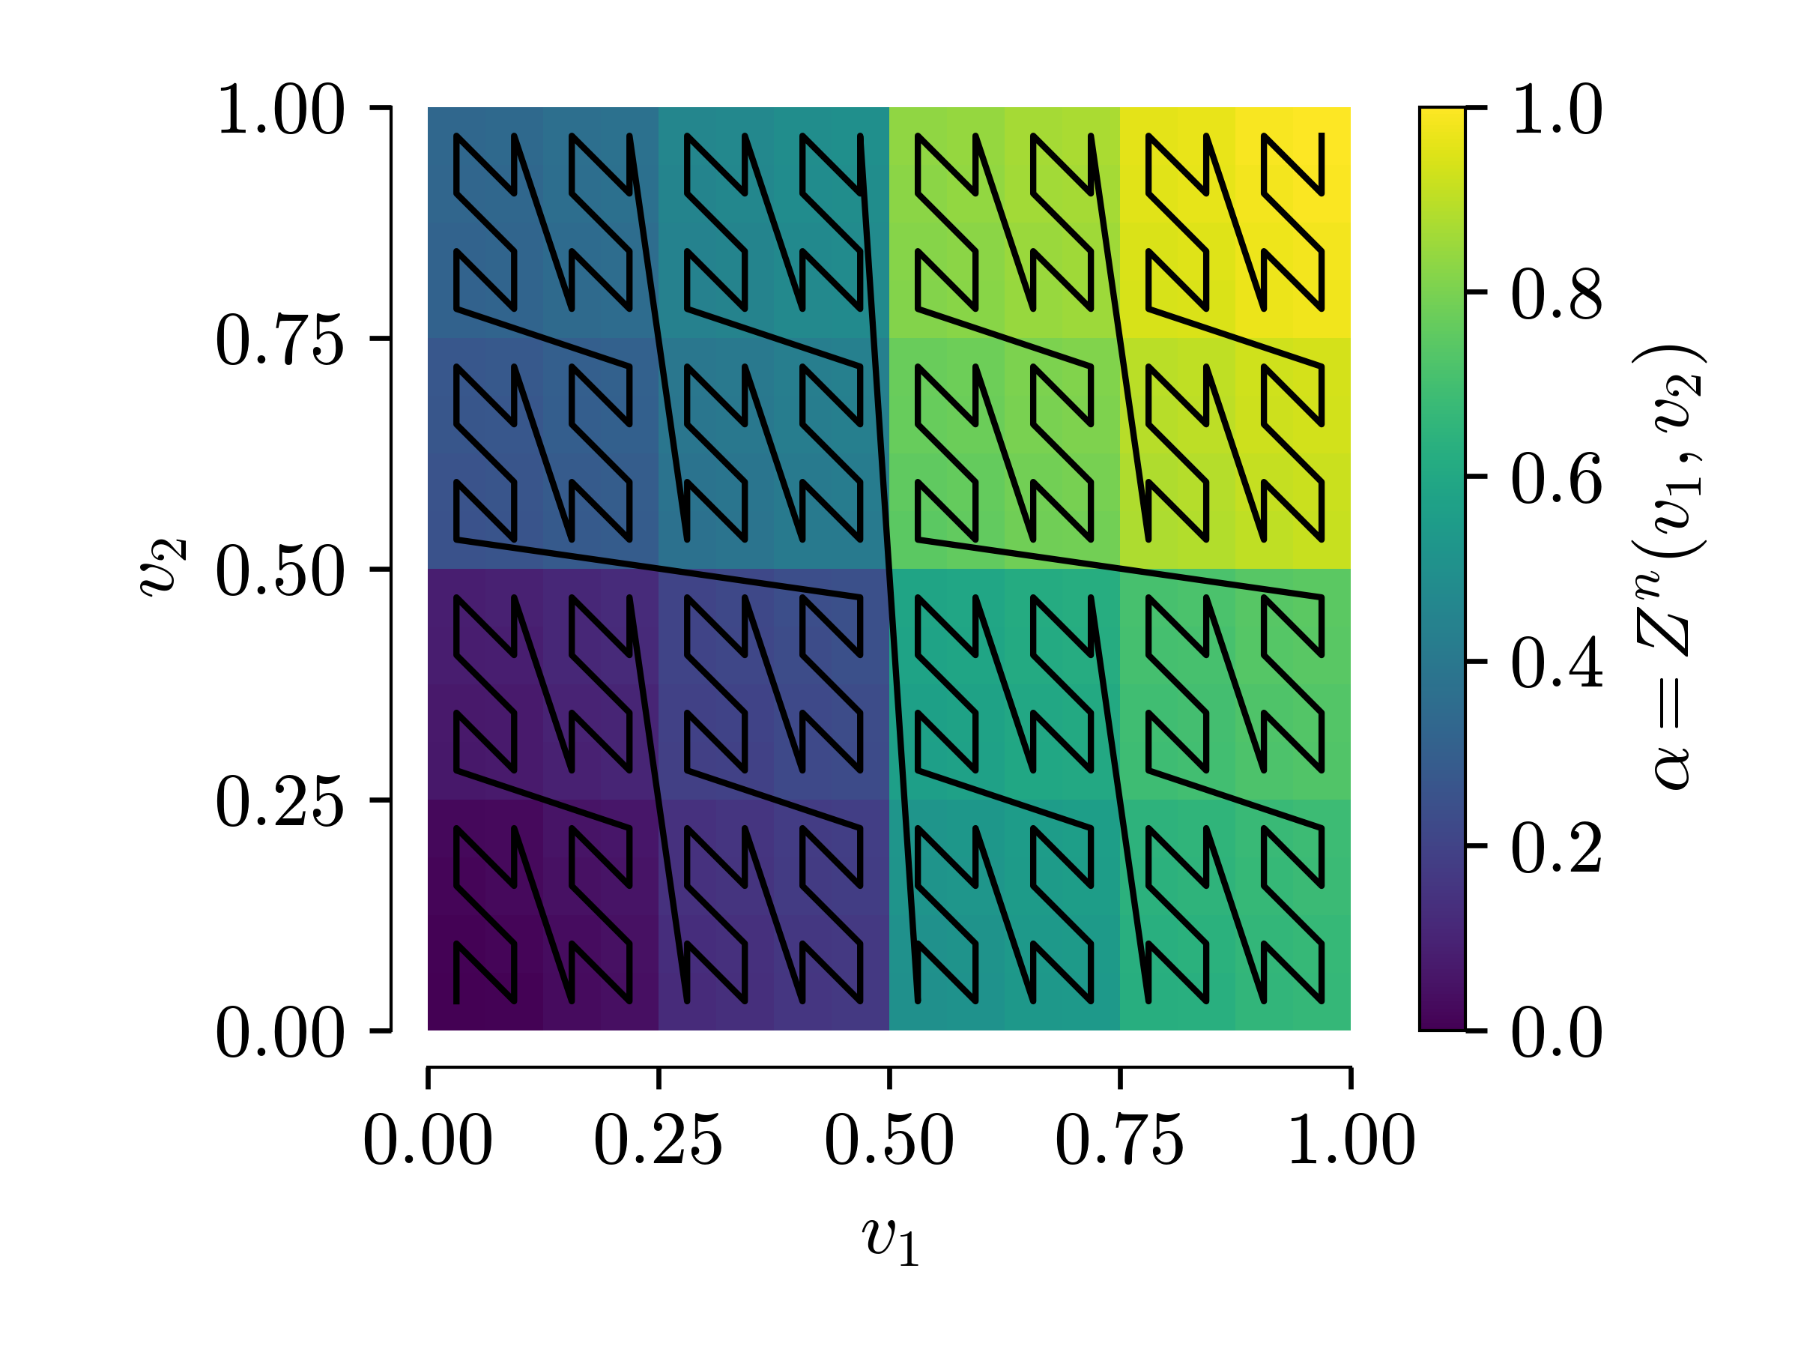
a less naive mapping: Z-mapping
↓ n = 1
↓ n = 2
(recursively) draw Z shapes
again, inverse is
converges to a bijection between the segment and the square
↓ n = 3
↓ n = 4
Notes:
interleave bits of v1 and v2
interpretation of going into each square and drawing Z shapes
limit has a fractal structure. clearly not continuous

Slide 9

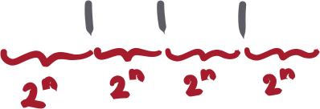

coarse-graining: how to simulate the 1-dimensional neural field
naive numerical kernel for [0,1]
problem: permutation invariance
=> identical dynamics indep. of
the mapping!
in 2D: 2^{n} bins per dimension
in 1D: 4^{n} bins per dimension
reduce to 2^{n} bins in 1D by coarse-graining
↑ coarse-graining averages 2^{n}
consecutive populations in 1D,
forming effective bins of size 2^{-n}
Notes:
every segment in 1D corresponds to a square in 2D. averging segments in 1D corresponds to finding the "mean position" ("center of mass") of the corresponding squares in 2D
don't compensate for the reduction in dimensionality by an increase in the number of bins

Slide 10

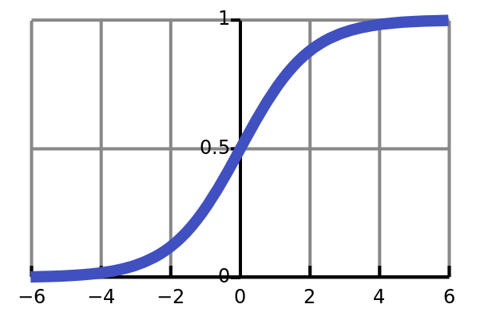
let's simulate!
..., but first, we'll need a toy model
low-rank cycling gaussian neural field
cycling behavior with "duration" δ
we get latent trajectories for free:
"delay"
kernel has rank p
"rolling" induces recurrent drive to the next pattern
population density follows a p-dimensional Gaussian (zero mean, no covariance)
projection of the field onto the patterns
Notes:
toy model with non-stationary dynamics, so that we can compare neural field in p dim with neural field in 1 dim
dynamics will cycle through a sequence of patterns

Slide 11
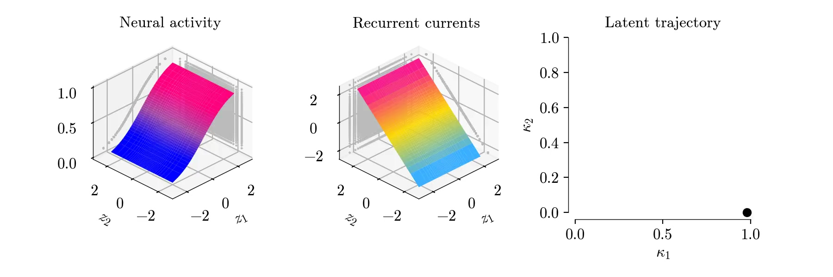
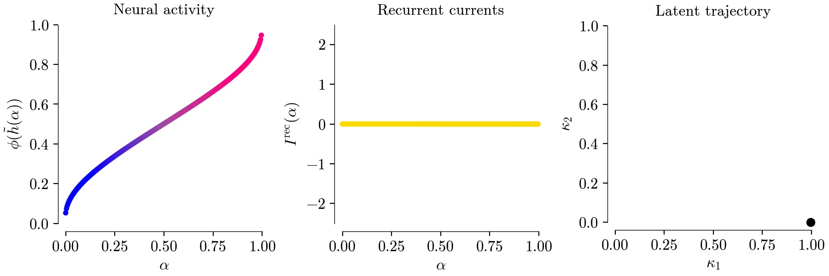
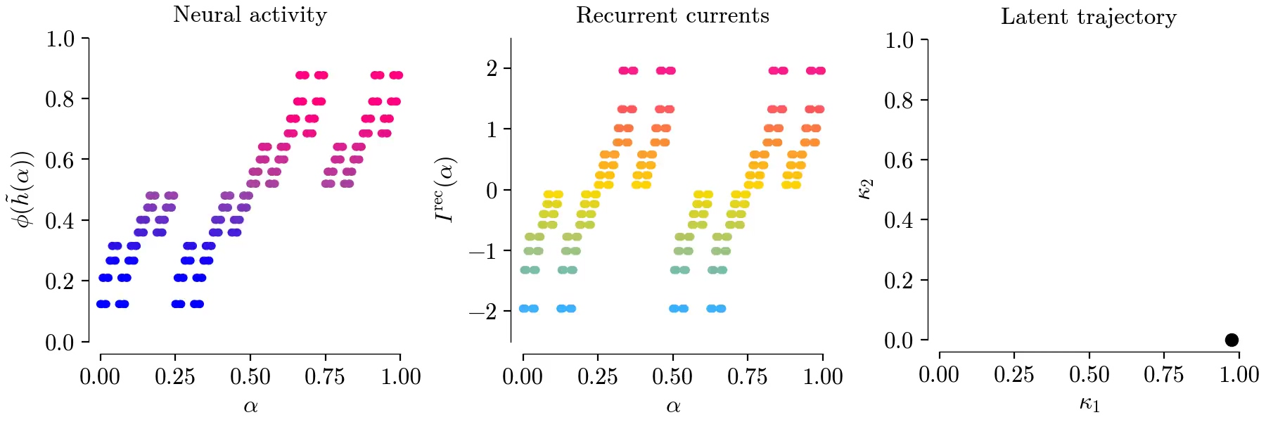
original neural field
for p = 2, δ = 6, h(z1, z2, 0) = z1
=> cycling behavior
mapped with Column mapping, then coarse-grained
=> quick decay
mapped with Z-mapping, then coarse-grained
=> identical cycling
behavior
animation
animation
animation
Notes:
stress we are simulating the neural field dynamics in 1d with its own kernel after coarse-graining
colors represent activity or recurrent current

Slide 12
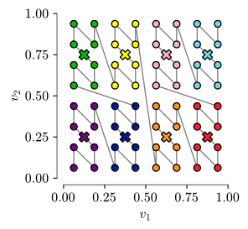
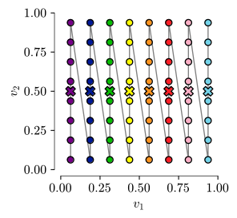
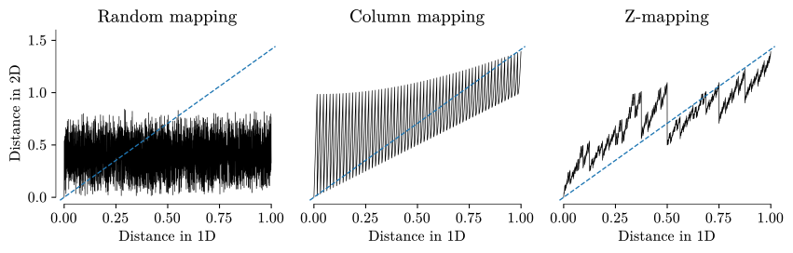
the notion of locality - motivation
Z-mapping
Column mapping
what positions in 2D get "averaged together" ?
colour-coded square populations corresponding to binned segment populations before coarse-graining →
how are neighbourhoods transformed ?
← distance between the first
population and all other
populations, in 1D and 2D

Slide 13
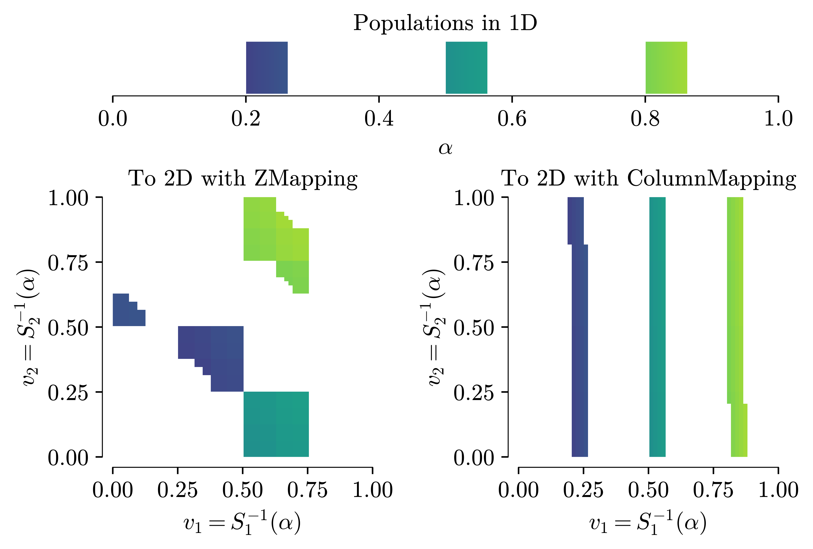
the notion of locality - motivation
are populations close in 1D also close in 2D ?
recall:
← 2D populations corresponding to
three small segments (each of length 1/16)
of 1D populations
Z-mapping
Column mapping
what positions in 2D get "averaged together" ?
colour-coded square populations corresponding to binned segment populations before coarse-graining →
Notes:
coarse-graining "enfores" locality, because non-local mapping get destroyed
theory of neural fields is based on the assumption that close neurons have a similar activity (→ smoothness/regularity of the field)

Slide 14
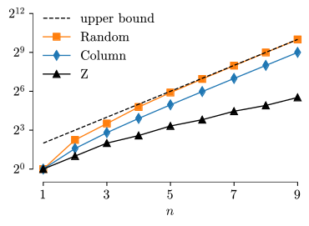
the notion of locality - formalism
average variation inside each coarse-graining bin
if f is continuous, then Vn(f) → 0
scaling behavior of numerator
  Random mapping saturates bound
  Column mapping ~ 2^{n} => Vn(C ⁻¹) > 0
  Z-mapping ~ 2^{n/2} => Vn(Z ⁻¹) → 0
distance in the p-dimensional embedding
average over all bins
↓ (numerator of the) average binned variation as a function of n
every pair of positions inside each bin
Notes:
weaker condition than continuity
random mapping saturates the upper bound 2x2^{n}

Slide 15
locality guarantees simulation accuracy
is regular enough that the integral on [0,1]
can be numerically evaluated. sketch of proof:
  define numerical and analytical integrals
  compare the integrals on each coarse-grained bin
  assume Lipschiz continuity of the original neural field with cst L(α)
  bound integrand by supremum and use locality
Notes:
locality implies the effect of coarse-graining vanishes as n → ∞
we show that the mappings of 2-dim to 1-dim are numerically viable

Slide 16
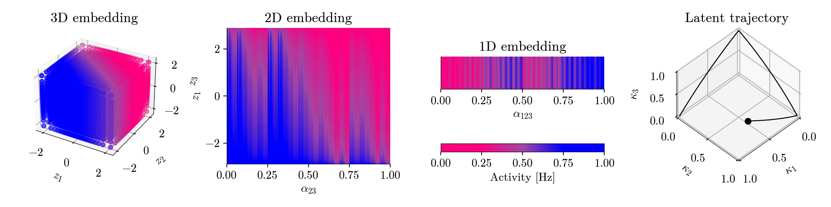
(bonus) iterating mapping and coarse-graining from p-dim to 1-dim
is regular enough that we can again
apply a mapping and do coarse-graining
"local mappings conserve regularity"
numerical demo with p=3: from [0,1]³ to [0,1]² to [0,1]
Notes:
local mappings conserve regularity

Slide 17
summary & conclusion
example of neural fields in p dimensions that can be mapped to equivalent neural fields in [0,1]
locality quantifies the conservation of "regularity"
coarse-graining numerically enforces the notion of locality: non local mappings are destroyed
the Z-mapping can be approximated numerically, and the numerical integral on [0,1] approaches the analytical integral on [0,1]
Thank you!

