Slide 1
Kisan Buddy
PIP2001 Capstone Project
Review-1
Batch Number: 08
Under the Supervision of,
Dr. Srinivas T R
Professor
School of Computer Science and Engineering
Presidency University
Student Name Roll Number
Shreya Paul - 20211CBD0002
K Faseeha Naaz - 20211CBD0012
Inzemam Quraishi - 20211CBD0026
Name of the Program: Computer Science and Engineering in Big Data.
Name of the HoD: Dr. Pravinthraja
Name of the Program Project Coordinator: Ms. Suma N G
Name of the School Project Coordinators: Dr. Sampath A K / Dr. Abdul Khadar A / Mr. Md Ziaur Rahman

Slide 2
Introduction
App Overview:
Kisan Buddy connects farmers with local mandis to maximize profit and offers consumers a platform to purchase high-quality products within their budget.
Unique Features:
Real-time Bidding & Price Matching: Ensures competitive pricing for farmers.
Market Insights: Provides farmers with current market trends and price analytics.
Profit Maximization: Helps farmers choose the optimal selling point.
Transportation Assistance: Offers solutions for transporting produce.
Consumer-focused Features: Allows consumers to check product quality and set desired price ranges for purchases.

Slide 3
Literature Review
Agriculture and Mandi Systems in India:
The Agricultural Produce Market Committee (APMC) system in India was designed to regulate agricultural trade, ensuring fair prices for farmers. Under this system, farmers are required to sell their produce in government-regulated mandis through licensed intermediaries. Mandis play a vital role in the agricultural supply chain, where prices are typically set through auctions based on supply and demand.
Farmers encounter several obstacles within the mandi system:
Middlemen Exploitation: Farmers depend on intermediaries who often set lower prices or charge high commissions, reducing farmers’ earnings.
Lack of Pricing Transparency: Farmers often do not have access to real-time market prices, making it difficult to know whether they are receiving fair deals.
Transportation Issues: Many farmers face high transportation costs and logistical difficulties, especially those in remote areas, which affect their profits.
Limited Market Access: Farmers often lack access to accurate market information, such as current prices and demand trends, leading to inefficient decision-making.

Slide 4
Literature Review (Contd..)
Need for Technology in Agriculture:
Technology offers solutions to these challenges by improving market access and efficiency.
Digital Platforms: Platforms like e-NAM provide farmers with real-time prices and allow them to connect directly with buyers, bypassing middlemen.
Price Transparency: Mobile apps give farmers access to updated pricing, helping them make informed decisions on where and when to sell.
Bidding Systems: Digital bidding platforms ensure competitive pricing for farmers by allowing buyers to compete, ensuring better profits.
Transportation Solutions: Digital platforms can also offer affordable logistics services, reducing transportation costs and enabling farmers to reach profitable markets.

Slide 5
Existing method Drawback
Gaps Identified
No real-time bidding or dynamic pricing mechanisms.
Limited market insights and analytics.
Lack of integrated transportation solutions.
Basic profit calculations without advanced tools.

Slide 6
Proposed Method
Real-Time Bidding: Dynamic pricing through consumer bids.
Price Range Setting: Consumers set prices; farmers choose the best offer.
Transportation Assistance: Logistics support for delivering crops.
Profit Maximization Tools: Calculations based on bids, costs, and market conditions.
Impact
Enhances price competitiveness.
Provides data-driven decision-making.
Optimizes farmers’ profits and streamlines logistics.

Slide 7

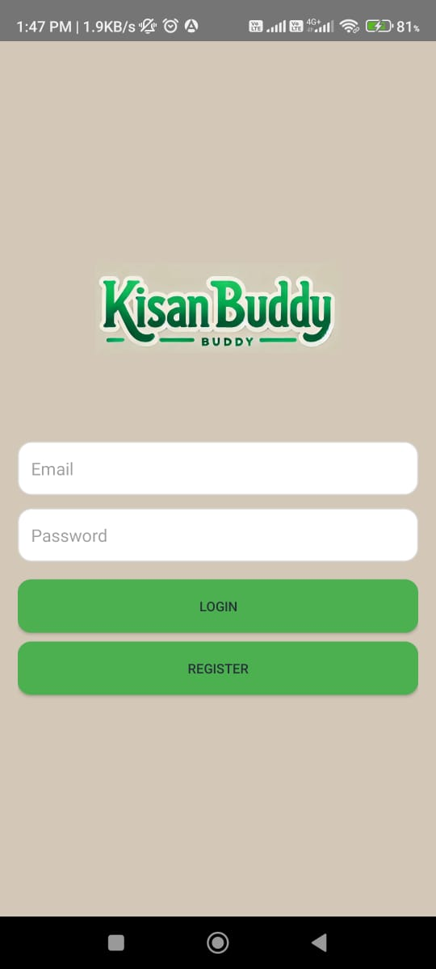
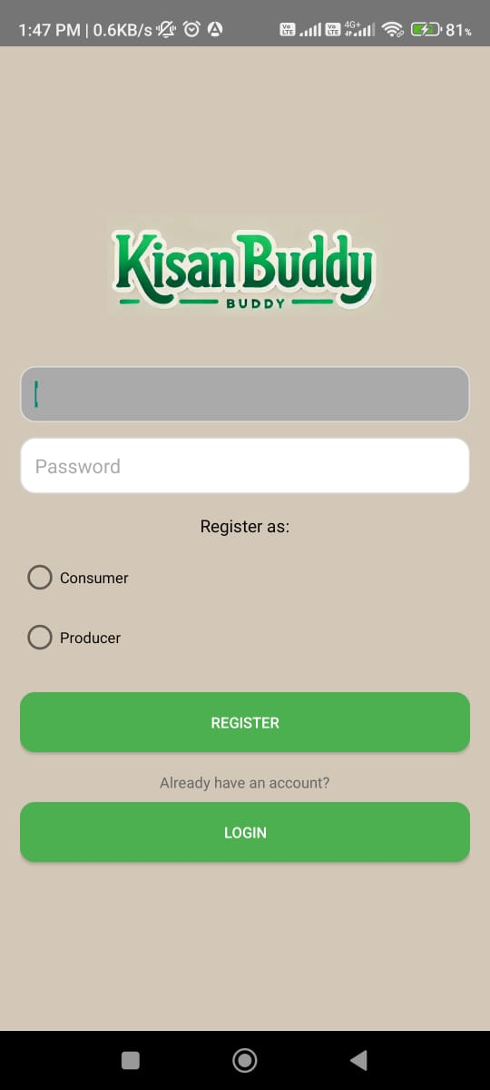
Proposed method (Contd..)

Slide 8
Objectives
Bridge the Gap Between Farmers and Consumers: Foster direct interactions between farmers and consumers, ensuring fair pricing and product quality.
Integrate Bidding and Price Matching: Create a platform where farmers can engage in competitive bidding and price negotiations for their produce.
Maximize Farmer Profits: Enable farmers to identify the nearest mandi offering the highest profit margin for their produce.
Provide Real-Time Market Data: Offer up-to-date pricing and bidding information to help farmers make informed selling decisions.
Enhance Product Transparency for Consumers: Allow consumers to check the quality of agricultural products and make purchases within their preferred price range.

Slide 9
Methodology
Splash Screen:
We’ve added a SplashActivity, which displays the splash screen when the app starts. After a delay of 3 seconds (3000 ms), it redirects to the Login activity.
User Authentication:
The app allows users to register with their email and password and then login using the same credentials.
Firebase Authentication has been integrated to handle user sign-ups, sign-ins, and session management.
Role Management:
During registration, the user is asked to select their role using a RadioGroup and RadioButton. The selected role is captured, and based on this role, you can implement role-specific functionalities (though these are not yet outlined in the current code).
Real-Time Database or Cloud Firestore (Future Integration):
Though not implemented in the shared code, once a user is authenticated, we could store additional details such as the user's profile, selected role, preferences, etc., using Firebase's Real-Time Database or Cloud Firestore.

Slide 10
Modules & Technologies
FireBase Authentication:
FirebaseAuth: Handles user registration and login with functions like “createUserWithEmailAndPassword()” and “signInWithEmailAndPassword()”.
EditText: Captures user inputs for email and password.
Session Management: Keeps track of the currently authenticated user during sessions.
UI Components:
Buttons: Triggers login and registration actions.
RadioGroup & RadioButton: Users select their role during registration.
Navigation: Managed through Intents to switch between Login, Registration, and Splash screens.
Error Handling: Uses “TextUtils.isEmpty()” to check for empty fields and displays error messages via Toast.

Slide 11
Modules contd..(Future Integration)
Dashboard Activity: Users access a personalized dashboard with role-specific features (e.g., market prices for farmers).
Role-Based Functionalities: Farmers get crop predictions; vendors manage orders, with custom interfaces.
Profile Management: Users can update contact or farm details, stored securely in Firebase Firestore.
Data Storage: Store user roles and preferences using Firebase Cloud Firestore or Realtime Database.
Push Notifications: Send market or weather alerts using Firebase Cloud Messaging (FCM).
Secure Authentication: Implement password recovery, MFA, and biometric login for security.

Slide 12
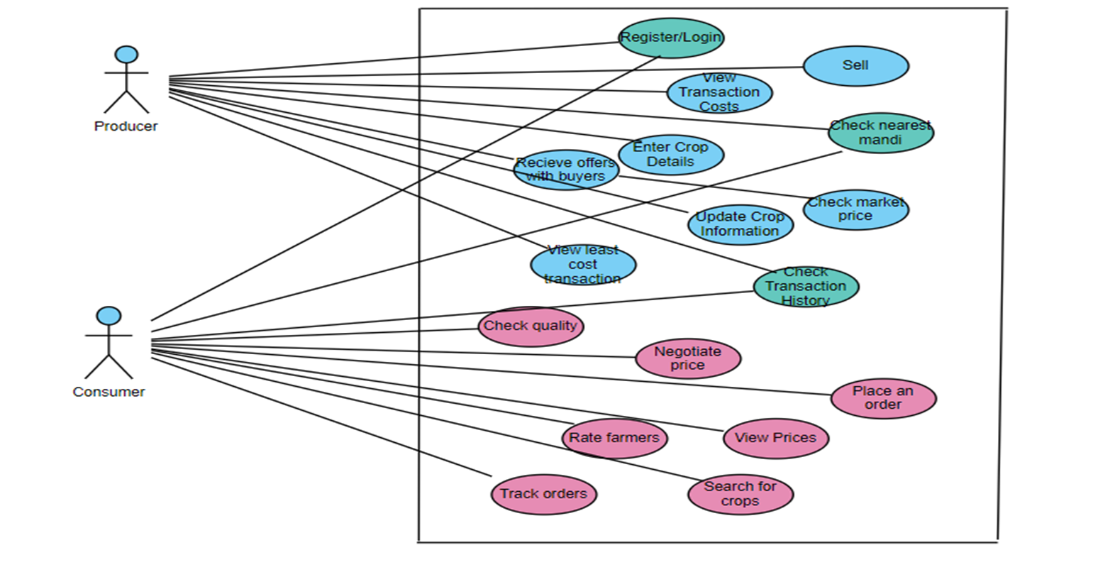
Architecture

Slide 13
Hardware/software components
Software:
Android Studio (version 4.2 or higher)
Firebase SDK (integrated with Android Studio)
Google Maps API Key (for accessing location services)
Hardware:
Smartphone/Tablet: Android 7.0 or higher for running and testing the app.
Laptop/PC: For development with Android Studio (minimum 8GB RAM and 10GB storage space).
Internet Connection: Required for Firebase and Google Maps services.

Slide 14
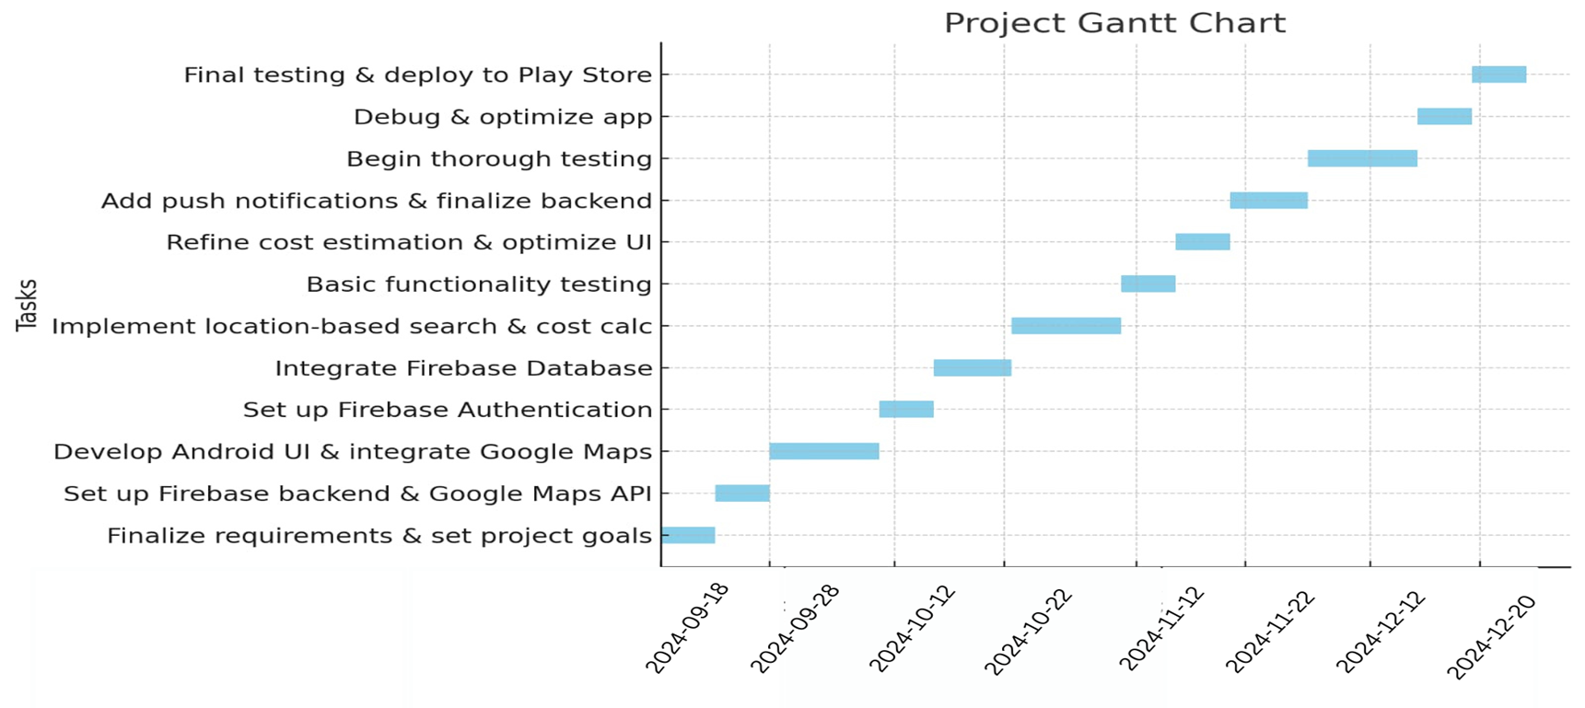
Timeline of Project

Slide 15
Expected Outcomes
Higher Farmer Profits
Better Market Access
Enhanced Consumer Buying
Improved Transportation
Smarter Decision-Making
Empowered Farmers

Slide 16
Conclusion
The Kisan Buddy app is designed to transform the agricultural marketplace by providing farmers with real-time price comparisons, transportation assistance, and direct access to consumers. The app enhances transparency in the mandi system, helping farmers maximize profits by connecting them to the most lucrative markets. Additionally, the app's image-based quality checking feature allows farmers and consumers to assess product quality visually, ensuring transparency and trust. By integrating these advanced features and leveraging technology, Kisan Buddy empowers farmers, improves consumer experience, and drives efficiency in the agricultural supply chain.

Slide 17
Github Link
Click here!!

Slide 18
References
"A Review on Smart Farming: Applications and Technologies"
Authors: B. K. Ghosh, S. B. Mandal
Link: IEEE Xplore
"Real-Time Price Prediction and Market Dynamics for Agricultural Products"
Authors: R. K. Gupta, A. Sharma
Link: IEEE Xplore
"Data-Driven Decision Making in Agriculture: An Overview of Techniques and Applications"
Authors: M. J. Davis, P. A. Williams
Link: IEEE Xplore
Optimization of Crop Supply Chain with Smart Farming Technologies"
Authors: J. M. Williams, L. Zhang
Link: IEEE Xplore

Slide 19
Project work mapping with SDG
SDG 1 – No Poverty: By helping farmers access better markets and maximize profits, the app supports economic growth, reduces poverty, and ensures farmers earn fair returns on their produce.
SDG 2 – Zero Hunger: The app improves the agricultural supply chain by providing farmers with better market access and price insights, which can help in ensuring food security and sustainable agriculture.
SDG 9 – Industry, Innovation, and Infrastructure: Integrating digital technologies, such as real-time bidding, price prediction, and quality checks, aligns with building resilient infrastructure and promoting innovation in the agricultural sector.
SDG 12 – Responsible Consumption and Production: By allowing consumers to check product quality and pricing, the app encourages responsible production and consumption practices, reducing waste and ensuring high-quality produce reaches consumers.

Slide 20
Thank You

