Slide 1
Kisan Buddy
PIP2001 Capstone Project
Review-2
Batch Number: 08
Under the Supervision of,
Dr. Srinivasan T R
Professor
School of Computer Science and Engineering
Presidency University
Student Name Roll Number
Shreya Paul - 20211CBD0002
K Faseeha Naaz - 20211CBD0012
Inzemam Quraishi - 20211CBD0026
Name of the Program: Computer Science and Engineering in Big Data.
Name of the HoD: Dr. Pravinthraja
Name of the Program Project Coordinator: Ms. Suma N G
Name of the School Project Coordinators: Dr. Sampath A K / Dr. Abdul Khadar A / Mr. Md Ziaur Rahman

Slide 2
Introduction
App Overview:
Kisan Buddy connects farmers with local mandis to maximize profit and offers consumers a platform to purchase high-quality products within their budget.
Unique Features:
Real-time Bidding & Price Matching: Ensures competitive pricing for farmers.
Market Insights: Provides farmers with current market trends and price analytics.
Profit Maximization: Helps farmers choose the optimal selling point.
Transportation Assistance: Offers solutions for transporting produce.
Consumer-focused Features: Allows consumers to check product quality and set desired price ranges for purchases.

Slide 3
Objectives
Bridge the Gap Between Farmers and Consumers: Foster direct interactions between farmers and consumers, ensuring fair pricing and product quality.
Integrate Bidding and Price Matching: Create a platform where farmers can engage in competitive bidding and price negotiations for their produce.
Maximize Farmer Profits: Enable farmers to identify the nearest mandi offering the highest profit margin for their produce.
Provide Real-Time Market Data: Offer up-to-date pricing and bidding information to help farmers make informed selling decisions.
Enhance Product Transparency for Consumers: Allow consumers to check the quality of agricultural products and make purchases within their preferred price range.

Slide 4
Existing method Drawback
Gaps Identified
No real-time bidding or dynamic pricing mechanisms.
Limited market insights and analytics.
Lack of integrated transportation solutions.
Basic profit calculations without advanced tools.

Slide 5
Proposed Method
Real-Time Bidding: Dynamic pricing through consumer bids.
Price Range Setting: Consumers set prices; farmers choose the best offer.
Transportation Assistance: Logistics support for delivering crops.
Profit Maximization Tools: Calculations based on bids, costs, and market conditions.
Impact
Enhances price competitiveness.
Provides data-driven decision-making.
Optimizes farmers’ profits and streamlines logistics.

Slide 6
Hardware/software components
Software:
Android Studio (version 4.2 or higher)
Firebase SDK (integrated with Android Studio)
Google Maps API Key (for accessing location services)
Hardware:
Smartphone/Tablet: Android 7.0 or higher for running and testing the app.
Laptop/PC: For development with Android Studio (minimum 8GB RAM and 10GB storage space).
Internet Connection: Required for Firebase and Google Maps services.

Slide 7
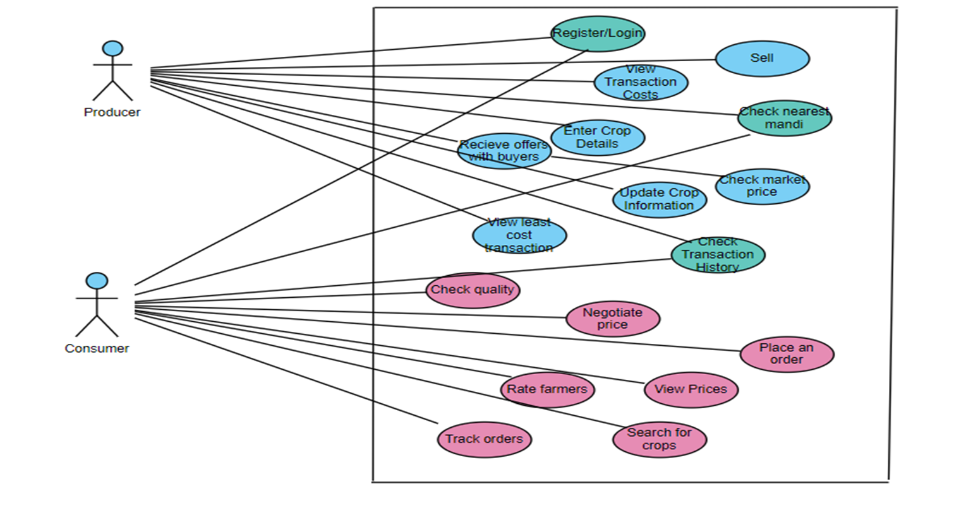
Architecture

Slide 8
Methodology
Splash Screen:
We’ve added a SplashActivity, which displays the splash screen when the app starts. After a delay of 3 seconds (3000 ms), it redirects to the Login activity.
User Authentication:
The app allows users to register with their email and password and then login using the same credentials.
Firebase Authentication has been integrated to handle user sign-ups, sign-ins, and session management.
Role Management:
During registration, the user is asked to select their role using a RadioGroup and RadioButton. The selected role is captured, and based on this role, you can implement role-specific functionalities (though these are not yet outlined in the current code).
Real-Time Database or Cloud Firestore (Future Integration):
Though not implemented in the shared code, once a user is authenticated, we could store additional details such as the user's profile, selected role, preferences, etc., using Firebase's Real-Time Database or Cloud Firestore.

Slide 9
Modules
1. User Authentication and Profile Management
Purpose: Ensures secure access and personalized experiences for users.
Key Features:
User Registration
Secure Login
Profile Customization
Role-Based Access
Account Security
2. Product Listing and Management
Purpose: Enables producers to showcase their crops effectively for potential buyers.
Key Features:
Product Addition
Inventory Management
Quality Assurance
Availability Indicators - Producers can mark items as available, sold out, or under negotiation.

Slide 10
Modules (Contd..)
3. Product Browsing and Search
Purpose: Helps consumers find the products they need efficiently.
Key Features:
Search Functionality
Advanced Filters
Sorting Options
Product Details View
4. Bidding and Price Negotiation
Purpose: Facilitates dynamic pricing for the mutual benefit of producers and consumers.
Key Features:
Initiate Bids
Counter Offers
Real-Time Updates
Time-Limited Offers

Slide 11
Modules (Contd..)
5. Price Comparison and Cost Estimation
Purpose: Helps users make informed financial decisions.
Key Features:
Price Comparison
Transportation Cost Calculator
Profit Estimation for Producers
Dynamic Updates
6. Mandi Price and Location Management
Purpose: Provides market intelligence for producers and consumers.
Key Features:
Real-Time Mandi Prices
Profitable Options
Location Tracking

Slide 12
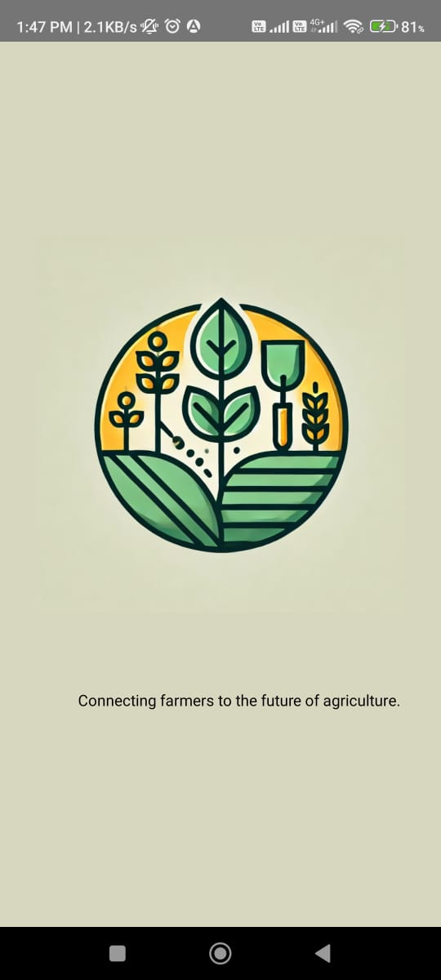
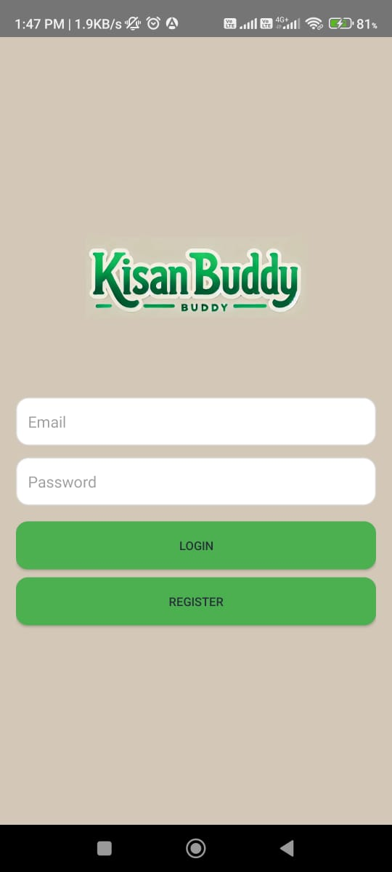
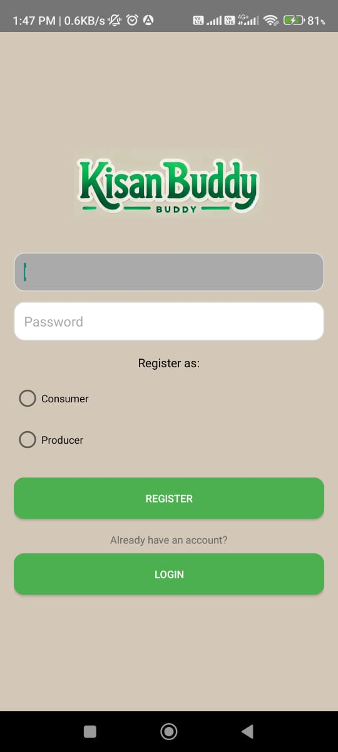
Output

Slide 13
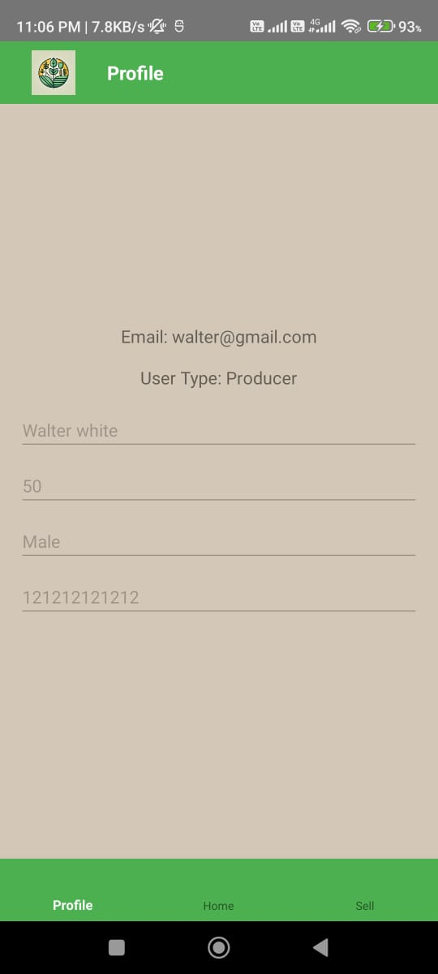
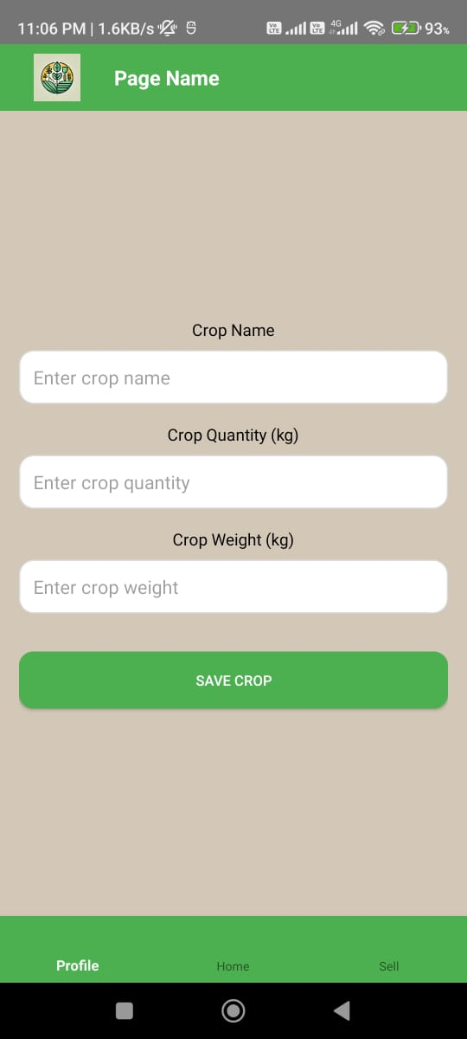
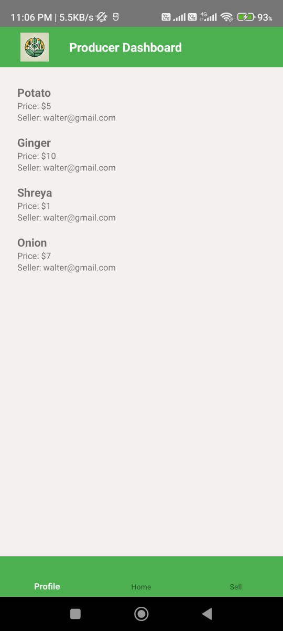
Output

Slide 14
Github Link
Click here!!

Slide 15
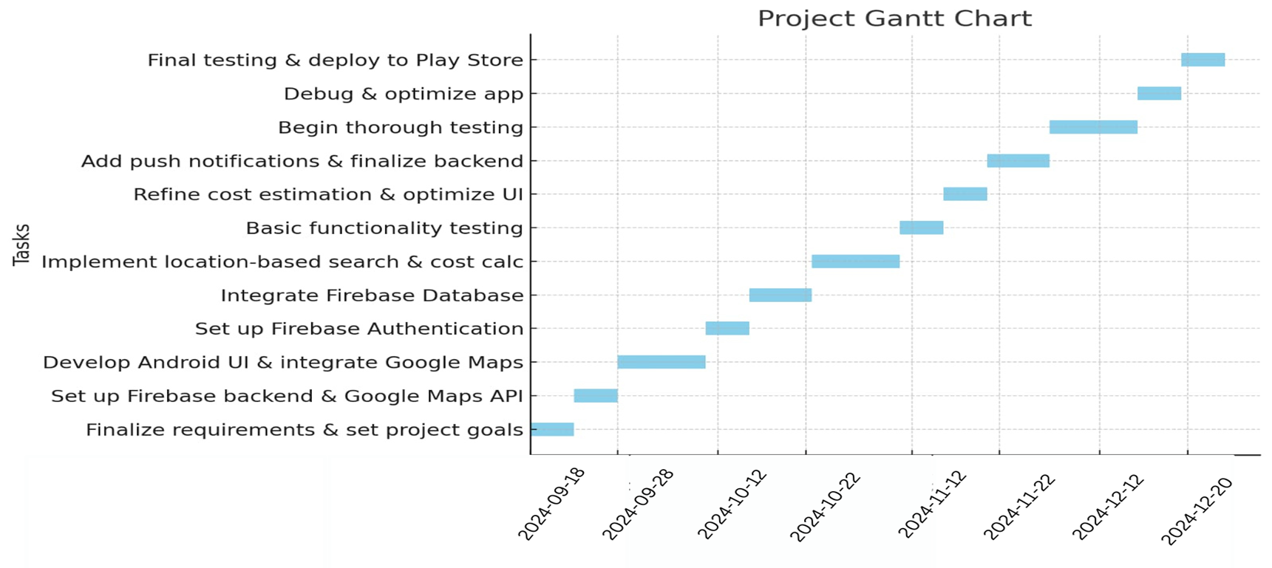
Timeline of Project

Slide 16
Conclusion
The Kisan Buddy app is designed to transform the agricultural marketplace by providing farmers with real-time price comparisons, transportation assistance, and direct access to consumers. The app enhances transparency in the mandi system, helping farmers maximize profits by connecting them to the most lucrative markets. Additionally, the app's image-based quality checking feature allows farmers and consumers to assess product quality visually, ensuring transparency and trust. By integrating these advanced features and leveraging technology, Kisan Buddy empowers farmers, improves consumer experience, and drives efficiency in the agricultural supply chain.

Slide 17
References
B. Ahmed, H. Shabbir, S. R. Naqvi, and L. Peng, "Smart Agriculture: Current State, Opportunities, and Challenges," in IEEE Access, vol. 12, pp. 144456-144478, 2024, Doi: 10.1109/ACCESS.2024.3471647.
K. Chicaiza, R. X. Paredes, I. M. Sarzosa, S. G. Yoo and N. Zang, "Smart Farming Technologies: A Methodological Overview and Analysis," in IEEE Access, vol. 12, pp. 164922-164941, 2024, doi: 10.1109/ACCESS.2024.3487497.
S. Vashista, A. K. Dubey, A. Goyal, and R. Vashisth, "Design and Implementation of AI-based Kisan Se Kisan Tak (KSKT) Mobile App," 2022 International Mobile and Embedded Technology Conference (MECON), Noida, India, 2022, pp. 408-413, doi: 10.1109/MECON53876.2022.9752052.
T. Yadav, P. Sable and D. Kalbande, "SMART KISAN: A Mobile App for Farmers' Assistance in Agricultural Activities," 2023 International Conference on Smart Systems for applications in Electrical Sciences (ICSSES), Tumakuru, India, 2023, pp. 1-6, doi: 10.1109/ICSSES58299.2023.10199471.
M. J. Bisheko and R. G, "A study on farmers' perceptions about the scope of the Kisan Suvidha App in improving agricultural sustainability," 2023 Conference on Information Communications Technology and Society (ICTAS), Durban, South Africa, 2023, pp. 1-5, doi: 10.1109/ICTAS56421.2023.10082741.

Slide 18
Project work mapping with SDG
SDG 1 – No Poverty: By helping farmers access better markets and maximize profits, the app supports economic growth, reduces poverty, and ensures farmers earn fair returns on their produce.
SDG 2 – Zero Hunger: The app improves the agricultural supply chain by providing farmers with better market access and price insights, which can help in ensuring food security and sustainable agriculture.
SDG 9 – Industry, Innovation, and Infrastructure: Integrating digital technologies, such as real-time bidding, price prediction, and quality checks, aligns with building resilient infrastructure and promoting innovation in the agricultural sector.
SDG 12 – Responsible Consumption and Production: By allowing consumers to check product quality and pricing, the app encourages responsible production and consumption practices, reducing waste and ensuring high-quality produce reaches consumers.

Slide 19
Thank You

