Slide 1
Kisan Buddy
PIP2001 Capstone Project
Review-0
Batch Number: 08
Under the Supervision of,
Dr. Srinivas T R
Professor
School of Computer Science and Engineering
Presidency University
Roll Number Student Name
Shreya Paul - 20211CBD0002
K Faseeha Naaz - 20211CBD0012
Inzemam Quraishi - 20211CBD0026
Name of the Program: Computer Science and Engineering in Big Data.
Name of the HoD: Dr. Pravinthraja
Name of the Program Project Coordinator: Ms. Suma N G
Name of the School Project Coordinators: Dr. Sampath A K / Dr. Abdul Khadar A / Mr. Md Ziaur Rahman

Slide 2
Content
Problem Statement
Github Link
Analysis of Problem Statement
Timeline of the Project
References

Slide 3
Problem Statement Number: PSCS226
Organization : Mahindra & Mahindra (FarmEq)
Category: Software
Problem Description: Input to the app: Farmer's location, crops he produces, and cost. This app gives the estimate of the nearest mandi where the farmer can sell his produce in his location while earning the maximum profit. In addition, the app allows consumers to check the quality of products and buy them in their desired price range.
Objectives of Kisan Buddy App
Integrate real-time bidding and price-matching.
Offer market insights, profit maximization, and transportation assistance.
Difficulty Level: Simple

Slide 4
Github Link
https://github.com/Faseeha-naaz/Kisan-Buddy

Slide 5
Analysis of Problem Statement
Current Existing Solutions :
Existing Agricultural Apps
Crop Advisory: Best practices and cultivation tips.
Market Prices: Static price information for crops.
Weather Forecasts: Predictions and alerts.
Government Schemes: Information on subsidies and financial assistance.

Slide 6
Analysis of Problem Statement
Gaps Identified
No real-time bidding or dynamic pricing mechanisms.
Limited market insights and analytics.
Lack of integrated transportation solutions.
Basic profit calculations without advanced tools.

Slide 7
Analysis of Problem Statement
Key Features
Real-Time Bidding: Dynamic pricing through consumer bids.
Price Range Setting: Consumers set prices; farmers choose the best offer.
Transportation Assistance: Logistics support for delivering crops.
Profit Maximization Tools: Calculations based on bids, costs, and market conditions.
Impact
Enhances price competitiveness.
Provides data-driven decision-making.
Optimizes farmers’ profits and streamlines logistics.

Slide 8
Analysis of Problem Statement (contd...)
Technology Stack Components:
Frontend:
Platform: Android Studio (Java/Kotlin)
UI/UX: XML layouts, Google Maps for location-based UI.
Backend:
Database: Firebase Realtime Database for storing mandi locations, crop prices, and transaction details.
Cloud Services: Firebase for authentication, data storage.
API: Google Maps API for geolocation and mapping nearest mandis.

Slide 9
Analysis of Problem Statement (contd...)
Software and Hardware Requirements:
Software:
Android Studio (version 4.2 or higher)
Firebase SDK (integrated with Android Studio)
Google Maps API Key (for accessing location services)
Hardware:
Smartphone/Tablet: Android 7.0 or higher for running and testing the app.
Laptop/PC: For development with Android Studio (minimum 8GB RAM and 10GB storage space).
Internet Connection: Required for Firebase and Google Maps services.

Slide 10
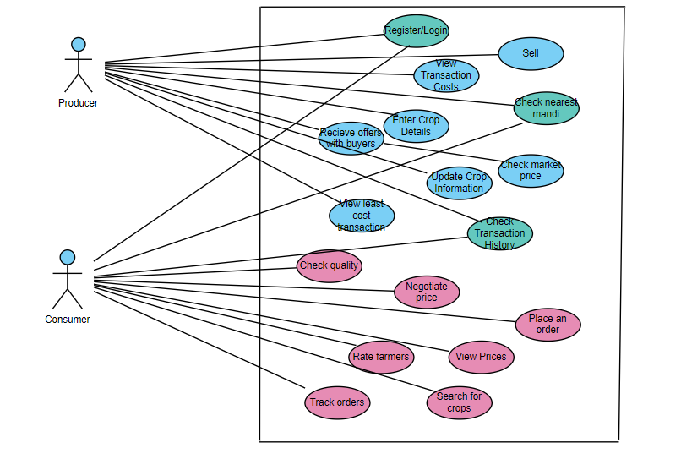
Use Case diagram
.

Slide 11
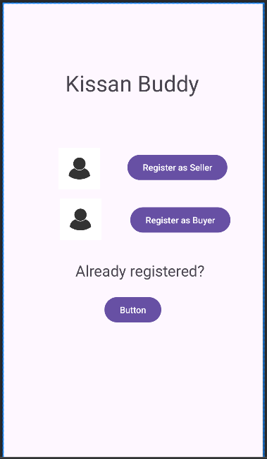
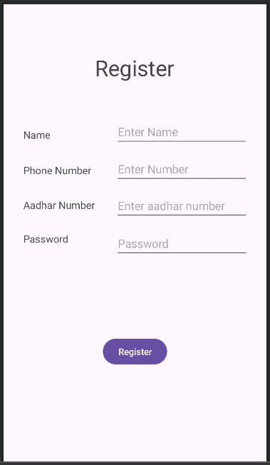
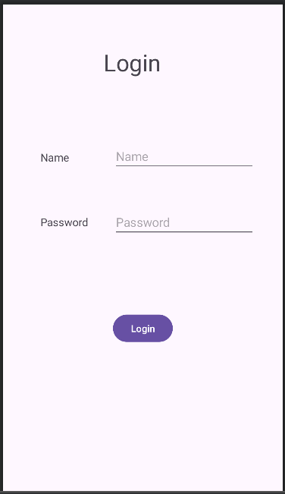
Prepared Plan
.

Slide 12
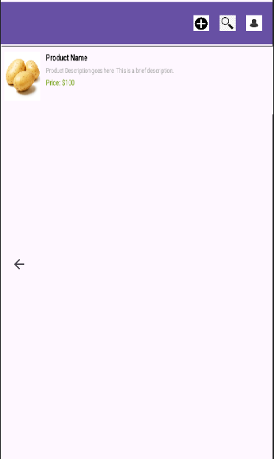
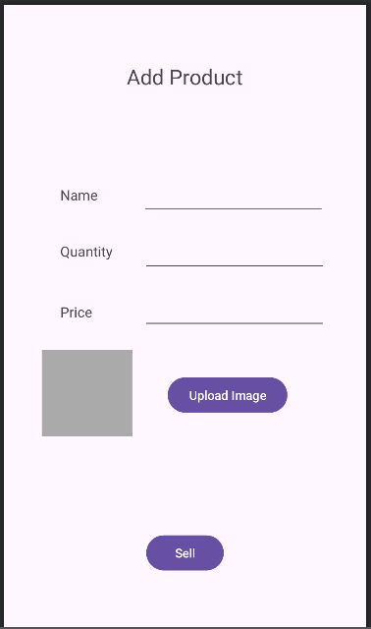
Prepared Plan (Cont..)
.

Slide 13
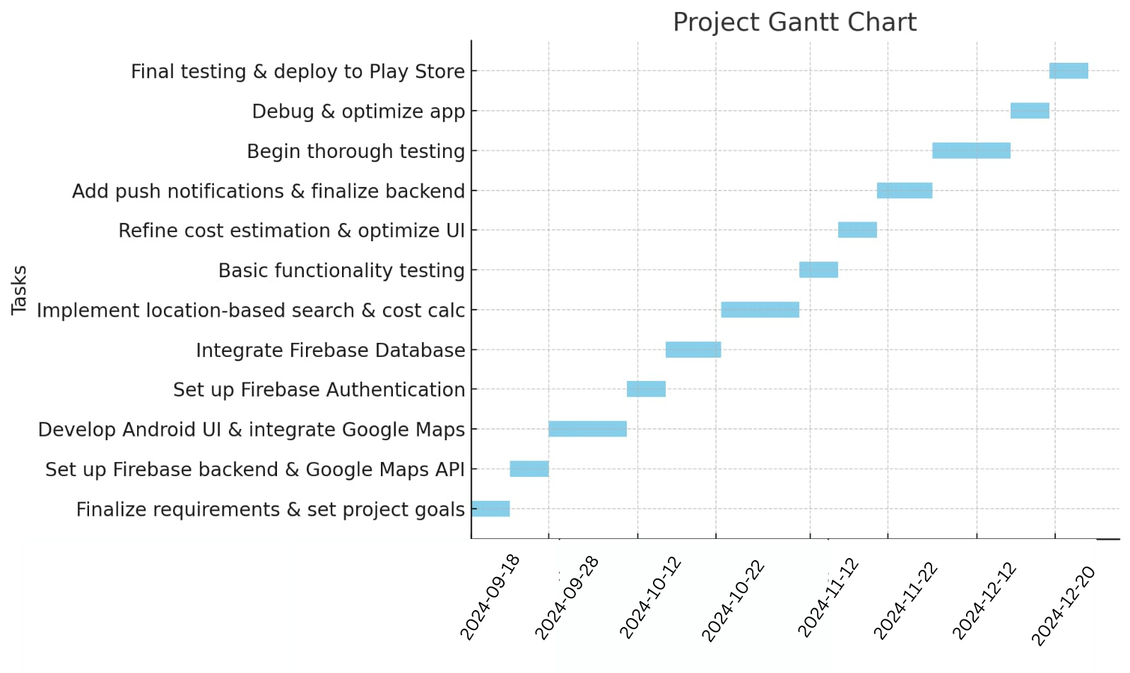
Timeline of the Project (Gantt Chart)
.

Slide 14
References (IEEE Paper format)
"A Review on Smart Farming: Applications and Technologies"
Authors: B. K. Ghosh, S. B. Mandal
Link: IEEE Xplore
"Real-Time Price Prediction and Market Dynamics for Agricultural Products"
Authors: R. K. Gupta, A. Sharma
Link: IEEE Xplore
"Data-Driven Decision Making in Agriculture: An Overview of Techniques and Applications"
Authors: M. J. Davis, P. A. Williams
Link: IEEE Xplore
Optimization of Crop Supply Chain with Smart Farming Technologies"
Authors: J. M. Williams, L. Zhang
Link: IEEE Xplore

Slide 15


