Slide 1
Modeling kernels

Slide 2



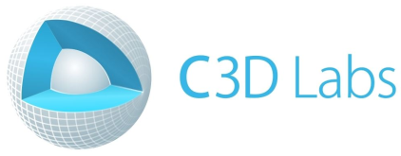


Kernels on the market
ACIS
Parasolid
CGM
C3D
RGK
SMLib
OpenCascade

Slide 3
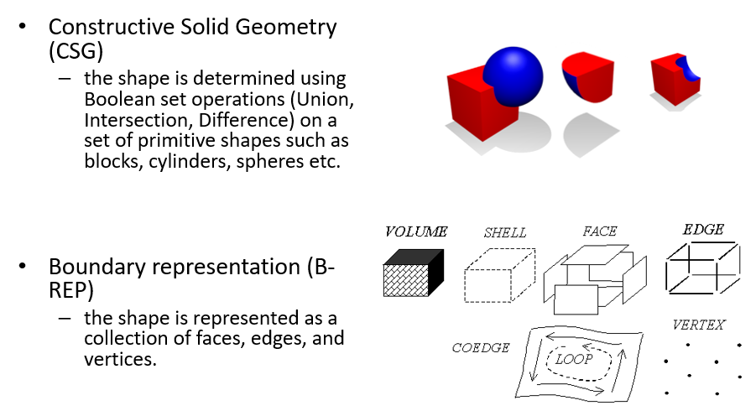
Exact reps

Slide 4
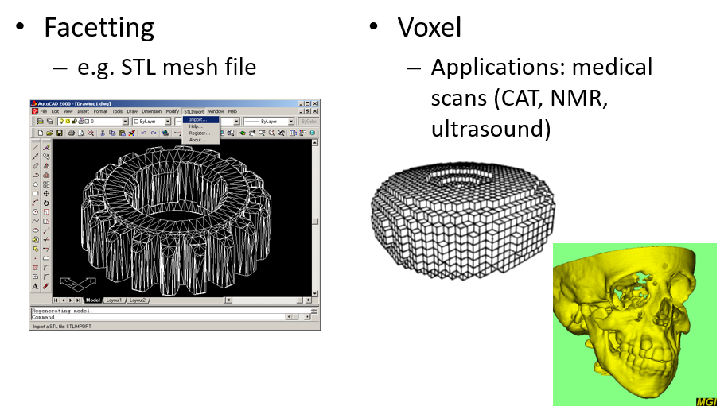
Inexact reps

Slide 5
ISO 10303, part 42
This part of ISO 10303 [part 42] specifies the resource constructs for the explicit geometric and topological representation of the shape of a product. The scope is determined by the requirements for the explicit representation of an ideal product model; tolerances and implicit forms of representation in terms of features are out of scope.

Slide 6
Why B-Rep?
Boundary modelers are currently dominating the CAD/CAM market. Why is it so? The short answer to this question as defined in [5]:
WYSIWYG: every EDGE and FACE displayed on the screen is explicitly held in the model’s data structure, making the editing and interrogation of objects straightforward. This may appear to be a trivial point but it makes the attachment of attributes, such as machining tolerances, to elements very easy.

Slide 7
But…
It is extremely hard to build a robust modeler. In general, the following criteria are used to assess every single algorithm:
Accuracy
Robustness
Efficiency
(*) Intelligence
Moreover, there should be ENOUGH algorithms to allow for general-purpose geometric modeling.

Slide 8
Meet OpenCascade

Slide 9
What is OpenCascade?
«Although there are facilities for displaying graphics in Open CASCADE, the real function of the library is to do the math. There are dozens of graphics libraries (if not hundreds), but there are very few solid modeling libraries, and Open CASCADE is the only open source solid modeler»
(our forum).

Slide 10
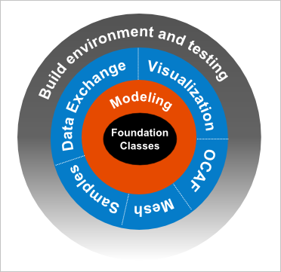
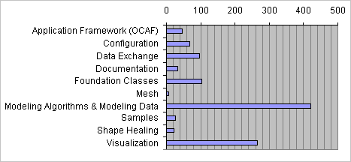
Modules
Math support (CAGD)
Modeling (CAGD + CAD)
Data exchange
Faceter → Visualization
Services

Slide 11
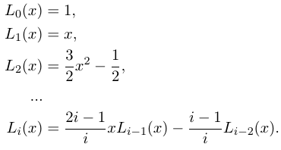
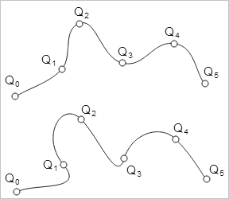

Math support
Linear algebra
Solvers
Eigen values & vectors
SVD
Optimization
Newton, BFGS, FRPR, Powell
PSO
Approximation and interpolation
By points or sections (discrete data)
By continuous function (e.g. from offset surface to polynomial)

Slide 12
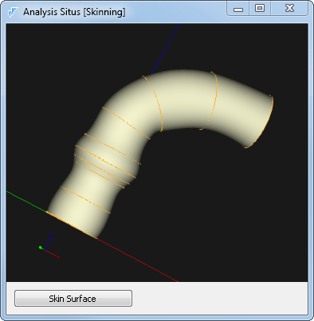
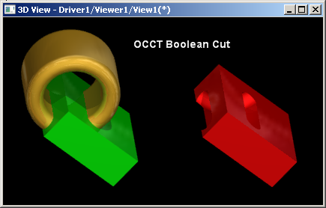
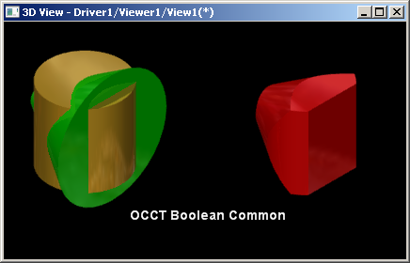
Modeling
Surface
Kinematic surfaces
Skinning
…
Solid
Prism
Draft
Thin-walled solid
Booleans
…

Slide 13
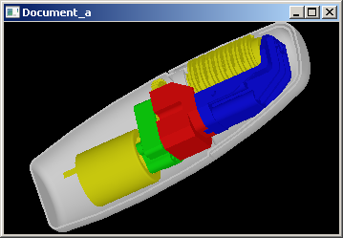
Data exchange
Format:
Exact: STEP (ISO 10303), IGES
Polygonal: STL, VRML, OBJ, glTF
Data:
Geometry
Meta (assemblies, colors, names, attributes, etc.)

Slide 14
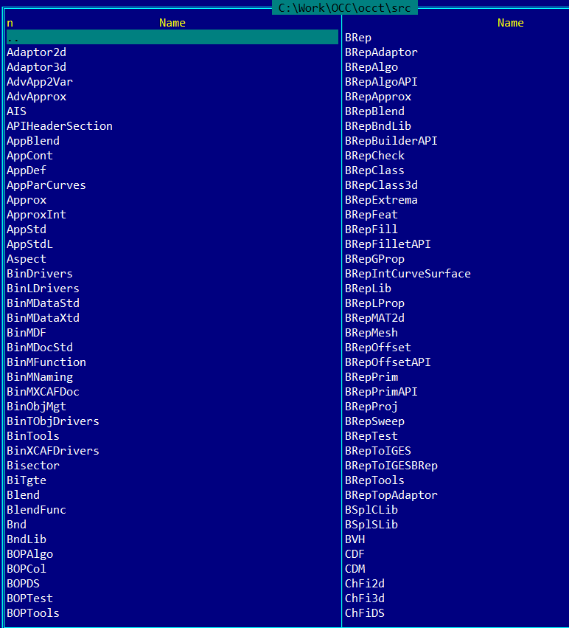
In filesystem
Package 1 / Class 1
Package 1 / Class 2
Package 2 / Class 1
Package 2 / Class 2
…

Slide 15
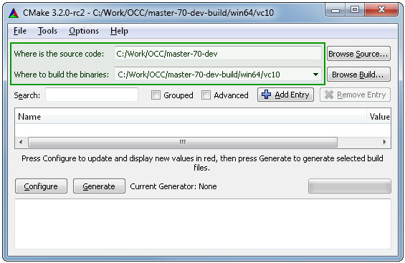
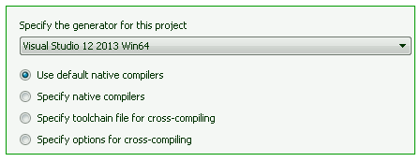
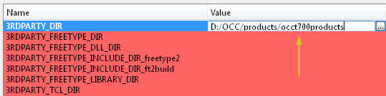
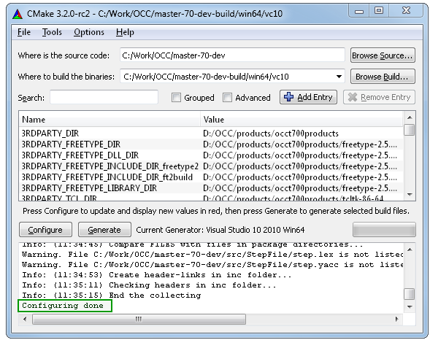
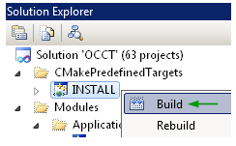
Build with CMake
2
1
4
3
5

Slide 16
Interesting reading
An Introduction to Solid Modeling. M. Mantyla. 1988.
The NURBS Book. L. Piegl, W. Tiller.
Solid Modelling and CAD Systems. How to Survive a CAD System. I. Stroud. 2011.
Open Cascade Technology Overview // URL: http://isicad.net/articles.php?article_num=17368
3D Modelling with ACIS. Corney J.R., Lim T. 2001.

Slide 17
Hello World

Slide 18
Entry point: Draw
Tcl interpreter with extensions
Access to the entire modeling API
Rapid prototyping

Slide 19
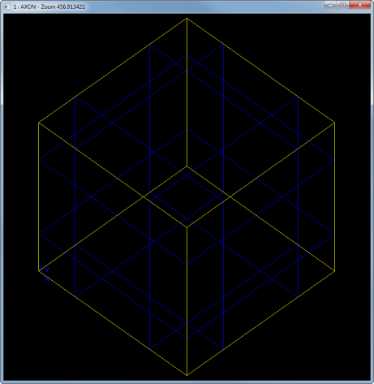
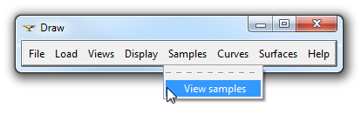
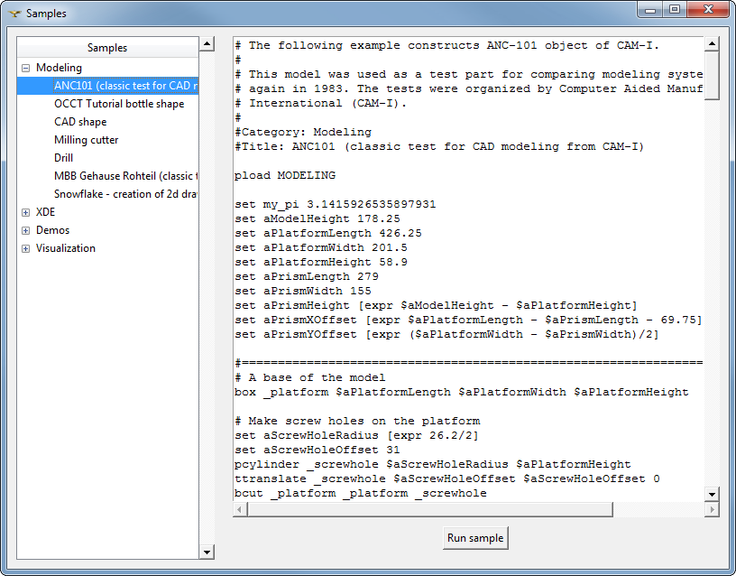
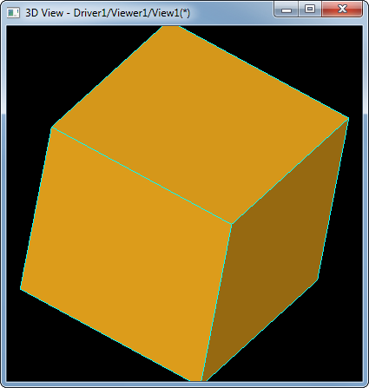
Basic commands
1
3
> pload ALL
> box a 1 1 1
> axo; fit
2
> vinit
> vdisplay a
>> f
>> s
>> Ctrl + RMB

Slide 20
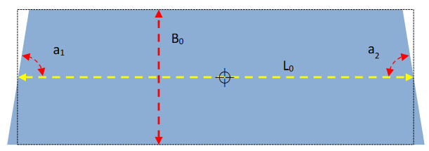
Prismatic block
proc buildBlock {resname L0 B0 a1Deg a2Deg height} {
global $resname
set Pi 3.1415926535897931
# Design variables.
set a1 [expr $a1Deg.*$Pi/180.]
set a2 [expr $a2Deg.*$Pi/180.]
set V1x [expr -$L0/2 - tan($a1)*$B0/2]
set V1y 0
set V2x [expr $L0/2 + tan($a2)*$B0/2]
set V2y 0
set V3x [expr $L0/2 - tan($a2)*$B0/2]
set V3y $B0
set V4x [expr -$L0/2 + tan($a1)*$B0/2]
set V4y $B0
# Build topology.
vertex V1 $V1x $V1y 0.
vertex V2 $V2x $V2y 0.
vertex V3 $V3x $V3y 0.
vertex V4 $V4x $V4y 0.
#
edge e1 V2 V1
edge e2 V1 V4
edge e3 V4 V3
edge e4 V3 V2
wire w e1 e2 e3 e4
mkplane f w
#
prism $resname f 0 0 $height
}
# pload ALL
# source C:/Work/lendlease/demo-ssv/create-block-01.tcl
# buildBlock b 130 60 20 45 30
# top; fit
V3
V4
V1
V2

Slide 21
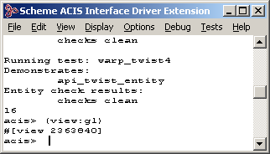
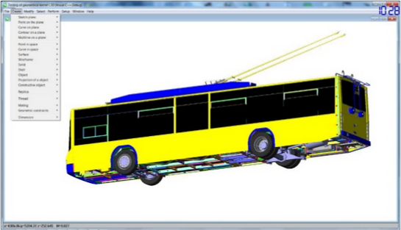
Similar things
ACIS Scheme AIDE
C3D Test Application
It is never a CAD-system, just a console or test app.

Slide 22
How to build a simple app?
Options
Your main() function // No visualization
Executable with Draw // .exe
Plugin for Draw // .dll

Slide 23
Understanding B-rep

Slide 24
Geometry vs Topology
“To solve many of geometric problems we do not need to know spatial information but what is required to be known is neighborhood or connectivity information termed as topology.” Sandip Jadhav

Slide 25
ISO 10303-42 says
The geometry … is exclusively the geometry of parametric curves and surfaces. It includes the curve and surface entities and other entities, functions and data types necessary for their definition. A common scheme has been used for the definition of both two-dimensional and three-dimensional geometry.
The topology … is concerned with connectivity relationships between objects rather than with the precise geometric form of objects. This clause contains the basic topological entities and specialised subtypes of these. In some cases the subtypes have geometric associations. Also included are functions, particularly constraint functions, and data types necessary for the definitions of the topological entities.

Slide 26
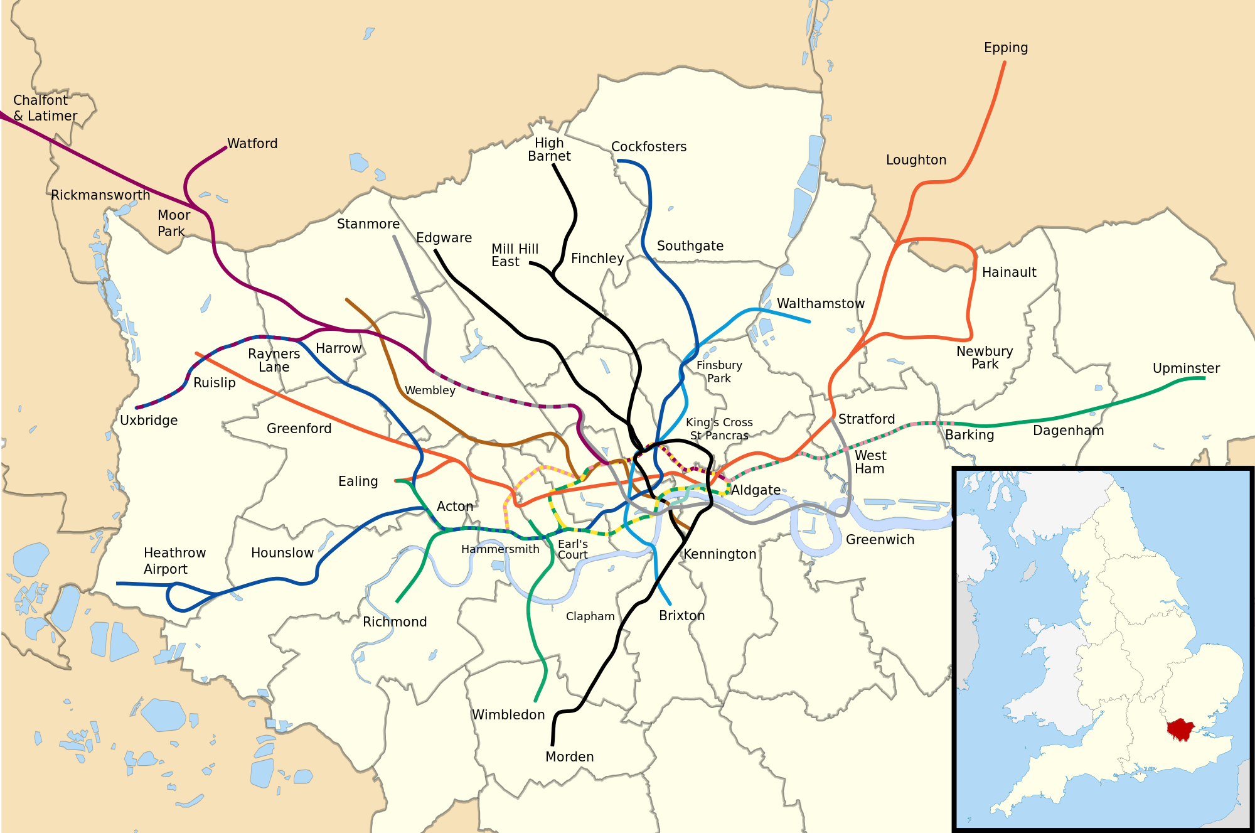

Geometry vs Topology

Slide 27
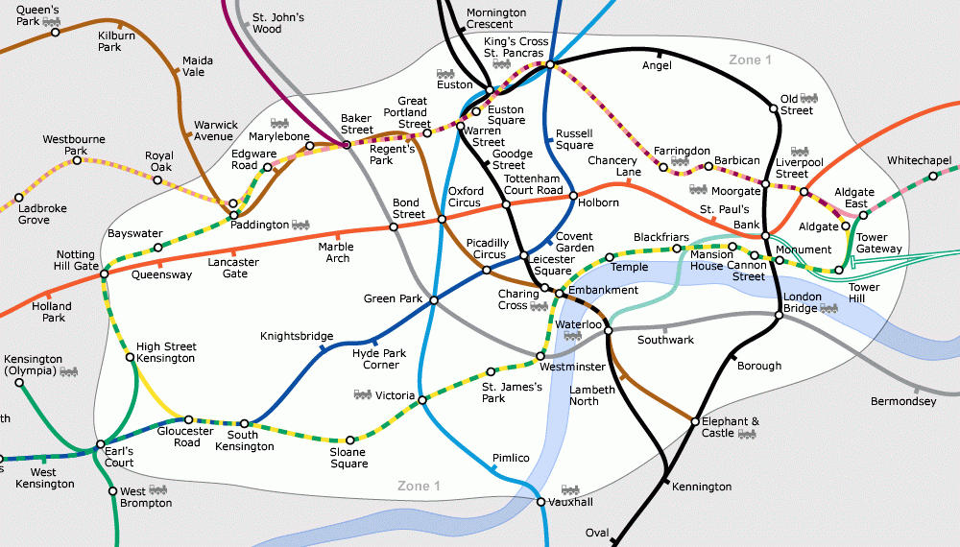
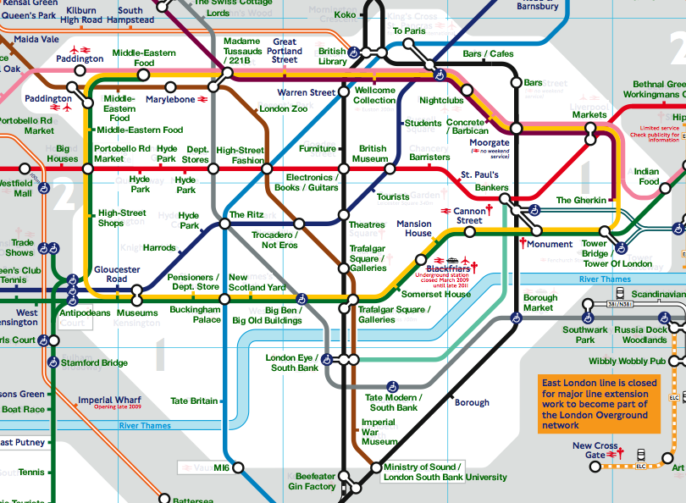
Geometry vs Topology
Geometry = real locations
Topology = connections

Slide 28
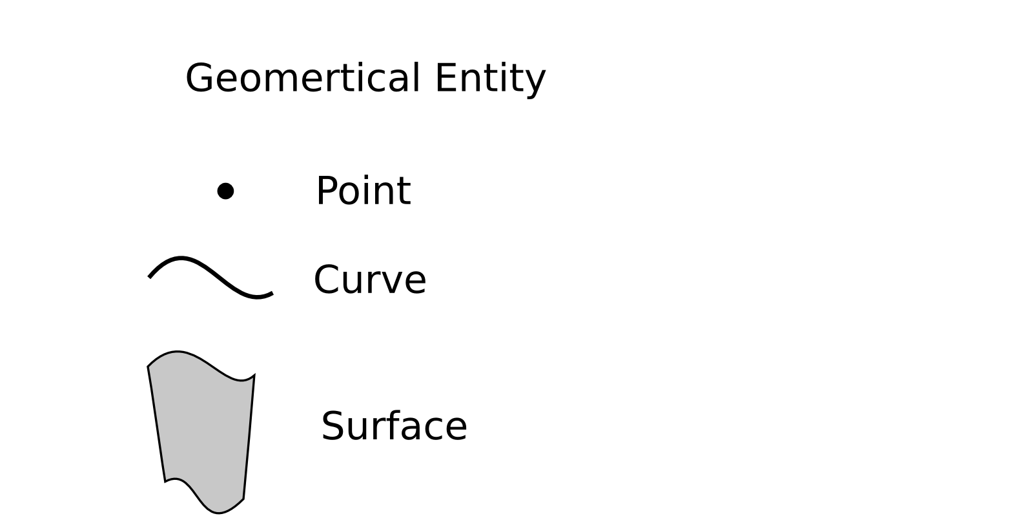
Geometry vs Topology

Slide 29
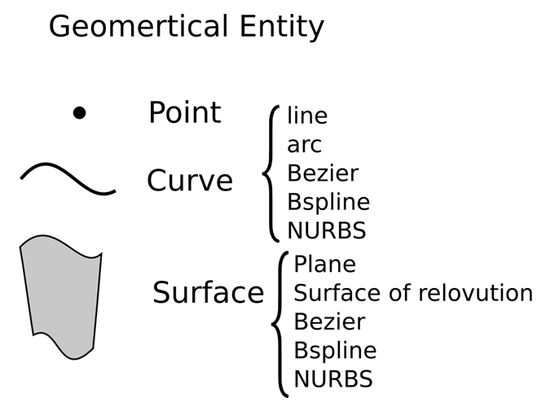
Geometry vs Topology

Slide 30
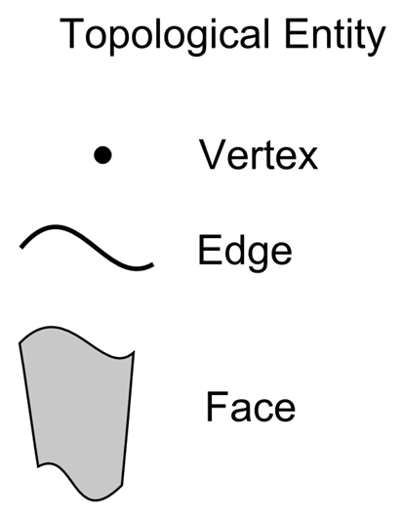
Geometry vs Topology

Slide 31
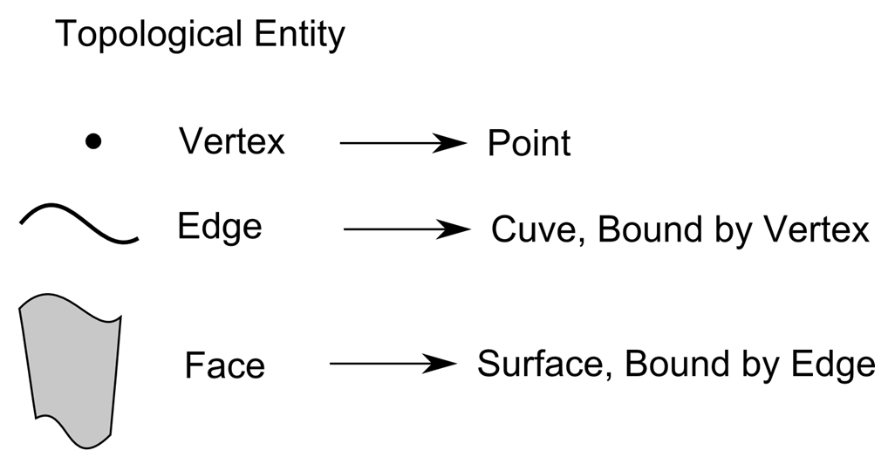
Geometry vs Topology

Slide 32
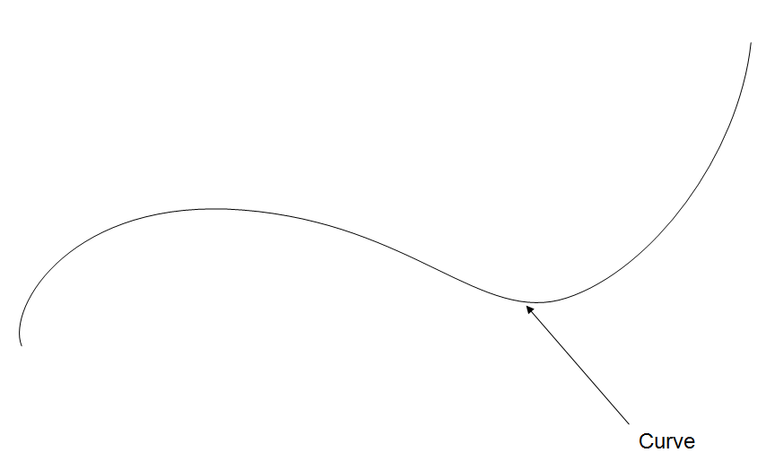
Geometry vs Topology

Slide 33
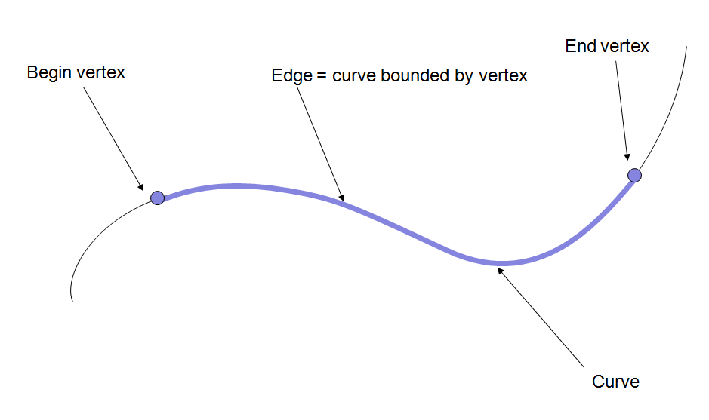
Geometry vs Topology

Slide 34
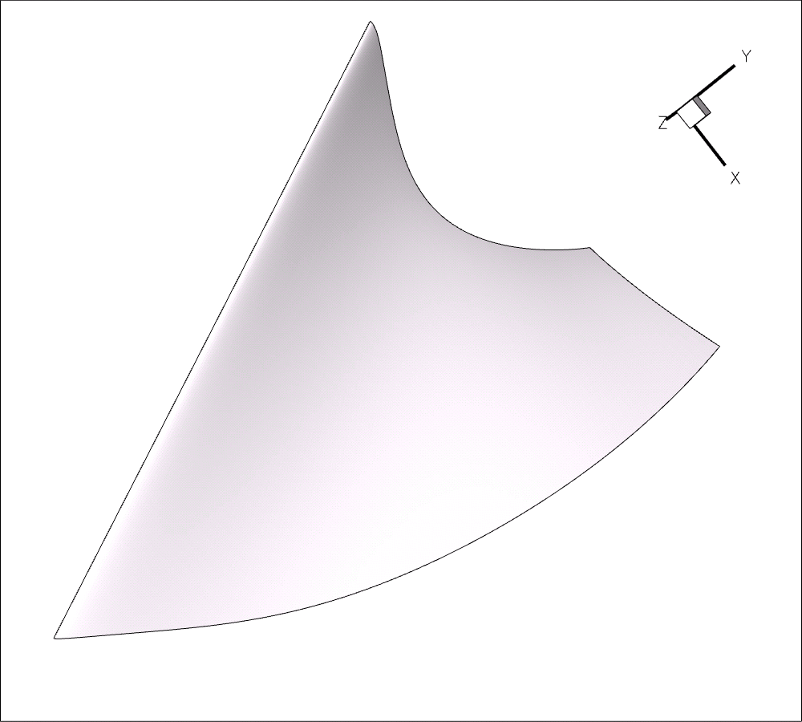
Geometry vs Topology

Slide 35
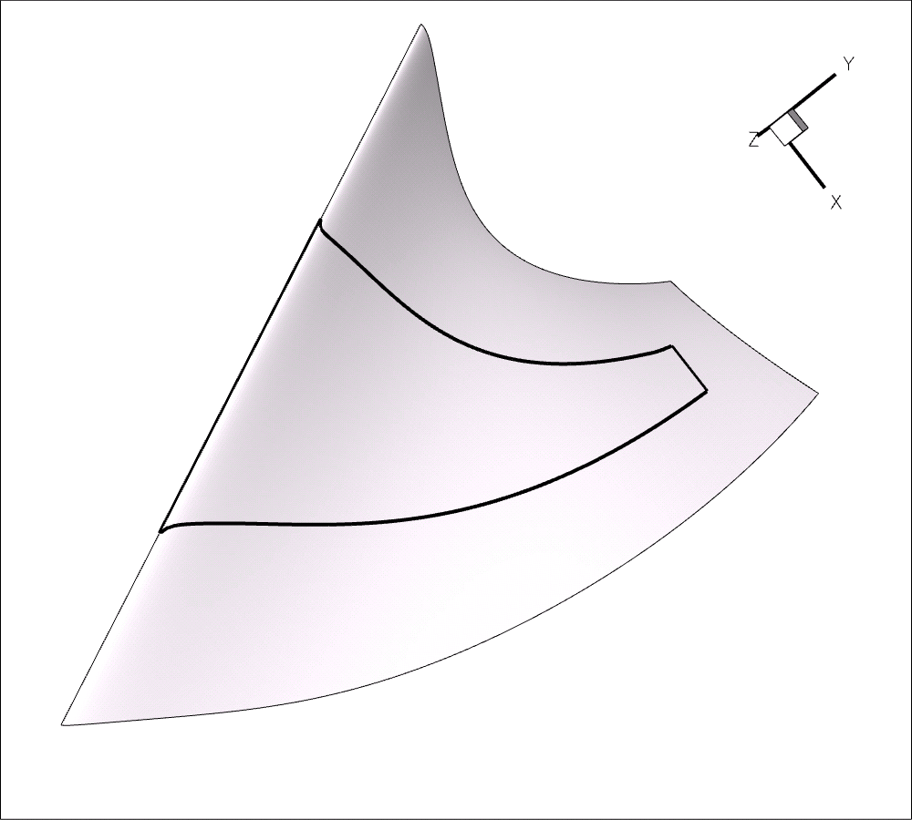
Geometry vs Topology

Slide 36
Geometry vs Topology
VERTEX
FACE
EDGE

Slide 37
Реализация в OpenCascade
Geom
TopoDS
Geom2d

Slide 38
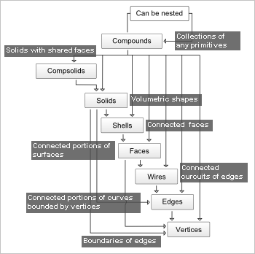
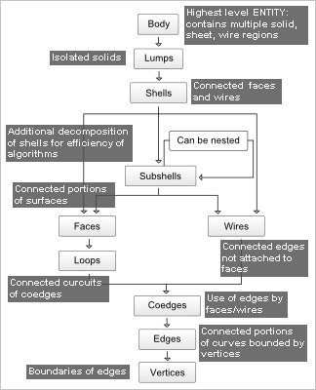
OpenCascade vs ACIS

Slide 39
Assemblies and data exchange

Slide 40
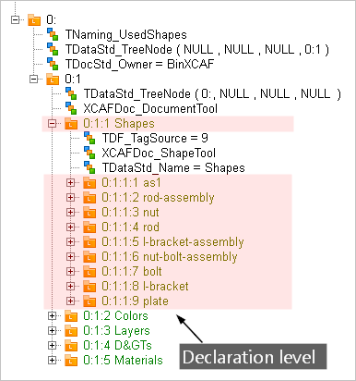
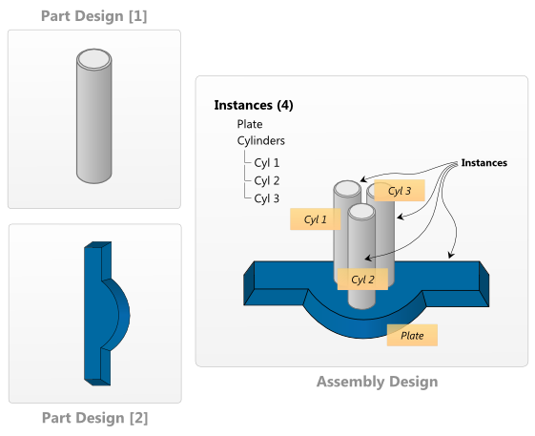
Assemblies
Geometry: TopoDS
Assemblies and meta: XDE/OCAF

