Slide 1
OCAF: OpenCascade Application Framework
Sergey Slyadnev

Slide 2
Training contents
OCAF fundamentals

Slide 3
Training contents
OCAF fundamentals
Object interfaces

Slide 4
Training contents
OCAF fundamentals
Object interfaces
Custom attributes

Slide 5

Global view
Open-source 3D modeling kernel
Data exchange
Solid and surface modeling
Application framework
Visualization services

Slide 6
OCAF fundamentals

Slide 7
OCAF fundamentals / Introduction
The motivation behind OCAF is to free a software developer from implementing (and re-implementing (and re-implementing (…))) the very basic functionality often demanded in engineering applications. Examples:

Slide 8
OCAF fundamentals / Introduction
The motivation behind OCAF is to free a software developer from implementing (and re-implementing (and re-implementing (…))) the very basic functionality often demanded in engineering applications. Examples:
Enriching B-Rep with attributes (colors, names, boundary conditions, etc.)

Slide 9
OCAF fundamentals / Introduction
The motivation behind OCAF is to free a software developer from implementing (and re-implementing (and re-implementing (…))) the very basic functionality often demanded in engineering applications. Examples:
Enriching B-Rep with attributes (colors, names, boundary conditions, etc.)
Application/Document architecture.

Slide 10
OCAF fundamentals / Introduction
The motivation behind OCAF is to free a software developer from implementing (and re-implementing (and re-implementing (…))) the very basic functionality often demanded in engineering applications. Examples:
Enriching B-Rep with attributes (colors, names, boundary conditions, etc.)
Application/Document architecture.
Hierarchical organization of data (several Views are allowed for one Data container).

Slide 11
OCAF fundamentals / Introduction
The motivation behind OCAF is to free a software developer from implementing (and re-implementing (and re-implementing (…))) the very basic functionality often demanded in engineering applications. Examples:
Enriching B-Rep with attributes (colors, names, boundary conditions, etc.)
Application/Document architecture.
Hierarchical organization of data (several Views are allowed for one Data container).
Open/Save.

Slide 12
OCAF fundamentals / Introduction
The motivation behind OCAF is to free a software developer from implementing (and re-implementing (and re-implementing (…))) the very basic functionality often demanded in engineering applications. Examples:
Enriching B-Rep with attributes (colors, names, boundary conditions, etc.)
Application/Document architecture.
Hierarchical organization of data (several Views are allowed for one Data container).
Open/Save.
Undo/Redo.

Slide 13
OCAF fundamentals / Introduction
The motivation behind OCAF is to free a software developer from implementing (and re-implementing (and re-implementing (…))) the very basic functionality often demanded in engineering applications. Examples:
Enriching B-Rep with attributes (colors, names, boundary conditions, etc.)
Application/Document architecture.
Hierarchical organization of data (several Views are allowed for one Data container).
Open/Save.
Undo/Redo.
Copy/Paste.

Slide 14
OCAF fundamentals / Introduction
The motivation behind OCAF is to free a software developer from implementing (and re-implementing (and re-implementing (…))) the very basic functionality often demanded in engineering applications. Examples:
Enriching B-Rep with attributes (colors, names, boundary conditions, etc.)
Application/Document architecture.
Hierarchical organization of data (several Views are allowed for one Data container).
Open/Save.
Undo/Redo.
Copy/Paste.
Transactions (how to revert model changes if something goes wrong?)

Slide 15
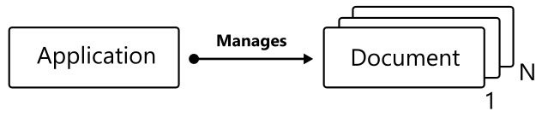
OCAF fundamentals / Introduction
The motivation behind OCAF is to free a software developer from implementing (and re-implementing (and re-implementing (…))) the very basic functionality often demanded in engineering applications. Examples:
Enriching B-Rep with attributes (colors, names, boundary conditions, etc.)
Application/Document architecture.
Hierarchical organization of data (several Views are allowed for one Data container).
Open/Save.
Undo/Redo.
Copy/Paste.
Transactions (how to revert model changes if something goes wrong?)

Slide 16
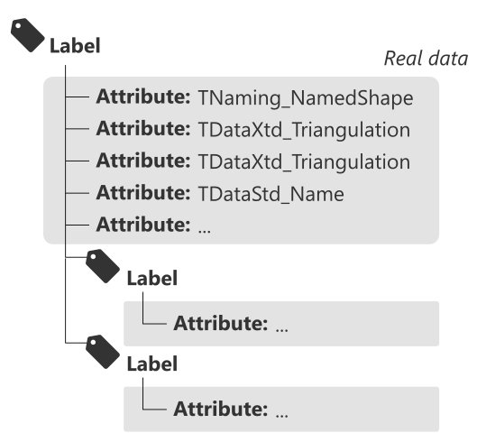
OCAF fundamentals / Introduction
The motivation behind OCAF is to free a software developer from implementing (and re-implementing (and re-implementing (…))) the very basic functionality often demanded in engineering applications. Examples:
Enriching B-Rep with attributes (colors, names, boundary conditions, etc.)
Application/Document architecture.
Hierarchical organization of data (several Views are allowed for one Data container).
Open/Save.
Undo/Redo.
Copy/Paste.
Transactions (how to revert model changes if something goes wrong?)

Slide 17
OCAF fundamentals / Typical architecture
OCAF serves as a hierarchical database, i.e. the low-level backend of your application.
Frontend
GUI
Scripting
Visualization
(*) Try DRAW
API
API
Data Model
Algorithms
Data Model
Algorithms
Utilities
Utilities
Backend
Backend
OCAF

Slide 18
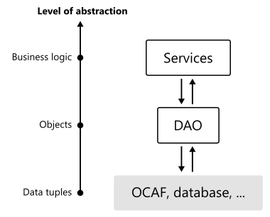
OCAF fundamentals / Typical architecture
OCAF serves as a hierarchical database, i.e. the low-level backend of your application.
Although you’re free to invoke OCAF functions at any level of your architecture, the best practice is to interface OCAF in the same manner as people in Enterprise software development do:
Frontend
GUI
Scripting
Visualization
(*) Try DRAW
API
API
Data Model
Algorithms
Data Model
Algorithms
Utilities
Utilities
Backend
Backend
OCAF

Slide 19
OCAF fundamentals / Application & Document
OCAF starts with the two main classes:
TDocStd_Application: manages documents; defines format; defines resource files.
TDocStd_Document: contains real data.

Slide 20
OCAF fundamentals / Application & Document
OCAF starts with the two main classes:
TDocStd_Application: manages documents; defines format; defines resource files.
TDocStd_Document: contains real data.
Application is usually a singleton providing Instance() method. As a developer, you have to subclass TDataStd_Application and override the following methods:
Formats(): string alias for your format.
ResourcesName(): filename where to look for the format definition and storage/retrieval plugins.
Browse OCCT packages

Slide 21
OCAF fundamentals / Application & Document
OCAF starts with the two main classes:
TDocStd_Application: manages documents; defines format; defines resource files.
TDocStd_Document: contains real data.
Application is usually a singleton providing Instance() method. As a developer, you have to subclass TDataStd_Application and override the following methods:
Formats(): string alias for your format.
ResourcesName(): filename where to look for the format definition and storage/retrieval plugins.
Browse OCCT packages
Build OcafEx:
OcafExLib is a library to serve as storage/retrieval driver.
OcafExApp is executable.
Have a look at CMake configuration;
Have a look at OcafEx_Application class;
Have a look at Plugin and Resources files. Notice that TKBin standard package is used as a reader and writer.
bit of practice #1

Slide 22
OCAF fundamentals / Practice
Label with entry “0:1” is called “Main” label in OCAF.
In main.cpp create a new Application instance: app;
Create an empty document using app->NewDocument() method;
The document can be closed with app->Close() method.
Attempt to save the new document will result with PCDM_SS_No_Obj (empty document) error.
PCDM_SS: PCDM means Persistent Cascade Document Model; SS means Storage Status
bit of practice #2

Slide 23
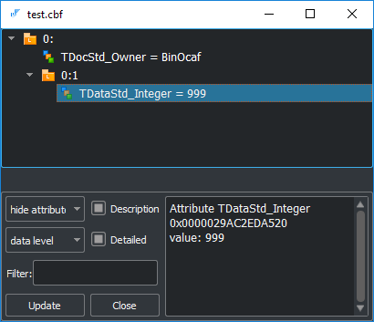
OCAF fundamentals / Practice
Label with entry “0:1” is called “Main” label in OCAF.
In main.cpp create a new Application instance: app;
Create an empty document using app->NewDocument() method;
The document can be closed with app->Close() method.
Attempt to save the new document will result with PCDM_SS_No_Obj (empty document) error.
PCDM_SS: PCDM means Persistent Cascade Document Model; SS means Storage Status
bit of practice #2
Set integer attribute to the main label of a document with TDataStd_Integer::Set() method.
Save document to file. The writer should end up with PCDM_SS_OK code.
Browse the document using GUI Workbench (“ocaf-browse” command).
bit of practice #3

Slide 24
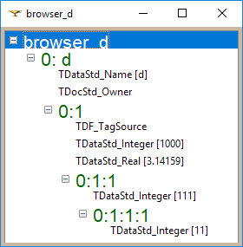
OCAF fundamentals / Practice
Label with entry “0:1” is called “Main” label in OCAF.
In main.cpp create a new Application instance: app;
Create an empty document using app->NewDocument() method;
The document can be closed with app->Close() method.
Attempt to save the new document will result with PCDM_SS_No_Obj (empty document) error.
PCDM_SS: PCDM means Persistent Cascade Document Model; SS means Storage Status
bit of practice #2
Set integer attribute to the main label of a document with TDataStd_Integer::Set() method.
Save document to file. The writer should end up with PCDM_SS_OK code.
Browse the document using GUI Workbench (“ocaf-browse” command).
bit of practice #3
Check implementation of “ocaf-browse” command. Notice TDocStd_Application::IsInSession() method returning the index of a document. This index is later used for TDocStd_Application::GetDocument().
Alternatively, use DRAW:
> pload ALL
> Open …
> DFBrowse …
bit of practice #4

Slide 25
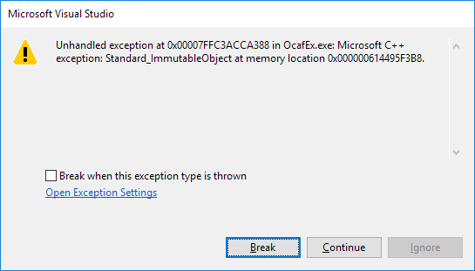
OCAF fundamentals / Practice
Come back to OcafEx.
Set transactional mode of modification with TDocStd_Document::SetModificationMode() method.
Run OcafEx: exception Standard_ImmutableObject should raise.
Enable undo/redo deltas by TDocStd_Document::SetUndoLimit() invocation. Pass positive value.
Use transaction to set the integer attribute:
doc->OpenCommand();
{
TDataStd_Integer::Set(doc->Main(), 999);
}
doc->CommitCommand();
Try undo/redo checking the result using “ocaf-browse” command.
bit of practice #5
Add floating-point attribute to the main label using TDataStd_Real::Set() method. Use another transaction for that.
Undo once with TDocStd_Document::Undo(). Check the result.
Redo once with TDocStd_Document::Redo(). Check the result.
bit of practice #6

Slide 26
OCAF fundamentals / Elements / Label
Motivation:
Label is an abstract node which is purposed for
Building hierarchy (via sublabels);
Binding attributes.
The hierarchy of labels defines the structure of your document.
Identification:
A label has a certain persistent ID which is named Entry. Here is an example of entry: “1:2:1”.

Slide 27
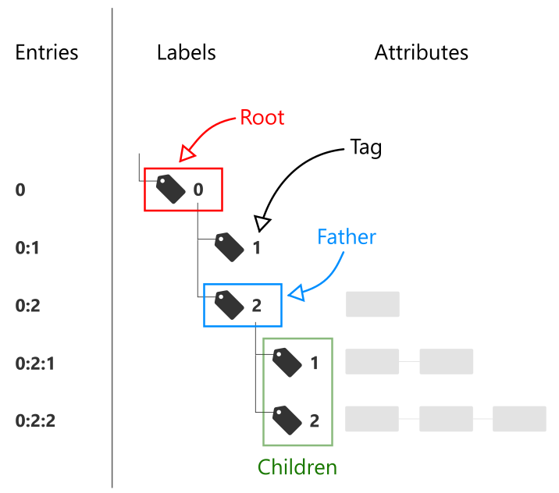
OCAF fundamentals / Elements / Label
Motivation:
Label is an abstract node which is purposed for
Building hierarchy (via sublabels);
Binding attributes.
The hierarchy of labels defines the structure of your document.
Identification:
A label has a certain persistent ID which is named Entry. Here is an example of entry: “1:2:1”.
A label is a lightweight entity manipulated by value. Still, it can be checked by IsNull() method just like a handle.

Slide 28
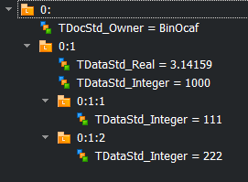
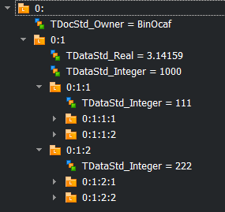
OCAF fundamentals / Elements / Label
Use TDF_Label to create the hierarchy and TDF_ChildIterator to iterate it. A label is always created as a child of another label (its “father”). The root of the document has the reserved value 0 of its tag.
The method TDF_Label::FindChild() allows creating a new child under your label.
The class TDF_ChildIterator allows visiting all children of the given label.
The method TDF_Label::AddAttribute() allows adding new attribute to the label.
Start another transaction and create two labels under the main one.
Notice that you have to specify the tag of each child.
Notice that you can call FindChild() in read-only mode.
Notice that empty label are erase on saving the document.
bit of practice #7
Iterate the main label using TDF_ChildIterator.
Print the entry of each current label using TDF_Tool::Entry().
Add more children to have a deeper hierarchy in bit of practice #7.
Notice that TDF_ChildIterator does not perform in-depth iteration.
bit of practice #8

Slide 29
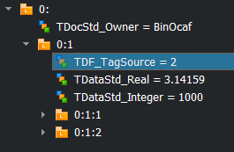
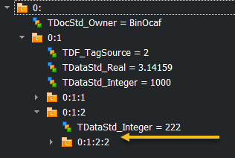
OCAF fundamentals / Elements / Label
The method TDF_Label::FindAttribute() allows finding attribute by its GUID.
To avoid passing tag explicitly in TDF_Label::FindChild(), you may want to let OCAF do this under the cover. For that, use TDF_TagSource attribute.
To remove attributes, call TDF_Label::ForgetAttribute() & TDF_Label::ForgetAllAttributes() methods.
Use FindAttribute() method to access attribute on a label.
Do not forget to check if such an attribute exists.
bit of practice #9
Change code from #7 to use TDF_TagSource instead of explicit tags. Use TDF_TagSource::NewChild() static method.
Notice that the list of used tags is stored as an attribute.
bit of practice #10
Remove attributes from some label which can be found by entry using TDF_Tool.
Notice that the empty (“ghost”) label (with no attributes, no children and no reference to this label from other labels) is kept (for undo/redo) until the document is saved.
Notice that child labels can be cleaned by passing an extra Boolean flag.
bit of practice #11

Slide 30
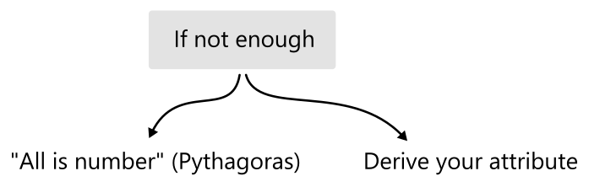
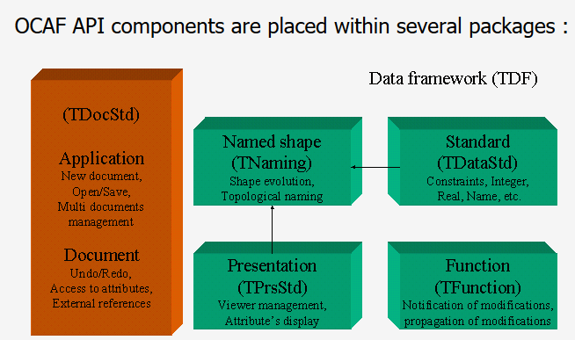
OCAF fundamentals / Elements / Attribute
Attribute is a data container. There are many ready-to-use attributes, and you may create your own. To name a few existing ones:
Scalar (integer, double, Boolean);
Array (integer, double, Boolean);
String (ASCII, Unicode);
Bit mask;
B-Rep shape;
Triangulation;
Tree node (alternative hierarchies);
Reference;
Tree function (for parametric dependencies);
…
What’s the best?
+ TDataXtd

Slide 31
OCAF fundamentals / Elements / Best practice
As practice shows, it is better to hide the complexity of your data in attributes rather than creating too complex hierarchies of labels. That is because too many labels pose noticeable memory overhead (without any added value). At the same time, using the standard attributes only is more simple programmatically as you do not need to customize storage/retrieval functions. Neither you need to think of Undo/Redo deltas. Hence the advice is:
Prefer standard attributes for data models of moderate size.
Prefer heavy attributes whenever large data sets are employed.
L >> [0:2:10:1:2:101]
L >> [0:2:10:1:2:101:1]
A >> [TDataStd_Integer {Type}] - 2
L >> [0:2:10:1:2:101:2]
A >> [TDataStd_Name {Name}] - X
L >> <MTime is not dumped>: tag = 5
L >> [0:2:10:1:2:101:6]
A >> [TDataStd_Integer {Validity}] - 1
L >> [0:2:10:1:2:101:7]
A >> [TDataStd_Integer {UFlags}] - 0
L >> [0:2:10:1:2:101:8]
A >> [TDataStd_Integer {Pending}] - 0
L >> [0:2:10:1:2:101:101]
A >> [TDataStd_Real] - 0
L >> [0:2:10:1:2:102]
L >> [0:2:10:1:2:102:1]
A >> [TDataStd_Integer {Type}] - 2
L >> [0:2:10:1:2:102:2]
A >> [TDataStd_Name {Name}] - Y
L >> <MTime is not dumped>: tag = 5
L >> [0:2:10:1:2:102:6]
A >> [TDataStd_Integer {Validity}] - 1
L >> [0:2:10:1:2:102:7]
A >> [TDataStd_Integer {UFlags}] - 0
L >> [0:2:10:1:2:102:8]
A >> [TDataStd_Integer {Pending}] - 0
L >> [0:2:10:1:2:102:101]
A >> [TDataStd_Real] - 0
L >> [0:2:10:1:2:103]
L >> [0:2:10:1:2:103:1]
A >> [TDataStd_Integer {Type}] - 2
L >> [0:2:10:1:2:103:2]
A >> [TDataStd_Name {Name}] - Z
L >> <MTime is not dumped>: tag = 5
L >> [0:2:10:1:2:103:6]
A >> [TDataStd_Integer {Validity}] - 1
L >> [0:2:10:1:2:103:7]
A >> [TDataStd_Integer {UFlags}] - 0
L >> [0:2:10:1:2:103:8]
A >> [TDataStd_Integer {Pending}] - 0
L >> [0:2:10:1:2:103:101]
A >> [TDataStd_Real] - 0
Example: very verbose (X, Y, Z) triple

Slide 32
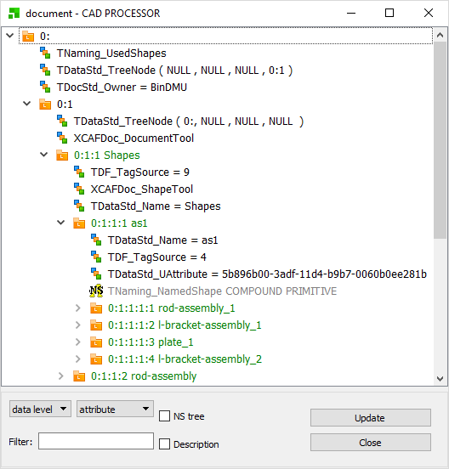
OCAF fundamentals / Elements / Attribute
Each Attribute has its global universal identifier (GUID). At one label, you can have only one attribute with a given GUID. How does this limit you?
You can create sub-labels.
You can derive a new attribute to have primitive types packed into one place.
For some attributes, it is possible to change GUIDs, so you may have several attributes of the same type on one label (examples: TDataStd_UAttribute, TDataStd_TreeNode).
Example: XDE for representing assemblies (UAtrribute, Tree Nodes)

Slide 33
OCAF fundamentals / Transactions
Transaction in OCAF is named Command. The Commands are managed at the level of a Document.
OpenCommand() to start new transaction.
CommitCommand() to commit transaction.
AbortCommand() to abort transaction.
HasOpenCommand() to check if a transaction is running.

Slide 34
OCAF fundamentals / Transactions
It is possible to trace which elements were affected by a transaction to take advantage of lazy updates in UI (e.g., redisplay only the modified object in 3D scene). The following code should be used BEFORE undo as it is based on consulting undo deltas.
const TDF_DeltaList& deltaList = doc->GetUndos();
int nbDeltas = deltaList.Extent();
int deltaIndex = 0;
int firstDeltaIndex = nbDeltas - nbUndoes + 1;
// Loop by number of requested undoes.
for ( TDF_ListIteratorOfDeltaList it(deltaList); it.More(); it.Next() )
{
deltaIndex++;
if ( deltaIndex < firstDeltaIndex )
continue; // Skip the oldest non-requested deltas.
const Handle(TDF_Delta)& delta = it.Value();
// Loop by attribute deltas.
const TDF_AttributeDeltaList& attrDeltas = delta->AttributeDeltas();
for ( TDF_ListIteratorOfAttributeDeltaList it(attrDeltas); it.More(); it.Next() )
{
Handle(TDF_AttributeDelta)& attrDelta = it.Value();
if ( attrDelta.IsNull() )
continue;
TDF_Label lab = attrDelta->Label();
//
TCollection_AsciiString entry;
TDF_Tool::Entry(aLab, entry);
std::cout << "\tEntry of affected label: " << entry.ToCString() << std::endl;
}
}

Slide 35
OCAF fundamentals / Memo
Few things to keep in mind:
Attributes within a single label should have unique IDs.
A label cannot be removed. Instead, attributes are cleaned.
Prefer custom attributes instead of complex hierarchy of labels.

Slide 36
OCAF fundamentals / Alternatives
A natural alternative to OCAF is a database (either hierarchical or relational). Some examples:
MongoDB (NoSQL database) // https://www.mongodb.com/;
SQLite (https://www.sqlite.org), PostgreSQL, MySQL, etc.
Unlike general-purpose database engines, OCAF is specialized for constructing engineering software. In particular, it gives:
Ready-to-use attributes for B-Rep and surface triangulation.
Undo/redo.
Parametric dependencies.
OCAF does not give:
Any query language.
Any client-server architecture (local database for a local application).

Slide 37
Object interfaces

Slide 38
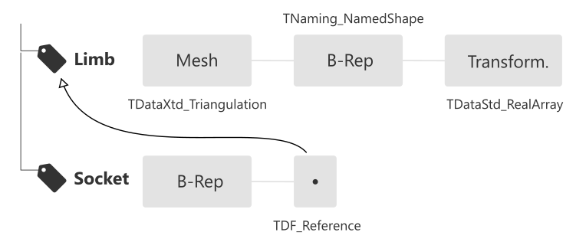
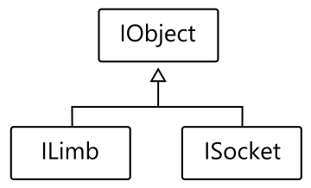
Interfaces / Data Scheme
Data Model design starts with defining the document structure. You should think in object-oriented manner and then map all objects and their properties to labels & attributes of OCAF. OCAF does not speak objects, only labels and attributes.
To operate with OCAF data programmatically, DAO (Data Access Object) is the best practice. So you derive two interfaces:
OcafEx_ILimb
OcafEx_ISocket
The “I” prefix emphasizes that these entities are only accessors while the data remains in its persistent storage. A good idea is to use a base class (OcafEx_IObject) to hold the label and provide common SetName()/GetName() methods.

Slide 39
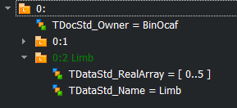
Interfaces / Limb
Add class OcafEx_ILimb inheriting from OcafEx_IObject.
Provide accessors for:
Setting/getting mesh as Poly_Triangulation.
Setting/getting B-Rep as TopoDS_Shape.
Setting/getting transformation as:
Tx translation along OX axis.
Ty translation along OY axis.
Tz translation along OZ axis.
Rx rotation around OX axis.
Ry rotation around OY axis.
Rz rotation around OZ axis.
Create Limb object on label 0:2 as 0:1 (main) is occupied by previous exercises.
Notice that low-level labels and attributes are now hidden behind a more object-oriented interface like SetMesh(), SetTransform(), etc.
bit of practice #13
bit of practice #12
Guide lines:
Do not forget that in setter methods it is necessary to check whether the corresponding attribute already exists. If so, it should not be set again.
Interface objects “understand” the underlying storage scheme for a specific object and encapsulate it for the upper levels of architecture.
You may express an object with an arbitrarily complex sub-hierarchy of labels. For the interface it is basically enough hold only the root label.
If nested labels are used, it is a good practice to handle their tags via a dedicated enum declared in the interface class.
Use TDataXtd_Triangulation to store mesh.
Use TNaming_Builder (its Generated() method) from the topological (persistent) naming package to store shape.
Use TDataStd_RealArray to store transformation components.

Slide 40
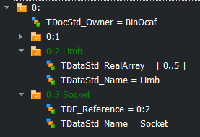
Interfaces / Socket
Add class OcafEx_ISocket inheriting from OcafEx_IObject.
Provide accessors for:
Setting/getting B-Rep as TopoDS_Shape. Notice that this method can be moved to some intermediate base class (not IObject because the latter one can be CAD-agnostic).
Setting/getting reference to the limb.
Create Socket object on label 0:3.
bit of practice #14
Guide lines:
Allocate OcafEx_ILimb whenever you need to work with a limb. Notice that “new OcafEx_ILimb” does not create a persistent object. It rather creates an interface.
Use smart pointers for the interface objects to avoid any memory leaks.

Slide 41
Сustom attribute

Slide 42
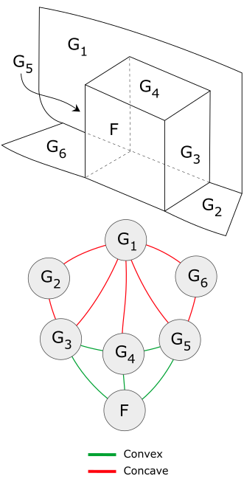
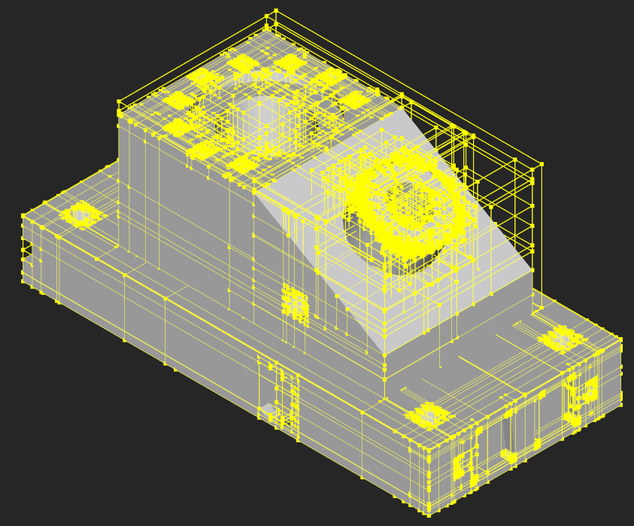
Custom Attr. / Motivation
Custom attributes are used in the following situations:
You want to reduce complexity of labels hierarchy (relevant for projects with large amount of data).
Your specific data is not easily mapped to standard attributes. Few examples:
Attributed Adjacency Graph.
Bounding Volume Hierarchy.
Naming service for parametric modeling.
…
Note: even though custom attributes can be designed at high level of abstraction, the lack of encapsulation power in attributes should not be an issue: you should anyway encapsulate in the interfaces (DAO)!
Acceleration Structures
Spatial Hierarchies
Object Hierarchies
Attributed Adjacency Graph (AAG)
Uniform Grid
Octree
K-D tree
BVH

Slide 43
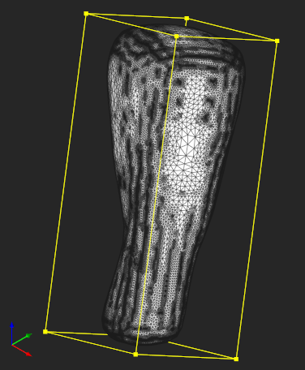
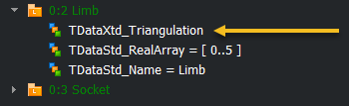
Custom Attr. / Use case
We will practice customization of OCAF by introducing an attribute to hold Oriented Bounding Box of a mesh. The method can be found in [Gottschalk S. et al. OBB Tree: A Hierarchical Structure for Rapid Interference Detection // Proc. SIGGRAPH 96. 1996. P. 171-180]. It is based on finding eigenvectors of a covariance matrix defined by mesh nodes.
Check OcafEx_BuildOBB to see how oriented bounding box is computed for Poly_Triangulation.
Notice that Eigen library is used for linear algebra solvers.
bit of practice #15
Import STL triangulation from the file shipped with OcafEx and store it in Limb. Write your code so that to abort transaction if loading fails.
Use OcafEx_BuildOBB to get the oriented bounding box.
Save the obtained solid to STEP file.
Load both STEP file and STL in GUI Workbench for visual check.
bit of practice #16
Guide lines:
Use RWStl to read STL file.
Use STEPControl_Writer and STEPControl_AsIs mode to save STEP file. The expected status is IFSelect_RetDone.

Slide 44
Custom Attr. / Persistence
The storage/retrieval mechanism of OCAF has plugin architecture. This architecture is based on the following principles:
A persistence plugin is a dynamically loaded library or a couple of libraries (one for storage and one for retrieval). The names of those libraries (i.e., their filenames without extension) are defined in the Plugin resource file where these libraries are associated with GUIDs.
A plugin should have an entry point, i.e., a specific function which OpenCascade is looking for:
Standard_Transient* PLUGINFACTORY(const Standard_GUID&)
The PLUGINFACTORY() function is called twice with different GUIDs: one for storage driver and one for retrieval. If both drivers are implemented within the same library (e.g., OcafExLib), then this library will have two GUIDs in the Plugin resource file.
Use PLUGIN() macro to define your entry point with a custom name.
The returned Standard_Transient* pointer should correspond to a subclass of PCDM_StorageDriver or PCDM_RetrievalDriver. Normally you choose a subclass corresponding to the preferred format:
ASCII
XML
Binary

Slide 45
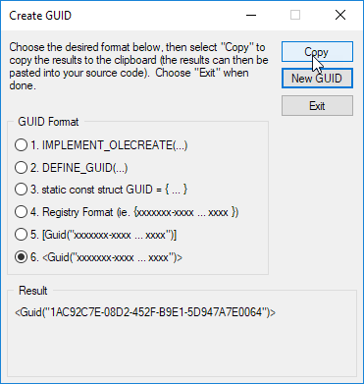
Custom Attr. / Implementation
Create OcafEx_OBBAttr class inheriting from TDF_Attribute.
Keep Restore() method empty.
Keep Paste() method empty.
Create OcafEx_OBBDriver class inheriting from BinMDF_ADriver. This way you create an Attribute Driver.
Implement two variations of Paste() method in OcafEx_OBBDriver for data transferring to and from binary stream.
Notice that the order of reading and writing from/to stream should be identical. The function of driver is to serialize your custom data to primitive types.
Have a look how entry point is realized in OcafEx_Plugin.cpp.
Easy way to generate GUID in MS Visual Studio IDE
bit of practice #17
Each custom attribute should be supplied by the corresponding custom storage/retrieval driver. Once all attribute drivers are ready, they should be registered in a centralized way:
OcafEx_BinStorageDriver
OcafEx_BinRetrievalDriver
The specific library is searched using information from Plugin/Resources files in CDF_Application::WriterFromFormat(). The dynamic libraries are loaded in Plugin::Load() function.
Make sure to have GUIDs in lower case

Slide 46
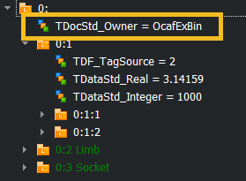
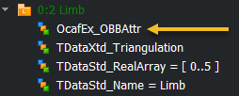
Custom Attr. / Implementation
bit of practice #18
Have a look at Plugin/Resource files: notice OcafExBin format.
Change application format to OcafExBin.
In main() function, change file extension of the saved document to .ottobock.
Run exercise: the file will be stored in a new format.
Copy OcafExLib.lib to the directory with Workbench binaries and try “ocaf-browse” command.
Extend ILimb interface to handle OBB attribute.
Store the new OcafEx_OBBAttr in the label for limb.
bit of practice #19
Dump OBB to cout to easily check its contents:
ILimb->SetOBB(limbObb);
ILimb->GetOBB().Dump();
Enlarge OBB manually and store the updated OBB in limb in another transaction.
Check the contents of updated OBB.
Undo changes and check the contents again: OBB attribute disappears!
To make undo/redo work:
complete Restore() and Paste() methods,
call this->Backup() in SetOBB().
bit of practice #20

Slide 47
That’s all.

Slide 48
Data scheme

Slide 49
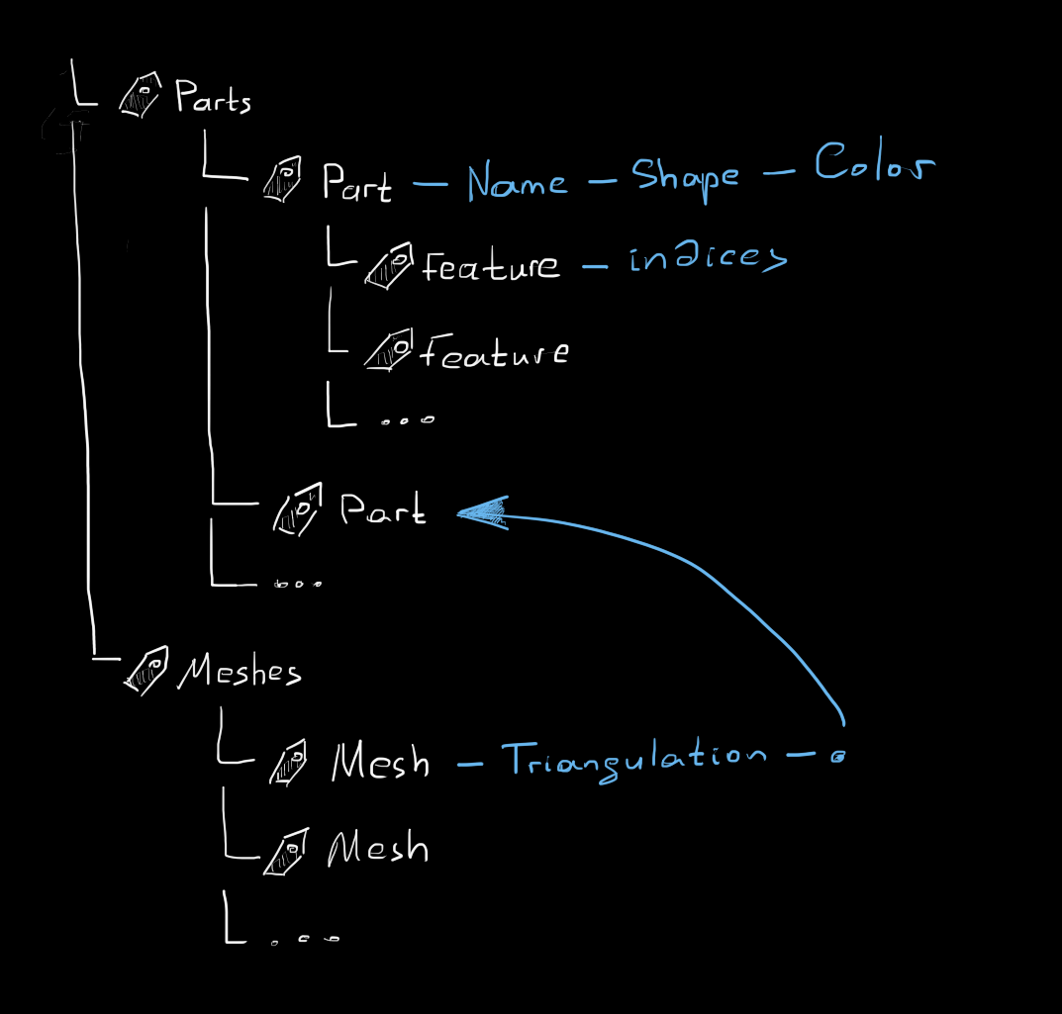

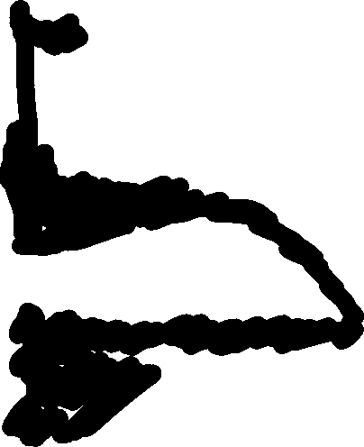

Slide 50




Slide 51




Slide 52




Slide 53




Slide 55

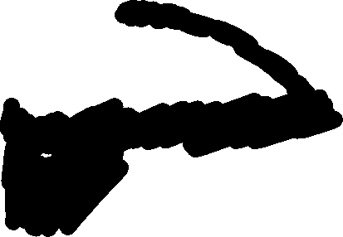




Slide 56

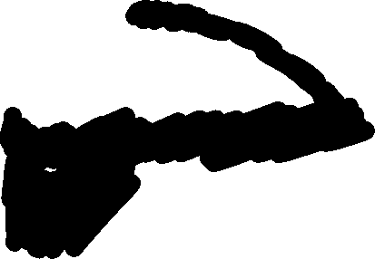




Slide 58



Slide 59

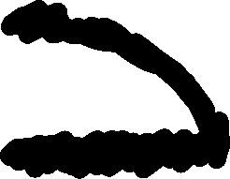

Slide 60

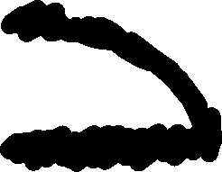

Slide 62
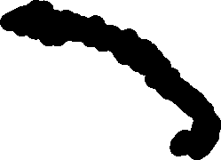

Slide 63
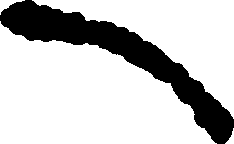

Slide 76
0:1

Slide 77
0:1
0:2

Slide 78
0:1
0:1:1
0:2

Slide 79
0:1
0:1:1
0:1:2
0:1:N
0:2

Slide 80
0:1
0:1:1
0:1:2
0:1:N
0:2
0:2:1

Slide 81
0:1
0:1:1
0:1:2
0:1:N
0:2
0:2:1
0:2:2
0:2:M

Slide 82
0:1
0:1:1
0:1:i:j
0:1:2
0:1:N
0:2
0:2:1
0:2:2
0:2:M

Slide 83
OCAF fundamentals / Elements / Label
Motivation:
Label is an abstract node which is purposed for
Building hierarchy (via sublabels);
Binding attributes.
The hierarchy of labels defines the structure of your document.
Identification:
A label has a certain persistent ID which is named Entry. Here is an example of entry: “1:2:1”.

Slide 84
OCAF fundamentals / Elements / Label
Motivation:
Label is an abstract node which is purposed for
Building hierarchy (via sublabels);
Binding attributes.
The hierarchy of labels defines the structure of your document.
Identification:
A label has a certain persistent ID which is named Entry. Here is an example of entry: “1:2:1”.
A label is a lightweight entity manipulated by value. Still, it can be checked by IsNull() method just like a handle.

Slide 85
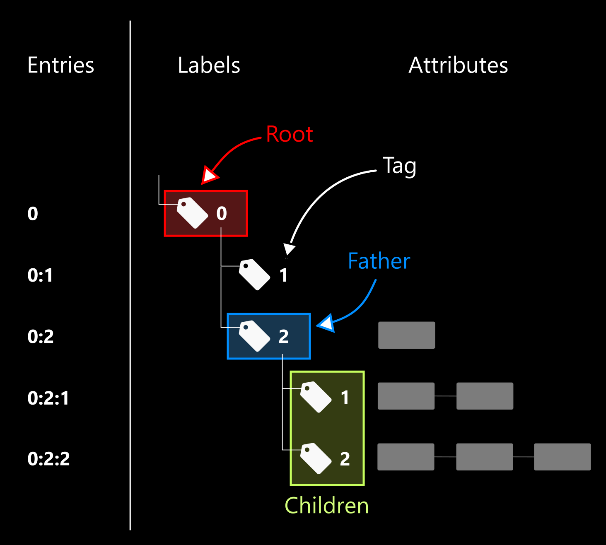
OCAF fundamentals / Elements / Label

Slide 86
OCAF fundamentals / Elements / Label
Use TDF_Label to create the hierarchy and TDF_ChildIterator to iterate it. A label is always created as a child of another label (its “father”). The root of the document has the reserved value 0 of its tag.
The method TDF_Label::FindChild() allows creating a new child under your label.
The class TDF_ChildIterator allows visiting all children of the given label.
The method TDF_Label::AddAttribute() allows adding new attribute to the label.
Start another transaction and create two labels under the main one.
Notice that you have to specify the tag of each child.
Notice that you can call FindChild() in read-only mode.
Notice that empty label are erase on saving the document.
bit of practice #7
Iterate the main label using TDF_ChildIterator.
Print the entry of each current label using TDF_Tool::Entry().
Add more children to have a deeper hierarchy in bit of practice #7.
Notice that TDF_ChildIterator does not perform in-depth iteration.
bit of practice #8

Slide 87
OCAF fundamentals / Elements / Label
The method TDF_Label::FindAttribute() allows finding attribute by its GUID.
To avoid passing tag explicitly in TDF_Label::FindChild(), you may want to let OCAF do this under the cover. For that, use TDF_TagSource attribute.
To remove attributes, call TDF_Label::ForgetAttribute() & TDF_Label::ForgetAllAttributes() methods.
Use FindAttribute() method to access attribute on a label.
Do not forget to check if such an attribute exists.
bit of practice #9
Change code from #7 to use TDF_TagSource instead of explicit tags. Use TDF_TagSource::NewChild() static method.
Notice that the list of used tags is stored as an attribute.
bit of practice #10
Remove attributes from some label which can be found by entry using TDF_Tool.
Notice that the empty (“ghost”) label (with no attributes, no children and no reference to this label from other labels) is kept (for undo/redo) until the document is saved.
Notice that child labels can be cleaned by passing an extra Boolean flag.
bit of practice #11

Slide 88
OCAF fundamentals / Elements / Attribute
Attribute is a data container. There are many ready-to-use attributes, and you may create your own. To name a few existing ones:
Scalar (integer, double, Boolean);
Array (integer, double, Boolean);
String (ASCII, Unicode);
Bit mask;
B-Rep shape;
Triangulation;
Tree node (alternative hierarchies);
Reference;
Tree function (for parametric dependencies);
…
What’s the best?
+ TDataXtd

Slide 89
OCAF fundamentals / Elements / Best practice
As practice shows, it is better to hide the complexity of your data in attributes rather than creating too complex hierarchies of labels. That is because too many labels pose noticeable memory overhead (without any added value). At the same time, using the standard attributes only is more simple programmatically as you do not need to customize storage/retrieval functions. Neither you need to think of Undo/Redo deltas. Hence the advice is:
Prefer standard attributes for data models of moderate size.
Prefer heavy attributes whenever large data sets are employed.
L >> [0:2:10:1:2:101]
L >> [0:2:10:1:2:101:1]
A >> [TDataStd_Integer {Type}] - 2
L >> [0:2:10:1:2:101:2]
A >> [TDataStd_Name {Name}] - X
L >> <MTime is not dumped>: tag = 5
L >> [0:2:10:1:2:101:6]
A >> [TDataStd_Integer {Validity}] - 1
L >> [0:2:10:1:2:101:7]
A >> [TDataStd_Integer {UFlags}] - 0
L >> [0:2:10:1:2:101:8]
A >> [TDataStd_Integer {Pending}] - 0
L >> [0:2:10:1:2:101:101]
A >> [TDataStd_Real] - 0
L >> [0:2:10:1:2:102]
L >> [0:2:10:1:2:102:1]
A >> [TDataStd_Integer {Type}] - 2
L >> [0:2:10:1:2:102:2]
A >> [TDataStd_Name {Name}] - Y
L >> <MTime is not dumped>: tag = 5
L >> [0:2:10:1:2:102:6]
A >> [TDataStd_Integer {Validity}] - 1
L >> [0:2:10:1:2:102:7]
A >> [TDataStd_Integer {UFlags}] - 0
L >> [0:2:10:1:2:102:8]
A >> [TDataStd_Integer {Pending}] - 0
L >> [0:2:10:1:2:102:101]
A >> [TDataStd_Real] - 0
L >> [0:2:10:1:2:103]
L >> [0:2:10:1:2:103:1]
A >> [TDataStd_Integer {Type}] - 2
L >> [0:2:10:1:2:103:2]
A >> [TDataStd_Name {Name}] - Z
L >> <MTime is not dumped>: tag = 5
L >> [0:2:10:1:2:103:6]
A >> [TDataStd_Integer {Validity}] - 1
L >> [0:2:10:1:2:103:7]
A >> [TDataStd_Integer {UFlags}] - 0
L >> [0:2:10:1:2:103:8]
A >> [TDataStd_Integer {Pending}] - 0
L >> [0:2:10:1:2:103:101]
A >> [TDataStd_Real] - 0
Example: very verbose (X, Y, Z) triple

Slide 90
OCAF fundamentals / Elements / Attribute
Each Attribute has its global universal identifier (GUID). At one label, you can have only one attribute with a given GUID. How does this limit you?
You can create sub-labels.
You can derive a new attribute to have primitive types packed into one place.
For some attributes, it is possible to change GUIDs, so you may have several attributes of the same type on one label (examples: TDataStd_UAttribute, TDataStd_TreeNode).
Example: XDE for representing assemblies (UAtrribute, Tree Nodes)

Slide 91
OCAF fundamentals / Transactions
Transaction in OCAF is named Command. The Commands are managed at the level of a Document.
OpenCommand() to start new transaction.
CommitCommand() to commit transaction.
AbortCommand() to abort transaction.
HasOpenCommand() to check if a transaction is running.

Slide 92
OCAF fundamentals / Transactions
It is possible to trace which elements were affected by a transaction to take advantage of lazy updates in UI (e.g., redisplay only the modified object in 3D scene). The following code should be used BEFORE undo as it is based on consulting undo deltas.
const TDF_DeltaList& deltaList = doc->GetUndos();
int nbDeltas = deltaList.Extent();
int deltaIndex = 0;
int firstDeltaIndex = nbDeltas - nbUndoes + 1;
// Loop by number of requested undoes.
for ( TDF_ListIteratorOfDeltaList it(deltaList); it.More(); it.Next() )
{
deltaIndex++;
if ( deltaIndex < firstDeltaIndex )
continue; // Skip the oldest non-requested deltas.
const Handle(TDF_Delta)& delta = it.Value();
// Loop by attribute deltas.
const TDF_AttributeDeltaList& attrDeltas = delta->AttributeDeltas();
for ( TDF_ListIteratorOfAttributeDeltaList it(attrDeltas); it.More(); it.Next() )
{
Handle(TDF_AttributeDelta)& attrDelta = it.Value();
if ( attrDelta.IsNull() )
continue;
TDF_Label lab = attrDelta->Label();
//
TCollection_AsciiString entry;
TDF_Tool::Entry(aLab, entry);
std::cout << "\tEntry of affected label: " << entry.ToCString() << std::endl;
}
}

Slide 93
OCAF fundamentals / Memo
Few things to keep in mind:
Attributes within a single label should have unique IDs.
A label cannot be removed. Instead, attributes are cleaned.
Prefer custom attributes instead of complex hierarchy of labels.

Slide 94
OCAF fundamentals / Alternatives
A natural alternative to OCAF is a database (either hierarchical or relational). Some examples:
MongoDB (NoSQL database) // https://www.mongodb.com/;
SQLite (https://www.sqlite.org), PostgreSQL, MySQL, etc.
Unlike general-purpose database engines, OCAF is specialized for constructing engineering software. In particular, it gives:
Ready-to-use attributes for B-Rep and surface triangulation.
Undo/redo.
Parametric dependencies.
OCAF does not give:
Any query language.
Any client-server architecture (local database for a local application).

