Slide 1
OCAF: OpenCascade Application Framework Advanced Modeling Shape Healing
Sergey Slyadnev

Slide 2
Training contents
OCAF fundamentals
Object interfaces
Custom attributes
Active Data framework
UI Workbench
* Shape Healing

Slide 3

Global view
Open-source 3D modeling kernel
Data exchange
Solid and surface modeling
Application framework
Visualization services

Slide 4
OCAF fundamentals

Slide 5
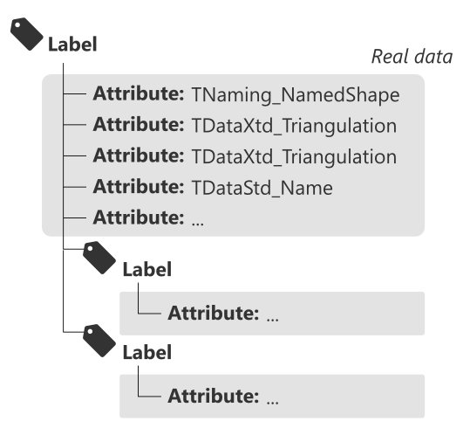
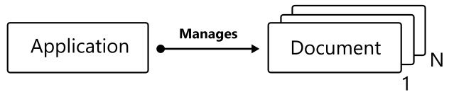
OCAF fundamentals / Introduction
The motivation behind OCAF is to free a software developer from implementing (and re-implementing (and re-implementing (…))) the very basic functionality often demanded in engineering applications. Examples:
Enriching B-Rep with attributes (colors, names, boundary conditions, etc.)
Application/Document architecture.
Hierarchical organization of data (several Views are allowed for one Data container).
Open/Save.
Undo/Redo.
Copy/Paste.
Transactions (how to revert model changes in something goes wrong?)

Slide 6
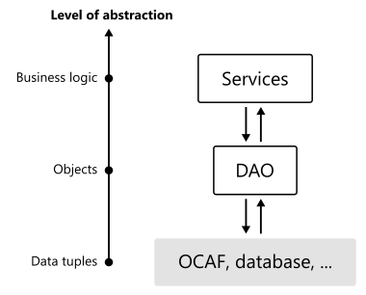
OCAF fundamentals / Typical architecture
OCAF serves as a hierarchical database, i.e. the low-level backend of your application.
Although you’re free to invoke OCAF functions at any level of your architecture, the best practice is to interface OCAF in the same manner as people in Enterprise software development do:
Frontend
GUI
Scripting
Visualization
(*) Try DRAW
API
API
Data Model
Algorithms
Data Model
Algorithms
Utilities
Utilities
Backend
Backend
OCAF

Slide 7
OCAF fundamentals / Application & Document
OCAF starts with the two main classes:
TDocStd_Application: manages documents; defines format; defines resource files.
TDocStd_Document: contains real data.
Application is usually a singleton providing Instance() method. As a developer, you have to subclass TDataStd_Application and override the following methods:
Formats(): string alias for your format.
ResourcesName(): filename where to look for the format definition and storage/retrieval plugins.
Browse OCCT packages
Build OcafEx:
OcafExLib is a library to serve as storage/retrieval driver.
OcafExApp is executable.
Have a look at CMake configuration;
Have a look at OcafEx_Application class;
Have a look at Plugin and Resources files. Notice that TKBin standard package is used as a reader and writer.
bit of practice #1

Slide 8
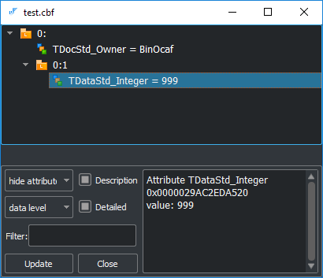
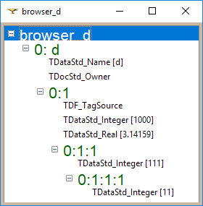
OCAF fundamentals / Practice
Label with entry “0:1” is called “Main” label in OCAF.
In main.cpp create a new Application instance: app;
Create an empty document using app->NewDocument() method;
The document can be closed with app->Close() method.
Attempt to save the new document will result with PCDM_SS_No_Obj (empty document) error.
PCDM_SS: PCDM means Persistent Cascade Document Model; SS means Storage Status
bit of practice #2
Set integer attribute to the main label of a document with TDataStd_Integer::Set() method.
Save document to file. The writer should end up with PCDM_SS_OK code.
Browse the document using GUI Workbench (“ocaf-browse” command).
bit of practice #3
Check implementation of “ocaf-browse” command. Notice TDocStd_Application::IsInSession() method returning the index of a document. This index is later used for TDocStd_Application::GetDocument().
Alternatively, use DRAW:
> pload ALL
> Open …
> DFBrowse …
bit of practice #4

Slide 9
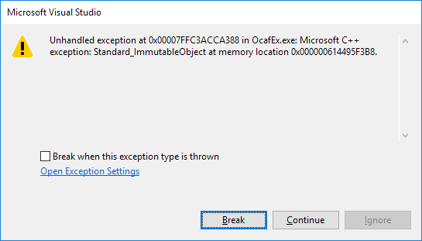
OCAF fundamentals / Practice
Come back to OcafEx.
Set transactional mode of modification with TDocStd_Document::SetModificationMode() method.
Run OcafEx: exception Standard_ImmutableObject should raise.
Enable undo/redo deltas by TDocStd_Document::SetUndoLimit() invocation. Pass positive value.
Use transaction to set the integer attribute:
doc->OpenCommand();
{
TDataStd_Integer::Set(doc->Main(), 999);
}
doc->CommitCommand();
Try undo/redo checking the result using “ocaf-browse” command.
bit of practice #5
Add floating-point attribute to the main label using TDataStd_Real::Set() method. Use another transaction for that.
Undo once with TDocStd_Document::Undo(). Check the result.
Redo once with TDocStd_Document::Redo(). Check the result.
bit of practice #6

Slide 10
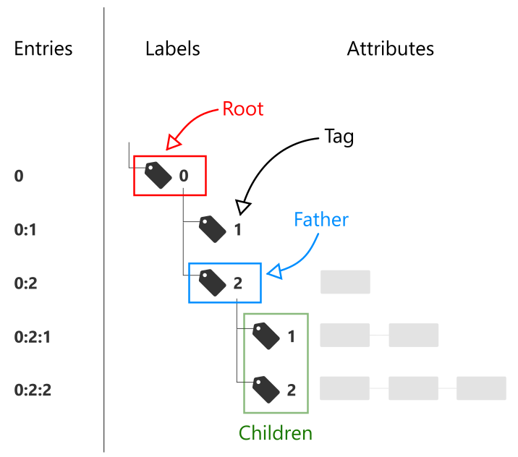
OCAF fundamentals / Elements / Label
Motivation:
Label is an abstract node which is purposed for
Building hierarchy (via sublabels);
Binding attributes.
The hierarchy of labels defines the structure of your document.
Identification:
A label has a certain persistent ID which is named Entry. Here is an example of entry: “1:2:1”.
A label is a lightweight entity manipulated by value. Still, it can be checked by IsNull() method just like a handle.

Slide 11
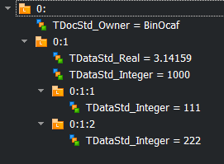
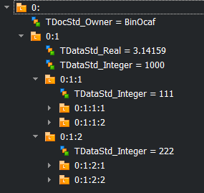
OCAF fundamentals / Elements / Label
Use TDF_Label to create the hierarchy and TDF_ChildIterator to iterate it. A label is always created as a child of another label (its “father”). The root of the document has the reserved value 0 of its tag.
The method TDF_Label::FindChild() allows creating a new child under your label.
The class TDF_ChildIterator allows visiting all children of the given label.
The method TDF_Label::AddAttribute() allows adding new attribute to the label.
Start another transaction and create two labels under the main one.
Notice that you have to specify the tag of each child.
Notice that you can call FindChild() in read-only mode.
Notice that empty label are erase on saving the document.
bit of practice #7
Iterate the main label using TDF_ChildIterator.
Print the entry of each current label using TDF_Tool::Entry().
Add more children to have a deeper hierarchy in bit of practice #7.
Notice that TDF_ChildIterator does not perform in-depth iteration.
bit of practice #8

Slide 12
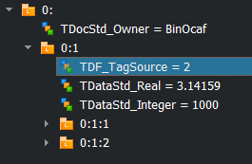
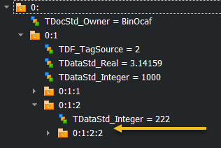
OCAF fundamentals / Elements / Label
The method TDF_Label::FindAttribute() allows finding attribute by its GUID.
To avoid passing tag explicitly in TDF_Label::FindChild(), you may want to let OCAF do this under the cover. For that, use TDF_TagSource attribute.
To remove attributes, call TDF_Label::ForgetAttribute() & TDF_Label::ForgetAllAttributes() methods.
Use FindAttribute() method to access attribute on a label.
Do not forget to check if such an attribute exists.
bit of practice #9
Change code from #7 to use TDF_TagSource instead of explicit tags. Use TDF_TagSource::NewChild() static method.
Notice that the list of used tags is stored as an attribute.
bit of practice #10
Remove attributes from some label which can be found by entry using TDF_Tool.
Notice that the empty (“ghost”) label (with no attributes, no children and no reference to this label from other labels) is kept (for undo/redo) until the document is saved.
Notice that child labels can be cleaned by passing an extra Boolean flag.
bit of practice #11

Slide 13
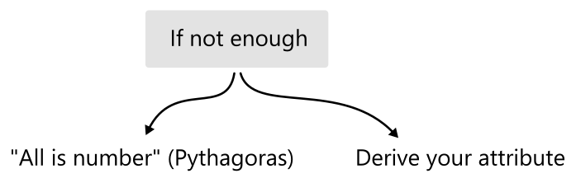
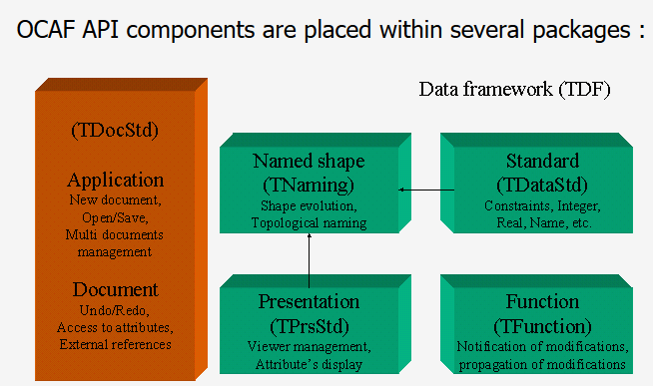
OCAF fundamentals / Elements / Attribute
Attribute is a data container. There are many ready-to-use attributes, and you may create your own. To name a few existing ones:
Scalar (integer, double, Boolean);
Array (integer, double, Boolean);
String (ASCII, Unicode);
Bit mask;
B-Rep shape;
Triangulation;
Tree node (alternative hierarchies);
Reference;
Tree function (for parametric dependencies);
…
What’s the best?
+ TDataXtd

Slide 14
OCAF fundamentals / Elements / Best practice
As practice shows, it is better to hide the complexity of your data in attributes rather than creating too complex hierarchies of labels. That is because too many labels pose noticeable memory overhead (without any added value). At the same time, using the standard attributes only is more simple programmatically as you do not need to customize storage/retrieval functions. Neither you need to think of Undo/Redo deltas. Hence the advice is:
Prefer standard attributes for data models of moderate size.
Prefer heavy attributes whenever large data sets are employed.
L >> [0:2:10:1:2:101]
L >> [0:2:10:1:2:101:1]
A >> [TDataStd_Integer {Type}] - 2
L >> [0:2:10:1:2:101:2]
A >> [TDataStd_Name {Name}] - X
L >> <MTime is not dumped>: tag = 5
L >> [0:2:10:1:2:101:6]
A >> [TDataStd_Integer {Validity}] - 1
L >> [0:2:10:1:2:101:7]
A >> [TDataStd_Integer {UFlags}] - 0
L >> [0:2:10:1:2:101:8]
A >> [TDataStd_Integer {Pending}] - 0
L >> [0:2:10:1:2:101:101]
A >> [TDataStd_Real] - 0
L >> [0:2:10:1:2:102]
L >> [0:2:10:1:2:102:1]
A >> [TDataStd_Integer {Type}] - 2
L >> [0:2:10:1:2:102:2]
A >> [TDataStd_Name {Name}] - Y
L >> <MTime is not dumped>: tag = 5
L >> [0:2:10:1:2:102:6]
A >> [TDataStd_Integer {Validity}] - 1
L >> [0:2:10:1:2:102:7]
A >> [TDataStd_Integer {UFlags}] - 0
L >> [0:2:10:1:2:102:8]
A >> [TDataStd_Integer {Pending}] - 0
L >> [0:2:10:1:2:102:101]
A >> [TDataStd_Real] - 0
L >> [0:2:10:1:2:103]
L >> [0:2:10:1:2:103:1]
A >> [TDataStd_Integer {Type}] - 2
L >> [0:2:10:1:2:103:2]
A >> [TDataStd_Name {Name}] - Z
L >> <MTime is not dumped>: tag = 5
L >> [0:2:10:1:2:103:6]
A >> [TDataStd_Integer {Validity}] - 1
L >> [0:2:10:1:2:103:7]
A >> [TDataStd_Integer {UFlags}] - 0
L >> [0:2:10:1:2:103:8]
A >> [TDataStd_Integer {Pending}] - 0
L >> [0:2:10:1:2:103:101]
A >> [TDataStd_Real] - 0
Example: very verbose (X, Y, Z) triple

Slide 15
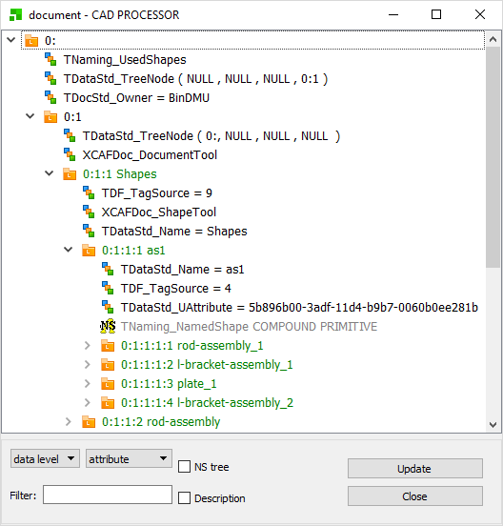
OCAF fundamentals / Elements / Attribute
Each Attribute has its global universal identifier (GUID). At one label, you can have only one attribute with a given GUID. How does this limit you?
You can create sub-labels.
You can derive a new attribute to have primitive types packed into one place.
For some attributes, it is possible to change GUIDs, so you may have several attributes of the same type on one label (examples: TDataStd_UAttribute, TDataStd_TreeNode).
Example: XDE for representing assemblies (UAtrribute, Tree Nodes)
Check in CAD Processor software (https://www.opencascade.com/content/cad-processor)

Slide 16
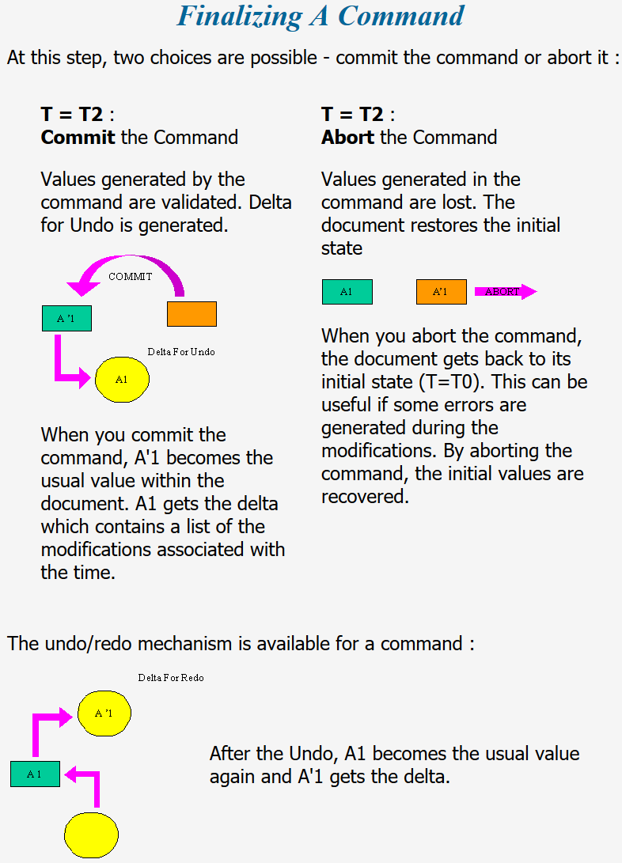
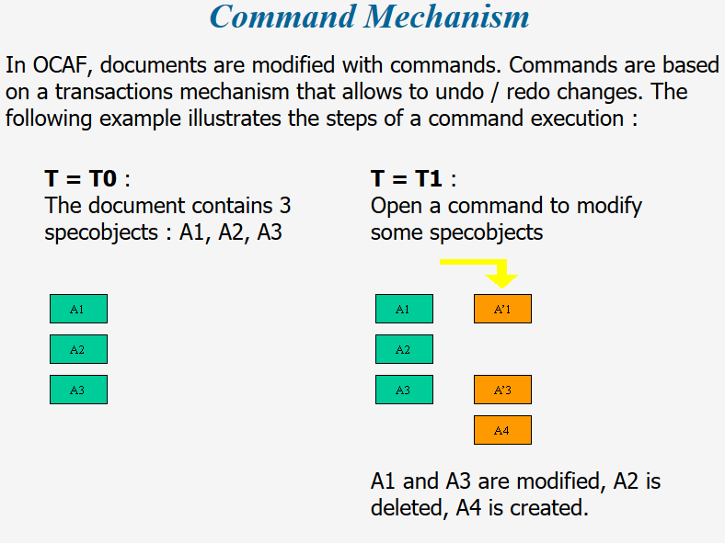
OCAF fundamentals / Transactions
Transaction in OCAF is named Command. The Commands are managed at the level of a Document.
OpenCommand() to start new transaction.
CommitCommand() to commit transaction.
AbortCommand() to abort transaction.
HasOpenCommand() to check if a transaction is running.

Slide 17
OCAF fundamentals / Transactions
It is possible to trace which elements were affected by a transaction to take advantage of lazy updates in UI (e.g., redisplay only the modified object in 3D scene). The following code should be used BEFORE undo as it is based on consulting undo deltas.
const TDF_DeltaList& deltaList = doc->GetUndos();
int nbDeltas = deltaList.Extent();
int deltaIndex = 0;
int firstDeltaIndex = nbDeltas - nbUndoes + 1;
// Loop by number of requested undoes.
for ( TDF_ListIteratorOfDeltaList it(deltaList); it.More(); it.Next() )
{
deltaIndex++;
if ( deltaIndex < firstDeltaIndex )
continue; // Skip the oldest non-requested deltas.
const Handle(TDF_Delta)& delta = it.Value();
// Loop by attribute deltas.
const TDF_AttributeDeltaList& attrDeltas = delta->AttributeDeltas();
for ( TDF_ListIteratorOfAttributeDeltaList it(attrDeltas); it.More(); it.Next() )
{
Handle(TDF_AttributeDelta)& attrDelta = it.Value();
if ( attrDelta.IsNull() )
continue;
TDF_Label lab = attrDelta->Label();
//
TCollection_AsciiString entry;
TDF_Tool::Entry(aLab, entry);
std::cout << "\tEntry of affected label: " << entry.ToCString() << std::endl;
}
}

Slide 18
OCAF fundamentals / Memo
Few things to keep in mind:
Attributes within a single label should have unique IDs.
A label cannot be removed. Instead, attributes are cleaned.
Prefer custom attributes instead of complex hierarchy of labels.

Slide 19
OCAF fundamentals / Alternatives
A natural alternative to OCAF is a database (either hierarchical or relational). Some examples:
MongoDB (NoSQL database) // https://www.mongodb.com/;
SQLite (https://www.sqlite.org), PostgreSQL, MySQL, etc.
Unlike general-purpose database engines, OCAF is specialized for constructing engineering software. In particular, it gives:
Ready-to-use attributes for B-Rep and surface triangulation.
Undo/redo.
Parametric dependencies.
OCAF does not give:
Any query language.
Any client-server architecture (local database for a local application).

Slide 20
Object interfaces

Slide 21
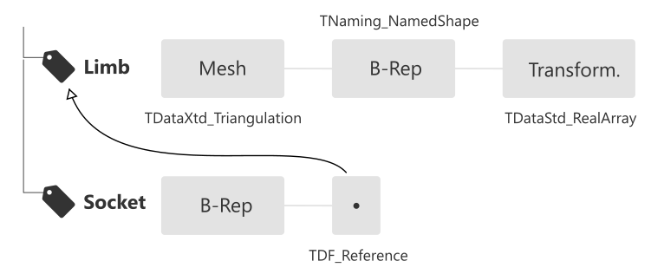
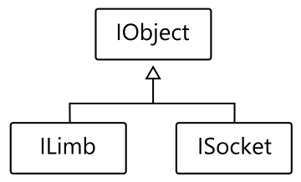
Interfaces / Data Scheme
Data Model design starts with defining the document structure. You should think in object-oriented manner and then map all objects and their properties to labels & attributes of OCAF. OCAF does not speak objects, only labels and attributes.
To operate with OCAF data programmatically, DAO (Data Access Object) is the best practice. So you derive two interfaces:
OcafEx_ILimb
OcafEx_ISocket
The “I” prefix emphasizes that these entities are only accessors while the data remains in its persistent storage. A good idea is to use a base class (OcafEx_IObject) to hold the label and provide common SetName()/GetName() methods.

Slide 22
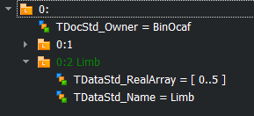
Interfaces / Limb
Add class OcafEx_ILimb inheriting from OcafEx_IObject.
Provide accessors for:
Setting/getting mesh as Poly_Triangulation.
Setting/getting B-Rep as TopoDS_Shape.
Setting/getting transformation as:
Tx translation along OX axis.
Ty translation along OY axis.
Tz translation along OZ axis.
Rx rotation around OX axis.
Ry rotation around OY axis.
Rz rotation around OZ axis.
Create Limb object on label 0:2 as 0:1 (main) is occupied by previous exercises.
Notice that low-level labels and attributes are now hidden behind a more object-oriented interface like SetMesh(), SetTransform(), etc.
bit of practice #13
bit of practice #12
Guide lines:
Do not forget that in setter methods it is necessary to check whether the corresponding attribute already exists. If so, it should not be set again.
Interface objects “understand” the underlying storage scheme for a specific object and encapsulate it for the upper levels of architecture.
You may express an object with an arbitrarily complex sub-hierarchy of labels. For the interface it is basically enough hold only the root label.
If nested labels are used, it is a good practice to handle their tags via a dedicated enum declared in the interface class.
Use TDataXtd_Triangulation to store mesh.
Use TNaming_Builder (its Generated() method) from the topological (persistent) naming package to store shape.
Use TDataStd_RealArray to store transformation components.

Slide 23
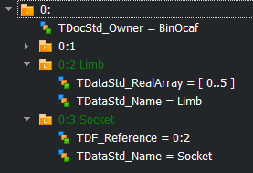
Interfaces / Socket
Add class OcafEx_ISocket inheriting from OcafEx_IObject.
Provide accessors for:
Setting/getting B-Rep as TopoDS_Shape. Notice that this method can be moved to some intermediate base class (not IObject because the latter one can be CAD-agnostic).
Setting/getting reference to the limb.
Create Socket object on label 0:3.
bit of practice #14
Guide lines:
Allocate OcafEx_ILimb whenever you need to work with a limb. Notice that “new OcafEx_ILimb” does not create a persistent object. It rather creates an interface.
Use smart pointers for the interface objects to avoid any memory leaks.

Slide 24
Сustom attribute

Slide 25
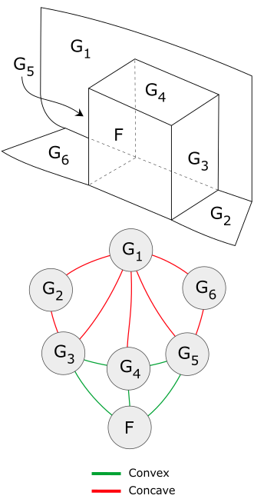
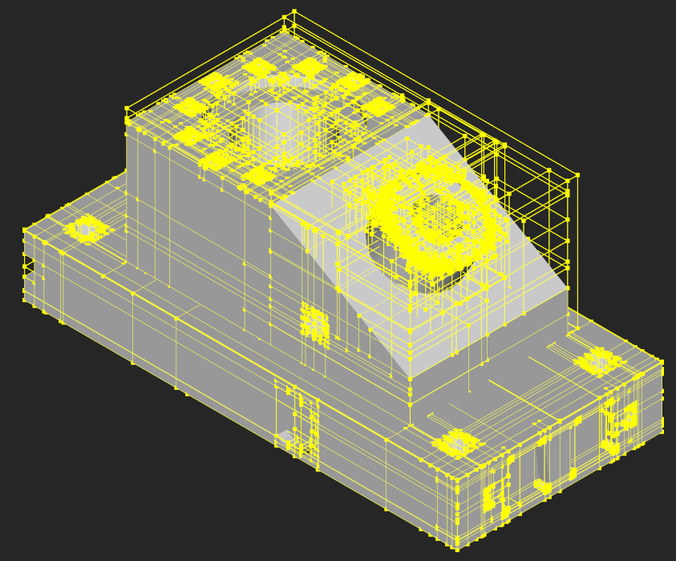
Custom Attr. / Motivation
Custom attributes are used in the following situations:
You want to reduce complexity of labels hierarchy (relevant for projects with large amount of data).
Your specific data is not easily mapped to standard attributes. Few examples:
Attributed Adjacency Graph.
Bounding Volume Hierarchy.
Naming service for parametric modeling.
…
Note: even though custom attributes can be designed at high level of abstraction, the lack of encapsulation power in attributes should not be an issue: you should anyway encapsulate in the interfaces (DAO)!
Acceleration Structures
Spatial Hierarchies
Object Hierarchies
Attributed Adjacency Graph (AAG)
Uniform Grid
Octree
K-D tree
BVH

Slide 26
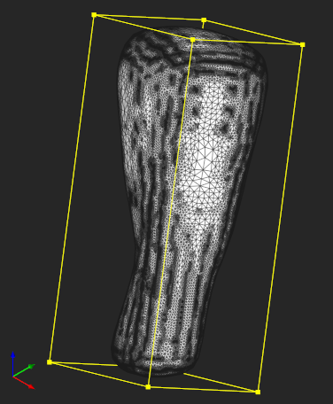
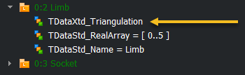
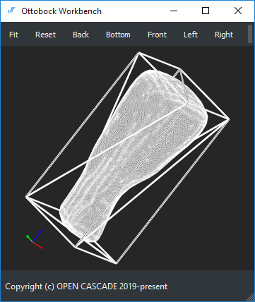
Custom Attr. / Use case
We will practice customization of OCAF by introducing an attribute to hold Oriented Bounding Box of a mesh. The method can be found in [Gottschalk S. et al. OBB Tree: A Hierarchical Structure for Rapid Interference Detection // Proc. SIGGRAPH 96. 1996. P. 171-180]. It is based on finding eigenvectors of a covariance matrix defined by mesh nodes.
Check OcafEx_BuildOBB to see how oriented bounding box is computed for Poly_Triangulation.
Notice that Eigen library is used for linear algebra solvers.
bit of practice #15
Import STL triangulation from the file shipped with OcafEx and store it in Limb. Write your code so that to abort transaction if loading fails.
Use OcafEx_BuildOBB to get the oriented bounding box.
Save the obtained solid to STEP file.
Load both STEP file and STL in GUI Workbench for visual check.
bit of practice #16
Guide lines:
Use RWStl to read STL file.
Use STEPControl_Writer and STEPControl_AsIs mode to save STEP file. The expected status is IFSelect_RetDone.

Slide 27
Custom Attr. / Persistence
The storage/retrieval mechanism of OCAF has plugin architecture. This architecture is based on the following principles:
A persistence plugin is a dynamically loaded library or a couple of libraries (one for storage and one for retrieval). The names of those libraries (i.e., their filenames without extension) are defined in the Plugin resource file where these libraries are associated with GUIDs.
A plugin should have an entry point, i.e., a specific function which OpenCascade is looking for:
Standard_Transient* PLUGINFACTORY(const Standard_GUID&)
The PLUGINFACTORY() function is called twice with different GUIDs: one for storage driver and one for retrieval. If both drivers are implemented within the same library (e.g., OcafExLib), then this library will have two GUIDs in the Plugin resource file.
Use PLUGIN() macro to define your entry point with a custom name.
The returned Standard_Transient* pointer should correspond to a subclass of PCDM_StorageDriver or PCDM_RetrievalDriver. Normally you choose a subclass corresponding to the preferred format:
ASCII
XML
Binary

Slide 28
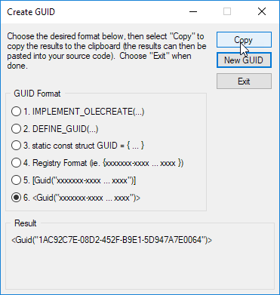
Custom Attr. / Implementation
Create OcafEx_OBBAttr class inheriting from TDF_Attribute.
Keep Restore() method empty.
Keep Paste() method empty.
Create OcafEx_OBBDriver class inheriting from BinMDF_ADriver. This way you create an Attribute Driver.
Implement two variations of Paste() method in OcafEx_OBBDriver for data transferring to and from binary stream.
Notice that the order of reading and writing from/to stream should be identical. The function of driver is to serialize your custom data to primitive types.
Have a look how entry point is realized in OcafEx_Plugin.cpp.
Easy way to generate GUID in MS Visual Studio IDE
bit of practice #17
Each custom attribute should be supplied by the corresponding custom storage/retrieval driver. Once all attribute drivers are ready, they should be registered in a centralized way:
OcafEx_BinStorageDriver
OcafEx_BinRetrievalDriver
The specific library is searched using information from Plugin/Resources files in CDF_Application::WriterFromFormat(). The dynamic libraries are loaded in Plugin::Load() function.
Make sure to have GUIDs in lower case

Slide 29
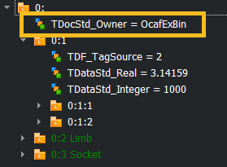
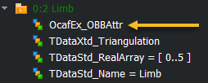
Custom Attr. / Implementation
bit of practice #18
Have a look at Plugin/Resource files: notice OcafExBin format.
Change application format to OcafExBin.
In main() function, change file extension of the saved document to .ottobock.
Run exercise: the file will be stored in a new format.
Copy OcafExLib.lib to the directory with Workbench binaries and try “ocaf-browse” command.
Extend ILimb interface to handle OBB attribute.
Store the new OcafEx_OBBAttr in the label for limb.
bit of practice #19
Dump OBB to cout to easily check its contents:
ILimb->SetOBB(limbObb);
ILimb->GetOBB().Dump();
Enlarge OBB manually and store the updated OBB in limb in another transaction.
Check the contents of updated OBB.
Undo changes and check the contents again: OBB attribute disappears!
To make undo/redo work:
complete Restore() and Paste() methods,
call this->Backup() in SetOBB().
bit of practice #20

Slide 30
Active Data framework

Slide 31
Active Data / Overview
The approach of dealing with OCAF via the interface objects (DAOs) has been industrialized into a common framework by OPEN CASCADE which was used several times as a basis for pre-/post-processing software.
History: Pre-/Post-processing framework similar to ANSYS Workbench.
Highlights:
Custom (user-centric) hierarchy is maintained via TDataStd_TreeNode attributes.
References are fulfilled with back-references.
Parametric dependencies are a part of the framework (TreeFunction objects).
Labels/attributes are completely encapsulated for the client application.
Undo/Redo, Open/Save, Copy/Paste, Find object, Delete object, etc.
Compatibility conversion tools are available.
Data model is pure object oriented: an object (Node) is defined as a set of its properties (Parameters).
Standard attributes are used, so the data scheme is more verbose than it could be if application-specific attributes were defined. Still, custom attributes are not restricted.

Slide 32
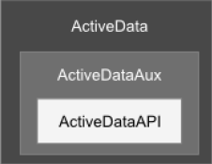
Active Data / Contents
Library | Purpose
ActiveDataAPI | Contains pure abstract classes (interfaces) for the main data types and utilities of the library. Think of this package as of an entry point to the Active Data framework.
ActiveDataAux | Some useful utilities which are not related to OCAF and data framework but intensively used internally.
ActiveData | Core classes representing the atomic blocks for constructing your data objects. This package also contains the algorithmic kernel of the framework (dependency graphs, undo/redo, copy/paste, etc.).
ActiveDataTestLib | Test engine. Contains launching mechanism for unit tests, parser of description files, report generator etc.
ActiveDataTest | Test cases. Normally these tests are launched automatically after compilation of AD libraries.
ActiveDataDraw | Draw extensions for working with Active Data via command line.
Dependency | Why?
OpenCascade | AD is based on OCAF. That is why OCCT is the essential groundwork for Active Data. Moreover, AD framework takes advantage of the entire OCCT ecosystem: we use the mechanism of smart pointers, standard OCCT collections and plenty of different tools.
TBB | This is the way how CPU-based parallelism is injected into AD. Basically, this dependency is not very strict and can be avoided.

Slide 33
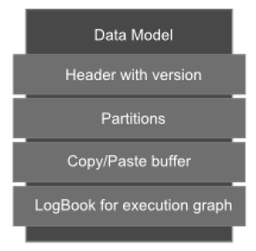
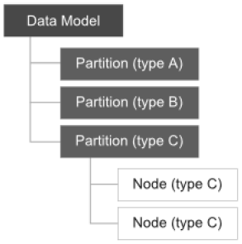
Active Data / Entities
There are the following main entities constituting the Active Data framework:
Data Model: holds OCAF document, provides all necessary services such as Open, Save, Undo/Redo, Copy/Paste, Find Node, etc. The Data Model unites Application and Document within one façade.
Data Partition: the collection of objects of a certain type.
Data Node: application-specific object.
Data Parameter: object’s property.
Tree Function: stores ID of an algorithm to run, its inputs and outputs.
DAO classes in Active Data are named Data Cursors.
Data Cursor | Purpose
ActAPI_IModel | The biggest Cursor. Normally you have only one Model instance for your data. It covers the entire project hierarchy.
ActAPI_IPartition | Interface for accessing a "folder" containing data objects of the same type. Using Partitions it is very easy to iterate over the objects of a specific type in their actual storage order (used internally by OCAF).
ActAPI_INode | Accessor to a data object. Your data object should be expressed as a collection of primitive-type properties called Parameters.
ActAPI_IParameter | Accessor to a primitive-type property of the data object. In Active Data framework this is the terminal type of entity: you are not supposed to deal with any entities which are "more atomic" than Parameters.

Slide 34
Active Data / Node statuses
Node statuses:
DETACHED: the Data Node is not bound to any raw data (TDF_Label) and cannot be used for data manipulation so;
ATTACHED + WELL-FORMED: the Data Node is charged with valid raw data and can be used for data manipulation so;
ATTACHED + BAD-FORMED: the Data Node is charged with invalid raw data. This may happen if the Data Cursor is moved to improper OCAF label or if the underlying data object is not yet initialized. This state of a Data Node gives you a limited access to the underlying data. E.g., you can populate the underlying OCAF and switch your cursor to a WELL-FORMED state so, but you cannot read the underlying data until you perform such population.
Design Limb Node in OcafEx using Active Data framework:
Create new Model class.
Create new Limb Node class.
Implement Populate() method in the Model class.
Save Model to file and Open it.
Recompile Active Data using “BinOcaf” as a format in ActData.h. Now the saved model can be opened with standard browsing tools (workbench, Draw’s DFBrowse, etc.)
bit of practice #21

Slide 35
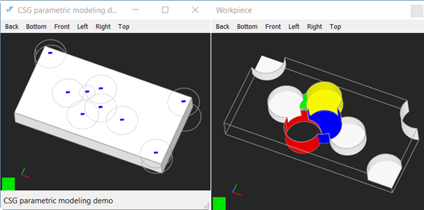
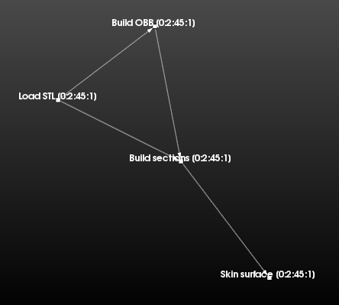
Active Data / Tree Functions
OCAF offers a mechanism which is similar to database triggers: when some object is changed, the framework can update its dependent objects. This functionality is useful for:
Constructing parametric models.
Connecting algorithms in Pre-/Post-processing frameworks.

Slide 36
Active Data / Tree Functions
Main entities:
TFunction_Scope: attribute which holds all labels having TFunction_Function attributes. All root functions can be taken from this attribute.
TFunction_Driver: function itself (the algorithm).
MustExecute() checks whether the function must be executed or skipped (based on logbook).
Execute() executes the algorithm reading its inputs from Arguments() and affecting the output labels from Results() method.
Arguments() returning the list of labels which are the inputs of a function.
Results() returning the list of labels which are the outputs of a function.
Note: Arguments() and Results() are enough to build a dependency graph. The graph is built with TFunction_IFunction::UpdateDependencies() function.
TFunction_IFunction: interface (DAO) which is constructed on labels having specific TFunction_Function attributes.
Logbook which stores all labels modified during the last transaction. The logbook is used at MustExecute() method of a function driver. To hold records persistently, the logbook should be allocated somewhere at OCAF hierarchy (invisibly for the users).
Prepare a Tree Function to load STL file to Limb Node.
bit of practice #22

Slide 37
UI Workbench

Slide 38
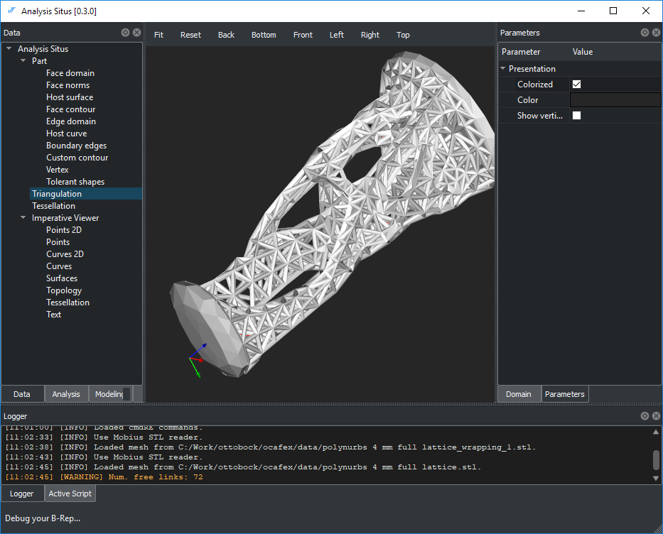
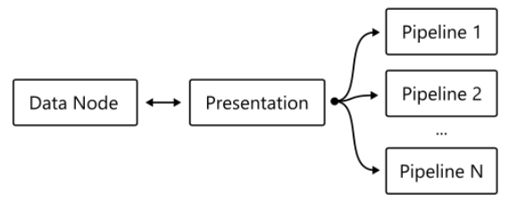
UI Workbench / Overview
Test Workbench is aimed to demonstrate how OCAF can be integrated into a basic engineering application together with the following technologies:
CMake for configuration.
Qt for user interface.
VTK for visualization.
OpenCascade for modeling.
Active Data as a data framework.
Eigen for linear algebra.
Compile UI workbench.
Check the architecture of VTK-OCAF integration.
Create Tree functions for:
loading STL file,
building OBB,
constructing section planes,
skinning the surface,
extending the surface,
deviation checks.
bit of practice #23

Slide 39
B-Rep Anomalies and Elements of Shape Healing

Slide 40
Shape Healing Elements / Types of defects
A careful analysis of CAD model validity should employ thinking at several levels of abstraction:
Consistency of representation
Geometric validity (parameterization irregularities, curve/surface self-intersections, parametric discontinuities, etc.). The geometric validity checks are concerned with the mathematics of form. The input data for those checks are the equations of curves and surfaces while the verification methods usually employ some computationally expensive algorithms (intersection tests, sampling, evaluation of derivatives, etc.).
Topological validity (orientations of boundary elements, face/solid closeness, formal shape structure, etc.). The topological validity checks are concerned with the syntactical analysis of the model and perform verification of the data structure consistency.
Validity w.r.t. the design intent
Dirtiness of presentation (e.g., spline surfaces where canonical geometry is a better fit).
Fitness to functional requirements.
The analysis of the design intent requires the understanding of the function of the part, its manufacturing constraints and other reasoning which may often require human intervention. The following rule often works in practice: to fix the problem of a lower level, it is necessary to rise to the upper level of abstraction. E.g., to correctly fill a gap due to a missing face, it might be necessary to recognize and recover its containing feature (e.g., to extend and intersect surfaces rather than to patch a hole with a NURBS surface).
The reasoning on the validity of a CAD model should always be based on its application domain. E.g., self-intersection defects might be critical for mesh generation algorithms while they often have zero impact on specific modeling procedures such as unfolding of sheet metals

Slide 41
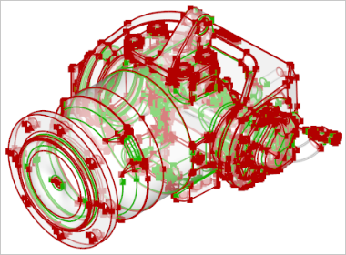
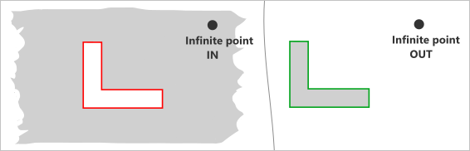
Shape Healing Elements / Consistency of repr.
Check | Description
Euler-Poincare property | To check v - e + f = 2(s - h) + r, where v is the number of vertices, e is the number of edges, f is the number of faces, s is the number of shells, h is the genus of the manifold, and r is the number of internal loops.
Orientation of vertex in edge | To check if the vertices of the part are distinguishable by their orientation flags. A valid edge should have one FORWARD vertex and one REVERSED vertex to properly signify its topological extremities. As a result of some poorly implemented modeling operators, this rule may appear to be violated.
Orientation of edge in wire | The edges should be oriented so that their owning contour is traversed in a determined order (clockwise or counterclockwise).
Orientation of wire in face | The wire should be oriented so that the material of its owning face is either enclosed (for the outer wires) or lies outside (for holes).
Orientation of face in solid | The faces of a solid model should be oriented so that to point outwards the bounded volume. This requirement is relaxed for surface modeling (shells).
Contour closeness | To check if the contours of the part faces are closed (have no gaps).
Solid closeness (finiteness) | To check if the solid body is finite. It should be noted that in some workflows infinite volumes are perfectly valid.
Open (naked) edges | The open edges (those owned by less than two faces) are valid for shells and prohibited for solid models. To fix this problem, face stitching (sewing) algorithm might be necessary.

Slide 42
Shape Healing Elements / Consistency of repr.
Check | Description
Missing face (gap) | The gap filling algorithm is required to fix this anomaly.
Intersection and overlapping of surfaces | All surface intersections should be resolved by inserting the corresponding topological primitives (vertices, edges or patches in case of overlapping). If surfaces interact while having no topological resolution, the shape is considered locally faulty. Intersections or overlaps of the trimmed NURBS surfaces are a huge challenge for healing algorithms [Frischmann, F. 2011. Topological and Geometric Healing on Solid Models. Master's thesis].
Singular surface points | Surface degeneracies usually occur due to the coincidence of NURBS control points. Such surfaces are often used to represent triangular patches, e.g., in ship hull design. Even though the singularity points are usually allowed by a modeler, their existence may cause problems in subsequent operators (e.g., offsets).
Missing 3D curve | The 3D curve is a primary edge representation. If the 3D curve does not exist, it is clearly a problem. To fix the issue, the corresponding p-curves should be evaluated against their host surfaces. The obtained points are then reapproximated.
Missing p-curve | In OpenCascade kernel, the primary 3D curve should be followed by its images in all surface patches meeting at this curve. These p-curves can be recovered by projection of a 3D curve to each host surface.
Non-synchronous parameterization of curves | The 3D curves and the corresponding p-curves should be parameterized synchronously, so that they yield identical points for the same parameter value (with tolerance).
Missing seam | The seam edges correspond to a period value of a periodic surface. These edges are necessary to close the parametric domain of a face. Not all geometric kernels use the notion of seam edges, so it is necessary to recover them sometimes after data exchange.
Non-manifoldness | A boundary surface is two-manifold if it is homeomorphic to a disk in the neighborhood of every point (i.e., resembles a two-dimensional Euclidian space near each point. Non-manifold vertices, edges and faces might be perfectly valid if they are modeled like this intentionally. Otherwise, the existence of non-manifold boundary elements might be a problem for subsequent modeling operators and manufacturing planning (such models are clearly non-manufacturable).
Unexpected shape type | It sometimes happens that the visually fine, closed models are defined as shells instead of being formal solids. Other examples include single faces defined as shells or compound parts wrapping a single result of a solid Boolean operation. These anomalies can be traced down using a topology graph representation of B-Rep model. The graph will contain excessive nodes and/or nodes of improper type.
Tolerance inclusion | A geometric tolerance of a vertex should not be less than a geometric tolerance of an edge. A geometric tolerance of an edge should not be less than a geometric tolerance of a face.

Slide 43
Shape Healing Elements / Dirtiness
Check | Description
Non-canonic geometry | Example: a geometrically planar surface represented with a NURBS surface.
Small edges | Sometimes a CAD model contains excessive number of small (usually straight) edges which are hard to treat numerically (e.g., when generating FEA meshes). Such edges can be enlarged by reapproximation.
Small faces | It is possible to merge small faces by reapproximating them.
Non-maximized boundary elements | Face/edge maximization is usually performed as a post-processing stage of a Boolean operation.
High geometric tolerances | Maintaining high-fidelity B-Rep is a challenge. Geometric modeling kernels, such as OpenCascade or Parasolid, implement "tolerant modeling" approach. I.e., instead of using a global geometric inaccuracy, each boundary element (vertex, edge and face) has its own associated imprecision value called [geometric] tolerance. A visually fine B-Rep model may contain significant geometric flaws like small gaps between faces or wild parameterization of curves.
C0 geometry | The support of C0 geometric primitives is limited in all geometric kernels. It is usually a good idea to split such entities with the relevant boundary elements (vertices or edges) to enhance the smoothness of the geometry. Alternatively, for NURBS curves and surfaces, it is possible to remove knots if the shape is geometrically continuous though parameterized improperly. The knot insertion algorithm can also be applied for non-G-smooth geometric elements if a certain deformation (within the prescribed tolerance) is allowed.
Nested local transformations | In OpenCascade kernel, each topological element might be assigned with a local transformation to place it relative to its parent element. While this capacity of the modeler is convenient for representing assemblies as compounds, we discourage using the transformed boundary elements in a single solid representation. Formally speaking, a local transformation is a property of an arc in the topology graph. In Analysis Situs, it is possible to colorize the arcs for a visual check of internal transformations. It is Ok to have a local transformation for in-compound inclusions and not Ok to have them deeper in the graph.
Non-beautified model | A beautified geometric model is a modification of the input model that incorporates appropriate symmetries and regularities. Beautification-pending models usually emerge as a result of reverse engineering of a B-Rep model from a discrete dataset (point clouds, mesh).

Slide 44
Shape Healing Elements / Fitness
Check | Description
Too many details | he overcomplicated CAD parts may require simplification prior to the engineering analysis, manufacturing planning, data interoperability, visualization, etc. To simplify model, the defeaturing techniques should be employed.
Insufficient thickness | Thickness is a severe requirement, e.g., in die casting manufacturing.
Invalid sheet metal | Non-existing bends or non-constant sheet thickness is somewhat unexpected in sheet metal working.

Slide 45
Shape Healing Elements / Invert face
Here is an example how to reverse a face.
void buildTopoGraphLevel(const TopoDS_Shape& root,
const TopoDS_Shape& face2Invert,
TopoDS_Shape& result) const
{
BRep_Builder BB;
// NOTICE: we enable accumulation of locations because TopoDS_Builder::Add()
// recomputes the relative transformations. So if we do not accumulate
// transformations here, we will have an improperly placed result.
// E.g., imagine that your root shape is transformed.
for ( TopoDS_Iterator it(root, false, true); it.More(); it.Next() )
{
const TopoDS_Shape& currentShape = it.Value();
TopoDS_Shape newResult;
if ( currentShape.ShapeType() < TopAbs_FACE )
{
newResult = makeShape( currentShape.ShapeType() );
this->buildTopoGraphLevel( currentShape, face2Invert, newResult );
}
else
{
if ( currentShape.ShapeType() == TopAbs_FACE && currentShape == face2Invert )
newResult = currentShape.Reversed();
else
newResult = currentShape;
}
BB.Add(result, newResult);
}
}

Slide 46
That’s all.

