Slide 1
Reasonable Software
Code and processes you can reason about
@ijohnson_tnf

Slide 2

About me…
Pronouns: He/Him/His
Software developer for 18 years
Passionate about maintainable code
Currently working at Redgate
Loves sketch-noting
@ijohnson_tnf

Slide 3
Agenda
What is reasonable?
Reasonable processes
Reasonable user interaction
Discover, evaluate, refactor(?)
And useful tools to help with this process
Reasonable code
@ijohnson_tnf

Slide 4
What is reasonable?
Almost anything can be reasoned about given enough effort, time and energy.
Only the justifiably complex things should require that effort we should aim in everything else to avoid accidental complexity.
We should work hard to avoid complicating simple things in order to make REASONABLE with the least amount of effort.
@ijohnson_tnf
Notes:
The difference between SIMPLE and FAMILIAR… when you are FAMILIAR with a tool you start to think that things are simple, but true simplicity does not require that familiarity

Slide 5
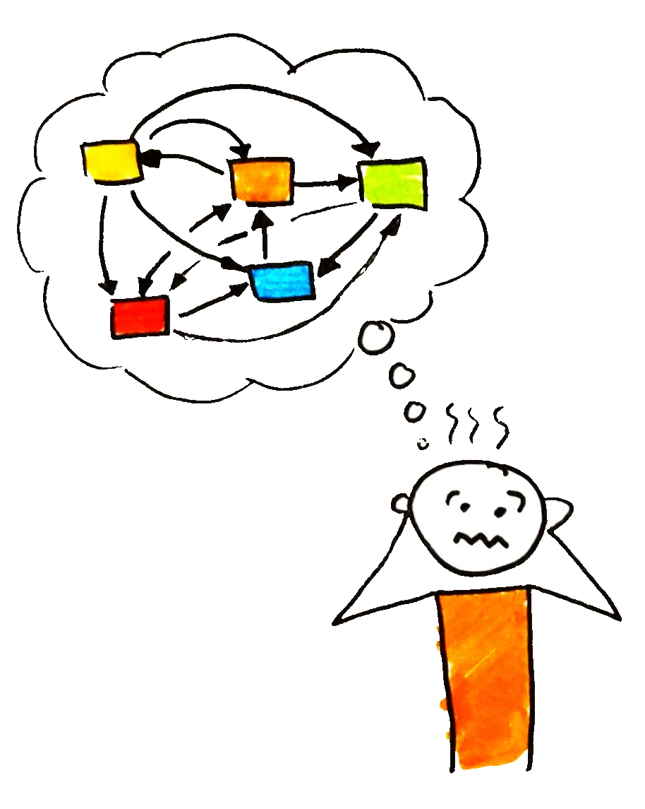
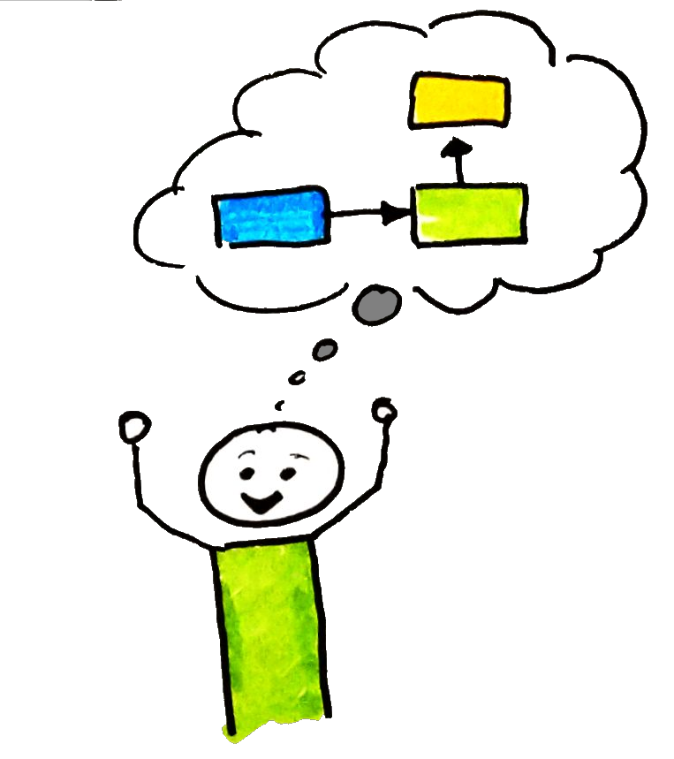
What is reasonable?
Less Reasonable
More reasonable
Cleaner
Small simple components
Coupling
Predictability/Consistency
Clearer responsibilities
DOES IT FIT IN YOUR HEAD?
@ijohnson_tnf
Notes:
This is not just about coupling within the code, this is about coupling within an organisation too, about how many people are coupled to processes, about decision making etc

Slide 6
Reasonable human interaction
In the company
In the team
In the wild open-source world
Reasonable user interaction
@ijohnson_tnf
Notes:
So we’ve had a brief discussion about some of the areas that make things reasonable, that we should be able to reason about the code and our processes so that we can predict what will happen, we can act in some degree of safety without having to hold the entire world in our heads

Slide 7
Reasonable interaction in the company
Clear values
And reward those values
Well-defined policies
Decisions made at the right level
Autonomy within boundaries
Clear vision/mission
Help people to make better decisions
@ijohnson_tnf
Notes:
We like autonomy… but in most companies there is rarely total autonomy for an individual/team, there are boundaries on their powers to make decisions (whether hidden or not) so trying to make these boundaries clear is important. Also, give examples, give some ideas of points of conflict (e.g. the manager is away, do the team make this kind of decision or do they escalate up)

Slide 8
Reasonable team interactions
Clarity of values
Understanding your colleagues
Documentation
“Getting started” guides should work
Contribution guidelines
Clear tasks
Definition of done
Team safety
Automate
@ijohnson_tnf
Notes:
Understanding your colleagues, what are they like when they are happy, passionate about something, when they are down, what are their emotions at the moment? How do they react in different moods? Knowing how to work with the team allows you to get the best out of them.
People should feel free to express opinions
People don’t have to agree but they should disagree constructively
Talk about how our team have used the occupy hand signals because we were struggling to get the communication right, we introduced a process that helped us communicate which allowed us to make better decisions.
To help your team mates you need to be predictable in your interactions, you should understand your own emotions, feelings. There will be days when you are not in the right mood to engage in lengthy debate, you might feel defensive, you have to be honest with the team and sometimes trust them to make decisions, or to postpone discussions.

Slide 9
Reasonable open source processes
README
How do I use this framework/library?
How to build/run?
Do the instructions work? Are they tested?
Contribution guidelines
Explain what it means to be a good contributor
Hold yourself to these same standards
Explain what they can expect from you
Time to review of pull reviews etc
Clear and consistent APIs
@ijohnson_tnf
Notes:
Put yourself in the shoes of someone coming new to the project
Why are they coming to this project?
Are they someone looking to use the framework/library?
Are they a new starter to the team wanting to get started with the product?

Slide 10
Reasonable user interaction
YOU ARE NOT THE TYPICAL USER
You are too close to the code to truly appreciate how usable it is
Who is a typical user?
What do they do?
What do they need?
For a typical user…
Frequent, repetitive tasks should be instinctive and quick
Or automated
Complex, infrequent tasks can be less usable
Functionality needs to be discoverable
Consistency improves reasonability
@ijohnson_tnf
Notes:
This is not just about user interfaces, this is also about APIs for frameworks/libraries.
Consistency means that people start to learn the patterns of interaction with your product/API

Slide 11
Discover, evaluate, refactor(?)
D.R.Y.
S.O.L.I.D
C.Q.S.
Design patterns
Connascence
@ijohnson_tnf
Notes:
So we have looked at how we can be more reasonable in our interactions, that other developers are consumers of what we do, that as a company and as a team we have a responsibility to each other to work together. That it is important to know who the users of your code are and we should ensure that our documentation is appropriate and accurate.
These are tools that we can use to discuss and improve our codebases, the first step in any change is to know the problem exists, to evaluate

Slide 12
Useful tools: Don’t Repeat Yourself
You see the same pattern repeated
1st time write a custom implementation
2nd time write a custom implementation
3rd time write a custom implementation
THEN REFACTOR to shared solution
BEWARE OF OVER-GENERALISATION
@ijohnson_tnf
Notes:
Over-generalisation of the code means that the code becomes difficult to reason about. We are in danger of adding complexity to the generic object to support all of the edge cases needed by the specific usages

Slide 13
Useful tools: S.O.L.I.D.
Single responsibility principle
An object should only have one reason to change
Open-Closed principle
Objects/entities should be open for extension but closed for modification
Liskov substitution principle
Every object derived from a type can be substituted for one another
Interface segregation principle
An entity should never be forced to implement something it does not need/intend to use
Dependency inversion principle
High level modules should not depend on low-level modules, dependencies should be abstract
@ijohnson_tnf
Notes:
Open Closed can be achieved by writing new code, wrapping in decorators, composites etc
Liskov comes with a bit of an issue when it comes to handling exceptions, if I replace a SQL Server backing store with a MongoDB backing store different exceptions but should the client know how to handle both sets of exceptions? Java introduced checked exceptions but people are lazy, got bored and “throws Exception” became prevalent. The idea was to force people to wrap exceptions in a specific type to add context and give clients a limited number of exceptions to follow.

Slide 14
Useful tools: C.Q.S. (Command-Query Separation)
Commands
Return void but change state somewhere in the system
Queries
Return values, perform calculations
Do not change state
@ijohnson_tnf

Slide 15
Useful tools: Design patterns
Patterns that have evolved over time
Often built on the S.O.L.I.D. principles
The patterns have a name
They are used to express intent
They can be unfamiliar to new people
They can be over-used
E.g. FooBarStrategyBuilderFactory
@ijohnson_tnf
Notes:
Many of the kinds of connascence are needed for a systems to work. We share the connascence of algorithm to pull down a gzipped resource from the web, we share connascence of type or of meaning in the values that are passed, even the URLs we share are a connascence of value (to an extent)
In 2003, Netgear routers were hard-coded to point to a single time server, this effectively provided a Denial of Service attack, against the university of Wisconsin’s time server. Eventually they had to change the address of their NTP server and the routers were then left without any way to connect up to a time server.

Slide 16
Useful tools: Connascence
Static
Name
E.g. name of a method
Type
E.g. the type of a parameter to a method
Meaning
E.g. string orderDate
Position
multiple entities agree on the order of elements
Algorithm
multiple entities agree on an algorithm
E.g. base64 encoding
Dynamic
Execution
Where the order of execution of multiple elements matters
foo.Init(); foo.Bar();
Timing
Threading?
Value
E.g. magic numbers in methods
Identity
Singleton instances, single points of failure, baked into the system
Weaker = Better
Prefer static over dynamic
@ijohnson_tnf
Notes:
Many of the kinds of connascence are needed for a systems to work. Coupling has to occur but we should aim for static over dynamic and weaker over the stronger
Meaning, if I don’t have a type for order date then many places in the code may have to validate the format, convert it to a DateTIme to perform operations. Prefer using a DateTime type where possible
Position – if you have an array of strings and the first element is the first name, the second element is the surname and the third element is the date of birth, if we change the ordering within the collection then we have to change anywhere that parses this collection. Prefer a type. This can also be seen in dynamic languages, e.g. Javascript where the order in which you pass in methods matters but there is no help for the user, changing the function declaration will lead to broken code as all consumers will have to be evaluated and fixed, if needed
In 2003, Netgear routers were hard-coded to point to a single time server, this effectively provided a Denial of Service attack, against the university of Wisconsin’s time server. Eventually they had to change the address of their NTP server and the routers were then left without any way to connect up to a time server.

Slide 17
Reasonable code
Layers of abstraction
High level architecture
Service API
Internal architecture
Class/interface design
Methods
In a single line of code
Tests
@ijohnson_tnf
Notes:
So, I’ve talked about what I mean about reasonable, about our processes, I’ve talked about how tools like DRY, SOLID, CQS, Design Patters and Connascence can help us discover, talk about and reason about potential refactorings in our code.
So now let’s take a look at the architecture/code itself

Slide 18
Layers of abstraction
Focus on the current layer of abstraction
It should fit in my head
I should trust the API
That I am looking at
And the APIs of the things I am consuming
The names should be clear
The responsibilities should be clear
There should be some tests
Maybe even submitted by the clients to simulate their specific usage?
I should not need to hold the entire system in my head
@ijohnson_tnf

Slide 19
High-level architecture
Components should be named well
Components should be documented
How do they interact?
Events
API calls
RPC
Does it make sense to operations?
How are services monitored?
Is there trouble-shooting guides?
Are there any single points of failure?
@ijohnson_tnf
Notes:
At the highest level you should know who your target audience is.
For the most part, if I’m developing a new feature I should be able to reason about where in the architecture it should fit and how to implement it
For operations I care about how the things work, how they are monitored, how will I know if something is going wrong

Slide 20
Service API
Documentation
Versioning strategy
Sensible error codes/messages
Have you produced a client library for the API?
What patterns are being used?
E.g. ReST, RPC, Messaging
Is this a long-running process?
If so, how do I know when it is done?
@ijohnson_tnf
Notes:
Who are the consumers of the API? Internal systems or are there external people? Perhaps the documentation could be tests internally, or example applications
Does this even matter? Even if this is internal you will have new developers starting at your company, do they have to deal with trial and error?
If long-running, do you hold the connection open? Do you have a separate URL to poll for progress? Are you using websockets?
Versioning, if you are parsing JSON for requests/responses/events then normally older clients/servers can cope with additions to the types, but deletions or changes to the existing properties are breaking changes. Yet there is still some coupling, the BEHAVIOUR change may be a breaking change due to Connascence of Execution, Connascence of timing
Using consistent patterns

Slide 21
Class/interface design
Clear naming
Of the class
Of the methods/properties
Number of methods/properties
Mutable/Immutable?
Is it thread safe?
What level of documentation?
@ijohnson_tnf
Notes:
Do we have versioning issues if this is part of the surface area of the assembly? Is it externally visible? What would a first time user of your class need to know? Does this obey Liskov for the types it is derived from?
What about documentation? We should avoid pointless repetition “connectionString” – “The connection string” – any docs around this class should add meaning, explain why

Slide 22

Class/interface design cont’d…
public abstract class Component
: IDisposable
{
IHandle Handle { get; }
Component Parent { get; set; }
void Init();
void RegisterChild(Component child);
void SetParent(Component parent);
void Render();
}
@ijohnson_tnf
Notes:
So we have Connascence of Execution…
… does Init need to be declared before we call RegisterChild/SetParent?
… do I need to call RegisterChild, or SetParent? Will one call the other? Will they work it out themselves?
… what happens when call Handle before I call init? Or after Dispose?
… Why are there two ways to set the parent?
… Can I change the parent later or is that not allowed?
… Do I need a parent to render?

Slide 23
Class/interface design cont’d…
public interface IConnectionDetails
{
…
IConnectionDetails MasterConnection { get;}
…
}
public class MasterConnectionDetails
: IConnectionDetails
{
…
MasterConnectionDetails MasterConnection
{
get { // WTF???? }
}
…
}
connectionDetails.MasterConnection.MasterConnection.MasterConnection…
@ijohnson_tnf
Notes:
This was something I saw in a product I once worked on. The idea was that, given a connection details, I should be able to get the connection to the Master database on the server.
However, does this belong on the connection details or is their some utility function that we can produce to make the master database connection

Slide 24
Class/interface design cont’d…
WTF….
@ijohnson_tnf
Notes:
Look at the Expression.cs class
Try to explain what happens through the flow of this class.

Slide 25
Methods
Visibility
Parameters
public void Add(ILog log, Item item)
public void Add (Item item, ILog log)
Set expectations
Naming
Convention (C.Q.S.)
How big is the method?
Does it only have one responsibility?
@ijohnson_tnf
Notes:
The visibility of the method matters, if it forms part of the public surface area of an assembly then the does it need documentation? Is it an internal assembly or something that people external to your team will be consuming? We possibly have to think about versioning at some point too.
Should the log be a dependency of the class? Or is the log specific to the thing we are current doing?
We set expectations with the name of a method ‘GetFoo’ probably suggests that we are not changing state

Slide 26
Each line of code is important
Variable naming is important, e.g.
if (l1 > l2) {…}
People get Boolean logic wrong, keep your if’s simple
Don’t make me think!
foo != bar ? foo != baz ? baz : foo : bar
@ijohnson_tnf

Slide 27
Tests
WRITE TESTS!
Treat your test code as if it were production
Clean code
Simple to read
What you are testing should be clear!
Good tests can document a class
@ijohnson_tnf

Slide 28
Questions
@ijohnson_tnf

