Slide 1
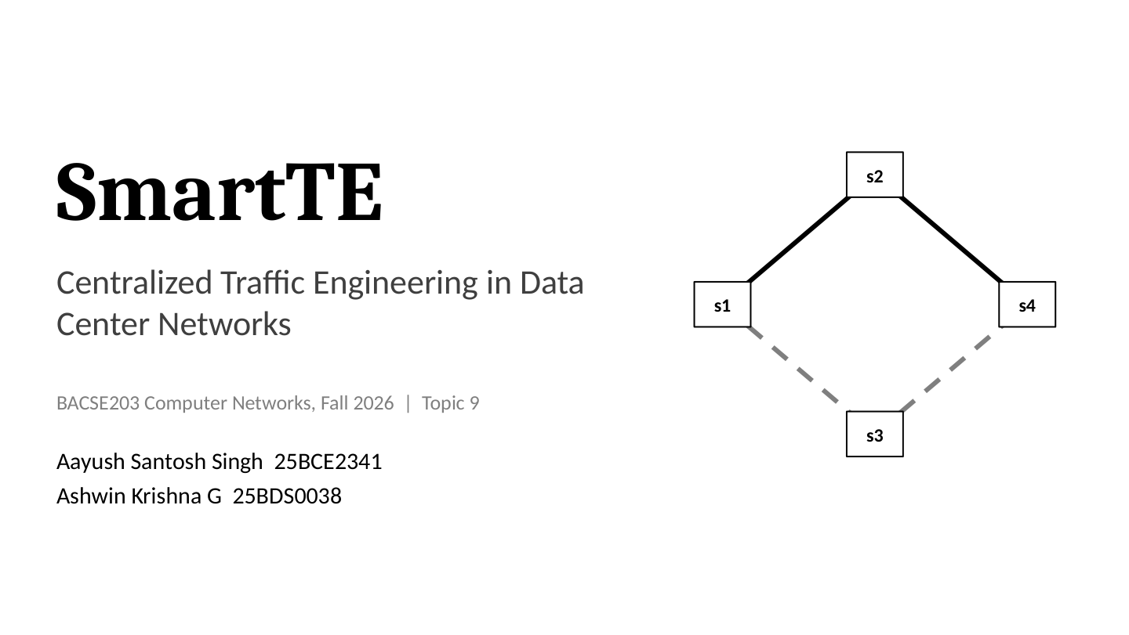

Slide 2
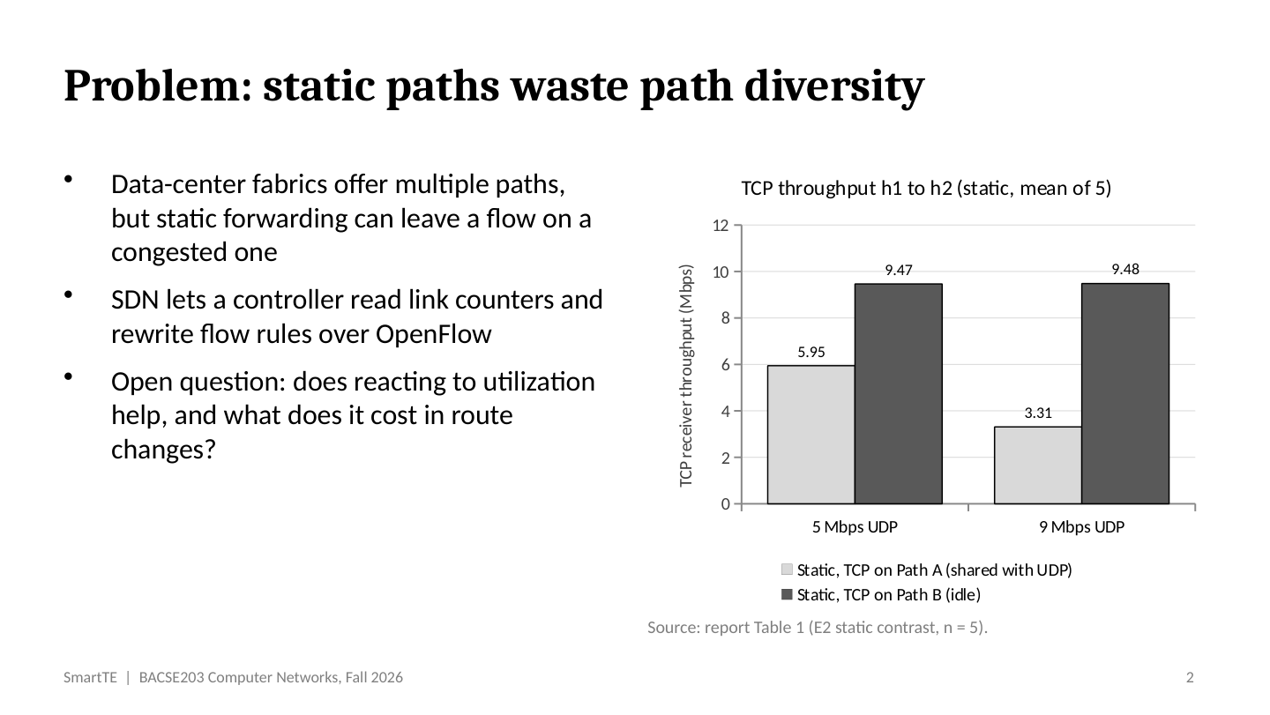

Slide 3
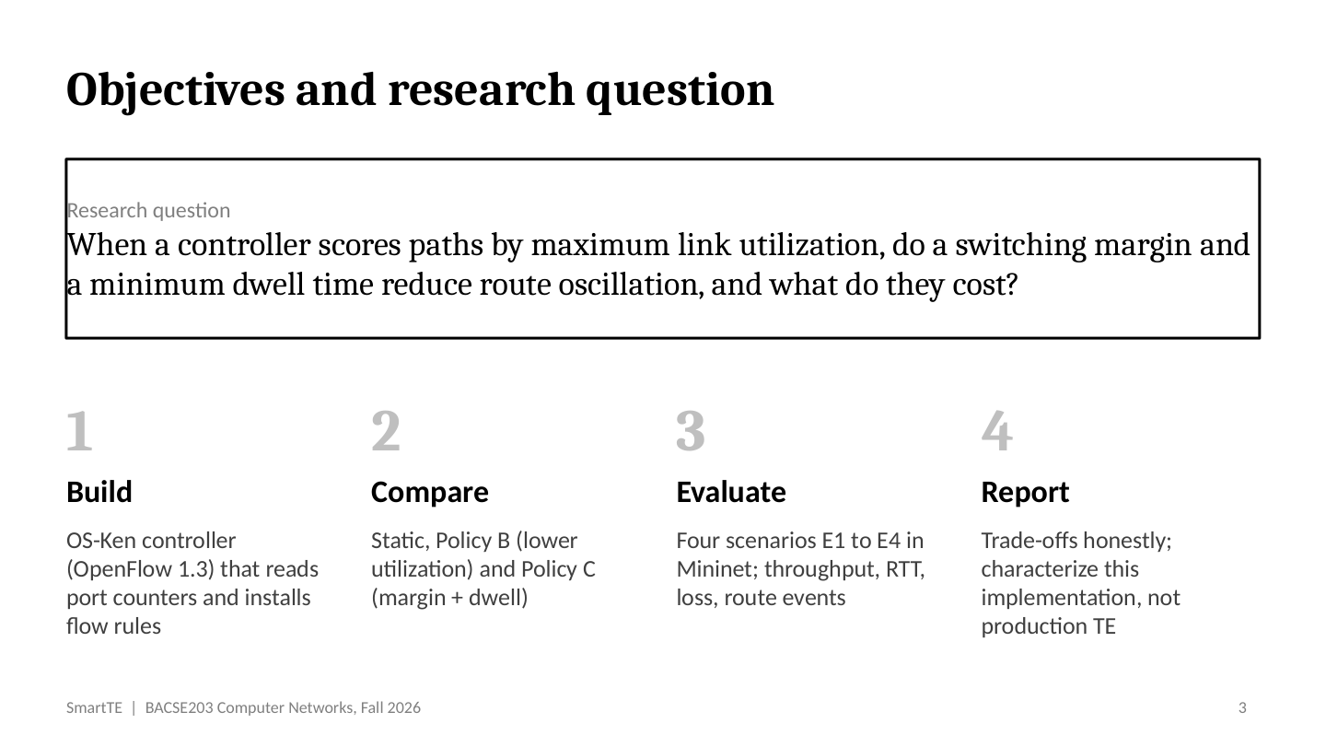

Slide 4
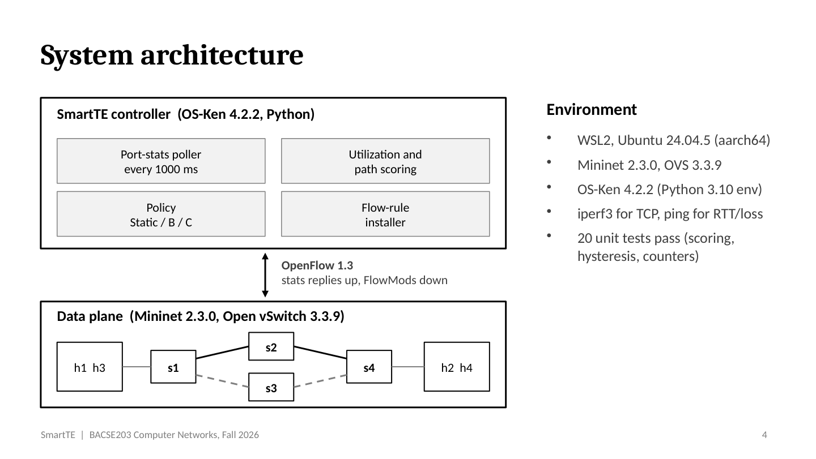

Slide 5
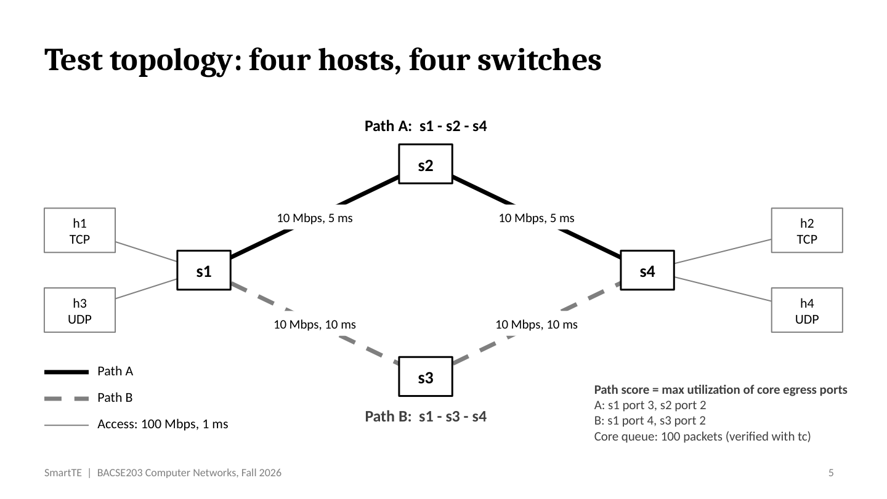

Slide 6
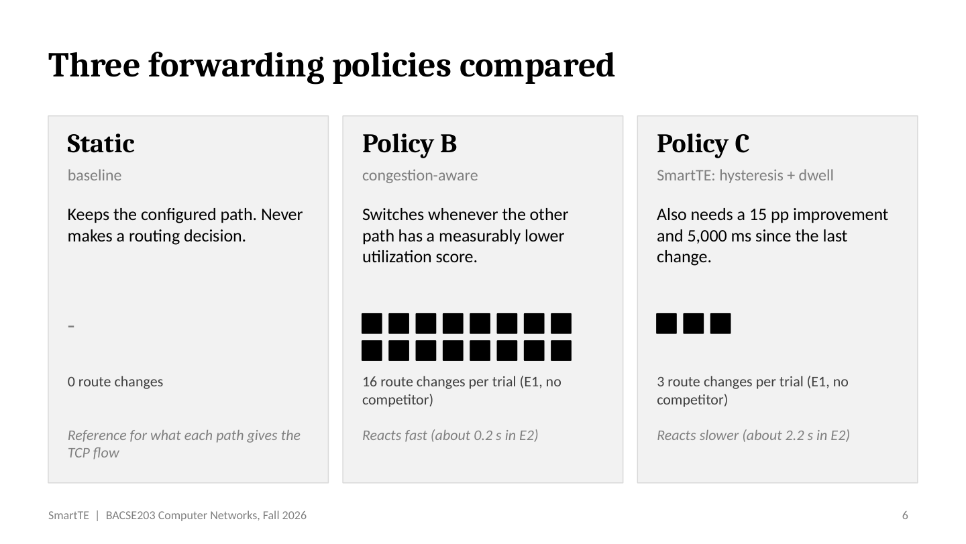

Slide 7
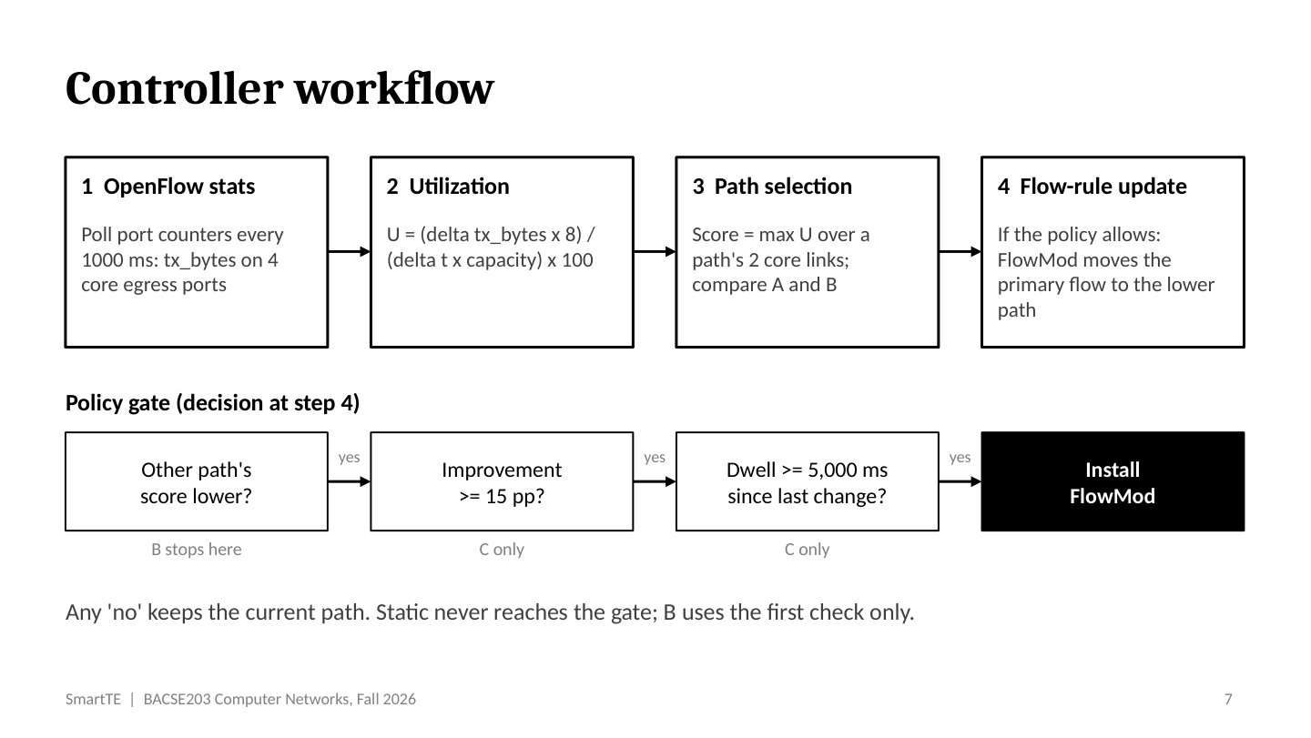

Slide 8
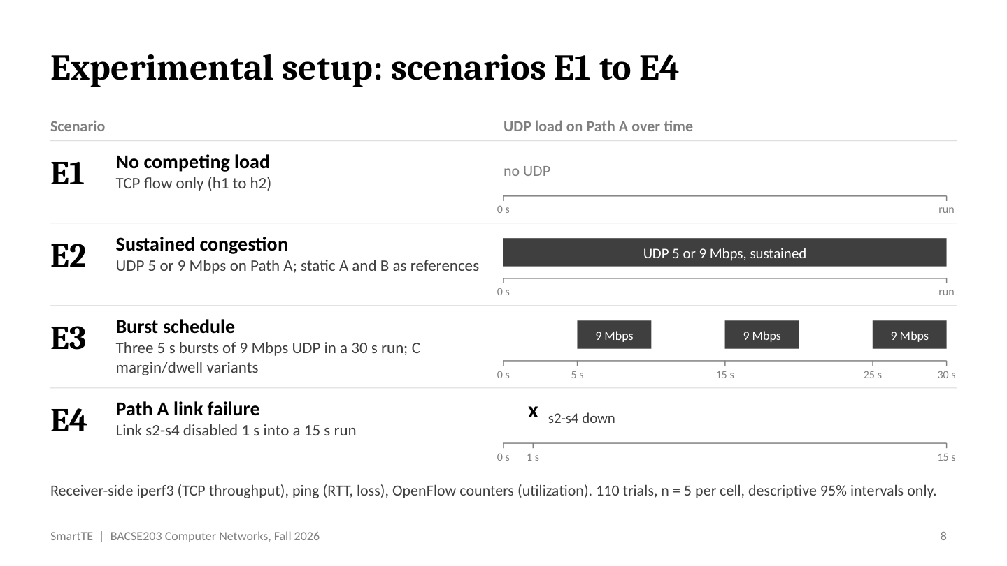

Slide 9
SmartTE | BACSE203 Computer Networks, Fall 2026
Congestion results: throughput, RTT and packet loss (E2)
Mean [descriptive 95% CI]; five trials per condition. Ping loss is receiver-side ICMP loss.
UDP load
Policy / path
TCP throughput (Mbps)
Mean ping RTT (ms)
Ping loss (%)
5 Mbps
Static (A)
5.95 [5.83, 6.06]
159.86 [145.37, 174.35]
3.40 [0.54, 6.26]
Static (B)
9.46 [9.40, 9.53]
195.68 [169.36, 222.00]
1.60 [0.49, 2.71]
Policy B
6.26 [5.96, 6.56]
51.80 [49.79, 53.81]
10.60 [3.99, 17.21]
Policy C
7.44 [7.30, 7.58]
140.72 [136.63, 144.81]
4.40 [3.29, 5.51]
9 Mbps
Static (A)
3.31 [3.16, 3.46]
152.75 [142.46, 163.03]
5.20 [1.54, 8.86]
Static (B)
9.48 [9.45, 9.52]
203.64 [185.71, 221.56]
1.20 [0.00, 2.82]
Policy B
6.22 [5.76, 6.68]
68.31 [60.15, 76.47]
12.20 [7.69, 16.71]
Policy C
9.45 [9.43, 9.47]
206.71 [187.90, 225.52]
1.40 [0.72, 2.08]
At 9 Mbps, Policy C preserved TCP throughput but had higher RTT; Policy B had lower RTT but higher ping loss.
Intervals are descriptive t-based 95% CIs (n = 5); ping-loss lower bounds are clipped at the physical limit of 0%.
Source: processed campaign m5_campaign_20261011T115819Z, E2-congestion metrics_summary.csv.
9

Slide 10
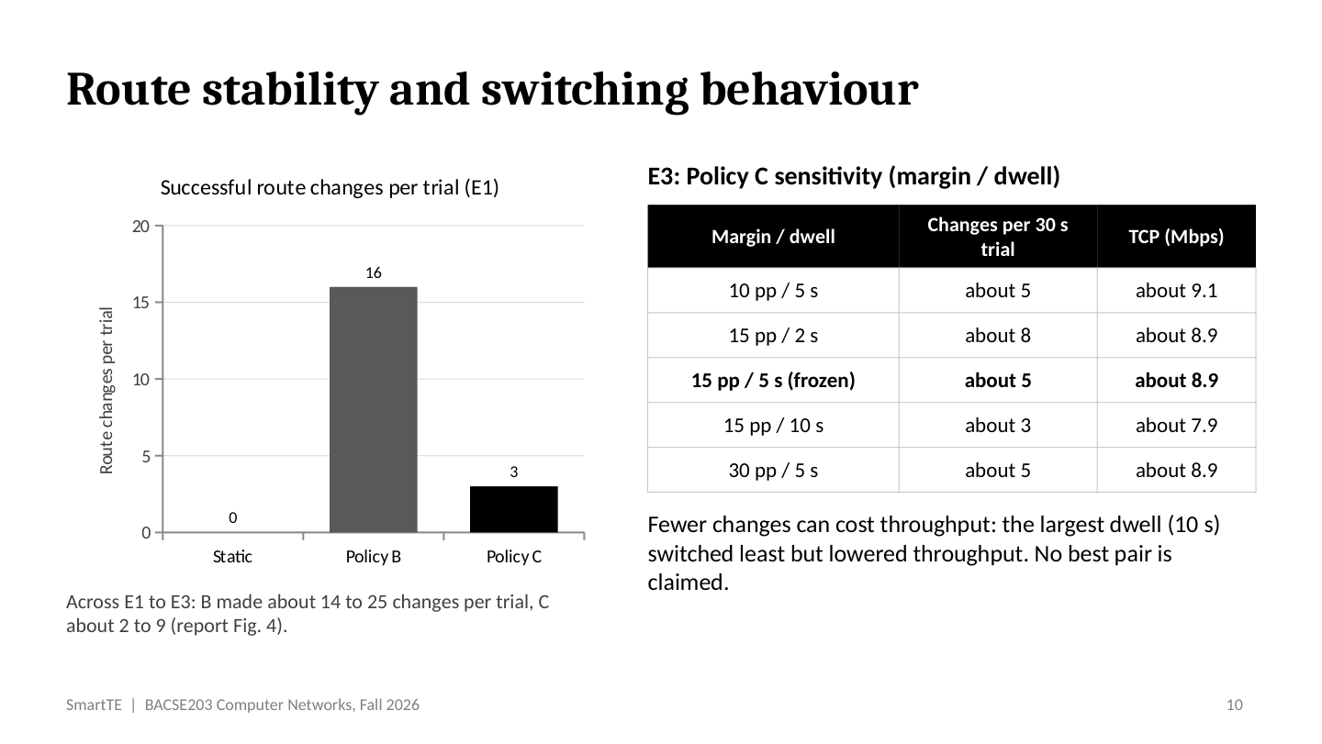

Slide 11
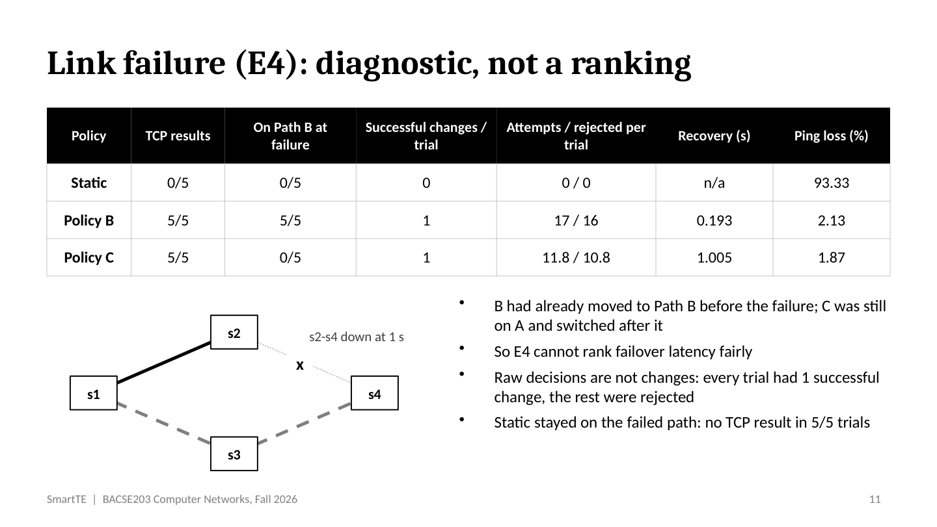

Slide 12
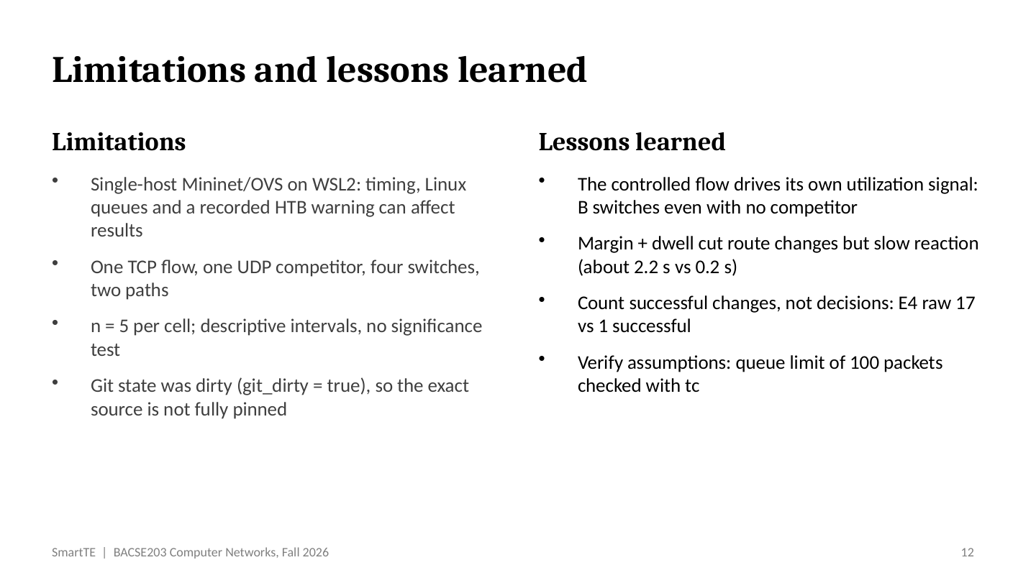

Slide 13
SmartTE | BACSE203 Computer Networks, Fall 2026
Literature review and research gap
Prior work motivates the problem; SmartTE tests a narrower, implementation-specific question.
What prior work establishes
Research gap addressed here
Centralized traffic engineering
Not a novelty claim
B4 and SWAN coordinate paths with demand, rates and priorities at WAN scale [8, 9].
Centralized traffic engineering and route-stability mechanisms are established; this project does not claim otherwise.
Data-center multipath
Bounded experiment
Hedera, MicroTE and CONGA use global scheduling, traffic patterns or distributed congestion signals [7, 11, 19].
Under one two-path topology and periodic max-link-utilization score, compare lower-score switching (B) with a 15 pp margin plus 5 s dwell (C).
Stability and safe updates
What we measure
ECMP disruption, consistent updates and hybrid-routing instability are distinct concerns [2, 13, 14].
Successful route changes alongside TCP throughput, ping RTT/loss and controller observations across E1–E4.
Contribution: a controlled emulation of this feedback loop, not a direct benchmark against production systems.
Evidence boundary: 110 trials, n = 5 per cell; descriptive intervals. No universal superiority or statistical significance is claimed.
13

Slide 14
SmartTE | BACSE203 Computer Networks, Fall 2026
Comparison with representative research
Different scopes and evaluation methods: this is a conceptual comparison, not a numerical benchmark.
Work | Approach / evidence | Relation to SmartTE
OSPF / ECMP [1, 2, 15, 16] | IGP link-weight optimization or per-flow hashing; protocol analysis and network-wide studies. | Different control granularity; not this per-poll centralized congestion feedback.
Hedera / MicroTE / CONGA [7, 11, 19] | Large-flow scheduling, traffic-matrix prediction or distributed congestion feedback; data-center studies. | More global flow context or in-network coordination than SmartTE's one-flow, two-path setup.
B4 / SWAN [8, 9] | WAN-scale path, rate and priority coordination; production, prototype and data-driven evaluation. | Different scale and objectives; SmartTE does not allocate rates or claim comparable performance.
Reitblatt / Tseng [13, 14] | Consistent network updates and routing-stability methods; formal mechanisms and simulation. | Update correctness and stability are related but distinct; SmartTE measures a margin/dwell policy in emulation.
SmartTE (this study) | OS-Ken/OpenFlow 1.3; 1 s port-counter polling; Static vs B vs C in Mininet E1–E4. | Measures throughput, RTT, ping loss and successful route changes; bounded evidence (n=5 per cell).
Sources: report references [1], [2], [7]–[9], [11], [13]–[16], [19].
14

Slide 15
