Slide 1


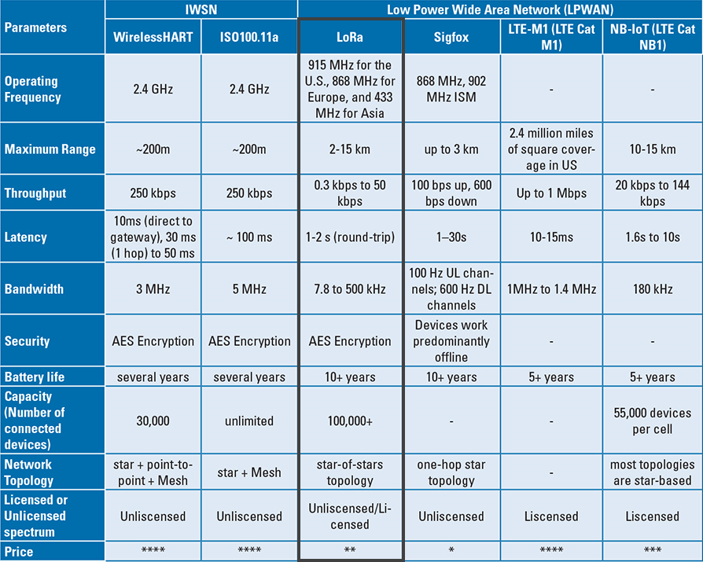
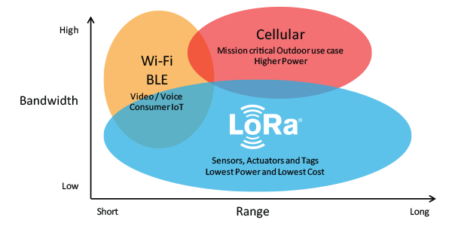
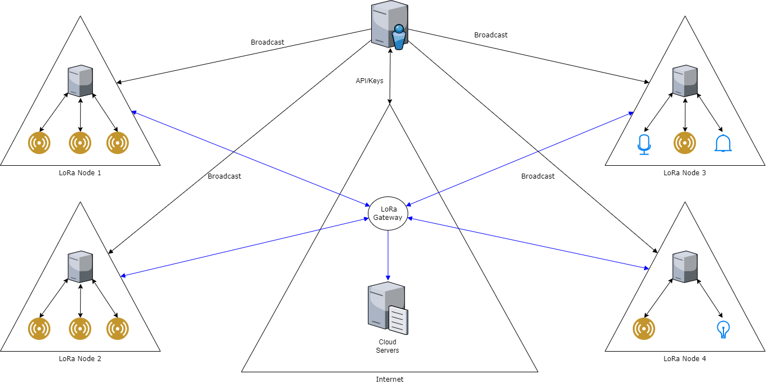
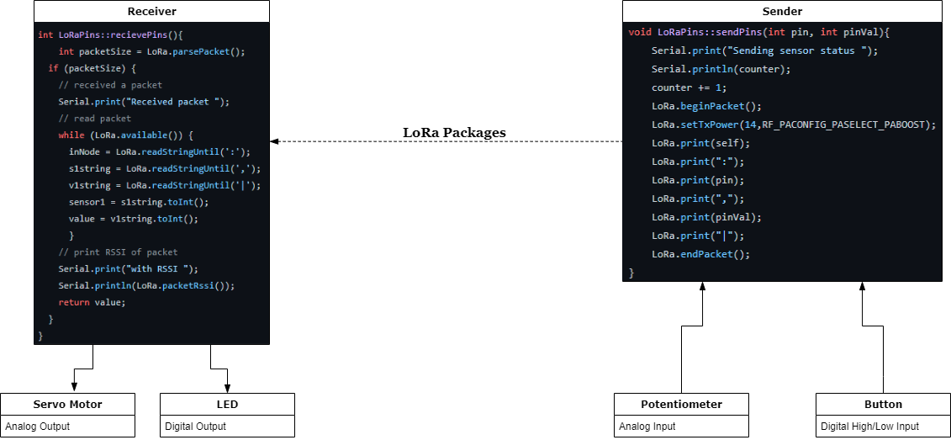
Remote GPIO Control Based on LoRa
Jack Locke, Maniadarsh Sivaram, Juehao Lin
Background
Why LoRa?
Preliminary Results
The Internet of Things (IoT) describes the network of physical objects—“things”—that are embedded with sensors, software, and other technologies for the purpose of connecting and exchanging data with other devices and systems over the internet. These devices range from ordinary household objects to sophisticated industrial tools. Over the past few years, IoT has become one of the most important technologies of the 21st century. Now that we can connect everyday objects—kitchen appliances, cars, thermostats, baby monitors—to the internet via embedded devices, seamless communication is possible between people, processes, and things.
LoRa (short for long range) is a spread spectrum modulation technique derived from chirp spread spectrum (CSS) technology. LoRa is a long range, low power wireless platform that enable users to construct a robust wireless platform of Internet of Things.
The main benefits of LoRa are long-range, low-power and low-cost connectivity. Compared to other protocol such as Cellular protocols or the WiFi protocol, LoRa’s range and power consumption advantage has give LoRa capability to construct a larger, cheaper IoT network.
At the end of this development, we have successfully designed and implemented a setup package for user to set up a local LoRa mesh network of microcontroller devices. User can simply use the setup package to configure each different LoRa Nodes to construct a multiple networks of local nodes.
After the user configures and constructs the local network, user may use the LoRa Message Broadcast system to Read and Write respective pre-configured GPIO pins on target LoRa Node.
We also attempted to integrate such system with the LoRaWan protocol to enable user to have Across-the-Internet access to LoRaWan gateways and other LoRa Network Meshes. We were able to establish a LoRaWan gateway in order to utilize the LoRaWan protocol, but further work will be needed to make the protocol able to identify and communicate with other LoRaWan gateway and LoRa local mesh network.
Figure 1. LoRa vs. Other Communication Protocols
Table 1. LoRa vs. Other Communication Protocols
Research Questions
System Architecture
Due to the limitation of the size and power supply of most IoT components, IoT devices have to tradeoffs between data transmission rate, range and battery life. Most IoT sacrifice Long-range communication capability for faster a data transmission rate and longer battery life. However, under some circumstances user will require a Long-range network in order to make an IoT network that works in area with poor infrastructures. In order to solve such problem, we decided the best way to handle the Long-Range IoT Communications would be reconstruct a communication protocol based on LoRa standard due to its excellent Long-Range Communication capability and low power consumption. To generalize the protocol for most Microcontroller devices and enable user to access lower-level hardware control, we focus on implementing our protocol as a Serial GPIO control protocol.
Our GPIO Remote Control System is composed of subsystems below:
LoRa Node: Microcontroller that set up with LoRa module, capable of controlling Sensors and Actuators using GPIO ports
LoRa Gateway: Router equipped with a LoRa concentrator, allowing it to receive LoRa packets and send it across the Internet to give user Across-the-Internet access to other LoRa Gateway.
Command Console: Optional central control node to give user option to remotely configure LoRa Nodes or broadcast any given message.
Cloud Server: Integrated via The Things Network, capable of communicating with multiple LoRa Gateways
Sensors/Actuators: Devices that communicate with LoRa Node via GPIO ports, capable of sensing and interacting with surrounding environments.
Conclusion
During the development of this project, we have built a solid foundation for the future development of the protocol. Due to the limitation of time, we were only able to utilize local LoRa protocol for LoRa local mesh network construction. However, we are close to implementing the LoRaWan protocol to enable user to have Across-the-Internet access via LoRaWan gateway in order to expand user’s IoT network. In short, we have achieved:
Enable user to remotely Read/Write target LoRa Node’s GPIO port (Digital & Analog)
LoRa node identification in LoRa mesh network
Package that allow user to construct LoRa mesh network with relative ease
Objectives
Figure 2. LoRa/LoRaWan GPIO Control System
The goal of this project is to use LoRa protocol’s advantage to build our Low-Power, Long-Ranged remote GPIO control protocol. Such system will enable user alternative for remote control and monitoring of GPIO pins on a demote device from a local console using LoRa protocol. Such protocol should enable user to:
Construct LoRa mesh network via setup wizard
LoRa node identification in LoRa mesh network
Read/Write target LoRa Node’s GPIO pin via command lines
Across-the-Internet access to LoRaWan gateways and LoRa Network Meshes
Example Use Case
Future Works
More API support
LoRaWan integration
User keys/tokens support for better security
Messages Queue System to ensure communication robustness
Across-the-Internet access to LoRaWan gateways and LoRa Network Meshes
Figure 3. An example of using different types of I/O in two LoRa Node

