Slide 1





FOOD-101 IMAGE CLASSIFICATION
CV PROJECT
EFFICIENTNETB3 • RESNET101 • DENSENET201
By Nashrah & Kashaf

Slide 2








INTRODUC-
TION
Dataset: Food-101
101 food categories
75,750 training images and 25,250 testing images
Provided train/test split
Images are real-world, high-variance, non-studio quality
Used original authors’ metadata to build clean directory structure

Slide 3





DEEP LEARNING MODELS
We trained three transfer learning models:
EfficientNetB3
Best parameter efficiency
Prefers 300×300 but trained at 224×224 for speed
ResNet101
Very deep residual architecture
Helps avoid vanishing gradients
DenseNet201
Dense connections → strong feature reuse
Efficient and stable training

Slide 4



MODEL PERFORMANCE COMPARISON
Model | Accuracy | Loss | Macro Precision | Macro Recall | Macro F1
EfficientNetB3 | 0.033505 | 4.411595 | 0.018741 | 0.033386 | 0.012116
ResNet101 | 0.097703 | 3.989144 | 0.093745 | 0.097545 | 0.077837
DenseNet201 | 0.698099 | 1.118766 | 0.700891 | 0.698178 | 0.693492

Slide 5
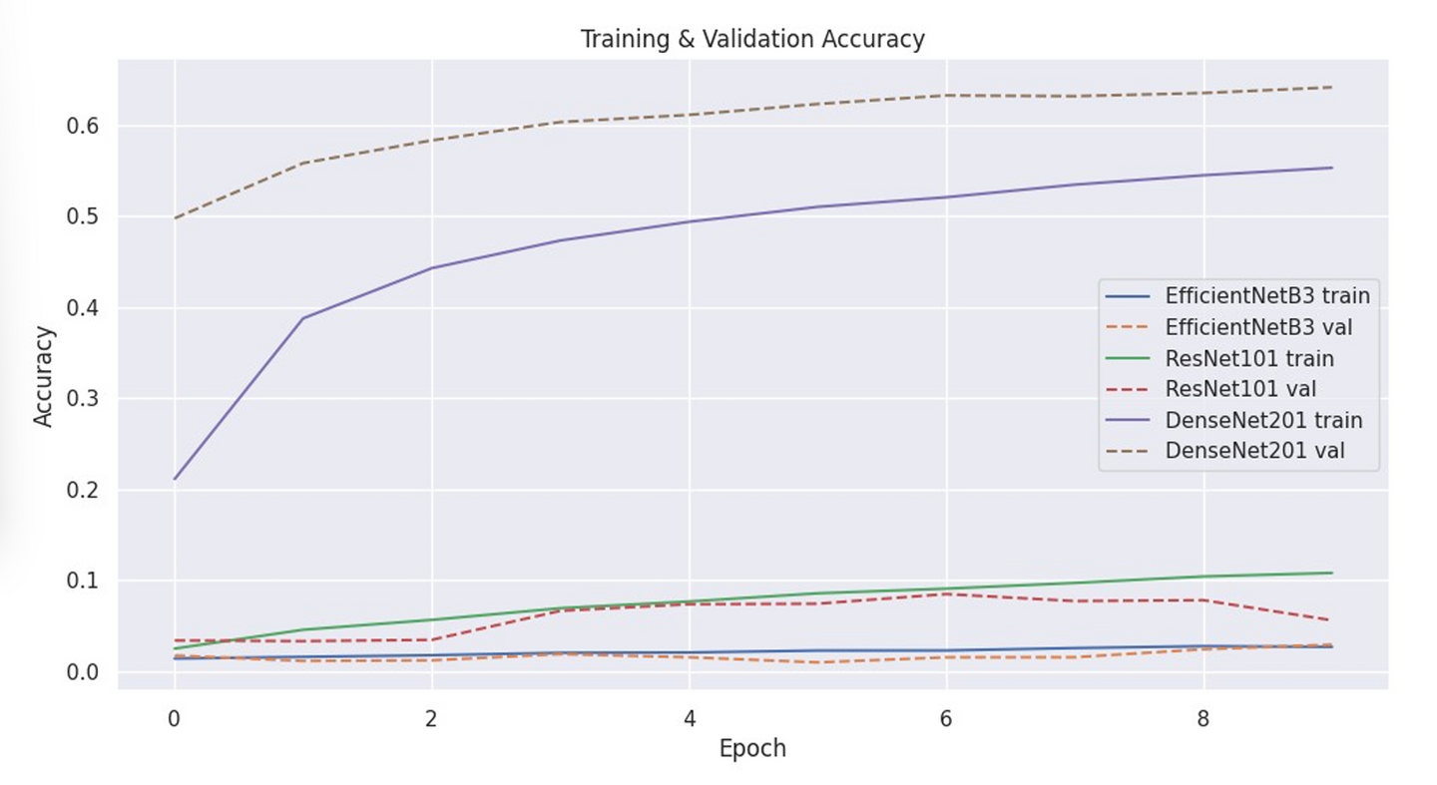
ACCURACY CURVE

Slide 6
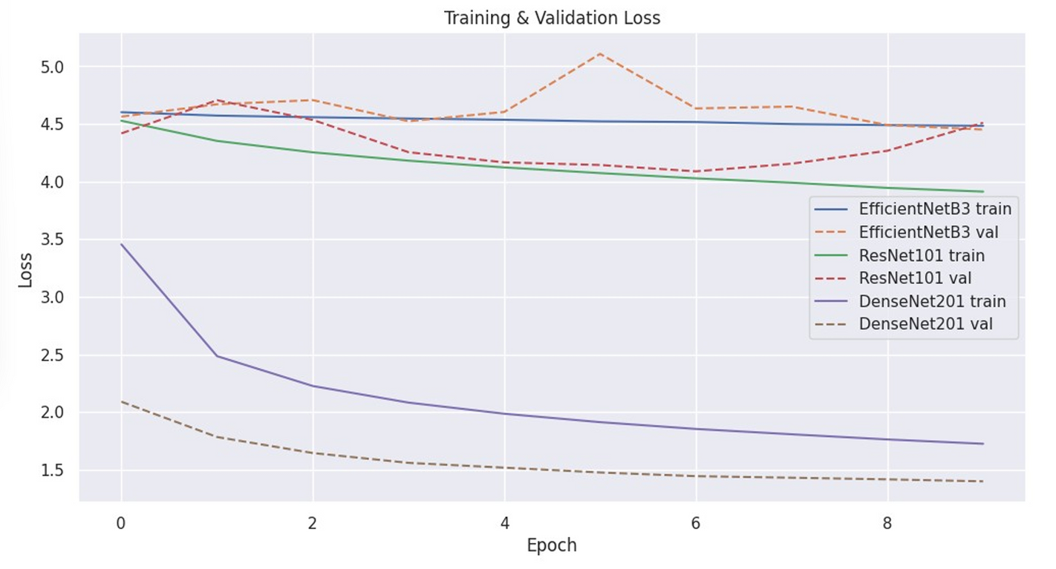
LOSS CURVE

Slide 7
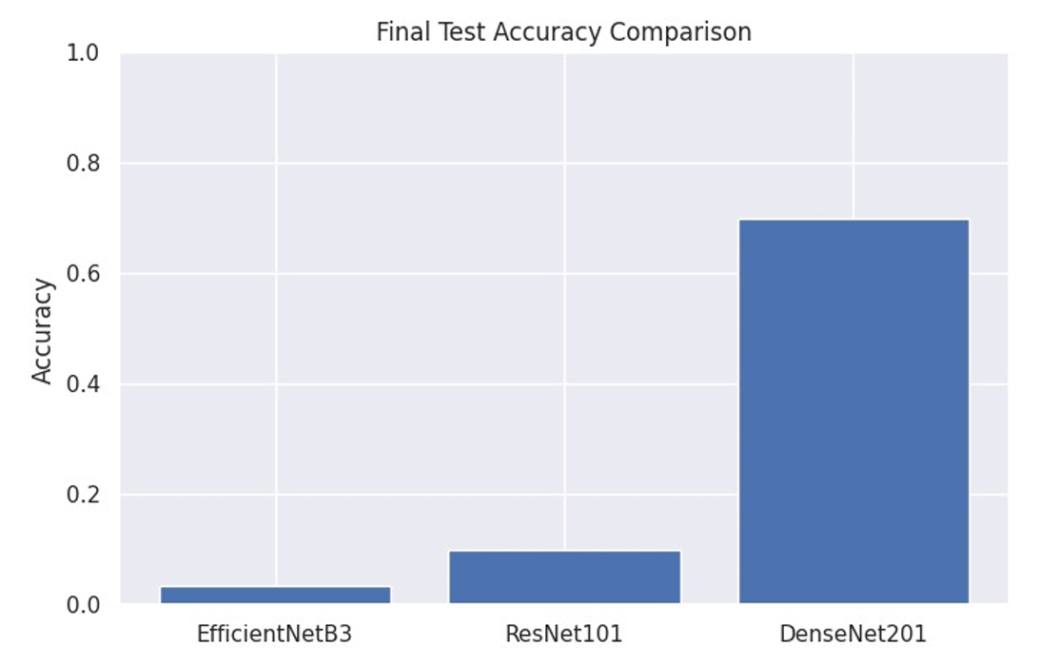
FINAL ACCURACY BAR CHART

Slide 8

INFERENCE DEMO
This section shows:
Three correct predictions
Three incorrect predictions
per model

Slide 9
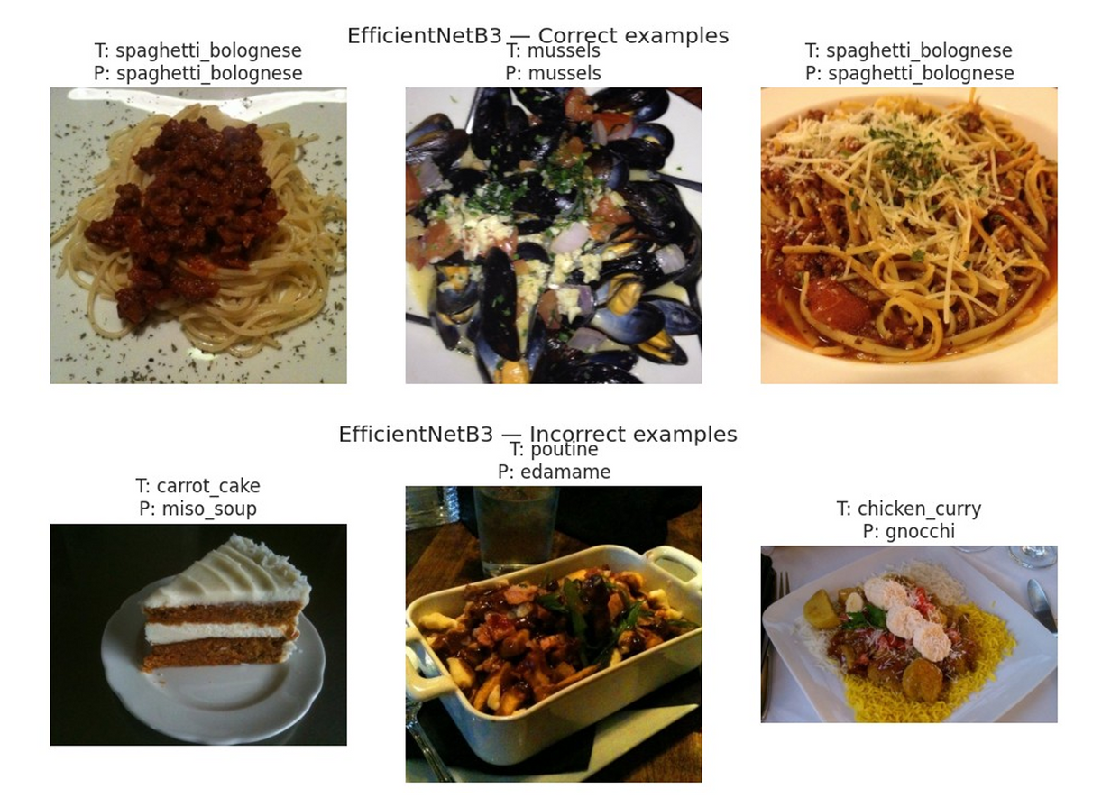


EFFICIENT NET B3

Slide 10
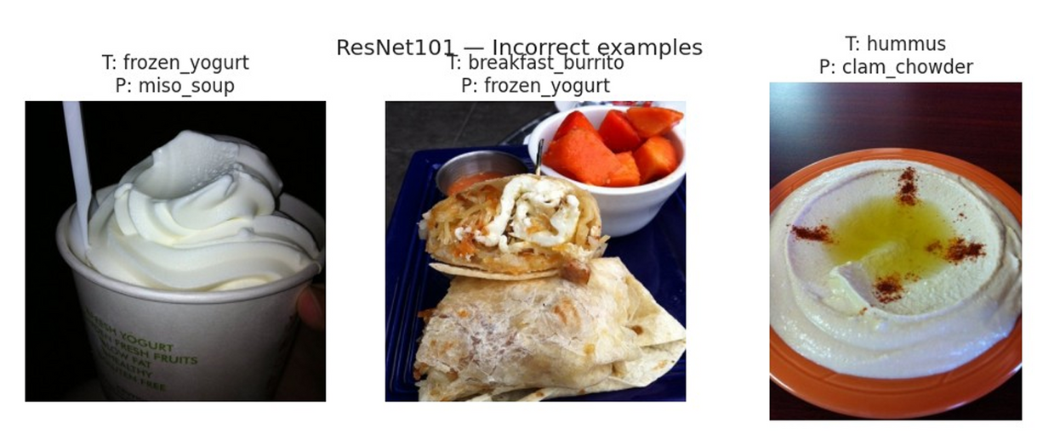
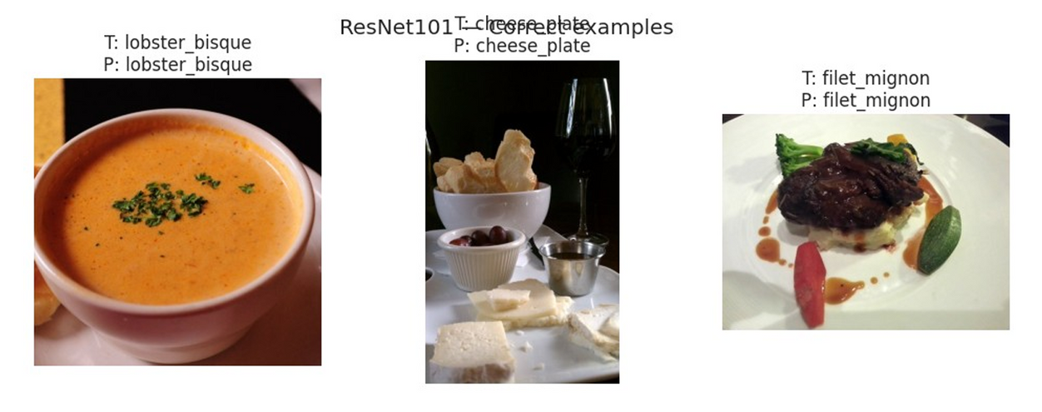
RES
NET
101

Slide 11
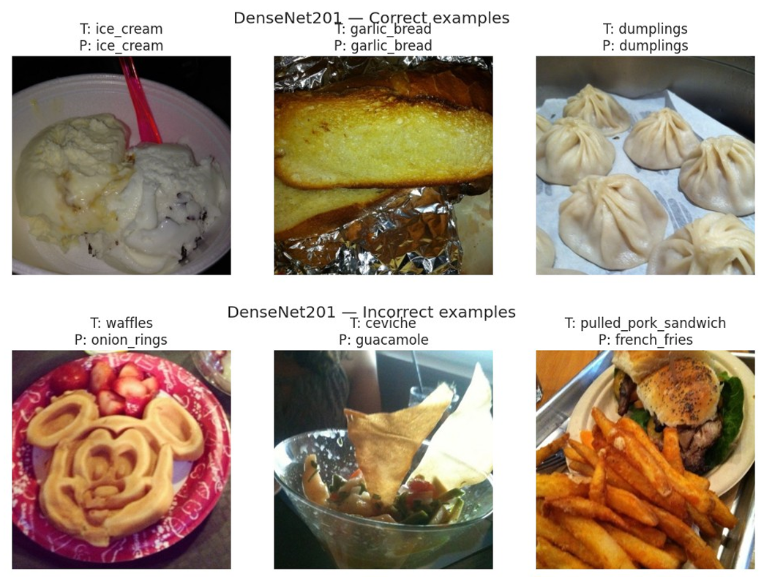
DENSE NET
201

Slide 12
LEARNINGS & CONTRIBUTIONS
Technical Learning
Preprocessing large datasets and creating Keras-friendly directory structures
Using ImageDataGenerator + augmentation
Training large CNN architectures on limited GPU time
Managing model saving, history logs, metrics, and confusion matrices
Using transfer learning and selective layer unfreezing

Slide 13
LEARNINGS & CONTRIBUTIONS
Personal Contributions
Dataset organization and preprocessing
Implemented training pipeline for all models
Designed comparison framework and metrics extraction
Developed final comparison notebook
Conducted inference visualization

Slide 14

CONCLUSION
This project strengthened our understanding of deep CNNs, experiment tracking, and model evaluation.
(also made us cry :_)

Slide 15
THANK YOU
By
Kashaf Nadeem (F223095)
Nashrah Ahmed (F223156)
-

