Slide 1
Fast HTML

Slide 2
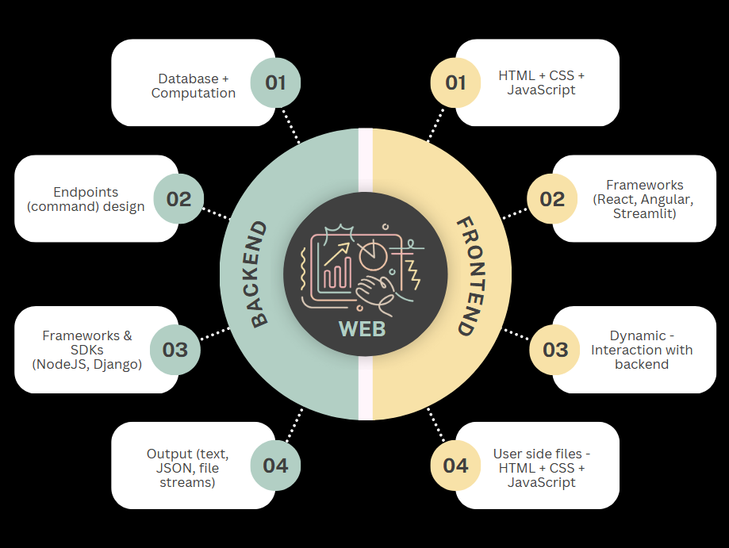
Traditional approach
Combination of backend + frontend
Backend returns dynamic information (usually in JSON format)
Frontend inserts information into template & returns HTML files to the user-side browser

Slide 3
More – API endpoints
API endpoints are the addresses at which you communicate with your server.
Inputs
Header
Body
API
URL (path)
Method
Outputs
Status code
Information (JSON, file-stream, text) sent to client
Path / query params

Slide 4
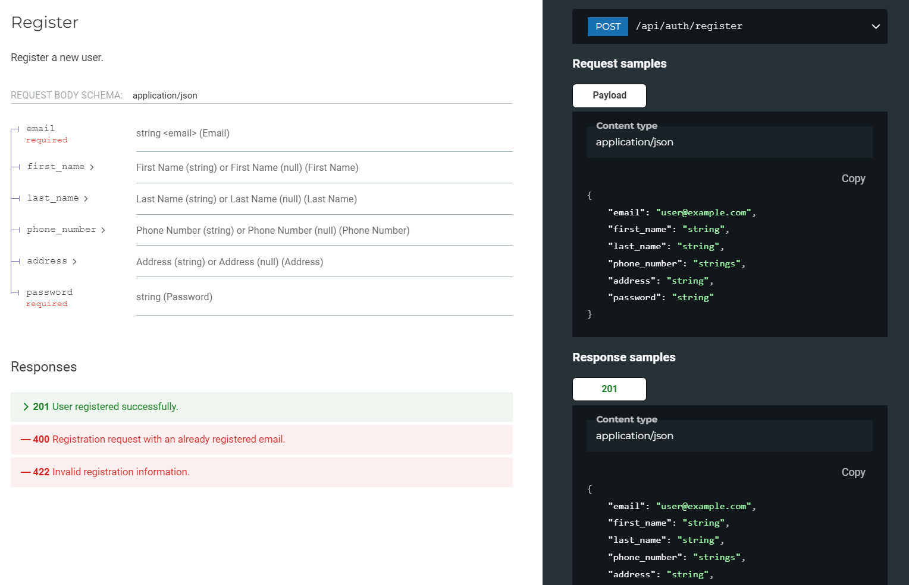
More – API endpoints
Input – payload (body) in JSON format, with fields like ‘email’ and ‘password’
API – POST (method) & /api/auth/register (URL)
Output – Multiple responses, success being status code 201 and JSON output with registration information

Slide 5

More – Client-side HTML
‘Template’ files
The code from developer-side is considered ‘template’ to be copied, modified and distributed to users.
Server integration
Retrieve raw data from server (most commonly in JSON format).
Client-side files
HTML + CSS + JavaScript files are complete and ‘static’.
Files are readable by browsers and opened by browser to generate UI.
These templates can have empty variables to be filled unique to each users & interactions (dynamic website).
Fill data to placeholders in template.

Slide 6
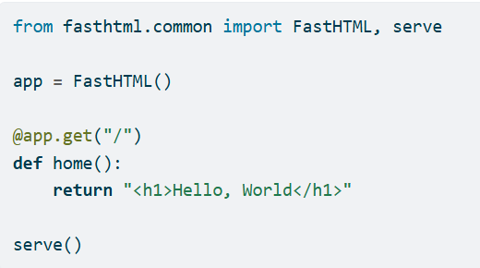
FastHTML – Merge backend & frontend
Define interactions via API endpoints
Endpoints send HTML instead of raw data
Use HTMX for partial updates (API driven & simpler on the client-side)

Slide 7
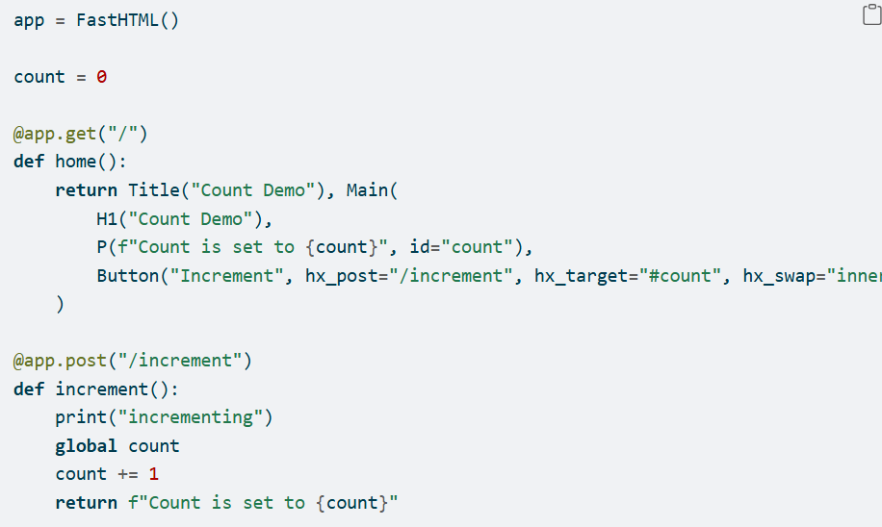
Interaction flow
Access
Interpret as GET endpoint
Render full page on browser
Interact
Send information with forms
Computes & (save) results
Update
Modify UI content (HTML) of indicated targets
Send UI content (HTML)
Re-render targets on browser
Return new UI content (HTML)

Slide 8
General pros & cons
Lightweight & easy set-up
High rendering speed
Compact single-component web application
Lack of built-in components & state management options
Low reusability without intermediate API raw data
Small ecosystem
Full UI customization (in theory)

Slide 9
Comparison – Usability
Streamlit + FastAPI
FastHTML
Data-driven applications
Built-in components & state management
General purpose web-app
High rendering speed
Excellent data interactivity & utilities
Default styling & structures
Reusable backend APIs
Highly customizable UI & flexible structure
Custom styling & flexible bootstrap
High SEO (visibility)

Slide 10
Comparison – Development
Streamlit + FastAPI
FastHTML
Easy for Python developers & non-experts
Full control of UI elements & structure
Resistant to future updates
Straightforward testing process
Built-in components & state management
Developed ecosystem
High integrations
Integration with existing JavaScript / CSS packages for frontend

Slide 11
Conclusion
FastHTML is a very powerful and flexible tool. It can be used to create highly customizable and fast-rendering websites.
However, it puts the burden on developers to use pure HTML and design manual user interactions.
It is suitable for dynamic, small – medium scale web applications.

