Slide 1
Case study - 3
Team Name : BackBenchers
Team Members:
Rishabh Gupta(Leader) : 18BCS6223
Yash Pant: 18BCS6087
Shrey Nagpal: 18BCS6079
Rohan Arora: 18BCS6102

Slide 2
ABSTRACT
A Chinese automobile company Geely Auto aspires to enter the US market by setting up their manufacturing unit there and producing cars locally to give competition to their US and European counterparts. They have contracted an automobile consulting company to understand the factors on which the pricing of cars depends. Specifically, they want to understand the factors affecting the pricing of cars in the American market, since those may be very different from the Chinese market.
The company wants to know:
Which variables are significant in predicting the price of a car.
How well those variables describe the price of a car

Slide 3
Primary Goal of Data Analysis
We are required to model the price of cars with the available independent variables. It will be used by the management to understand how exactly the prices vary with the independent variables. They can accordingly manipulate the design of the cars, the business strategy etc. to meet certain price levels. Further, the model will be a good way for management to understand the pricing dynamics of a new market.

Slide 4
Introduction
The files were downloaded and stored in the folder and they are uploaded to the jupyter notebook for data analysis.
The files included 2 csv files namely car_price.csv and Data Dictionary - carprices.csv

Slide 5
Problem Solving Methodology
Checkpoint 1
Checkpoint 2
Checkpoint 3
Checkpoint 4
Plotting the data according to variables and comparing it with price
Fitting model on training data using Linear Regression and train data and test data is splitted in 80-20 ratio
Checking the predicted data values and accuracy score and predicted data will prevent us overfitting and underfitting
Importing and visualizing the data

Slide 6
Data Understanding
importing dataset using pandas
Inspecting the dataset
Checking if any value in a particular row is empty
False denote no empty columns

Slide 7
Data Plotting
Using scatter plot for plotting highway mileage, city mileage, horsepower and comparing it with price
Cmap is set to cool for better visualization
Labeling the plot
Setting the color bar according to values in price column by printing them in bar chart
With this plot we can see that car with Highway mileage ranging between 35 to 45,
City mileage ranging between 14.5 to 30, have price range between 45000 to 20000.
Visualizing the data with seaborn heat_map.

Slide 8
Linear and logistic regression
Creating test and train variables, here train data and test data is splitted in 80-20 ratio
Fitting model on training data using Linear Regression, will give less accuracy
Making predictions about test data
Classification report will give us the precision, recall and f1 score
Printing the above confusion matrix and checking it with the predicted data value

Slide 9
Training model
Test the model on the testing data and comparing the result with the actual target.
checking the predicted data values and accuracy score
Predicted data will prevent us overfitting and underfitting
The number of correct and incorrect predictions are summarized with count values and broken down by each class.
This is the key to the confusion matrix.
The confusion matrix shows the ways in which your classification model is confused when it makes predictions.
Getting the accuracy score as 0.977

Slide 10
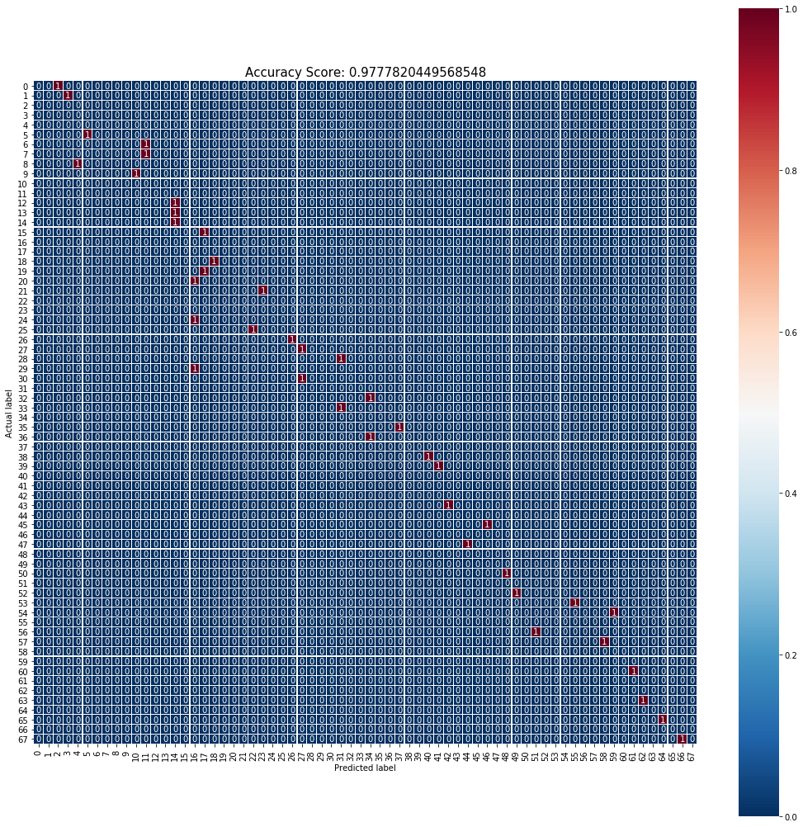
Result
The predicted label is shown below:

