Slide 1
Message Queue
Sender
Receiver

Slide 2


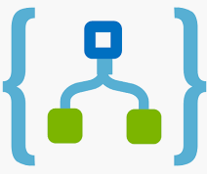



Proof of Concept – Azure Disconnected- on going
1
AIM is to develop 3 micro service each dealing with OICS, CBS and Card system as Rest Service
Orchestrated service : using Logic app and expose with API Gateway
Azure API gateway.
DB combination of Cosmo DB and SQL
Future Scope-
Deployment to Azure k8s engine.(Blue green deployment )
Logging and monitoring of Micro service.
Orchestration MS using Open source technology (Spring integration)
Event driven MS to update informationzzxz
1
Orchestrated Business Service
2
AZURE API Gateway
2
3
Composer Service
3
AZURE Function
4
4
OCIS
CBS
CARD
AZURE
API Gateway
5
6
7
8
AZURE Cosmo DB

Slide 3
Proof of Concept – Azure Disconnected- on going
1
AIM is to develop 3 micro service each dealing with OICS, CBS and Card system as Rest Service
Orchestrated service : using Logic app and expose with API Gateway
Azure API gateway.
DB combination of Cosmo DB and SQL
Future Scope-
Deployment to Azure k8s engine.(Blue green deployment )
Logging and monitoring of Micro service.
Orchestration MS using Open source technology (Spring integration)
Event driven MS to update informationzzxz
1
Orchestrated Business Service
3
2
AZURE API Gateway
2
Composer Service
3
AZURE Function
4
4
AZURE
API Gateway
OCIS
CBS
CARD
5
6
Third Party API
7
8
AZURE Cosmo DB

Slide 4

Which instance
Retry on Failure
Who is calling
Authorized
Which Version
Quota exhausted
How to call
Are my service healthy
MS1
MS2
?
?
?
?
?
?
Caller Service
Callee Service
Is service Secure?
How to manage all this without changing Service Implementation

Slide 5
Management & Configuration
Lookup Routing Timeout Circuit Breaker
Policy Enforcement TLS Termination Throttling
Proxy
Proxy
In
Out
In
Out
MS1
MS2
Caller Service
Callee Service

Slide 6
Caller Service
Callee Service
MS1
MS2
Request
Blocked State
Request

Slide 7
Caller Service
Callee Service
MS1
MS2
Request +reference to call back
Step-2-Server acknowledges the request
Step-3–server processes the request. (Time to process the request)
No wait/blocked
Response

Slide 8
Caller Service
Callee Service
MS1
Step-1 – client sendsRequest
MS2
Step-2- Server acknowledges the request
Client polls the status of the request
Response not ready Client polls the status of the request
Client continues its work
Step-3–server processes the request. (Time to process the request)
Response not ready Client polls the status of the request
No wait/blocked
Ready. Server sends the response

Slide 9

Message Queue
Sender
Receiver

Slide 10
Caller service Callee service
MS1
MS2
Blocked State
Request
Response

Slide 11

Rest API Call
MQ Channel
Https Request handler
Inbound request
handler
outbound Event publisher
Database Connector
MQ Channel

Slide 12
Microservice
Instance-1
Microservice
Instance-1
API gateway
Client
Microservice
Instance-1
Microservice-2
Instance-1

Slide 13
Decomposition Pattern
Decomposed by functional capabilities
Context
While Designing new automatic services for new application
Decomposed by Domain (Domain Driven Design)
Strangler Pattern
Context
While refactoring large , legacy application
Context
While Designing common functional services that are used across a sub domain.

Slide 14
Typical MSA Principles
Continuous Delivery & Deployment
Scalability
Availability
Resiliency
Decentralised governance
Failure Isolation
Auto-provisioning
Independent & Autonomous

Slide 15
Order Created
Payment Service
Order Created Event
Payment Received Event
Subscribes order
created event
Order DB
Event Bus
Payment DB
Order_ID | Cust_ID | Status | Amount
Order001 | Cust001 | New | $10.50
Payment_ID | Order_ID | Status | Amount
Pay001 | Order001 | Paid | $10.50

Slide 16
A successful Saga transaction.
Saga Transaction Coordinator
Begin Saga
Start T1
End T1
Start T2
End T2
Start T3
End T3
End Saga
Start T1
Order Service
Order DB
END T1
Start T2
Payment Service
Payment DB
END T2
Start T3
Shipment Service
shipment DB
END T3

Slide 17
A compensation Saga transaction.
Saga Transaction Coordinator
Begin Saga
Start T1
End T1
Start T2
End T2
Start compensation to update Order Service
Start C1
End C1
End Saga
Start T1
Order Service
Order DB
END T1
Start T2
Payment Service
Payment DB
Abort /failed
Start C1
Order Service
Order DB
END C2

Slide 18
Highly available service registry for registration & discovery
Service Registry
Service Registry
Microservices
Service Client
GET
POST
Service Client
Client Discover their microservices by REST-GET
Microservices register/publish their locations through REST-POST

Slide 19
Service Registry
Service Registry
Microservices
POST-1. Register service metadata
POST-2. Send Refresh update
Delete. Deregister by delete or not sending update
IP
Port
Auth credentials
protocols
versions numbers
Environment Detail

Slide 20
Service Registry Third party
Service Registry
Service Registry
Microservices
POST-1. Register service metadata
POST-2. Send Refresh update
Delete. Deregister by delete or not sending update
IP
Port
Auth credentials
protocols
versions numbers
Environment Detail
Get metadata Track changes
Heartbeat status

Slide 21
Step-1: Service Discovery
Client
Client
Service Registry
Instance-1
Instance-2
Client
Services publish its dynamic location, port and other metadata
Service discovery mechanism
Instance-3
Instance-4
Load balancing algorithms
Step-3:Submission of
request to instance-5
Instance-5
Instance-6
Step-2: Load balancing
Microservices Instances

Slide 22
Server side discovery
Step-1: Discovery
Service Registry
Instance-1
Instance-2
Load Balancer/API gateway
Services publish its dynamic location, port and other metadata
Service discovery mechanism
Client
Instance-3
Instance-4
Load balancing algorithms
Step-3:Request Submission
Instance-5
Instance-6
Step-2: Load balancing
Microservices Instances

Slide 23
API Gateway
Service Client
Microservices
</>
API Gateway
Single Entry Point to application
Creation of client specific APIs
Service orchestration
Security implementation
Service discovery & routing
Data aggregation
Data/protocol conversion

Slide 24
Service Registry
API Gateway
Service Client
</>
2. API gateway discovers required service
3. API gateway route request to discovered service
Service registers/updates
its end point
Client submits request
Microservices

Slide 25
API Gateway
Purchase Order Service
(Centralised Orchestration logic)
1. Invoke purchase order Services
2. Invoke payment service
3. Invoke shipment service
(it contains the necessary API transformation, data format and Protocol conversion, etc)
Service Client
Payment Service
Client submits request
Shipment Service
Service Registry

Slide 26
(Orchestrated Microservice)
1. Call purchase order API
2. Invoke payment API
3. Invoke shipment API
(it contains the necessary API transformation,
data format and Protocol conversion, etc)
Purchase Order Service
1. Invoke purchase order Services
API Gateway
Service Client
Payment Service
2. Invoke Payment Service
</>
Client submits request for Orchestrated Service via API call
Shipment Service
3. Invoke Shipment Service
Service Registry

Slide 27
Update Shipment status
Purchase Order Service
Update payment status
Update Order
Details
1. Invoke purchase order Services
API Gateway
Order Event
Client App/Application
Order Service
Payment Service
Payment Service
Payment Event
2. Invoke Payment Service
</>
Shipment Event
Shipment Service
3. Invoke Shipment Service
Service Registry

Slide 28

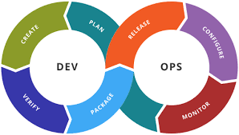
MS-A
Monitoring
Routing
Observe and troubleshoot services
MS-B
MS-D
Dashboard
Alerting
MS-C
Configure and manage services
Service management interface
Runtime Service management
Update services

Slide 29
Service instance
Source doe
Runtimes
Runtimes
Machine-1
Machine-2
Production
Service Runtime management
Deployment Pipeline

Slide 30
Service instance A
Service instance A
Service instance A
Webserver
Webserver
Webserver
Runtimes
Runtimes
Runtimes
Process
Process
Process
Physical or Virtual machine

Slide 31
Service instance A
Service instance B
Service instance
C
Webserver
Runtimes
Process
Physical or Virtual machine

Slide 32
Autoscaling group
Autoscaling Group
VM Instances
Routing
VM Instances
Load Balancer
Call Service
Source doe
Deployed to
VM Instances
Deployment bundle
Create VM using Image

Slide 33
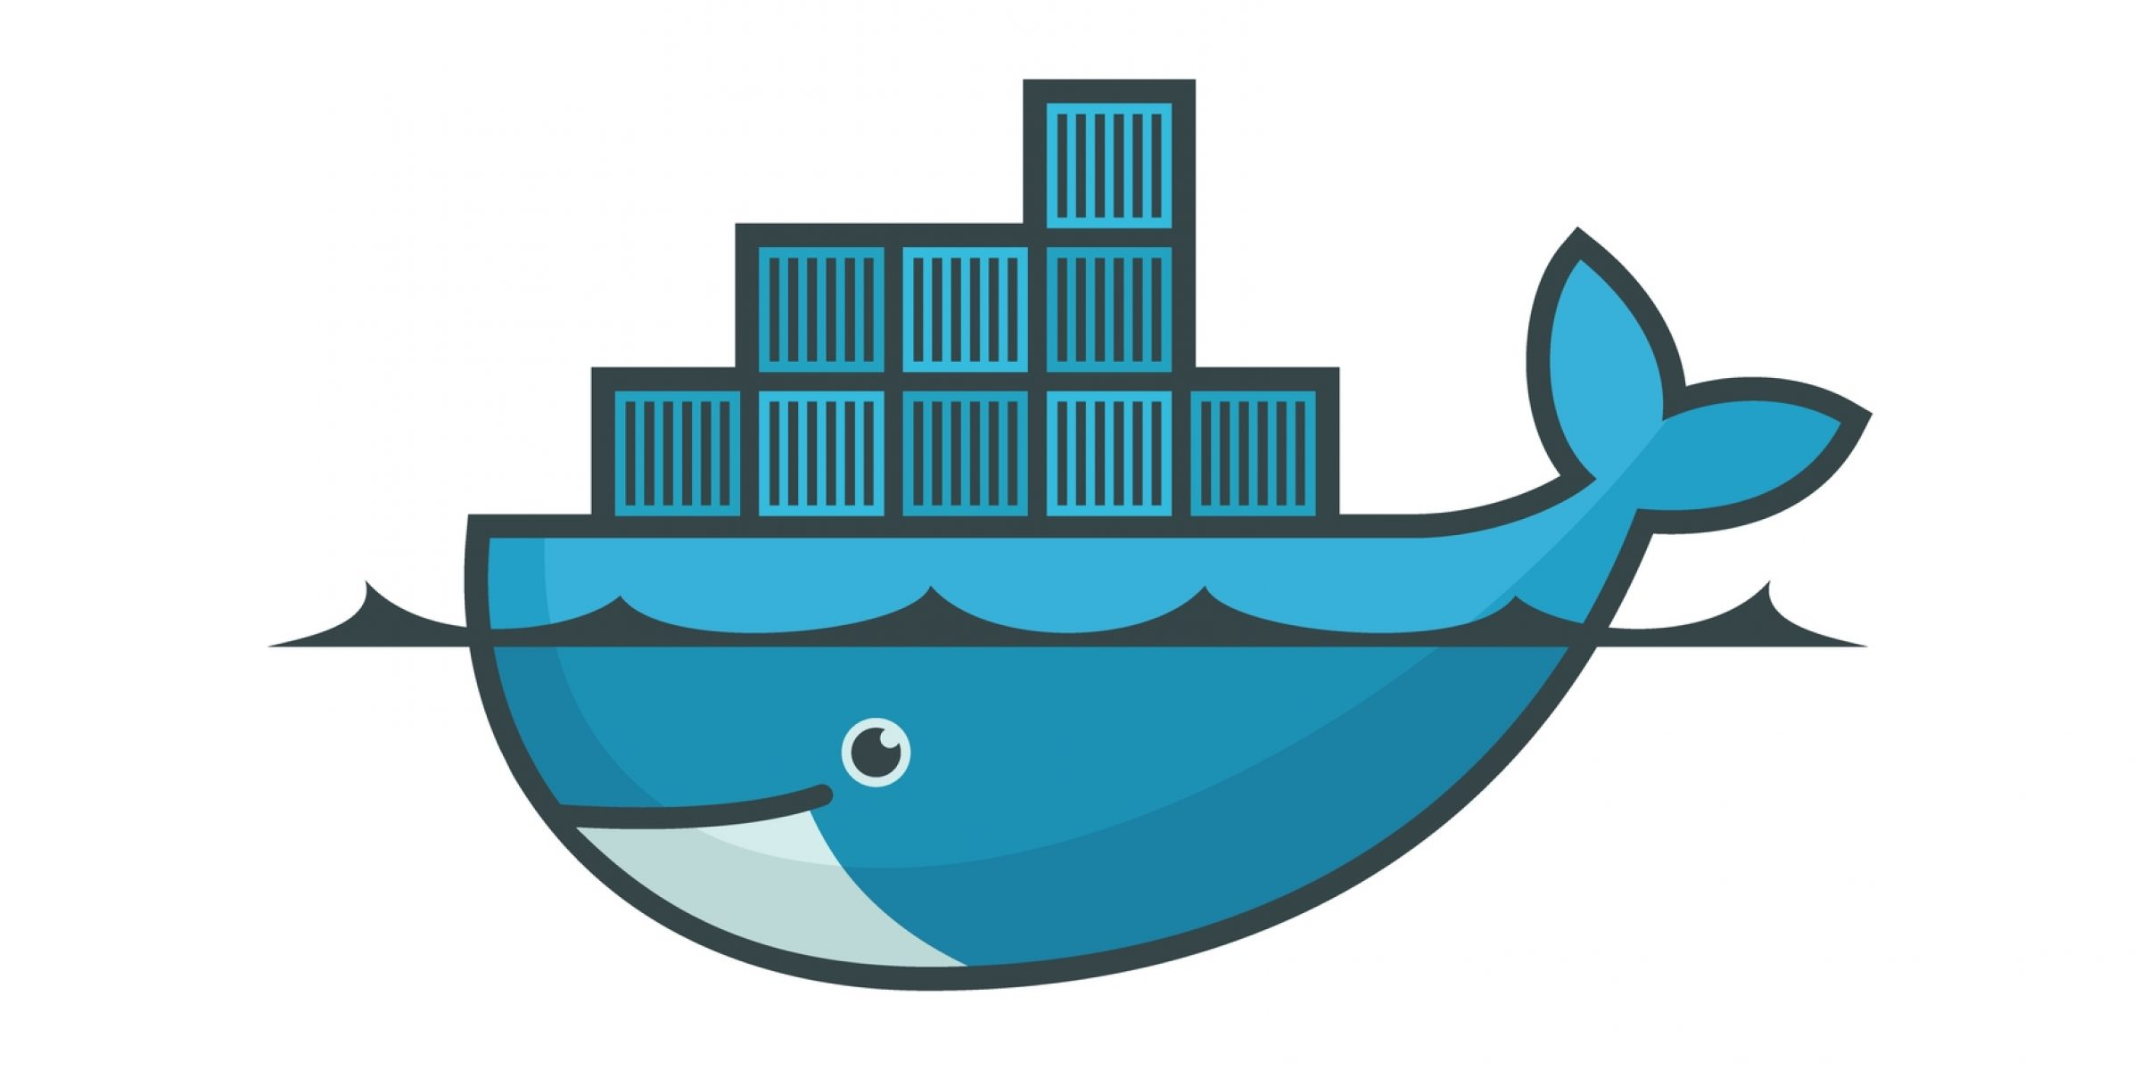
MS-A
MS-B
MS-C
Container runtime as Docker , such as Docker
Operating System
Physical Machine/Virtual machine

Slide 34
Autoscaling group
Virtual Machine
Container
Call Service
Load Balancer
Container
Routing
Source code
Deployed to VM
Virtual Machine
Container Image Registry
Container Image
Container Image
Container
Dockerfile

Slide 35
Load Balancer
Large Legacy Application
Individual Function
Strangler Pattern
Design of new microservices as independently deployable services in incremental fashion
Ms-1
Individual Function
Ms-2
Individual Function
Ms-3
New Self Deployable microservices

Slide 36
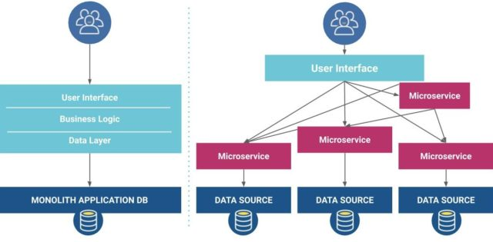

Slide 37

User Interface
User Interface
Business logic
Data Layer
MS-4
MS-1
MS-2
MS-3
DB
DB
DB
DB
DB
Monolithic Application
Microservice Application

Slide 38
Microservices Design Principles
Key Architecture Element for service communications
Client Side Discovery
Communication Model
Inter Service- Communication
Service Discovery
Synchronous Communication
REST
Server Side Discovery
RabbitMQ
Entry Point for MSA
API Gateway
Asynchronous Communication
Choreography
Apache Kafka
DB Transaction
SAGA
Orchestration
Data format
JSON 2. XML 3. YAML
Service Registration
Rest API Design
APIDesign
Apache Thrift
Service Deployment
gRPC
Security
Key Architecture Elements of MSA

Slide 39
Monolithic Application
Routes
Controller
Service Layer
Data Access Layer
DB

Slide 40

UI Layer
Restful API
Service Handler
Service Handler
Service Handler
3rd party API

Slide 41


CEC Microservices
API Composer Service
Accounts Service
Customer Service
API Gateway
Card Service
Notification Service
Frontend
Third-party CC Service

Slide 43

Users
Rest API Routers
Account
Controller
Customer
Controller
Card
Controller
Third-party
Controller
Service Handler
Third-party
Handler
Service Handler
DB Handler
Service Handler
Service Handler
Service Handler
Third-Party API
DB

Slide 45
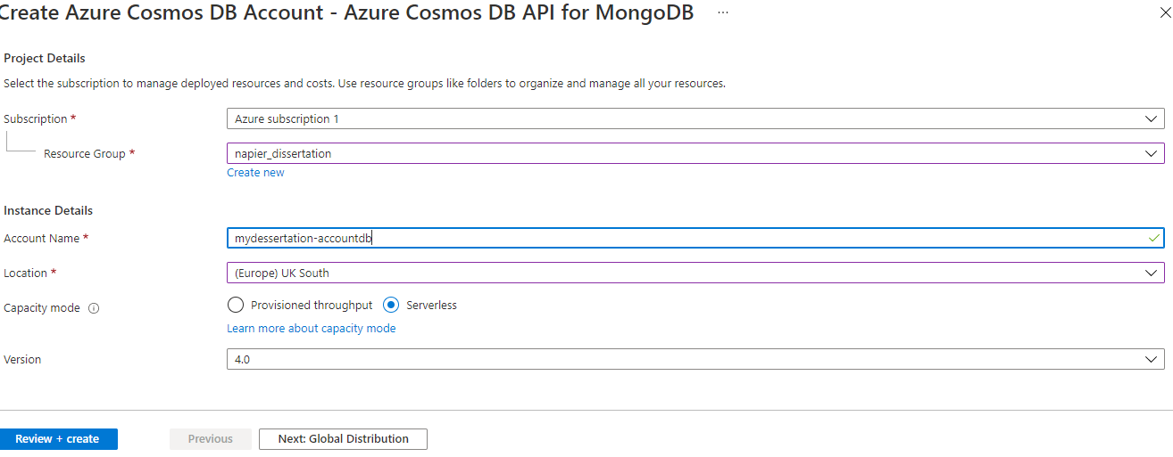

Slide 46
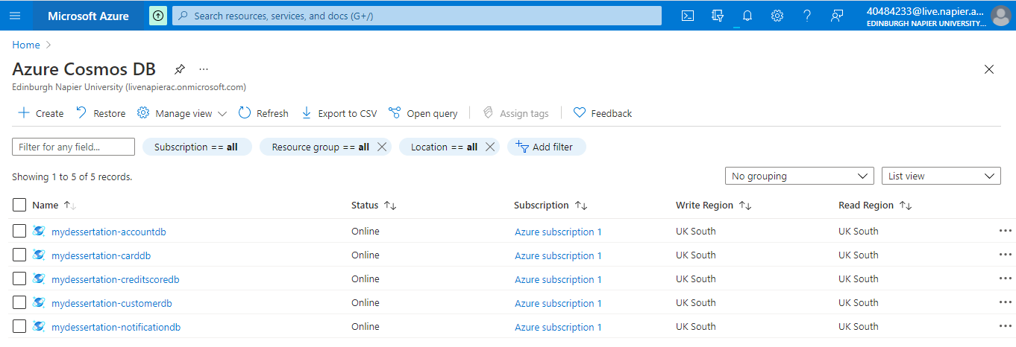

Slide 47
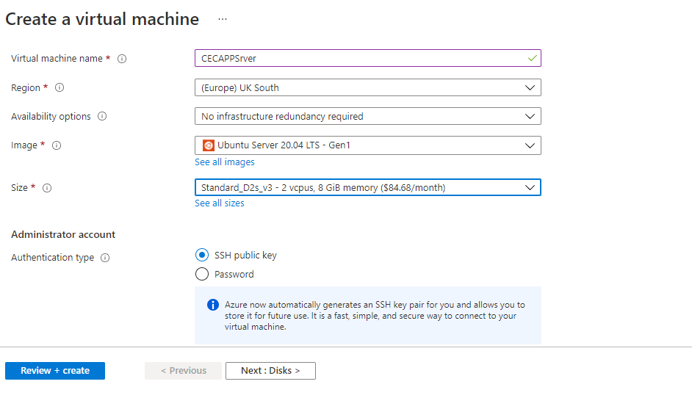

Slide 48
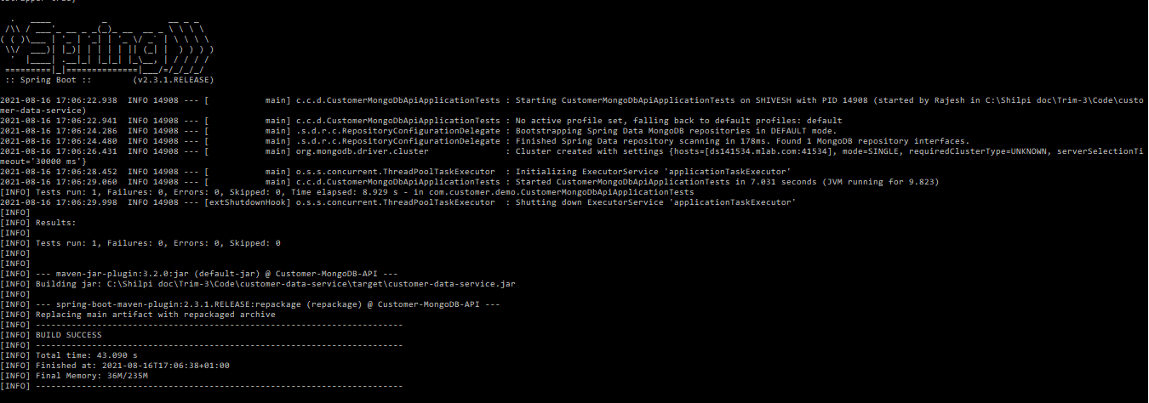

Slide 49
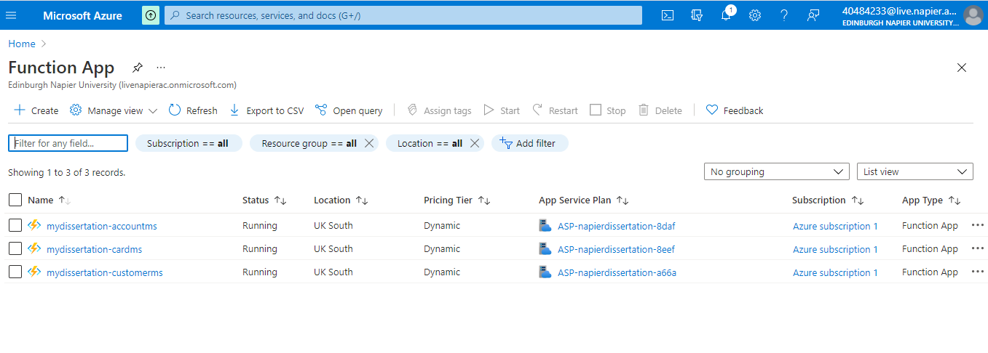

Slide 50
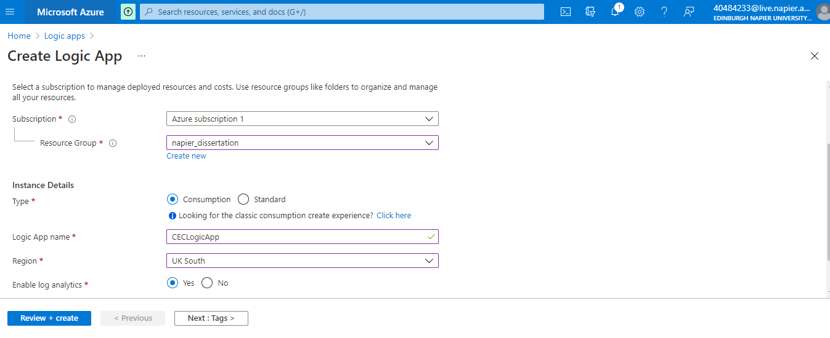

Slide 51
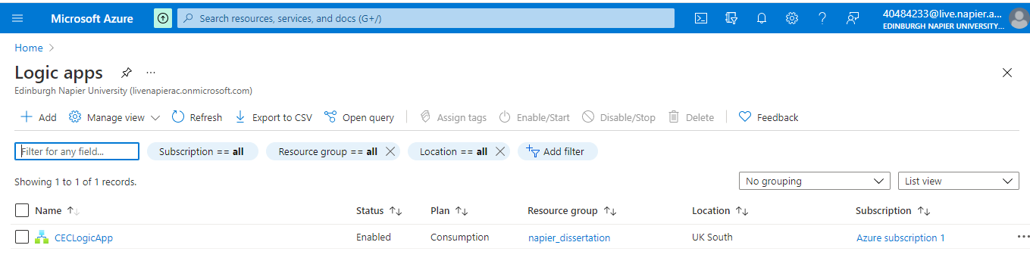
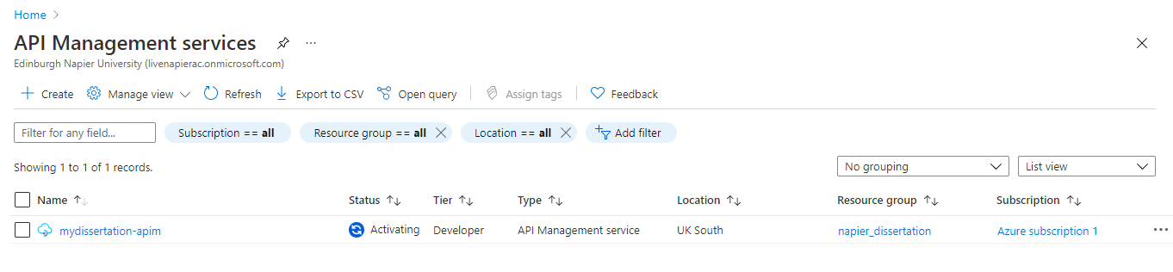

Slide 52
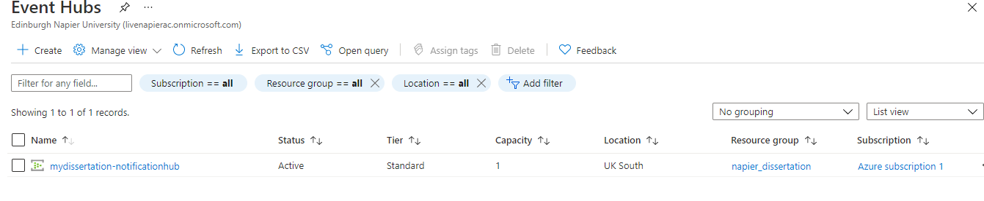

Slide 53
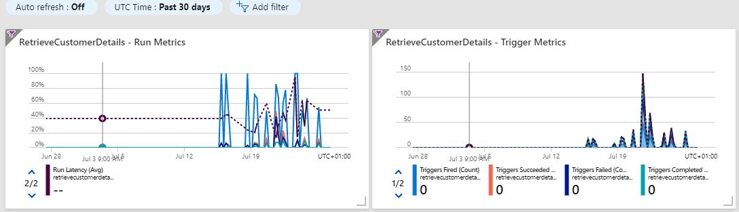
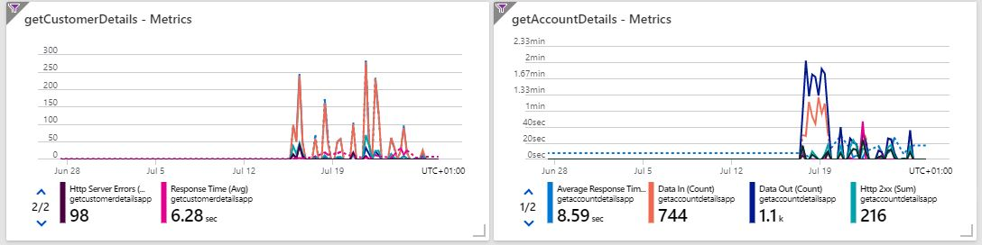
Azure DashBoard Snapshots
mydissertation-accountms
mydissertation-notifications
mydissertation-cards
mydissertation-customers

Slide 54
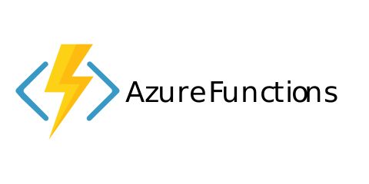


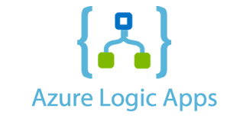
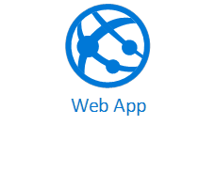
Service Flow
Azure Logic App WorkFlow
REST/JSON
getCustomerDetails
REST/JSON
REST/JSON
REST/JSON
RetrieveCustomerDetails
getCardDetails
SOAP/XML
getAccountDetails

