Slide 1


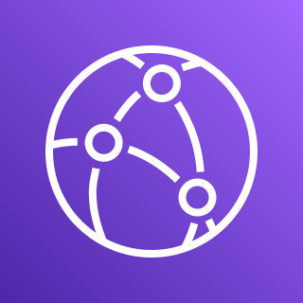
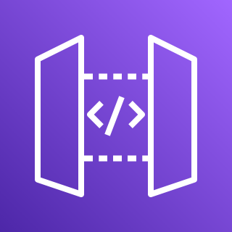

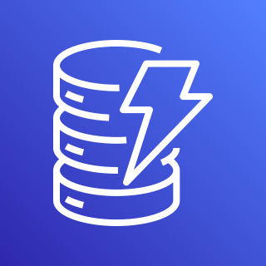





AWS Cloud
S3
CloudFront
Amazon
API Gateway
Lambda Function
Amazon
DynamoDB
User
Client Machine
Route 53
Amazon
Cognito
Cloud Watch Logs

