Slide 1
PWM
PC
Microcontroller
SPI
FPGA
EMG30
Motor
UART
Encoder Ticks

Slide 2
Microcontroller
FPGA
Hardware
PID
Task
PWM
Modul
H-Bro
Motor + P/T
SPI
Task
SPI
Modul
Positions-
Modul
Encoder

Slide 3



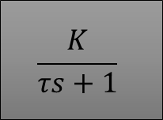






12V
$$T_{d}(s)$$
$$K_{c}$$
$$\frac{K}{τs+1}$$
-
$$\frac{1}{s}$$
$$R(s)$$
$$E(s)$$
$$PWM$$
$$V_{a}(s)$$
$$ω(s)$$
$$Y(s)$$
+
-
+
H-bro
Controller
Encoder + Positionsmodul

Slide 4

Output Max
Duty Cycle Max
$$P+I+D$$
DC Out
Output Min
Duty Cycle Min

Slide 5
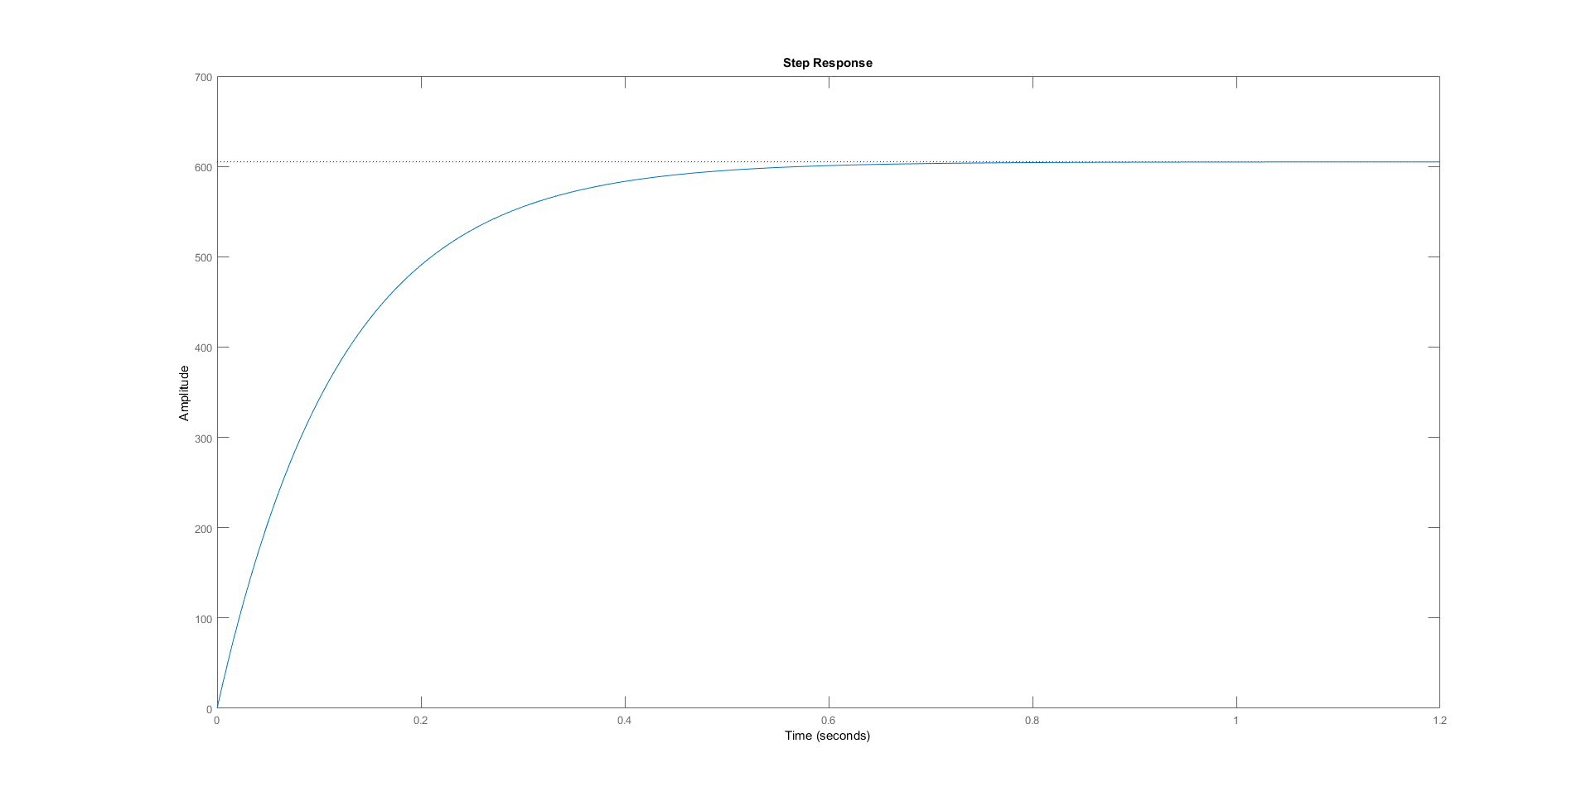



$$K$$
$$K⋅0.632$$
$$τ$$

