Slide 1
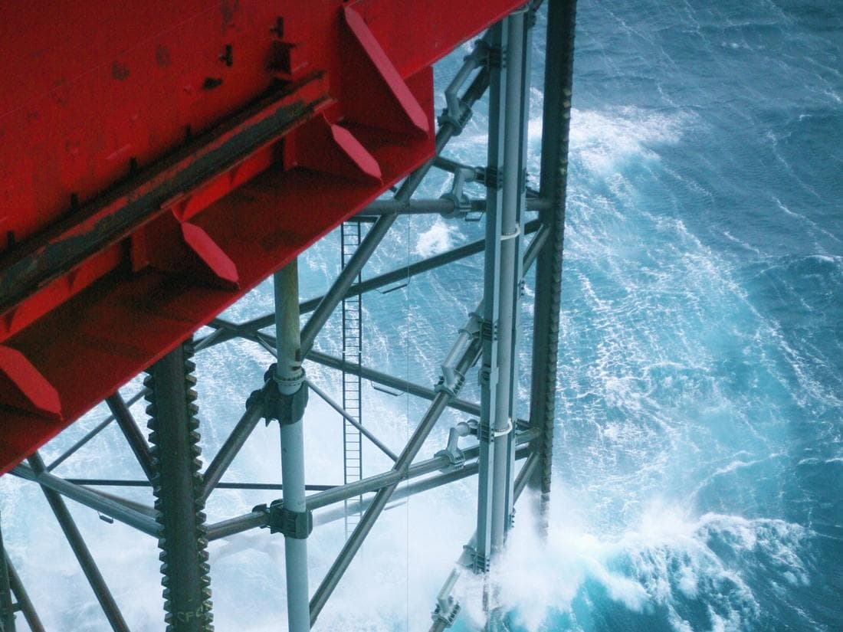
Equinor Presents: Industrial AI Hackathon 2026

Slide 2
Agenda
Thursday
14:00 Introduction
17:00 Pizza!
19:00 End day 1
Friday
08:00 Start day 2
11:00 Lunch
14:00 Demo and awards
15:00 End

Slide 3

Introduction
Women in AI Norway is a national chapter of the global Women in AI organization.
Our mission is to ensure that women are equally represented and actively involved in the development of AI technologies through initiatives that include education, training, networking, and mentoring events, fostering an inclusive environment where women can thrive and contribute meaningfully to the future of AI.
We have active collaborations with companies and organizations across Norway and this event is hosted by Equinor and supported by Aker Solutions.

Slide 4
Practical information
Safety
No planned fire drills
Please do not roam the building
Food and drinks
Have some snacks and drinks in the back
Breakfast & Lunch will be provided on Friday
Practicalities
Bathroom locations
WiFi:
Network: Equinor-Internet
Username: Last Name
Password: *9-digit number on the right bottom of your guest ID*
For any other questions just ask the organisers! - The ones in the red tee-shirts

Slide 5
Presentations / demo
First of all
No requirement to share code
No requirement to share data
Presentation format
Practical demo of your solution aimed at senior leaders
Quick introduction of the problem
Hands on demo
Three minutes time limit
Judging criteria
Best presentation
Most creative idea
Most potential

Slide 6
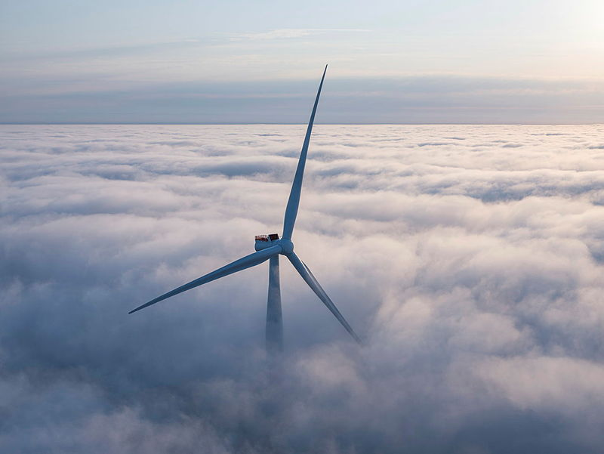
Hywind Tampen Wind Forecast
The problem
What to build
Data
Hywind Tampen is the worlds biggest floating wind farm
Rapid weather changes threaten usability
Especially sudden wind drops
Can we use sensor data from surrounding assets to improve weather forecasts?
Develop a model that predicts future wind conditions at Hywind Tampen
BONUS: create a dashboard that visualizes forecasts and recommends actions for the operator
Time series dataset
Wind observations from nearby offshore assets
Hywind Tampen Turbine level data

Slide 7
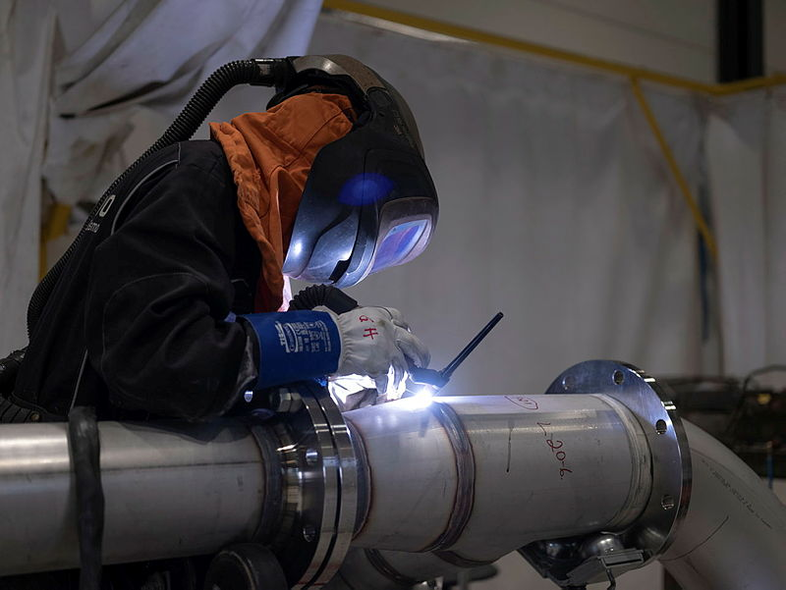

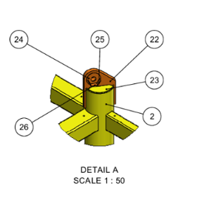
2. Welding
The problem
What to build
Data
Fabrication drawings contain many welded connections between steel profiles. Today, engineers manually identify connections and calculate weld requirements.
This is time-consuming and difficult to scale for large structures.
Build an AI-based assistant that detects connections and calculates weld requirements in fabrication drawings
automatically.
A fabrication drawing (pdf and dwg format), detailing material/part list, dimensions, and thickness.

Slide 8
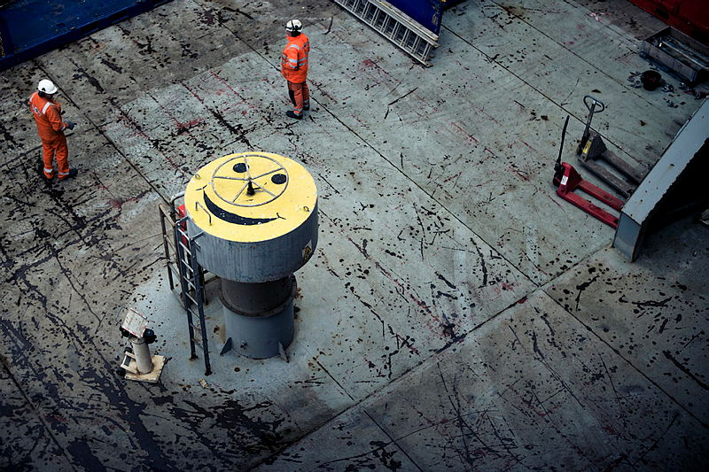
3. Volve
The problem
What to build
Data
Equinor has openly released the complete dataset from the decommissioned Volve field: roughly 40,000 files covering a real North Sea oil field from 2008 to 2016.
Open to each group, no hard requirements, what you could build:
Conversational assistant over unstructured documents
Production forecasting
Multiple different data types
Drilling logs in PDF form
Production data in csv’s
Seismic data
Reservoir models
Not all data is expected to be used!

Slide 9
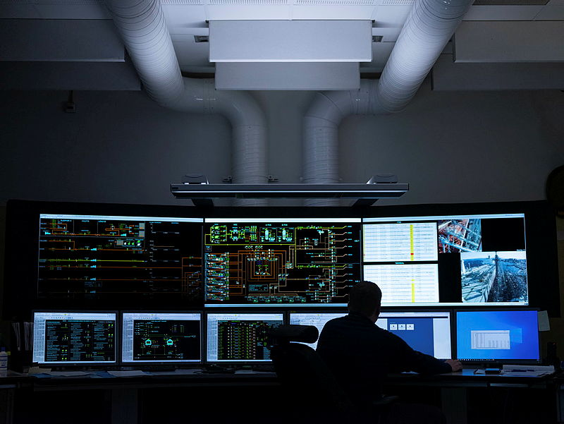
Other use-cases are also welcomed!

Slide 10
Get started repo
https://github.com/equinor/industrial-hackathon-2026

