Slide 1
Data Tools
(2) Reproducible Research

Slide 2
This class
1 | RStudio Projects
2 | RMarkdown
3 | Code Chunks
4 | R Notebooks
5 | Practice
6 | Data Manipulation in the tidyverse – first steps

Slide 3



Tools to stay organized
R project | Organizes files for specific projects
R Markdown | Allows user to combine prose, code, and metadata into one file to increase reproducibility and reporting capabilities
R Notebook | An R Markdown document that allows for independent and interactive execution of code chunks. Great for sharing

Slide 4
The ‘data journey’
Visualize
Import
Tidy
Transform
Communicate
Model
Understand
This lecture focusses on the last step: communicating results (via reports)

Slide 5
RStudio Projects

Slide 6
Projects
RStudio projects make it straightforward to divide your work into multiple contexts, each with their own:
working directory
workspace
history
source documents

Slide 7

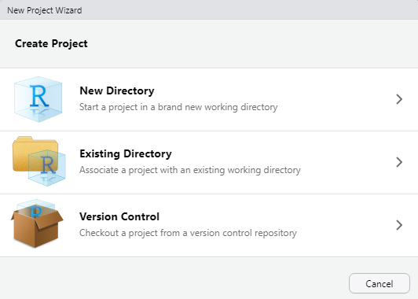
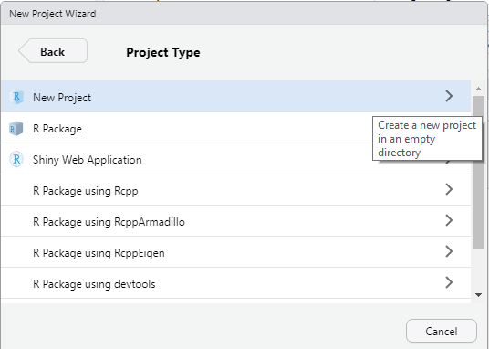
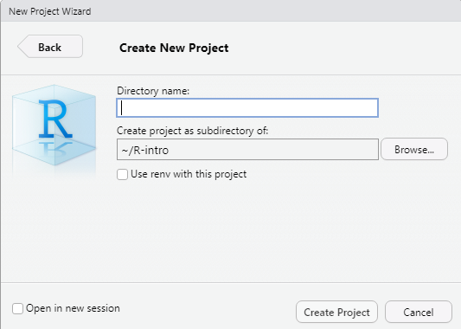
Creating new projects

Slide 8
When a project is opened
A new R session is started
The .Rprofile file in the project's main directory is sourced
The .RData file in the project's main directory is loaded
The .Rhistory file in the project's main directory is loaded
The current working directory is set to the project directory
Previously edited source docs are restored to the editor tab
Other RStudio settings (active tabs, splitter positions, etc) are restored

Slide 9
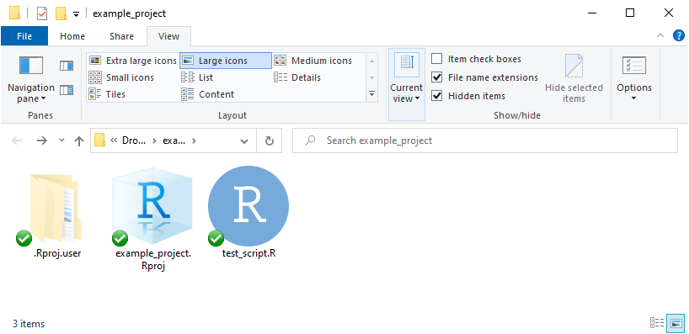
Dropbox/OneDrive/Google Drive/Box issues
The hidden .Rproj.user folder contains lots of temporary files
To prevent issues, do NOT sync this folder

Slide 10
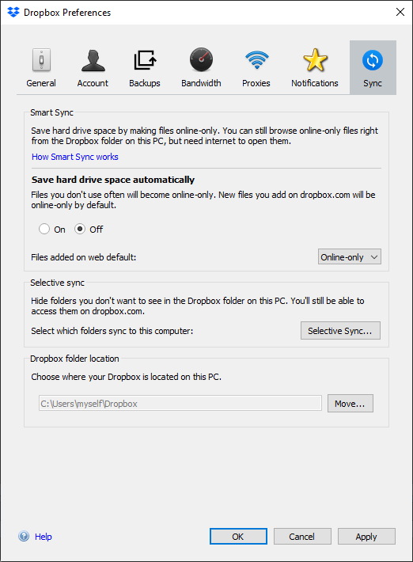
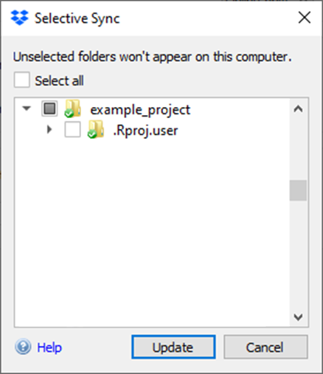
Dropbox/OneDrive/Google Drive/Box issues
In Dropbox, you can use ‘selective sync’ to prevent syncing the .Rproj.user folder

Slide 11
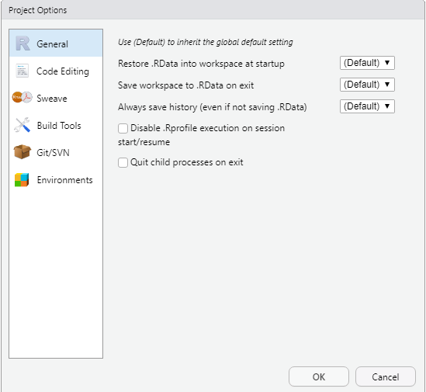
Project Options

Slide 12

RMarkdown

Slide 13
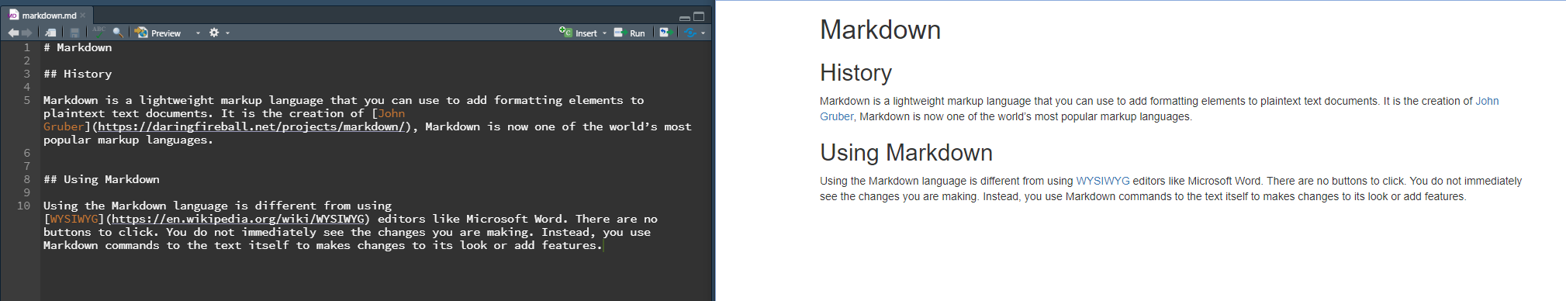
First: what is Markdown (without R)?
A markup language used to format plain text used by social media like Reddit … and by R, Python, …

Slide 14
What is RMarkdown
Allowing others to follow your thought process and recreate (or modify) your work to fit their situation
Becoming a primary reason for popularity of R
Allows for the transfer of ideas as well as group editing
Integrated within Rstudio

Slide 15
What does Rmarkdown do?
R Markdown, a file format that leverages Markdown, allows you to turn your analyses into high quality documents, reports, presentations, and dashboards
HTML
PDF
LaTex
ePUB
etc.

Slide 16






RMarkdown
Standard markdown document
Your report … as .html, .docx, .pdf, .pptx …
The package knitr was designed to give the user access to every part of the process of dealing with a literate programming document.
Literate programming is a programming paradigm introduced by Donald Knuth in which a computer program is given an explanation of its logic in a natural language, such as English, interspersed with snippets of macros and traditional source code, from which compilable source code can be generated.
If you need to convert files from one markup format into another, pandoc is your swiss-army knife. Pandoc can convert between the following formats:

Slide 17
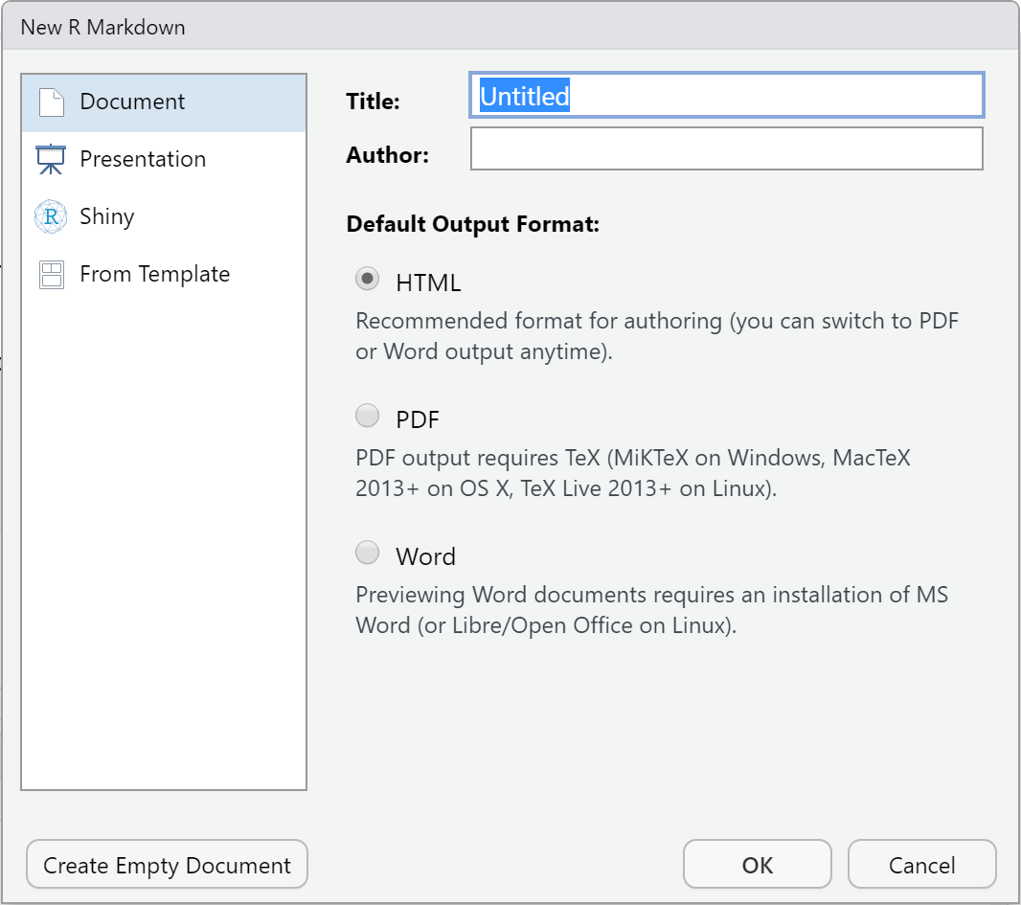
Output types
When you create a new RMarkdown document, you can select among a number of output types
If you create presentations, the new slides are marked using the ## header
Otherwise, the RMarkdown document looks similar regardless of output (Document or Presentation)

Slide 18
What RMarkdown files look like
---
title: "Example"
output: html_document
---
```{r setup, include=FALSE}
knitr::opts_chunk$set(echo = TRUE)
```
## R Markdown
This is an R Markdown document. Markdown is a simple formatting syntax for authoring HTML, PDF, and MS Word documents. For more details on using R Markdown see <http://rmarkdown.rstudio.com>.
When you click the **Knit** button a document will be generated that includes both content as well as the output of any embedded R code chunks within the document. You can embed an R code chunk like this:
```{r cars}
summary(cars)
```
R Markdown files typically contain 3 things:
YAML header
Chunks of R code
Text mixed with simple formatting, leveraging Markdown

Slide 19
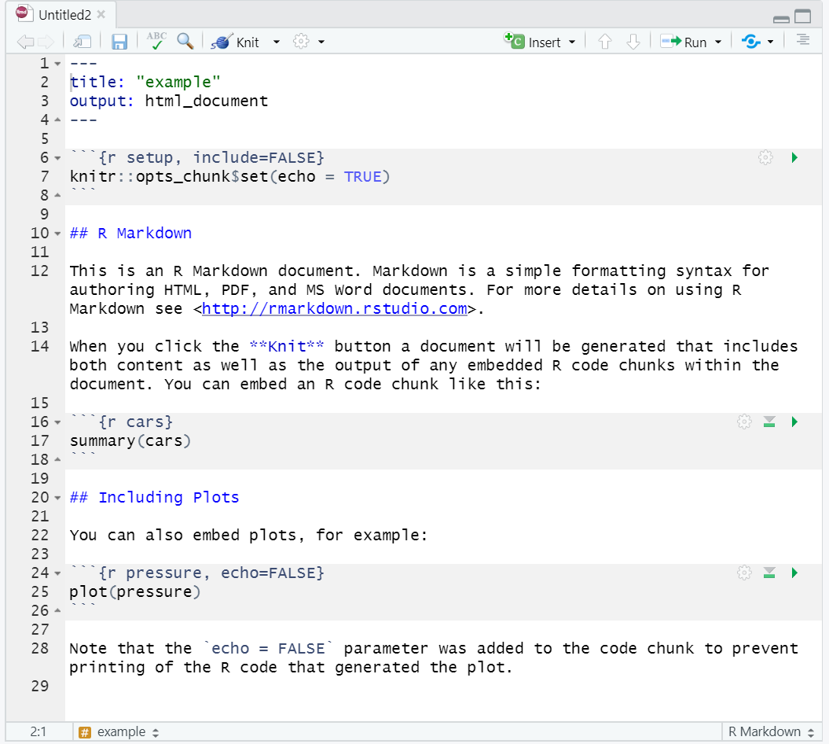


Running code Chunks and Entire R Markdown Files
“Knitting” a document means to execute all code chunks and produce a markdown document
Run individual code chunks with the green play icon
The icon to its left lets you run all previous code chunks
The wheel opens a dialogue which helps you change code chunk options

Slide 20
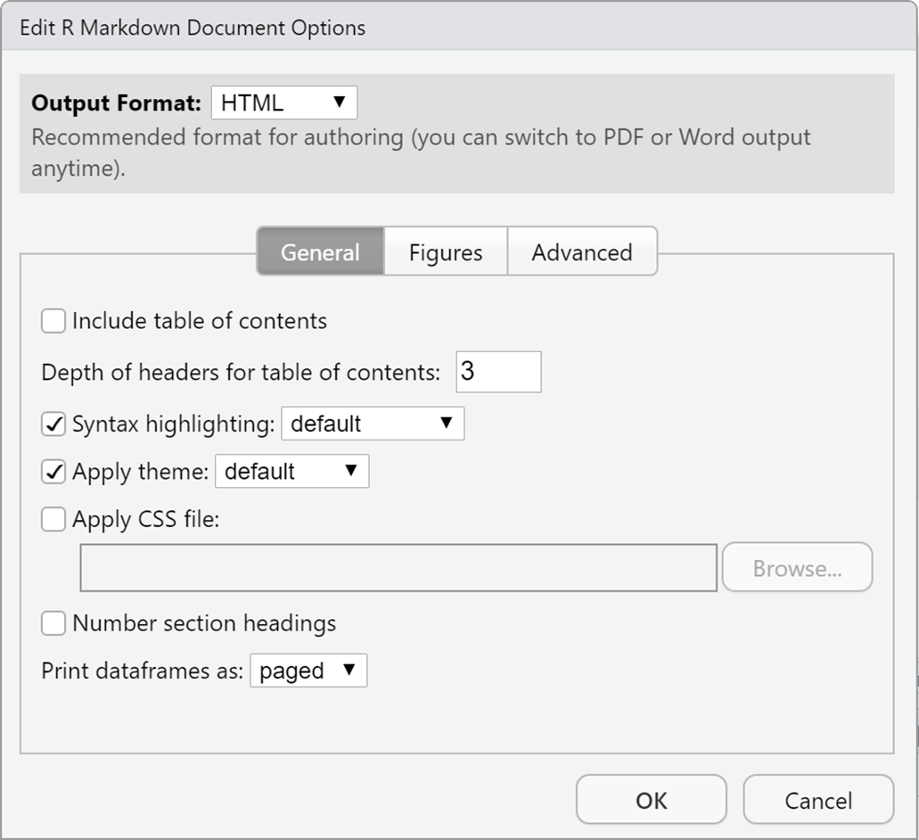
Changing the output type
In the previous example, an html report is created, since output: html_document
You can change it to pdf_document or powerpoint_presentation
There is also a menu that lets you change output options without having to manually change the YAML header – click on the pinwheel next to ‘knit’

Slide 21
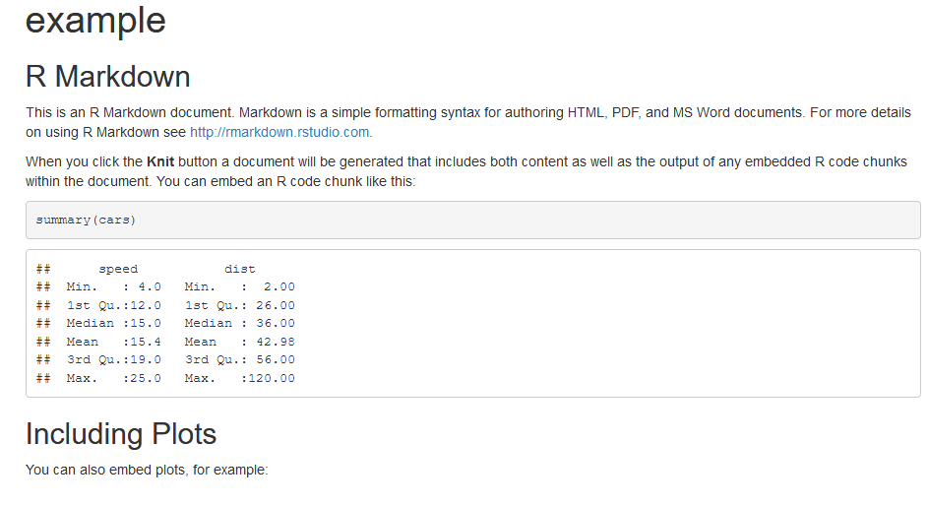
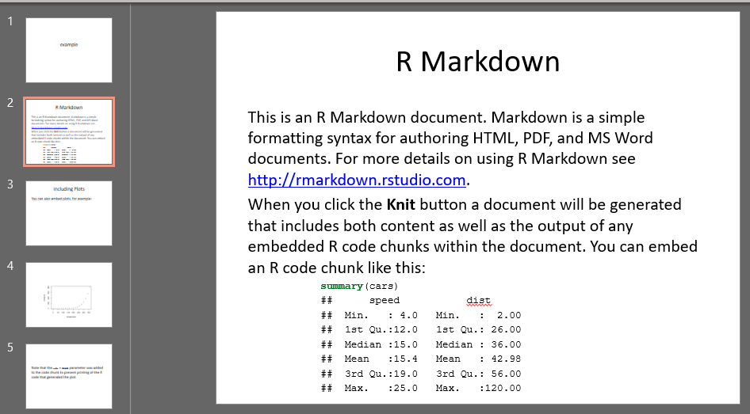
Changing the output type

Slide 22
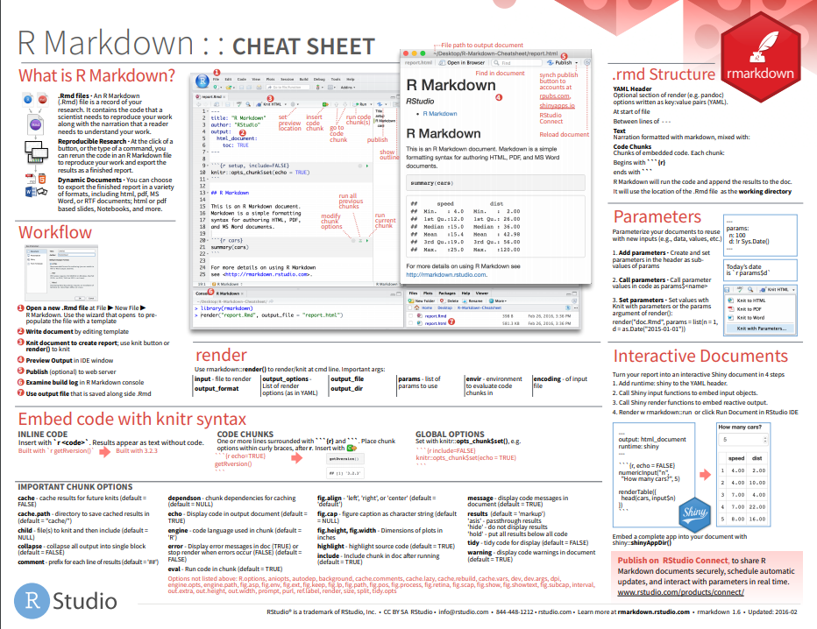
R Markdown Cheat Sheet!
RStudio creates cheat sheets to help you remember everything
The R Markdown cheat sheet will help you today
In RStudio, go to Help → Cheatsheets

Slide 23
Format Plain Text
# italicize a word/phrase
*italic*
_this phrase is in italics_
# bold a word
**hey I am bold**
__bold__
# inline code chunks with backticks `package_name` # this appears in monospaced font
`nrow(iris)` # this will show a number
# superscript and subscript
superscript^2^
subscript~2~
Place one asterisk or one underscore on each side of a word/phrase to italicize it
Place two asterisks or two underscores on each side of a word/phrase to bold it
Place `` (backticks, that `~ key below the Esc key) around an R command to create inline code (if you want to run it, start with `r `)
End a word/phrase with ^2^ for superscript or ~2~ for subscript

Slide 24
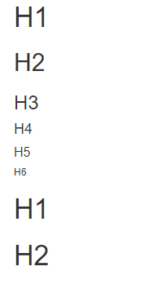
Headers
# H1
## H2
### H3
#### H4
##### H5
###### H6
H1
======
H2
======

Slide 25
Bullet points and numbers
# numbered lists (don’t forget the space after the dot)
1. One
2. Two
3. Three
# bulleted list with sub points (two spaces in front for sub points)
# can use *, -, or + symbol for bullet points
* eggs
* milk
- oat
- real
* bread
# can mix types
1. This is
2. A list
+ that mixed
+ numbers and bullets

Slide 26
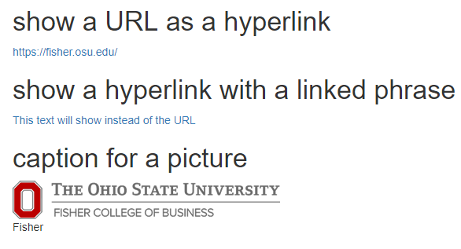
Links and Images
# show a URL as a hyperlink
<https://fisher.osu.edu/>
# show a hyperlink with a linked phrase
[This text will show instead of the URL](https://fisher.osu.edu/)
# caption for a picture (can also point to local .png images)
![Fisher](https://fisher.osu.edu/themes/fcob/images/logos/osu.png)

Slide 27
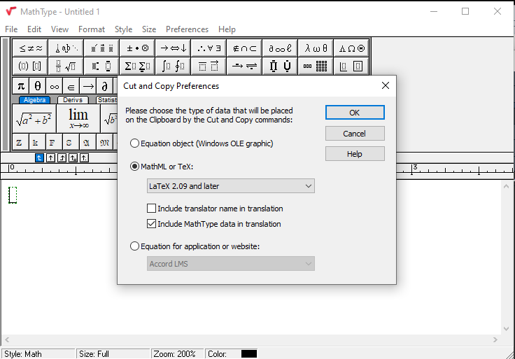
Formulas
# create inline formula
$\forall x \in X, \quad \exists y \leq \epsilon$
# create displayed formula
$$\cos (2\theta) = \cos^2 \theta - \sin^2 \theta$$
Multiple markdown syntaxes exist to place inline formulas and to display formulas (centered on page on its own line)
LaTeX formulae:
Surround formula with one $ sign to create an inline formula
Surround formula with two $ signs to display a formula
Don’t know LaTeX? Mathtype can generate it for you.

Slide 28
Code Chunks

Slide 29
Code Chunks
# code chunk example
# What will this code chunk do?
```{r}
summary(cars)
```
A code chunk runs code (this is a markdown principle in general, not just for R Markdown)
Necessary to run code in an R Markdown file
Three ways to insert code chunk:
Keyboard shortcut! Ctrl + Alt + I
“Insert” button in the toolbar
Manually typing ```{r} ```

Slide 30
Code Chunk Names
# code chunk example
# What will this code chunk do?
```{r cars-summary}
summary(cars)
```
Can give code chunk an optional name
Place code chunk name inside {} after the letter r
Advantages of naming code chunks:
Navigate to specific code chunks easily with the drop-down code navigator in the bottom-left of the script editor
Graphs made from chunks will be easier to use elsewhere
Can cache chunks to knitting time later

Slide 31
Code Chunk options
# code chunk example
# What will this code chunk do?
```{r cars-summary, echo = FALSE, warning = FALSE}
summary(cars)
```
Customize code chunks with options that are placed in the chunk header
There are over 60 options! The most important options are below.
Option | Run code | Show code | Output | Plots | Messages | Warnings
eval=F | - |  | - | - | - | -
include=F |  | - | - | - | - | -
echo=F |  | -
results=‘hide’ |  |  | -
fig.show=‘hide’ |  |  |  | -
message=F |  |  |  |  | -
warning=F |  |  |  |  |  | -

Slide 32
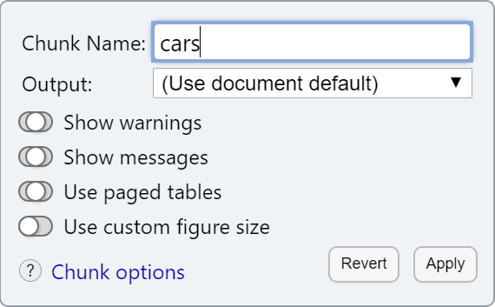
Code Chunk options
RStudio gives you a little helper menu to control those chunk options
Click the pinwheel attached to a code chunk to access it

Slide 33
Format data tables
# code chunk example
# What will this code chunk do?
```{r echo = FALSE}
knitr::kable(
airquality[1:10, ],
caption = "What a cool table format!"
)
Use the knitr::kable() function to display a table with additional formatting
Some thought that this was not pretty enough, and the kableExtra::kbl() function was created
pander:pander() helps create pandoc tables
We will keep it simple for now, and learn about more fancy tables along the way

Slide 34
Dependencies and cache
# code chunk example
```{r echo = FALSE, cache = TRUE}
data <- read.csv(“some_huge_file.csv”)
data
```
Use the code chunk option cache = TRUE to cache results, meaning save chunk output for future use
VERY handy if code take a long time and you need to update/change code
Can use the dependson option to create dependencies (e.g., when a previous chunk loads a dataset that is required)

Slide 35
R Notebooks

Slide 36
R Notebook vs Markdown document
An R Markdown document that allows for independent and interactive execution of code chunks.
Creates greater interactivity while creating your document
Easy to share your notebook directly
When complete, knit to the publication format desired

Slide 37
Practice

Slide 38
Practicing RMarkdown
Let’s create …. our own Covid report for Ohio, containing the latest data
To keep things organized, create a new RStudio project, … then
Create a new .Rmd file, call it something appropriate
ohio_covid_report.Rmd (or so)
The YAML header should be quite simple
---
title: "Ohio Covid Report"
author: Yourname
output: html_document
---

Slide 39
1. Headline and Introduction
Create a second level header, call it “Covid in Ohio” or so, and write a brief description of the purpose of this report (provide a report containing the latest covid statistics)
You should also specify where the data is coming from in your introduction. Create a hyperlink to ‘www.covidtracking.com’ and name it ‘The COVID Tracking Project’.
Bonus: Download a fitting illustration/picture of the virus, put it in the project folder and include it in the introduction section.

Slide 40
2. Loading data
Create a new r code chunk, name it ‘setup’
Use read.csv to load in the latest state-level covid data, and assign it to a new object called covid_data
You can directly pull it from its https source https://api.covidtracking.com/v1/states/daily.csv

Slide 41
3. Data types
The column called date contains the date. It needs to be converted into a ‘Date’ type. Do this in the same code chunk (setup).
as.Date(as.character(coviddata$date),format='%Y%m%d’)

Slide 42
4. Select relevant data
Create a new object called ‘covid_ohio’ that contains rows related to Ohio.
There are lots of columns. We will not need all of them. Select only relevant columns so that you don’t get los using the covid_ohio object
This page has descriptions of all the columns: https://covidtracking.com/data/api (go to Historic values for all states)
We definitely need date, positive (cases), positiveIncrease (new cases), totalTestResultsIncrease (new tests)
Do this in the same code chunk (setup).

Slide 43
5. Transformations
The tracking project puts in some effort to manage data quality
However, notice the order of the data.frame by looking at it ➔ The most recent observations appear up on top
Re-arrange the entire data.frame covid_ohio so that the first row corresponds to the earliest record, and the last row corresponds to the latest record
This will make plotting easier

Slide 44
6. The first plot
The first graph in any covid dashboard usually shows the number of cumulative cases.
Create a new code chunk
Write code to plot the number of cumulative cases over time
You can use plot(x-axis, y-axis, type=‘l’) to create a corresponding line graph
Run the previous and this code chunk to see if it works
To make sure everything works, click on the knit button. A short html report should appear after a few seconds.

Slide 45
7. More plots
The other common plot in covid reporting shows the number of daily new cases
Create a new code chunk
A. Create a plot showing daily new cases.
If you want to use a barplot representation, use the barplot function.
You can see its documentation by typing ?barplot
The time axis needs to be passed to the names.arg argument of barplot
B. Create a plot showing the positivity rate over time
Verify that this works. Knit a report and check for errors.

Slide 46
8. Text and inline code chunks
A proper report does also contain some explanation
Create a new header, call it summary
Use a few bullet points to summarize the covid situation in Ohio based on the previous plots
However, static text is risky. What if someone runs your markdown file all the while the situation has improved or worsened?
Use inline code to make this report dynamic.
`r max(covid_ohio$date)`([backtick] [r] [yourcode]) will display the latest day recorded in the dataset
The latest/last value of covid_ohio$positiveIncrease will probably set the mood. If it’s lower than 100, you could write ‘things are good’, and otherwise ‘things are not good’. The ifelse() function let’s you write conditional text like that.

Slide 47
9. Slides
Instead of an html_document, let’s create powerpoint_presentation slides
We probably don’t want to see R code on powerpoint slides. Set echo=FALSE on all code chunks.
New slides are started with a second level header (## header). Adjust if needed.

Slide 48
Data Manipulation in the tidyverse – first steps

Slide 49
Data Manipulation
What is data manipulation?
Filter observations
Arrange observations
Select variables
Mutate variables (i.e., recode or create new variables)
Join data frames
dplyr provides grammar of data manipulation with functions (a.k.a., verbs) that mirror SQL.
Don’t forget to load dplyr or the entire tidyverse!
library(tidyverse)

Slide 50
Chaining commands - the Pipe
Part of the common philosophy for the tidyverse is that:
Each function should do one specific thing well.
Each function should have a data frame as an input and a data frame as an output.
This allows us to use the pipe operator %>% to chain functions in consecutive lines of code so that it is easy for humans to read:
data.frame %>% Function1 %>% Function2
Will perform the task of Function1 on the original objects, then perform the task of Function2 on the output of Function1
The base-R version is much harder to read, especially for non-programmers:
Function2(Function1(data.frame))

Slide 51
Selecting observations / rows - filter
#Select cases in Ohio only
covid_data %>%
filter(state=='OH')
#Select cases in Ohio or Indiana
covid_data %>%
filter(state %in% c("OH","IN"))
#which you can also do with a logical OR
covid_data %>%
filter(state=='OH' | state=="IN")
filter() lets you select observations
You can use ‘logic’ to make selections( = , >, <, %in%)
You can combine selection criteria with & or simply chain calls to filter()

Slide 52
Arrange
#sort by date ascending
covid_data %>%
filter(state=='OH') %>%
arrange(date)
#sort by date descending
covid_data %>%
filter(state=='OH') %>%
arrange(desc(date))
#you can save the output to a new object
covid_ohio<-
covid_data %>%
filter(state=='OH') %>%
arrange(desc(date))
#this also works
covid_data %>%
filter(state=='OH') %>%
arrange(desc(date)) -> covid_ohio
We can arrange observations to reveal helpful information and check the data … like finding the best or worst customers

Slide 53
Selecting variables / columns
#selecting just 2 columns
covid_ohio %>%
select(date,positiveIncrease)
Select variables with select()

Slide 54
‘Mutating’ variables
#creating a new variable containing the positivity rate
covid_ohio %>%
mutate(positivity_rate=
positiveIncrease / totalTestResultsIncrease)
mutate() lets you create new variables based on a transformation
If you use existing names, you can overwrite variables in a data frame

Slide 55
Combining joining data.frames
#for this example, first create a lookup that links state abbreviation to region
data('state')
states = data.frame( state=state.abb, region=state.region)
#Now we can join, thereby adding a region variable to our data.frame
covid_data=
covid_data%>%
left_join(states)
#Check (region will come up as the last column)
View(covid_data)
In the simplest case, a common variable (like an ID, State abbreviation) allows us to join two data frames
Very common when you have tables from normalized databases

