Slide 1
Data Tools
(4) Data Organization II

Slide 2
This class
1 | Relational data
2 | Mutating joins
3 | Filtering joins
4 | Set operations
5 | Databases and R basics
6 | Connecting to remote databases
7 | Dealing with big data

Slide 3
The ‘data journey’
Visualize
Import
Tidy
Transform
Communicate
Model
Understand
This lecture covers key elements of importing and tidying data, as well as some essential transformations

Slide 4
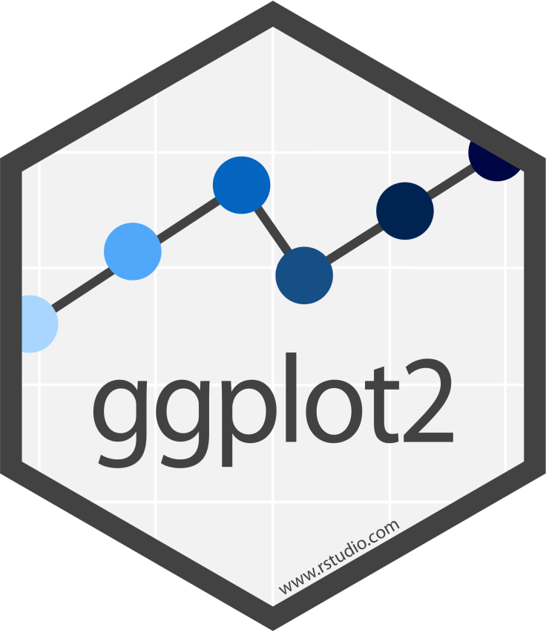

















Tidyverse and ‘data journey’
Visualize
Import
Tidy
Transform
Communicate
Model
Understand
gggg

Slide 5
Relational data

Slide 6
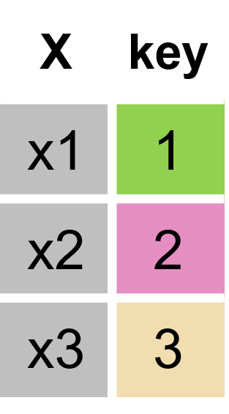
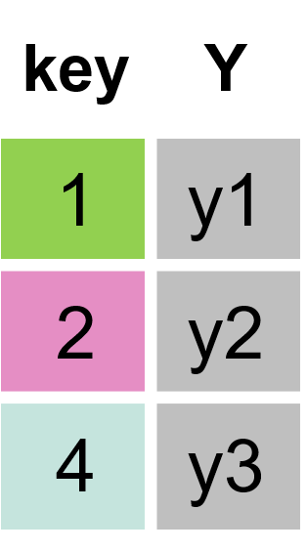
Multiple tables of data are called relational data
key | X
1 | x1
2 | x2
3 | x3
key | Y
1 | y1
2 | y2
4 | y3

Slide 7
Example: inner join

Slide 8
Example: inner join

Slide 9
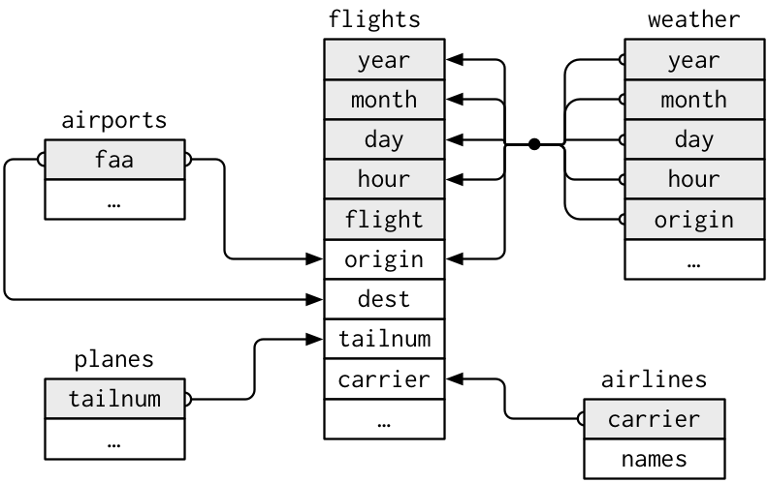
Relational data: nycflights13
https://r4ds.had.co.nz/relational-data.html

Slide 10
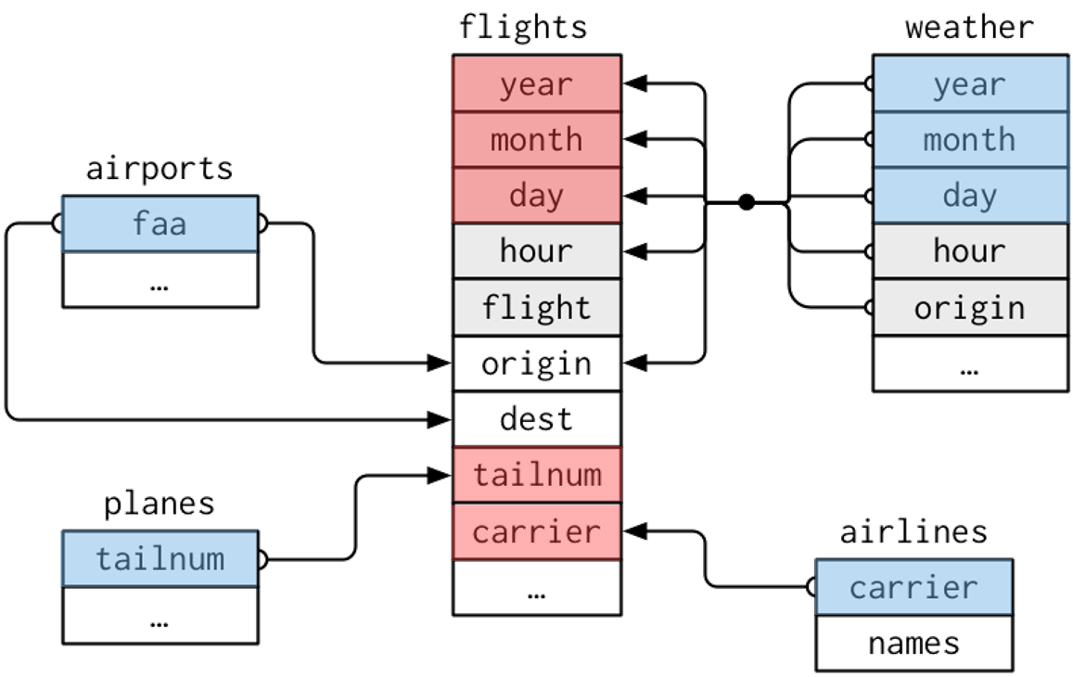
nycflights13 relationships
flights connects to planes via tailnum
flights connects to airlines via carrier
flights connects to airports via origin & dest
flights connects to weather via origin, year, month, day, & hour

Slide 11
Groups of verbs
To work with relational data you need verbs that work with pairs of tables. There are three groups of verbs designed to work with relational data:
Mutating joins: add new variables to one data frame by matching observations in another.
Filter joins: filter observations from one data frame based on whether or not they match an observation in the other table.
Set operations: treat observations as if they were set elements

Slide 12
Mutating joins

Slide 13
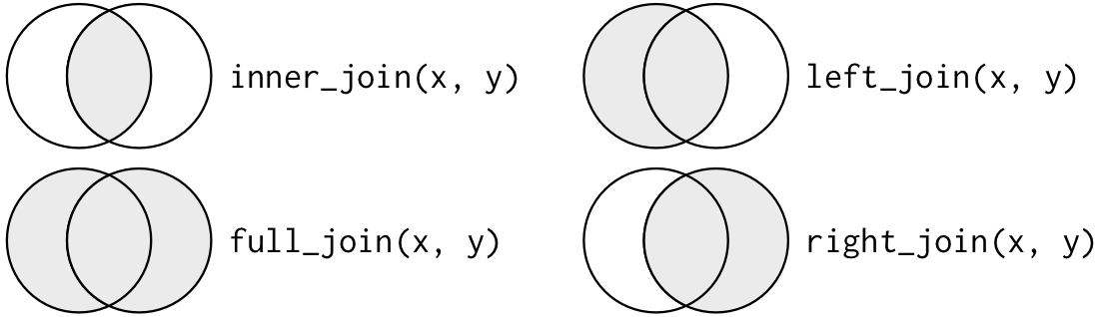
Join types and matching dplyr functions
inner join:
inner_join()
outer joins
left: left_join()
right: full_join()
full: right_join()

Slide 14
Inner join
Simplest type of join
matches pairs of observations whenever their keys are equal
keys are variables that connect pairs of tables
key | X
1 | x1
2 | x2
3 | x3
key | Y
1 | y1
2 | y2
4 | y3

Slide 15
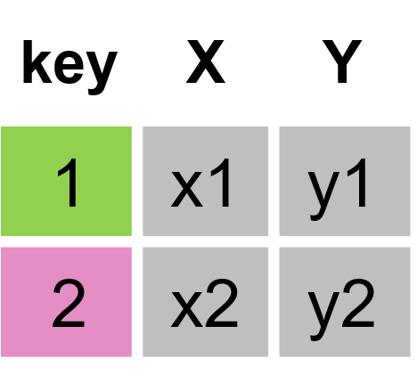
Inner join
# Example set-up
x <- tribble( ~key, ~val_x,
1, "x1",
2, "x2",
3, "x3")
y <- tribble( ~key, ~val_y,
1, "y1",
2, "y2",
4, "y3")
# inner join
x %>% inner_join(y, by = "key")
# A tibble: 2 × 3
key val_x val_y
<dbl> <chr> <chr>
1 1 x1 y1
2 2 x2 y2
use by to tell dplyr which variable is the key
unmatched rows are not included in the result

Slide 16
by with diverging key names
# Example set-up
xx <- tribble( ~keyX, ~val_x,
1, "x1",
2, "x2",
3, "x3")
yy <- tribble( ~keyY, ~val_y,
1, "y1",
2, "y2",
4, "y3")
# inner join
xx %>% inner_join(yy, by = c("keyX"="keyY"))
# A tibble: 2 x 3
keyX val_x val_y
<dbl> <chr> <chr>
1 1 x1 y1
2 2 x2 y2
They key variable(s) can have different name(s) in tables xx and yy
by = c(“key-name-X"="key-name-Y"))

Slide 17
Outer joins
Outer joins keep observations that appear in at least one of the tables
There are 3 types of outer joins:
left: left_join()
right: full_join()
full: right_join()

Slide 18
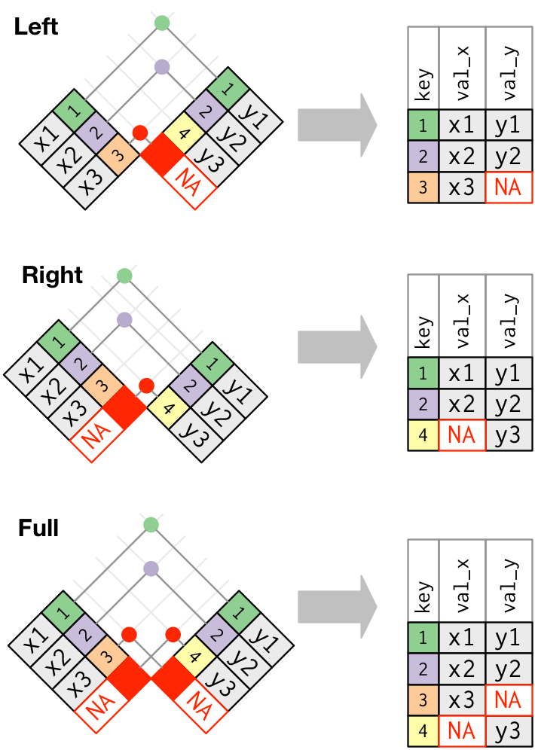
left join
# Example set-up
x <- tribble( ~key, ~val_x,
1, "x1",
2, "x2",
3, "x3")
y <- tribble( ~key, ~val_y,
1, "y1",
2, "y2",
4, "y3")
# Left join
x %>% left_join(y, by = "key")
# A tibble: 3 × 3
key val_x val_y
<dbl> <chr> <chr>
1 1 x1 y1
2 2 x2 y2
3 3 x3 NA
keeps all observations in x
Missing values get NA

Slide 19
right join
# Example set-up
x <- tribble( ~key, ~val_x,
1, "x1",
2, "x2",
3, "x3")
y <- tribble( ~key, ~val_y,
1, "y1",
2, "y2",
4, "y3")
# Right join
x %>% right_join(y, by = "key")
# A tibble: 3 x 3
key val_x val_y
<dbl> <chr> <chr>
1 1 x1 y1
2 2 x2 y2
3 4 NA y3
keeps all observations in y
Missing values get NA

Slide 20
full join
# Example set-up
x <- tribble( ~key, ~val_x,
1, "x1",
2, "x2",
3, "x3")
y <- tribble( ~key, ~val_y,
1, "y1",
2, "y2",
4, "y3")
# Full join
x %>% full_join(y, by = "key")
# A tibble: 4 x 3
key val_x val_y
<dbl> <chr> <chr>
1 1 x1 y1
2 2 x2 y2
3 3 x3 NA
4 4 NA y3
keeps all observations in x and y
Missing values get NA

Slide 21
Practice joins
take the flights data and then
left join airlines data
filter for “Virgin America”
group by time_hour
summarise data by computing the mean departure delay
identify the top 10 date-times with the highest average departure delay
Can you figure out how to add the full name of the origin and destination (i.e. name) from airports to flights data? Hint: use two consecutive left_joins.

Slide 22
Solution
# problem 1
flights %>%
#left join airlines data
left_join(airlines) %>%
#filter for “Virgin America”
filter(name == "Virgin America") %>%
#group by time_hour
group_by(time_hour) %>%
#summarise data by computing the mean departure delay
summarise(delay = mean(dep_delay, na.rm = TRUE)) %>%
#identify the top 10 date-times with highest average departure delay
top_n(10, wt = delay) %>%
arrange(desc(delay))

Slide 23
Solution
# problem 2
flights %>%
left_join(airports, by = c("origin" = "faa")) %>%
left_join(airports, by = c("dest" = "faa")) %>%
select( dest, origin,
origin_name = name.x,
dest_name = name.y,
arr_delay)

Slide 24
Filtering joins

Slide 25
filtering joins
Filtering joins affect the observations rather than adding variables
There are 2 types of filtering joins:
semi join keeps all observations in x that have a match in y
anti join drops all observations in x that have a match in y

Slide 26
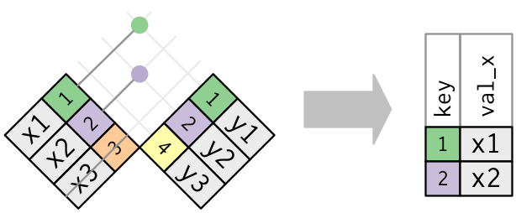
semi join
# Example set-up
x <- tribble( ~key, ~val_x,
1, "x1",
2, "x2",
3, "x3")
y <- tribble( ~key, ~val_y,
1, "y1",
2, "y2",
4, "y3")
# semi join
x %>% semi_join(y, by = "key")
# A tibble: 2 × 2
key val_x
<dbl> <chr>
1 1 x1
2 2 x2
keeps all observations in x that have a match in y

Slide 27
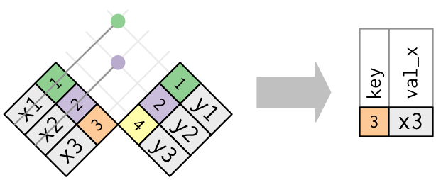
anti join
# Example set-up
x <- tribble( ~key, ~val_x,
1, "x1",
2, "x2",
3, "x3")
y <- tribble( ~key, ~val_y,
1, "y1",
2, "y2",
4, "y3")
# anti join
x %>% anti_join(y, by = "key")
# A tibble: 1 × 2
key val_x
<dbl> <chr>
1 3 x3
drops all observations in x that have a match in y

Slide 28
Practice
How many flights in the flights data have matching planes metadata (tailnum is your key)? How many do not? Hint: use tally() after your joining functions.
Filter the airports data for those airports that do not have matching destination values in the flights data (faa and dest are your keys). How many unique airports do you find? Hint: use the distinct() and tally() functions after your joining function.

Slide 29
Solution
# problem 1a ——> 284,170
flights %>%
semi_join(planes, by = "tailnum") %>%
tally()
# problem 1b ——> 52,606
flights %>%
anti_join(planes, by = "tailnum") %>%
tally()
# problem 2 —-> 1,357
airports %>%
anti_join(flights, by = c("faa" = "dest")) %>%
distinct(faa) %>%
tally()

Slide 30
Set operations

Slide 31
set operations
Compares entire row in each data set
intersect(x, y) return only observations in both x and y
union(x, y) return unique observations in x and y
setdiff(x, y) return observations in x, but not in y

Slide 32
intersect(x, y)
# Example set-up
tib1 <- tribble( ~x, ~y,
1, 1,
2, 1)
tib2 <- tribble( ~x, ~y,
1, 1,
1, 2 )
#intersect
intersect(tib1, tib2)
# A tibble: 1 x 2
x y
<dbl> <dbl>
1 1 1
return only observations in both x and y

Slide 33
union(x, y)
# Example set-up
tib1 <- tribble( ~x, ~y,
1, 1,
2, 1)
tib2 <- tribble( ~x, ~y,
1, 1,
1, 2 )
#union
union(tib1, tib2)
# A tibble: 3 x 2
x y
<dbl> <dbl>
1 1 1
2 2 1
3 1 2
return unique observations in x and y

Slide 34
setdiff(x, y)
# Example set-up
tib1 <- tribble( ~x, ~y,
1, 1,
2, 1)
tib2 <- tribble( ~x, ~y,
1, 1,
1, 2 )
#setdiff
setdiff(tib1, tib2)
# A tibble: 1 x 2
x y
<dbl> <dbl>
1 2 1
return observations in x, but not in y

Slide 35
Functions for relational data
Operator/Function | Type | Description
inner_join(), left_join(), right_join(), full_join() | mutating join | add new variables to one data frame by matching observations in another.
semi_join(), anti_join() | filtering joins | filter observations from one data frame based on whether or not they match an observation in the other table
intersect(), union(), setdiff() | set operations | treat observations as if they were set elements

Slide 36
Databases and R basics

Slide 37
Connecting and working with databases
Database connection
Via ODBC R can connect to almost any database
RStudio sells licenses for professional drivers
sparklyr lets you use Apache Spark (which can connect to various databases including Hadoop)
Specialized packages (e.g., bigrquery)
Communicating with the database engine
The DBI package
dbplyr translates dplyr verbs to database language / SQL

Slide 38
How to obtain data from databases
DBI::dbGetQuery
Barebones approach, few additional packages required
dbplyr / dplyr
No sql knowledge required
R Notebook SQL engine
Use standard sql syntax
syntax highlighting

Slide 39
Basic operations with DBI
#Create a local SQLite database for practice
local_SQLite_database_connection <-
dbConnect(RSQLite::SQLite(), ":memory:")
#Copy mtcars dataset into database
dbWriteTable(local_SQLite_database_connection,
"mtcars", mtcars,
overwrite = TRUE)
#check that it is there
dbListTables(local_SQLite_database_connection)
#Pull copy of table
mtcars_from_database <-
dbReadTable(local_SQLite_database_connection,
'mtcars')
The SQLite database comes with the RSQLite package, great for quick testing of code

Slide 40
Send queries with DBI
#Send SQL query
sample_query <-
dbSendQuery(local_SQLite_database_connection,
"SELECT * FROM mtcars WHERE cyl = 4")
#Fetch results
dbFetch(sample_query)
You can send queries in actual SQL code
Make sure your code matches the database your are connected to

Slide 41
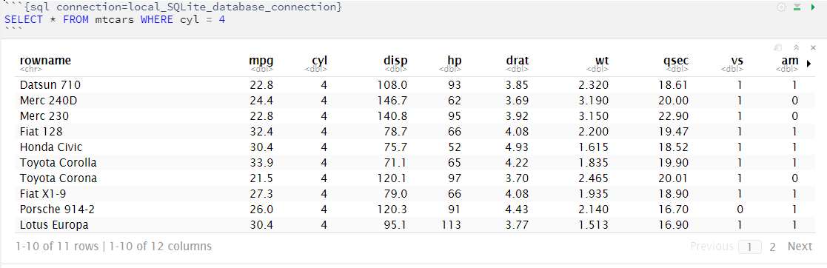
SQL code chunks in RMarkdown
Chunk begins ```{sql instead of ```{r
Connection needs to be specified
Within chunk, you can use SQL commands (which match the SQL version of the connected database)

Slide 42
Using dbplyr
#Using dplyr copy_to instead of dbWriteTable
#adding rownames which otherwise get lost
mtcars %>%
rownames_to_column() %>%
copy_to(local_SQLite_database_connection,
df=.,
name='mtcars',
overwrite = TRUE)
#Create a tibble that is connected to database
mtcars_db_tbl <-
local_SQLite_database_connection %>%
tbl(from="mtcars")
dbplyr allows you to use the familiar dplyr language and interact with databases
No need to learn SQL!
We can use dplyr::copy_to to copy tables into the database
Using tbl() we can create tibbles that are pointers to the database table
Lazy evaluation! SQL queries are not run before it is necessary

Slide 43
dbplyr converts dplyr syntax to sql
#dplyr verbs can be applied to database
mtcars_4cyl=
mtcars_db_tbl %>%
filter(cyl==4)
#lazy evaluation
mtcars_4cyl %>% is.data.frame()
[1] FALSE
#Query inside!
mtcars_4cyl %>% show_query()
<SQL>
SELECT *
FROM `mtcars`
WHERE (`cyl` = 4.0)
#Collect to force evaluation
mtcars_4cyl %>% collect() %>% is.data.frame()
[1] TRUE
Again, lazy evaluation
dplyr syntax is converted to sql
We can force evaluation with collect()

Slide 44
Not everything converts to sql
mtcars_db_tbl %>%
select(-rowname) %>%
lm(mpg~.,data=.)
#no lazy eval
mtcars_db_tbl %>%
select(-rowname) %>%
lm(mpg~.,data=.) %>% show_query()
For instance, calling lm() results in pulling the table

Slide 45
nycflights13 example
#load nyflights13 sample database
nyc_db <- nycflights13_sqlite()
nyc_con <- nyc_db$con
#connecting to dplyr tables
nycflight_tbls <-
nyc_con %>%
dbListTables(local_SQLite_database_connection) %>%
str_subset('sqlite', negate = TRUE) %>%
purrr::set_names() %>%
map(tbl, src=nyc_con)
#put in Environment
nycflight_tbls %>%
list2env(.GlobalEnv)
nycflights13 package comes with a sqlite database for practice
If there are many tables to connect to, purrr::map makes it easy to programmatically link too all relevant tables

Slide 46
left_join example
#Left join query translation
flights %>%
left_join(airports %>%
transmute(faa, origin_name = name),
by = c("origin" = "faa")) %>%
show_query()
#collect
flights_joined <-
flights %>%
left_join(airports %>%
transmute(faa, origin_name = name),
by = c("origin" = "faa")) %>%
collect
flights_joined %>% is.data.frame()
Just another example of sql translation and lazy evaluation

Slide 47
Key database functions
Package | Function | Description
DBI | dbConnect | Connect to database
DBI | dbWriteTable | Write table to connected database
DBI | dbListTables | List tables in connected database
DBI | dbReadTable | Read table from connected database
DBI | dbSendQuery | Send SQL query to database
DBI | dbFetch | Fetch results from query
dplyr | copy_to | Copy tibble into database table
dplyr | tbl | Create tibble with pointer to database source
dplyr | show_query | Show SQL converted by dbplyr
dplyr | collect | Force evaluation of query

Slide 48
Connecting to remote databases

Slide 49
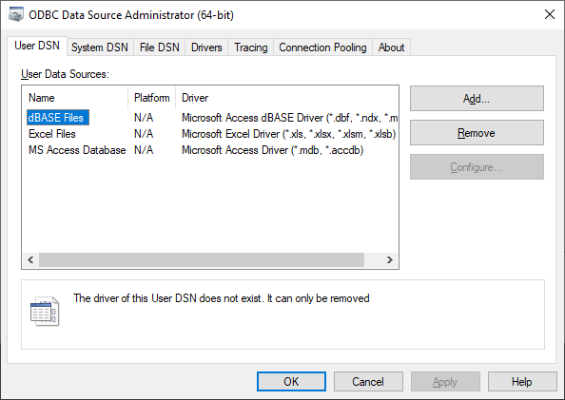
ODBC
In windows, the ODBC Data Sources (32-bit) / (64-bit) Administrator lets you add DNSs which point to a data source

Slide 50
Using DSN
jpmc_odbc <- dbConnect(odbc::odbc(), dsn = “DSN-name")
dbConnect can use DSN to establish connections
However, when you share your code, the other user needs to have the same DSN set up

Slide 51
Not using DSN (for better portability)
jpmc_odbc <- dbConnect(odbc::odbc(),
Driver = "SQL Server",
Server = “0.0.0.0",
Database = “name",
Trusted_Connection = "True")
To make code more portable, we can connect without setting up DSN
More information:
https://db.rstudio.com/best-practices/managing-credentials/#integrated-security-without-dsn

Slide 52

sparklyr
Spark
Hadoop
Hive
S3
Redshift
…
Translates dplyr verbs to spark sql
You can cache data in spark and use spark-specific operations (ML, pivoting data,…)
For more: https://rstudio.com/resources/webinars/part-1-introducing-an-r-interface-for-apache-spark/

Slide 53
https://db.rstudio.com
Regularly check RStudio’s database page: https://db.rstudio.com/databases/
Package updates and new packages pop up at a fast rate

Slide 54
Dealing with big data

Slide 55




Working with databases - alternatives
Obtain data from database in chunks, e.g. random samples and/or analyzing chunk by chunk.
Load all data onto a powerful workstation. You may need an expensive workstation with a lot of working memory (RAM).
As much ‘analysis in place’ as possible. E.g., estimate model using random sample, translate predictive model into SQL code and let database compute predictions.

Slide 56
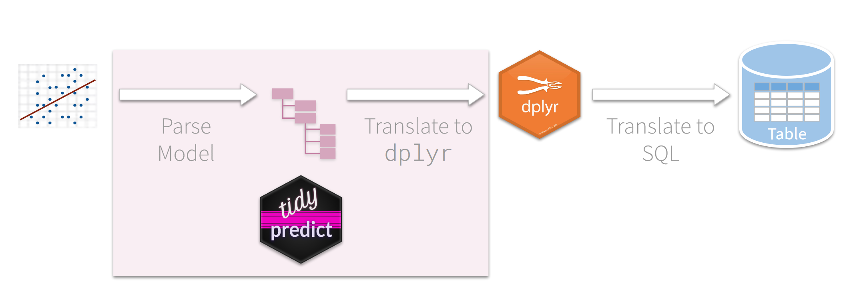
Tidypredict
Model is estimated in R (or python,…) based on subset of data.
Prediction instructions are sent to database as SQL

Slide 57
Other considerations
R and RStudio can be run on a server
Instead of sending data to your local R session, all computations can be run on a server – with more memory and a fast connection to database of interest
RStudio server can be accessed from any web browser
Other services like Azure can also run R, however, you would rely on proprietary software

