Slide 1
Data Tools
(5) Data Visualization

Slide 2
This class
1 | Data visualizations and ggplot2
2 | Setting up the canvas
3 | Geom
4 | Facets
5 | Multiple geoms
6 | barplot-position
7 | coordinate system
8 | Titles, labels, themes
9 | Misc

Slide 3
The ‘data journey’
Visualize
Import
Tidy
Transform
Communicate
Model
Understand
This lecture covers visualization tools, mostly ggplot2

Slide 4
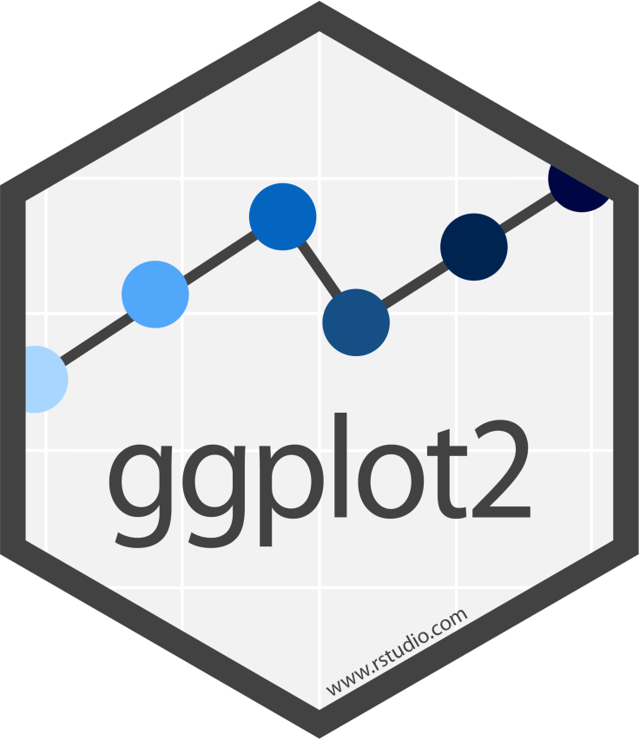










Tidyverse and ‘data journey’
Visualize
Import
Tidy
Transform
Communicate
Model
Understand

Slide 5
Good Visualizations (Tufte 2001)
Show the data
Induce the reader to think about the data being presented (rather than some aspect of the data)
Avoid distorting the data
Present many numbers with minimal ink
Make large datasets coherent
Encourage the reader to compare different pieces of data
Reveal data
Serve a clear purpose
Be integrated with the statistical and verbal descriptions of the dataset

Slide 6
Storytelling with data
Be clear on your intent
The right graph creates an ‘aha’ moment
Do not overcomplicate
Get rid of the non-essential
Make it clear where to look (focus attention)
Words make the graph accessible
Audience trumps all else
http://www.storytellingwithdata.com/blog/2017/8/9/my-guiding-principles

Slide 7
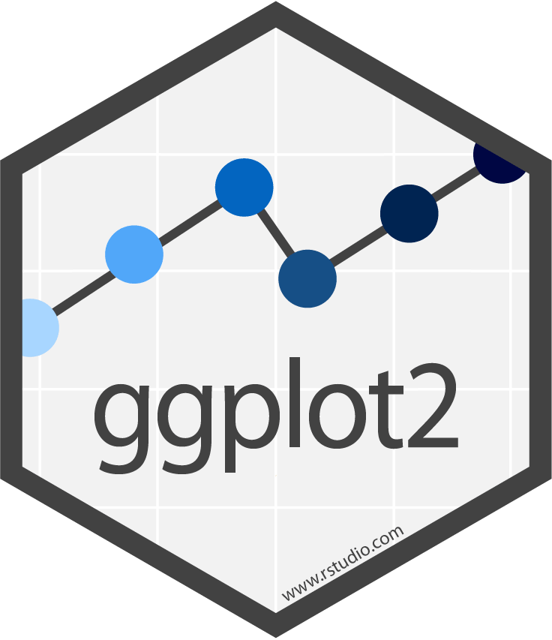
Data visualizations and ggplot2

Slide 8
ggplot2
Mature tidyverse package (version 3.3.x)
Still very dynamic, with new features being added
If you look for examples on google, check the date. Code from 2018 will still work, but there could be better ways of doing it. Code from 2016 may result in warnings or even errors.
There are many complementary packages
ggplot extension gallery: https://exts.ggplot2.tidyverse.org/gallery/

Slide 9
The ‘grammar of graphics’
Data (e.g., data.frame)
Aesthetic mapping
Geometric elements (i.e., chart types; note: plural – you can ‘overplot’, i.e. multiple geoms)
Modifications
Scales
Labels
Annotations
Themes
Facets
Arranging multiple plots
Output (size, filetype,…)

Slide 10
Setting up the canvas

Slide 11
The mpg dataset
library(tidyverse); mpg %>% skimr::skim()
-- Variable type: character --------------------------------------------------
# A tibble: 6 x 8
skim_variable n_missing complete_rate min max empty n_unique whitespace
* <chr> <int> <dbl> <int> <int> <int> <int> <int>
1 manufacturer 0 1 4 10 0 15 0
2 model 0 1 2 22 0 38 0
3 trans 0 1 8 10 0 10 0
4 drv 0 1 1 1 0 3 0
5 fl 0 1 1 1 0 5 0
6 class 0 1 3 10 0 7 0
-- Variable type: numeric --------------------------------------------------------------
# A tibble: 5 x 11
skim_variable n_missing complete_rate mean sd p0 p25 p50 p75 p100
* <chr> <int> <dbl> <dbl> <dbl> <dbl> <dbl> <dbl> <dbl> <dbl>
1 displ 0 1 3.47 1.29 1.6 2.4 3.3 4.6 7
2 year 0 1 2004. 4.51 1999 1999 2004. 2008 2008
3 cyl 0 1 5.89 1.61 4 4 6 8 8
4 cty 0 1 16.9 4.26 9 14 17 19 35
5 hwy 0 1 23.4 5.95 12 18 24 27 44

Slide 12
Canvas
# blank canvas
ggplot(data = mpg)
# canvas with axes
ggplot(data = mpg, aes(x = displ, y = hwy))
Notes:
600x400

Slide 13
Geom

Slide 14
geoms
We display data with geometric shapes
Almost 40 built-in geoms (with many more offered by other pkgs)
All geom functions start with geom_
Check documentation: https://ggplot2.tidyverse.org/reference/

Slide 15








Some common geoms
 | geom_abline() geom_hline() | Reference lines: horizontal, vertical, and diagonal
 | geom_bar() geom_col() | Bar charts
 | geom_boxplot() stat_boxplot() | A box and whiskers plot (in the style of Tukey)
 | geom_density() stat_density() | Smoothed density estimates
 | geom_histogram() stat_bin() | Histograms and frequency polygons
 | geom_point() | Points
 | geom_smooth() stat_smooth() | Smoothed conditional means
 | geom_label() geom_text() | Text

Slide 16
Univariate: geom_histogram()
#create a histogram
ggplot(data = mpg, aes(x = hwy)) +
geom_histogram()

Slide 17
Univariate: geom_bar()
#create a barplot
ggplot(data = mpg, aes(x = class)) +
geom_bar()

Slide 18
geom_bar()
#create a barplot
ggplot(data = mpg, aes(x = class)) +
geom_bar()
#Using the pipe %>%
mpg %>%
ggplot(aes(x = class)) +
geom_bar()
#alternative
mpg %>%
ggplot() +
geom_bar(aes(x = class))
This is called an aesthetic mapping argument
Every geom requires a mapping argument to be used
Univariate geoms require just one (x variable)
Bivariate other geoms require two (x, y variable)
Data can be piped to ggplot
aesthetic mappings can be applied ‘globally’ or for each geom

Slide 19
geom_bar()
mpg %>%
ggplot(aes(x = class)) +
geom_bar(stat = 'count')
mpg %>%
group_by(class) %>%
count(name = 'count') %>%
ggplot(aes(x = class, y = count )) +
geom_bar(stat = 'identity')
By default, geom_bar will create a frequency table from which it creates the barplot (stat='count')
Alternatively, we can first obtain the frequency table using dplyr::count, and then create a barplot (stat='identity')

Slide 20
Bivariate: numeric x ~ numeric y
ggplot(data = mpg, aes(x = displ, y = hwy)) +
geom_point()
40
40
30
30
hwy
hwy
20
20
2
3
4
5
6
7
2
3
4
displ
5
6
7
displ
For bivariate plots, both x and y need to be mapped to data

Slide 21
Bivariate: numeric y ~ categorical x
mpg %>%
ggplot(aes(x = class, y = hwy)) +
geom_boxplot()
mpg %>%
ggplot(aes(x = class, y = hwy)) +
geom_violin()
40
30
hwy
20
2seater
compact
midsize
minivan
pickup
subcompact
suv
class

Slide 22
Bivariate: categorical y ~ categorical x
mpg %>%
ggplot(aes(x = drv, y = manufacturer)) +
geom_bin2d()
Like a heatmap of a crosstable
Not used much in practice

Slide 23
Practice
Create a chart that illustrates the distribution of the cty variable
Create a chart that shows the number of observations for each manufacturer
Create a scatter plot of cty vs displ

Slide 24
Answer
# distribution of cty variable
mpg %>%
ggplot(aes(x = cty)) +
geom_histogram()
# number of observations for each manufacturer
mpg %>%
ggplot(aes(x = manufacturer)) +
geom_bar()
# scatter plot for cty vs displ
mpg %>%
ggplot(aes(x = displ, y = cty)) +
geom_point()

Slide 25
Aesthetics not mapped to variable
#modify aesthetics within geom_point()
mpg %>%
ggplot(aes(x = displ, y = hwy)) +
geom_point(color = "darkblue",
size = 3,
shape = 4,
alpha = .5)
#does not work; aes maps to variable
mpg %>%
ggplot(aes( x = displ,
y = hwy, color = "darkblue")) +
geom_point(size = 3,
shape = 4,
alpha = .5)
Common for things like
color
size
shape
opacity

Slide 26
Additional dimensions
#Additional dimension can be brought in as colors, shapes, sizes, ...
mpg %>%
ggplot(aes( x = displ,
y = cty,
color = class )) +
geom_point()
Additional dimension can be brought in as colors, shapes, sizes

Slide 27
Practice
Which variables in mpg are categorical? Which variables are continuous?
Starting with a scatterplot of displ and hwy, create additional aesthetic mappings. Map a continuous variable to color, size, and shape. How do these aesthetics behave differently for categorical vs. continuous variables?
What happens if you map the same variable to multiple aesthetics?
What happens if you map an aesthetic to an expression instead of a variable name, like aes(colour = displ < 2)?

Slide 28
Answer (1)
# 1. which variables are continuous vs categorical
?mpg
mpg %>% str
tibble [234 x 11] (S3: tbl_df/tbl/data.frame)
$ manufacturer: chr [1:234] "audi" "audi" "audi" "audi" ...
$ model : chr [1:234] "a4" "a4" "a4" "a4" ...
$ displ : num [1:234] 1.8 1.8 2 2 2.8 2.8 3.1 1.8 1.8 2 ...
$ year : int [1:234] 1999 1999 2008 2008 1999 1999 2008 1999 1999 2008 ...
$ cyl : int [1:234] 4 4 4 4 6 6 6 4 4 4 ...
$ trans : chr [1:234] "auto(l5)" "manual(m5)" "manual(m6)" "auto(av)" ...
$ drv : chr [1:234] "f" "f" "f" "f" ...
$ cty : int [1:234] 18 21 20 21 16 18 18 18 16 20 ...
$ hwy : int [1:234] 29 29 31 30 26 26 27 26 25 28 ...
$ fl : chr [1:234] "p" "p" "p" "p" ...
$ class : chr [1:234] "compact" "compact" "compact" "compact" ...
mpg %>% sapply(typeof)

Slide 29
Answer (2)
# 2. Map a continuous variable to color, size, and shape
mpg %>%
ggplot(aes(x = displ,
y = hwy,
color = cty,
shape = cty)) +
geom_point()
Error: A continuous variable can not be mapped to shape
mpg %>%
ggplot(aes(x = displ,
y = hwy,
color = cty,
size = cty)) +
geom_point()

Slide 30
Answer (3)
# 3. What happens if you `map` the same variable to multiple aesthetics?
mpg %>%
ggplot(aes(x = displ,
y = cty,
color = drv,
shape = drv)) +
geom_point()

Slide 31
Answer (4)
# 4. Map an aesthetic to an expression:
mpg %>%
ggplot(aes(x = displ,
y = cty,
color = displ < 2)) +
geom_point()

Slide 32
Facets

Slide 33
small multiples
Panels can help see spot and compare distinct patterns in data
facet_wrap small multiples based on a single variable
facet_grid create a small multiples grid based on two variables

Slide 34
facet_wrap
mpg %>%
ggplot(aes(x = displ, y = hwy)) +
geom_point() +
facet_wrap(~ class, nrow = 2)
use nrow or ncol to specify dimensions
Notes:
800x400

Slide 35
facet_grid
mpg %>%
ggplot(aes(x = displ, y = hwy)) +
geom_point() +
facet_grid(drv ~ cyl)
Grid is arranged according to rows ~ columns

Slide 36
facet_grid – multiple variables per dimension
mpg %>%
ggplot(aes(displ, cty)) +
geom_point() +
facet_grid(~ year + cyl)
year and cyl are stacked, both in columns

Slide 37
facet_grid – scales
mpg %>%
ggplot(aes(displ, cty)) +
geom_point() +
facet_grid(year ~ cyl,
scales = "free")

Slide 38
facet_grid – space
mpg %>%
ggplot(aes(displ, cty)) +
geom_point() +
facet_grid(year ~ cyl,
scales = "free",
space = "free")

Slide 39
Multiple geoms

Slide 40
Multiple geoms
Multiple geoms can be added to a canvas, e.g.
A ‘trendline’ in a scatterplot
Individual observations over a boxplot
…
Aesthetic mappings can be applied globally, per geom or a combination of both

Slide 41
geom_smooth
#Adding a smooth line
mpg %>%
ggplot(aes( x = displ,
y = hwy)) +
geom_point() +
geom_smooth()
#Using a linear model
mpg %>%
ggplot(aes( x = displ,
y = hwy)) +
geom_smooth(method = 'lm') +
geom_point()
#Adding a smooth line
mpg %>%
ggplot(aes( x = displ,
y = hwy)) +
geom_point() +
geom_smooth()
#Using a linear model
mpg %>%
ggplot(aes( x = displ,
y = hwy)) +
geom_smooth(method = 'lm')
#Adding a smooth line
mpg %>%
ggplot(aes( x = displ,
y = hwy)) +
geom_point() +
geom_smooth()
#Adding a smooth line
mpg %>%
ggplot(aes( x = displ,
y = hwy)) +
geom_point()

Slide 42
geom_smooth – aes considerations
#applying to all geoms
mpg %>%
ggplot(aes(x = displ,
y = hwy,
color = drv)) +
geom_point() +
geom_smooth(method = 'lm')
#applying only to geom_smooth
mpg %>%
ggplot(aes( x = displ,
y = hwy)) +
geom_point() +
geom_smooth(aes(color = drv),
method = 'lm')

Slide 43
geom_jitter
#adding actual observations
mpg %>%
ggplot(aes(x = class, y = hwy)) + geom_boxplot() +
geom_point()
#however, since x-axis is categorical,
#we do not see all actual observations
#jittering adds some noice to make it visible
mpg %>%
ggplot(aes(x = class, y = hwy)) +
geom_boxplot() +
geom_jitter()
geom_jitter adds some random noise, but otherwise behaves like geom_point
This allows us to see patterns when points are stacked on top of each other

Slide 44
barplot-position

Slide 45
bar charts
All geoms have a position argument but rarely will you need to adjust it
geom_bar and a few others benefit from its use though:
position = "stack" (default)
position = "fill"
position = "dodge"

Slide 46
Positioning and bar charts
mpg %>%
ggplot(aes(class,
color = factor(year))) +
geom_bar()
mpg %>%
ggplot(aes(class,
fill = factor(year))) +
geom_bar()
mpg %>%
ggplot(aes(class,
fill = factor(year))) +
geom_bar(position = "fill")
mpg %>%
ggplot(aes(class,
fill = factor(year))) +
geom_bar(position = "dodge")

Slide 47
Practice
Use geom_bar and the different position arguments to assess how the cyl variable is distributed within each class.

Slide 48
Answer
mpg %>%
ggplot(aes(x = class,
fill = factor(cyl))) +
geom_bar(position = "fill")

Slide 49
coordinate system

Slide 50
Flipping coordinates
mpg %>%
ggplot(aes(x = class, y = hwy)) +
geom_boxplot() +
coord_flip()

Slide 51
‘Zooming’ in
# Scatterplot
ggplot(data = mpg, aes(x = displ, y = cty)) +
geom_point()
# Use coord_cartesian to specify area to be plotted
ggplot(data = mpg, aes(x = displ, y = cty)) +
geom_point() +
coord_cartesian( xlim = c(2, 5),
ylim = c(10, 25))

Slide 52
Transformations: Simple example
#Some sample data, with exponential relationship
some_data <-
tibble(var_a = 1:100,
var_b = seq(1,10,length.out=100),
var_exp = exp(var_b))
#Line plot
some_data %>%
ggplot(aes(x=var_a,
y=var_exp)) +
geom_line()
Exponential relationship

Slide 53
Transformations: log-scale
#Log10 transformation on y-axis
some_data %>%
ggplot(aes(x=var_a,
y=var_exp)) +
geom_line() +
scale_y_continuous(trans = log10_trans())
# Log10 transformation on y-axis
# Breaks follow logarithmic scale
some_data %>%
ggplot(aes(x=var_a,
y=var_exp)) +
geom_line() +
coord_trans(y = "log10")

Slide 54
Gapminder data example
gapminder::gapminder %>%
filter(year>1970) %>%
group_by(year) %>%
summarise(`GDP per capita` = mean(gdpPercap)) %>% #plot
ggplot(aes(x=year, y=`GDP per capita`)) + geom_line() +
scale_y_continuous(name = "GDP per capita (log- scaled)",
trans = log10_trans(),
labels= scales::label_dollar())
We can adjust axis names
however using `` we can also give meaningful names to variables already
We log-scale the y-axis
We label it and format the axis to show dollar values

Slide 55
Titles, labels, themes

Slide 56
Value labels (barplot)
#let ggplot count
mpg %>%
ggplot(aes(x = class)) +
geom_bar()+
geom_text(stat = "count",
aes(label = after_stat(count)), vjust = -1) +
scale_y_continuous(expand=c(0,10))
#create your own frequency table first
mpg %>%
group_by(class) %>%
count(name = 'count') %>%
ggplot(aes(x=class, y=count)) +
geom_bar(stat='identity') +
geom_text(aes(label = count), vjust = -1) +
scale_y_continuous(expand=c(0,10))
Using the expand argument we can add a little extra space up top to make enough room for data labels
If you let ggplot create the counts, you need to use the special after_stat function for the aes mapping

Slide 57
Value labels (scatterplot) - geom_text
#using geom_text
mpg %>%
filter(year==2008, cyl==4, class=='compact') %>%
ggplot(aes(x = cty, y = hwy)) +
geom_point() +
geom_text(aes(label=model))
#using ggrepel yields better results
mpg %>%
filter(year==2008, cyl==4, class=='compact') %>%
ggplot(aes(x = cty, y = hwy)) +
geom_point() +
geom_text_repel(aes(label=model))

Slide 58
Value labels (scatterplot) - geom_label
#text
mpg %>%
filter(year==2008, cyl==4, class=='compact') %>%
ggplot(aes(x = cty, y = hwy)) +
geom_point() +
geom_text_repel(aes(label = model))
#label
mpg %>%
filter(year==2008, cyl==4, class=='compact') %>%
ggplot(aes(x = cty, y = hwy)) +
geom_point() +
geom_label_repel(aes(label = model))

Slide 59
Title
mpg %>%
ggplot(aes(x = class)) +
geom_bar()+
geom_text(stat = "count", aes(label = after_stat(count)), vjust = -1) +
scale_y_continuous(expand=c(0,10)) +
ggtitle("Number of cars included",
subtitle = 'source: mtcars')

Slide 60
Themes
mpg %>%
ggplot(aes(x = class)) +
geom_bar()+
geom_text(stat = "count",
aes(label = after_stat(count)), vjust = -1) +
scale_y_continuous(expand=c(0,10)) +
ggtitle("Number of cars included",
subtitle = 'source: mtcars') +
theme_minimal()
mpg %>%
ggplot(aes(x = class)) +
geom_bar()+
geom_text(stat = "count",
aes(label = after_stat(count)), vjust = -1) +
scale_y_continuous(expand=c(0,10)) +
ggtitle("Number of cars included",
subtitle = 'source: mtcars') +
theme_classic()

Slide 61
Misc

Slide 62
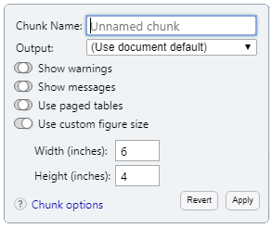
Figure size - .Rmd
```{r fig.height=4, fig.width=6}
mpg %>%
ggplot(aes(x = class)) +
geom_bar()+
geom_text(stat = "count",
aes(label = after_stat(count)), vjust = -1) +
scale_y_continuous(expand=c(0,10)) +
ggtitle("Number of cars included",
subtitle = 'source: mtcars') +
theme_minimal()
```
You can set custom figure sizes in RMarkdown

Slide 63
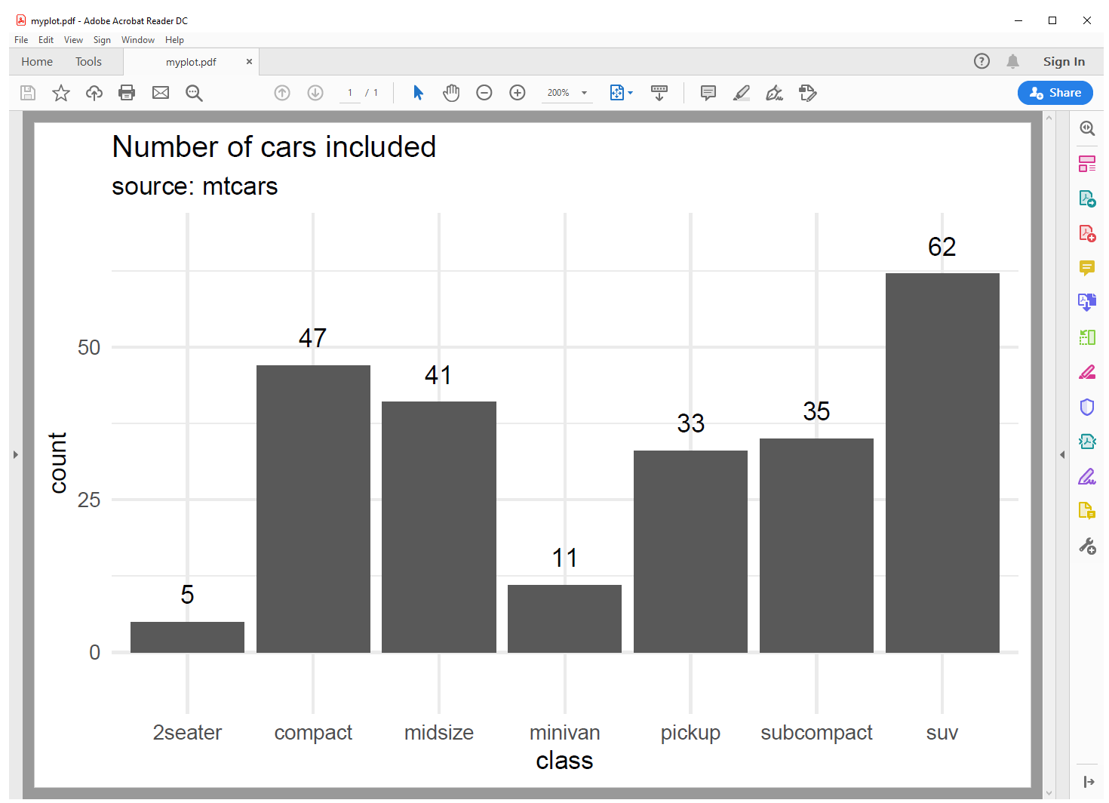
PDF export
mpg %>%
ggplot(aes(x = class)) +
geom_bar()+ geom_text(stat = "count", aes(label =after_stat(count)), vjust = -1) +
scale_y_continuous(expand=c(0,10)) +
ggtitle("Number of cars included",
subtitle = 'source: mtcars') +
theme_minimal()
ggsave("myplot.pdf", width = 6, height = 4)

Slide 64



Extensions, other packages
Create GIFs with Gifski
Create interactive web graphics with plotly
Using officer and mschart to create Microsoft charts
ggplot extension gallery: https://exts.ggplot2.tidyverse.org/gallery/
R graph Gallery: https://www.r-graph-gallery.com/ggplot2-package.html

Slide 65
officer and mschart
# Create a barchart in the Microsoft chart format
mpg %>%
group_by(class) %>%
count(name = 'count') %>%
ms_barchart(x="class", y="count") -> mybarchart
#Create a new powerpoint presentation:
ppt <-
read_pptx() %>%
#add slide
add_slide(layout = "Title and Content", master = "Office Theme")
#add barchart
mybarchart %>%
ph_with_chart(x = ppt) -> ppt
#save file
ppt %>%
print(target = "ppt.pptx")
Mschart creates actual MS charts that you can integrate in Powerpoint, Word
Not as flexible as ggplot, but may be helpful for some applications
see mschart.RMD

Slide 66
Reminder
Not everything needs to be visualized using a graph/chart
Tables can be powerful tools for communication as well
There are many R packages to help design stunning tables

Slide 67



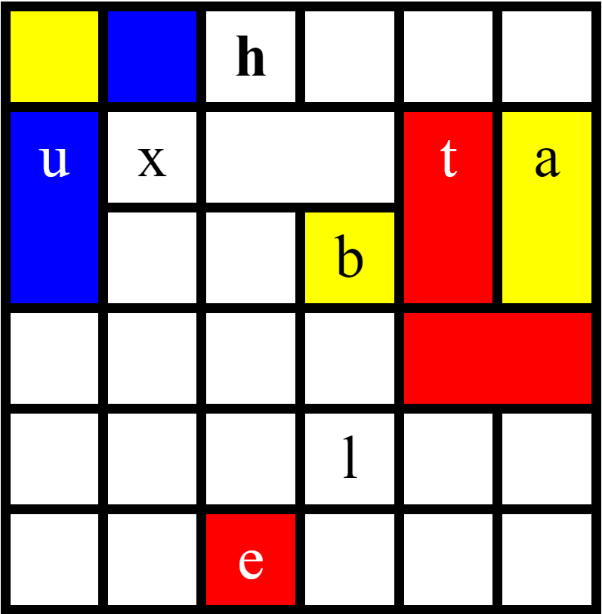
Packages for awesome tables
flextable, reactable and gt are maturing packages that look extremely promising. Their behavior can still change as they mature.
gt “Grammar of tables” – the table equivalent of ggplot
flextable Great for export into MS Word documents
reactable Interactive tables
Huxtable Mature package for text tables

Slide 68
huxtable
#correlation matrix example
cor_matrix <- cor(mtcars)
cor_matrix %>%
as_tibble(rownames = "var") %>%
mutate_if(is.numeric,round,digits=2) %>%
#huxtable
huxtable() %>%
#for each cell, select matching color
map_background_color(-1, -1,
by_ranges(breaks= seq(-1,1,length.out = 8),
values=brewer.pal(n = 7,'RdBu'),
right=F,extend=F))
var | mpg | cyl | disp | hp | drat | wt | qsec | vs | am | gear | carb
mpg | 1 | -0.85 | -0.85 | -0.78 | 0.68 | -0.87 | 0.42 | 0.66 | 0.6 | 0.48 | -0.55
cyl | -0.85 | 1 | 0.9 | 0.83 | -0.7 | 0.78 | -0.59 | -0.81 | -0.52 | -0.49 | 0.53
disp | -0.85 | 0.9 | 1 | 0.79 | -0.71 | 0.89 | -0.43 | -0.71 | -0.59 | -0.56 | 0.39
hp | -0.78 | 0.83 | 0.79 | 1 | -0.45 | 0.66 | -0.71 | -0.72 | -0.24 | -0.13 | 0.75
drat | 0.68 | -0.7 | -0.71 | -0.45 | 1 | -0.71 | 0.09 | 0.44 | 0.71 | 0.7 | -0.09
wt | -0.87 | 0.78 | 0.89 | 0.66 | -0.71 | 1 | -0.17 | -0.55 | -0.69 | -0.58 | 0.43
qsec | 0.42 | -0.59 | -0.43 | -0.71 | 0.09 | -0.17 | 1 | 0.74 | -0.23 | -0.21 | -0.66
vs | 0.66 | -0.81 | -0.71 | -0.72 | 0.44 | -0.55 | 0.74 | 1 | 0.17 | 0.21 | -0.57
am | 0.6 | -0.52 | -0.59 | -0.24 | 0.71 | -0.69 | -0.23 | 0.17 | 1 | 0.79 | 0.06
gear | 0.48 | -0.49 | -0.56 | -0.13 | 0.7 | -0.58 | -0.21 | 0.21 | 0.79 | 1 | 0.27
carb | -0.55 | 0.53 | 0.39 | 0.75 | -0.09 | 0.43 | -0.66 | -0.57 | 0.06 | 0.27 | 1
Huxtable is very efficient and offers colorful console output
see huxtable.RMD

Slide 69
flextable
#correlation matrix example
cor_matrix <- cor(mtcars)
#color palette for conditional format
col_palette <- brewer.pal(n = 8,'RdBu')
#for each cell, select matching color
cor_colors <-
cor_matrix %>%
cut(breaks = seq(1,-1,length.out = 8),
include.lowest = TRUE,
label = FALSE) %>%
(function(x)col_palette[x])
cor_matrix %>%
as_tibble(rownames = "var") %>% mutate_if(is.numeric,round,digits=2) %>%
#create flextable
flextable() %>%
#set background color accordingly
bg(j = colnames(cor_matrix), bg = cor_colors) %>%
autofit(add_w = -.01)
var | mpg | cyl | disp | hp | drat | wt | qsec | vs | am | gear | carb
mpg | 1.00 | -0.85 | -0.85 | -0.78 | 0.68 | -0.87 | 0.42 | 0.66 | 0.60 | 0.48 | -0.55
cyl | -0.85 | 1.00 | 0.90 | 0.83 | -0.70 | 0.78 | -0.59 | -0.81 | -0.52 | -0.49 | 0.53
disp | -0.85 | 0.90 | 1.00 | 0.79 | -0.71 | 0.89 | -0.43 | -0.71 | -0.59 | -0.56 | 0.39
hp | -0.78 | 0.83 | 0.79 | 1.00 | -0.45 | 0.66 | -0.71 | -0.72 | -0.24 | -0.13 | 0.75
drat | 0.68 | -0.70 | -0.71 | -0.45 | 1.00 | -0.71 | 0.09 | 0.44 | 0.71 | 0.70 | -0.09
wt | -0.87 | 0.78 | 0.89 | 0.66 | -0.71 | 1.00 | -0.17 | -0.55 | -0.69 | -0.58 | 0.43
qsec | 0.42 | -0.59 | -0.43 | -0.71 | 0.09 | -0.17 | 1.00 | 0.74 | -0.23 | -0.21 | -0.66
vs | 0.66 | -0.81 | -0.71 | -0.72 | 0.44 | -0.55 | 0.74 | 1.00 | 0.17 | 0.21 | -0.57
am | 0.60 | -0.52 | -0.59 | -0.24 | 0.71 | -0.69 | -0.23 | 0.17 | 1.00 | 0.79 | 0.06
gear | 0.48 | -0.49 | -0.56 | -0.13 | 0.70 | -0.58 | -0.21 | 0.21 | 0.79 | 1.00 | 0.27
carb | -0.55 | 0.53 | 0.39 | 0.75 | -0.09 | 0.43 | -0.66 | -0.57 | 0.06 | 0.27 | 1.00
Flextable is great for creating MS Office style tables for html and docx
This example adds ‘heatmap’ style conditional formatting over a correlation matrix
see flextable.RMD

Slide 70
Functions to remember
Operator/Function | Description
ggplot() | Initializes a ggplot object
aes() | Creates aesthetic mappings
geom_ | Geometric shapes to plot the data
color, shape, size, alpha, … | Aesthetic parameters
facet_wrap, facet_grid | Create small multiples
position | Position argument (primarily used with bar charts)
coord_ | Functions to adjust the coordinate system
scale_ | Functions to adjust x and y axis

