Slide 1
Data Tools
(7) Advanced issues
(week 8)

Slide 2
This class
1 | Control statements – if
2 | Control statements – for
3 | Functions
4 | Numerical optimization and Maximum-Likelihood
5 | purrr – efficient functional programming
6 | Apps with shiny

Slide 3
Control statements

Slide 4
Using control statements help reduce code duplication
Code is more readable, because your eyes are drawn to what’s different, not what stays the same
Code is more adaptable. As your needs change, you only need to make changes in one place, rather than remembering to change every place that you copied-and-pasted the code
Code is more reliable, because each line of code is used in more places

Slide 5
Select control statements in R
Selection
if
if…else
else if
switch
Repetition
For
while

Slide 6
Control statements
if

Slide 7
if
if(some_check){
do_this()
}
some_check
Some expression that evaluates to TRUE/FALSE
do_this()
Statement, e.g. calling a function if test expression evaluates to TRUE

Slide 8
if - example
#Example 1
x = 10
if(x>5){
print("x is larger than 5")
}
What happens as you run this code?

Slide 9
if – example 2
#Example 2
x = c(10, 1)
if(x>5){
print("x is larger than 5")
}
the condition has length > 1 and only the first element will be used[1] "x is larger than 5“
if(any(x > 5)) {
print("at least one element of x is larger than 5")
}
What happens as you run this code?
Check needs to evaluate to a scalar/vector of length 1!

Slide 10
Control statements
if…else

Slide 11
if…else
if(some_check){
do_this()
} else{
do_that()
}
do_that()
Statement, e.g. calling a function if test expression evaluates to TRUE

Slide 12
Control statements
else if

Slide 13
else if
if(some_check){
do_this()
} else if(another_check){
do_that()
} else{
do_something_else()
}
another_check
We can add additional checks and corresponding actions
do_that()
Statement, e.g. calling a function if test expression evaluates to TRUE

Slide 14
else if- example
#Example 1
x = c(1, 2)
if(any(x > 5)) {
print("at least one element of x is larger than 5")
} else if(all(x>0)){
print("x' elements are all positive, but none is larger than 5")
} else{
print("no element of x is larger than 5")
}
[1] "at least one element of x is larger than 5"
Three possibilities: one x>5, all x>0, x<=5 & at least one x<0

Slide 15
Errors to avoid
#Errors to avoid - closing } and else need to be on the same line!
if(any(x > 5)) {
print("at least one element of x is larger than 5")
} else if(any(x>0)){
print("x' elements are all positive, but none is larger than 5")
}
else{
print("no element of x is larger than 5")
}
Closing } and else need to be on the same line!

Slide 16
Control statements
for

Slide 17
for
#Example 1: a very simple loop
for(i in 1:5){
print(i)
}
[1] 1
[1] 2
[1] 3
[1] 4
[1] 5
#seq_len should be preferred!
for(i in seq_len(5)){
print(i)
}
Simple pattern:
for(iterator in sequence){
}
Be careful specifying the integers to iterate over

Slide 18
for - sequences
#the variable may take on `0`
y=0
#sequence with :
1:y
[1] 1 0
#using seq_len
seq_len(y)
integer(0)
Let's say the number of elements to loop over is a variable, called y
y might take on `0`
What happens?
seq_len ensures desired result

Slide 19
for - sequences alongside another object
years = 2010:2020
#works
1:length(years)
[1] 1 2 3 4 5 6 7 8 9 10 11
#preferred
seq_along(years)
[1] 1 2 3 4 5 6 7 8 9 10 11
#why preferred?
years_0 = c()
1:years_0
Error in 1:years_0 : argument of length 0
seq_along(years_0)
integer(0)
Let’s say you need to run some analysis for each year listed in a vector
Your loop has as many iterations as there are years in the vector

Slide 20
for - looping alongside another object
years = 2010:2013
for(i in seq_along(years)){
paste0('the ', i, 'th ', 'year is ', years[i]) %>% print
}
[1] "the 1th year is 2010"
…
#empty years vector
years = c()
#works
for(i in seq_along(years)){
paste0('the ', i, 'th ', 'year is ', years[i]) %>% print
}
#not the desired result
for(i in 1:length(years)){
paste0('the ', i, 'th ', 'year is ', years[i]) %>% print
}
[1] "the 1th year is "
[1] "the 0th year is "
An example illustrating the benefit of seq_along

Slide 21
functions

Slide 22
Functions
Using appropriate names for functions, code may become more readable
If changes need to be made, (ideally) only the functions needs to be changed – in one place, making code easier to change
The code is more reliable, as there are less opportunities for error
Using functions, you can implement whatever you want!

Slide 23
Considerations
If you copy&paste a code block several times, a function may be good idea
It saves time and prevents errors
However, consider the time it takes to write the function

Slide 24
Writing a basic function
my_fun <- function(my_arg){
output<-some_operation(x=my_arg)
return(output)
}
my_arg
Arguments of your function
some_operation
Whatever computation, plot, operation you want to do
return
The last operation is returned automatically; however an explicit return is good practice

Slide 25
Computing the geometric mean
test_data <-tibble(a=rnorm(100),b=runif(100), c=rgamma(100,5,5),d=rbeta(100,5,5))
#geometric mean
test_data$a %>% prod %>% `^`(1/nrow(test_data))
test_data$b %>% prod %>% `^`(1/nrow(test_data))
test_data$c %>% prod %>% `^`(1/nrow(test_data))
test_data$d %>% prod %>% `^`(1/nrow(test_data))
Let’s compute the geometric mean for each of the 4 columns a:d in this example dataset called test_data

Slide 26
Writing the geo_mean function
#function
geo_mean <- function(x){
x %>% prod %>% `^`(1/length(x)) %>% return
}
#use function
test_data$a %>% geo_mean
test_data$b %>% geo_mean
test_data$c %>% geo_mean
test_data$d %>% geo_mean
One argument x: a numeric vector
Returns vector of length 1 - geometric mean of x

Slide 27
Using the geo_mean function
#apply function with purrr:map
test_data %>% map_dbl(geo_mean)
#apply function with apply
test_data %>% apply(2,geo_mean)
#use map without defining a function
test_data %>% map_dbl(~prod(.)^(1/length(.)))
Now we can apply the function to all columns of a data.frame
We can use apply or purrr:map to do so
We can also use purrr:map without explicitly specifying a function; however, I think this is less readable

Slide 28
Function - tidyverse style
tidy_geo_mean <- function(df){
#vector to store my results
results=rep(NA, ncol(df))
#loop over columns, compute mean, store
for(i in seq_along(df)){
results[i]<-geo_mean(df[[i]])
}
#prepare output data.frame
output <
data.frame(variable = names(df),
geo_mean = results)
return(output)
}
#test
test_data %>% tidy_geo_mean
Tidyverse functions
input is a data.frame
output is a data.frame
Argument df needs to be data.frame, otherwise the function may run into an error

Slide 29
Checking inputs
#Error
1:10 %>% tidy_geo_mean
Error in rep(NA, ncol(df)) : invalid 'times' argument
#Function with check
tidy_geo_mean_check <- function(df){
stopifnot(is.data.frame(df))
results=rep(NA,ncol(df))
for(i in seq_along(df)){
results[i]<-geo_mean(df[[i]])
}
output <- data.frame(variable=names(df),geo_mean=results)
return(output)
}
stopifnot Returns stops the function and returns an error message if a condition is not fulfilled

Slide 30
Argument defaults
my_fun <- function(x, y=1){
return(x+y)
}
my_fun(1)
[1] 2
my_fun(1,1)
[1] 2
my_fun(1,2)
[1] 3
#This works, but is bad practice
my_fun <- function(x=1,y){
return(x+y)
}
my_fun(,2)
You can set default values for your arguments
Arguments with defaults should come after arguments without

Slide 31
functions
benchmarking

Slide 32
Many ways to code a function
tidy_geo_mean_2 <- function(df){
stopifnot(is.data.frame(df)) return(rownames_to_column(data.frame(
geo_mean=apply(df,2,geo_mean)),
var = 'variable'))
}
tidy_geo_mean_3 <- function(df){
stopifnot(is.data.frame(df))
results=apply(df,2,geo_mean)
output <-data.frame(variable=names(df),
geo_mean=results)
return(output)
}
tidy_geo_mean_4 <- function(df){
apply(df,2,geo_mean)}
There are many different ways to code this function.
Which ones is best?

Slide 33
Benchmarking with microbenchmark
microbenchmark(
test_data %>% tidy_geo_mean,
test_data %>% tidy_geo_mean_2,
test_data %>% tidy_geo_mean_3,
test_data %>% tidy_geo_mean_4)
Unit: microseconds
expr min lq mean median uq max neval
test_data %>% tidy_geo_mean 519.3 547.55 558.525 553.50 567.00 858.8 100
test_data %>% tidy_geo_mean_2 1075.5 1114.05 1143.851 1136.35 1156.40 1598.1 100
test_data %>% tidy_geo_mean_3 595.3 614.15 715.861 629.45 642.65 9111.8 100
test_data %>% tidy_geo_mean_4 438.5 455.00 466.918 464.60 474.80 541.3 100
tidy_geo_mean_4 is fastest – it avoids a loop using the apply function
This has generally been recommended in R – vectorise instead of using loops (and this is quite different from other languages)

Slide 34
numerical optimization

Slide 35
Minimizing sum of squared errors to fit regression
#using lm to fit linear regression
lm(y~x, data = sim1)
#sum of squared errors
lmsse<-function(beta, y,x){
yhat=beta[1]+beta[2]*x
return(sum((y-yhat)^2))
}
#numerical optimization
optim(par = c(0,0), fn = lmsse,
y = sim1$y, x = sim1$x,
method = 'BFGS')
Didactic example only
Compute the sum of squared deviations between true and fitted y values using lmsse
Minimize SSE using optim by adjusting beta

Slide 36
Logistic Regression
$$P\left([Y=1]\right)=P(Y)=\frac{1}{1+e^{\left.−(β_{0}+β_{1}X_{1}+ε\right)}}=\frac{e^{\left(β_{0}+β_{1}X_{1}+ε\right)}}{1+e^{\left(β_{0}+β_{1}X_{1}+ε\right)}}$$
Outcome
We predict the probability of the outcome occurring
$b_{0}$ and $b_{1}$ are estimates of $β_{0}$and $β_{1}$, respectively
$b_{0}$ is an ‘intercept’, capturing the baseline distribution of 1s and 0s
$b_{1}$ captures the effect of $X_{1}$on the probability of Y=1
Note the linear regression equation forms part of the logistic regression equation

Slide 37
Simulate logistic regression data
#true parameters
beta_true=c(1,2)
#independent variable
x=rnorm(100)
#obtaining probabilities
z=beta_true[1]+beta_true[2]*x
y_prob=exp(z)/(1+exp(z))
#simulate dependent variable
y=runif(100)<y_prob
boxplot(x~y)
Simulate IV called x, then obtain probabilities according the model, then simulate realizations

Slide 38
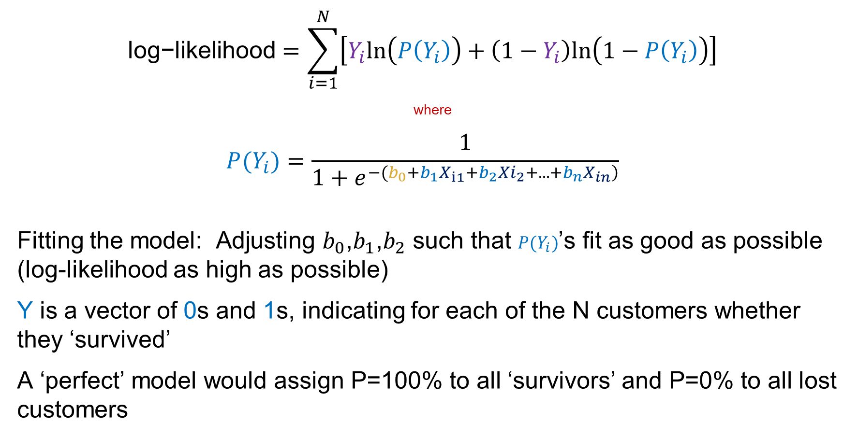
Fitting the model
$$\text{log}\text{−}\text{likelihood}=\sum_{i=1}^{N}{\left[Y_{i}ln\left(P\left(Y_{i}\right)\right)+\left(1−Y_{i}\right)ln\left(1−P\left(Y_{i}\right)\right)\right]}$$
where
$$P(Y_{i})=\frac{1}{1+e^{\left.−(b_{0}+b_{1}X_{i1}+b_{2}{Xi}_{2}+...+b_{n}X_{in}\right)}}$$
Fitting the model: Adjusting $b_{0}$,$b_{1}$,$b_{2}$ such that $P(Y_{i})$’s fit as good as possible (log-likelihood as high as possible)
Y is a vector of 0s and 1s, indicating for each of the N customers whether they ‘survived’
A ‘perfect’ model would assign P=100% to all ‘survivors’ and P=0% to all lost customers

Slide 39
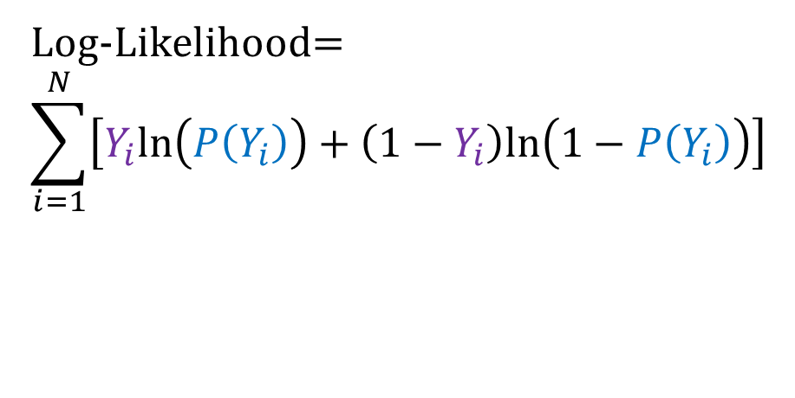
Coding up the log-likelihood function
#negative log-likelihood
nll_fun<-function(beta,x,y){
z=beta[1]+beta[2]*x
y_prob=exp(z)/(1+exp(z))
ll=sum(y*log(y_prob) + (1-y)*log(1-y_prob))
return(-ll)
}
#numerical optimization
optim(par = c(0,0), fn = nll_fun,
y = y, x = x,
method = 'BFGS’)
$par
[1] 1.139632 1.805388
Log-Likelihood=
$$\sum_{i=1}^{N}{\left[Y_{i}ln\left(P\left(Y_{i}\right)\right)+\left(1−Y_{i}\right)ln\left(1−P\left(Y_{i}\right)\right)\right]}$$
By default, optim minimizes; minimizing the negative log-likelihood will maximize the log-likelihood

Slide 40
purrr

Slide 41

meow?
The purrr package provides an alternative means to iterate over elements and perform a set function
Each map function works roughly the same way
1. loop over
2. apply function to each element
3. return the results as list, data.frame or vector
It can help you create more efficient and more readable code

Slide 42
Many ways of computing column means
#dedicated functions
mtcars %>% colMeans
mtcars %>% skimr::skim() %>% pull(numeric.mean)
#loop
mtcars_means=c()
for(i in seq_along(mtcars)){
mtcars_means[i] <- mean(mtcars[[i]])}
mtcars_means
#apply
apply(mtcars,2,mean)
#purr::map
mtcars %>% map(mean)
#purrr::map_dbl, output as tibble
mtcars %>% map_dbl(mean)
mtcars %>% map_dbl(mean) %>% enframe
The map functions from purrr allow you to apply functions or formula to lists or vectors
Let’s take a look at how they compare
Generally speaking, loops should be avoided because they tend to be slower in R
Apply is a classic function for vectorization – avoiding loops
When you know the output type of a function, you can use a specific map_* function

Slide 43
Many ways of counting missing values
#result is count data (integers)
flights %>%
map_int(~ sum(is.na(.))) %>% enframe %>% filter(value>0)
#double also works
flights %>%
map_dbl(~ sum(is.na(.))) %>% enframe %>% filter(value>0)
#we can pipe inside a map function specification
flights %>%
map_dbl(. %>% is.na %>% sum) %>% enframe %>% filter(value>0)
#we can define a function inside map
flights %>%
map_dbl(function(x)sum(is.na(x))) %>% enframe %>% filter(value>0)
#alternative: just using the pipe
flights %>% is.na %>% colSums %>% enframe %>% filter(value>0)
Using dot (.) we can access list elements
The leading tilde (~) lets us use anonymous/lambda functions – they are not bound to an identifier
We can also pipe inside map, starting with . %>%

Slide 44
Defining your own function
#concatenating
mtcars %>% map_dfr(function(x)c(mean(x),sd(x)))
#creating a tibble
mtcars %>% map_dfr(function(x)tibble(mean=mean(x), sd=sd(x)))
#.id allows you to use named objects' names
mtcars %>% map_dfr(function(x)tibble(mean=mean(x), sd=sd(x)),.id = 'name')
#you can also access names with imap class of functions
mtcars %>% imap_dfr(function(x,idx)tibble(name=idx,mean=mean(x), sd=sd(x)))
If you want to apply several operations/functions on each list/vector element, you can define your own helper function
The .id argument lets you set the name of a column that tracks the name of input list/vector elements
The imap_* functions let you do whatever you want with the names of input list/vector elements

Slide 45
Using ‘quotation’ (advanced stuff)
#exec() evaluates a function call built from its inputs
mtcars %>%
map_dfr(~ c(mean = mean, sd = sd) %>% map(exec, .x), .id = "var")
#if you want to pass arguments
mtcars %>%
map_dfr(~ c(mean = mean, sd = sd) %>% map(exec, .x, !!!list(na.rm=TRUE)), .id = "var")
Defining your own functions is convenient, easy to check
A fancier (and more elegant?) way is to use quotation … here mean and sd aren’t evaluated right away
I have to admit: I don’t use this regularly…

Slide 46
Speed benefits
microbenchmark(
quotation =
mtcars %>%map_dfr(~ c(mean = mean, sd = sd) %>% map(exec, .x), .id = "var"),
fun =
mtcars %>% map_dfr(function(x)tibble(mean=mean(x), sd=sd(x)),.id = 'name')
)
Unit: milliseconds
expr min lq mean median uq max neval
quotation 1.607901 1.652601 1.831621 1.710551 1.767001 9.410701 100
fun 4.944501 5.085601 5.451559 5.199801 5.356751 14.366002 100
… even though it’s faster

Slide 47
Working with subsets of a dataset
#group_split
mtcars %>%
group_by(cyl) %>% group_split() %>%
map(~ lm(mpg ~ wt+qsec, data = .)) %>%
map_dfr(tidy,.id='cyl’)
# A tibble: 9 x 3
cyl term estimate
<chr> <chr> <dbl>
1 1 (Intercept) 24.9
2 1 wt -7.51
3 1 qsec 0.990
4 2 (Intercept) 25.5
#base split
mtcars %>%
split(.$cyl) %>%
map(~ lm(mpg ~ wt+qsec, data = .)) %>%
map_dfr(tidy,.id='cyl')
Great use case for purrr
group_split is a dplyr function to create subsets, however, it does not name subsets
Using map we can fit the same lm model to each subset
And we can extract coefficients for each subset, and stack them
Split from base R names elements correctly, just remember the added .$ to access the variable used for subsetting

Slide 48
Working with subsets of a dataset
mtcars %>%
split(.$cyl) %>%
map(~ lm(mpg ~ wt+qsec, data = .)) %>%
map_dfr(tidy,.id='cyl') %>%
select(cyl,term,estimate) %>%
pivot_wider(term,cyl,values_from=estimate)
# A tibble: 3 x 4
term `4` `6` `8`
<chr> <dbl> <dbl> <dbl>
1 (Intercept) 24.9 25.5 14.0
2 wt -7.51 -5.20 -2.81
3 qsec 0.990 0.584 0.735
Finally, we use pivot_wider to show parameter estimates side-by-side

Slide 49
purrr
nesting

Slide 50

Let’s create a nest
mtcars %>%
group_by(cyl) %>%
nest
# A tibble: 3 x 2
# Groups: cyl [3]
cyl data
<dbl> <list>
1 6 <tibble [7 x 10]>
2 4 <tibble [11 x 10]>
3 8 <tibble [14 x 10]>
Elements of a tibble can be integers, doubles, …. and tibbles again!
A tibble column of tibbles is easy to work with

Slide 51
Working with nests – fit models
mtcars %>%
group_by(cyl) %>%
nest %>%
mutate(lm =
map(data, ~lm(mpg ~ wt+qsec, data = .)))
We can use mutate in conjunction with map to apply functions to all the tibbles
Here, we apply a lm model to the 3 cylinder subsets of mtcars

Slide 52
Working with nests – use model objects
mtcars %>%
group_by(cyl) %>%
nest %>%
mutate(lm =
map(data, ~lm(mpg ~ wt+qsec, data = .))) %>%
mutate(aug = map(lm, augment))
# A tibble: 3 x 4
# Groups: cyl [3]
cyl data lm aug
<dbl> <list> <list> <list>
1 6 <tibble [7 x 10]> <lm> <tibble [7 x 9]>
2 4 <tibble [11 x 10]> <lm> <tibble [11 x 9]>
3 8 <tibble [14 x 10]> <lm> <tibble [14 x 9]>
Then, we can apply broom functions like augment to the column containing the different submodels

Slide 53
Unnesting
mtcars %>%
group_by(cyl) %>%
nest %>%
mutate(lm = map(data, ~lm(mpg ~ wt+qsec, data = .))) %>%
mutate(aug = map(lm, augment)) %>%
unnest(cols=aug)
# A tibble: 32 x 7
# Groups: cyl [3]
cyl data lm mpg wt qsec .fitted
<dbl> <list> <list> <dbl> <dbl> <dbl> <dbl>
1 6 <tibble [7 x 10]> <lm> 21 2.62 16.5 21.4
2 6 <tibble [7 x 10]> <lm> 21 2.88 17.0 20.4
3 6 <tibble [7 x 10]> <lm> 21.4 3.22 19.4 20.1
4 6 <tibble [7 x 10]> <lm> 18.1 3.46 20.2 19.3
We can ‘unnest’ to access the information inside
Now we have integrated the predictions (.fitted) from all submodels into one single table

Slide 54
Example: prediction vs actual plot, colored by subset
mtcars %>%
group_by(cyl) %>%
nest %>%
mutate(lm = map(data, ~lm(mpg ~ wt+qsec,
data = .))) %>%
mutate(aug = map(lm, augment)) %>%
unnest(cols=aug,data)%>%
select(cyl,mpg,.fitted) %>%
ggplot(aes(x=mpg,y=.fitted,color=factor(cyl))) +
geom_point()
Fitted vs predictions, colored according to subset

Slide 55
Example: Model fit by subset
mtcars %>%
group_by(cyl) %>%
nest %>%
mutate(lm = map(data, ~lm(mpg ~ wt+qsec,
data = .))) %>%
mutate(fit = map(lm, glance)) %>%
unnest(fit) %>% select(cyl:r.squared)
# A tibble: 3 x 4
# Groups: cyl [3]
cyl data lm r.squared
<dbl> <list> <list> <dbl>
1 6 <tibble [7 x 10]> <lm> 0.582
2 4 <tibble [11 x 10]> <lm> 0.590
3 8 <tibble [14 x 10]> <lm> 0.507
Comparing model fit by subset

Slide 56
Applying multiple models
formulas <-
list(`2 predictors` = mpg ~ wt+qsec,
`3 predictors` = mpg ~ wt+qsec+drat)
formulas %>%
map(lm, data=mtcars) %>%
map_dfr(glance, .id='model')
# A tibble: 2 x 2
model r.squared
<chr> <dbl>
1 2 predictors 0.826
2 3 predictors 0.837
Now let’s assume we have just one dataset without subsets, but we want to fit different model specifications:
Put specifications in a list
Use map to iterate over the specifications

Slide 57
Apps with shiny

Slide 58
Shiny
Allows you to build interactive web apps within R
Can release to others who don’t have R
https://shiny.rstudio.com/gallery/
Useful to allow others to visualize data in a clear way and to explore on their own (and potentially develop new questions to answer)

Slide 59
Components
Each shiny app contains
ui.R – User interface
server.R – Creates plots and data manipulation
Or
app.R – Combining both the ui and server code as objects

Slide 60
Basic structure
library(shiny)
#UI
ui <- fluidPage(
*panel(dosomething(output$element))
)
#Server
server <- function(input, output) {
output$element <-
renderPlot({
some_ggplot_code
})
#other changes to output
}
# Run the application
shinyApp(ui = ui, server = server)
In a combined app file, you have a ui and a server object
The server has inputs (input made by the user on the UI) and outputs (a plot or so)
The app is launched via shinyApp
RStudio has a dedicated launch button

Slide 61
Output
titlePanel('title’)
sidebarLayout(
sidebarPanel('sidebar title'),
mainPanel('main title')
)
Common layout: controls on a sidebar panel, plots and tables to the right of it in the main panel
Arguments in sidebarLayout are separated by commas (common in shiny)

Slide 62
Control widgets
function | Widget
actionButton | Action Button
checkboxGroupInput | Multiple checkboxes
checkboxInput | Single checkbox
dateInput | Calendar for date selection
dateRangeInput | Pair of calendars
fileInput | File upload wizard
helpText | Help for input form
numericInput | Field to enter numbers
radioButtons | Set of radio buttons
selectInput | Dropdown menu
sliderInput | Slider bar
submitButton | Submit button
textInput | Field to enter text

Slide 63
Arguments for widget use
Required arguments
Name for the widget (used to access the value)
Label (a string to label the widget in ‘’)
Other arguments are specific to the widget

Slide 64
Reactive output
Reactive output changes when a new option is selected
Two steps
Add an R object to your user interface ui.R / ui object
Tell shiny to build the object in server.R /server object
In the ui.R, output is generally in the mainPanel with the widgets in the sidebarPanel

Slide 65
R object in UI
Output function | Creates
htmlOutput | Raw HTML
imageOutput | Image
plotOutput | Plot
tableOutput | Table
textOutput | Text
uiOutput | Raw HTML
verbatimTestOutput | text

Slide 66
R code in server function
Need to build the ‘reactive’ element that is referred to in *output
Suppose this is in ui.R
textOutput(“text1”)
In the server function, we need to define “text1”
output$text1 <- renderText({
“Hello world!”
})
Notice the value is contained in renderText

Slide 67
Render functions
Render function | Creates
renderImage | Images
renderPlot | Plots
renderPrint | Anything printed
renderTable | Data frame/matrix/table
renderText | Character string
renderUI | Shiny tag object
render* functions take one argument: an R expression surrounded by {}
Could be multiple lines of code
Can access values of widgets
i.e., suppose the sliderInput is called “slider” . Access this value in the serve function with input$slider

Slide 68
Reactive
Shiny renders plots and output values every time something anything is changed (i.e., it is reactive)
Sometimes, we want to change the axes or a title, but the actual data we are using is the same.
This can cause a major drag when pulling data from the web
Imagine downloading a large dataset every time an element of the plot is changed
The reactive function helps with this

Slide 69
reactive({})
A reactive expression saves its result the first time you run it
The next time it runs, it checks to see if the saved value is out of date
If it’s out of date, the reactive object is recalculated
If it’s up to date, no additional computation is performed

Slide 70
A very simple example
ui <- fluidPage(
titlePanel("Get rich!"),
# Sidebar
sidebarLayout(
sidebarPanel(
textInput("tickerindex", "Index", value = "JPM", width = "100%")
),
# Show a plot in main panel
mainPanel(
plotOutput("stock_timeseries")
)
)
)
# Define server logic
server <- function(input, output) {
output$stock_timeseries <- renderPlot({
stockprices<-tq_get(input$tickerindex, get="stock.prices")
stockprices %>% ggplot(aes(x=date,y=close)) + geom_line() + theme_tq()
})
}
# Run the application
shinyApp(ui = ui, server = server)
Type in a ticker and get a plot with the latest time series
getrich_app.R

