Slide 1
Smartphones
File created on: 10/4/24 2:54:43 PM GMT+2

Slide 2
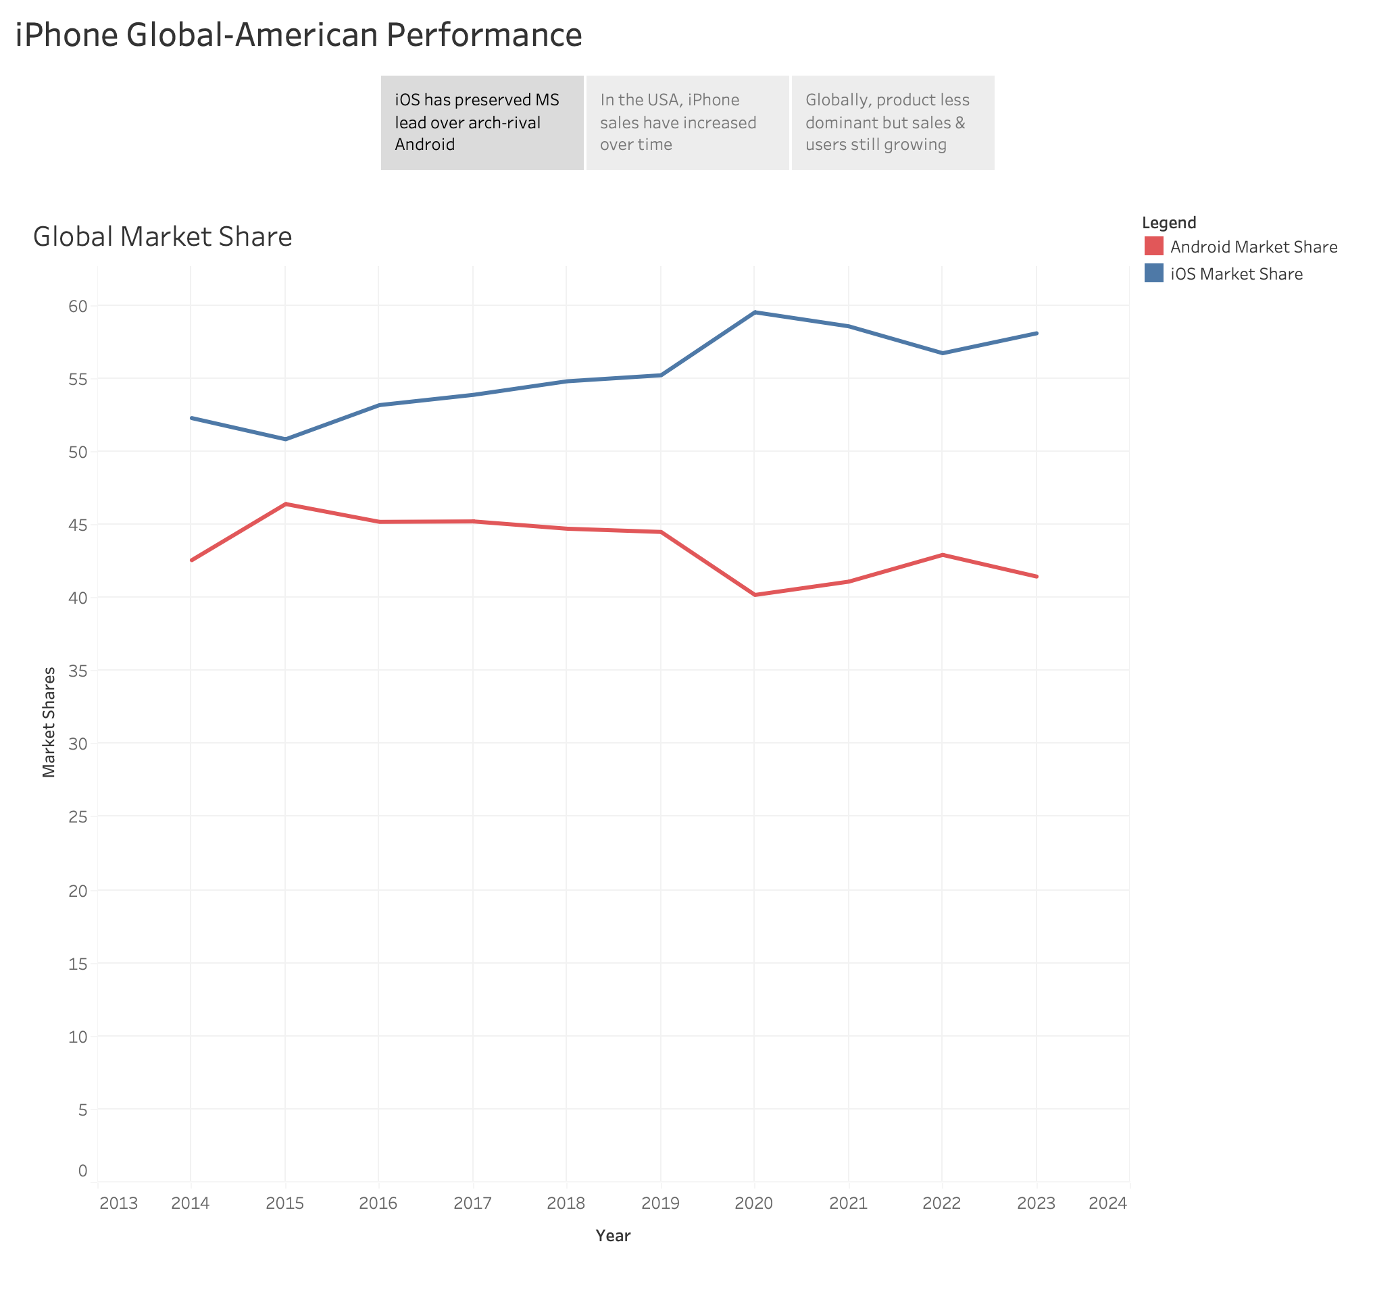

Slide 3
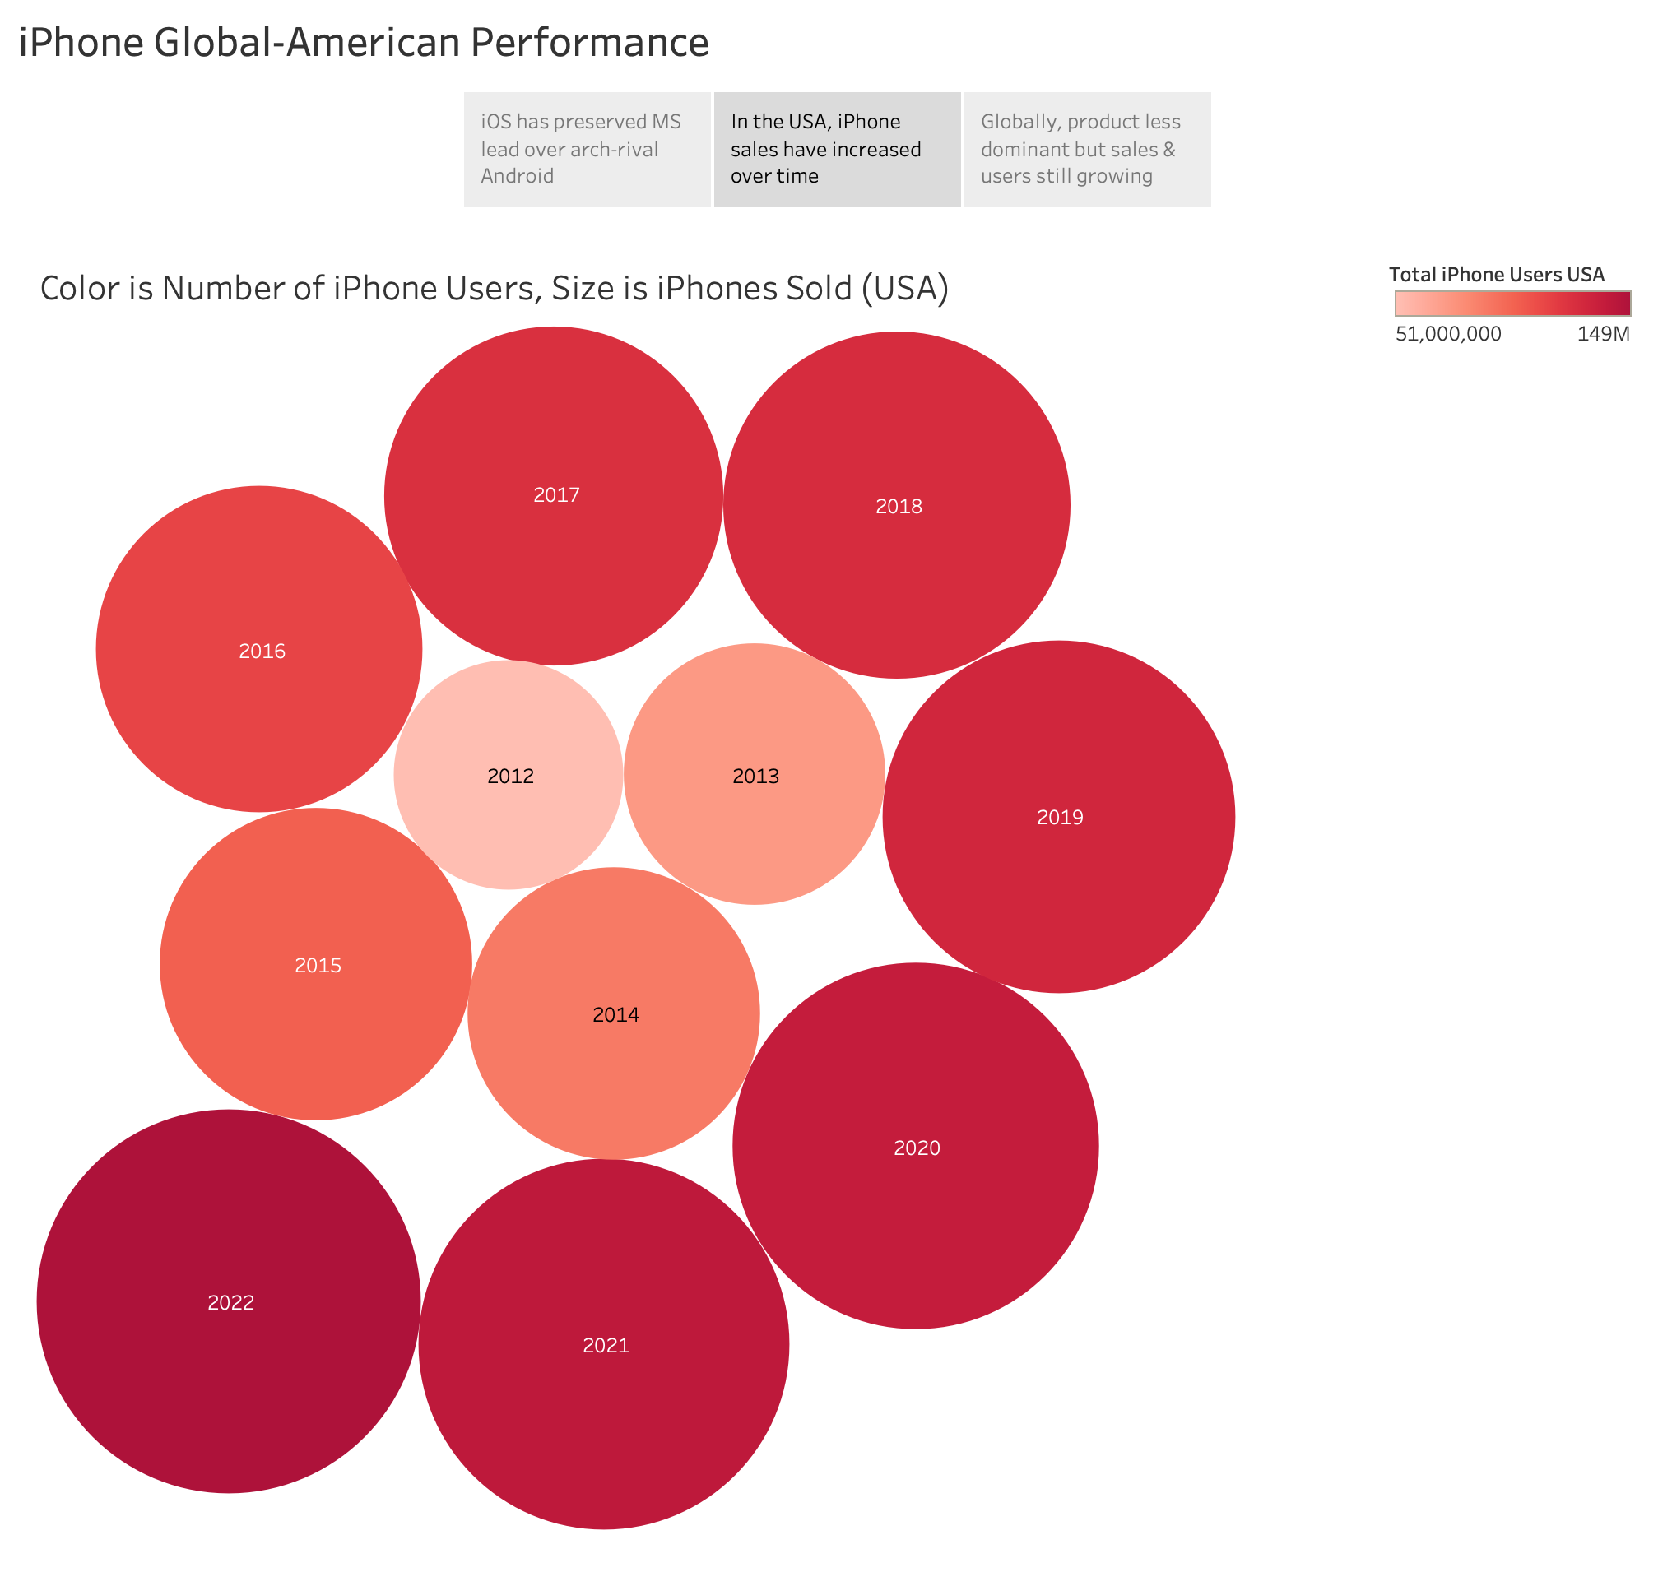

Slide 4
