Slide 1




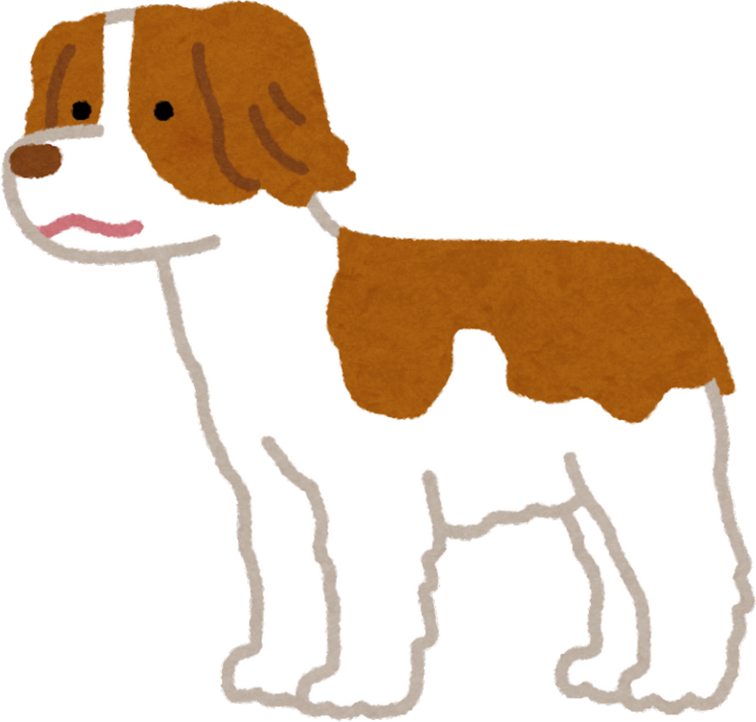

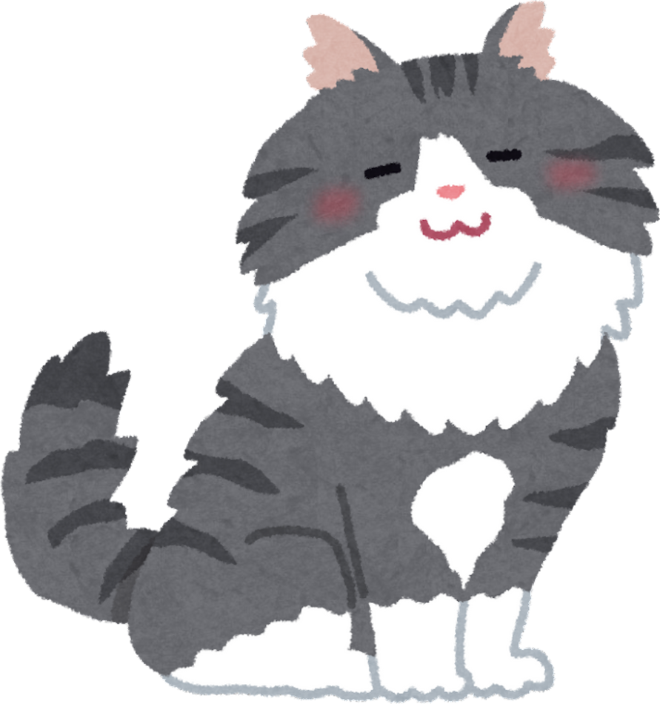

Cats vs Dogs
Classification
Semesterproject CVNLP WS25
Alexandra Chava Seymann, Lisa Mayrhofer, Fanni Horvath

Slide 2
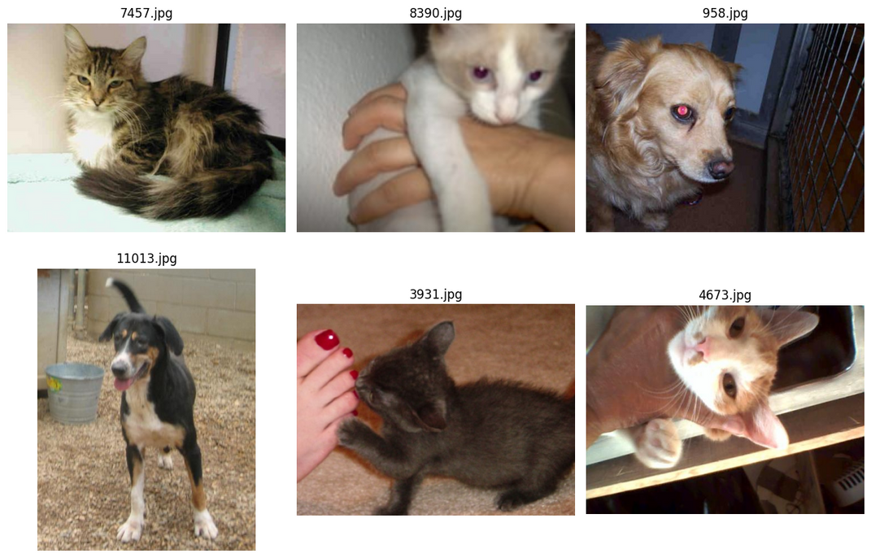
Dataset
Source:
Kaggle Cats vs Dogs dataset
~25 000 labeled images, split into train / validation / test sets
Images vary in size, lighting, and background -> good for generalization
Balanced classes (~50 % cats / 50 % dogs)
Folder structure created dynamically for reproducibility
Sample visualization helped detect outliers and confirm balance

Slide 3
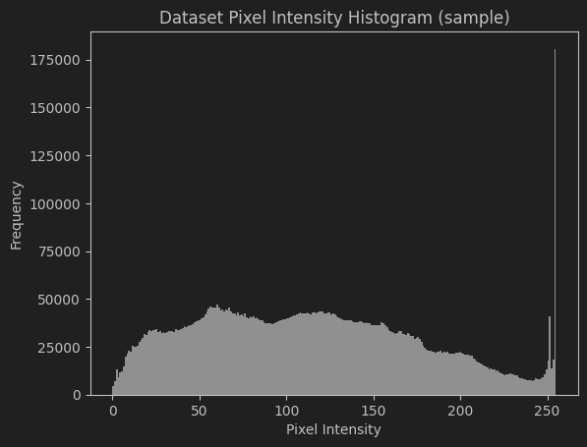
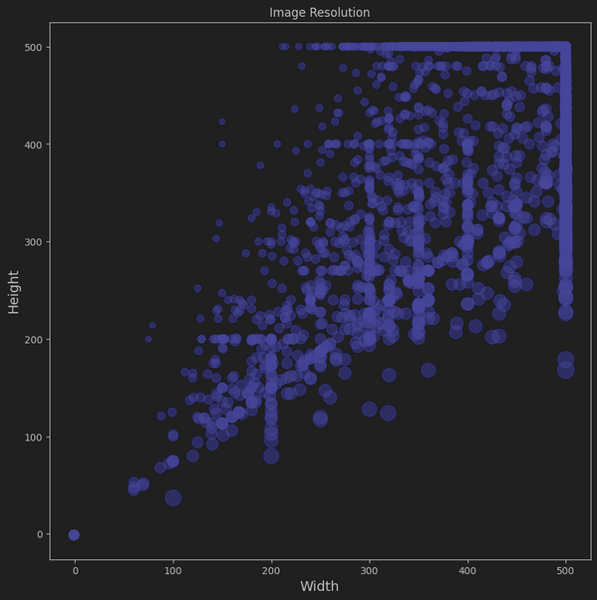
Preprocessing
All images were resized to 224×224 pixels so the model gets inputs of the same size
We added random flips so the model sees cats and dogs from both left and right sides
Used color changes (brightness, contrast, etc.) to make the model less sensitive to lighting
Applied normalization to help the model train faster and more stable
For validation and test, we only resized the images
We wanted the model to see many small variations of each image, but only during training — so it learns general patterns, not just memorizes specific pictures.

Slide 4



Model
Mission
To provide the best care, products, and love for pets and their owners.
Architecture
A custom CNN (SimpleCNN) with three convolutional layers is used to extract visual features
Batch normalization and dropout layers improve training stability and reduce overfitting
The output from the convolutional part is flattened and passed through two fully connected layers for classification into cat or dog
The AdamW optimizer adjusts weights efficiently during training
A learning rate scheduler (ReduceLROnPlateau) automatically lowers the learning rate when improvement slows down

Slide 5
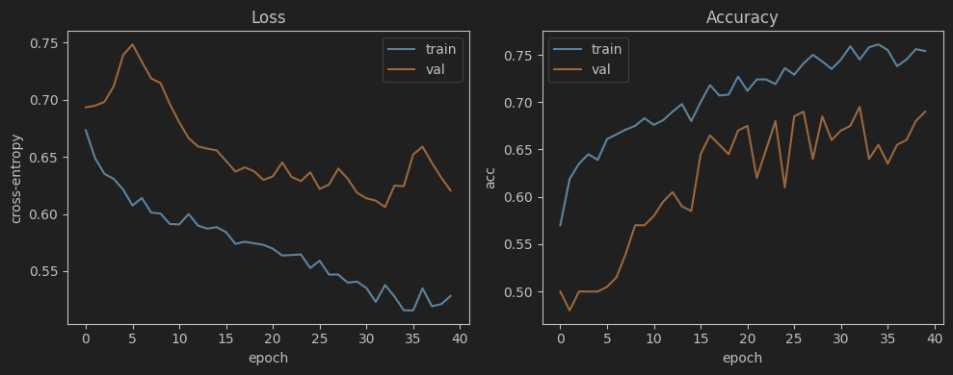
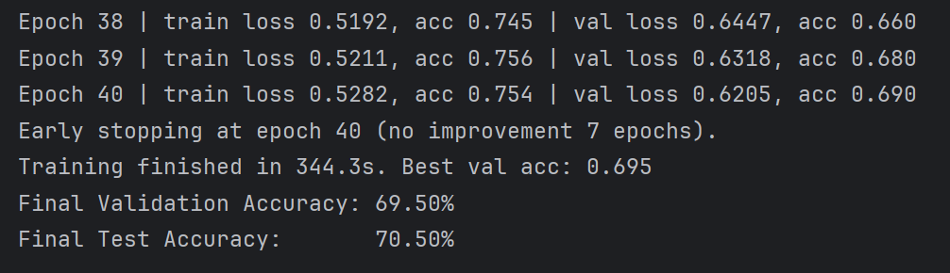
Training process
Training was performed for 15–40 epochs on a GPU with early stopping to prevent overfitting
Training and validation accuracy were compared throughout to monitor model performance
A fixed random seed ensured reproducible and deterministic results
Loss and accuracy were recorded each epoch and visualized using matplotlib
The learning curve stabilized once the scheduler adjusted the learning rate
The training remained stable and repeatable, and early stopping helped stop before the model started memorizing the training data.

Slide 6
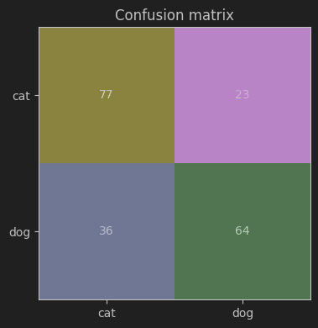
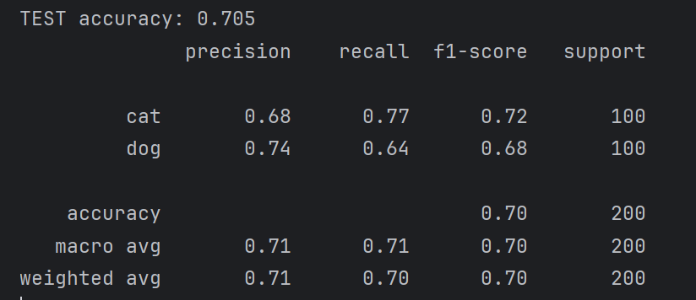
The model performs consistently across both categories, and the few mistakes mostly happen in images that are difficult even for humans to label.
Results
Final test accuracy: ≈ 71 %
Confusion matrix → mostly correct, few cat/dog mix-ups on low-light images
The classification report indicates balanced precision and recall between both classes
Example predictions show robust features like fur texture and snout shape

Slide 7
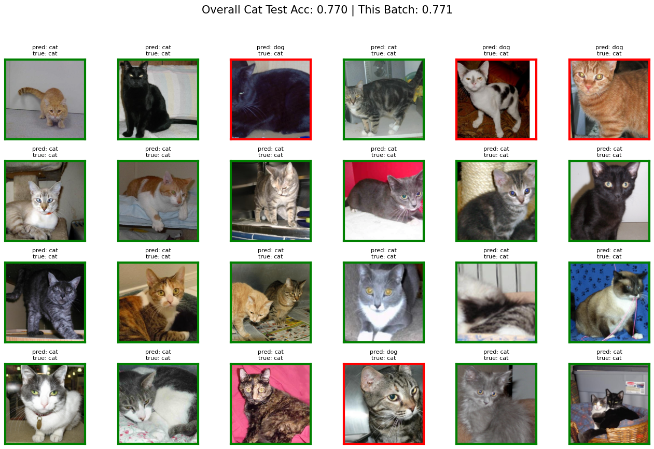


Slide 8
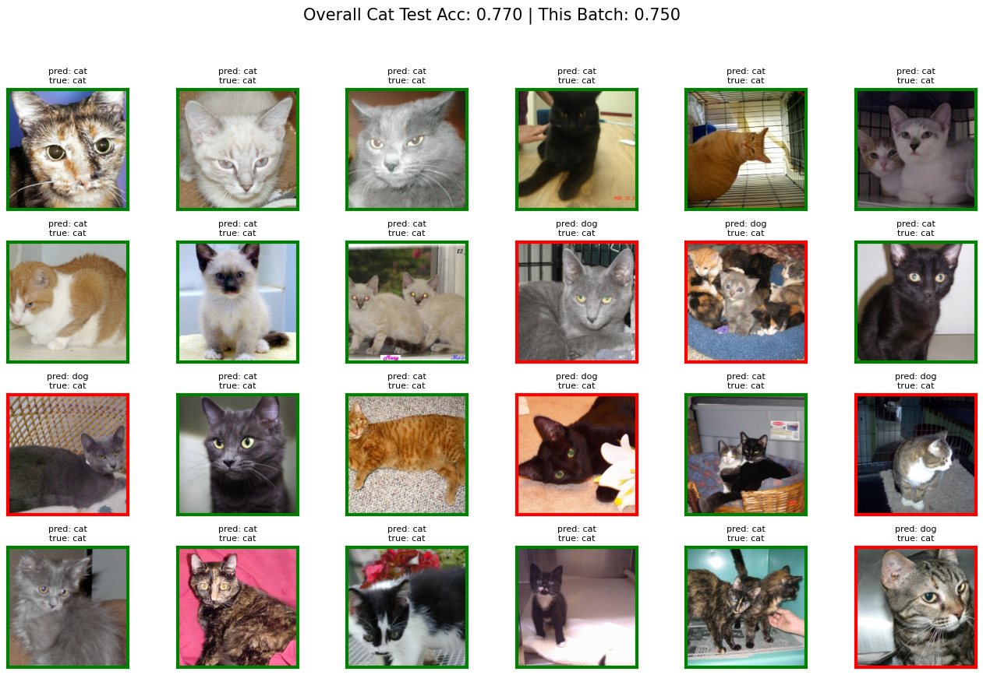

Slide 9
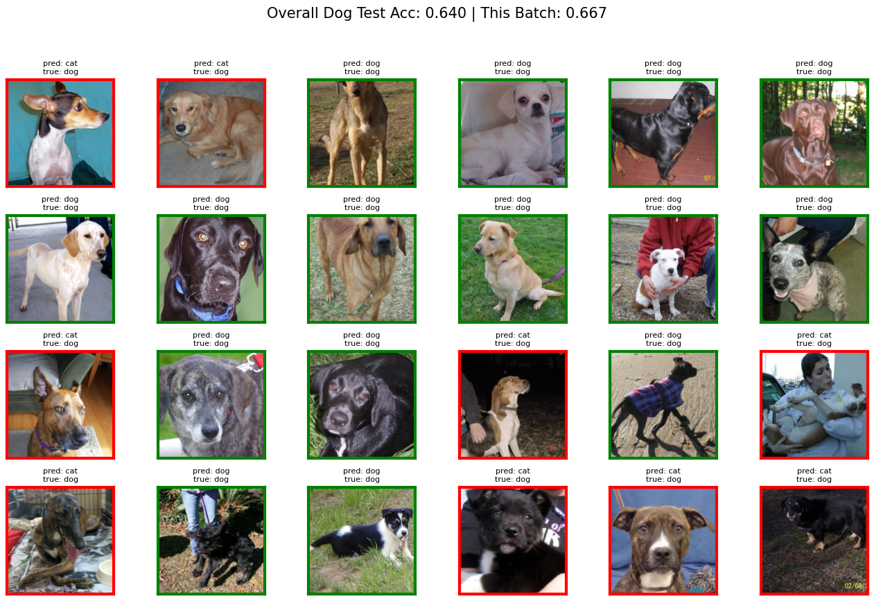

Slide 10
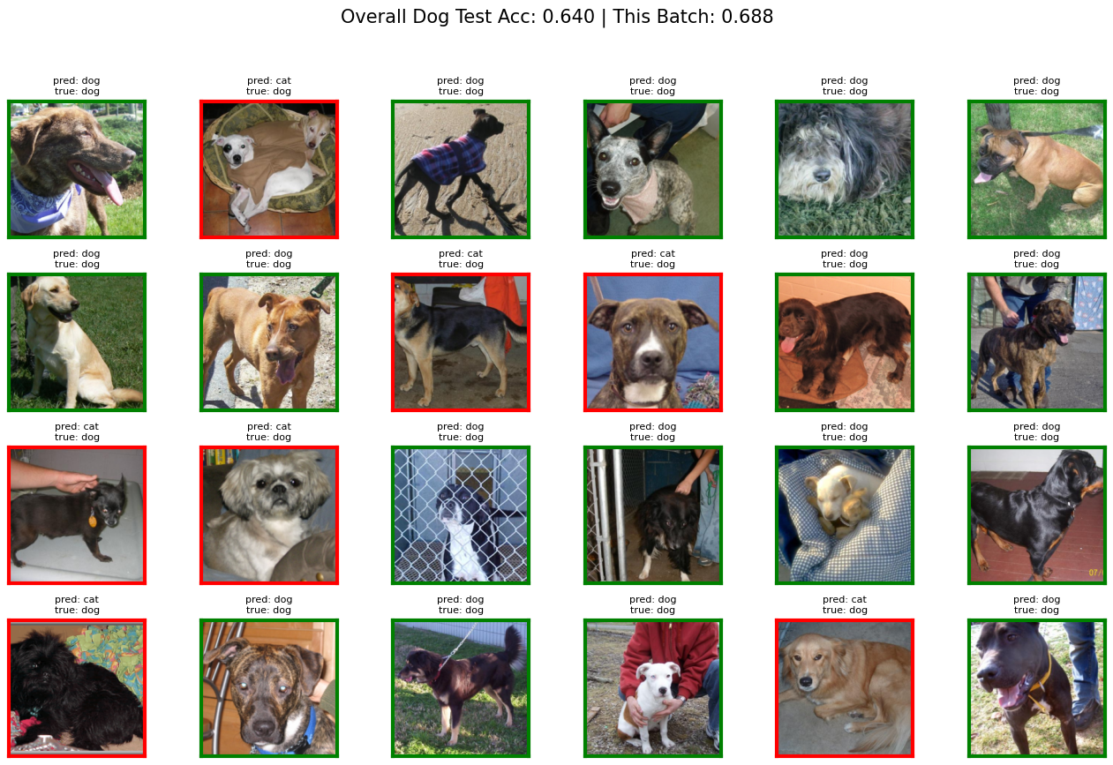

Slide 11
Challenges & Fixes
Most issues were related to stability and consistency — once the data and learning rate were under control, the model performed much more reliably.
Overfitting occurred due to a small validation set → mitigated through stronger data augmentation and dropout (0.3)
Learning rate instability was resolved by using ReduceLROnPlateau, triggered by validation loss
Inconsistent image resolutions were standardized by resizing all inputs to 224×224 pixels
Memory usage was optimized with pin_memory=True and multiple data loader workers
Reproducibility was ensured by setting fixed random seeds and maintaining a consistent folder structure
Affordable prices for every budget
We treat your pets like our own!

Slide 12
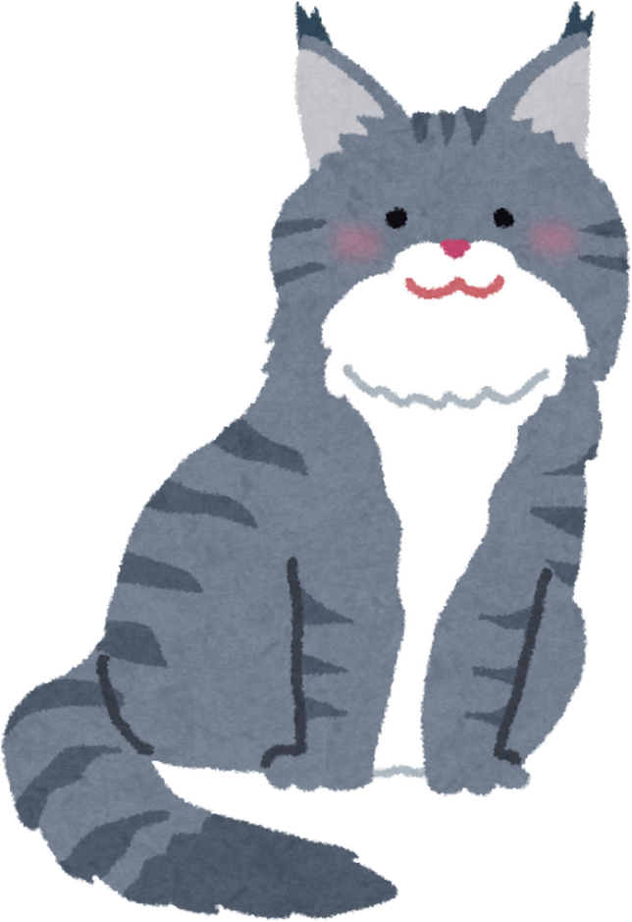
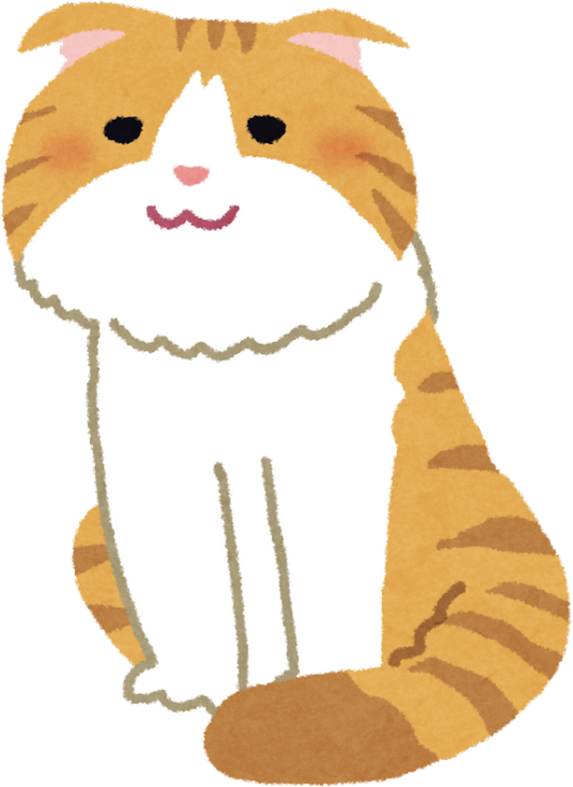

Real-World Applications
Same principles power pet-recognition apps and animal monitoring systems
Shows how CNNs extract meaning from raw pixels → useful in medicine, security, or retail
Model can run on low-end devices due to its small size
Demonstrates importance of balanced datasets and data quality
Foundation for transfer learning on other image tasks

Slide 13



Stay Connected
with Borcelle!
Follow us for pet care tips, special promos & adorable pet content!
@reallygreatsite
www.reallygreatsite.com
+123-456-7890

Slide 14
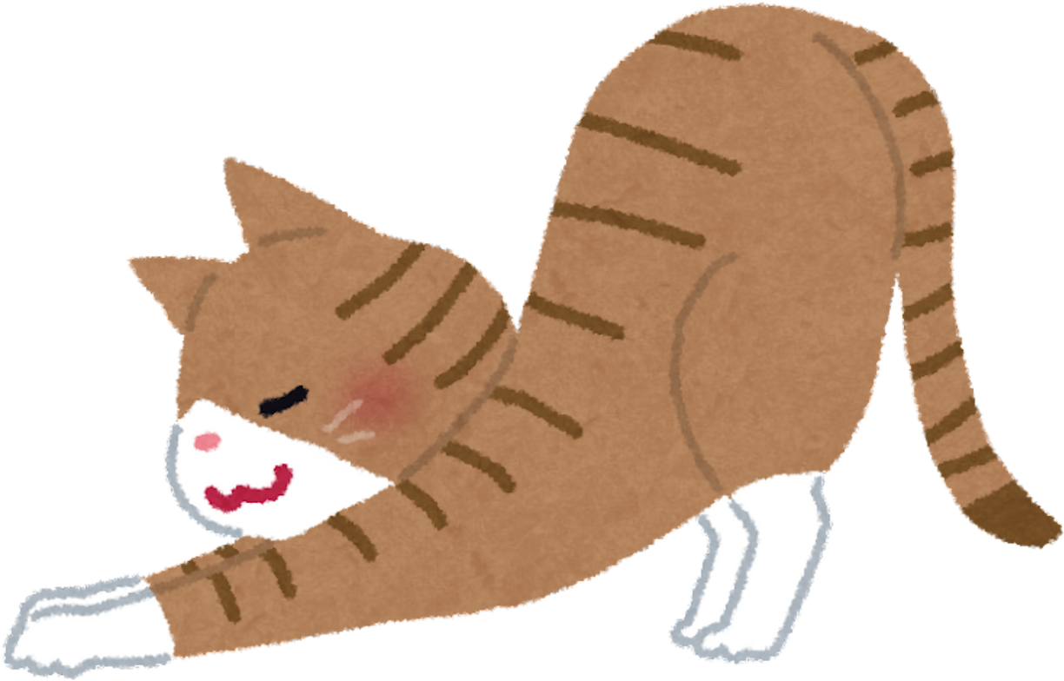
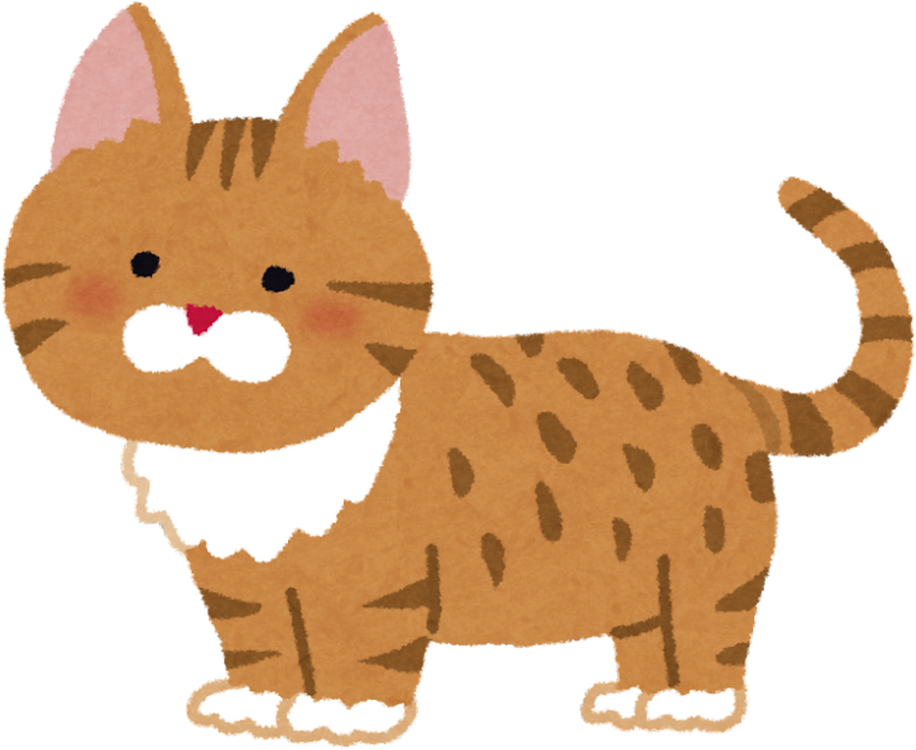

Thank you for choosing
Borcelle!
Happiness starts with a happy pet!

Slide 15


