Slide 1
Addressable LED Table
Thinh Do

Slide 2
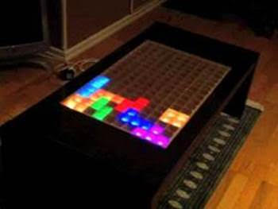
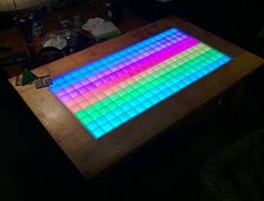
Introduction
What is it?
Coffee table embedded with LEDs that are programmed by a microcontroller.
Software Features:
Play retro pixel games such as Tetris, Pong, Snake, etc.
Audio Spectrum Display
Interface with a Mobile Device (Android Application)
Hardware Features:
Touchscreen
Interface with a game controller
Internal speakers and audio out

Slide 3
System Design
Hardware Requirements:
Microcontroller (Arduino Due)
Addressable RGB LEDs
Touch detection sensors
5V Power Supply
Gamepad controller
Speakers
Software Requirements:
Arduino Software
Android Studio

Slide 4
Scheduling
Notes:
Greens are lowest priority or even optional.
Yellows are medium priority.
Blue are highest priority.
Software Development Phase I: Develop retro pixel games such as Tetris, Pong, Snake, etc.
Software Development Phase II: Develop Android application to be interfaced with hardware.

