Slide 1
PROVIDE INSIGHTS TO MANAGEMENT IN CONSUMER GOODS DOMAIN
Ninya Narayanan Codebasics project challenge

Slide 2
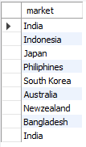
1. Provide the list of markets in which customer "Atliq Exclusive" operates its business in the APAC region.
Here we listed all the markets which has customers named ‘Atliq Exclusive’ in the APAC regain by simply using where clause

Slide 3

2. What is the percentage of unique product increase in 2021 vs. 2020? The final output contains these fields,
unique_products_2020 unique_products_2021 percentage_chg
Unique products in year 2020 is 245 Unique product year in 2021 is 334 Percentage increases is 36.3265

Slide 4
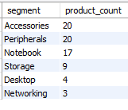
3. Provide a report with all the unique product counts for each segment and sort them in descending order of product counts. The final output contains 2 fields,
segment product_count
The query result has 6 segment and there product count
(used COUNT aggregate function)

Slide 5
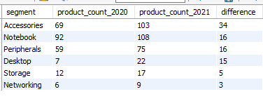
4. Follow-up: Which segment had the most increase in unique products in 2021 vs 2020? The final output contains these fields,
segment product_count_2020 product_count_2021 difference
We have product count and difference between the year 2020 & 2021 for each segment

Slide 6

5. Get the products that have the highest and lowest manufacturing costs. The final output should contain these fields,
product_code product manufacturing_cost
In this query we found product_code,product with max and min manufacturing_cost by using the aggegrate function

Slide 7
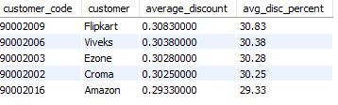
6. Generate a report which contains the top 5 customers who received an average high pre_invoice_discount_pct for the fiscal year 2021 and in the Indian market. The final output contains these fields,
customer_code customer
average_discount_percentage
Found the top 5 customer who received discount in fiscal year 2021. Used Limit to get Top 5

Slide 8
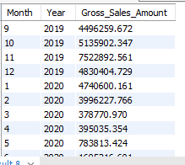
7. Get the complete report of the Gross sales amount for the customer “Atliq Exclusive” for each month
. This analysis helps to get an idea of low and high-performing months and take strategic decisions. The final report contains these columns:
Month Year
Gross sales Amount
Here we have a calculated Gross sales amount for each month in a Year. In the query used multiple join

Slide 9

8. In which quarter of 2020, got the maximum total_sold_quantity? The final output contains these fields sorted by the total_sold_quantity,
Quarter total_sold_quantity
In this quary main change is extract year and quarter from the date column & find the maximum total sold quantity in year 2020

Slide 10

9. Which channel helped to bring more gross sales in the fiscal year 2021 and the percentage of contribution?
The final output contains these fields,
channel gross_sales_mln percentage
The channel Retailer brought more gross sales in the fiscal year 2021 and the percentage is 1702390.843

Slide 11
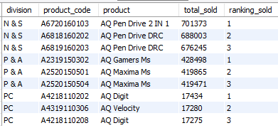
10. Get the Top 3 products in each division that have a high total_sold_quantity in the fiscal_year 2021? The final output contains these fields,
Division product_code product total_sold_quantity rank_order
Used window function (rank) top 3 product in each division and calculated total sold quantity accordingly

Slide 12
Thank you

