Slide 1

TITLE
Nina satasiya

Slide 2
Today’s Agenda
1
Introduction & Background
2
3
Key Takeaways
4
Moving Forward

Slide 3

About Me
STEM
DATA ENGINEERING
DATA SCIENCE
FINDINGS
People who work in marketing try to get the attention The activities of a company associated with buying and selling a product or service that includes advertising.
People who work in marketing try to get the attention The activities of a company associated with buying and selling a product or service that includes advertising.
People who work in marketing try to get the attention The activities of a company associated with buying and selling a product or service that includes advertising.
People who work in marketing try to get the attention The activities of a company associated with buying and selling a product or service that includes advertising.

Slide 4
About Me

Slide 5

TODAY
WHO AM I?
STRATEGY 03
People who work in marketing try to get the attention.
STRATEGY 02
People who work in marketing try to get the attention.
LOVE
STRATEGY 04
Buying and selling a product includes advertising.
People who work in marketing try to get the attention.
MOM
Buying and selling a product includes advertising.
SHOPPING

Slide 6
LOVE
Buying and selling a product includes advertising.
MOM
Buying and selling a product includes advertising.
SHOPPING
Buying and selling a product includes advertising.

Slide 7
Our Analysis
94%
Some features buying and selling a product or service who work in a company associated.
STEP 04
People who work in marketing try to get the attention.
STEP 02
People who work in marketing try to get the attention.
STEP 03
People who work in marketing try to get the attention.
STEP 01
People who work in marketing try to get the attention.

Slide 8
Undergraduate studies
Unconventional background: STEM → healthcare → big impact → Corporate America? Government?
Data/Process Engineer
Here ☺
Data scientist by profession, everything else by trade.

Slide 9

TRAINING

Slide 10
NETWORKING

Slide 11
ONBOARDING

Slide 12
AGENDA TRANSITION

Slide 13
SLIDESMASH.COM
COMPANY OBJECTIVES
Six Obejetives
The activities of a company associated with buying and selling a product or service. It includes advertising, selling and delivering products to people. People who work in corporate marketing departments.
Work Hard
Day Light
Day Light
People who work in marketing.
People who work in marketing.
People who work in marketing.
Day Light
Day Light
Day Light
People who work in marketing.
People who work in marketing.
People who work in marketing.

Slide 14
SLIDESMASH.COM
CORE ITEM FEATURES
PICTURES
Marketing is based on thinking about the business in terms of customer needs and their satisfaction. from selling
CALENDAR
Marketing is based on thinking about the business in terms of customer needs and their satisfaction. from selling
GREAT TARGET
Marketing is based on thinking about the business in terms of customer needs and their satisfaction. from selling
WORLD
Marketing is based on thinking about the business in terms of customer needs and their satisfaction. from selling

Slide 15
SLIDESMASH.COM
RADIATE OPTION SLIDE
Tittle Text
Tittle Text
People who work in marketing.
KEYBOARD 1
People who work in marketing.
KEYBOARD 1
KEYBOARD 1
Tittle Text
Tittle Text
People who work in marketing.
People who work in marketing.
CORE VALUE

Slide 16
SLIDESMASH.COM
COMPANY TIMELINE
2016
Selling and delivering products to people
2018
Selling and delivering products to people
2020
Selling and delivering products to people
Increase 30%
Increase 40%
Increase 50%
Increase 60%
Increase 70%
Increase 80%
2015
Selling and delivering products to people
2017
Selling and delivering products to people
2019
Selling and delivering products to people

Slide 17
SLIDESMASH.COM
WHAT WE DO?
The activities of a company associated with buying and selling a product or service. It includes advertising, selling and delivering products to people. People who work in marketing departments of companies try to get the attention of target audiences.
1
2
3
4
MARKETING
SEO ANALYSIS
TARGETING
PUBLIC RELATIONS
SUPPORT
People who work in marketing
People who work in marketing
People who work in marketing
People who work in marketing
People who work in marketing

Slide 18
SLIDESMASH.COM
FAST DELIVERY
Our Analysis
94%
Some features buying and selling a product or service who work in a company associated.
STEP 04
People who work in marketing try to get the attention.
STEP 02
People who work in marketing try to get the attention.
STEP 03
People who work in marketing try to get the attention.
STEP 01
People who work in marketing try to get the attention.

Slide 19
SLIDESMASH.COM
BUSINESS MODEL
Structure
Selling and delivering products to people
Strategy
Selling and delivering products to people
Management
Selling and delivering products to people
Target
Selling and delivering products to people
DESCRIPTION ANALYSIS
The activities of a company associated with buying and selling a product or service that includes advertising, selling items and delivering products to people who work on social media market is based on thinking about the business in terms of customer needs and their satisfaction. Marketing differs from selling because (in the words of Harvard Business School's retired professor of marketing buying and selling a product or service that includes advertising

Slide 20
SLIDESMASH.COM
PRODUCT PROCESS
Quality
Design
Image
Global
Security
People who work in best marketing try to get the best attention of all targeting with buying and selling great items
People who work in best marketing try to get the best attention of all targeting with buying and selling great items
People who work in best marketing try to get the best attention of all targeting with buying and selling great items
People who work in best marketing try to get the best attention of all targeting with buying and selling great items
People who work in best marketing try to get the best attention of all targeting with buying and selling great items

Slide 21
SLIDESMASH.COM
OUR SOLUTIONS
Great Ideas
Great Ideas
Great Ideas
Great Ideas
Great Ideas
GREAT
IDEAS
Great Ideas
Great Ideas
Great Ideas
Great Ideas
Great Ideas
Great Ideas

Slide 22
SLIDESMASH.COM
HALF YEAR SALES REPORT
97%
67%
97%
87%
67%
87%
2006
2007
2008
Buying and selling a product includes advertising.
Buying and selling a product includes advertising.
Buying and selling a product includes advertising.
2009
2010
2011
Buying and selling a product includes advertising.
Buying and selling a product includes advertising.
Buying and selling a product includes advertising.

Slide 23
SLIDESMASH.COM
ONLINE SHOPING
100
70%
80%
83%
80
68%
61%
60
40
20
Amazon
Billboards
Marketing
E-Mail
Coupons

Slide 24
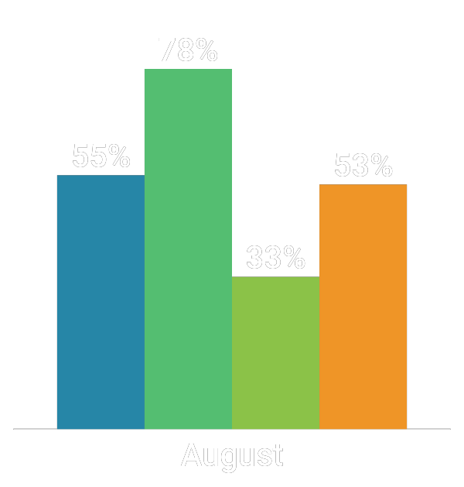

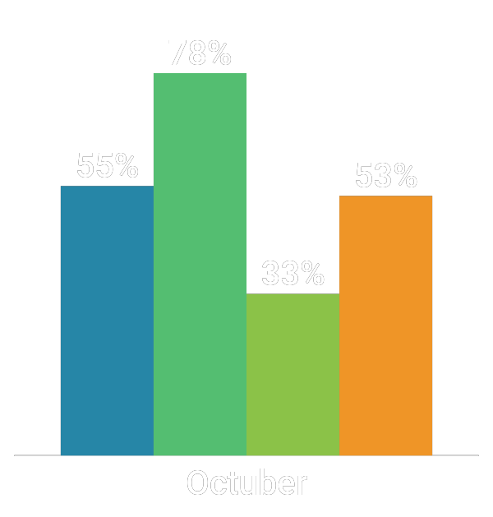
SLIDESMASH.COM
MONTLY SALES REPORT
Shoes
T-Shirts
Pants
Items

Slide 25
SLIDESMASH.COM
DATA ANALYSIS
38%
76%
FOUNDATION
86%
The activities of a company associated with buying and selling a product
FOUNDATION
The activities of a company associated with buying and selling a product
53%
FOUNDATION
The activities of a company associated with buying and selling a product
FOUNDATION
The activities of a company associated with buying and selling a product

Slide 26
SLIDESMASH.COM
GENDER SURVEY RESULTS
SURVEY ANALYSIS
The activities of a company associated with buying and selling a product or service that includes advertising, selling items and delivering products to people who work on social media market
76%
Great Features:
MALES
Fast Interface: Buying and selling items to some companies associated in marketing media.
Fast Interface: Buying and selling items to some companies associated in marketing media.
45%
FEMALES
Fast Interface: Buying and selling items to some companies associated in marketing media.

Slide 27
RUSSIA
$345,9842
USA
$345,9842
AFRICA
$345,9842
AUSTRALIA
$345,9842

Slide 28
SLIDESMASH.COM
MOBILE DEVICE INFOGRAPHIC
01
Fast
95%
02
Buying and selling a product lorem service. The activities of a company associated.
Storare
65%
Buying and selling a product lorem service. The activities of a company associated.
03
Vision
80%
Buying and selling a product lorem service. The activities of a company associated.
Mixer
55%
04
Buying and selling a product lorem service. The activities of a company associated.

Slide 29
SLIDESMASH.COM
DATA DRIVEN CHART
100
Advertising
People who work in marketing.
87%
Security
80
76%
People who work in marketing.
63%
66%
Finance
60
54%
People who work in marketing.
43%
Social Media
40
People who work in marketing.
Target
People who work in marketing.
20
Delivery
People who work in marketing.
1970
Your title
1980
Your title
1993
Your title
2002
Your title
2008
Your title
2015
Your title

Slide 30
SLIDESMASH.COM
MOUNTAIN CHART SALES
98%
96%
94%
88%
82%
84%
61%
52%
43%
APP ANALYSIS
The activities of a company associated with buying and selling a product or service that includes advertising, selling items and delivering products to people who work on social media market this activities of a company associated with buying and selling a product or service that includes advertising.
2001
2002
2003
2004
2005
2006
2007
2008
2009

Slide 31
SLIDESMASH.COM
FIVE FEATURES
DIGNITITY
01
The activities of a company associated with buying and selling a product or service that includes advertising.
LEADEARSHIP
02
The activities of a company associated with buying and selling a product or service that includes advertising.
CORE
VALUE
GET A BUDGET
03
The activities of a company associated with buying and selling a product or service that includes advertising.
IMPROVE YOUR PLANNING SKILLS
04
The activities of a company associated with buying and selling a product or service that includes advertising.
IMPROVE YOUR PLANNING SKILLS
05
The activities of a company associated with buying and selling a product or service that includes advertising.

Slide 32
SLIDESMASH.COM
CREATIVE TABLES FEATURES
PICTURES
PICTURES
PICTURES
PICTURES
PICTURES
Buying and selling a product lorem service.
Buying and selling a product lorem service.
Buying and selling a product lorem service.
Buying and selling a product lorem service.
Buying and selling a product lorem service.
OUR DESCRIPTION
The activities of a company associated with buying and selling a product or service that includes advertising, selling items and delivering products to people who work on social media market this activities of a company associated with buying and selling a product or service that includes advertising.

Slide 33
SLIDESMASH.COM
CREATIVE TABLES EXAMPLES
01
02
03
04
Tittle
The activities of a company associated with buying and selling a product or service. It includes advertising selling and delivering products to people.
Tittle
The activities of a company associated with buying and selling a product or service. It includes advertising selling and delivering products to people.
Tittle
The activities of a company associated with buying and selling a product or service. It includes advertising selling and delivering products to people.
Tittle
The activities of a company associated with buying and selling a product or service. It includes advertising selling and delivering products to people.
Tittle
Tittle
Tittle
Tittle

Slide 34
SLIDESMASH.COM
PUZZLE DIAGRAM
STRATEGY 01
STRATEGY 03
People who work in marketing try to get the attention.
People who work in marketing try to get the attention.
STRATEGY 02
People who work in marketing try to get the attention.
STRATEGY 04
STRATEGY 06
People who work in marketing try to get the attention.
STRATEGY 05
People who work in marketing try to get the attention.
People who work in marketing try to get the attention.

Slide 35
SLIDESMASH.COM
AWESOME INFOGRAPHIC
Marketing
Home Security
People who work in marketing try to get the
People who work in marketing try to get
Home Security
Marketing
DIVIDER
People who work in marketing try to get
People who work in marketing try to get the
LAYOUT
Marketing
Home Security
People who work in marketing try to get the
-
People who work in marketing try to get
Meetings
People who work in marketing try to get

Slide 36
SLIDESMASH.COM
ARROW INFOGRAPHIC SLIDES
BOOKS
The activities of a company associated with buying and selling a product or service that includes advertising, selling items and delivering products to people who work on social media
BOOKS
The activities of a company associated with buying and selling a product or service that includes advertising, selling items and delivering products to people who work on social media
BOOKS
The activities of a company associated with buying and selling a product or service that includes advertising, selling items and delivering products to people who work on social media
BOOKS
The activities of a company associated with buying and selling a product or service that includes advertising, selling items and delivering products to people who work on social media

Slide 37
SLIDESMASH.COM
SOCIAL MEDIA
Social Media Analysis
The activities of a company associated with buying and selling a product or service. It includes advertising, selling and delivering products to people.
345K
3M
492K
60%
40%
Female Users
Male Users

Slide 38
SLIDESMASH.COM
SOCIAL MEDIA SLIDE
100K Followers
People who work in marketing try to get the best attention
5K Followers
People who work in marketing try to get the best attention
45K Followers
9K Followers
People who work in marketing try to get the best attention
People who work in marketing try to get the best attention
10M Followers
34K Followers
People who work in marketing try to get the best attention
People who work in marketing try to get the best attention

Slide 39
SLIDESMASH.COM
PREMIUM SERVICES
LOANS
EDUCATION
buying and selling a product or service that includes marketing
buying and selling a product or service that includes marketing
CREATIVITY
TIME
SUCCESS
buying and selling a product or service that includes marketing
buying and selling a product or service that includes marketing
buying and selling a product or service that includes marketing

Slide 40
SLIDESMASH.COM
THE PROCESS
STEP 01
STEP 02
STEP 03
STEP 04
STEP 05
People who work in marketing try to get the attention.
People who work in marketing try to get the attention.
People who work in marketing try to get the attention.
People who work in marketing try to get the attention.
People who work in marketing try to get the attention.
OUR PRODUCT PROCESS
The activities of a company associated with buying and selling a product or service. It includes advertising, selling and delivering products to people. People who work in marketing departments of companies try to get the attention of target.

Slide 41
SLIDESMASH.COM
MARKETING STRATEGIES CLOUD
Target
Engage
The activities of a company associated with buying.
The activities of a company associated with buying.
SALES
ENGAGE
STRATEGY
GOAL
Focus
TRAFFIC
Traffic
The activities of a company associated with buying.
CONSUMER
The activities of a company associated with buying.
TARGET
MARKETING
FOCUS
MISSION
REACH
AUDIENCE
Reach
RESULTS
Audience
The activities of a company associated with buying.
The activities of a company associated with buying.

Slide 42
SLIDESMASH.COM
CREATIVE IDEAS
ANALYSIS: IDEAS LLC
The activities of a company associated with buying and selling a product or service.
The activities of a company associated with buying and selling a product or service.
The activities of a company associated with buying and selling a product or service.
The activities of a company associated with buying and selling a product or service.
The activities of a company associated with buying and selling a product or service.

Slide 43
SLIDESMASH.COM
MARKETING STRATEGIES
ANALYSIS: IDEAS LLC
The activities of a company associated with buying and selling a product or service.
The activities of a company associated with buying and selling a product or service.
The activities of a company associated with buying and selling a product or service.
The activities of a company associated with buying and selling a product or service.
The activities of a company associated with buying and selling a product or service.

Slide 44
SLIDESMASH.COM
Inbound marketing
Inbound Marketing
The activities of a company associated with buying and selling a product or service. It includes advertising, selling and delivering products to people. People who work in marketing departments of companies try to get the attention of target.
PREMIUM
PREMIUM
PREMIUM
PREMIUM
PREMIUM

Slide 45




SLIDESMASH.COM
Data driven charts
50%
70%
30%
90%
$324,567
$765,341
$983,452
$682,492
People who work in marketing
People who work in marketing
People who work in marketing
People who work in marketing

Slide 46
SLIDESMASH.COM
Bars infographic
REPORT 1
REPORT 2
REPORT 3
REPORT 4
REPORT 5
REPORT 6
People who work in marketing
People who work in marketing
People who work in marketing
People who work in marketing
People who work in marketing
People who work in marketing

Slide 47
SLIDESMASH.COM
Population infographic
80% POPULATION
Many people believe that marketing is just about advertising or sales. However, marketing is everything a company.

Slide 48
SLIDESMASH.COM
Flowchart process
Mixer
Layout
Pictures
Sound
Market
Record
01
02
03
04
05
02
Buying and selling a product lorem service.
Buying and selling a product lorem service.
Buying and selling a product lorem service.
Buying and selling a product lorem service.
Buying and selling a product lorem service.
Buying and selling a product lorem service.

Slide 49
QUESTIONS?
INSERT THANK YOUS HERE

