Slide 1

Lab Book 0.2. Couplers
Student:

Slide 2
Instructions General
SCRIPTS
From GitHub →
Fork the repo: https://github.com/cccanvas-upv/pic-upv-lab0.git
Clone the repo using VSCode
Run the Jupyter Notebook:
020_COUPLERS_Student.ipynb
Cross-Sections to be studied:
w (width)
w (width)
h
(height)
Core
Core
h
(height)
MMI Body
g
(gap)
Cladding
Cladding
Directional coupler (DC)
Multimode Interference (MMI) coupler

Slide 3
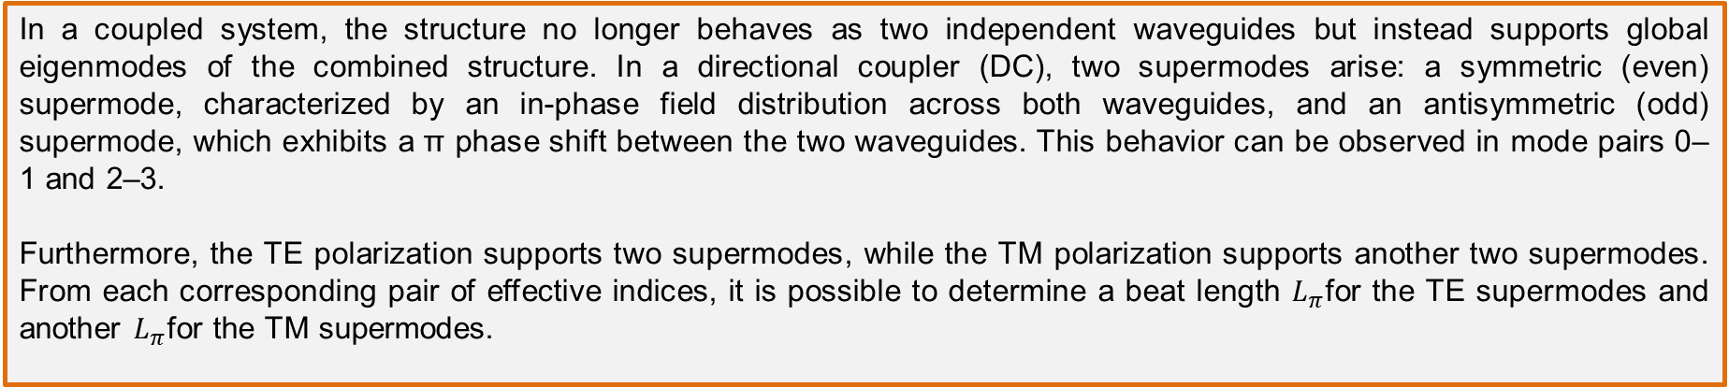

Learning outcome #1 – Directional coupler cross-section in GDSFactory
INSTRUCTOR:
Present Python and GDSFactory implementation of DC cross-section
Describe how to obtain the beating length $L_{π}$
Describe the outputs.
ALL EXAMPLE #1: waveguide width 1.2 µm, gap between waveguides 0.6 µm, deep wvg, wavelength start and end same 1.55 µm → all ”Run”
ALL: Follow instructor, that will show how to 1) plot mode, 2) explore the results (neff …)
In a coupled system, the structure no longer behaves as two independent waveguides but instead supports global eigenmodes of the combined structure. In a directional coupler (DC), two supermodes arise: a symmetric (even) supermode, characterized by an in-phase field distribution across both waveguides, and an antisymmetric (odd) supermode, which exhibits a π phase shift between the two waveguides. This behavior can be observed in mode pairs 0–1 and 2–3.
Furthermore, the TE polarization supports two supermodes, while the TM polarization supports another two supermodes. From each corresponding pair of effective indices, it is possible to determine a beat length $L_{π}$for the TE supermodes and another $L_{π}$for the TM supermodes.

Slide 4
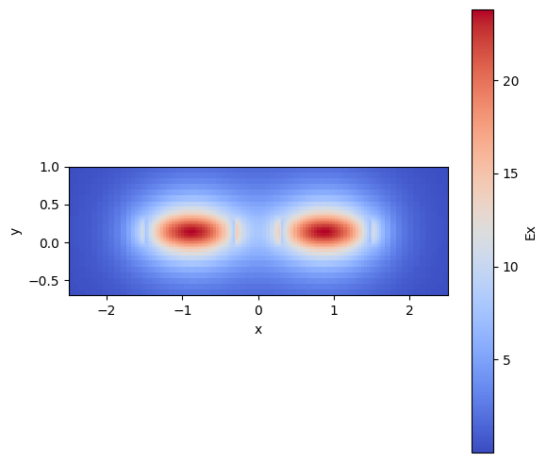
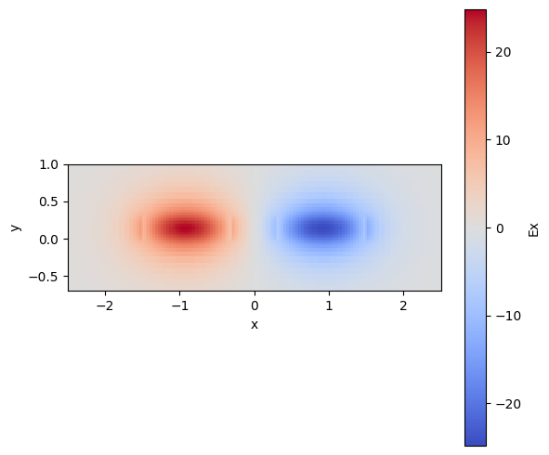
Learning outcome #1 – Directional coupler cross-section in GDSFactory
Mode 0: TE Fraction: 99,49 %, TM Fraction 0,51 %
Mode 1: TE Fraction: 99,53 %, TM Fraction 0,47 %
Even (Symmetric) mode
Odd (Antisymmetric) mode

Slide 5
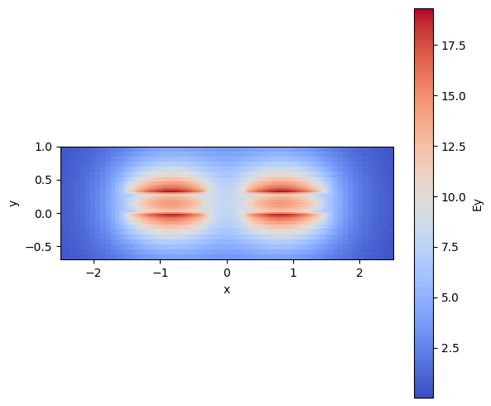
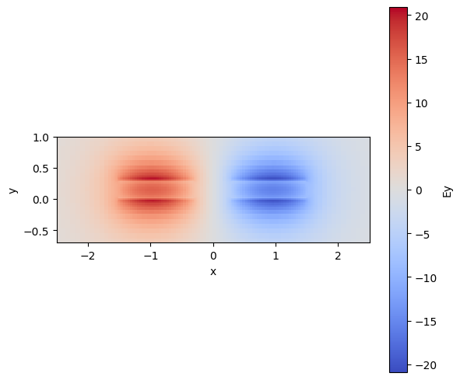
Learning outcome #1 – Directional coupler cross-section in GDSFactory
Mode 2: TE Fraction: 0,89 %, TM Fraction 99,11 %
Mode 3: TE Fraction: 1,13 %, TM Fraction 98,87 %
Even (Symmetric) mode
Odd (Antisymmetric) mode

Slide 6

Learning outcome #2 – Multimode Interference (MMI) Coupler cross-section
INSTRUCTOR:
Present Python and GDSFactory implementation of DC cross-section
Describe how to obtain the beating length $L_{π}$
Describe the outputs.
ALL EXAMPLE #2: waveguide width 12 µm, gap between waveguides 0.6 µm, deep wvg, wavelength start and end same 1.55 µm → all ”Run”
ALL: Follow instructor, that will show how to 1) plot mode, 2) explore the results (neff …)
During the simulation process, it is important to consider that as the waveguide becomes wider, a larger number of modes are able to propagate. A practical way to determine how many modes are actually guided is to verify whether their effective index is higher than the refractive index of the cladding. If this condition is satisfied, the mode is confined; otherwise, it corresponds to a radiation or leaky mode.
In the case of an MMI, the calculation of Lπ no longer describes the transfer of optical power between two adjacent waveguides, as happens in a directional coupler. Instead, Lπ represents the periodicity of the interference that occurs between the modes propagating inside the multimode section.
It is possible to take the difference between the effective indices of the first two guided modes to find Lπ. However, it is important to respect the polarization of the modes, meaning that the calculation must be performed using either TE modes or TM modes separately, since modes belonging to different polarization families do not interfere with each other.

Slide 7
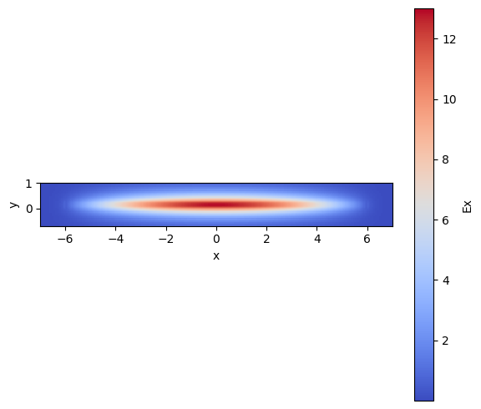
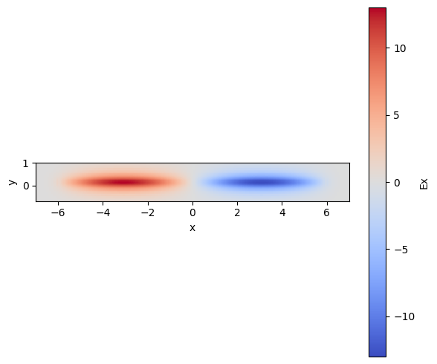
Learning outcome #2 – Multimode Interference (MMI) Coupler cross-section
Mode 0: TE Fraction: 100,00 %, TM Fraction 0,00 %
Mode 1: TE Fraction: 100,00 %, TM Fraction 0,00 %

Slide 8
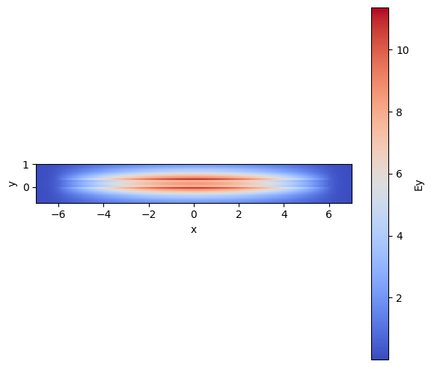
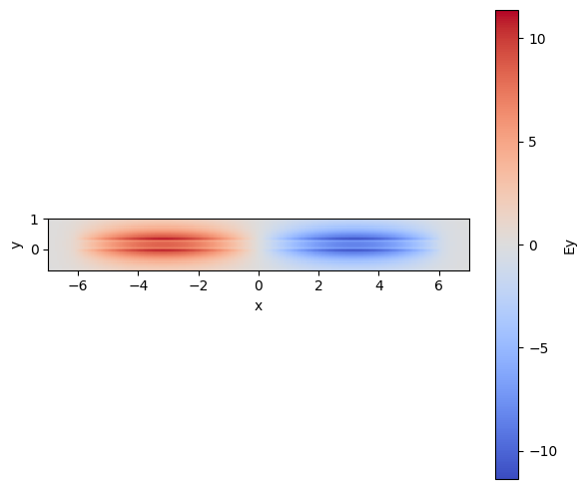
Learning outcome #2 – Multimode Interference (MMI) Coupler cross-section
Mode 9: TE Fraction:0,02%, TM Fraction 99,98 %
Mode 10: TE Fraction: 0,10 %, TM Fraction 99,98 %

Slide 9
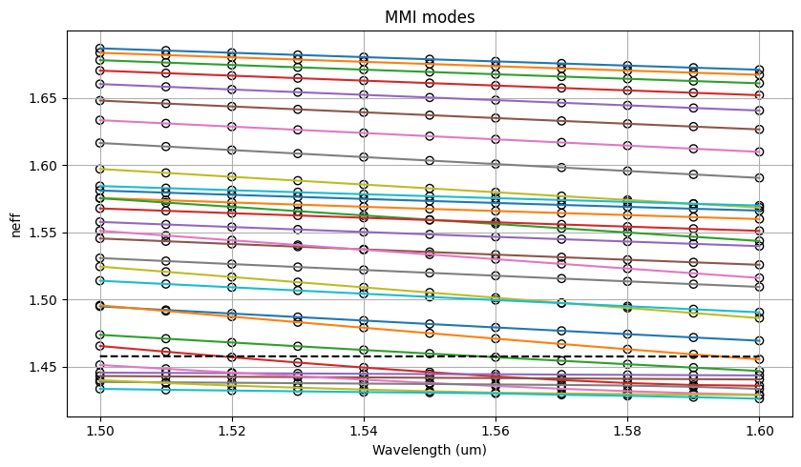
Learning outcome #2 – Modes propagating on a MMI with a width of 12 um
Notes:
Mencionar que a medida que incrementa el ancho de la guía se incrementa el numero de modos que se propaga a través de la misma, una forma practica de conocer el numero de modos es llevar a cabo las simulaciones de su índice efectivo y verificar el punto en los que estos comienzan a acercarse al índice efectivo del cladding, podríamos afirmar que a partir del modo 23 comienza a acercarse al índice de refracción del silicio de 1,45

Slide 10

Thank you

