Slide 1

Lab Book 1.0. Waveguides
Student:

Slide 2
Instructions General
SCRIPTS
From GitHub →
Fork the repo: cccanvas-upv/pic-upv-lab1
Clone the repo using VSCode
Run the Jupyter Notebook:
WAVEGUIDES_Student.ipynb
W (width)
W (width)
Core
Core
h_core
h
(height)
Cladding
Cladding
Slab
h_slab
deep waveguide
shallow waveguide

Slide 3
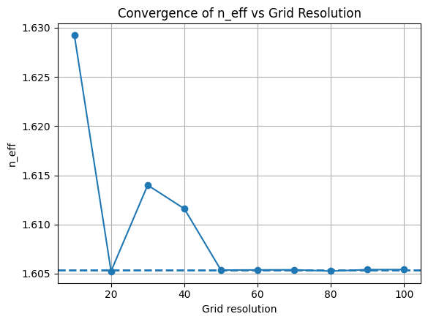
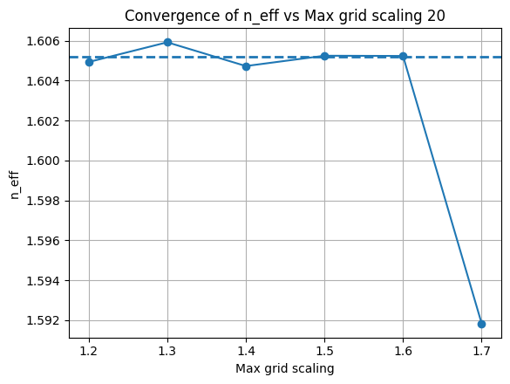
Learning outcome #1 – Convergence tests DE waveguide, w = 1.2 µm, neff_TE0, wvl 1.55 µm.
The simulated waveguide is based on Si₃N₄ (Silicon Nitride) technology, with dimensions of 300 nm height and 1.2 um width. By performing simulations with different grid resolutions, it is observed that the effective refractive index stabilizes around an average value of n_"eff" ≈1.605.
For the grid resolution parameter, a larger value subdivides the computational cell into smaller elements, which increases numerical accuracy but also raises the computational cost. Since the objective is to reduce the simulation time a grid resolution of 20 points per micron is selected.
For the variation of max_grid_scaling, the grid resolution was fixed at 20, an average effective index of n"eff" ≈1.605 is obtained. In this case, a smaller value of max_grid_scaling results in a finer mesh near material interfaces, improving accuracy but increasing the simulation time. To reduce the computational cost a value of 1.6 was selected.

Slide 4
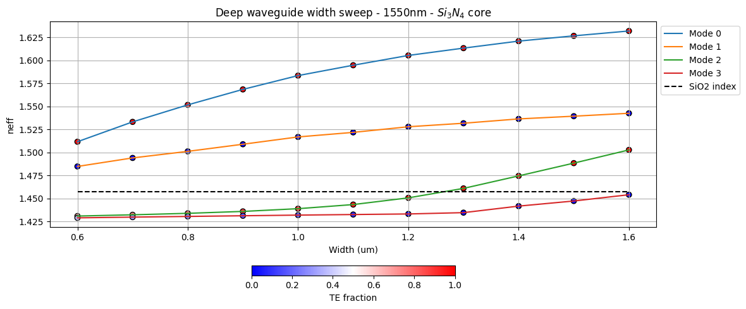
Learning outcome #2 – Width dependence Width 0.6 - 1.6 µm (step 0.1 µm) – Wavelength 1.55 µm
As the waveguide width increases, the optical mode becomes more confined within the core, reducing the field penetration into the cladding. Consequently, the effective refractive index increases and approaches the refractive index of the silicon nitride core.
In addition, the polarization of the modes is also affected by the waveguide width. TE and TM modes experience different levels of confinement due to their field distributions, which leads to changes in their TE and TM proportions however this phenomenon is better appreciated on Si core waveguides.

Slide 5
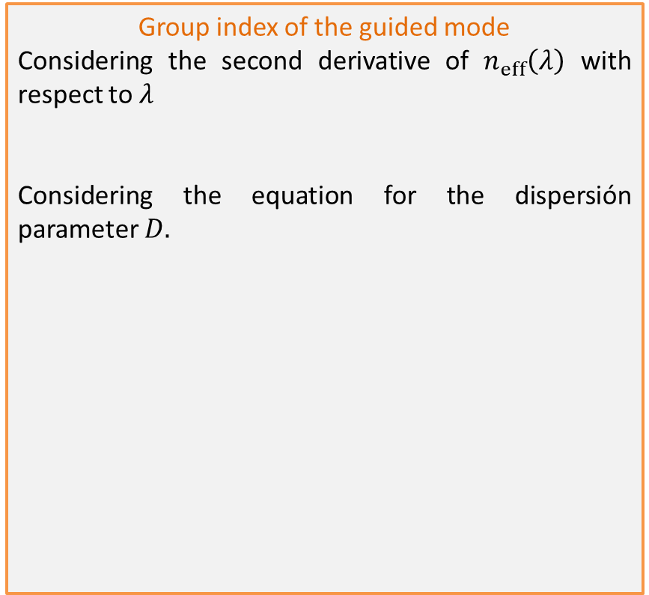



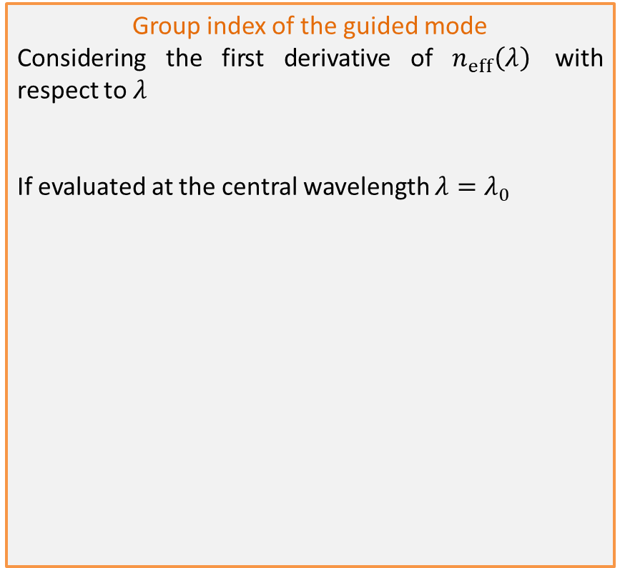


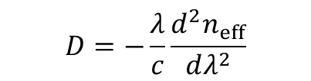
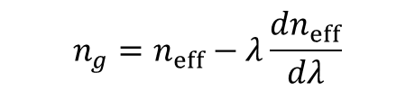

Learning outcome #3 – Waveguide compact model Let’s model the waveguide using a second order polynomial: $$n_{eff}\left(λ\right)=n_{1}+n_{2}\left(λ−λ_{0}\right)+n_{3}{\left(λ−λ_{0}\right)}^{2}$$
Group index of the guided mode
Considering the first derivative of $n_{eff}\left(λ\right)$ with respect to $λ$
If evaluated at the central wavelength ${λ=λ}_{0}$
Group index of the guided mode
Considering the second derivative of $n_{eff}\left(λ\right)$ with respect to $λ$
Considering the equation for the dispersión parameter $D.$
$$\begin{matrix}\frac{dn_{eff}}{dλ}=n_{2}+2n_{3}\left(λ−λ_{0}\right)\end{matrix}$$
$$\begin{matrix}\frac{d^{2}n_{eff}}{dλ^{2}}=2n_{3}\end{matrix}$$
$$\begin{matrix}\frac{dn_{eff}}{dλ}=n_{2}\end{matrix}$$
$$\begin{matrix}D=−\frac{λ}{c}\frac{d^{2}n_{eff}}{dλ^{2}}\end{matrix}$$
Considering the equation for the group index $n_{g}$
$$\begin{matrix}n_{g}=n_{eff}−λ\frac{dn_{eff}}{dλ}\end{matrix}$$
$$\begin{matrix}D=−\frac{2λ}{c}n_{3}\end{matrix}$$
$$\begin{matrix}n_{g}=n_{1}−λn_{2}\end{matrix}$$

Slide 6
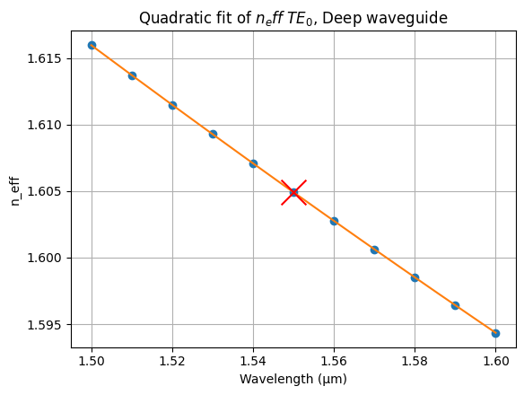
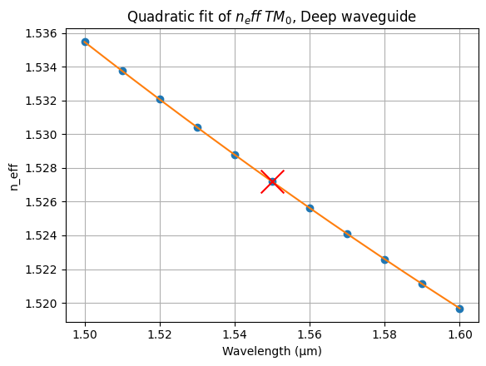



Learning outcome #3 – Waveguide compact model Let’s model the waveguide using a second order polynomial: $$n_{eff}\left(λ\right)=n_{1}+n_{2}\left(λ−λ_{0}\right)+n_{3}{\left(λ−λ_{0}\right)}^{2}$$
$n_{eff}\left(λ\right)=1,60−0,22\left(λ−λ_{0}\right)+0,10{\left(λ−λ_{0}\right)}^{2}$
$n_{g}=$ 1,94
$$\begin{matrix}D=−1.01×{10}^{−9}\end{matrix}$$
$$n_{eff}\left(λ\right)=1,53−0,16\left(λ−λ_{0}\right)+0,15{\left(λ−λ_{0}\right)}^{2}$$
$$n_{g}=\text{ 1}\text{,}\text{77}$$
$$\begin{matrix}D=−1.59×{10}^{−9}\end{matrix}$$

Slide 7
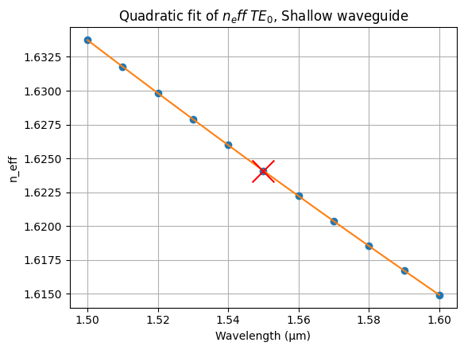
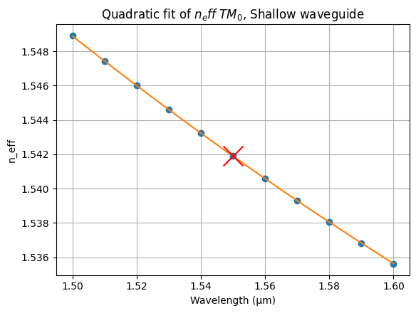



Learning outcome #3 – Waveguide compact model Let’s model the waveguide using a second order polynomial: $$n_{eff}\left(λ\right)=n_{1}+n_{2}\left(λ−λ_{0}\right)+n_{3}{\left(λ−λ_{0}\right)}^{2}$$
slab: 150nm
$n_{eff}\left(λ\right)=1,62−0,19\left(λ−λ_{0}\right)+0,10{\left(λ−λ_{0}\right)}^{2}$
$n_{g}=$ 1,92
$$\begin{matrix}D=−9,89×{10}^{−10}\end{matrix}$$
$n_{eff}\left(λ\right)=1,54−0,13\left(λ−λ_{0}\right)+0,15{\left(λ−λ_{0}\right)}^{2}$
$n_{g}=$ 1,75
$$\begin{matrix}D=−1.53,×{10}^{−9}\end{matrix}$$

Slide 8
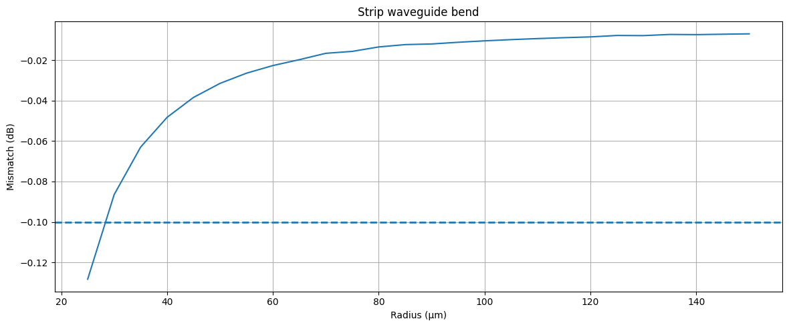
Learning outcome #4 – Bend waveguide radius vs. loss – deep Find neff_TE0 for wvl 1.55 µm, width 1.0 µm for R=25,50,75,100, 125,150 µm
For radii larger than 30 μm, it can be ensured that the losses remain below 0.1 dB for silicon nitride (Si₃N₄) technology.

Slide 9
Extras

Slide 10
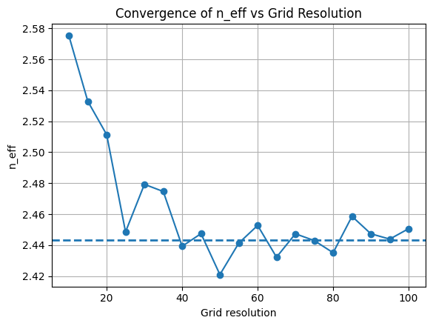
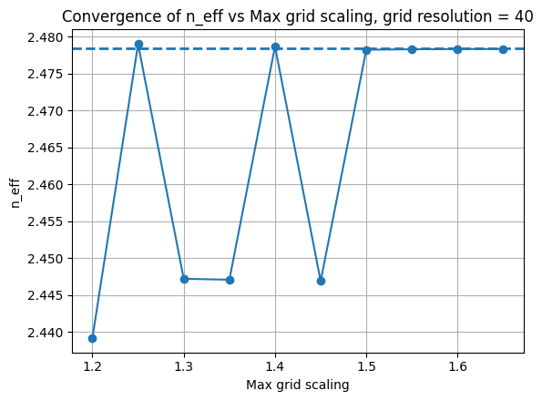
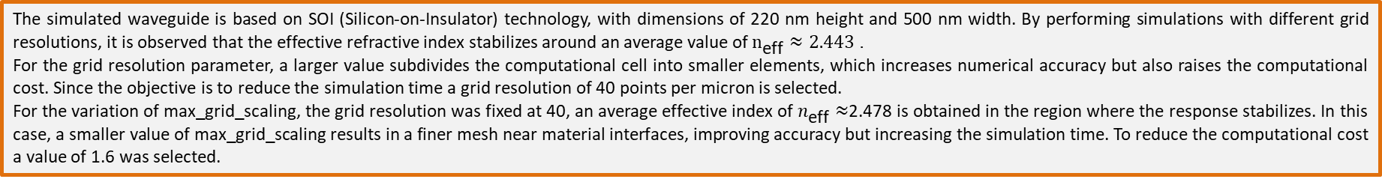
Learning outcome #1 – Convergence tests DE waveguide, w = 0.5 µm, neff_TE0, wvl 1.55 µm.
deep waveguide
Paste neff_TE0 vs grid_resolution plot here
deep waveguide
Paste neff_TE0 vs max_grid_scaling plot here
The simulated waveguide is based on SOI (Silicon-on-Insulator) technology, with dimensions of 220 nm height and 500 nm width. By performing simulations with different grid resolutions, it is observed that the effective refractive index stabilizes around an average value of $n_{\text{eff}}≈2.443$.
For the grid resolution parameter, a larger value subdivides the computational cell into smaller elements, which increases numerical accuracy but also raises the computational cost. Since the objective is to reduce the simulation time a grid resolution of 40 points per micron is selected.
For the variation of max_grid_scaling, the grid resolution was fixed at 40, an average effective index of $n_{\text{eff}}≈$2.478 is obtained in the region where the response stabilizes. In this case, a smaller value of max_grid_scaling results in a finer mesh near material interfaces, improving accuracy but increasing the simulation time. To reduce the computational cost a value of 1.6 was selected.

Slide 11
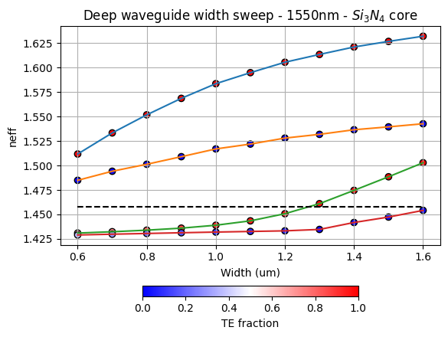
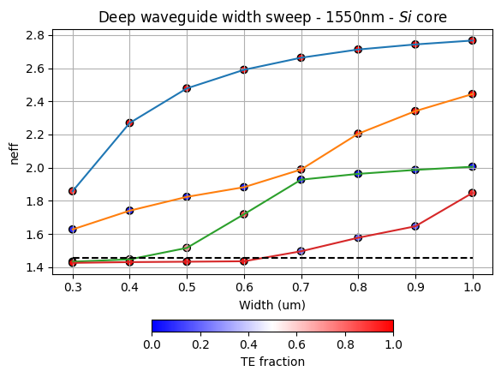
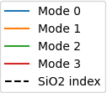
Learning outcome #2 – Width dependence Width 0.6 - 1.6 µm (step 0.1 µm) Si core, Width 0.3 - 1.0 µm (step 0.1 µm) Si core – Wavelength 1.55 µm
deep waveguide
Paste neff_TE0 vs grid_resolution plot here
deep waveguide
Paste neff_TE0 vs max_grid_scaling plot here
The results show that increasing the waveguide width allows additional modes to propagate within the core. As previously observed for Si₃N₄ core waveguides, a thickness of 1.2 µm is sufficient to ensure single-mode operation. In contrast, for a silicon core waveguide with a width of 500 nm, the structure is close to the multimode regime

Slide 12
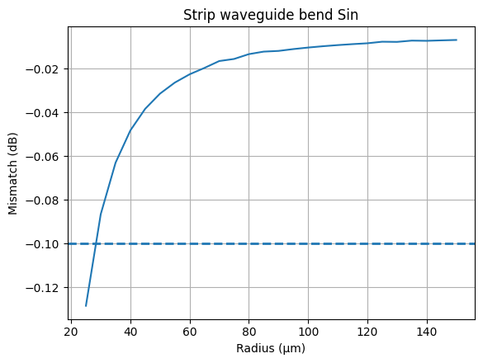
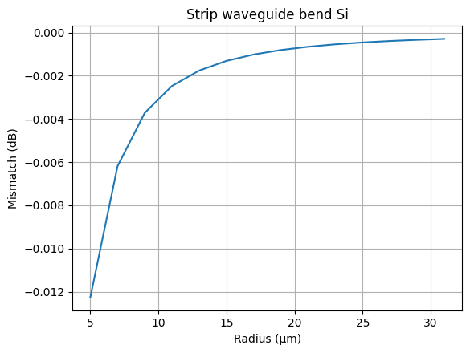
Learning outcome #4 – Bend waveguide radius vs. loss – deep Find neff_TE0 for wvl 1.55 µm
With SOI technology, bend radii as small as 5 μm can be achieved without exceeding losses of 0.1 dB. This is due to the stronger optical confinement provided by SOI waveguides.

Slide 13

Thank you

