Slide 1

Lab Book 3. Interferometers I – MZI
Student:

Slide 2




Instructions General
SOFTWARE
Python notebook supplied by instructors
SCRIPTS
From Poliformat → download the 030_INTERFEROMETERS_v2025_Student_UPDATE2.ipynb
https://github.com/cccanvas-upv/pic-upv-lab3.git
COMPONENT to be studied: Mach-Zendher Interferometer (MZI)
$β_{u}$, $L_{u}$
In2
Out2
$$k_{a}$$
$$k_{b}$$
In1
Out1
$β_{d}$, $L_{d}$

Slide 3

ASSESSMENT #1 – Recap from theory – MZI configurations
Provide one example of implementation for each one of the configurations studied during MZI lecture:
1. Balanced configuration
2. Unbalanced configuration:
2.1. Phase difference
2.2. Delay imbalance
Compute also some examples with $α≠0$ and $γ≠0$
Document all your results (neff, alpha, gamma, transfer function plots, etc.) and comment on the obtained results (in terms of FSR, amplitude, losses, etc.).

Slide 4
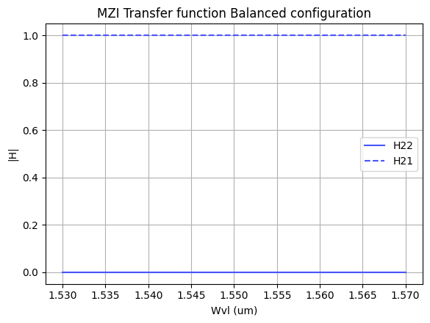

ASSESSMENT #1 – Recap from theory – MZI configurations
SOI Balanced configuration
Why does a perfectly balanced MZI ($ΔL = 0$, identical arms and 50:50 couplers) not exhibit spectral periodicity?
On a MZI transmission depends on a phase difference
$$Δφ_{ud}=β_{u}\left(λ\right)L_{u}−β_{d}\left(λ\right)L_{d}$$
If the MZI is perfectly balanced
$$ΔL=0 , Δβ= 0 , Δφ= 0$$
Which means there is no wavelenght-dependence interference; therefore, no periodic maxima or minima appear, and the transmission remains constant with wavelength.

Slide 5
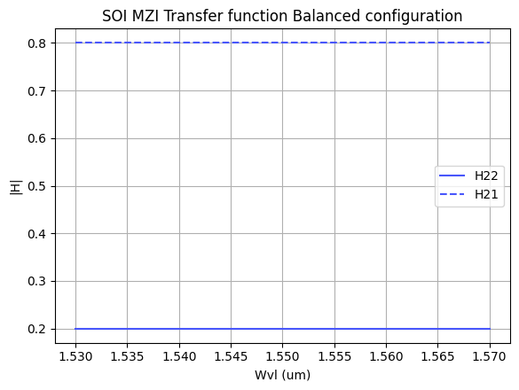
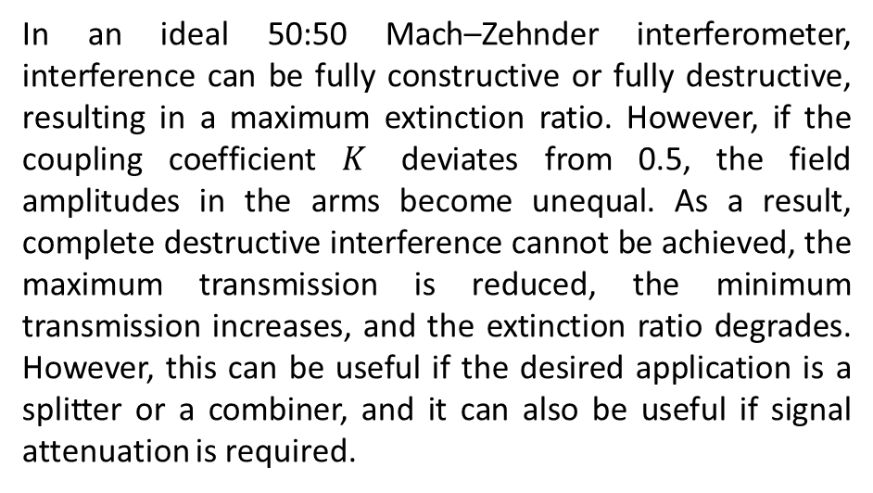
ASSESSMENT #1 – Recap from theory – MZI configurations
SOI Balanced configuration
What happens to the output transmission if the coupling ratio deviates from 50:50?
In an ideal 50:50 Mach–Zehnder interferometer, interference can be fully constructive or fully destructive, resulting in a maximum extinction ratio. However, if the coupling coefficient $K$ deviates from 0.5, the field amplitudes in the arms become unequal. As a result, complete destructive interference cannot be achieved, the maximum transmission is reduced, the minimum transmission increases, and the extinction ratio degrades. However, this can be useful if the desired application is a splitter or a combiner, and it can also be useful if signal attenuation is required.

Slide 6


ASSESSMENT #1 – Recap from theory – MZI configurations
SOI Balanced configuration
How does excess loss $(γ≠0$) affect the output ports in a balanced MZI?
If in some scenario one of the arms produces a different attenuation, as mentioned before, the amplitudes in the arms are not equal, and the same phenomenon observed when the couplers are not 50:50 occurs. There is no complete destructive interference, the maximum decreases, and the extinction ratio is reduced.

Slide 7
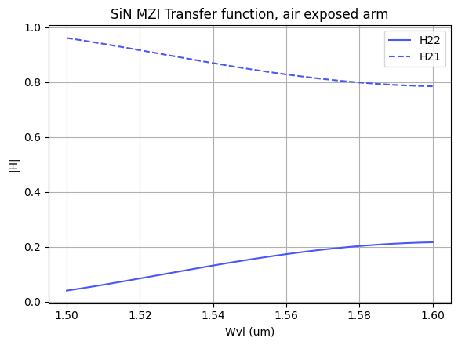
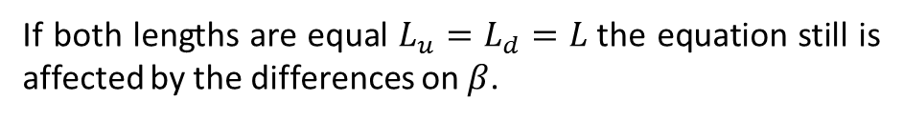

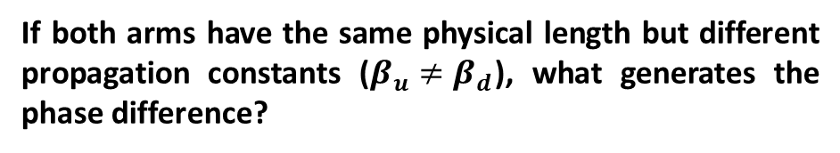

ASSESSMENT #1 – Recap from theory – MZI configurations
SOI Unbalanced configuration, phase difference
If both arms have the same physical length but different propagation constants ($β_{u}≠β_{d}$), what generates the phase difference?
As mentioned before the phase difference on a MZI comes from the following expression.
$$Δφ_{ud}=β_{u}\left(λ\right)L_{u}−β_{d}\left(λ\right)L_{d}$$
If both lengths are equal $L_{u}=L_{d}=L$the equation still is affected by the differences on $β$.
$$Δφ_{ud}=\left(β_{u}\left(λ\right)−β_{d}\left(λ\right)\right)L$$
For this example, one branch of the MZI has a cladding of SOI and the other branch has its core exposed to air.

Slide 8


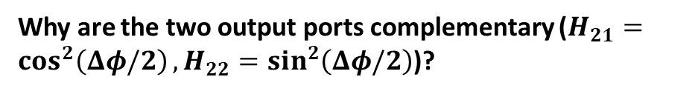

ASSESSMENT #1 – Recap from theory – MZI configurations
SOI Unbalanced configuration, phase difference
Why are the two output ports complementary ($H_{21}=\cos^{2}\left(Δφ/2\right),H_{22}=\sin^{2}\left(Δφ/2\right)$)?
Under what condition can the MZI behave as a tunable power coupler rather than a wavelength filter?
To understand why are complementary we can make use of the following identity:
If the phase difference depends on the wavelength, the device operates as a wavelength filter. However, if the phase difference does not depend on the wavelength and can be externally controlled, the device can operate as a tunable power coupler. Since making the interferometer arms physically longer or shorter is not practical, the phase difference is typically controlled by modifying the propagation constant $β$. This can be achieved by changing the effective index of one of the waveguides, for example through temperature variations (thermo-optic effect), carrier injection, or by exposing the core of the fiber to an external medium that modifies the effective index of the waveguide.
$$\cos^{2}\left(x\right)+\sin^{2}\left(x\right)=1$$
Which means that our outputs have the following behavior:
$$H_{21}+H_{22}=1$$
This means that the power that does not exit through one port exits through the other port. When one output reaches a maximum, the other reaches a minimum. The MZI does not generate power; it only redistributes the optical power between the two output ports.

Slide 9
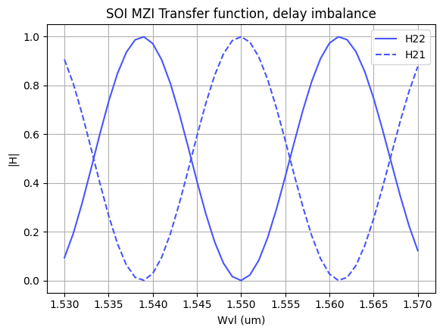


ASSESSMENT #1 – Recap from theory – MZI configurations
SOI Unbalanced configuration, delay imbalance
How does increasing the path length difference $ΔL$ affect the Free Spectral Range (FSR)?
By definition, the FSR is related to the path length difference of a MZI through the following expression.
$$FSR=\frac{λ_{0}^{2}}{n_{g}\left(λ_{0}\right)∗ΔL}$$
Therefore, as the path length difference increases, the Free Spectral Range (FSR) decreases.

Slide 10
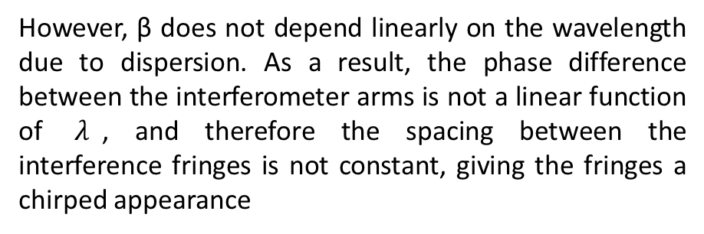
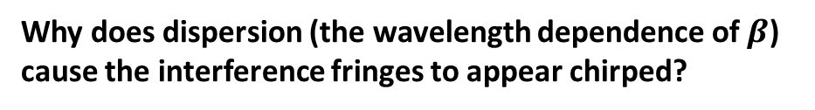
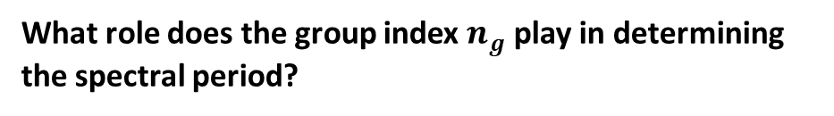


ASSESSMENT #1 – Recap from theory – MZI configurations
SOI Unbalanced configuration, phase difference
Why does dispersion (the wavelength dependence of $β$) cause the interference fringes to appear chirped?
What role does the group index $n_{g}$ play in determining the spectral period?
As mentioned before the change on the fringes are related to the phase difference
$$FSR=\frac{λ^{2}}{n_{g}ΔL}$$
$$Δφ_{ud}=β_{u}\left(λ\right)L_{u}−β_{d}\left(λ\right)L_{d}$$
However, β does not depend linearly on the wavelength due to dispersion. As a result, the phase difference between the interferometer arms is not a linear function of $λ$, and therefore the spacing between the interference fringes is not constant, giving the fringes a chirped appearance
$$β\left(λ\right)=\frac{2πn_{\text{eff}}\left(λ\right)}{λ}$$

Slide 11
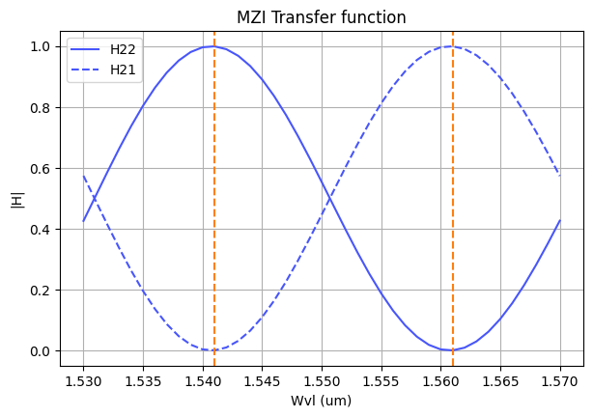


ASSESSMENT #2 – Recap from theory – Calculation of $ΔL$
Considering the n_{eff} values for the SOI cross-section, what would be the path difference ($ΔL= L_{u} −L_{d}$) needed to obtain a Free Spectral Range of 40 nm? Introduce the obtained value in the model to check the MZI response.
Hint: We assume 1550 nm as the central design wavelength ($λ_{0}=$1550 nm).
From the recorded values of the effective index $n_{\text{eff}}$ at different wavelengths for the SOI waveguide, it is possible to calculate the group index $n_{g}$using the following equation:
$$ng=n\text{eff}−λ\frac{dn_{\text{eff}}}{dλ}$$
Using this value, the length difference between the two interferometer arms can be calculated for a desired FSR of 40 nm.
$$ΔL=\frac{λ_{0}^{2}}{n_{g},\text{FSR}}$$
The results are $n_{g}=4,3$and $ΔL = 14000 nm$
20 nm
40 nm for next peak

Slide 12
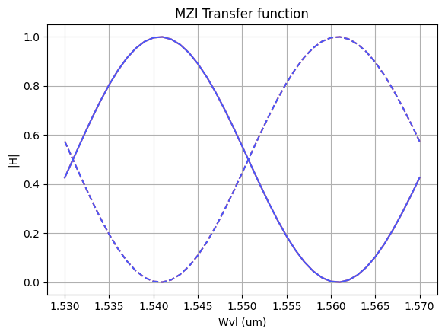
ASSESSMENT #3 – SAX implementation
Now, we are going to implement the design parameters in the MZI model developed in SAX and compare the response obtained with the one simulated by mathematical formulation. This will help us to identify any error in the definition of the SAX model single components.
In order to implement the SAX model, take as example the following lines:
mzi_test = mzi(wl=wl,
coup_a = ...
wvg_d={"length": l_d, "neff": ...},
wvg_u={"length": l_u, "neff": ...},
coup_b = ... )
H00 = mzi_test["in0", "out0"]

Slide 13
Extra assessments
Assessment 4. Design an MZI for filtering at a specific wavelength. Calculate and adjust the arm lengths to configure the MZI to have a maximum transmission at 1550 nm.
Assessment 5. Let's see how the response of the MZI varies with the effective index. Vary the effective index of one of the arms and analyze how the spectrum shifts. To do this, you can use the data provided in the .txt files entitled ‘SiN’. Can you give an example of an application where this configuration is used?
Advanced level assessment. Explore how cascading two MZIs affects the transmission spectrum. To do so, design a system in which two MZIs are cascaded. Simulate and observe the spectrum, explaining how the transmission peaks behave.
Document all your results

Slide 14

Thank you

