Slide 1

LAB EXERCISE 2(TWO)
Oluwanifemi OYEWOLE

Slide 2
Exercise 1
An algorithm for solving a quadratic equation.
Pseudocode
INPUT A
INPUT B
INPUT C
COMPUTE X1 =[(B^2)+(B – {4}*{A}*{C})^(1/2)] / (2 * A)
COMPUTE X2 =[(B^2) - (B – {4}*{A}*{C})^(1/2)] / (2 * A)
PRINT X1
PRINT X2

Slide 3
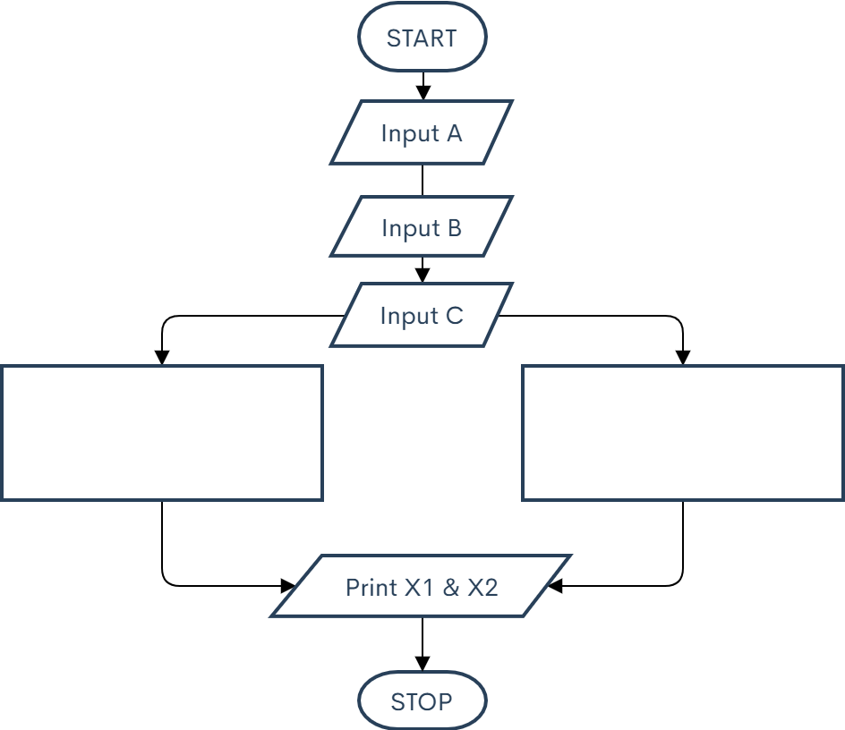


Exercise 1 contd.
Flowchart
$$x_{1}=\frac{−b−\sqrt{b^{2}−4ac}}{2a}$$
$$x_{2}=\frac{−b+\sqrt{b^{2}−4ac}}{2a}$$

Slide 4
Exercise 2
An algorithm for solving a Cubic equation.
Pseudocode
INPUT A
INPUT B
INPUT C
INPUT D
Compute the factors of D
Substitute the factors of D into the positions of the variable to find which factor gives zero
Value is represented as R
COMPUTE (x + R*[-1]) = 0
COMPUTE (Original cubic equation) / (x + R*[-1]) , using the long division method
Factorize the quadratic quotient that resulted from the division
WHILE S and T are the other factors
PRINT (x + R*[-1])
PRINT (x + S)
PRINT (x + T)

Slide 5
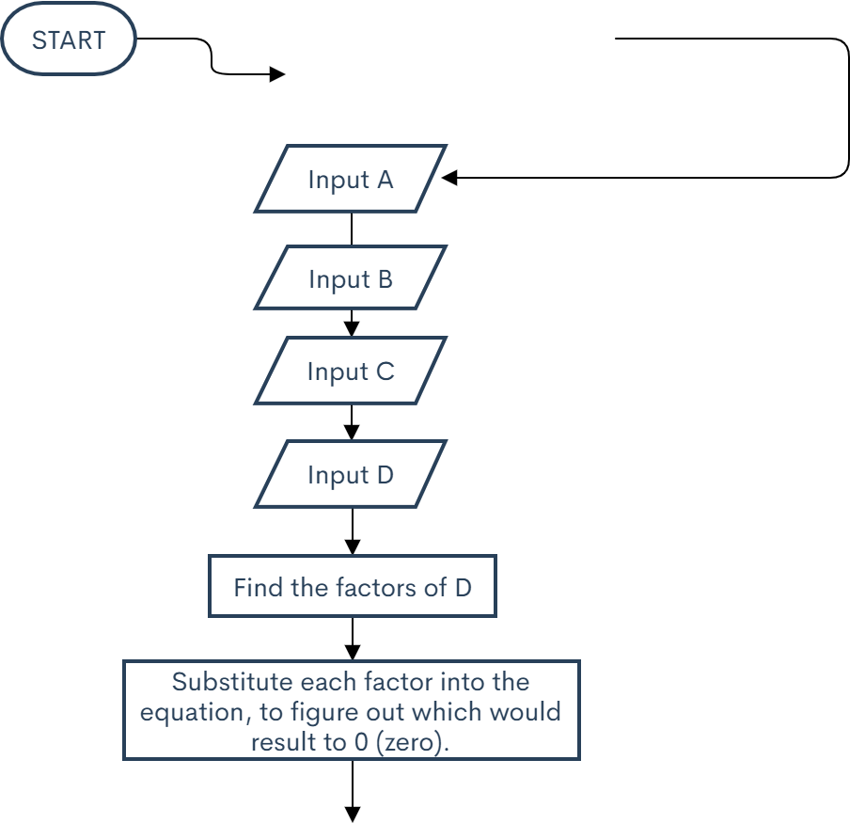
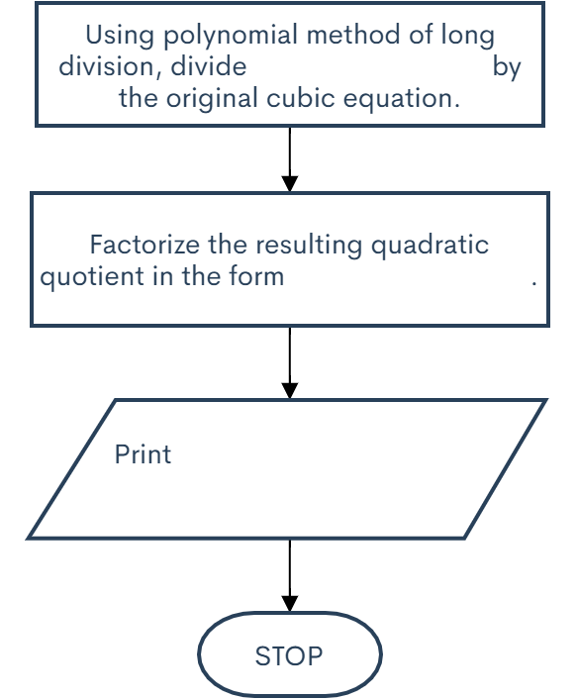
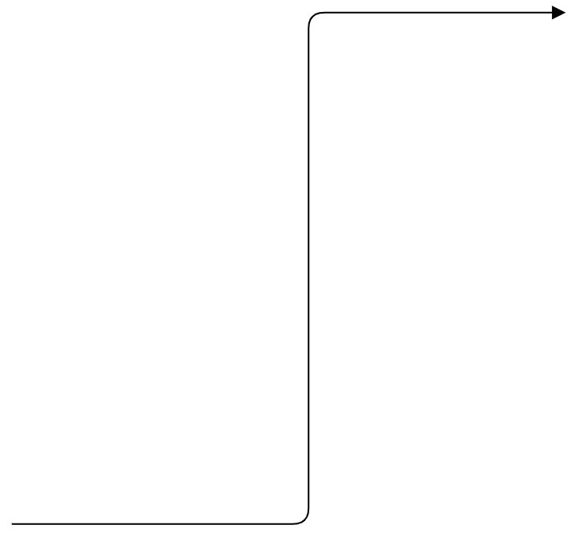





Exercise 2 contd.
Cubic equation in the form:
$$Ax^{3}+Bx^{2}+Cx+D.$$
Flowchart
$$x+\left(R∗\left[−1\right]\right)$$
$$(x+ ?)(x + ?)$$
$$x+\left(R∗\left[−1\right]\right)$$
$$(x+ ?)(x + ?)$$
Resulting value is represented as ‘R’
Since ‘R’ is a factor,
$$x+\left(R∗\left[−1\right]\right)=0$$

Slide 6
Exercise 3
An algorithm to find the largest of three numbers.
Pseudocode
INPUT A
INPUT B
INPUT C
If A is the greatest, PRINT A
If B is the greatest, PRINT B
If C is the greatest, PRINT C

Slide 7
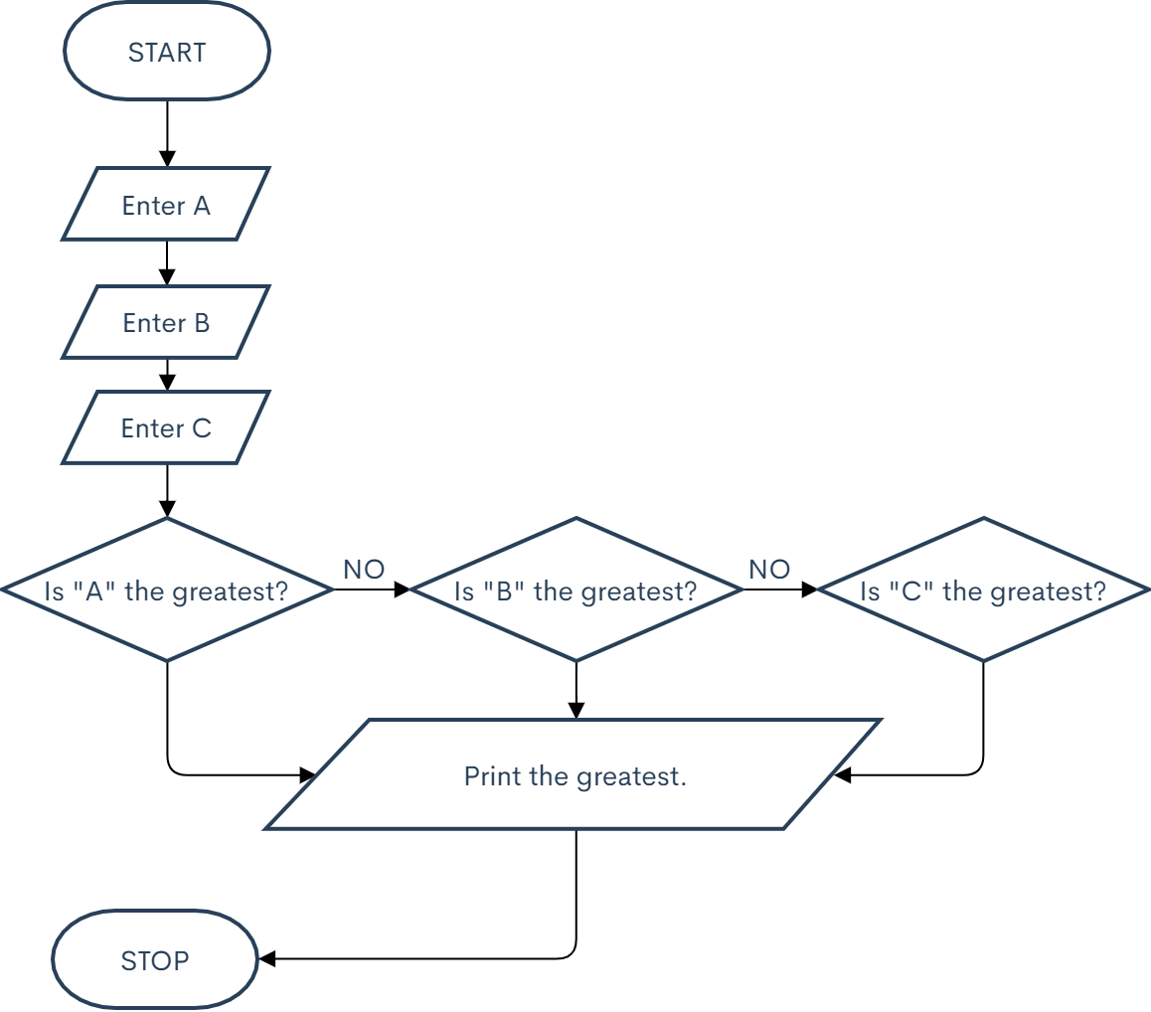
Exercise 3 contd.
Flowchart
YES
YES
YES

Slide 8
Exercise 4 (I)
An algorithm to find the LCM of two numbers.
Pseudocode
INPUT A
INPUT B
Z = Lowest number that can divide anyone of A or B
Store the value of Z used in each instance
IF both A and B are 1, multiply all values of Z
IF A/Z is a whole number, store the value of Z and return the new result as A and go back to step three
ELSE, return the same value and perform step three again
IF both A and B are 1, multiply all values of Z
IF B/Z is a whole number, store the value of Z and return the new result as B and go back to step three
ELSE, return the same value and perform step three again
IF both A and B are 1, multiply all values of Z
PRINT the multiplication of all the values of Z

Slide 9
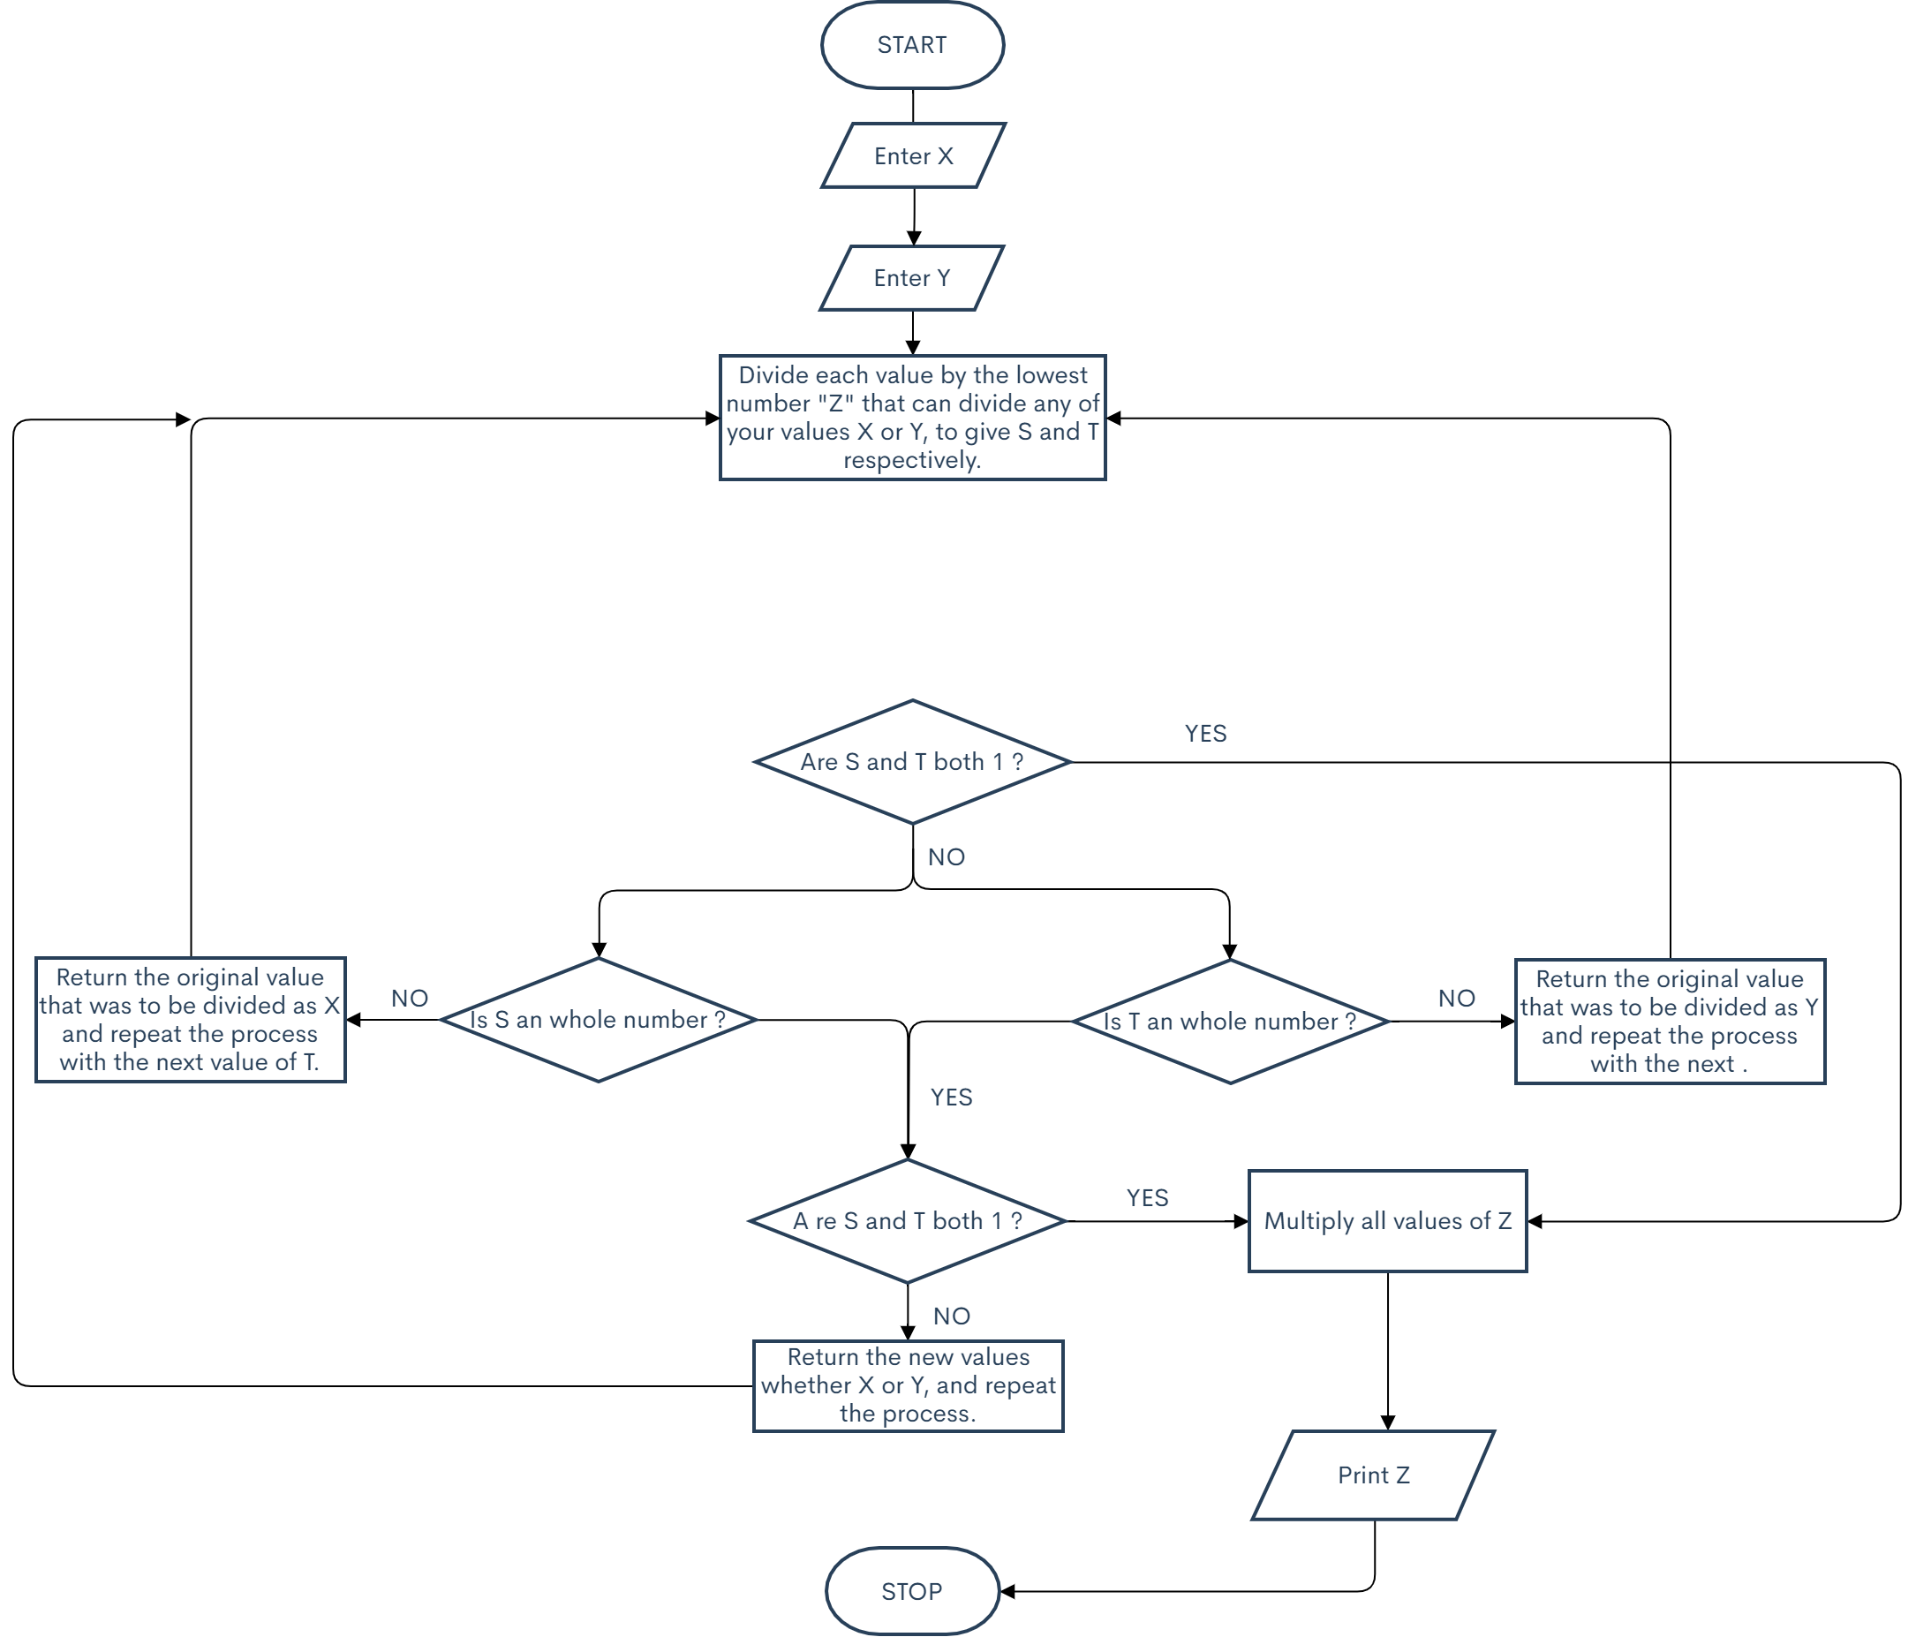
Exercise 4 (I) contd.
Flowchart
Store Z
Print result.

Slide 10
Exercise 4 (II)
An algorithm to find the GCD of two numbers.
Pseudocode
INPUT A
INPUT B
Z = Lowest number that can divide both A and B
Store the value of Z used in each instance
IF both A and B are 1, multiply all values of Z
Z = Lowest number that can divide both A and B
COMPUTE A/Z = S
COMPUTE B/Z = T
WHEN Z = 1, multiply all values of Z and end operation
Return S and T as new values of A and B respectively, and proceed to step three

Slide 11
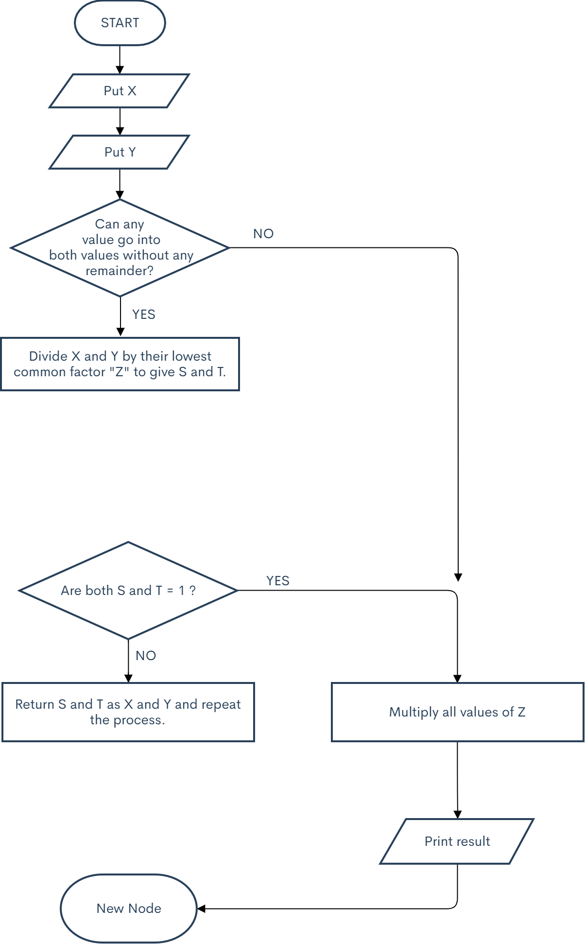
Exercise 4 (II) contd.
Flowchart
Store Z

Slide 12
Exercise 5
An algorithm to calculate the factorial of a number.
Pseudocode
ENTER the desired value “X”
COMPUTE F = X * (X – 1)
STORE F
IF F = 1, end operation and multiply all values of F
Return F and go back to step two
IF F = 1, end operation and multiply all values of F
Multiply all values of F
DISPLAY result of the multiplication

Slide 13
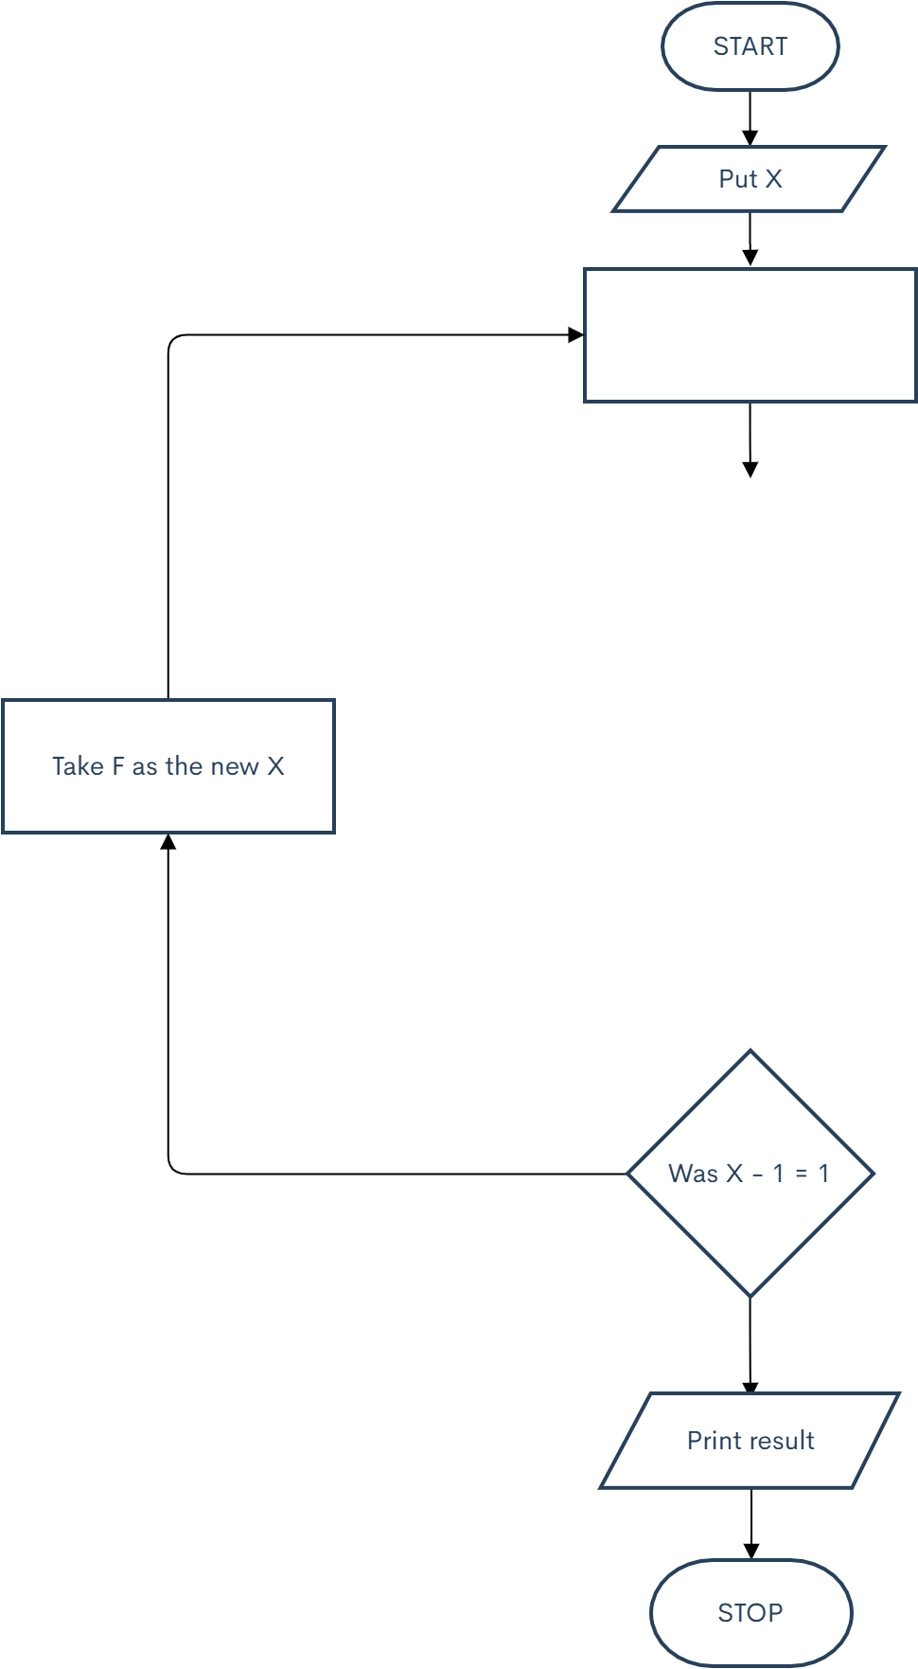

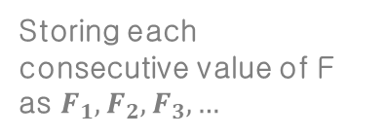
Exercise 5 contd.
$$F=x×(x −1)$$
Flowchart
Store F
Storing each consecutive value of F as $F_{1}, F_{2}, F_{3},…$

