Slide 1
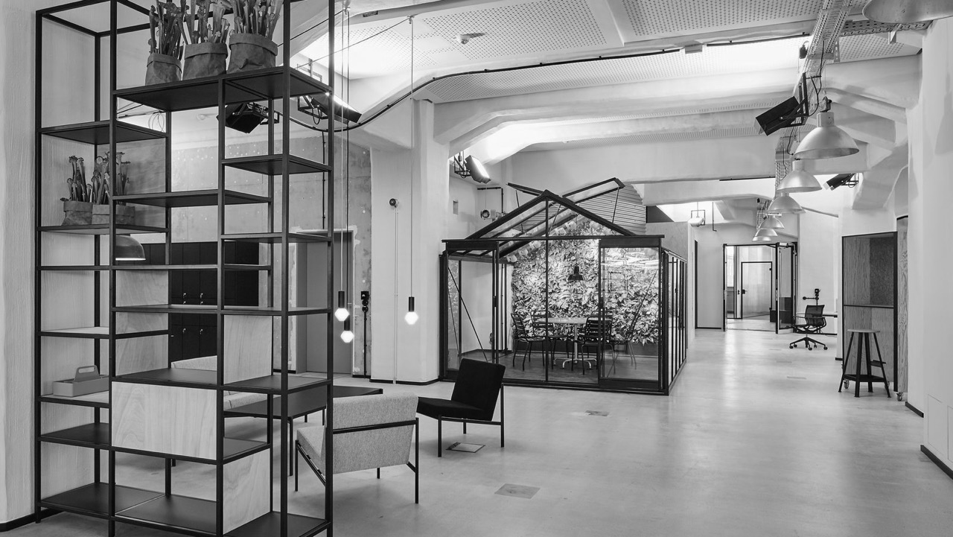
Shopping mall analysis of city of Warsaw
Coursera Capstone Project

Slide 2
Polish retail real-estate market continues to boom
INTRODUCTION
The first quarter of 2019 indicates continued strong interest in investing in Poland. What is more, our practice and market data show the group of active investors has grown since last year.
Modern retail stock
Average purchasing power per inhabitant Poland/Warsaw
Average density per 1000 inhabitants
14.3m m²
€7200/ €12,500
311 m²
Average vacancy rate in 6 major cities
New supply (2018)
Prime rent in Warsaw
3.9%
430,000 m²
€110-130 m²/month

Slide 3
Our understanding of your problem
INTRODUCTION
With the ambition to take advantage of growing boom in retail real-estate market, you are looking to open/acquire a shopping mall in Warsaw
In order to understand the commercial real-estate market better, the following key questions need to be answered:
What is the current landscape of the shopping centers/retail parks/high streets in the city of Warsaw?
What is the typical size?
Are they relatively modern construction or older?
What is their distribution in terms of their location (city-center, office district, residential district, suburbs etc.)
How are malls that are situated in city center/commercial district different from those situated in residential districts in terms of size and store formats?
Given, the client is looking to open/acquire a large shopping mall (60000 sq.m) near city center, what should be the typical stores in the mall based on current environment
1
2
3

Slide 4
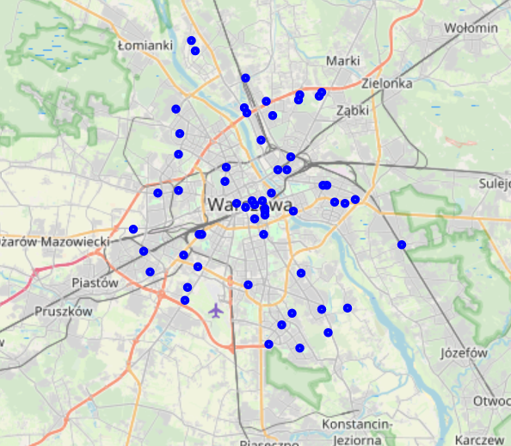
Shopping centers in Warsaw vary across size and format
INTRODUCTION
We see that currently there are 60 shopping centers in city of Warsaw with varied formats, ranging from traditional malls to high street. We have also included the malls which are currently planned or under construction to see short/medium term overview of the market
Type of mall | Number (#)
Traditional | 38
Mixed-use | 7
Retail park | 5
Specialty mall | 4
High street | 4
Outlet | 2
Total | 60
Status | Number (#)
Open | 50
In construction | 7
Planned | 2
Closed | 1
Total | 60

Slide 5
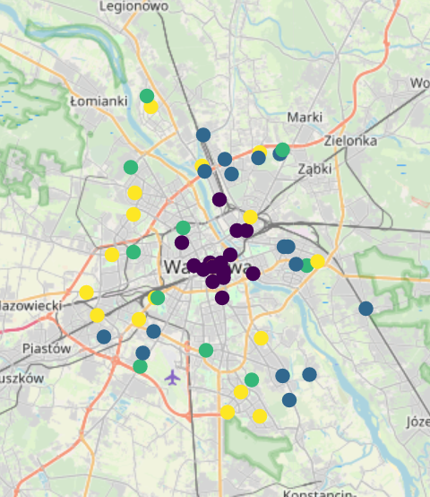
Current landscape of shopping centers in Warsaw
1
SHOPPING CENTERS SEGMENTS
Analysing the shopping centers based on size, years since operation and distance from center, we have identified four segments of shopping centers
FOUR SEGMENTS OF SHOPPING CENTERS
Cluster 0: Older, medium sized malls, located in residential districts
Cluster 1: Smaller sized units, located near city-center
Cluster 2:New/upcoming centers, mainly medium sized, located in residential districts
Cluster 3:Middle aged, large sized malls, located in business districts of Warsaw

Slide 6
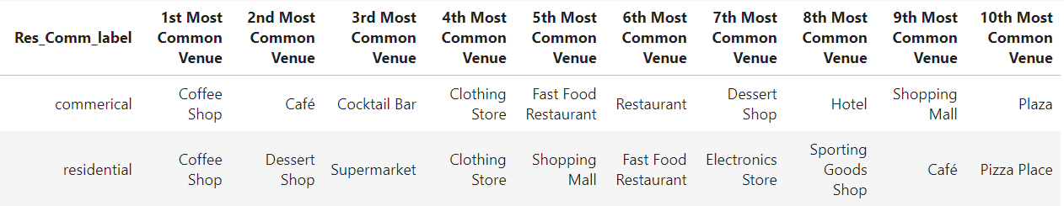
Difference in store formats of residential and commercial located shopping centes
2
STORE FORMATS
What we see from the above table is that the category of stores in shopping malls located in city center/commercial districts of Warsaw are more 'entertainment based' with focus on cafes, cocktail bars, restaurants. This could be influenced by the factor that these districts also attract a large volume of tourists.
On the other hand, the shopping malls located in residential districts dominate in 'utility based' stores such as Supermarket, Electronics store and sporting goods shop. These stores are family oriented and exist to cater to household needs of the city.

Slide 7
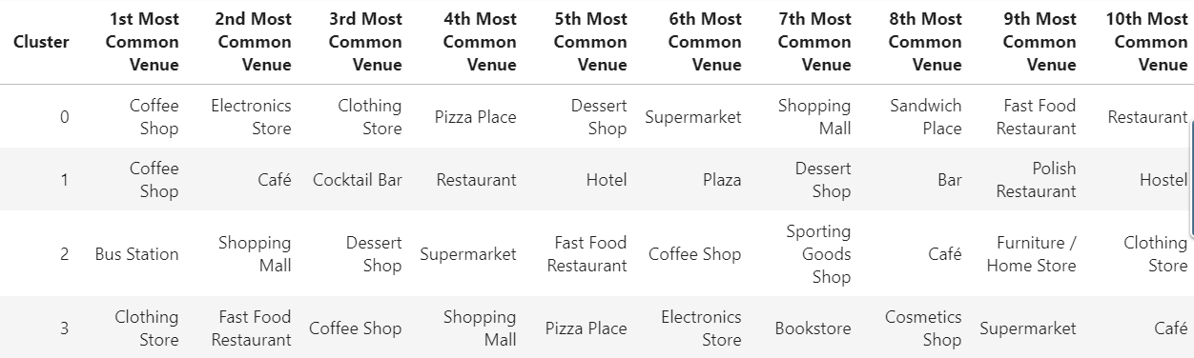
Store formats for large mall near city center
3
STORE FORMATS
As we see from the table, the cluster 3 shopping malls have a wide variety of store category including fast food restaurants, clothing store, Electronic stores and supermarket. These malls, owing to their size and location, are designed to cater to most of the needs of the visitors, that is both, entertainment based and utility based.

