Slide 1
Digital Asset Distribution System case
Nikita Politaev

Slide 2
Requirements
An application needs to be in place for content distribution so the digital platforms can consume it.
The application must expose content and metadata through an interface that can be easily consumed by digital platform developers as the briefing and order process.
+ Examples of metadata files

Slide 3
Requirements (based on the metadata)
The OrderListMetadata is the format for requests
AssetMetadata and BriefingMetadata represent the aggregated data responses
ContentDistributionMetadata is the comprehensive output of the content distribution platform.

Slide 4
Requirements (complexities)
The app has a backend where they aggregate data from many different domains
There are some missing link between BriefingMetadata and OrderListMetadata
The ContentDistribution file must come from cached or an equivalent solution for a local application
Solution must be designed to run in containers

Slide 5
Personal complexities
Limited knowledge of C#
No time to learn it before starting to work on the case

Slide 6
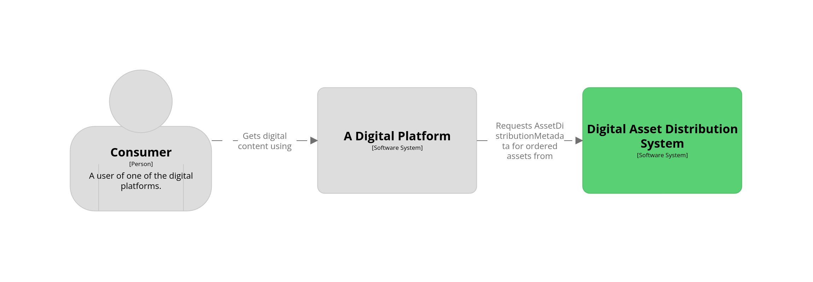
Solution diagram. System Context level

Slide 7
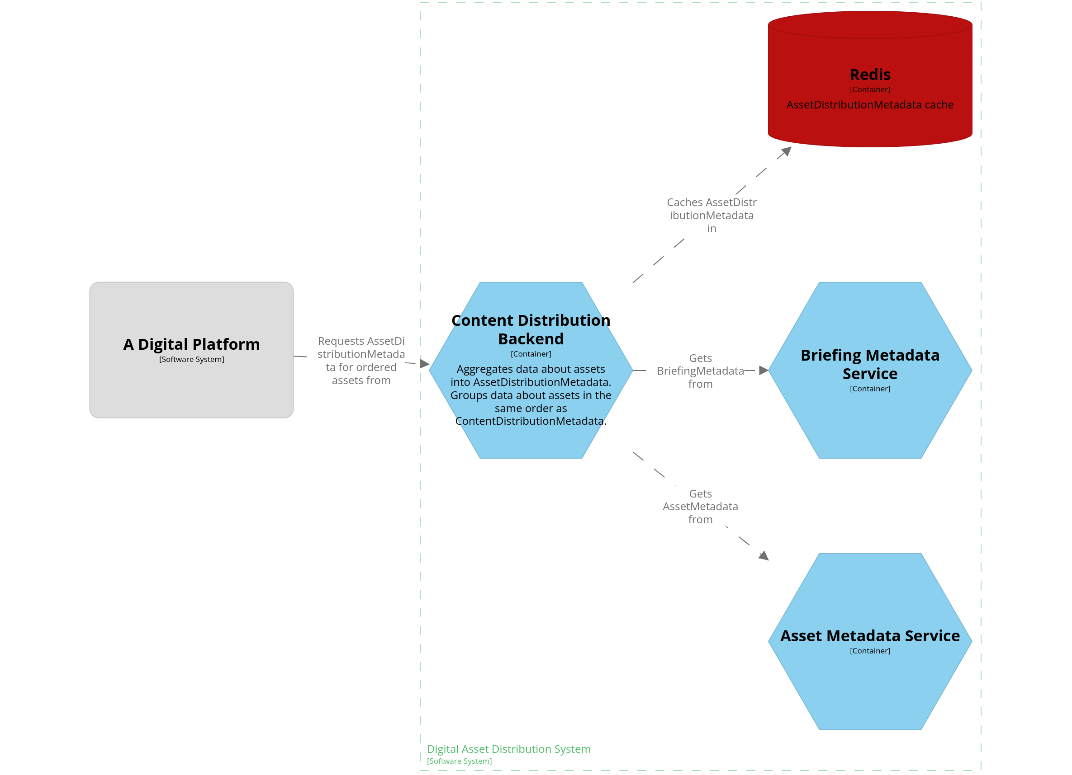
Solution diagram. Container level

Slide 8
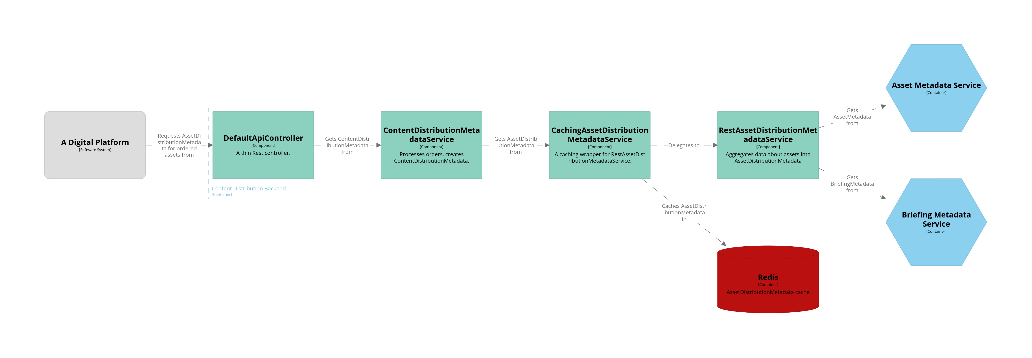
Solution diagram. Component level

Slide 9
Working around the lack of C# knowledge
Describe APIs in Swagger and generate the project code
Use hints from an IDE (tried ChatGPT, but it wasn’t helping)
Implementing only the “happy” flow
Using the simplest project setup:
Not using dependency injection
Hard-coding all the constants
Not writing tests
No security

Slide 10
Next steps. Technical
Pair-programming to improve code quality in a sense of following C# code conventions
Add tests and handle corner cases in the code (can be split into independent tickets)
Add security
Find out how BriefingMetadata is linked to an asset
Configure a Service Mesh (e.g. Istio)
Deploy to EKS/AKS using IaC (e.g. OpenTofu)

Slide 11
Next steps. Product
Present how the system works now. Does the flow make sense? Can the components have better names?
Discuss why is the metadata split this way. Is there a better way to organize it?
Does the metadata change over time? If so, how?
What are the requirements for the content delivery to the end consumer? Try to model it with less intermediate steps.
What else can the aggregated metadata be used for?

