Slide 1
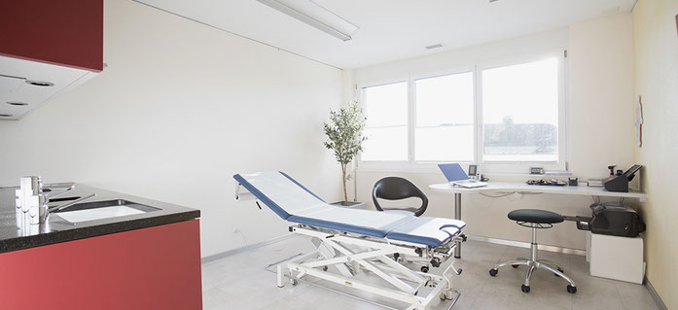
Task 1 – Doktor / Sucht
David Gaupp, Miletic Marko, Selvasingham Sugeelan, Velkov Viktor, Janahan Sellathurai, Alain Nippel

Slide 2
Inhalt
Storyboards
Literaturrecherche

Slide 3
Storyboard 1

Slide 4
Storyboard 2

Slide 5
Storyboard 3

Slide 6
Literaturrecherche

Slide 7


