Slide 1
CHINOOK MUSIC RECORDS
Strategic Analysis of the
Physical Music Market
Data-Driven Recommendations for Market Strategy
SQL Data Analytics Project | Submitted by Nippa

Slide 2

INTRODUCTION
About Chinook Music
01
Founded in 1995, Chinook Music Service has grown to become a trusted name in North Central Washington for quality musical instruments, accessories, rentals, and professional repairs.
Our dedicated team of music specialists and educators is passionate about helping musicians of all levels—from school bands to touring artists—find the right gear and support they need.
We proudly partner with local schools, music programs, and performers, offering reliable rentals and maintenance services to keep the music playing.
For more information : https://chinookmusic.com/
02
03
04
05
Data Foundation
Sales & Market
Customer Intelligence
Churn & Risk
Recommendations
Schema, missing values & data quality
Genre, artist, track & geo revenue
Demographics, top customers, behavior
Churn rate, inactivity, risk profiling, CLV
Promo albums, cross-sell, retention, campaigns

Slide 3
PROBLEM STATEMENT
Business Objective
Central Question
How can Chinook leverage its music sales data to drive growth and refine its strategy in the physical music market?
01
02
03
04
05
Data Foundation
Three Analytical Pillars
Sales & Market
Customer Intelligence
Churn & Risk
Recommendations
1. Understand the market
2. Know the Customer
3. Shape the Strategy
Schema, missing values & data quality
Demographics, top customers, behavior
Churn rate, inactivity, risk profiling, CLV
Promo albums, cross-sell, retention, campaigns
Which genres, artists & tracks lead USA sales?
___________________________
How does performance vary across geographies?
___________________________
What % of total sales does each genre command?
Who are the top revenue customers by country?
_________________________
What are the purchase behavior & spending patterns?
_________________________
Which customers are at risk of churning?
Which albums should be prioritized for promotion?
_________________________
How can cross-selling & bundling drive revenue?
_________________________
What re-engagement & retention actions to take?

Slide 4
AGENDA
Presentation Roadmap — Five Analytical Section
01
02
03
04
05
Data Foundation
Sales & Market
Customer Intelligence
Churn & Risk
Recommendations
Schema, project overflow, missing values & data quality
Genre, artist, track & geo revenue
Demographics, top customers, behavior
Churn rate, inactivity, risk profiling, CLV
Promo albums, cross-sell, retention, campaigns

Slide 5
EXECUTIVE SUMMARY
Five Key Findings — Conclusions First
Rock Dominates USA & Global Sales
100% Regional Churn in Key Cities
Rock is #1 genre in USA sales by total revenue. Alt & Punk #2, Metal #3. Consistent pattern internationally.
All analyzed cities show 100% churn rate over 1 year. Overall rate is 1.85% — regional picture is alarming.
Top 5 Customers Drive Disproportionate Revenue
Metal–Rock = Top Cross-Selling Pair
Top-ranked customers by country contribute the majority of regional revenue — VIP management is critical.
986 co-purchases of Metal & Rock — the highest affinity pair. Unlocks bundling & upselling potential.
Purchase Activity Declined 2017–2020
Year-wise analysis shows a clear decreasing trend in purchases across all customers heading into 2020.

Slide 6
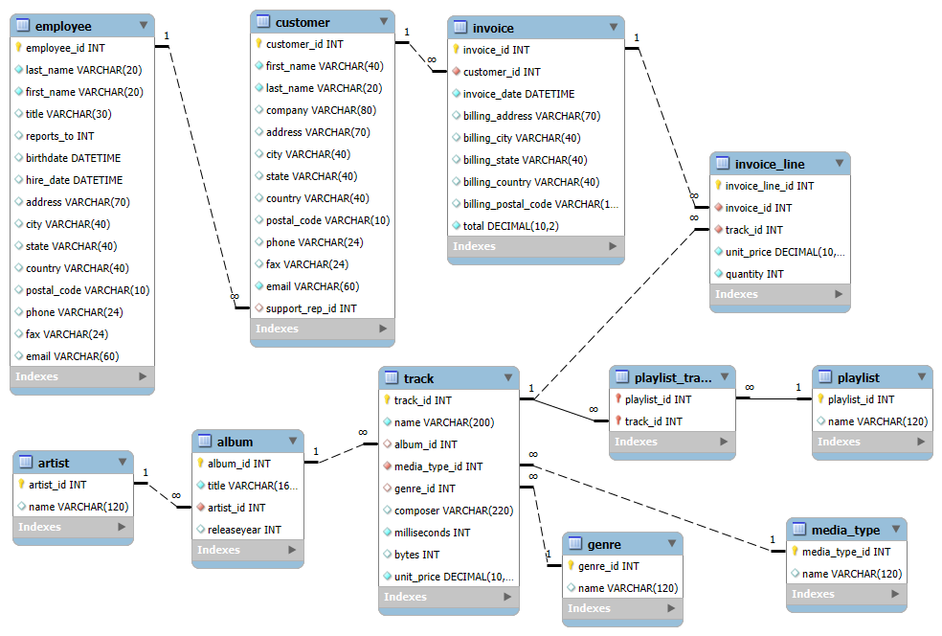
SECTION 1 · DATA FOUNDATION
Database Schema
Genre
Invoice
Album
InvoiceLine
Artist
Track
Employee

Slide 7
SECTION 1 · DATA FOUNDATION
Project Overflow
Data Collection:
Extracted raw data from the Chinook SQL database (customers, invoices, invoice_line, employee, tracks, albums, artists, genres, media_type, playlist, playlist_track).
Data Cleaning:
Identified and removed duplicates and NULL values using SQL (COALESCE, DISTINCT).
ERD Creation:
Built an ERD to understand table relationships and guide join operations.
SQL Analysis:
Used joins, CTEs, aggregations, and window functions (RANK, ROW_NUMBER) to analyze sales, customers, and genres.
Segmentation & Insights:
Segmented data by country, genre, and customer behavior; identified churn and purchase patterns.
Reporting:
Created PowerPoint slides with visual insights and strategic recommendations.
Genre
Invoice
Album
Artist
Track
Employee

Slide 8
SECTION 1 · DATA FOUNDATION
Data Quality & Schema — A Clean Foundation for Analysis
Tables with Missing Values
8 Tables Used in Analysis
Table | Affected Columns | Resolution
Customer | company, state, postal_code, phone, fax | COALESCE() → Default text
Employee | reports_to | COALESCE() → 'Not Available'
Track | composer, milliseconds | COALESCE() → Default values
Customer
Genre
Invoice
Album
InvoiceLine
Artist
💡 Key Principle
Track
Employee
No records were deleted. All null values were handled with COALESCE() to preserve data integrity and ensure reliable downstream analysis.

Slide 9
SECTION 2 · SALES & MARKET PERFORMANCE
USA Genre Rankings — Rock Commands the Market
Sales Rank
Rank | Genre | USD
#1 | Rock | $826.65
#2 | Metal | $261.36
#3 | Alt & Punk | $241.56
#4 | Jazz | $79.2
#5 | R&B/Soul | $53.46
#6 | Latin | $48.68
#7 | Blues | $36.63
#8 | Reggae | $29.7
🎸 Rock alone accounts for >50% of USA genre revenue

Slide 10
SECTION 2 · SALES & MARKET PERFORMANCE
Top Tracks, Artists & Genres Driving USA Revenue
🎵 Top Tracks
🎤 Top Artists
🎼 Top Genres
Track Name | Qty
Balls to the Wall | 2
Restless and Wild | 2
Put The Finger On You | 1
Inject The Venom | 1
Evil Walks | 1
Artist Name | Qty
Iron Maiden | 8
U2 | 7
Metallica | 6
Led Zeppelin | 5
Lost | 4
Genre | Count
Rock | 561
Metal | 124
Alternative & Punk | 130
Latin | 386
Jazz | 14

Slide 11
SECTION 2 · SALES & MARKET PERFORMANCE
Revenue by Geography — USA & Czech Republic Lead
Objective Q4 — Total revenue and invoices by country
Top Cities by Revenue
City | Country | Revenue
Prague | CZ | $273
Mountain View | USA | $37
São Paulo | BR | $28
Dublin | IE | $24
London | UK | $18
Prague (Czech Republic) records highest city-level spending — strong candidate for loyalty upselling programs.

Slide 12
SECTION 2 · SALES & MARKET PERFORMANCE
International Markets — Rock & Metal Lead Global Sales
Subjective Q2 — Non-USA genre analysis
Rock dominates both USA and international markets — a unified global genre strategy anchored in Rock is viable.

Slide 13
SECTION 3 · CUSTOMER INTELLIGENCE
Customer Base — Location-Driven Demographics Across 24 Countries
Objective Q3 — No age/gender data; location-based breakdown only
Key Observations
🌍 24 countries represented in the customer database
USA has the largest customer base with 13 customers
❌ No age or gender data available — location-only analysis
📍 Top cities: Prague, São Paulo, London, Mountain View
📊 Missing state field in many records limits state-level drill-down
Recommendation: Enrich dataset with age/gender for precision targeting.

Slide 14
SECTION 3 · CUSTOMER INTELLIGENCE
Top 5 Revenue Customers per Country — High-Value Accounts Identified
Objective Q5 & Q6 — RANK() window function applied
Country | Rank | Customer Name | Total Revenue | Top Track
USA | #1 | Frank Harris | $37.62 | Rock Track
Czech Republic | #1 | František Wichterlová | $144.54 | Rock Track
Canada | #1 | Mark Philips | $99.99 | Metal Track
Brazil | #1 | Luís Gonçalves | $108.90 | Latin Track
Germany | #1 | Hannah Schneider | $56.94 | Rock Track
France | #1 | Wyatt Girard | $99.99 | Rock Track
Ireland | #1 | Hugh O'Reilly | $114.84 | Rock Track
Implement VIP account management — top-ranked customers per country represent outsized revenue potential. Prioritize personalized engagement.

Slide 15
SECTION 3 · CUSTOMER INTELLIGENCE
Purchase Behavior — Declining Activity 2017–2020 Signals Disengagement
Avg Invoice Value by Customer (Top 8)
Average order value ~$9.77 across all customers
⚠️ Clear downward trend in purchases 2017→2020. No new customers after 2017 — acquisition pipeline is empty.

Slide 16
SECTION 3 · CUSTOMER INTELLIGENCE
Customer Segmentation — Long-Term Customers Dominate, No New Acquisition
80.63
80.63
$805
$9.77
Avg Purchase
Frequency
Avg Basket
Size (items)
Avg Total
Spend
Avg Order
Value
Customer Type Comparison
Segment | Count | Avg Spend | Avg Frequency | Status
Long-Term Customers | 59 | $805 | 80.6x | Active — historical
New Customers (recent) | 0 | — | — | None identified
⚠️ Critical Gap: Zero new customers identified in the dataset. The entire customer base consists of long-term buyers. Without new acquisition investment, this is a long-term growth risk — revenue depends entirely on retaining an aging customer cohort.

Slide 17
SECTION 3 · CUSTOMER INTELLIGENCE
Product Affinity — Metal & Rock Are the Cross-Selling Anchor
Genre Co-Purchase Frequency
Top Album Self-Pairings
Album | Times
Big Ones | 348
Facelift | 304
International Superhits | 284
For Those About To Rock | 250
Jagged Little Pill | 223
Are You Experienced? | 205
Customers buying 3+ genres show broadest spending. Rock buyers also buy Metal 986 times — ideal for bundle promotions.
Artist Affinity Pairs
Green Day + Led Zeppelin
Nirvana + The Rolling Stones
Metallica + Iron Maiden
U2 + Red Hot Chili Peppers

Slide 18
SECTION 4 · CHURN & RISK ANALYSIS
Churn Analysis — 1.85% Overall, but 100% City-Level Inactivity
1.85%
100%
1 Year
Overall 1-Year
Churn Rate
Churn Rate in
All Analyzed Cities
Inactivity Threshold
Used for Analysis
Regional Churn — All Cities Show 100% Churn
Country | City | Churn Rate | Implication
Brazil | São Paulo | 100% | Full re-engagement needed
Canada | Montréal | 100% | Full re-engagement needed
USA | Mountain View | 100% | Full re-engagement needed
Germany | Berlin | 100% | Full re-engagement needed
Czech Republic | Prague | 100% | Re-engage despite high spend
Low aggregate churn (1.85%) masks alarming 100% regional inactivity — the aggregate metric is misleading here.

Slide 19
SECTION 4 · CHURN & RISK ANALYSIS
Inactive Customers — 3-Month Inactivity Flags Immediate Re-engagement Targets
Methodology
Sample Inactive Customers
1
LEFT JOIN customer + invoice table to include customers with no recent activity
Customer | Country | Last Purchase
Frank Harris | USA | Dec 2020
Mark Phillips | Canada | Dec 2020
Luís Gonçalves | Brazil | Nov 2020
František Wichterlová | Czech Republic | Dec 2020
Wyatt Girard | France | Nov 2020
Hugh O'Reilly | Ireland | Oct 2020
2
GROUP BY customer ID to evaluate at individual level
3
MAX(invoice_date) used to find most recent purchase per customer
4
FILTER: last purchase > 3 months from current date
All 59 customers in the dataset are classified as inactive under the 3-month threshold — this is your complete re-engagement target list.

Slide 20
SECTION 4 · CHURN & RISK ANALYSIS
Customer Risk Profiling — Three-Tier Risk Classification
Subjective Q6 — Risk, Medium Risk, Low Risk segmentation
🔴 High Risk
Criteria: No purchase in 1+ year | Count: ~25 customers
Action: Win-back campaigns: discounts on past genre preferences, personalized emails
🟡 Medium Risk
Criteria: Moderate spend, limited recent activity | Count: ~20 customers
Action: Loyalty incentives: increase purchase frequency with targeted promotions
🟢 Low Risk
Criteria: Consistent engagement & spending | Count: ~14 customers
Action: Exclusive perks: early access, premium content, loyalty rewards

Slide 21
SECTION 4 · CHURN & RISK ANALYSIS
Customer Lifetime Value — Modeling Future Revenue Potential
Customers by Spending Segment
Customers by Purchase Frequency Segment
• All customers currently inactive — uniform churn signal across all CLV segments
• High-CLV frequent buyers should receive priority retention offers and exclusive perks
• Rare purchasers with high spend are 'dormant whales' — high-impact re-engagement targets
• Tenure analysis: even long-term customers losing interest — proactive re-engagement needed

Slide 22
SECTION 5 · STRATEGIC RECOMMENDATIONS
1. Prioritize R&B/Soul & Rock Albums for USA
#1
#2
#3
Seek And Shall Find:
More Of The Best
From The Muddy Banks
Of The Wishkah [Live]
Are You Experienced?
R&B / Soul
Rock
Rock
Highest total album sales in USA — proven demand & repeat listener base
Strong Rock audience — live album format drives collectible appeal
Classic Rock catalog — enduring audience demand & wide demographic reach

Slide 23
SECTION 5 · STRATEGIC RECOMMENDATIONS
2. Leverage Genre & Artist Affinity for Cross-Selling
🎁
🎧
Genre Bundles
Curated Playlists
Bundle Metal + Rock offerings — 986 co-purchases prove customer appetite. Offer combo discounts.
Cross-genre playlists: Rock × Alt & Punk × Metal to drive discovery and upselling across genres.
🎤
💿
Artist Bundles
Self-Paired Albums
Pair Green Day + Led Zeppelin, Nirvana + Rolling Stones — top artist affinity combinations.
Promote Big Ones (348×), Facelift (304×) via loyalty discounts — high standalone demand.
Metal–Rock is your highest affinity pair with 986 co-purchases. Lead with this pairing in any cross-selling or bundle campaign for maximum revenue lift.

Slide 24
SECTION 5 · STRATEGIC RECOMMENDATIONS
3. Regional Re-engagement & Customer Retention Strategy
⭐ Prague & High-Spend Cities
🔄 100% Churn Cities
(Brazil, Canada, USA, Germany)
🆕 New Customer Acquisition
(Zero new customers found)
Upselling campaigns on premium albums
Personalized win-back emails
Invest in digital acquisition channels
Loyalty program enrollment priority
Discounts on historically purchased genres
Genre-based audience targeting online
Early access to new releases
Lapsed customer reactivation offers
Partner with music platforms for referrals
Dedicated account manager contact
Survey to understand reasons for leaving
Introductory offer for first-time buyers

Slide 25
SECTION 5 · STRATEGIC RECOMMENDATIONS
Measuring Promotional Impact — Campaign Analysis Framework
Subjective Q8 — How to measure campaign effectiveness
📈 Customer Acquisition
🔁 Retention & Repeat
Monitor new customers joining during promotions.
Compare vs non-promo periods to measure lift.
Track new sign-ups, first-time buyers, referral sources.
Observe repeat purchases after campaign ends.
Compare repeat rate vs non-promotional baseline.
Measure whether campaign drove long-term loyalty.
💰 Sales Uplift
🎯 Segmented Response
Revenue during campaign vs comparable non-promo period.
Adjust for seasonal trends and external factors.
Calculate incremental revenue attributable to campaign.
Analyze how different customer groups responded.
Segment by country, spending tier, genre preference.
Identify highest-responding segments for future focus.

Slide 26
Next Steps & Conclusion
⚡ Immediate Actions (0–30 days)
📅 Medium-Term Actions (30–90 days)
1. Launch USA promotional campaign for top 3 albums (R&B/Soul + Rock)
1. Invest in new customer acquisition strategy — zero new customers is unsustainable
2. Deploy risk-tier re-engagement campaigns for High Risk & Medium Risk customers
2. Build CLV tracking dashboard — monitor spending, frequency & tenure monthly
3. Fix address/state data gaps — clean data for better regional segmentation
3. Introduce loyalty program tiers based on spending and purchase frequency segments
Key Takeaway
Chinook's physical music market opportunity is real — Rock and R&B/Soul dominate USA demand, high-value customers exist across 24 countries, and a structured re-engagement and cross-selling strategy can materially recover lapsing revenue. The data signals are clear; the next step is execution.
Thank You.

