Slide 1
Zomato Restaurants Expansion
Submitted by:
Nippa

Slide 2
Industry Snapshot – Key Market Highlights
_____________________________________________________________________________________________________
Factor Data / Insight
Market Size | India’s online food delivery market was valued at USD 31.7 billion in 2024 and is projected to reach USD 140+ billion by 2030.
Market Growth | The industry is expected to grow at ~28% CAGR, driven by urbanization and changing consumer lifestyles.
User Base | The restaurant delivery market is projected to reach 284+ million users by 2030.
Industry Revenue | India’s food delivery sector generated around ₹66,000 crore in 2023 and is expected to reach ₹2.1 lakh crore by 2030.
Platform Reach | Major platforms like Zomato and Swiggy together serve over 50 million monthly active users.
Market Competition | The market is largely dominated by two major players – Zomato and Swiggy, creating strong competition for restaurant partnerships.
Future Demand | Growth is expected to come from Tier-2 and Tier-3 cities, where digital adoption and food delivery demand are increasing rapidly.
Source: GlobeNewswire, Statista, The Times of India, NextLeap

Slide 3
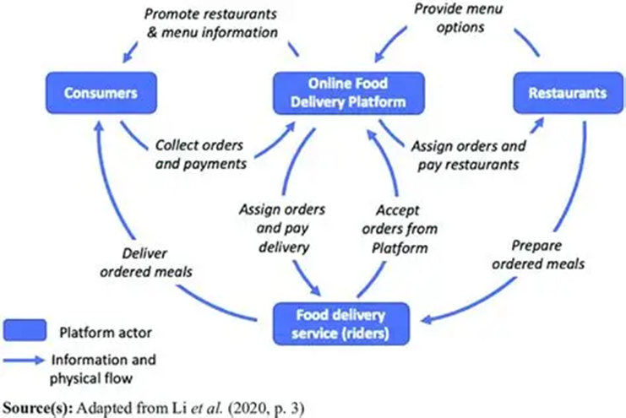
Food Delivery Ecosystem
_____________________________________________________________________________________________________
Why this Industry Analysis Matters?
Supports data-driven restaurant expansion strategies
Helps identify high-demand cuisines and dining trends
Enables platforms to improve customer experience and service availability

Slide 4
Market Opportunity
_____________________________________________________________________________________________________
Emerging Opportunities in the Food Delivery Market
Tier-2 & Tier-3 Expansion
Demand rising due to digital penetration
Digital Adoption
850+ million users driving online ordering
Urbanization Growth
600M urban population by 2031
Lifestyle Shift
Convenience-driven consumption increasing
Cloud Kitchens Boom
17–20% CAGR growth
These trends highlight strong structural tailwinds, making the food delivery market a high-growth opportunity.
Source: GlobeNewswire, Statista, The Times of India, NextLeap

Slide 5
Market Opportunity Framework – Scope for Zomato
_____________________________________________________________________________________________________
Increasing Urban Population
Higher Smartphone & Internet Usage
Growing Adoption of Online Food Delivery
Demand for More Restaurant Options
Opportunity for Strategic Market Expansion
The rapid growth of the food delivery market and increasing digital adoption creates a strong opportunity for Zomato to expand its restaurant network strategically.

Slide 6
Problem Statement
_____________________________________________________________________________________________________
Zomato aims to expand its restaurant network to drive growth and strengthen its presence across markets. Identify high-potential markets for restaurant expansion to maximize growth and capture emerging demand.
Key Business Question
Which markets should Zomato prioritize for expansion, based on demand potential, competitive intensity, customer engagement, and pricing dynamics?
Approach
Leverage data-driven insights across restaurant distribution, ratings, pricing, and customer behavior to inform expansion strategy.

Slide 7
Data Overview
_____________________________________________________________________________________________________
The dataset contains information about 9,551 restaurants with 20 columns detailing various attributes of these establishments. Below is an overview of the dataset:
Restaurant ID: Unique identifier for each restaurant.
Restaurant Name: The name of the restaurant.
CountryCode: Country code of the location where the restaurant is situated.
City: The city where the restaurant is located.
Address: The specific address of the restaurant.
Locality: The locality or neighborhood where the restaurant is situated.
Locality Verbose: Detailed information about the locality.
Longitude: The geographical longitude coordinate of the restaurant.
Latitude: The geographical latitude coordinate of the restaurant.
Cuisines: The type of cuisine offered by the restaurant.
Currency: The currency used for transactions in the restaurant.
Has_Table_booking: Indicates whether the restaurant has a table booking option (Yes/No).
Has_Online_delivery: Indicates whether the restaurant offers online delivery (Yes/No).
Is_delivering_now: Indicates whether the restaurant is currently delivering (Yes/No).
Switch_to_order_menu: Indicates whether users can switch to the order menu (Yes/No).
Price_range: A numeric value indicating the price range category of the restaurant.
Votes: The number of votes or ratings/(feedback) received by the restaurant.
Average_Cost_for_two: The average cost for two people dining at the restaurant.
Rating: The overall rating of the restaurant is based on user reviews.
Datekey_opening: The date when the restaurant was opened.

Slide 8
Data Snapshot
_____________________________________________________________________________________________________
1. Detailed Restaurant Information:
Covers IDs, names, addresses, and locations.
2. Geographical Data:
Provides longitude and latitude for precise location mapping.
3. Categorical Data:
Includes location (Country Code, City), cuisine types, and currency.
4. Service Indicators:
Shows availability of table booking, online delivery, and current delivery status.
Total Restaurants | 9551
Total Countries | 15
Total Cuisines | 1826
Average Rating | 2.89
Services Offered | Table Booking, Online Delivery
5. . Financial Metrics:
Contains price range, average cost for two, and rating.
6. Temporal Aspect:
Includes the opening date of each restaurant.

Slide 9
Data Cleaning and Pre-processing
_____________________________________________________________________________________________________
Data Cleaning
All blank cuisine cells were replaced with “Unknown”
Handled Data types for each column
Pre-processing
Identified the cities name by using lookup table given in country description sheet and changing the inconsistent format.
Added the country for respective country code using V-lookup Function
Changed all the ‘average price for two’ currency into INR and then categorized them under Range in new column ‘Average_Cost_in_INR’
Extracted the opening year, month from ‘Date key opening’ using TEXT function

Slide 10
Data Foundation for the Analysis
_____________________________________________________________________________________________________
Dataset Relevance
The dataset provides detailed information about restaurants across multiple countries listed on the Zomato platform. It contains key attributes such as restaurant location, cuisines offered, pricing levels, ratings, and service features.
These variables allow for a comprehensive understanding of restaurant distribution, customer preferences, and service offerings across different markets.
Key Focus Areas of the Analysis
Based on the available data, the analysis focuses on the following aspects:
🌍 Restaurant distribution across countries to understand geographic presence and market coverage.
🍜 Popular cuisines and food preferences to identify the most demanded food categories.
💰 Pricing patterns across markets to examine variations in dining costs.
📱Service features such as online delivery and table booking to evaluate the availability of digital dining services.

Slide 11
Analytical Approach and Tools
_____________________________________________________________________________________________________
Data Cleaning: Used Conditional Formatting, Removed missing data to ensure data accuracy
Data Enrichment: Enhanced the dataset with additional variables using TEXT function, V-lookup to add few columns to better efficiently understand the data.
Descriptive Analysis: Employed PIVOT TABLES for summarizing key metrics and understanding the country- wise, cuisines wise, price wise, rating wise data.
Customer Segmentation: Applied sort and filter function for classifying on the basis of price and rating.
Visualization: Created dynamic charts and dashboards for data representation, enabling interactive data exploration

Slide 12
Key Metrics and Visualization

Slide 13
Restaurant Presence is Highly Concentrated in India, with limited penetration in Int. market
_____________________________________________________________________________________________________
India dominates the platform while USA is a distant second
Other markets remain underpenetrated (UK, UAE, Brazil, South Africa)
Minimal presence in smaller markets (Canada, Qatar)
This distribution suggests that there is significant opportunity for expansion in underrepresented international markets.

Slide 14
Restaurant Listings Have Remained Consistent with signs of Recent Growth
_____________________________________________________________________________________________________
9551 restaurants opened (2010–2018) indicating consistent platform onboarding
Openings remain stable year-on-year indicating steady growth trajectory
Slight uptick in 2017–2018 indicating early signs of acceleration
Steady onboarding indicates consistent partner adoption, with recent uptick signaling rising demand for online discovery and delivery services.

Slide 15
Customer Engagement Varies Significantly Across Markets, led by Indonesia
_____________________________________________________________________________________________________
Indonesia leads in customer engagement
Strong participation in the United Arab Emirates, Turkey, United States, and Philippines
Low engagement in Brazil and Singapore show very low average voting activity
Engagement is highly skewed, driven by few key markets
User engagement varies significantly across markets, with clear opportunities to improve awareness, incentives, and restaurant visibility in low-participation regions.

Slide 16
Methodology to Identify Expansion Markets
_____________________________________________________________________________________________________
Identifying Potential Markets for Restaurant Expansion
Key Metrics Considered
Analytical Logic
• Lower restaurant count - indicates lower market saturation
• Higher average rating - suggests strong customer satisfaction and potential demand
• Cost levels - help identify market positioning (premium or budget oriented)
Metric | Purpose
Number of Restaurants | Indicates market competition in each country
Average Rating | Reflects customer satisfaction
Average Cost for Two | Indicates pricing levels and market positioning
Key Assumption
Low competition + high ratings + viable pricing = strong expansion potential

Slide 17
Market Opportunity Analysis
_____________________________________________________________________________________________________
Several International Markets Show Low Restaurant Density While Maintaining Strong Customer Ratings
Countries marked with
have very low Restaurant count,
yet maintains strong average ratings, and also shows higher average cost levels

Slide 18
Recommended Countries for New Restaurant Expansion
_____________________________________________________________________________________________________
Low Competition Markets with Strong Ratings Present Expansion Opportunities
Focus expansion on:
Philippines – Highest customer satisfaction with relatively low competition
Indonesia – High ratings indicating strong customer acceptance
Sri Lanka – Emerging market with limited competition
Qatar – Low competition with strong potential for premium positioning
Turkey – Moderate competition with high ratings; suitable for targeted expansion
Prioritize partnerships in these countries to capture early market opportunities and support future demand growth.

Slide 19
Identifying High-Potential Cities for Restaurant Expansion
_____________________________________________________________________________________________________
City-Level Analysis Reveals Several High-Demand Markets with Limited Restaurant Presence
Metrics used for city level evaluation:
Analytical Logic:
Low restaurant count + high votes - High demand but limited supply
Low votes - Weak customer engagement
High cost + high competition - Potentially saturated premium market
Metric | Purpose
Count of Restaurants | Measures competition intensity within each city
Average cost for two | Indicates pricing level and market positioning
Average votes | Represents customer engagement and demand intensity
Key Assumption
High engagement + low restaurant density = most attractive expansion opportunities.

Slide 20
Recommended Cities for Expansion
_____________________________________________________________________________________________________
Several Cities Across the Selected Countries Show Strong Customer Engagement with Low Competition

Slide 21
High Potential Cities Identified
_____________________________________________________________________________________________________
Focus expansion on:
Bogor (Indonesia)- Strong engagement; suitable for premium entry market
Tangerang (Indonesia)- Highest demand intensity; suggest premium pricing potential
Pasig City (Philippines)- Strong customer interest; moderate pricing suggest scalability
Pasay City (Philippines)- Good demand with limited supply; suggest premium positioning
Taguig City (Philippines)- Balanced demand and competition; with stable pricing dynamics
Bandung (Indonesia)- Very low demand despite minimal competition; indicating weak market readiness; (cautious consideration)
Prioritize partnerships in these cities to capture early demand and build presence in emerging markets.

Slide 22
Shortlisted Markets Maintain Strong Restaurant Ratings
_____________________________________________________________________________________________________
strong customer satisfaction and restaurant quality
Consistent positive dinning experiences
By prioritizing countries with higher average customer ratings, Business can optimize market entry decisions, reduce operational risk, and maximize the likelihood of successful expansion through data-backed, customer-centric strategy.
stable service quality and customer perception
Comparatively lower average ratings

Slide 23
Food Expenditure Levels Differ Across Shortlisted Markets, Indicating Distinct Pricing Segments
_____________________________________________________________________________________________________
Understanding the average spending on dining helps assess whether the market supports premium, mid-range, or budget restaurant positioning
The variation in expenditure levels suggests different market positioning strategies across countries.
• Premium markets: Indonesia
• Balanced markets: Philippines, Sri Lanka
• Affordable markets: Qatar, Turkey
This helps ensure expansion aligns with market affordability and financial viability.

Slide 24
Premium Competitors Exist, but Quality Gaps Create Entry Opportunities
_____________________________________________________________________________________________________
Markets exhibit strong top-tier competition but visible quality gaps in mid-to-low segments, creating opportunities for differentiated new entrants
Key Insights:
Country | Strong Competitors (Rating >= 4.5) | Lower-Rated Restaurants (~1.0–3.7)
Indonesia | Sushi Masa, Talaga Sampireun, Satoo – Shangri-La | Onokabe, Momo Milk, Fish Streat
Philippines | Spiral – Sofitel, Ooma, Silantro Fil-Mex | Cafe Arabelle
Qatar | Mainland China Restaurant, Gymkhana | Indian Coffee House, Ponderosa
Sri Lanka | Ministry of Crab, Simply Strawberries | Queen’s Cafe, Elite Indian Restaurant
Turkey | Draft Gastro Pub, Gaga Manjero, Starbucks | Liva, Huqqa, Leman Kültür
This indicates opportunity to back partnerships focused on quality, experience, and strong brand positioning.

Slide 25
Cuisine Choice Strongly Influences Restaurant Ratings and Customer Engagement
_____________________________________________________________________________________________________
High-Performing Cuisines in Priority Expansion Markets
Country | High performing Cuisines | Key Insight
Indonesia | Sunda, Indonesian, Japanese, Sushi | Strong customer preference with very high ratings and engagement
Philippines | Chinese, Italian | High ratings despite relatively lower vote volumes., emerging opportunity
Sri Lanka | Seafood, Deserts, Cafes | Seafood significantly outperforms country average; strong niche demand
Turkey | World Cuisine, Bar Food, Desserts | High ratings with strong engagement, especially in dessert category
Prioritizing these cuisines can drive faster adoption and stronger market positioning.

Slide 26
Convenience Services(Online Delivery & Table Booking)Drive Higher Customer Ratings
_____________________________________________________________________________________________________
Service convenience strongly affects customer perception and restaurant ratings
Highest ratings for restaurants offering both services (3.60)
Lowest ratings for those offering neither (2.68)
Even one feature materially improves customer perception
Adopt both delivery and table booking to enhance competitiveness in modern dining markets.

Slide 27
Cuisine Pricing Shows Weak Correlation with Customer Ratings
_____________________________________________________________________________________________________
Restaurant ratings are weakly correlated with pricing levels
Restaurant ratings do not consistently increase with higher cuisine prices, suggesting that pricing alone does not determine customer satisfaction.
Avoid relying solely on higher cuisine, instead focus on improving food quality and service standards.

Slide 28
Majority of Restaurants Operate in Low-to-Mid Price Segments Globally
_____________________________________________________________________________________________________
Affordable dining dominates global restaurant markets, while premium segments remain limited but strategically valuable
The global restaurant landscape is heavily concentrated in the lower price ranges, falling within price ranges 1 and 2. This indicates that budget and mid-range dining dominate the market, while premium restaurants remain relatively limited.
Focus primarily on mid-range pricing segments, which balance customer affordability and profitability, and adapt pricing strategies based on country-specific dining preferences and economic conditions.

Slide 29
Strategic Recommendations

Slide 30
Market Expansion Strategy
_____________________________________________________________________________________________________
Expand into Underserved High-Potential Markets
Target Low-Competition International Markets
Focus on Sri Lanka, Indonesia, Philippines, Qatar, Turkey
These markets show low restaurant density with strong ratings (~4.0+)
2. Prioritize High-Demand Cities
Enter cities like Jakarta, Istanbul, Colombo, Doha
Identified through high customer votes + low restaurant count
3. Reduce Entry Risk Through Market Selection
Avoid saturated markets like India
Leverage underpenetrated regions for faster growth

Slide 31
Customer Experience & Offering Strategy
_____________________________________________________________________________________________________
Drive Ratings Through Service & Cuisine Optimization
Enable Online Delivery & Table Booking
Ratings increase from 2.68 to 3.60 when both are offered
Improves convenience, accessibility, and experience
2. Focus on High- Performing Cuisines
Prioritize Seafood, Sushi, Desserts, Local cuisines
These show high ratings + strong customer engagement
3. Align Offerings with Market Preferences
Customize cuisine strategy country-wise
Leverage customer vote trends to capture

Slide 32
Pricing & Competitive Strategy
_____________________________________________________________________________________________________
Compete on Value in a Mid-Range Dominated Market
Position in Mid-Range Pricing Segment
~80% restaurants fall in price range 1 & 2
Captures largest and most active customer base
2. Focus on Value Over Premium Pricing
Weak correlation between price and ratings
Higher prices do not guarantee better feedback
3. Exploit Quality Gaps in Competitive Markets
Presence of low-rated competitors (≤3.5 ratings)
Opportunity to win through better service and consistency

Slide 33
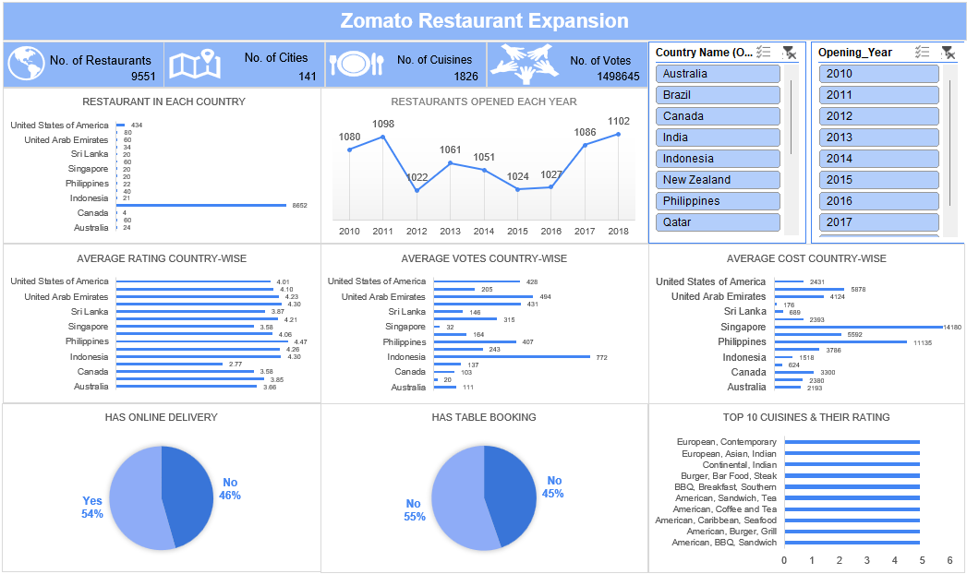

Slide 34
Conclusion
_____________________________________________________________________________________________________
Key Takeaways:
Expansion opportunities exist in low-competition, high-demand markets
City-level gaps reveal strong unmet demand pockets
Customer experience (delivery & booking) drives higher ratings
Cuisine choice significantly impacts engagement and feedback
Pricing has weak impact on ratings; value matters more
Mid-range segment dominates and offers maximum scalability
Restaurants that align market selection, customer experience, and value positioning with data-driven insights are best positioned to achieve sustainable growth and competitive advantage.

