Slide 1


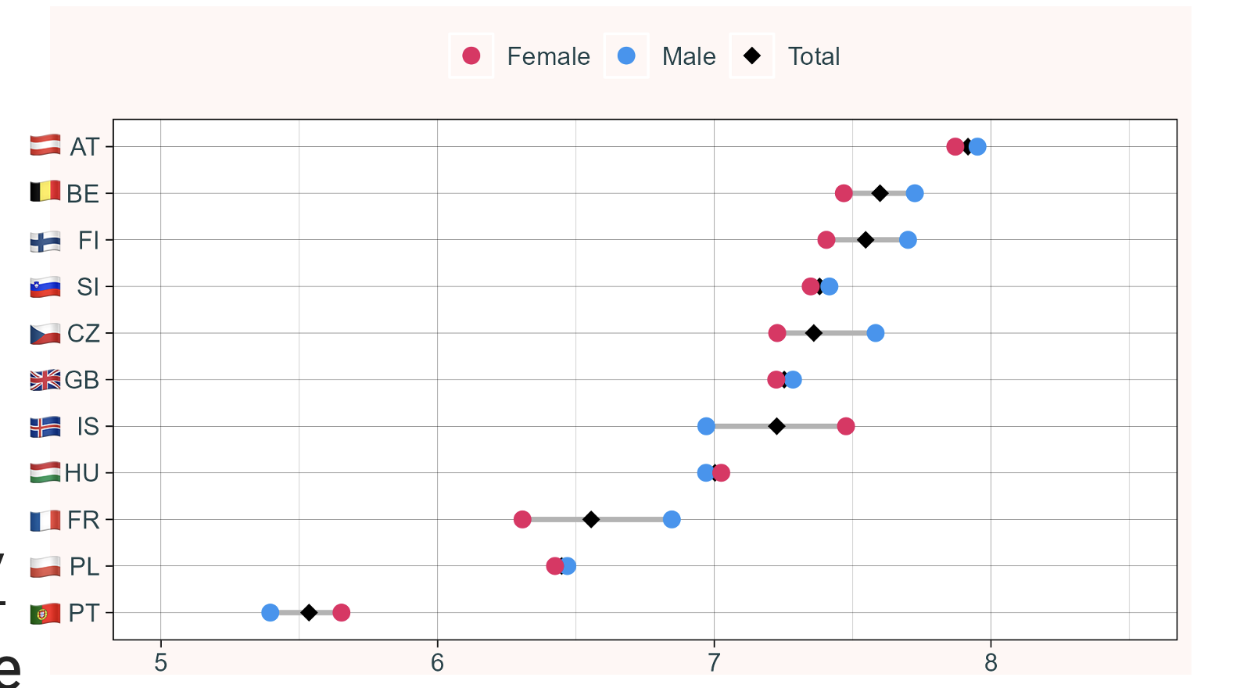
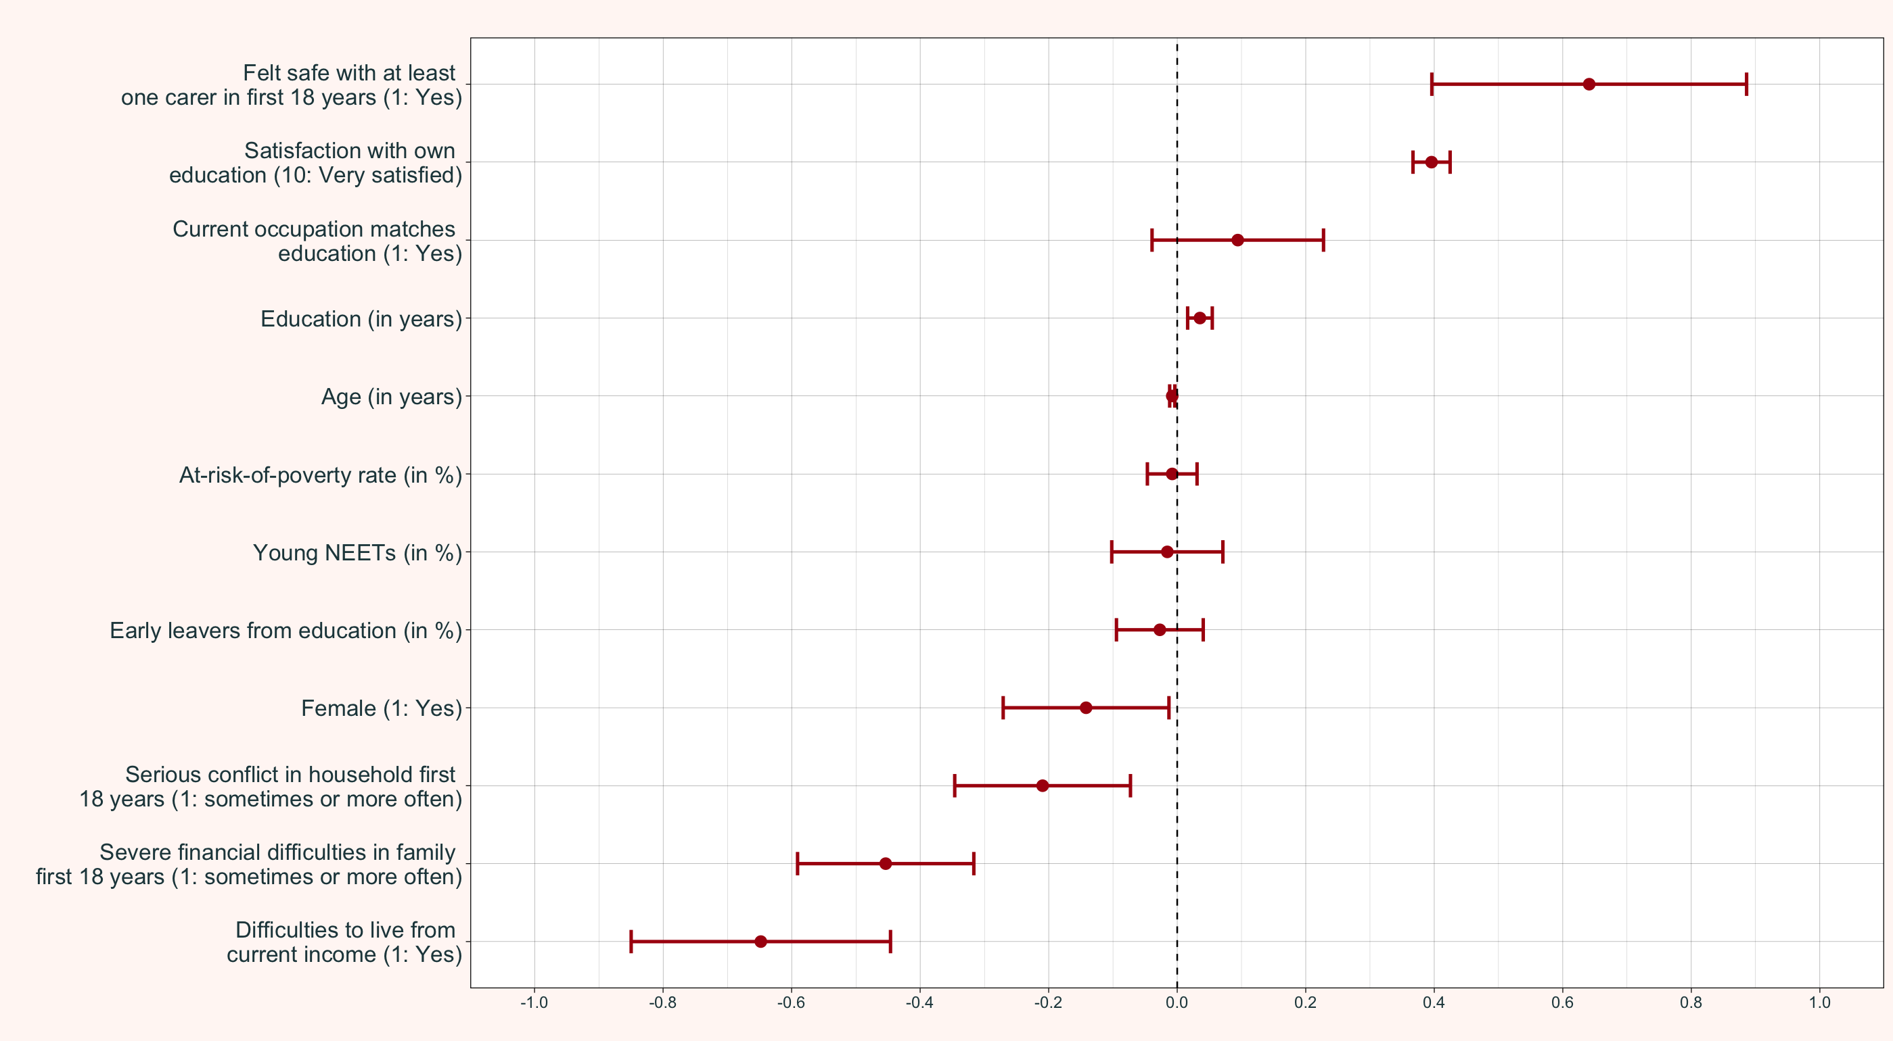



DID YOU GET WHAT YOU WANTED? PERSPECTIVES ON FAIRNESS IN EDUCATION ACROSS EUROPE
Jonas Rackl & Niklas Ippisch, Infra4NextGen Datathon (April 2026)
⚡️ Key Takeaways
Perceived chances to attain the education one wants vary based on individual (household) characteristics
Policy-Makers should also focus on measures related to the household (e.g., youth welfare and social work in families)
Structural variables like the youth unemployment seem to have no strong association
📚 Background & Motivation
Discrepancy between ‘objective’ education quality and perceived quality and fairness (Boyadjieva et al., 2024)
Regional variables also influence changes and might moderate associations (Boyadjieva et al., 2024)
Access to (higher) education researched mostly with individual characteristics like gender, race, and income (Naim, 2025)
Data Summary on Make it Strong indicates differences with respect to age and educational background (Stoilova et al., 2025)
🔎 To what extent do people’s perceived chances of attaining the education they wanted depend on their own background and on structural aspects of their region?
🛠️ Methods and Data
Linear Mixed Models with three levels: Individual and
Country (fixed effect)
Region (random effect)
Descriptive interactive map: https://jonasr.shinyapps.io/pfee/
robustness analysis and variable selection using the BIC
Figure 1: Mean perceived fairness by gender and country. Note: X-axis adjusted for better visibility (own calculations)
Dataset | Pillar / Name | Items
CRONOS-3 (Wave 1) (ESS ERIC, 2025a) | Make it Strong | - Perceived fairness of own education - Satisfaction with own education
CRONOS-3 (Wave 3) (ESS ERIC, 2025b) | Make it Strong | - Current occupation matches education
CRONOS-3 (Wave 5) (ESS ERIC, 2025c) | Make it Healthy | - Felt safe with at least one carer in first 18 years - Serious conflict in household in first 18 years - Severe financial difficulties in family first 18 years
Eurostat (2026a) | ilc_li41 | - Regional At-risk-of-poverty rate
Eurostat (2026b) | edat_lfse_16 | - Regional early leavers from education
Eurostat (2026c) | edat_lfse_22 | - Regional young NEET rate
📊 Results
Variables concerning the family (i.e., feeling safe, conflicts and financial difficulties) in youth significantly associated for perceived fairness of education
Results also emphasize existing association with current income
Close association with the own education: The more I am satisfied with my own education, the fairer I perceive my chances
Female respondents tend to perceive educational chances as less fair – even after controlling for age
Regional attributes have almost no predictive power
regional predictors almost 0 and insignificant
Figure 2: LMM coefficients of linear mixed model. Error bars indicate 95% confidence interval. w1pspweight applied. Note: In the model, fixed effects for countries (dummy variables) are included as well but not depicted here (own calculations).
📑 Discussion
Findings do not suggest strong influence regional variables
Individual aspects seem to be more important, especially concerning the childhood household
Gender and income remain crucial factors
Results must be interpreted in context of some limitations:
missing data on regional level
small sample sizes in some regions
Further research: small area methods (e.g., Fay-Harriot models) and focus on educational quality in regions
Interactive Map
References
Boyadjieva, P., Haralampiev, K., & Ilieva-Trichkova, P. (2024). Social Justice Profiles: An Exploratory Study towards an Empirically Based Multi-Dimensional Classification of Countries Regarding Fairness of Participation in Higher Education. Societies, 14(4), 44. https://doi.org/10.3390/soc14040044
European Social Survey European Research Infrastructure (ESS ERIC) (2025a) CRONOS-3 Wave 1 edition 1.4 [Data set]. Sikt - Norwegian Agency for Shared Services in Education and Research. https://doi.org/10.21338/cron3w1e01_4.
ESS ERIC (2025b) CRONOS-3 Wave 3 edition 1.1 [Data set]. Sikt - Norwegian Agency for Shared Services in Education and Research. https://doi.org/10.21338/cron3w3e01_1.
ESS ERIC (2025c) CRONOS-3 Wave 5 edition 1.0 [Data set]. Sikt - Norwegian Agency for Shared Services in Education and Research. https://doi.org/10.21338/cron3w5e01.
Eurostat (2026a). At-risk-of-poverty rate by NUTS 2 region. ilc_li41 [Data set]. https://doi.org/10.2908/ILC_LI41
Eurostat (2026b). Early leavers from education and training by NUTS 2 region. edat_lfse_16 [Data set]. https://doi.org/10.2908/EDAT_LFSE_16
Eurostat (2026c). Young persons neither in employment nor in education and training by NUTS 2 region. edat_lfse_22 [Data set]. https://doi.org/10.2908/EDAT_LFSE_22
Naim. A. (2025). Equity across the educational spectrum: innovations in educational access crosswise all levels. Frontiers in Education, 9, https://doi.org/10.3389/feduc.2024.1499642
Stoilova, R., Ilieva, P., & Velichkov, M. (2025). Building a Resilient Europe. Make it Strong Data Summary. Infra4NextGen Project.
Wanti, M., Wesselink, R., Biemans, H., & den Brok, P. (2022). Determining factors of access and equity in higher education: A systematic review. This work is licensed under CC BY 4.0. To view a copy of this Equity in Education & Society, 1(2), 279-296. https://doi.org/10.1177/27526461221092429 license, visit https://creativecommons.org/licenses/by/4.0/
GitHub Repository
https://github.com/nippisch/ datathon_make_it_strong
https://jonasr.shinyapps.io/pfee/

